Slide 1


NAVOLCHI - Nano Scale Disruptive Silicon-Plasmonic Platform for Chip-to-Chip Interconnection

Slide 2
Participants
Karlsruhe Institute of Technology, Germany | KIT | Juerg Leuthold Manfred Kohl
Interuniversity Microelectronics Centre VZW-IMEC, Belgium | IMEC | Dries Van Thourhout
Eindhoven University of Technology, Netherlands | TU/e | Meint Smit
Research and education laboratory in information technologies, Greece | AIT | Dimitrios Klonidis Ioannis Tomkos
University of Valencia, Institute of Materials Science, Spain | UVEG | Juan Martinez Pastor
ST-Microelectronics, Italy | ST | Alberto Scandurra
Ghent University, Belgium | Ugent | Zeger Hens

Slide 3
Welcome
Project Overview
Participants and Role in Project
Deliverables and Milestones up to Feb. 2012
Conclusions and Next Steps
News and Announcements
All information provided today is confidential!
Notes:
Welcome Note:
Who is present
Excuse CUDOS
Thank Mojca for organizing
Why Silicon Photonics?
Why this consortium?
Project goal

Slide 4
AGENDA

Slide 5
Agenda
Welcome
Introduction into Project:
  - Main objectives, global impact, ..;
  - Organisational issues: State of official documents, Consortium Agreement, election of technical manager?
  - Common deliverables and milestones up to February 2012
Partners presentation:
  - expertise, role in project, deliverables and milestones up to February 2012, connections to other partners
Next steps; important things not mentioned up to now
Web site, contact info
Kick-Off-Meeting in Karlsruhe
Next Tel.Conf.
Notes:
Welcome Note:
Who is present
Excuse CUDOS
Thank Mojca for organizing
Why Silicon Photonics?
Why this consortium?
Project goal

Slide 6
Introduction to the Project
Notes:
Coordinator presents the project (30min)
Who is the Coordinator
Work packages (WPs), contents, interrelation
Time schedule
Administrative Details
Webpage (restricted area, access to address lists, documents, etc.)
Consortium Agreement (Ownership of deliverables, materials & samples, IPR (foreground, background), funding money distribution)
Publications, Confidentiality
Discussion of dates for next meetings (General Assembly, Project Management Committee, Work Package Technical Groups) (* see below)
Open issues
Appointment of Technical Project Manager
Discussion of technical specifications
Visit of the premises of GigOptix-Helix (around 4pm)
WP 4 discussion including GigOptix-USA (by video link)
Diner for those staying in town

Slide 7
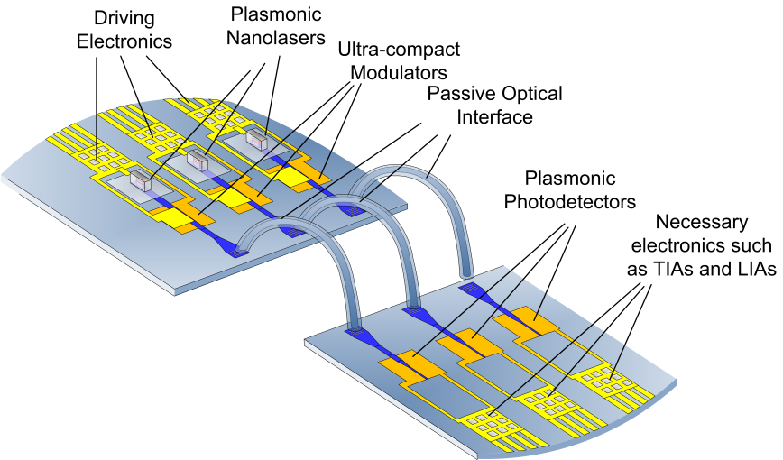
Project Goal
Plasmonic based chip to chip interconnect:
Fast
Low power consumption
Low processing costs
Development:
Plasmonic lasers
Plasmonic modulators
Plasmonic receivers
Fabrication / integration methodology
Photodetector
Laser
Notes:
Why our Consortium: Who provides which important component?

Slide 8
Outline for Project Intro
Administrative Details
  Status of Legal Documents
    EC-Grant Agreement
    Consortium Agreement (IPR, publications, confidentiality)
    Financial Forms
Organizational Aspects
  Budget
  Governance Structure
  Appointment of Technical Project Manager
Interrelation of work packages
  Time schedule
  Next Deadlines
Open Issues
  Means of Communication (webpage, mailing lists)

Slide 9
Status of Legal Documents
EC-Grant Agreement – Core contract
EC-Grant Agreement – Accession Forms
Consortium Agreement
under construction
Financial Identification Forms
Incomplete. TU/e, STi: If you want money..
Notes:
If all this has been done by a partner: Money can be transferred
EC_GA Accession Forms: 45 days after signature of EC-GA, otherwise: SOFI canceled
Explain contracts:
EC-GA with EC
CA among us

Slide 10
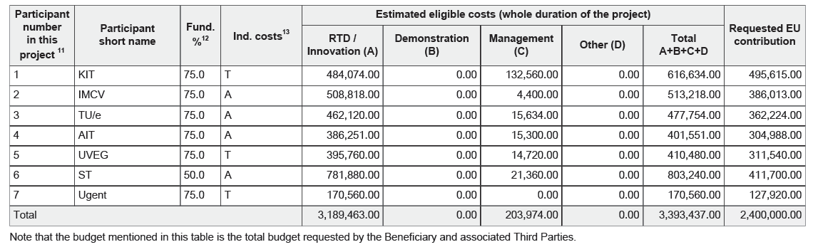
Budget & Distribution
1. Tranche at start of project: |  | 1 400 000 € | 58%
 | Total Sum | 58% | 1 Tranche
KIT | 495 615 € | 289 109 € | 290 000 €
IMCV | 386 013 € | 225 174 € | 225 000 €
TU/e | 362 224 € | 211 297 € | 210 000 €
AIT | 304 988 € | 177 910 € | 180 000 €
UEVG | 311 540 € | 181 732 € | 180 000 €
ST | 411 700 € | 240 158 € | 240 000 €
Ugent | 127 920 € | 74 620 € | 75 000 €
 | 2 400 000 € | 1 400 000 € | 1 400 000 €
First Payment:

Slide 11
Governance structure
Notes:
From DoW
Project Management Committee = Executive Board
6.3.2.3.1 The Executive Board shall prepare the meetings, propose decisions and prepare the agenda of the General Assembly according to Article 6.3.1.2.
6.3.2.3.3 The Executive Board shall be responsible for the proper execution and implementation of the decisions of the General Assembly.

Slide 12
Project Management Committee
Coordination, monitoring and control of the progress of the work in the project,
Launch or stop of Work-packages,
Technical Management of the project:
Analyses and solutions on technical issues,
Technological roadmaps,
Approval of the deliverables,
Launch selection of sub-contractors,
Preparation of dissemination and communication with the support of WP 7,
Management of foreground and IPR,
Publications and press releases.
The Project Management Committee shall consist of:
The NAVOLCHI Technical Project Manager
The Administrative Coordinator
The WP Leaders
WP7 leader when necessary for dissemination purposes
Additional Technical Experts from the WPs that will be elected upon a need base
Notes:
From DoW
Project Management Committee = Executive Board
6.3.2.3.1 The Executive Board shall prepare the meetings, propose decisions and prepare the agenda of the General Assembly according to Article 6.3.1.2.
6.3.2.3.3 The Executive Board shall be responsible for the proper execution and implementation of the decisions of the General Assembly.

Slide 13
Technical Manager
The Technical Project Manager will be elected upon the project start and he will have the following responsibilities:
Chair of the Project Management Committee
Liaisons between the Project Management Committee and the General Assembly
Technical relationship and coordination with other relevant R&D projects
Supervision of the overall technical progress of the project
Consolidation of the technical reports
Preparation of minutes of the General Assembly, and follow-up of its decisions
Follow-up and coordination of all technical work-packages
Transmission of any documents and information connected with the project between the partners
The Technical Project Manager is assisted in all the non-technical tasks by the Administrative Coordinator.
Vote!
Notes:
6.5 The Technical Project Manager shall be proposed by the Coordinator. He / she shall be appointed by the Executive Board and shall assist and facilitate the work of the Executive Board and the Coordinator for executing the decisions of the General Assembly as well as the day-to-day management regarding technical questions of the Project.
The Technical Project Manager will have the following responsibilities:
• Chair of the Executive Board
• Liaisons between the Executive Board and the General Assembly;
• Technical relationship and coordination with other relevant R&D projects,
• Supervision of the overall technical progress of the Project;
• Consolidation of the technical reports;
• Preparation of minutes of the General Assembly, and follow-up of its decisions;
• Follow-up and coordination of all technical Work Packages;
• Transmission of any documents and information connected with the Project between the partners,
The Technical Project Manager is assisted in all the non-technical tasks by the Administrative Coordinator.

Slide 14
Interrelation of work packages
Notes:
Talk about what each WP is supposed to accomplish
We all read the DoW, each task in these WPs will be subject to much more detailed discussion
For now, only name, say who needs work from whom

Slide 15
Gantt chart with the timing across all WPs and tasks

Slide 16
Next Deadlines up to Jan. 2012
Deliverables
Number | Title | WP | Leader | Pers. Months | Nature | Dissemination | Date
D1.1 | Project website with .eu domain (M 01) and continuous update | 1 | 1 | 4 | O | PU | 1
D1.2 | Project reference online manual | 1 | 1 | 2 | O | RE | 3
D2.1 | Definition of chip-to-chip interconnection system environment and specification | 2 | 6 | 7 | R | RE | 3
Milestones
Number | Title | WP | Leader | Date
MS1 | Definition of chip-to-chip interconnection system environment and specification | 2 | 4 | 3

Slide 17
Partner Presentations
Notes:
Partner presentations (10min each)
Institute / company (short)
Contribution to the project, own work effort and timeline (focus)

Slide 18
Institute of Photonics and Quantum Electronics &
Institute of Microstructure Technology at
Karlsruhe Institute of Technology
Notes:
Coordinator presents the project (30min)
Who is the Coordinator
Work packages (WPs), contents, interrelation
Time schedule
Administrative Details
Webpage (restricted area, access to address lists, documents, etc.)
Consortium Agreement (Ownership of deliverables, materials & samples, IPR (foreground, background), funding money distribution)
Publications, Confidentiality
Discussion of dates for next meetings (General Assembly, Project Management Committee, Work Package Technical Groups) (* see below)
Open issues
Appointment of Technical Project Manager
Discussion of technical specifications
Visit of the premises of GigOptix-Helix (around 4pm)
WP 4 discussion including GigOptix-USA (by video link)
Diner for those staying in town

Slide 19
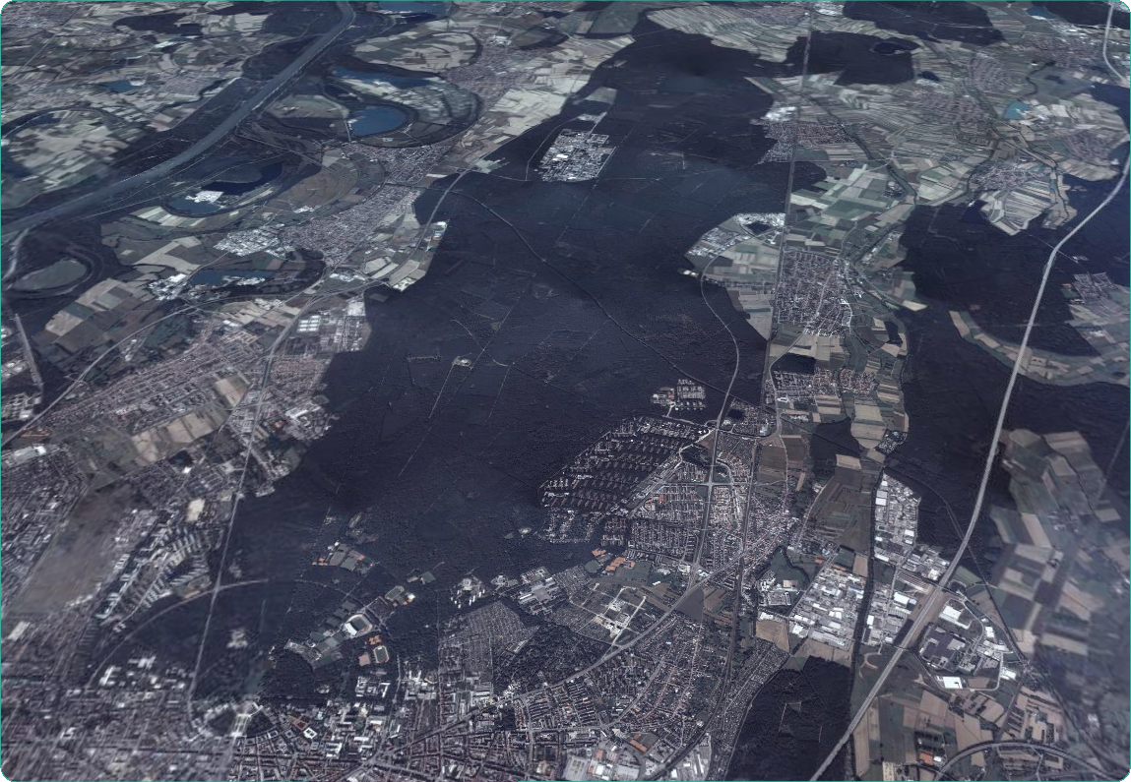

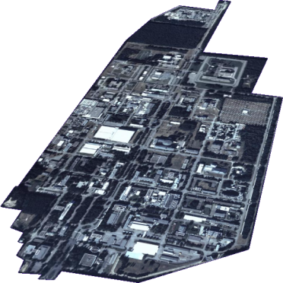
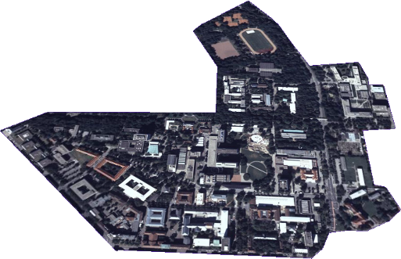
Karlsruhe Institute of Technology — KIT
Research Center
10 Programs
21 Large Institutes
4,000 Employees
310 mio € Budget
Research
Education
Executives
Institutes
Services
...
10 km
15 min
University
11 Departments
120 Institutes
4,000 Employees
18,500 Students
250 mio € Budget
Notes:
Blick aus 6 km Höhe auf Karlsruhe und den Hardtwald:
in 15 km Entfernung befindet sich das Forschungszentrum

Slide 20
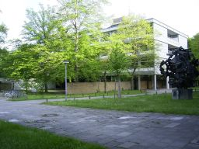
IPQ at University of Karlsruhe
Universität Karlsruhe (TH)
12 Departments
ca.16700 Students
Dept. of Electrical Engineering and Information Technology
13 Institutes
ca. 1200 Students
Institute of Photonics and
Quantum Electronics (IPQ)

Slide 21
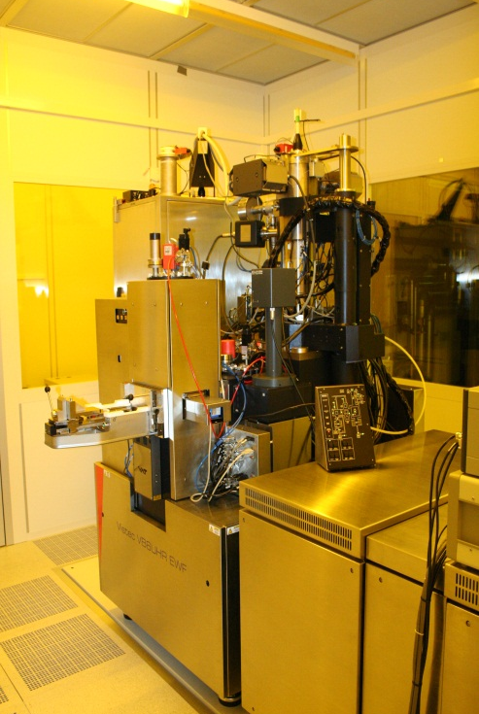
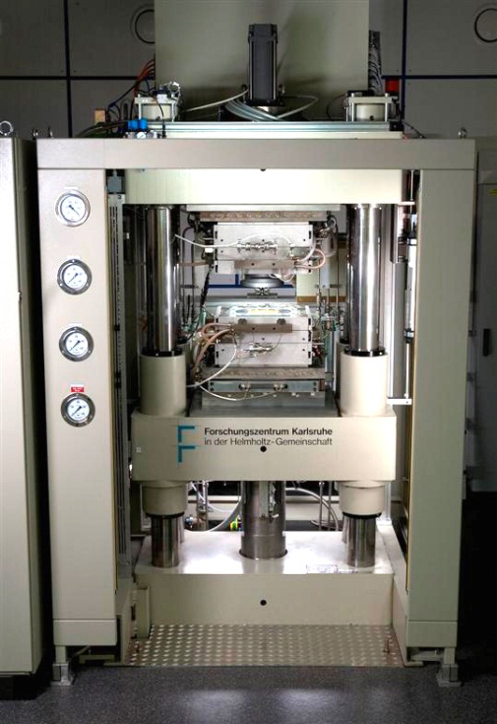
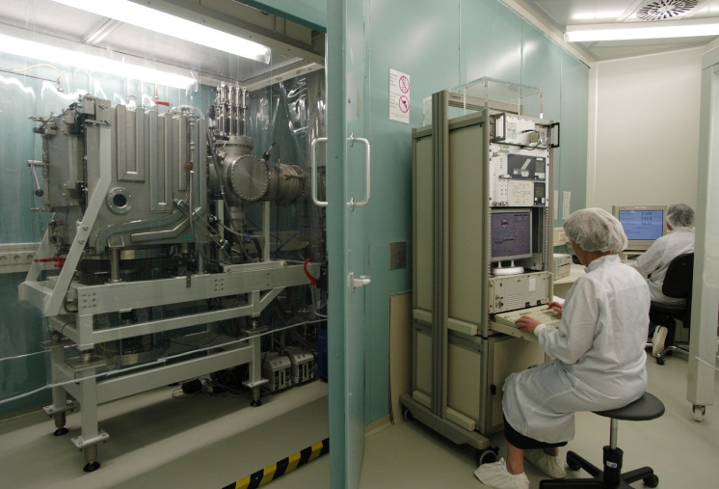
IMT and
Karlsruhe Micro- & Nanfabrication Facility (KMNF)
Lab for micro- and nanofabrication
Areas of competence
X-Reay Lithography
(Dr. Mohr, Dr. Börner)
E-Beam Lithography
(Dr. Kohl, DI Jakobs)
Moulding
(Dr. Worgull,
Dr. Guttmann)

Slide 22
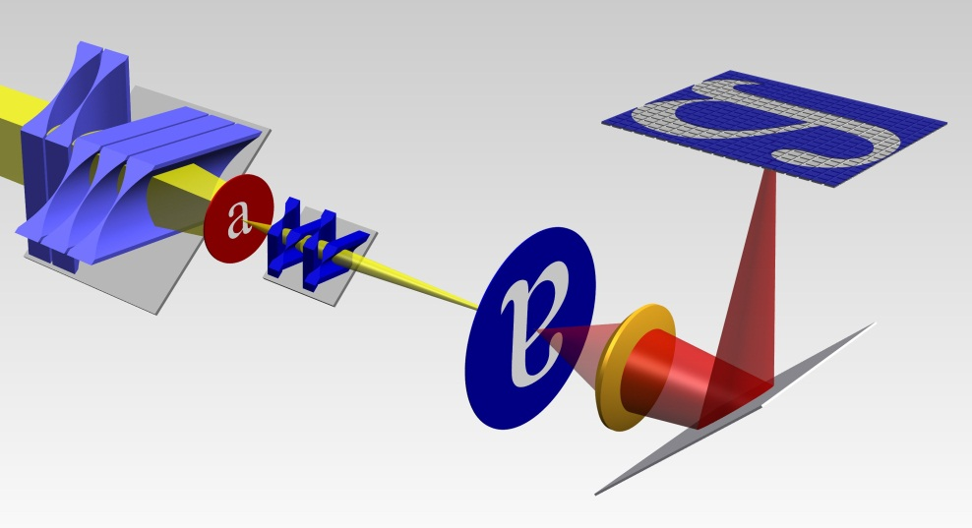
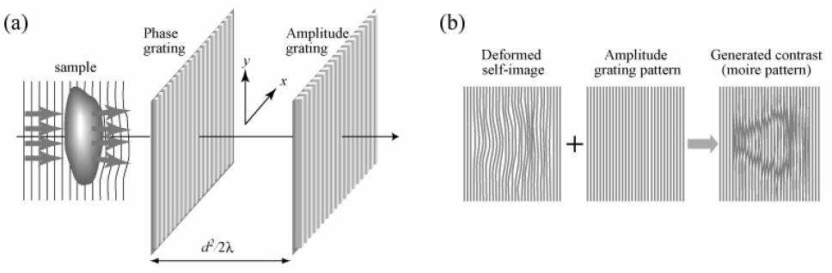
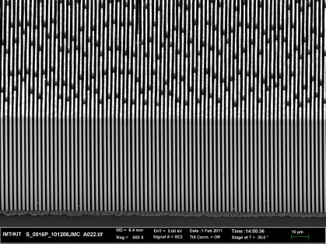
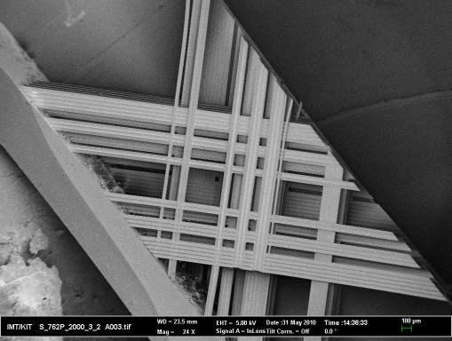
X-Ray Optics
Based on our experience and improvements in high aspect ratio fabrication technologies
X-ray imaging systems for high energies (> 10 keV) with resolutions less than 50 nm
develop the prerequisite for X-ray phase contrast imaging at high energies for medical and material analysis
condensor
CCD
gratings for Talbot Inter-ferometer
sample
szintillator
G1
modulates the wave front phase by π
G2 (moving)
records the interference pattern to demodulate the image
X-ray objective
height: 2 mm
target line
X-ray lens with the largest aperture worldwide (2 mm x 2 mm)
absorption grating with AR 100
world record in visibility with LIGA gratings over the whole energy range)

Slide 23
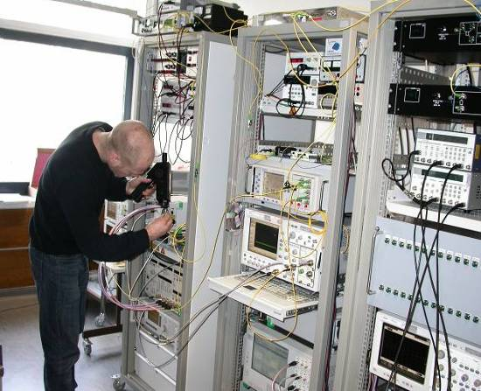
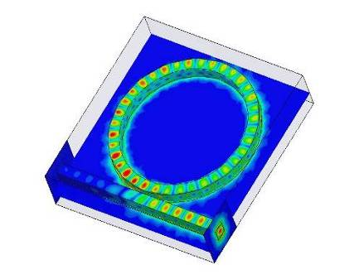
Institute of Photonics and Quantum Electronics (IPQ)
Main Research Topics: Photonics and Communications Technology
Equipment
Telecommunications test lab with capabilities to test architectures and devices for LAN, MAN and WAN networks
Design and fabrication of photonic
components
Current Research Activities
Silicon photonics design, fabless fabrication,
packaging, characterization
Semiconductor device design
Optical modulation formats, transparent network and router for bit rates 2.5…160 Gbit/s
Optically powered fibre networks
Heads of the institute: Prof. Dr. J. Leuthold & Prof. Dr. Dr. W. Freude
People: 3 Secretaries, 16 Scientific Staff, 8 Technical Staff
1 Visiting Scientist, 10-20 Students
1 Startup-Company

Slide 24
26 Tbit/s Super-Channel (50 km Transmission)
D. Hillerkuss et al.; Nature Photonics, June 2011

Slide 25
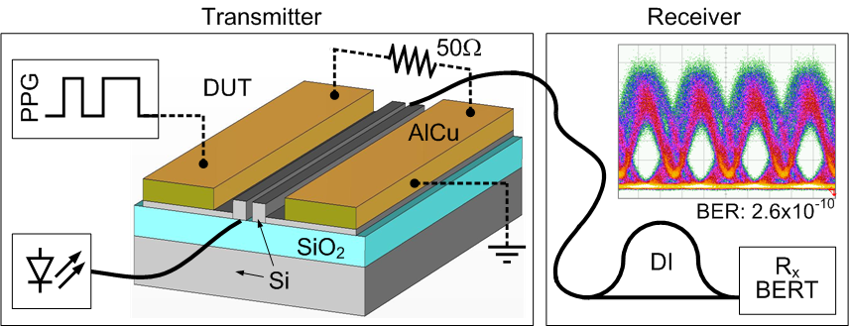
Data Transmission
First demonstration of a 42.7 Gbit/s electro-optic modulator:
42.7 Gbit/s data signal (PRBS length 2⁷−1)
Phase modulation converted by means of a delay interferometer (DI)
A bit error rate BER = 2 × 10^{‑10} is measured using a 70GHz photodiode and a bit error rate tester (BERT)
0.9 Vcm @ 1 KHz; 2 pJ/bit; 60 nm operation range
Ref.: L. Alloatti et al.; Optics Express, Vol. 19, Issue 12, pp. 11841-11851, June 2011

Slide 26
  Discussion
  Next Action Items
  Summary

Slide 27
Open Issues
Notes:
Scientific challenges: SOH laser, sensor (ask for support)
IPR GO
Apps for SELEX
Responsibilities in WP6 Summer school organized by AIT?

Slide 28
  Web page, contact info
  Kick-Off-Meeting in Karlsruhe
  Next Tel. Conf.

Slide 29


Web Page
Up to now:
Contact list & mailing list in restricted area
Password by email
.eu domain soon
Notes:
Scientific challenges: SOH laser, sensor (ask for support)
IPR GO
Apps for SELEX
Responsibilities in WP6 Summer school organized by AIT?

Slide 30
Kick Off Meeting
February 3rd, 2012 in Karlsruhe
Please let us know:
How many attendees?
Notes:
Scientific challenges: SOH laser, sensor (ask for support)
IPR GO
Apps for SELEX
Responsibilities in WP6 Summer school organized by AIT?

Slide 31
Next Tel. Conf.
December 12th-16th, 2011 ?
January 16th-20th, 2012 ?
Notes:
Scientific challenges: SOH laser, sensor (ask for support)
IPR GO
Apps for SELEX
Responsibilities in WP6 Summer school organized by AIT?

Slide 32
  Bye!

