Slide 1
Progress meeting
Victor Calzadilla
Meint Smit
Andrea Fiore
02/04/2012

Slide 2
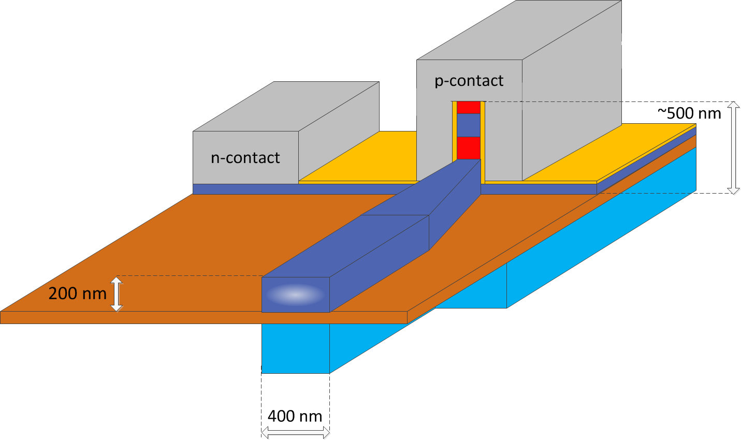
Structure 1
Main issue:
A pillar structure with p-contact at top will have around 5 times higher resistance, leading to a local increase of temperature:
→ An inversion of contacts is desirable
InGaAs
InP
Si
Ag
SiN
BCB

Slide 3
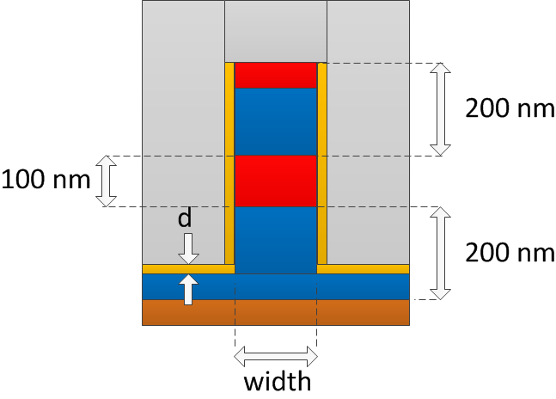
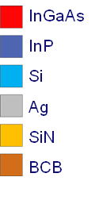
Impact of the insulating layer thickness
Structure:
Decreasing thickness leads to:
Higher confinement factor
Higher losses
Conclusion: thickness reduction is helpful only for a short waveguide width

Slide 4
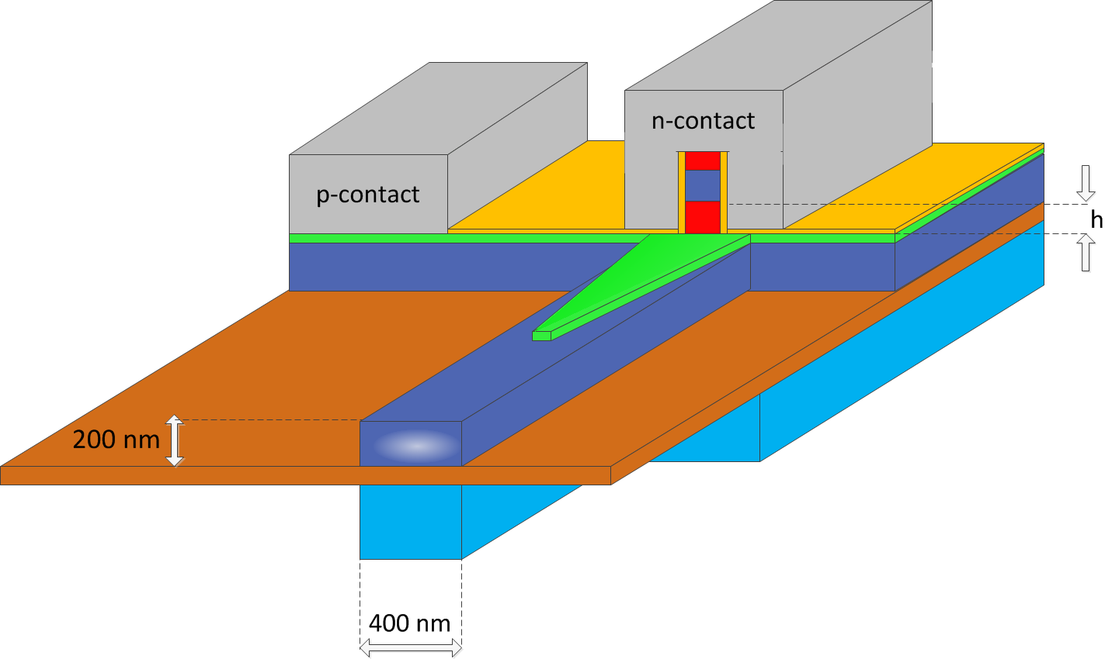
Structure 2
This design allows for n-contact at top
The impact of the core height was investigated
InGaAs
InP
Si
Ag
SiN
BCB
Q 1.25

Slide 5
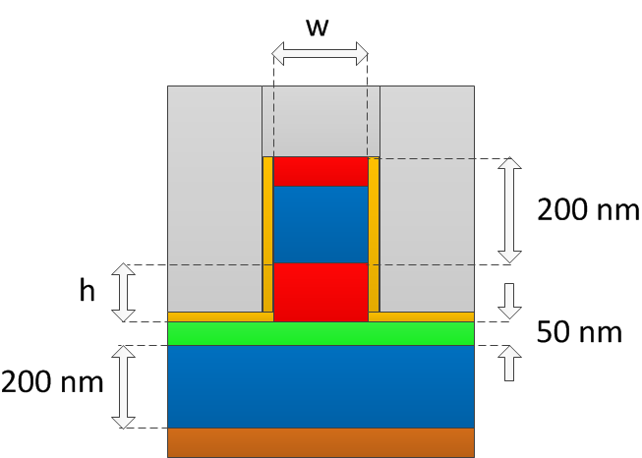
Structure 2 – Modal characteristics at 1.55 um
Structure with insulating layer thickness d = 10 nm
InGaAs
InP
Si
Ag
SiN
BCB
Q 1.25
Region of interest
|E|²

Slide 6
Milestone 3.1
M3.1: Decision on an optimized structure for metallic/plasmonic nano-laser and its coupling to a Si-waveguide
Official date: Month 6 (April 2012)
Announcement: we may need a few weeks more in order to take the decision on a structure with acceptable performance (both laser efficiency and coupling).

