Slide 1
Unit of Materials and Optoelectronic Devices
University of Valencia
www.uv.es/umdo
I. Suárez, P.J. Rodríguez-Cantó and J.P. Martínez-Pastor
Current State of the work
Phone Conference Mars 4th 2014

Slide 2
Outline
1-Deliverables and milestones
2-Current Status of the work
2.1-Plasmonic amplifiers by using polymers doped with QDs
2.2-Photodetectors based on QDs and polymers
3- Collaborations
2/7

Slide 3
Deliverables and Milestones
 | Names of the Milestones | Month | Partner
MS16 | Decision on optimized structures for plasmonic amplifiers | 12 | UVEG
MS17 | Synthesis of nanoparticles with gain at 1550nm | 12 | UGENT
MS18 | Demonstration of conductive QD layers with photoconductive properties | 15 | UVEG
MS19 | Demonstration of metal-(lithographic) polymer and QD metal-(lithographic) polymer nanocompo-sites | 15 | UVEG
MS20 | Demonstration and decision on photodetector operation: nano-gap (MIM) vs. Schottky / heterostructure | 18 | UVEG
MS22 | Demonstration of plasmonic amplifiers with optical pumping exhibiting 10 dB gain | 21 | IMEC
MS23 | Operation of QD based photodetector with responsivity > 0.1 A/W | 24 | UVEG
MS24 | Demonstration of SPP amplifiers with electrical injection exhibiting 10dB/cm gain | 30 | UVEG
➔ MS23 submitted
3/7

Slide 4
Deliverables and Milestones
 | Names of the Deliverables | Month | Partner
D4.1 | Designs of plasmonic amplifiers | 18 | UVEG
D4.2 | Report on optical properties of QDs layers and polymer nanocomposites | 18 | UVEG
D4.3 | Designs of plasmonic photodetectors | 24 | UVEG
D4.4 | Report on SPP amplifiers by using QDs | 30 | IMEC
D4.5 | Report on plasmonic photodetectors | 33 | UVEG
D.7.1 | First report on NAVOLCHI dissemination and promotion activities | 18 | AIT
D.7.2 | First report on NAVOLCHI exploitation activities | 18 | AIT
4/7

Slide 5
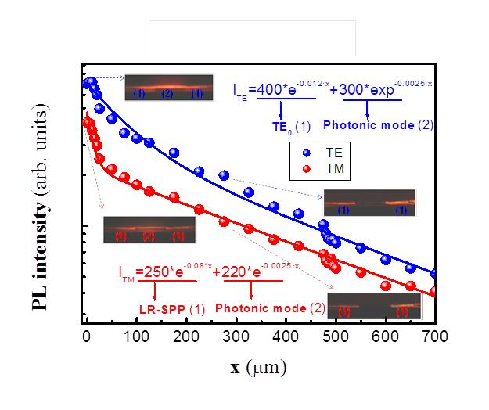
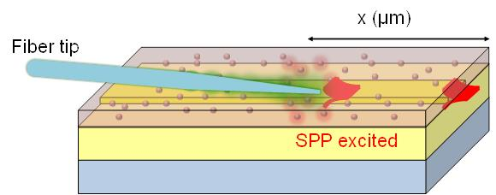
Plasmonics amplifiers
Plasmonic waveguides
Propagation length characterization with a fiber tip:
LR-SPP L_{P}=12.5 μm, close to the theoretical (11 μm)
5/7

Slide 6
Plasmonics amplifiers
Plasmonic waveguides
Propagation length characterization with a fiber tip+pump beam:
➔ Enhancement of 45 % Lp in TM mode!!!
➔ Characterization with HgTe QDs in the IR to be prepared
6/7

Slide 7
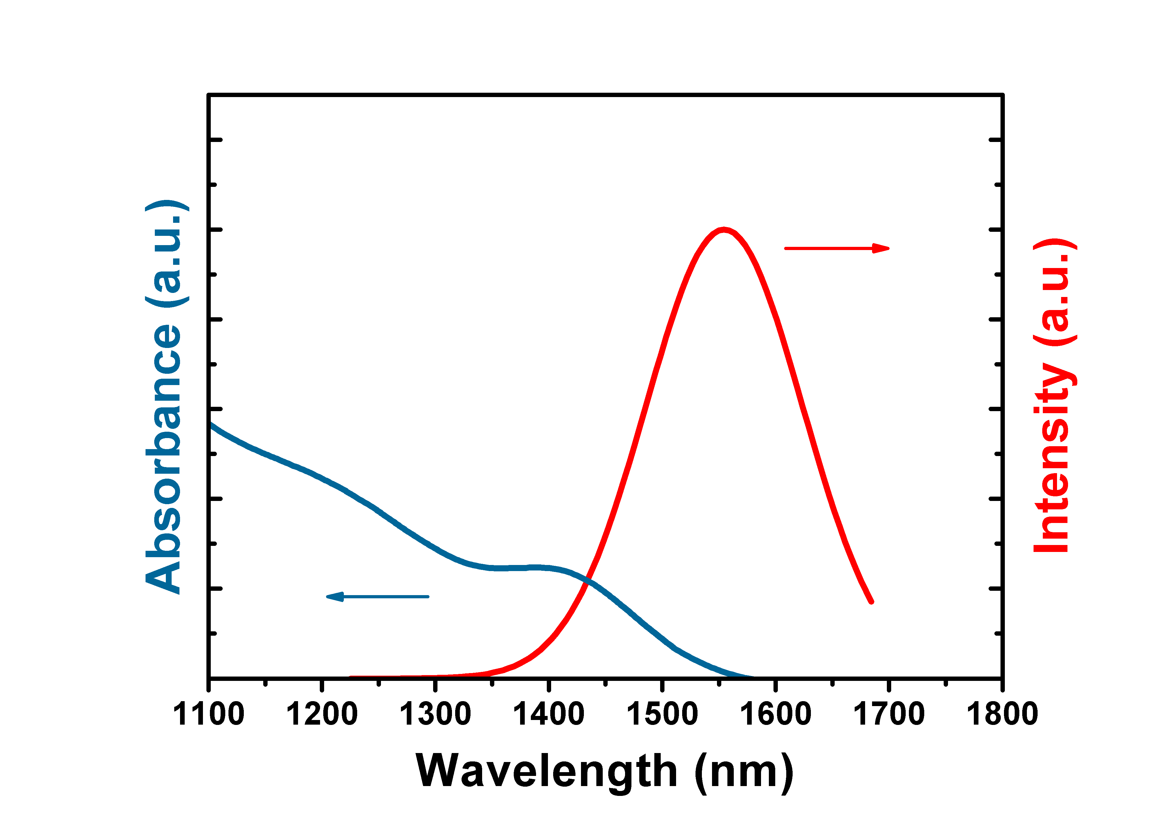
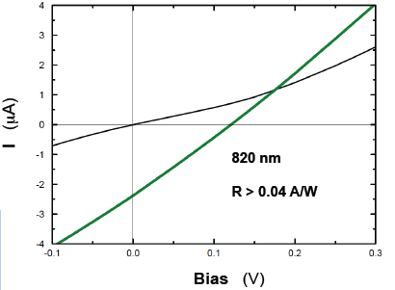
Schottky photodiode
- PbS QDs prepared for absorption at 1550 nm
- PbS QD films prepared by doctor blading
Improvement of a factor 10 in I(V) characteristics under illumination
Responsivities in the range 0.08 – 0.095 for wavelengths shorter than 1500 nm
7/7

