Slide 1
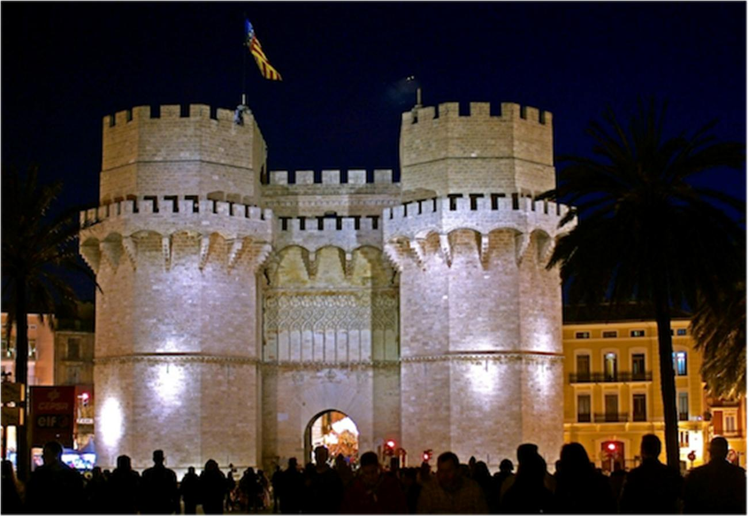


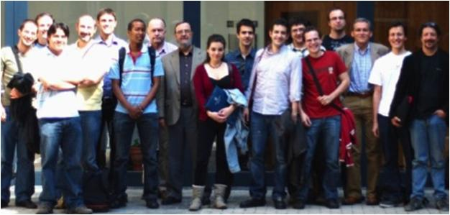
NAVOLCHI
Unit of Materials and Optoelectronic Devices
University of Valencia
www.uv.es/umdo
Prof. Dr. Juan P. Martínez Pastor
Dr. Pedro Rodríguez Cantó (QD and Polymer layers, metal nanostructures)
Dr. Isaac Suárez Álvarez (Plasmonics + Optical)
Henry Gordillo (PhD student: Plasmonics + Optical)
Mari Luz Martínez (PhD student: Polymer layers, metal nanostructures)
Dr. Rafael Abargues (Chemistry, Intenanomat/Spin-Off)
Dr. Guillermo Muñoz Matutano (Optical)
(Dr.) Josep Canet Ferrer (Optical)
David Rivas Góngora (Optical)
Torres de Serranos (1398)
Valencia, Spain

Slide 2
Torres de Serranos (1398)
Valencia, Spain

Slide 3

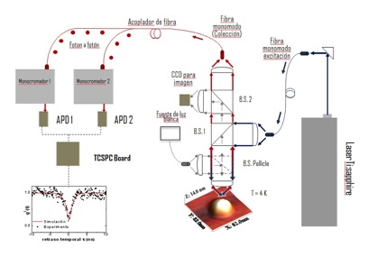
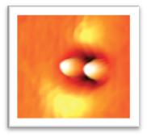
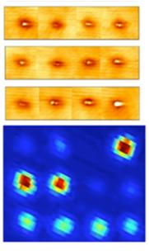
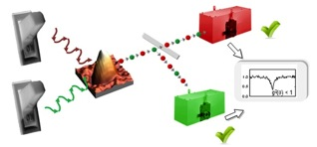
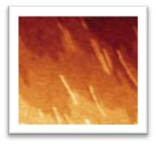
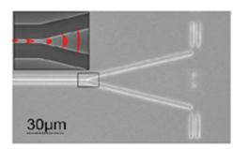
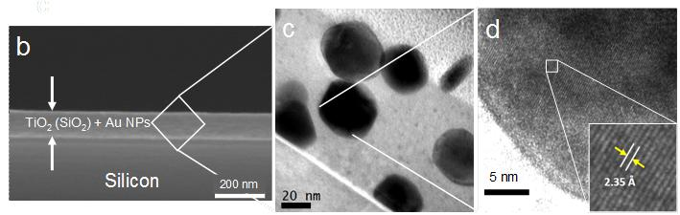
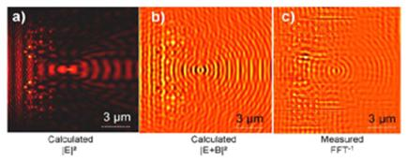
EXPERTISE
Quantum Nanostructures for Quantum Information Technologies:
optical properties at single level
Quantum Optics
Single-photon Logic gates
Plasmonic nanocomposites:
nanoparticles on oxides and polymers (resists)
SOI technology: photonic lens

Slide 4
Role in the project / Main Tasks
Plasmonic amplifiers by using polymers doped with QDs (embedding metal waveguides) (Task 4.3, 4.4, 5.1)
Fabrication of metal nanostructures based on patternable metal-polymer nanocomposites
Demonstration of amplification in polymer thin films / stripes
Light coupling to metal waveguides and plasmon propagation / amplification
Plasmon/Photon-Plasmon Photodetectors based on QDs and metal nanostructures (Task 4.2, 4.5)
Stacks of QDs (layer-by-layer method) for photoconductors/photodetectors
Patternable conductive polymers with added plasmonic capabilities

Slide 5
Nanocomposite QD-Polymer dielectric waveguides
QDs incorporated in PMMA: Planar waveguides
Simple fabrication and low cost
- Appropiate concentration shows low losses
- PL coupled to waveguide modes
- Emission wavelength can be tuned
Three color waveguiding CdS,CdTe, CDSe-PMMA film
IR waveguiding
PbS-PMMA film

Slide 6
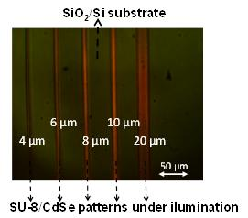
Nanocomposite QD-Polymer dielectric waveguides
QDs incorporated in SU8: Ridge waveguides
Ligand exchange to incorporate QDs in SU8
Low losses in 0.5-1.5 µm
PL confined in 2D
- Emission wavelength tunned with material/size
CdSe-SU8 waveguide
PbS-SU8 waveguide

Slide 7
Nanocomposite-Au plasmonic waveguides
Au film between nanocomposite and SiO₂
Laser coupled to the SPP mode (TM)
PL propagated in both polarizations
SPP GaN propagation (TM)
PL propagation (TE and TM)
Under current Work!!!

Slide 8
Nanocomposite-Au plasmonic waveguides
Coupling light in the gold nanowire with an optical fiber
Pumping QDs by end-fire coupling or from the surface
CCD camera monitors metal 1D-waveguiding
Possibility to measure the emission spectra at edge or at surface

Slide 9
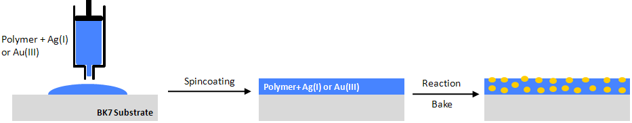
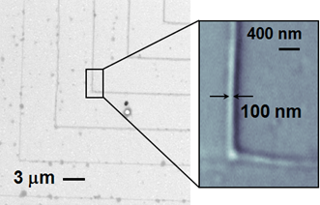
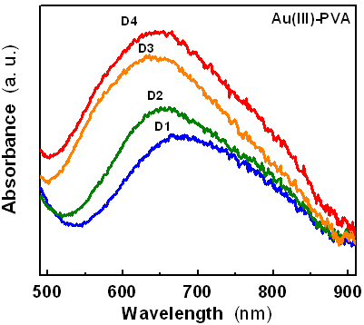
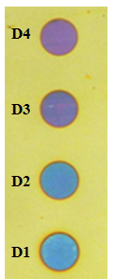

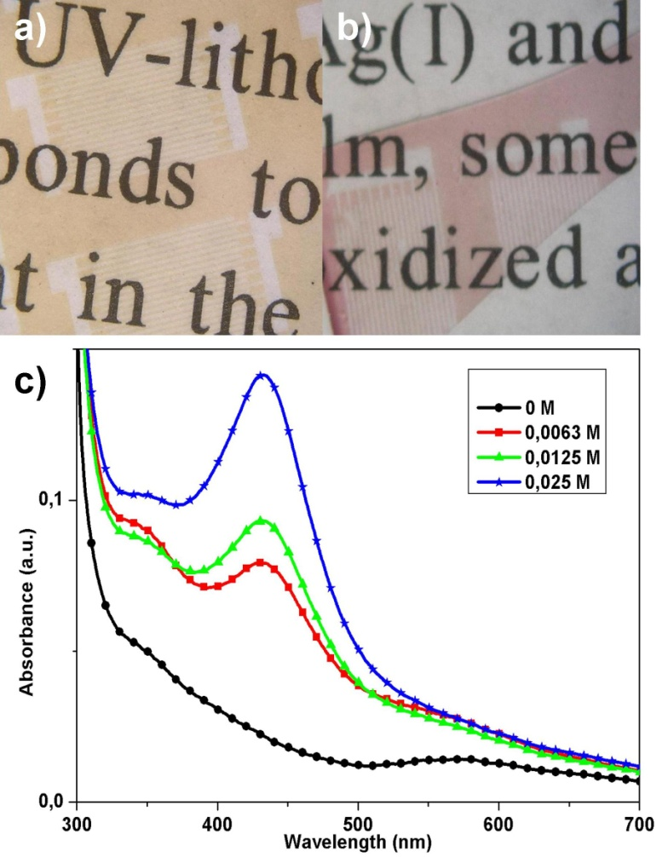
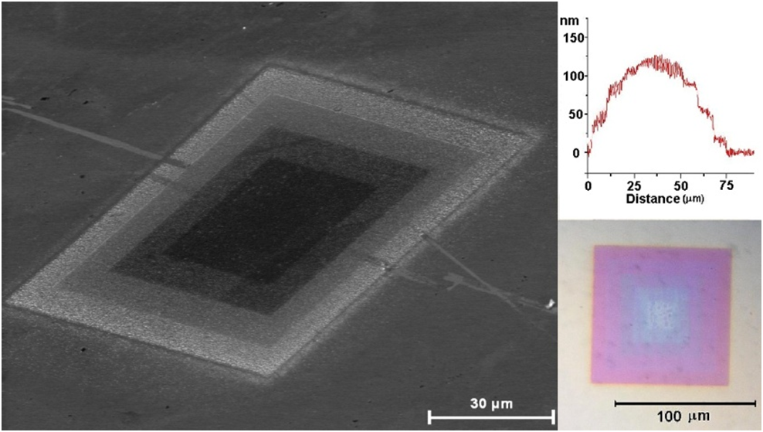
Development of plasmonic metal layers by chemical growing of metal NPs: Towards prepatterned plasmonic nanostructures
Patented method
Nanocomposite Film
In-Situ synthesis of Ag/PVA nanocomposites
Nanotechnology 19, 355308 (2008).
In-Situ synthesis of Ag(Au)/Novolac
Plasmon resonance in ebeam patterns
Langmuir 26, 2825-2830 (2010).
3D Lithography
J. Materials Chemistry 20, 7436 - 7443 (2010)

Slide 10
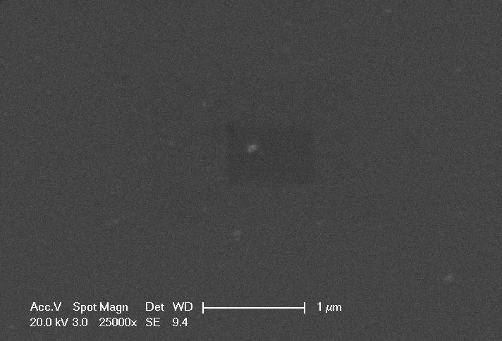
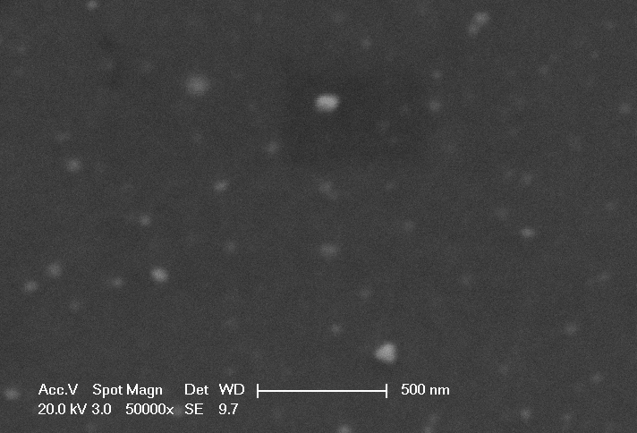
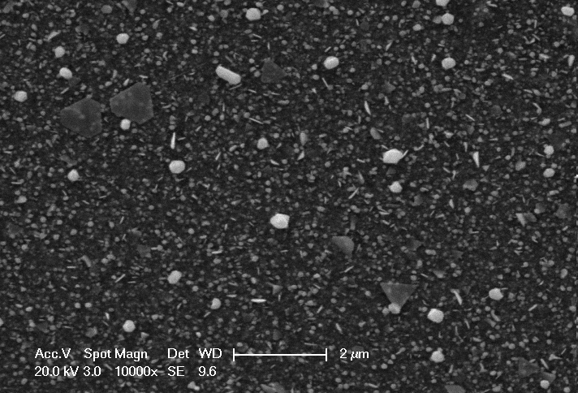
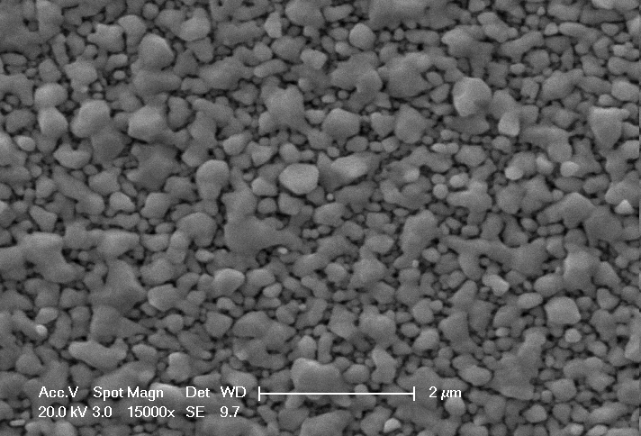
Development of plasmonic metal layers by chemical growing of metal NPs: Towards prepatterned plasmonic nanostructures
Patented method
Patent pending
Nanocomposite Film
In-Situ synthesis of the Au/Novolac nanocomposite
t = 0
t = 3 days. Not cond.
Increase of LSPR with growth time:
Increase of size + density of Nanoparticles
t = 8 days. Not conductive
t = 21 days. Conductive

Slide 11
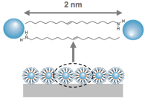
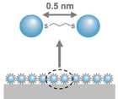


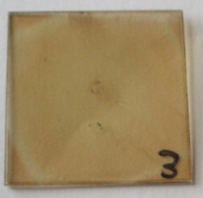
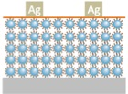
Development of layer stacks containing IV-VI QDs
Layer-by-Layer approach
to fabricate photodetectors
- Simple low-T processing
Wide variety of materials
High control of the thickness
Ligand Exchange
Spincoating
LbL
Oleyamin-capped PbS QDs
QD monolayer
Ethanedithiol
HS-CH₂-CH₂-SH
QD monolayer
QD multilayer
Device Fabrication
LiF
ITO

Slide 12
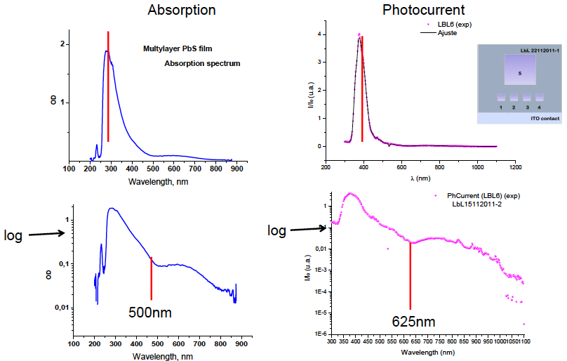
Development of layer stacks containing IV-VI QDs:
Photocurrent Measurements

Slide 13
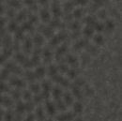
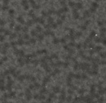
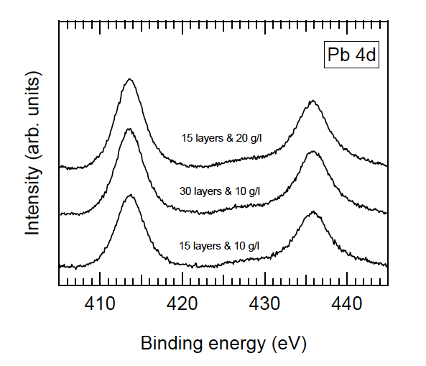
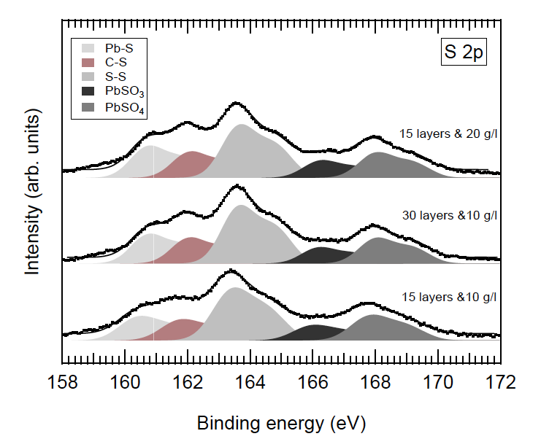
Development of layer stacks containing IV-VI QDs:
Film Characterization
TEM
OA-capped PbS
After EDT treatment
XPS

Slide 14
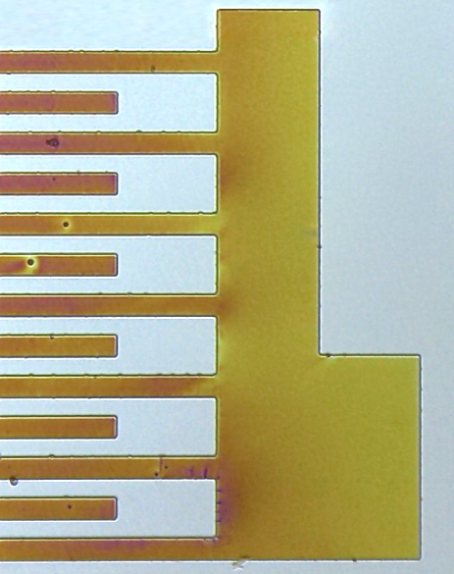
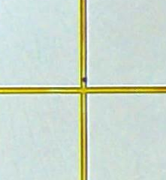
Development of Patternable Conductive Polymers
UV Light
Conducting
IPN Patterns
Photomask
Lithographic process
Photoresist
Resist + precursor
Substrate
2. Post bake 120-140 ºC
In-situ synthesis of conducting polymer into the patternable host matrix
Possibility of in-situ synthesis of Au NPs into the PCP
Possibility of easy incorporation of QDs into or on top of the PCP
20 µm
100 µm
200 µm
40 µm
Manuscript submitted to the Journal of Materials Chemistry (Jan, 2012)

Slide 15
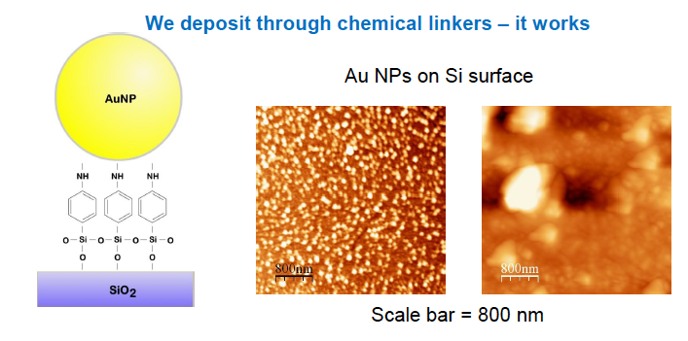
Perspectives in the project
Selectively functionalized surfaces to deposit homogenous monolayers of nanoparticles (QDs, metal)

Slide 16
Next Perspectives/Objectives
Plasmonics amplifiers (tasks 4.1,4.3,4.4 and 5.1)
Gain/Amplification in dielectric waveguides
Light coupling to metal nanowires/1D-waveguides
SPP propagation and amplification in gold waveguides
Photon-Plasmon Photodetectors (tasks 4.2,4.5 and 5.1)
- QD-LbL
- Conducting polymer
Modelling (AIT)
Core-shell PbS/PbSe (U. Ghent)

