Slide 1
IMEC in Navolchi
Karlsruhe Meeting Feb. 2012

Slide 2
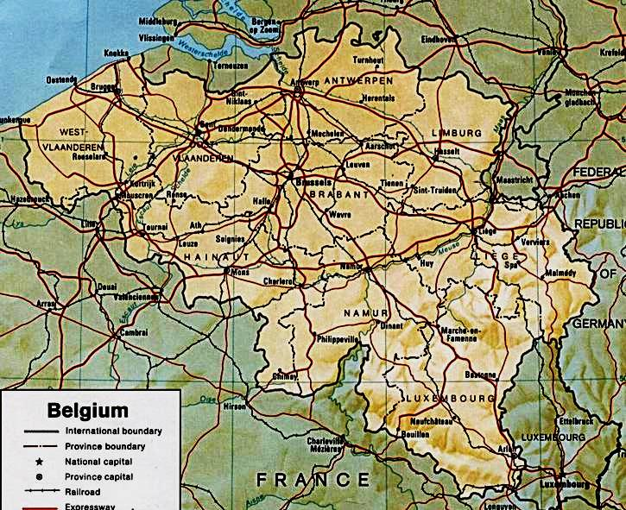
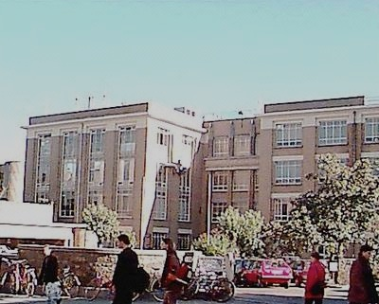


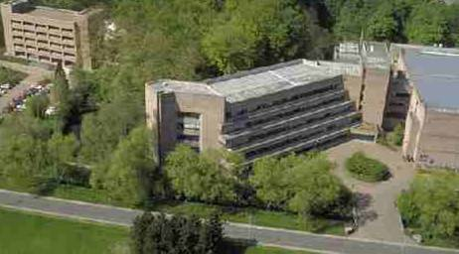
Photonics Group – Ghent University - IMEC
Ghent
Leuven
Brussels
Photonics Research Group
Headed by Roel Baets, 70 people
Exploratory research
Telecom, Datacom
Bio and physical sensing, beam steering …
“post-processing”
imec silicon photonics group
Coordinated by Philippe Absil
Industry oriented research
Optical Interconnect Program
“silicon processing”

Slide 3
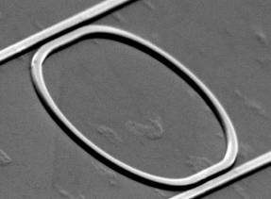
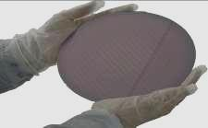
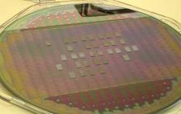
Research Vision and Focus: Technology
photonic integration
  Build photonic systems on a chip
silicon photonics
  Use the power of silicon CMOS-technology
  for integrated photonics
heterogeneous integration
  Avoid the weaknesses of silicon through
  combination with other materials and nanomaterials
Notes:
3

Slide 4
imec in NAVOLCHI
WP3 – transmitter
  Provide bonding to TU/e
  Provide passive silicon circuits through http://epixfab.eu/ platform
WP4 – amplifier for receiver
  Design and fabricate amplifier on silicon platform using UGent QDOTS
  Investigate possibilities for electrical injection
WP5 – interfaces
  WP-leader
  Design and fabricate passive filter for amplifier noise suppression
  Design and fabricate optical beam-steerer

Slide 5
WP4 - work
Objective: design and fabrication of QDOT amplifier
  Integrated with silicon waveguides
  Electrical injection
Timeline:
  Month 12 (M4.1) : decision on design
  Month 15 (M4.3) : conductive QD layers
  Month 18 (M4.6) : electroluminescence from QD-stack
  Month 21 (M4.8) : optically pumped amplifier (10dB gain)
  Month 30 (M4.9): electrical pumped amplifier 10dB/cm gain
Main input required: UGent QDOTS

Slide 6
WP4 - work
General approach (cross-section):
Stack of semiconducting oxide with QDot
Top-electrode
(forming plasmon waveguide)
Bottom Electrode
p-Si
H
Current flow

Slide 7


WP4 - Work
Initial focus of work:
  Overall design (Weiqiang Xie)
  Electrical injection: investigation of suitable layers (Pieter Geiregat)
  Improvement of related processes (QDOT embedding, local deposition, ebeam process …)(Katarzyna Komorowska)
Weiqiang

Slide 8
Generic structure for modeling
Cathode:
Metal (Ag, Al) , n-type amorphous silicon (a:Si)
Anode:
Silicon (p-type), metal (Au)
Active layers:
Metal-oxides , nanocrystals
How ?
2D FEM Mode solver (COMSOL) @ 1550 nm
Cathode
t
Active layers
Anode
Silica
SOI platform
Silicon
Outcome of simulations : Confinement Factor, Purcell Factor, Modal Loss
Notes:
In this slide it is quite important to stress the different combinations of cathode and anode.

Slide 9


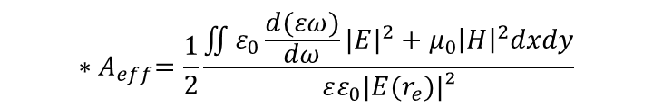
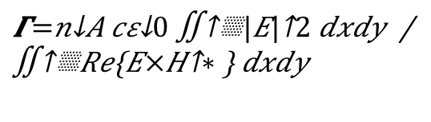
Output from simulations ?
$$Γ=\frac{n_{A}cε_{0}\iint{{|E|}^{2}dxdy} }{\iint{Re\left\{E×H^{∗}\right\} dxdy}}$$
Confinement factor:
Modal loss (due to materials, sidewall roughness and NC-self absorption):
Emission enhancement:
$$α_{m}=\frac{1}{L_{p}}$$
$$F_{p}=\frac{3}{4π}\frac{c/n}{v_{g}}\frac{(λ_{0}/n)²}{A_{eff}}$$
$${∗A}_{eff}=\frac{1}{2}\frac{\iint{ε_{0}\frac{d(εω)}{dω}{|E|}^{2}+μ_{0}{\left|H\right|}^{2}dxdy}}{εε_{0}|E(r_{e})|²}$$

Slide 10


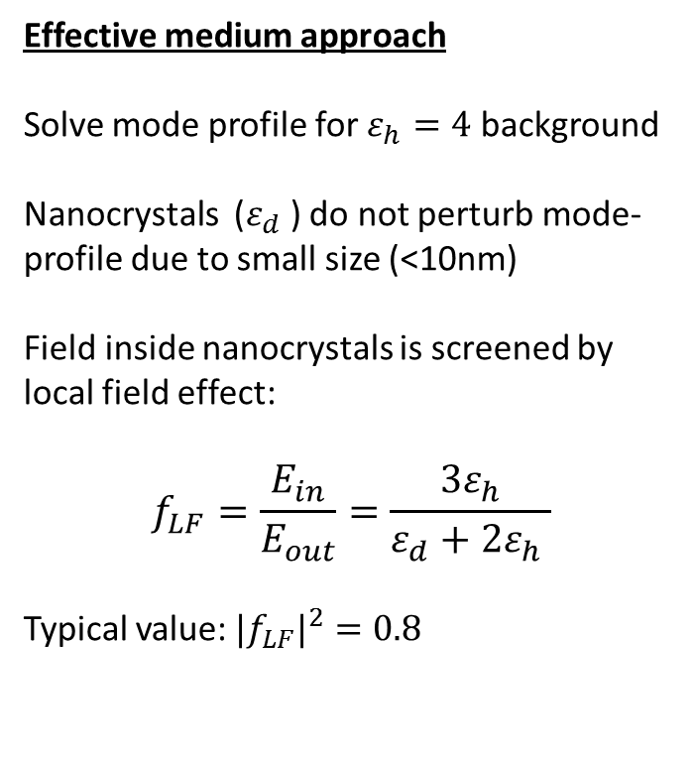
Modeling the nanocrystals: local field factor
Effective medium approach
Solve mode profile for $ε_{h}=4$ background
Nanocrystals ($ε_{d}$) do not perturb mode-profile due to small size (<10nm)
Field inside nanocrystals is screened by local field effect:
$$f_{LF}=\frac{E_{in}}{E_{out}}=\frac{{3ε}_{h}}{ε_{d}+2ε_{h} }$$
Typical value: ${|f}_{LF}|^{2}=0.8$
$$ε_{h}$$
$$ε_{d}$$
Correcting the expression: $Γ={|f}_{LF}|²×\frac{n_{A}cε_{0}\iint{{|E|}^{2}dxdy} }{\iint{Re\left\{E×H^{∗}\right\} dxdy}}$

Slide 11
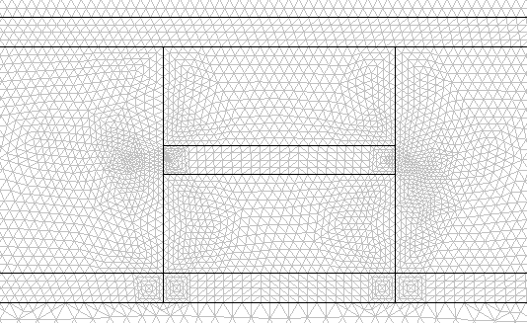

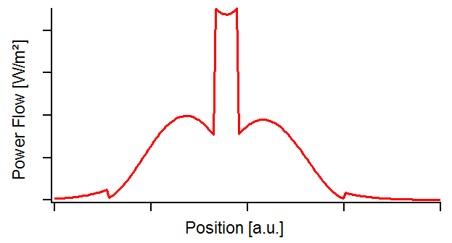
Typical mode profile
2D FEM Mode solver (COMSOL):
Meshing the 2D geometry and solving the eigenmodes at 1550 nm

Slide 12
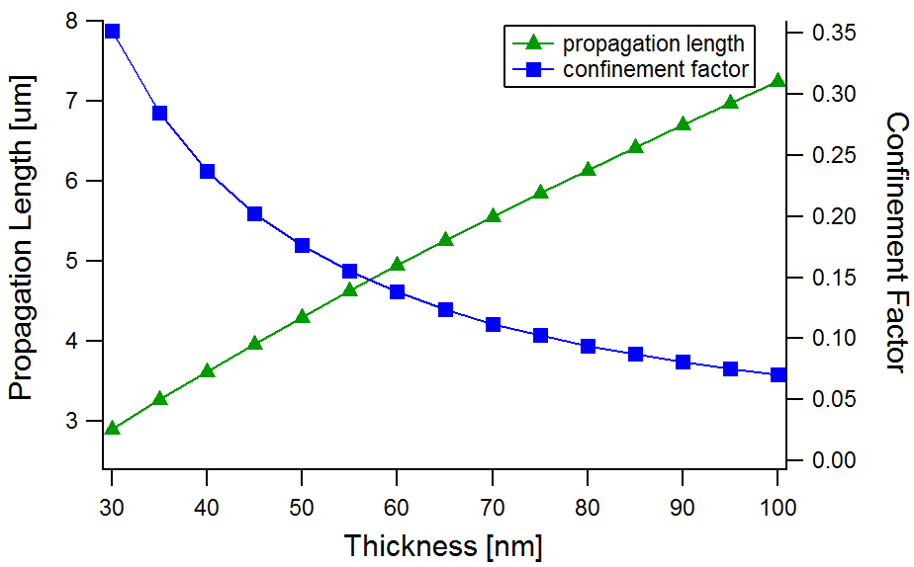
Structure A: metal – dielectric - metal
Silver: n = 0.14 + 11.36i
t
Oxide layers: n=2
Gold: n = 0.56 + 9.81i
Silica
Silicon
‘Plasmonic structure for on-chip active plasmonics’

Slide 13
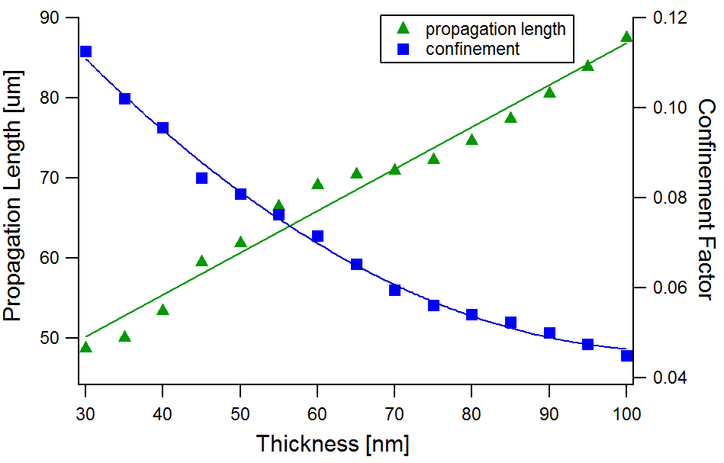
Structure B: metal – dielectric - metal
Silver: n = 0.14 + 11.36i
t
Oxide layers: n=2
Si: n = 3.445
Silica
Silicon
‘Hybrid metal-dielectric waveguide’
‘Strong TM character’

Slide 14
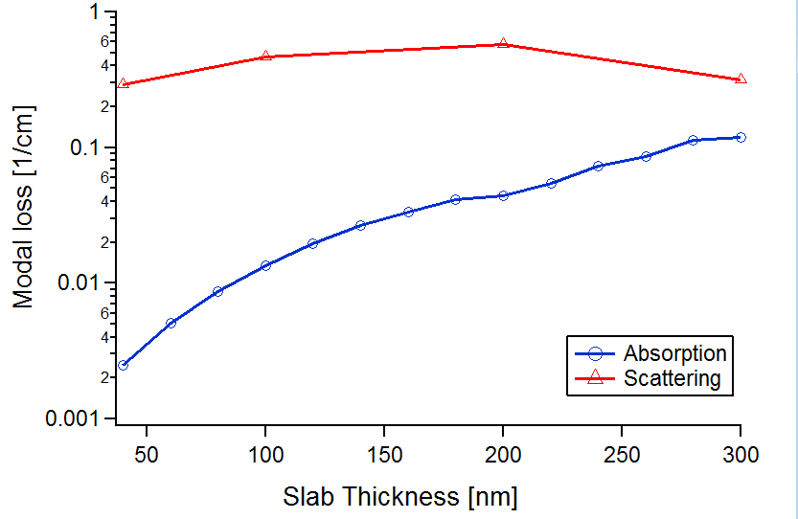
Structure C: a:Si – dielectric - silicon
a:Si: n = 3.4+2e-6i
T= variable
t = 60 nm
Oxide layer: n=2
Si: n = 3.45
Silica
W = 60 nm
Silica
Silicon
‘Double use of silicon gives high mode confinement with low loss’
‘Loss is dominated by roughness scattering ‘
Notes:
Light absorption in the amorphous silicon will cause modal loss (blue line). The scattering at the interface between the a:Si and silica will also induce losses.
Typical scatter parameters are derived from straight c:Si waveguides.

Slide 15
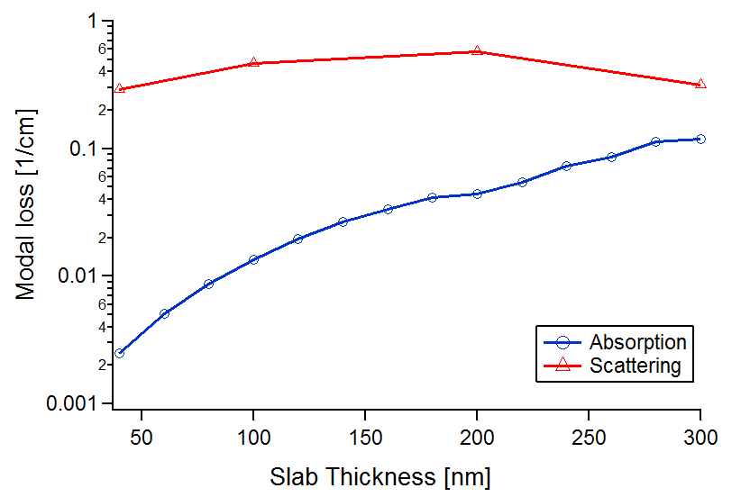
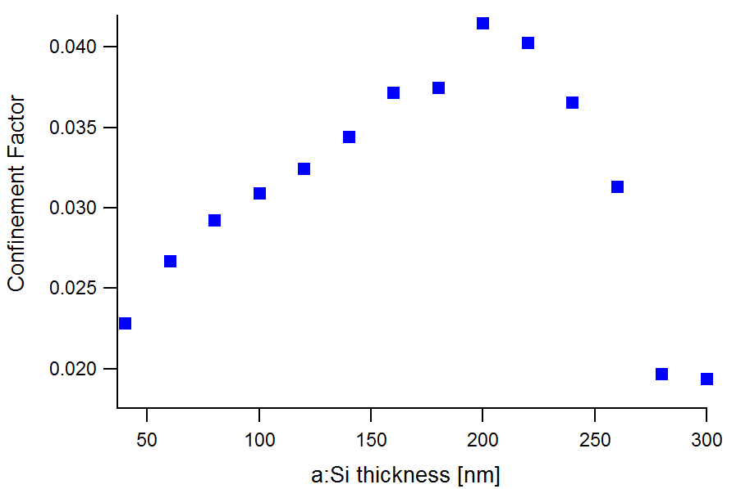
Structure C: a:Si – dielectric - silicon
a:Si: n = 3.4+2e-6i
T= variable
t = 60 nm
Oxide layer: n=2
Silica
Si: n = 3.45
W = 60 nm
Silica
Silicon
‘ Mode jumps to a:Si slab above 200 nm thickness’
Notes:
Light absorption in the amorphous silicon will cause modal loss (blue line). The scattering at the interface between the a:Si and silica will also induce losses.
Typical scatter parameters are derived from straight c:Si waveguides.

Slide 16
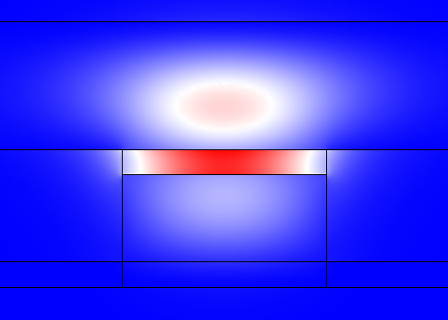
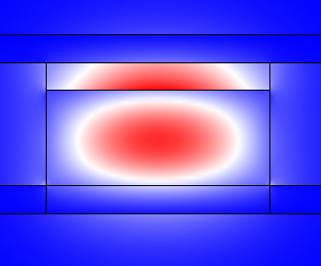
Structure C: a:Si – dielectric - silicon
a:Si: n = 3.4+2e-6i
T= variable
t = 60 nm
Oxide layer: n=2
Silica
Si: n = 3.45
W = 60 nm
Silica
Silicon
‘ Mode jumps to a:Si slab above 200 nm thickness’
Notes:
Light absorption in the amorphous silicon will cause modal loss (blue line). The scattering at the interface between the a:Si and silica will also induce losses.
Typical scatter parameters are derived from straight c:Si waveguides.

Slide 17
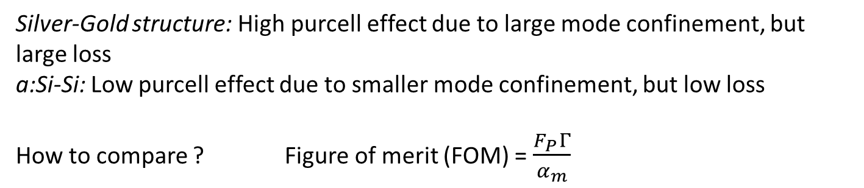
Emission enhancement ?
Purcell factor in 2D:
Cathode | Silver | Silver | a:Si
Anode | Gold | c-Si | c-Si
Fp | 33.9 | 7.12 | 5.8
FOM (x10⁻²) | 0,23 | 0,36 | 31
Silver-Gold structure: High purcell effect due to large mode confinement, but large loss
a:Si-Si: Low purcell effect due to smaller mode confinement, but low loss
How to compare ? Figure of merit (FOM) = $\frac{F_{P}Γ}{α_{m}}$

Slide 18
WP4 - Work
Initial focus of work:
  Overall design (Weiqiang Xie)
  Electrical injection: investigation of suitable layers (Pieter Geiregat)
  Improvement of related processes (QDOT embedding, local deposition, ebeam process …)(Katarzyna Komorowska)
Weiqiang

Slide 19
Integrated light source for silicon photonics
P-type Si
Silica

Slide 20
Integrated light source for silicon photonics
-V
N-type Si
P-type Si
Silica

Slide 21
Integrated light source for silicon photonics
p-NiO / Qdot / n-ZnO
-V
N-type Si
Electron
Hole
P-type Si
Silica
NiO ~ 30 nm
ZnO(:Al) ~ 50 nm
p-Si n-Si

Slide 22
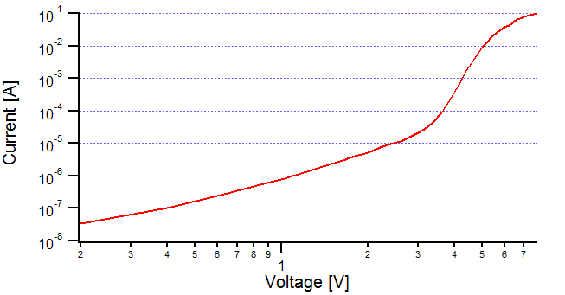
Metal oxides for charge transport
Demonstrator on glass
- V
“ ITO / NiO / PbS(nc) / ZnO / Al “
Sputter Spincoat ALD E-beam
Al
ZnO
NiO
ITO

Slide 23
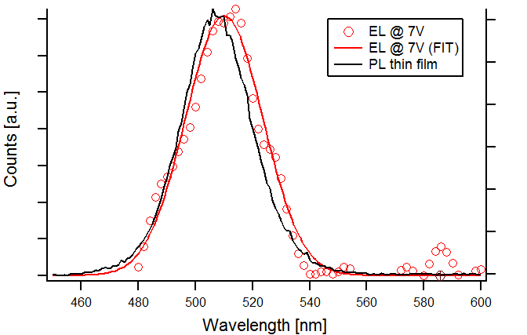
Observation of visible EL

Slide 24
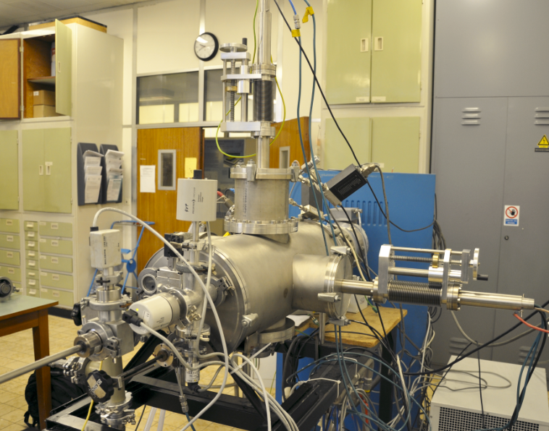
Reactive magnetron sputtering
Collaboration with Prof. Diederik Depla (DRAFT)
Oxygen Argon
DC sputtering process enhanced with magnetic fields
Target 2
Sample
Gas flow controllers
Ni, Zn, Al
Vacuum chamber
Target 1
Target
Sample loadlock
N S
Notes:
Negatively bias the target, ground the sample

Slide 25
WP4 - Work
Initial focus of work:
  Overall design (Weiqiang Xie)
  Electrical injection: investigation of suitable layers (Pieter Geiregat)
  Improvement of related processes (QDOT embedding, local deposition, ebeam process …)(Katarzyna Komorowska)
Weiqiang

Slide 26
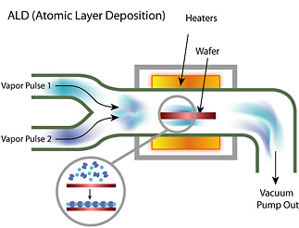
Atomic Layer Deposition
Collaboration with Prof. Christophe Detavernier (Coccoon, UGent)
Self limiting and very ‘soft’ deposition technique with monolayer precision
Control parameter ? Temperature
Oxygen source
(water, ozone, …)
Metal source
(Diethyl-zinc, …)

Slide 27
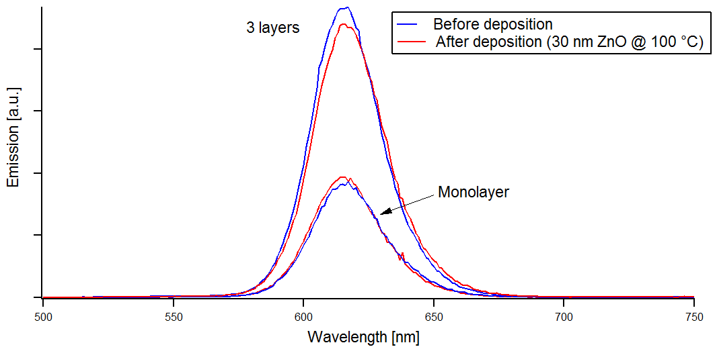
Atomic Layer Deposition
Nanocrystal emission conserved after ZnO deposition @ <150°C

Slide 28
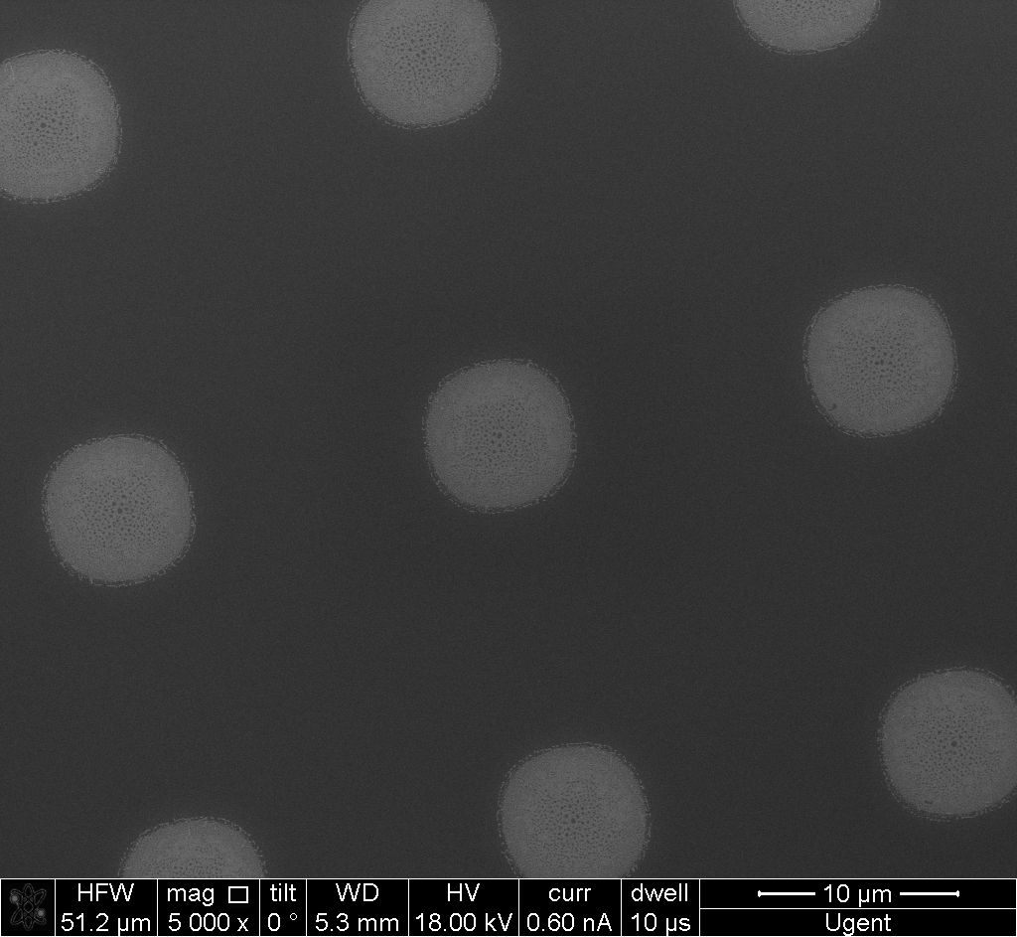
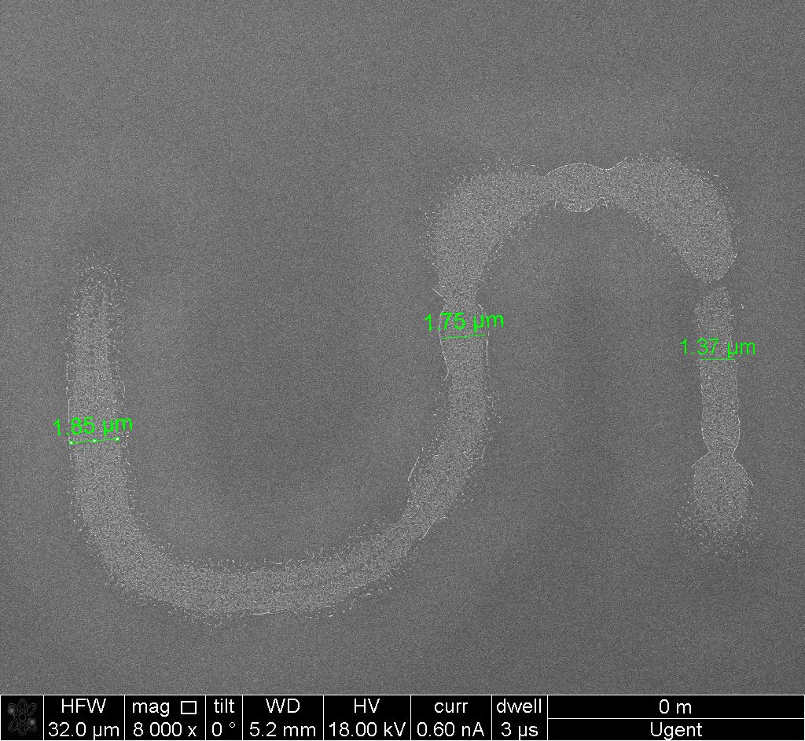
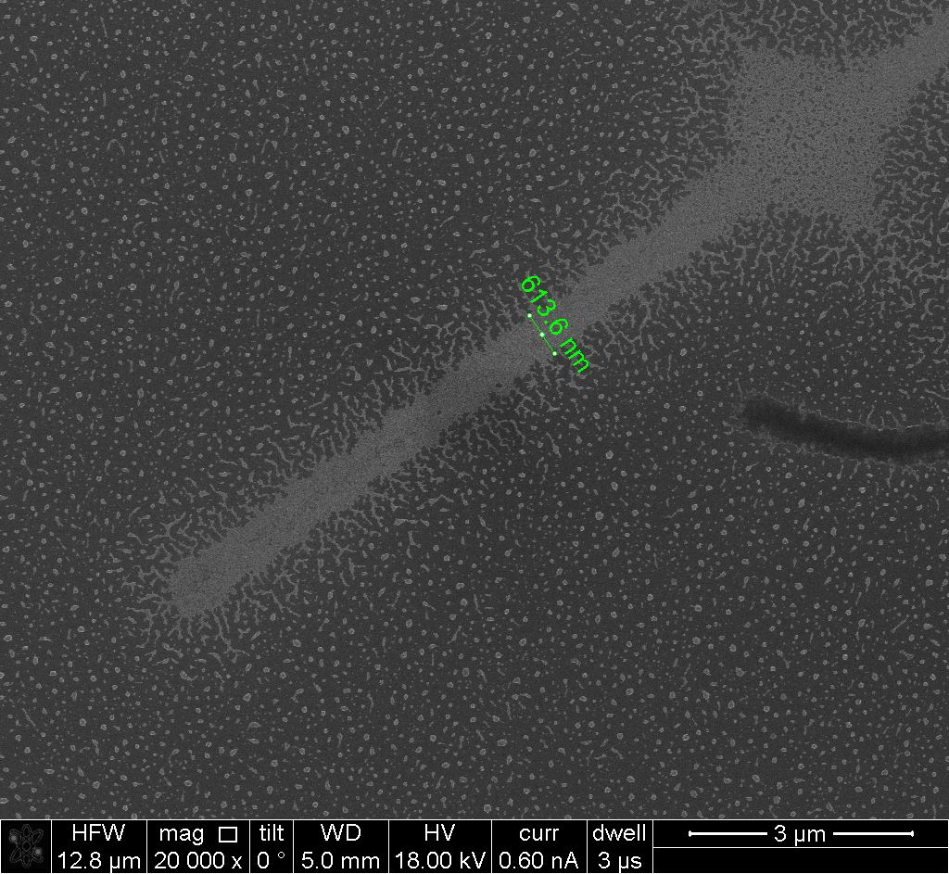
WP4 – Supporting processes
Different processes for local deposition of quantum dots
  Negative photoresist + lift off (optical lithography)
  Pretreatment of surface with anti-adhesion layer

Slide 29
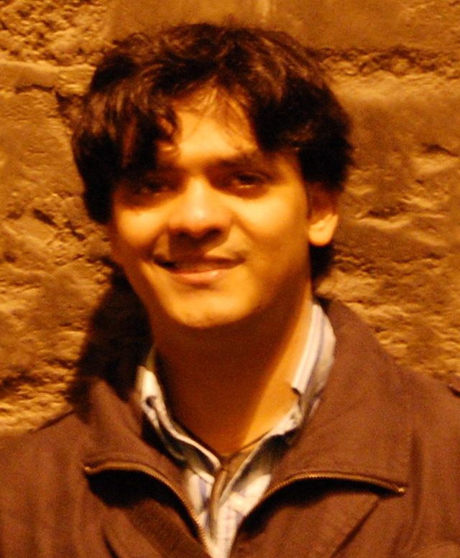
WP5 - work
Passive filter:
  1st gen: 3nm bandwidth, 10dB suppression, 30nm FSR
  options: ring resonator, AWG, PCG …
Beam steerer:
  1st gen: 5dB loss, 100um distance
  2nd gen: 3dB loss, 1mm distance, 10nm bandwidth
  “Challenging”
Time line:
  1st gen: Design (month 12, M5.3)→ Fabrication (month 18, M5.7) → characterisation (month 21, D5.3)
  2nd gen: Design (month 24, M5.9) → Fabrication (month 30, M5.11) → Characterisation (month 33, D5.7)
Sukumar Rudra

Slide 30
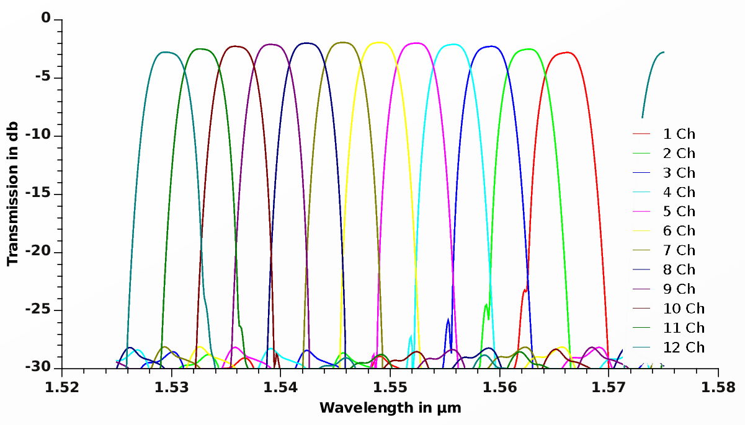
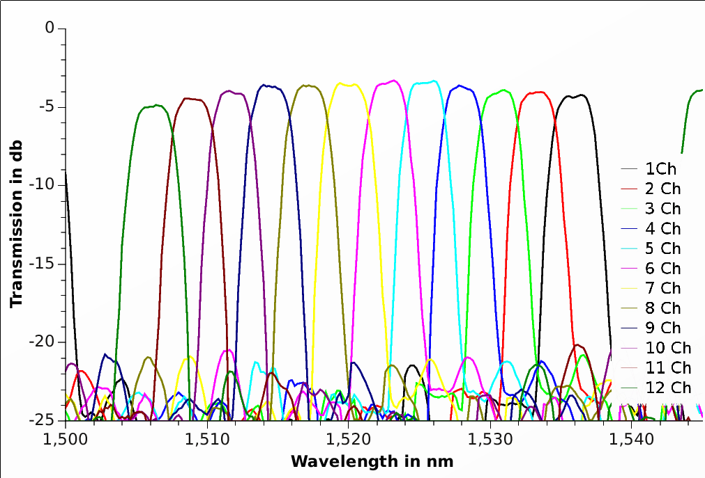
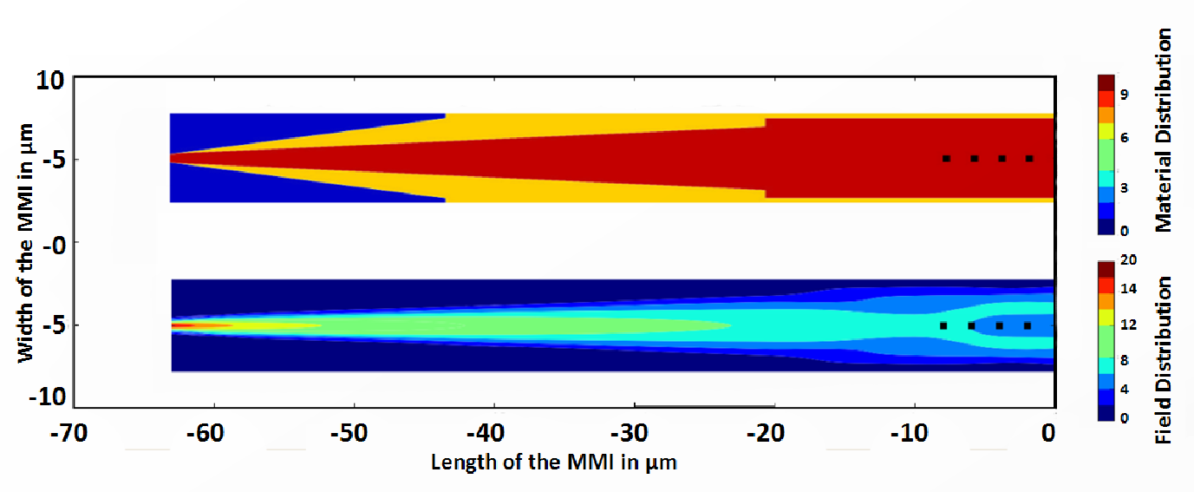
Passive filters
Simulation
Use passband flattened AWG ?
  Using MMI
  Extensive design effort
  1dB los (on top of intrinsic loss)
Measurement
Notes:
In year 1 and 2 our first efforts to fabricate these devices were not very succesful. Now we improved our simulation environment and carried out a whole fabrication sweep, resulting in very good performance

Slide 31
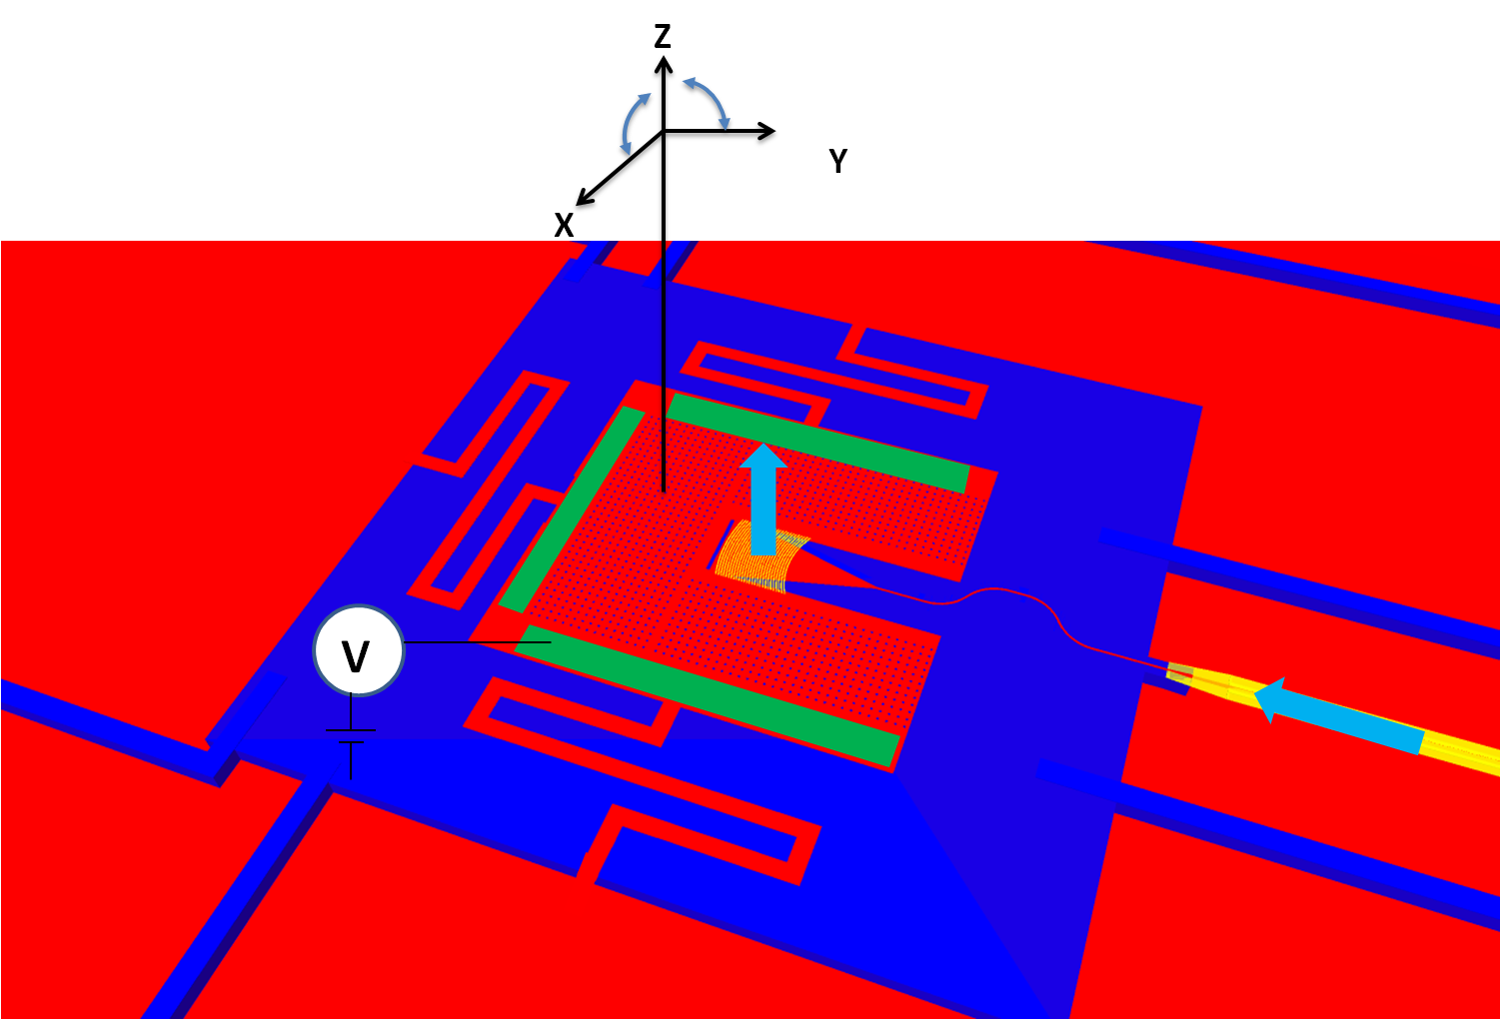
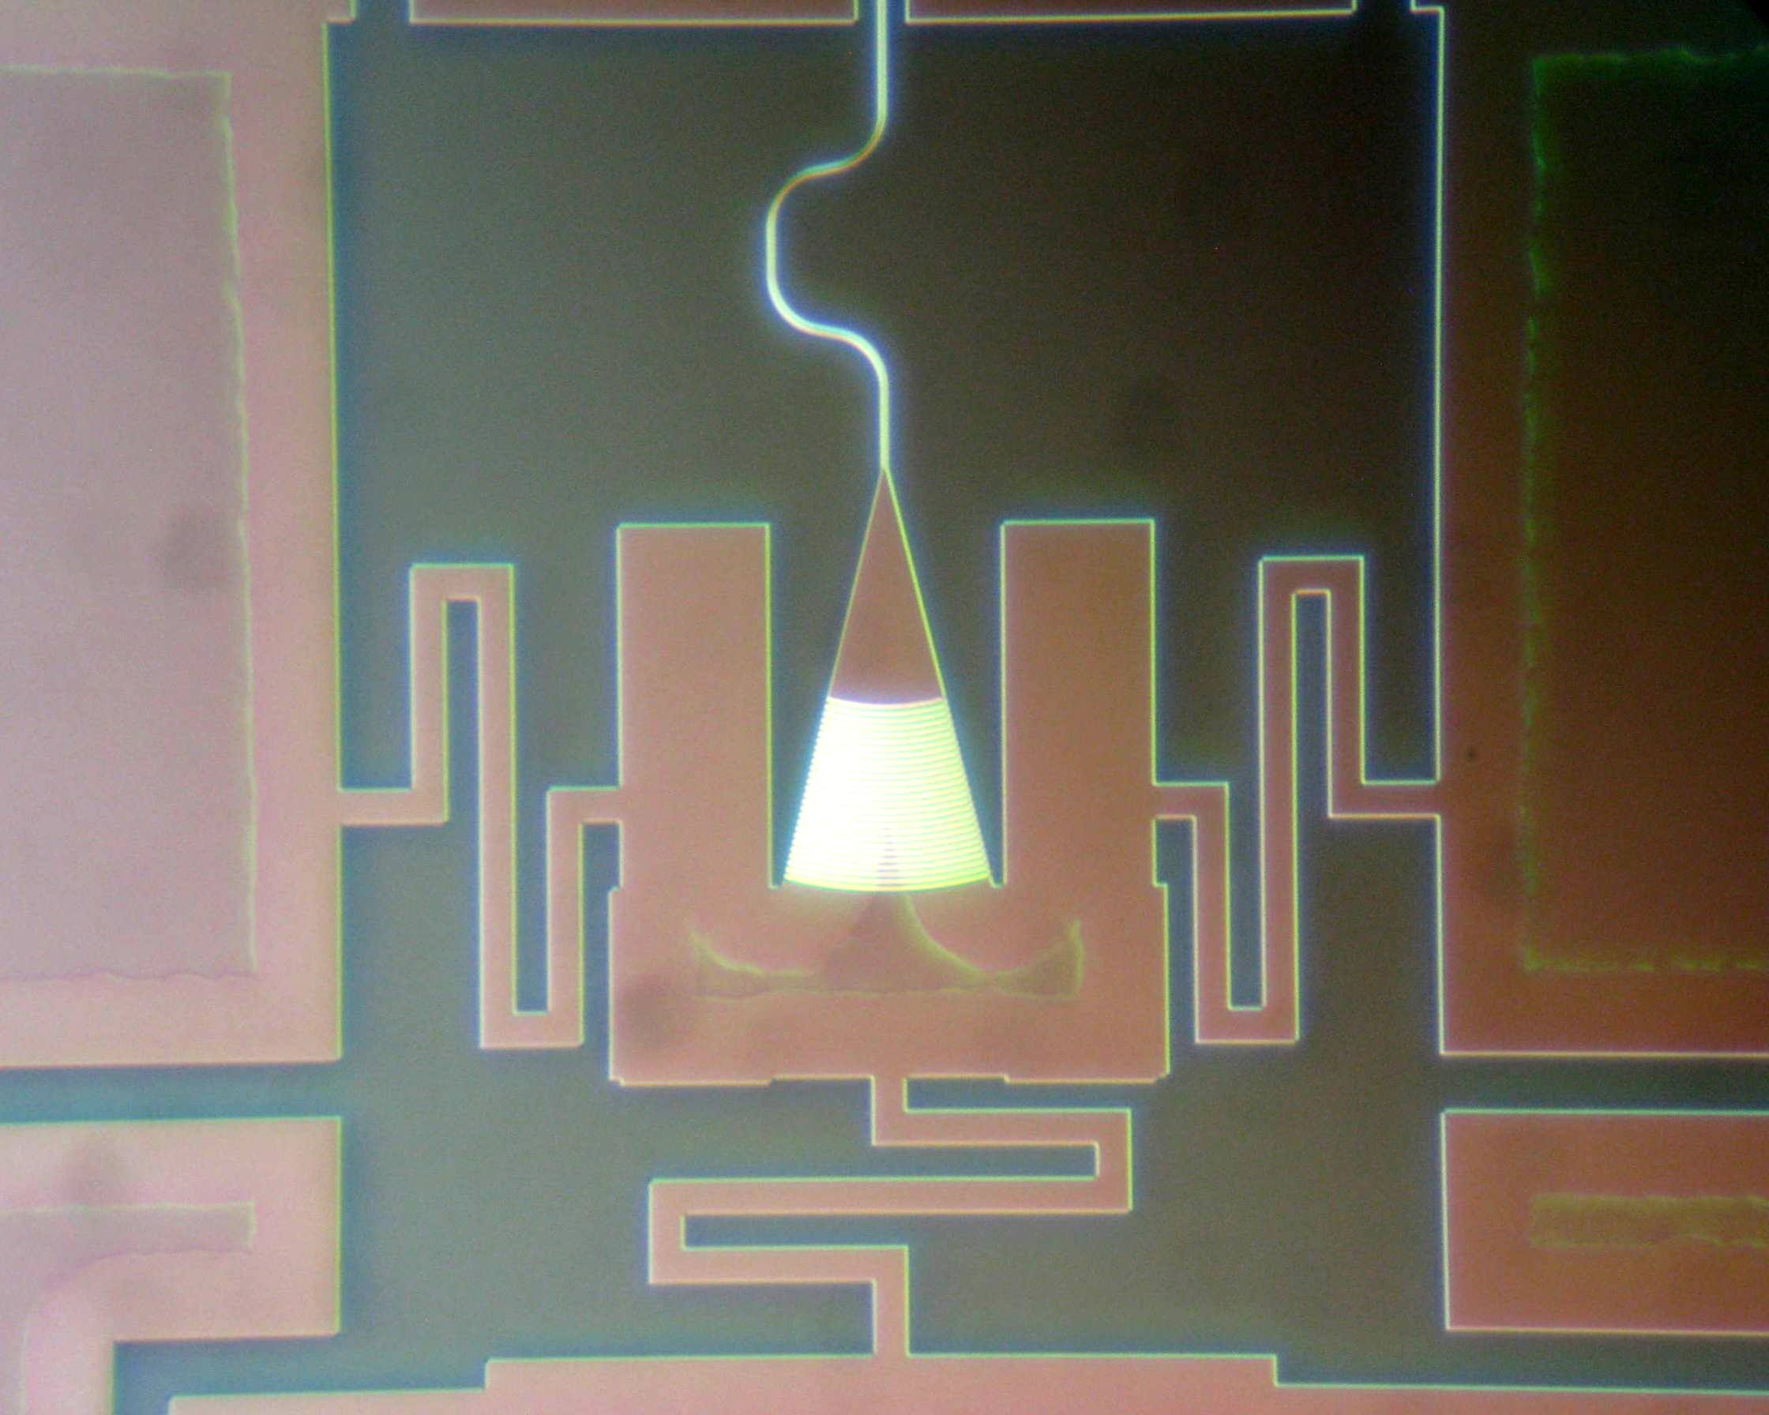
Beam steerers
Use movable gratings ?
To be combined with focussing grating

Slide 32
Providing silicon base circuits
Technology available:
  “Standard passives” : 220nm silicon, two etch depths (70nm, 220nm)
  “Advanced passives” : 220nm silicon + 380nm silicon, multiple etch depths
See: www.epixfab for details and schedule
2012 schedule on line Dec. 1
Need to discuss #runs + size with project partners

