Slide 1
NAVOLCHI
WP 3: Plasmonic Modulator (26MM)
WP 4: Photo detector Design (3MM)
WP 5: Plasmonic Couplers (12MM)
Argishti Melikyan, Sascha Muehlbrandt, Alban Muslija, Martin Sommer, Manfred Kohl
¹Institute of Photonics and Quantum Electronics (IPQ), Karlsruhe Insitute of Technology
¹Institute of Microstructure Technology (IMT), Karlsruhe Insitute of Technology

Slide 2
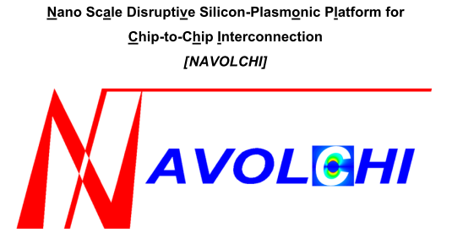







Slide 3
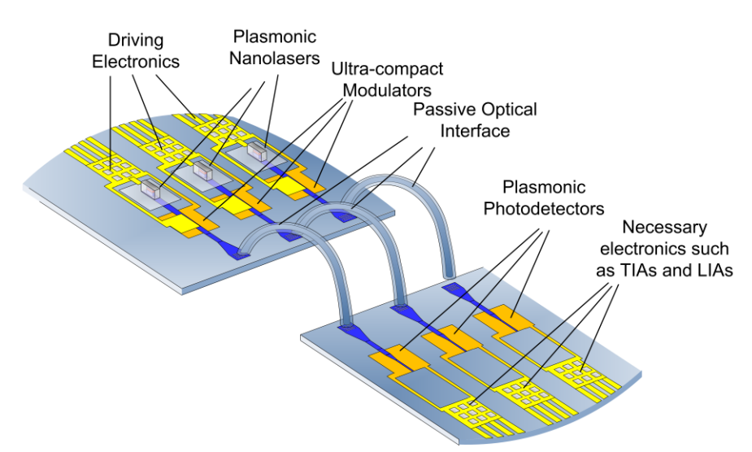
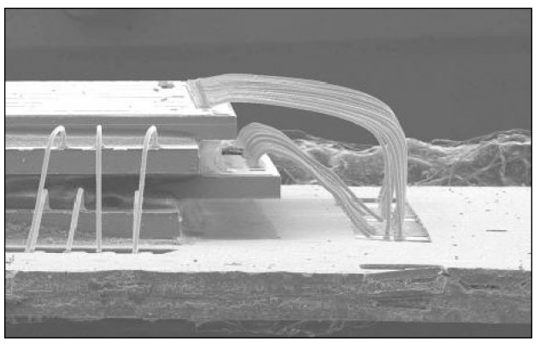
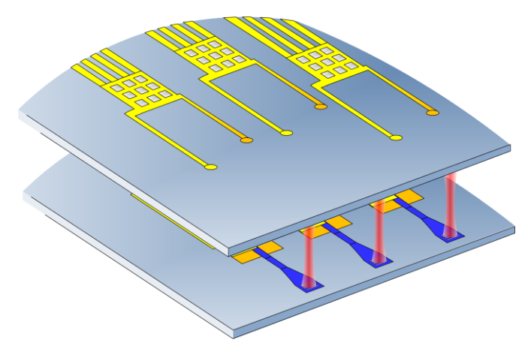
Role of the Plasmonic Modulator
Side-by-Side
Stacked on top of each other

Slide 4
Plasmonic Modulator Specification
Small footprint
High speed
Small driving voltages
Low loss
Integrated with Si-photonics
Simple to fabricate
Notes:
If we go back to the previous
Laser power
Electrical power consumption
Economical in the terms of it’s use of space as well as cost
Integrated Si-phootnics which is kindof already a solution for the low loss

Slide 5
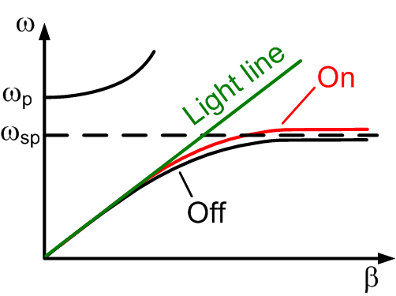
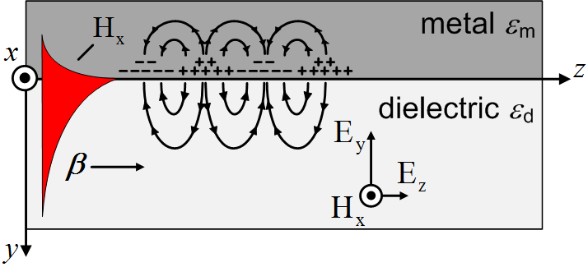
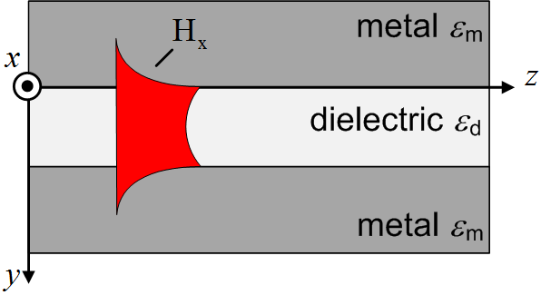
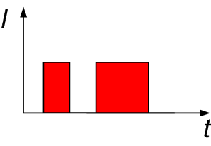
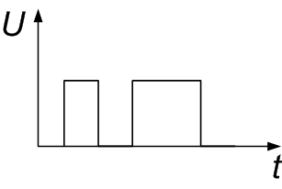
Surface Plasmon Polariton Modulation
Single Interface of metal/dielectric
Metal-dielectric-metal configuration
Optical Domain
Electrical Domain
U
Notes:
If we go back to the previous

Slide 6
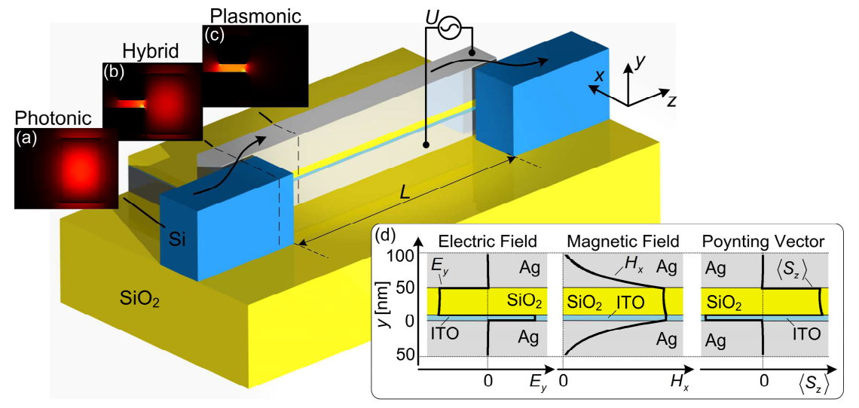
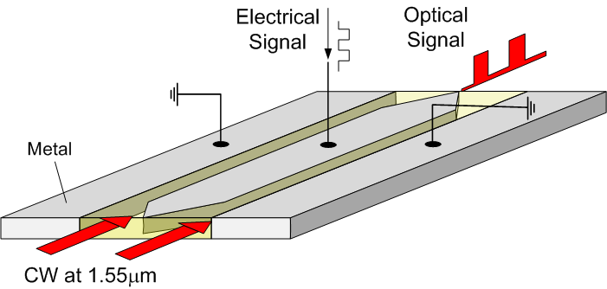
Plasmonic Modulator Approaches
Surface Plasmon Polariton Absorption Modulator (SPPAM)
Surface Plasmon Polariton Phase Modulator

Slide 7
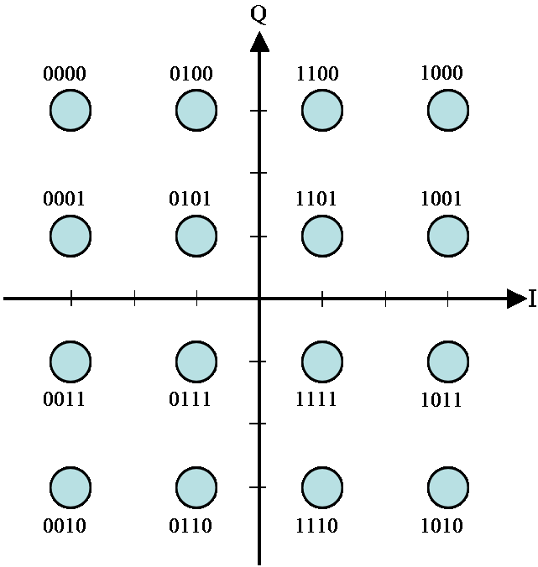

Plasmonic Phase Modulator
IQ modulators
More bits per symbol

Slide 8
SPP Phase Modulation
U_{pp}
r₃₃=70pm/V
U_{pp}=3.5V
Notes:
Single layer

Slide 9
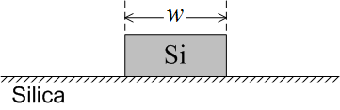
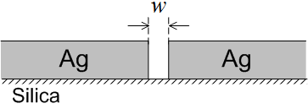
SPP Phase Modulation
Small footprint ✓
High speed ✓
Small driving voltages ✓
Low loss 
Integrated with Si-photonics 
Simple to fabricate 
Photonics
Plasmonics
 | Photonics | Plasmonics
Notes:
Two layer

Slide 10
WP 5: Optimization of the Coupling
2D Simulation Results
θ
Notes:
Expected Challenges

Slide 11
WP 5: Optimization of the Coupling
3D Simulation Results
θ
Notes:
Expected Challenges

Slide 12
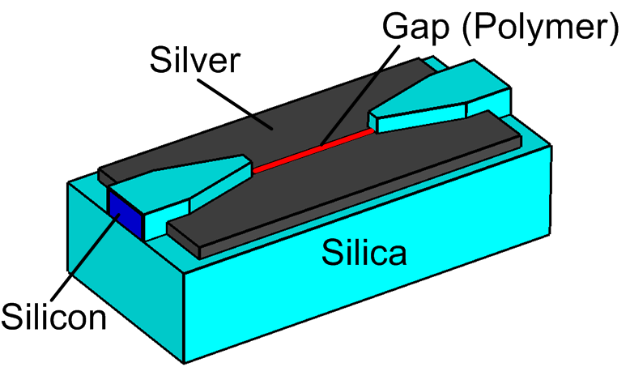
WP3: Modulator Design

Slide 13
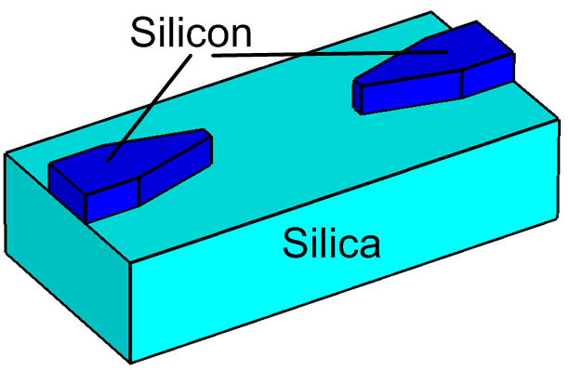
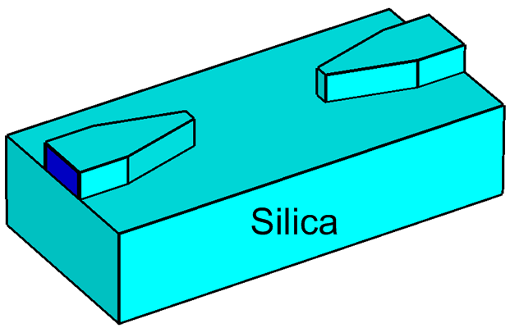
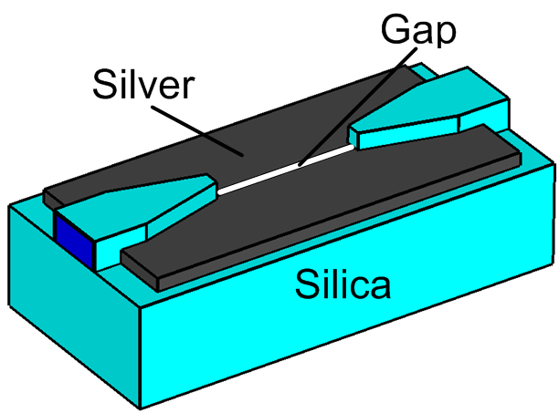
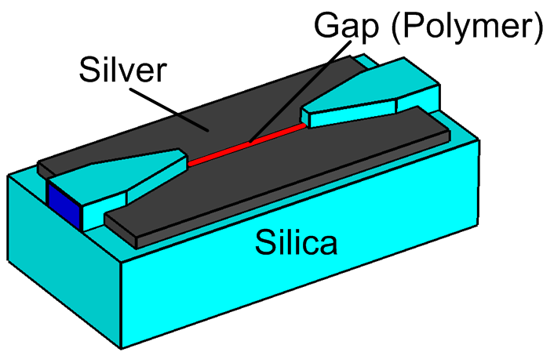
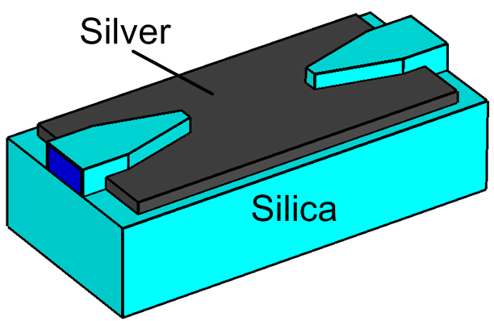
WP3: Fabrication Vision
Oxidation
Metallization
Gap Fabrication
Polymer Filling

Slide 14
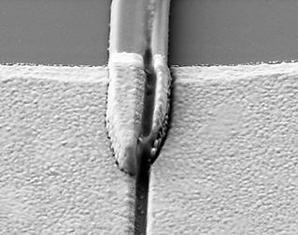
WP3: Device Fabrication with FIB
400 nm
Silver
Waveguides
Notes:
Covered Sidewalls for efficient SPP guiding ->Important!!!!
Milling directly in the middle ist important, instead metal might fall off and coupling ist already expected to be worse than fibbing in the middle. ->scattering losses as well
MANUAL ADJUSTMENT ist shit

Slide 15
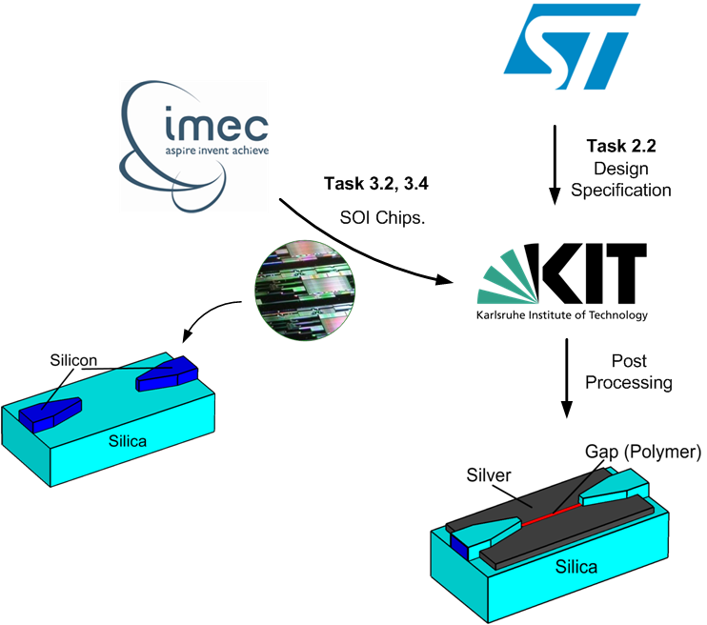
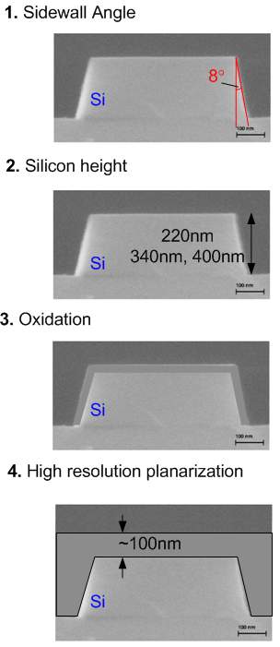
WP3: Plans within the Consortium

Slide 16
Surface Plasmon Polariton Absorption Modulator

Slide 17
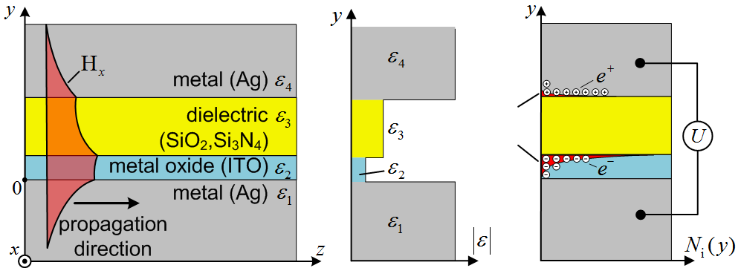
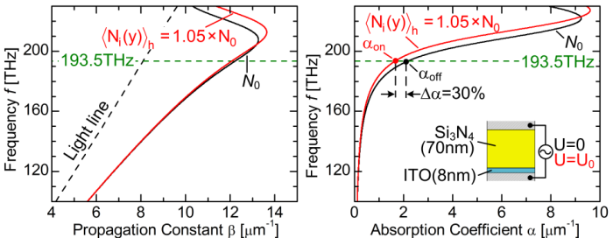
WP3: SPP Absorption Modulator
Design and Working Principle
Semi-analytic derivation of the dispersion relation
Estimation of the electron screening effect with
Thomas-Fermi theory
Extinction ratio calculation for a given voltage
Single Interface
SPPAM
193.5THz
Notes:
Absorption is very high

Slide 18
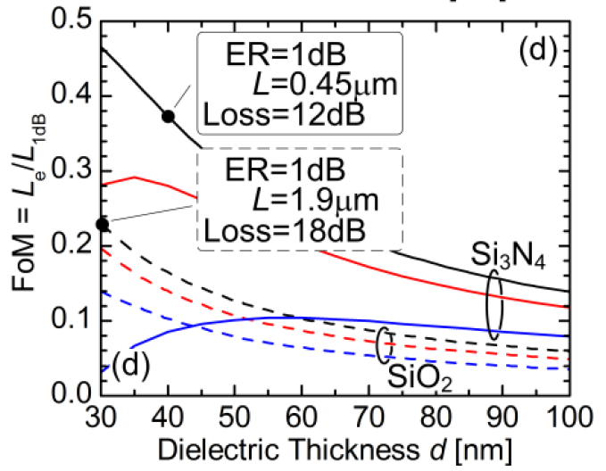
WP3: SPP Absorption Modulator
Design and Working Principle
U_{pp}=10V

Slide 19
WP3: Proof of Principle and the Vision
Fabricated Structure
Vision
Top Silicon > 340nm

Slide 20
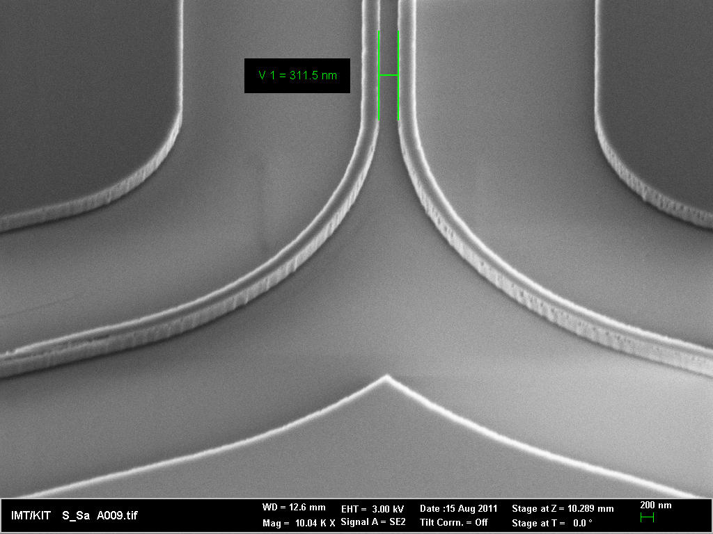
WP3: Future Plans
Example of the design
KIT
E-beam lithography
Etching
Metallization
Si slab
Post
Processing
Decisions to be made with IMEC!
Top silicon thickness ?
Sidewall angle ?
Silicon Oxidation ?
Metallization (Alignment Marks, Electrodes)
Planarization
Si nanowire

Slide 21
Thanks!

