Slide 1
TU/e Role in NAVOLCHI
Victor Calzadilla
Prof. Meint Smit
Prof. Andrea Fiore

Slide 2
Work package no. 3
Task 3.1 - Modeling of device structures plasmonic laser and optimization of bonding technology [M1-M6]
The aim of this task is to look at the choice of laser design and how to couple the laser output to the Si waveguide.
Task leader: TUE
Contributing Partners: TUE, IMEC
Task 3.3 - Fabrication of nano plasmonic laser [M7-M30]
The fabrication of the nanolaser will be done by epitaxial grown InP/InGaAs wafer, bonding it to the SOI waveguide structure, and then performing lithography, etch and material deposition steps to form the laser.
Task leader: TUE
Contributing Partners: TUE, IMEC

Slide 3
Deliverables and milestones
M3.1 - 04/2012 - Decision on an optimized structure for metallic/plasmonic nanolaser and its coupling to Si waveguides
Milestones
M3.5 - 04/2013 - Initial characterization of unbonded plasmonic lasers
M3.7 - 10/2013 - Initial testing of bonded plasmonic lasers
3 years period (started on 01/11/2011)
D6.1 – 02/2014 - Report on characterization results of all plasmonic devices
Deliverables
D3.3 - 10/2013 - Fabrication of plasmonic laser device(TUE)
D7.1/D7.3 - 10/2012 – Dissemination and promotion activities
D3.1 - 10/2012 - Report on the studies of optimized structure for metallic/plasmonic nanolaser and its coupling to Si waveguides (TUE)

Slide 4
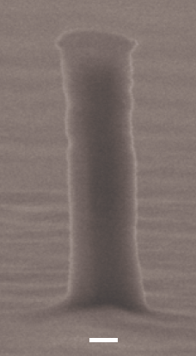
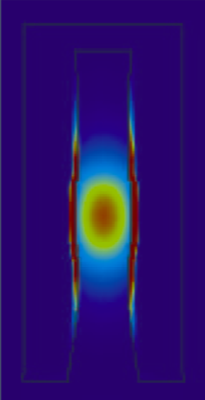
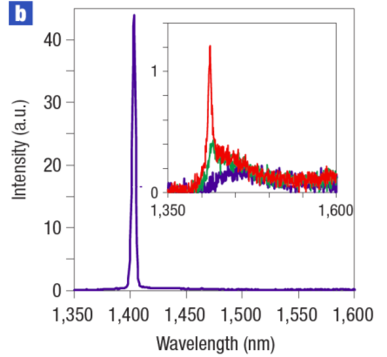
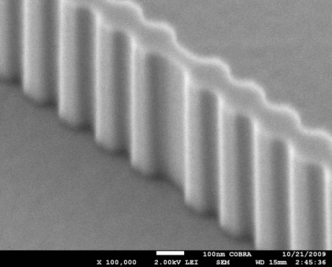
Metallic and plasmonic lasers
The world’s smallest electrically injected laser (diameter 250 nm)
Martin Hill et al., Nature Photonics, October 2007
I_{th} = 6 μA @ 77K
Gold
InP

Slide 5
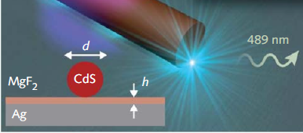
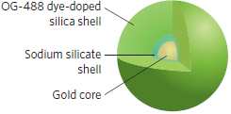
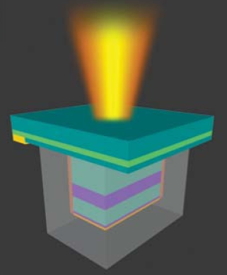
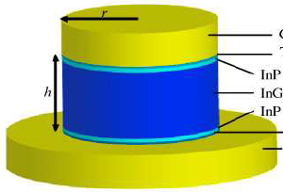
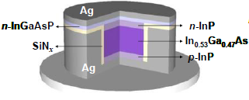
Typical laser structures
Nanowire laser
Spaser
Optically pumped
Hetero-structure pillar
Nanopatch
Nanocoin/nanopan
Electrically pumped

Slide 6
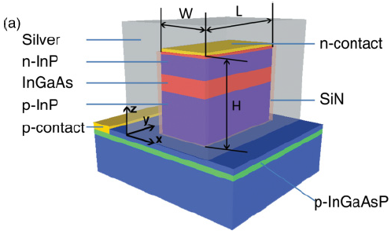
Room-temperature continuous wave lasing Room-temperature continuous wave lasing in deep-subwavelength metallic cavities under electrical injection, K.Ding et. al.
Structure
Vertical index: 3.1(InP) - 3.4(InGaAs) – 3.1(InP)
Horizontal structure: MISIM
Devices with laser volume ranging from 0.42 λ³ to 1.01 λ³
Measurement
Intensity, FWHM and polarization of radiation from the bottom is measured

Slide 7
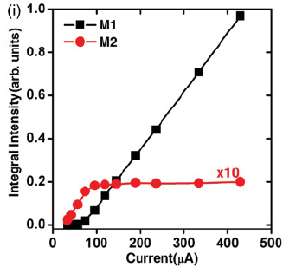
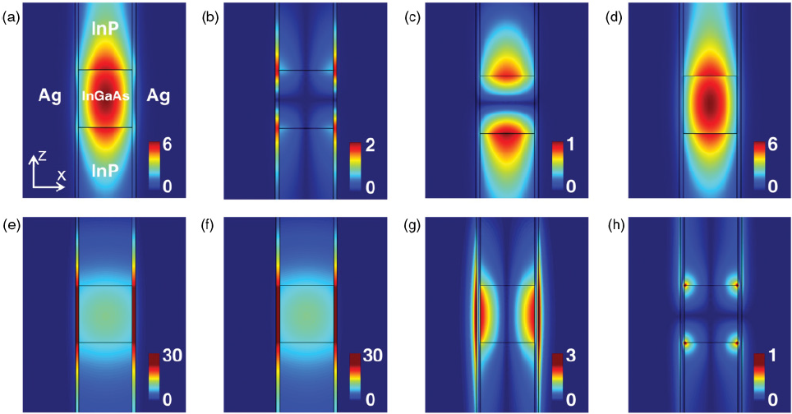
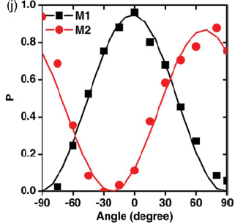
Room-temperature continuous wave lasing Room-temperature continuous wave lasing in deep-subwavelength metallic cavities under electrical injection, K.Ding et. al.
|E |
| Ex |
| Ey |
| Ez |
M1
dielectric
M2
plasmonic
Results
Mode 1 dominates
Lasing mode is polarized along y and mode 2 ~along x-direction

Slide 8
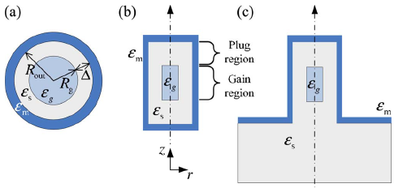
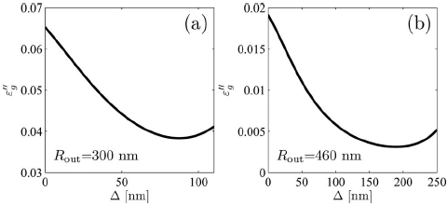
Low threshold by optimization of dielectric shield Low threshold gain metal coated laser nanoresonators, A. Mizrahi et al.
Investigation of effect of dielectric shield on threshold gain
Conclusion:
Reducing thickness → higher absorption
Increasing thickness → smaller volume of gain medium
Threshold gain
Optimum thickness

Slide 9
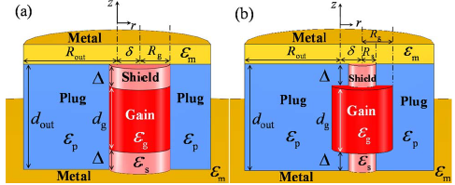
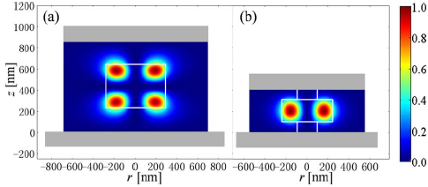
Dielectric shielded nanopatch resonators Dielectric shielded nanoscale patch laser resonators, Q. Ding et al.
Gain material and dielectric are sandwiched between metal patch and metallic layer
Threshold gain can be optimized by the parameters of cavity:
Shield: to decrease absorption
Plug: improves horizontal confinement

Slide 10
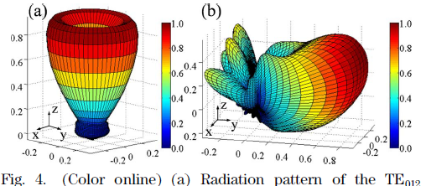
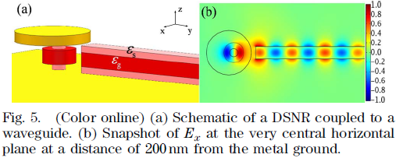
Dielectric shielded nanopatch resonators Dielectric shielded nanoscale patch laser resonators, Q. Ding et al.
Shift of the gain core to break symmetry of far field and allow a better coupling to waveguide.
Power injected into waveguide relative to the generated in gain core is 22%. Such efficiency is only 7% for the symmetric case.

Slide 11
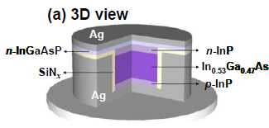
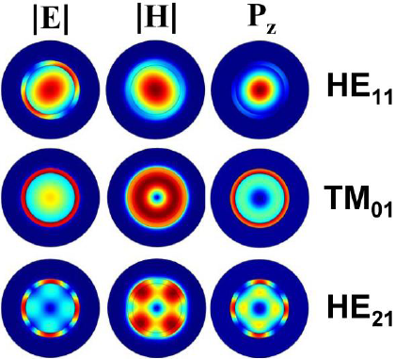
Nanocoin laser at room temperature A surface-emitting 3D metal-nanocavity laser: proposal and theory, Chien-Yao Lu et at.
Good characteristics
Microwatt output power
Circular beam shape
Crosstalk free environment
Optimization based on fundamental mode
Nodes in the center lead to poor overlapping with gain material
Modes with whispering gallery behavior is more dependent on bondaries (metal)

Slide 12
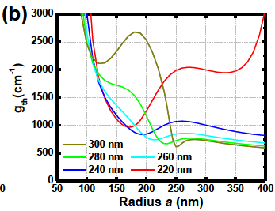
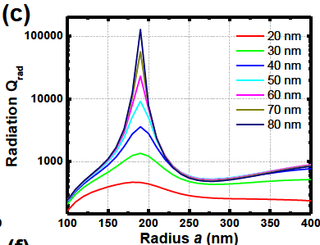
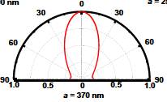
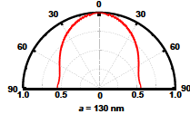
Surface-emitting nanocoin laser A surface-emitting 3D metal-nanocavity laser: proposal and theory, Chien-Yao Lu et at.
Optimization is done for: Q-factor, confinement factor and resonance frequency
From such data → threshold material gain is calculated
Material gain threshold for different cavity heights
Radiation Q-factor for different thickness of metal at top

Slide 13
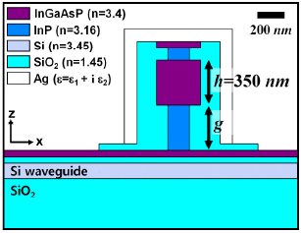
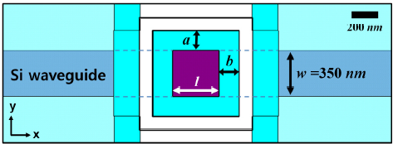
Efficient couplig of metal laser to Si-waveguide Efficient waveguide-coupling of metal-clad nanolaser cavities. Myung-Ki K. et al.
Structure
Si-waveguide with thickness of 150nm (single-mode) and same width as active medium
Optimization
Optimization of Q-factor by cladding thickness
Optimization of external efficiency by varying the post height ‘g’
Initially:
g = 600nm, g’=100nm
a = b = 150nm
h = w = l = 350nm

Slide 14
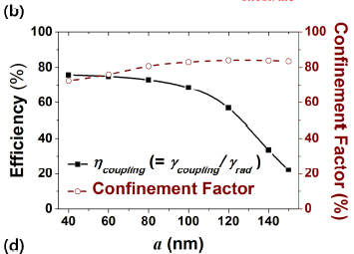
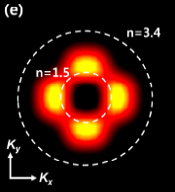
Efficient couplig of metal laser to Si-waveguide Efficient waveguide-coupling of metal-clad nanolaser cavities. Myung-Ki K. et al.
Optimization
Coupling efficiency to Si-waveguide by breaking the symmetry in cavity (i.e. modifying the k-vector distribution).
Two options: asymmetry in thickness of cladding or aspect ratio of cubic active medium.
Cubic cavity:
k-vectors coupling to waveguide

Slide 15
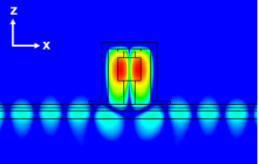
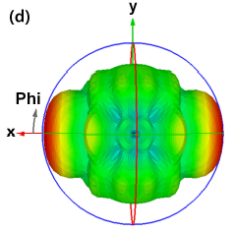
Efficient couplig of metal laser to Si-waveguide Efficient waveguide-coupling of metal-clad nanolaser cavities. Myung-Ki K. et al.
Results and conclusions
Result:
g = 350nm, a = 60nm, cubic cavity
High external efficiency and high Q-factor
Coupling efficiency = 78%
Total external efficiency = 43%
Q-factor = 630
Two main parameters can be engineered ~independently:
Coupling by tuning the cladding (breaking symmetry)
External efficiencies by post height

Slide 16
Desirable characteristics
Low threshold material gain = f(Q-factor, confinement factor, resonance freq.)
High confinement factor
High Q factor: material Q-factor + radiation Q-factor
In trade-off with external efficiency
High coupling efficiency with waveguide
An output power of 100 uW at least is needed

Slide 17
Laser core
Different possible designs
InP
SiN
InGaAsP
Silver
- Easier fabrication and modeling
Less absorption
Lower threshold gain
Smaller gain volume
Shorter pulses
Faster on/off

Slide 18
Coupling to InP-waveguide
Engineering of the cavity would allow coupling into a InP waveguide
InP
Si
SiN
InGaAsP
Silver
Gold
BCB
Only half of the emitted power is coupled into the waveguide
A coupling to the Si-waveguide can be done with a taper afterwards

Slide 19
Coupling to InP-waveguide: current design
Issues to solve:
Arrangement of contacts
Achieve enough Q-factor
How to test it before the bonding to silicon?
How to increase output directionality to the waveguide?
gold
p
gold
-
InP
silver
isolation layer
n
-
InP
250 nm
active region (InGaAsP)
BCB
silicon
BCB

