Slide 1
Physics and chemistry of nanostructures
Kick-off meeting Navolchi project
February 3th, 2012
Prof. Zeger Hens
Ghent University
Belgium

Slide 2
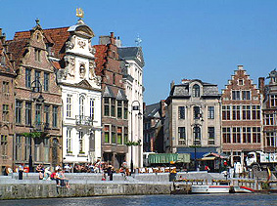
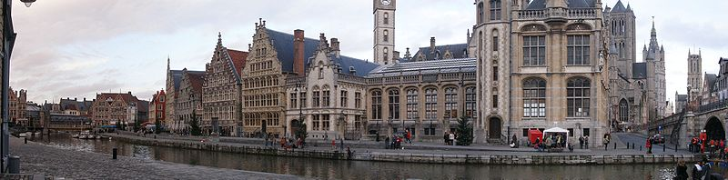

PCN
Inorganic and physical chemistry department
Krijgslaan 281—S3
Prof. Z. Hens
2 Postdocs, 10 PhD students
Part of
Center for Nano- and Biophotonics

Slide 3
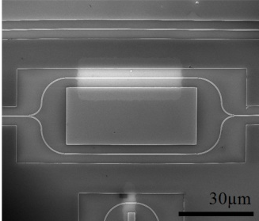
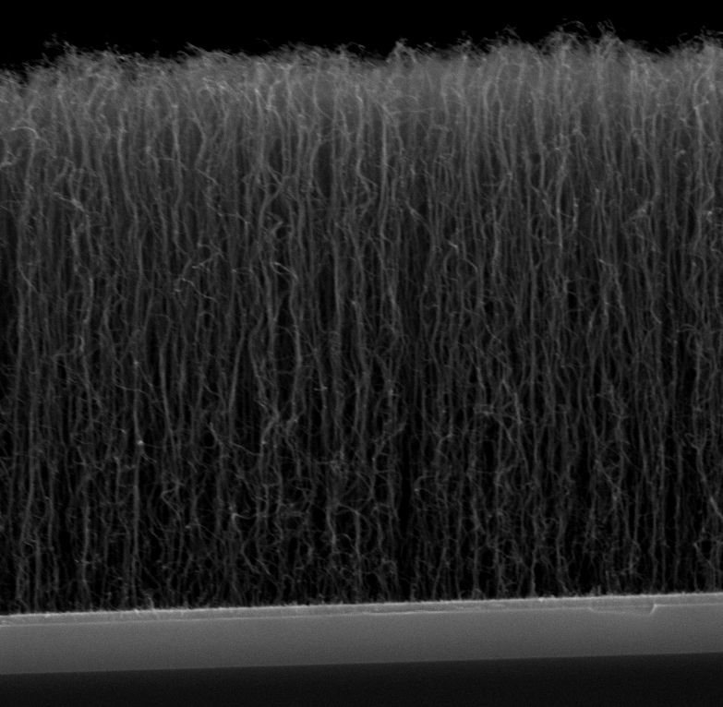
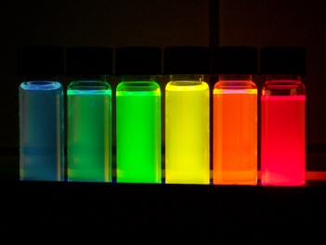
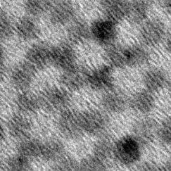
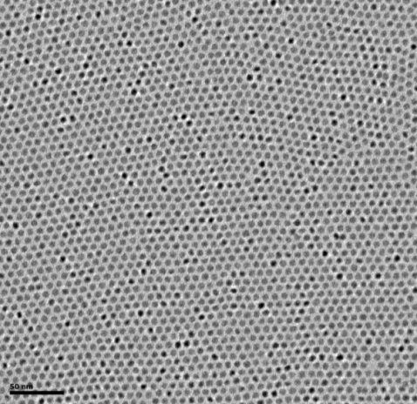
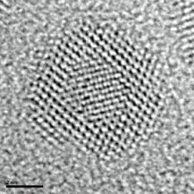
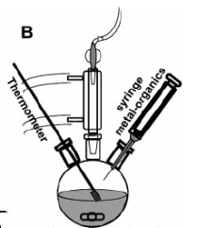
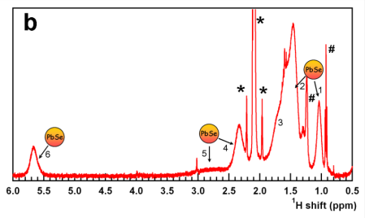
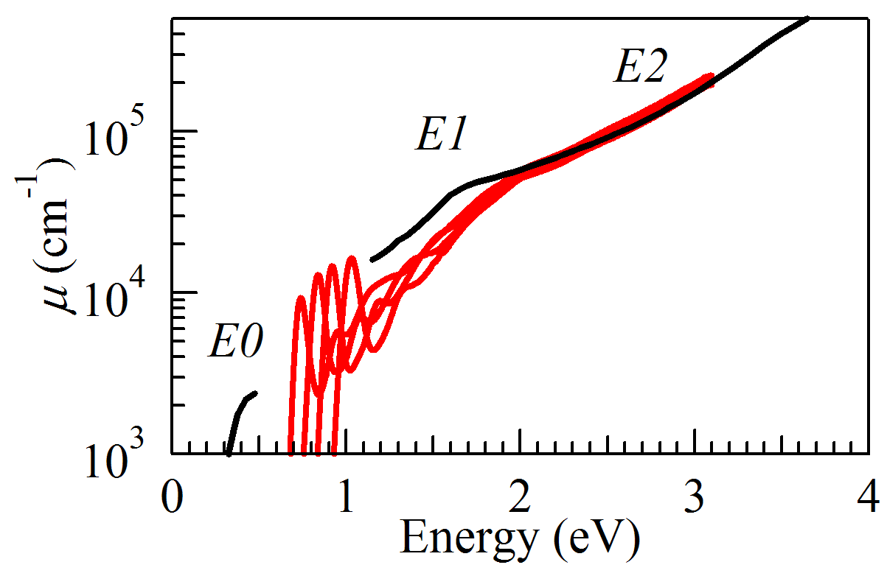
Research activities
A research group on (colloidal) nanomaterials
Physics and chemistry of nanostructures
Colloidal synthesis of nanoparticles
Analysis of surface chemistry
Processing and deposition
Characterization of physical properties
Applications in photonics
chemistry
physics
technology

Slide 4
Research activities
A research group on (colloidal) nanomaterials
Synthesis development
  II-VI, IV-VI, Pb- and Cd-free quantum dots
Structural characterization
  Elemental analysis / HR-TEM imaging / NMR spectroscopy
Development of processing technology
  Ligand engineering / monolayers and thin films / surface patterning / embedding in thin films / QD based devices
Characterization of physical properties
  QD absorption / photoluminescence (steady state, excitation, time-resolved) / non-linear properties (Kerr-effect, photo-induced absorption, gain)
Application development
  Integrated photonics / photovoltaics / white LEDs

Slide 5
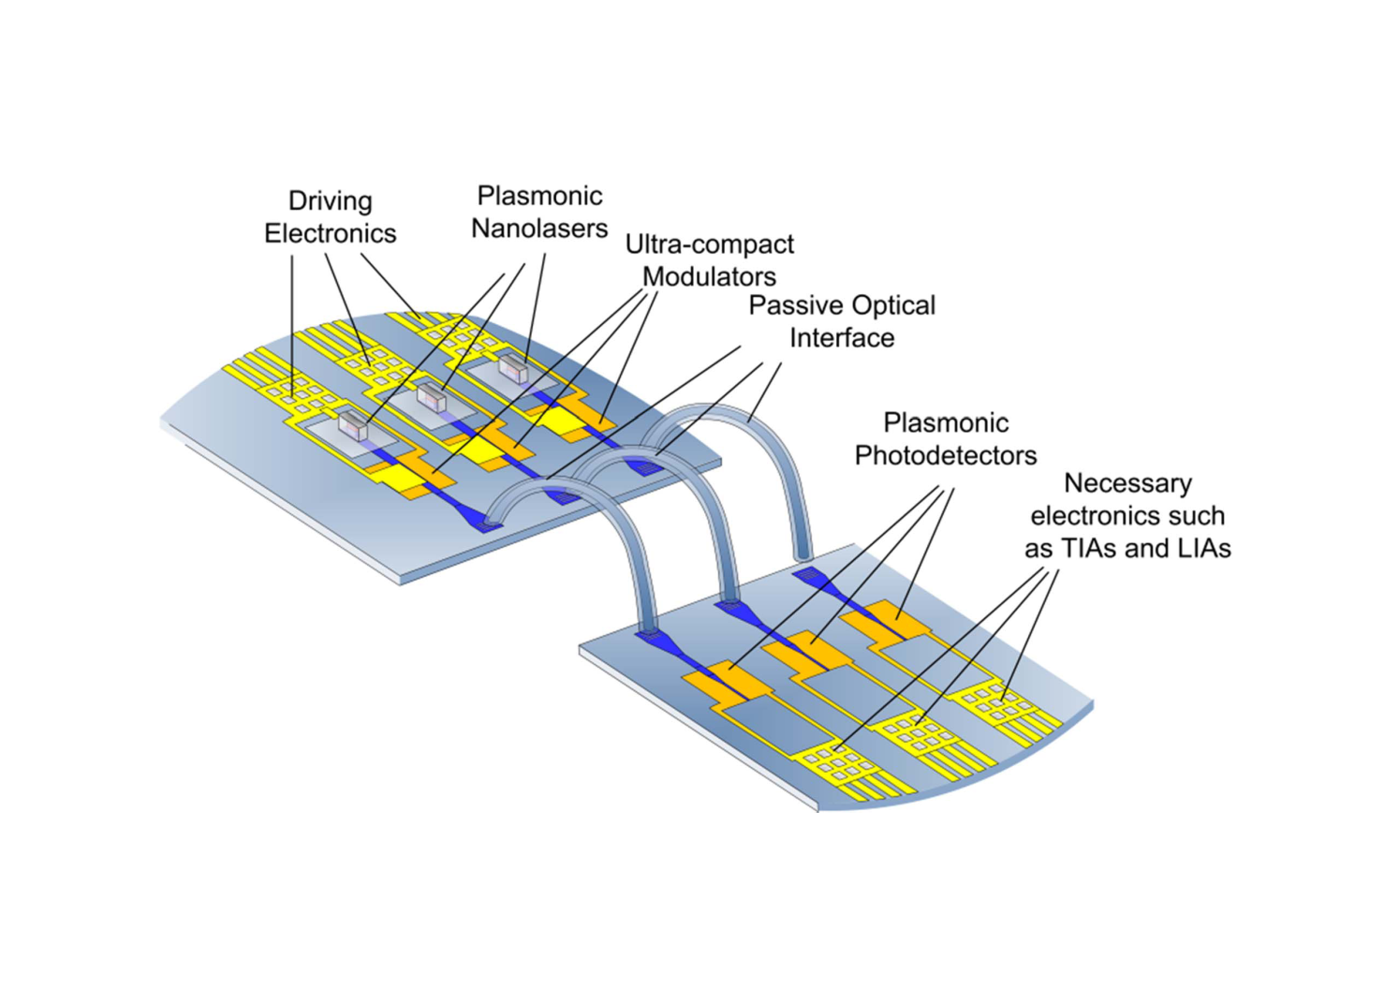
Role within Navolchi
Optical amplifiers based
on colloidal QDs as gain media

Slide 6
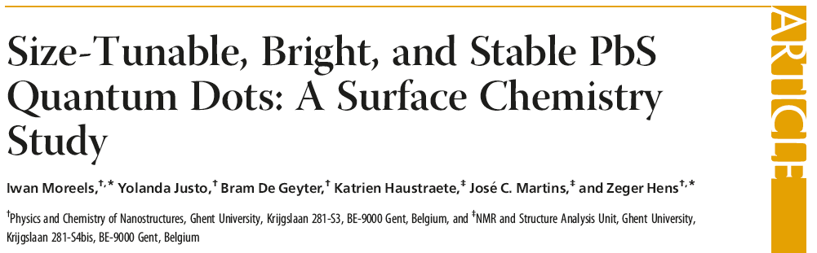
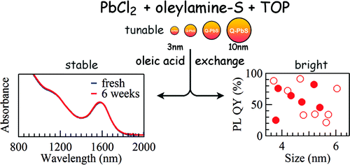
IR Quantum Dots
Based on Pb chalcogenide nanocrystals
Wavelength size tunable, 800-3000 nm
Highly efficient photoluminescence (up to 100% for PbS)

Slide 7
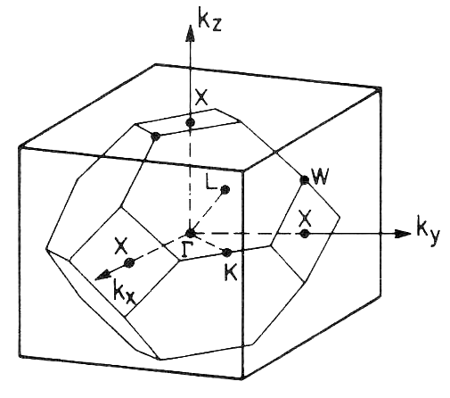
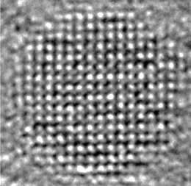
IR Quantum Dots
Gain with Pb chalcogenide nanocrystals?
HOMO & LUMO 8-fold degenerate
Population inversion requires > 4 excitons/QD
Bandgap in L point
of Brillouin zone

Slide 8
IR Quantum Dots
Gain with Pb chalcogenide nanocrystals?
HOMO & LUMO 8-fold degenerate
Population inversion requires > 4 excitons/QD
Problem – Auger recombination limits gain lifetime
Bandgap in L point
of Brillouin zone

Slide 9
IR Quantum Dots
Possible solutions
Increase level spacing between exciton levels
  Due to intervalley coupling and exchange interaction
Expected to be enhanced in PbS quantum rods

Slide 10


IR Quantum Dots
Possible solutions
Lift exciton degeneracy via Coulomb interactions in heterostructures
  Possible by using quantum dot heterostructures
$$E_{1}=ε_{e}−ε_{h}−Δ_{eh}$$
$$E_{2}=ε_{e}−ε_{h}−Δ_{eh}+\left(Δ_{ee}+Δ_{hh}−{2Δ}_{eh}\right)$$
Degeneracy lifted when
$Δ_{ee}+Δ_{hh}−{2Δ}_{eh}≠$ 0

Slide 11
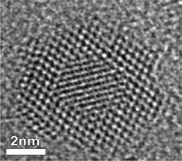
IR Quantum Dots
Possible solutions
Lift exciton degeneracy via Coulomb interactions in heterostructures
  Possible by using quantum dot heterostructures
Type 2 band alignment
Interfacial energy barrier
Degeneracy lifted when
$Δ_{ee}+Δ_{hh}−{2Δ}_{eh}≠$ 0

Slide 12
IR Quantum Dots
Possible solutions
Reduce rate of Auger recombination
  heterostructures with gradual interfaces
  Use rods instead of dots (volume scaling)

Slide 13
Our approach within Navolchi
Development of PbS rods and PbS/CdS heterostructures

Slide 14
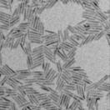
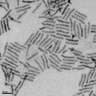
Status of the work
PbS quantum rods synthesized via cation exchange
28 nm
28 nm
3.7 nm
3.7 nm
CdS
Cu₂S
PbS

Slide 15
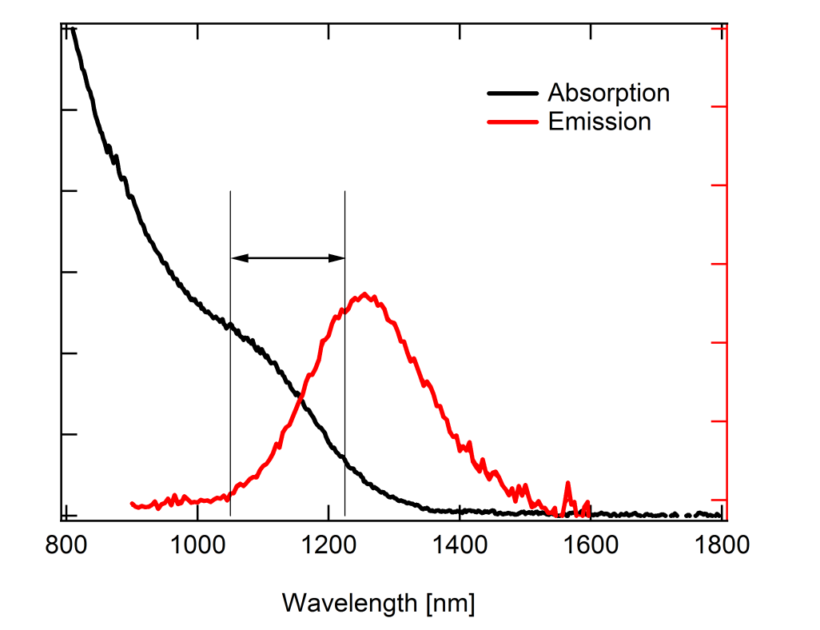
Status of the work
Enhanced Stokes shift indicates increased exciton splitting
200 meV vs. 60 meV for PbS dotsat same energy

Slide 16
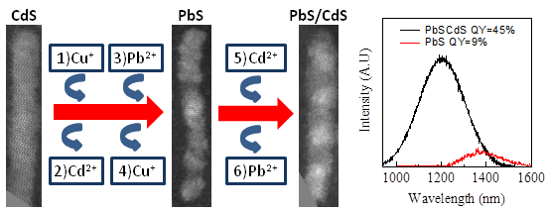
Status of the work
PbS/CdS multiple dot-in-rods
  Successive cation exchange steps transform original CdS rod into a PbS/CdS multiple dot-in-rod
  Passivation by CdS enhances PLQY to 45-55%
  Justo et al., submitted to JACS

Slide 17
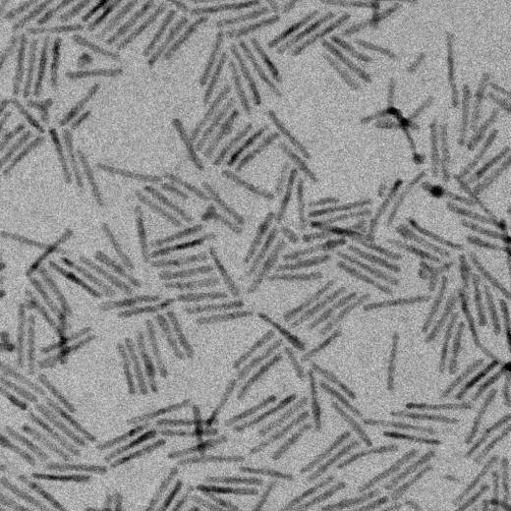
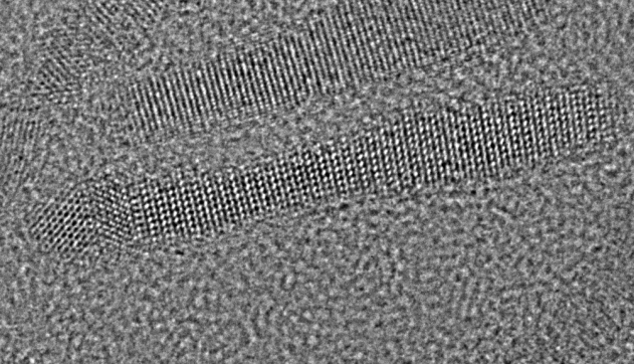
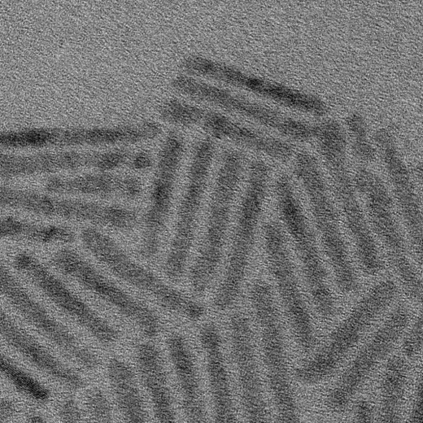
Status of the work
PbS/CdS dot-in-rods
CdS
PbS

Slide 18
Status of the work
PbS/CdS dot-in-rods
QR emission shows two features
  Long wavelength feature corresponds to PbS absorption onset
  Short wavelength feature fades out when exciting below CdS band gap

Slide 19
Status of the work
PbS/CdS dot-in-rods

Slide 20
Status of the work
PbS/CdS dot-in-rods

Slide 21
Problems/needs
Characterization of carrier dynamics/light amplification by newly synthesized heterostructures
  Now: pump/probe measurements via informal collaborations
    Strength: understanding of carrier dynamics crucial for achieving gain
    Weakness: too slow for rapid feedback
  Need: alternative method for rapid screening of promising materials
    Setup under development at UGent
    Is further collaboration on this possible within Navolchi consortium?

