Slide 1



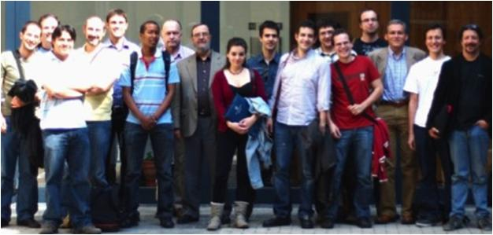
Unit of Materials and Optoelectronic Devices
University of Valencia
www.uv.es/umdo

Slide 2
Role in the project
Plasmonic amplifiers by using polymers doped with QDs
(Task 4.1, 4.3, 4.4, 5.1)
Design of plasmonic amplifiers
Light coupling to metal waveguides and plasmon propagation / amplification
Demonstration of amplification in polymer thin films / stripes
Fabrication of metal nanostructures based on patternable metal-polymer nanocomposites
Plasmon/Photon-Plasmon Photodetectors based on QDs and metal nanostructures
(Task 4.2, 4.5)
Stacks of QDs (layer-by-layer method) for photoconductors/photodetectors
Patternable conductive polymers with added plasmonic capabilities

Slide 3
Role in the project
Plasmonic amplifiers by using polymers doped with QDs
(Task 4.1, 4.3, 4.4, 5.1)
Design of plasmonic amplifiers
Light coupling to metal waveguides and plasmon propagation / amplification
Demonstration of amplification in polymer thin films / stripes
Fabrication of metal nanostructures based on patternable metal-polymer nanocomposites
Plasmon/Photon-Plasmon Photodetectors based on QDs and metal nanostructures
(Task 4.2, 4.5)
Stacks of QDs (layer-by-layer method) for photoconductors/photodetectors
Patternable conductive polymers with added plasmonic capabilities

Slide 4
Design of plasmonic amplifiers

Slide 5
Light coupling in metal waveguides
Probe laser
GaN pumps QDs and PL is coupled to the waveguides
Fiber tip to couple the probe laser
Gain and losses measurements
Set up with double Nd:Yag laser (533 nm) ready

Slide 6
SPP amplification
CdSe-PMMA nanocomposites
Linear increase with a slope close to 1
Gain up to 50 cm^{-1,} but with losses due to reabsorption

Slide 7
SPP amplification
PbS/CdS-PMMA nanocomposites
Linear increase with saturation due to low concentration
Gain about 3 cm⁻¹

Slide 8
SPP amplification
Gain chacterization
New model including losses, laser dependence and saturation effects
Basic curve
New model
Losses
Shape of the laser
Saturation intensity

Slide 9
SPP amplification
Gain chacterization
Gain increase
Losses
Saturation

Slide 10
New objectives
New nanostructures from UGENT
New designs to reduce losses

Slide 11
Role in the project
Plasmonic amplifiers by using polymers doped with QDs
(Task 4.1, 4.3, 4.4, 5.1)
Design of plasmonic amplifiers
Light coupling to metal waveguides and plasmon propagation / amplification
Demonstration of amplification in polymer thin films / stripes
Fabrication of metal nanostructures based on patternable metal-polymer nanocomposites
Plasmon/Photon-Plasmon Photodetectors based on QDs and metal nanostructures
(Task 4.2, 4.5)
Stacks of QDs (layer-by-layer method) for photoconductors/photodetectors
Patternable conductive polymers with added plasmonic capabilities

Slide 12
Layers of IV-VI QDs
Synthesis of PbS spherical QDs with two different sizes (900 and 1500 nm) exhibiting good air and light stabilty.
Investigation of the Influence of the type of ligand on the internal quantum efficiency IQE.
This IQE difference is consistent with the measured dark conductivity of the layers: 5.10⁷ and 8.10⁸ Wcm for 3-Mercaptopropionic acid (MPA) and 1,2-Ethanedithiol (EDT) based layers, respectively.

Slide 13
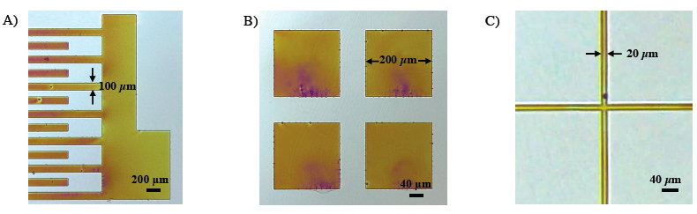
Patternable conductive polymers
Optimized the in-situ polymerization of 3T with Cu(ClO₄)₂ inside several host polymers. Particularly, Novolak photoresist was properly formulated to preserve as far as possible its negative lithographic characteristics and generate conductive (10⁻² S/cm) micropatterns by means of UV lithography.

Slide 14
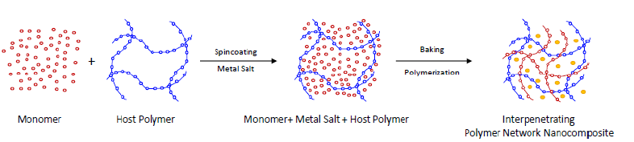
Plasmonic PCP
Synthesis in-situ of the Patternable conductive polymers (PCP) and Au nanoparticles, simultaneously, even if they can be dispersed by using appropriate solvents (and ligand exchange if necessary, as was proved to disperse QDs in SU-8 resist). Thus, we can combine the conductive and lithographic properties of the IPN composite with plasmonics.

