Slide 1

NAVOLCHI meeting
Warwick, July 2012
Victor Dolores-Calzadilla
Andrea Fiore
Meint Smit

Slide 2
Outline
Roadmap: milestones and deliverables
Progress:
    Fabry Perot plasmonic laser
    Metallo-dielectric nanolaser
Conclusions

Slide 3
Work package no. 3
Task 3.1 - Modeling of device structures plasmonic laser and optimization of bonding technology [M1-M6]
  The aim of this task is to look at the choice of laser design and how to couple the laser output to the Si waveguide.
  Task leader: TUe
  Contributing Partners: TUe, IMEC
Task 3.3 - Fabrication of nano plasmonic laser [M7-M30]
  The fabrication of the nanolaser will be done by epitaxial grown InP/InGaAs wafer, bonding it to the SOI waveguide structure, and then performing lithography, etch and material deposition steps to form the laser.
  Task leader: TUe
  Contributing Partners: TUe, IMEC

Slide 4
Deliverables and milestones
M8 - 04/2012 – Optimization of metallic/plasmonic nanolaser and its coupling to Si waveguides
?
Milestones
M13 - 04/2013 - Initial characterization of unbonded plasmonic lasers
M15 - 10/2013 - Initial testing of bonded plasmonic lasers
3 years period (started on 01/11/2011)
D6.1 – 01/2014 – Input to report on characterization results of all plasmonic devices (ST?)
?
D6.1 (ST) D7.3 (AIT)
M47 (AIT)
Deliverables
D3.3 - 10/2013 - Fabrication of plasmonic laser device
D7.1/D7.3 - 10/2012 – Dissemination and promotion activities
D3.1 - 10/2012 - Report on the studies of optimized structure for metallic/plasmonic nanolaser and its coupling to Si waveguides

Slide 5
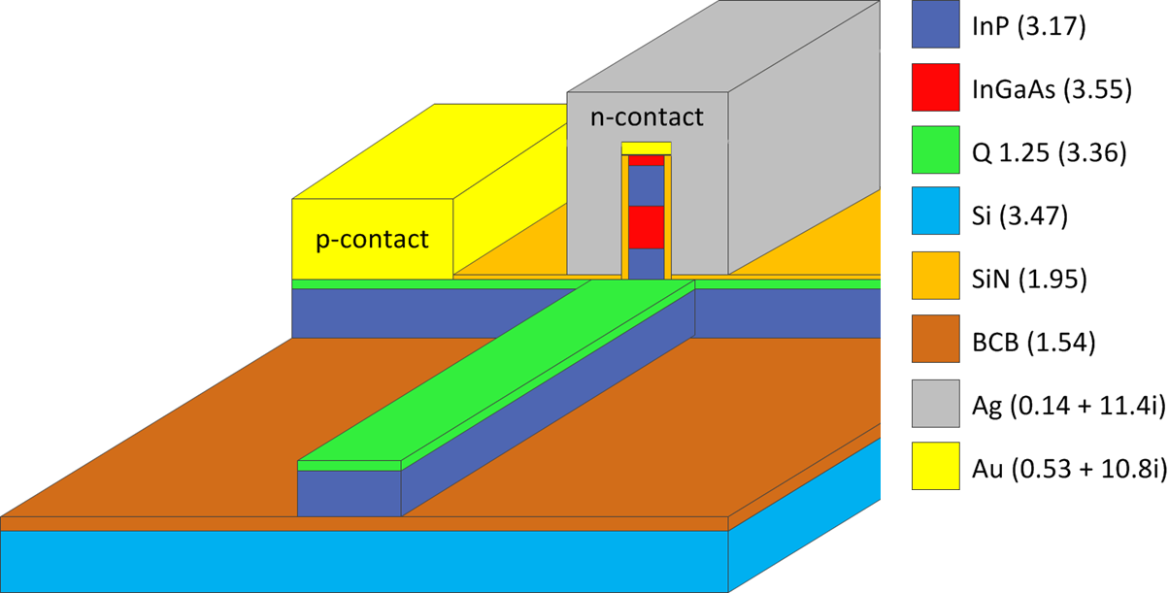
Fabry Perot plasmonic laser
FP cavity
Output waveguide

Slide 6
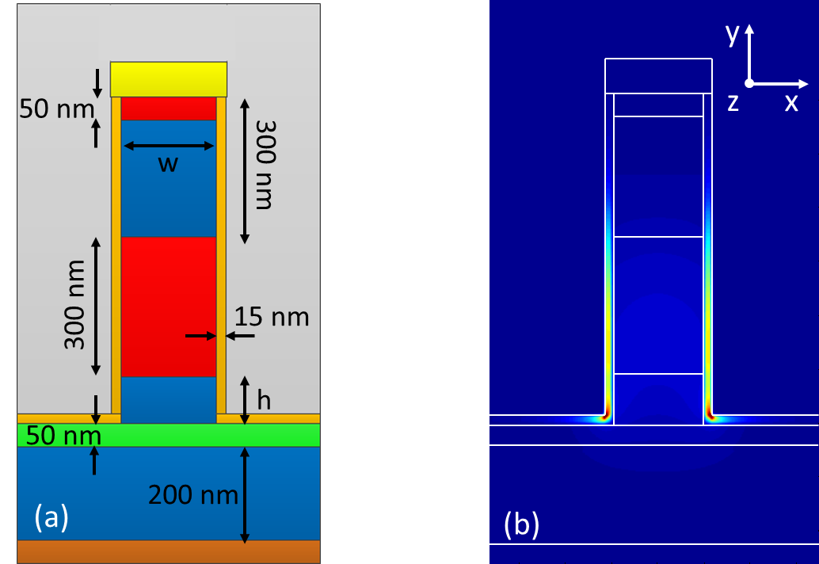
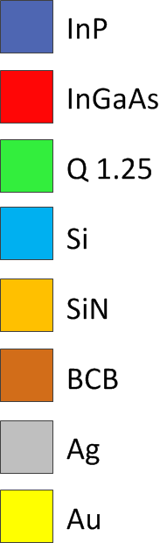

Mode properties: propagation loss
$${\left|E\right|}^{2}$$
The width w has an influence on the confinement and propagation loss
The post height h determines the facet reflectivity and outcoupling
When the post height increases the propagation loss decreases

Slide 7
Mode properties: confinement factor
(a)
(b)
The confinement factor increases for wider structures, however additional low loss (dielectric) modes could exist for very wide structures.
Decreasing the thickness of the insulation layer leads to a better confinement, however the propagation loss is also increased

Slide 8
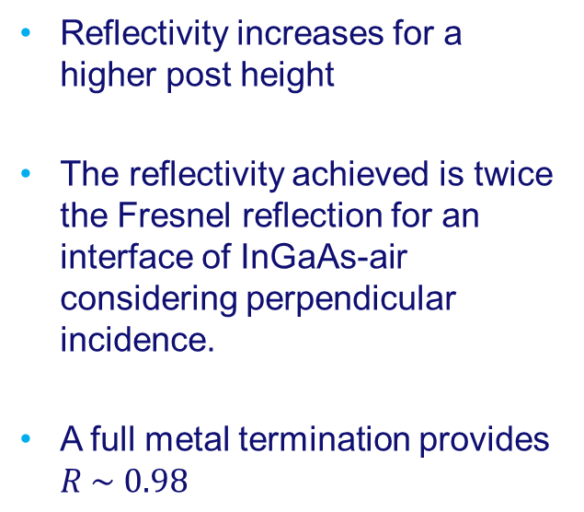
Facet reflectivity
Reflectivity increases for a higher post height
The reflectivity achieved is twice the Fresnel reflection for an interface of InGaAs-air considering perpendicular incidence.
A full metal termination provides $R \sim 0.98$

Slide 9
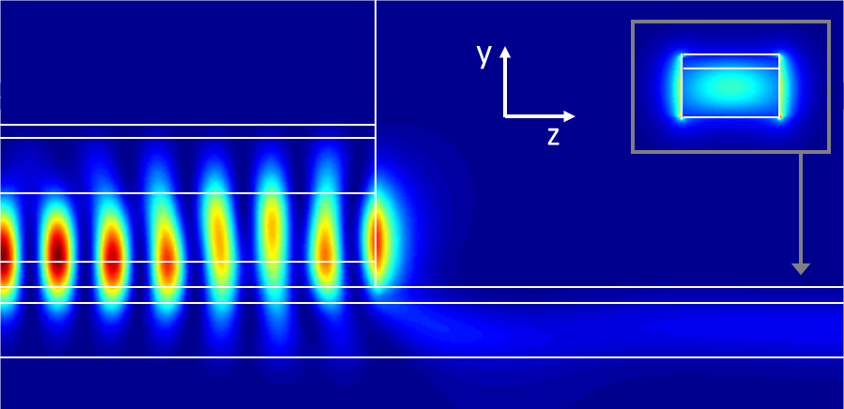

Coupling to waveguide
$${\left|E\right|}^{2}$$
The outcoupling decreases for a higher post height, since the vertical distance between the plasmonic mode and the dielectric waveguide is increased

Slide 10

Threshold gain and external efficiency
Considering $w=200 nm$, $h =100 nm$
For example:
  If 𝐿 = 50 𝜇m
  → $g_{th} = 1796 cm^{−1}, η = 11\%$
  If 𝐿 = 10 𝜇m
  → $g_{th} =2580 cm^{−1}, η =38\%$

Slide 11
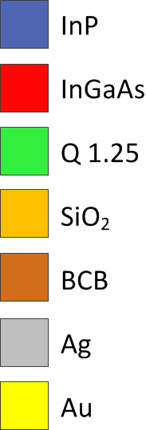
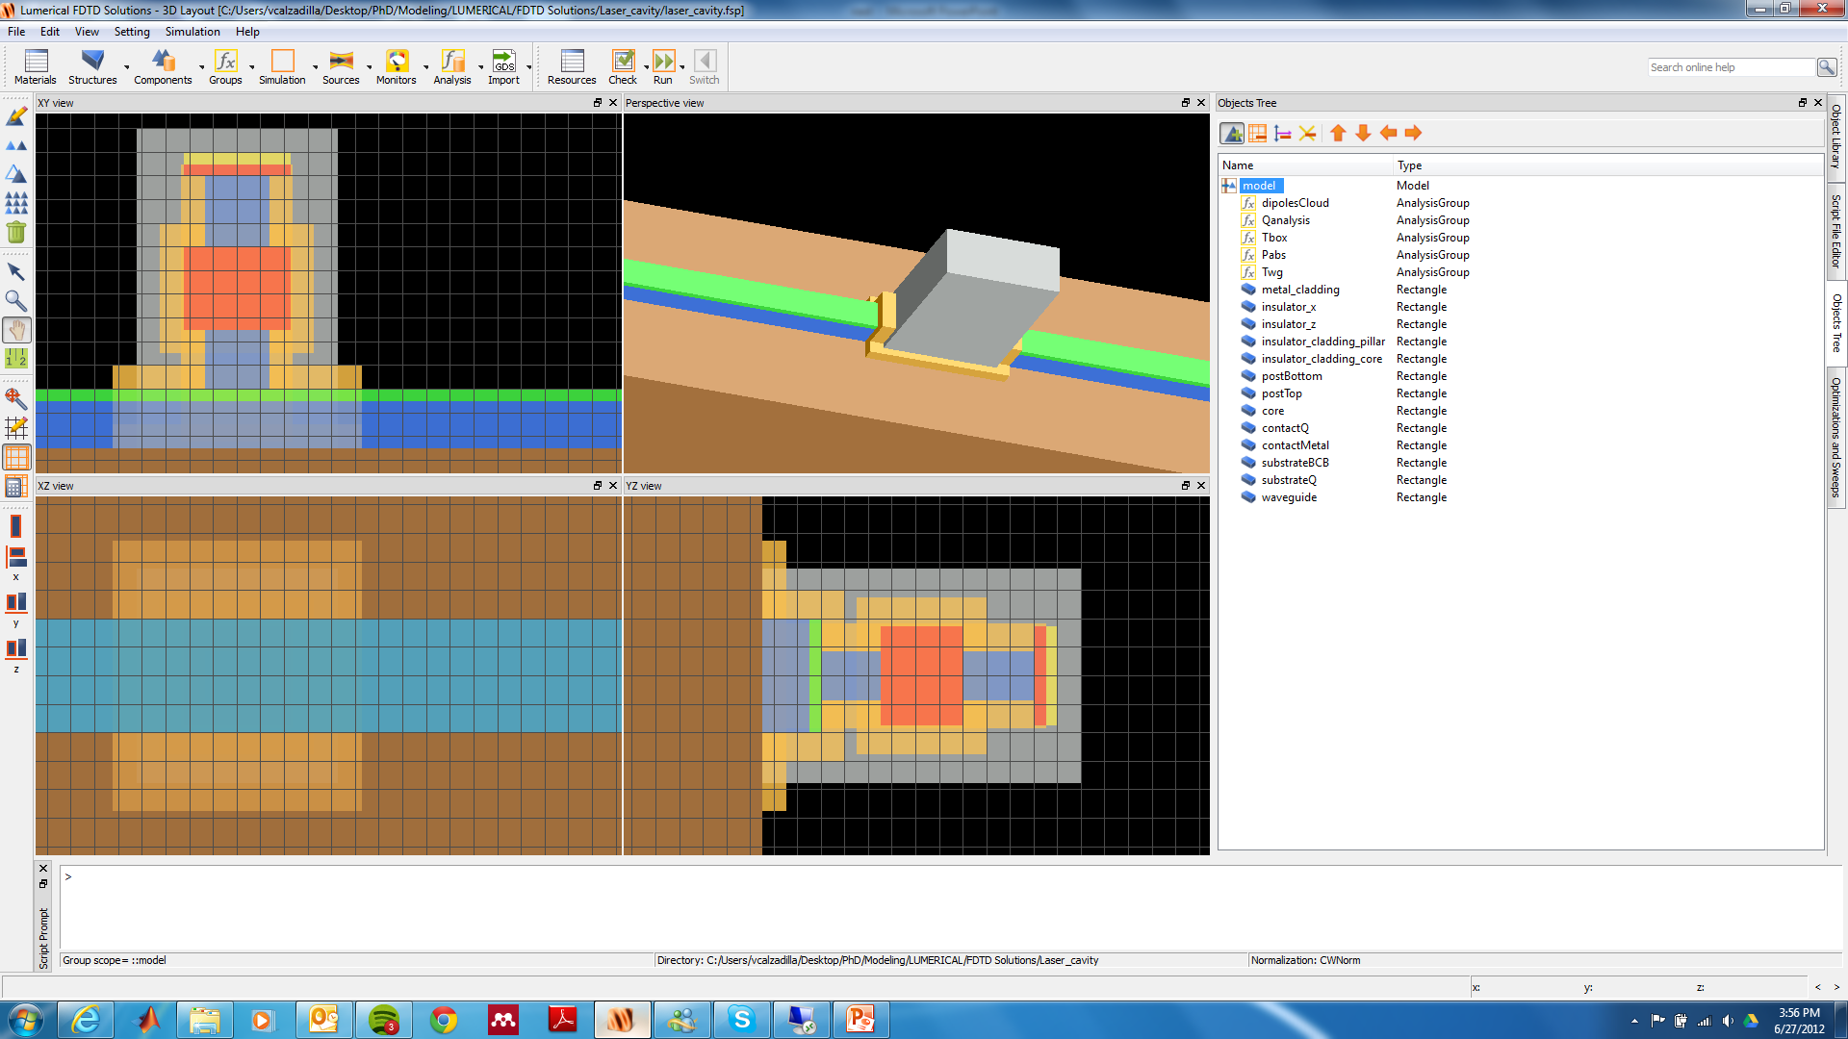
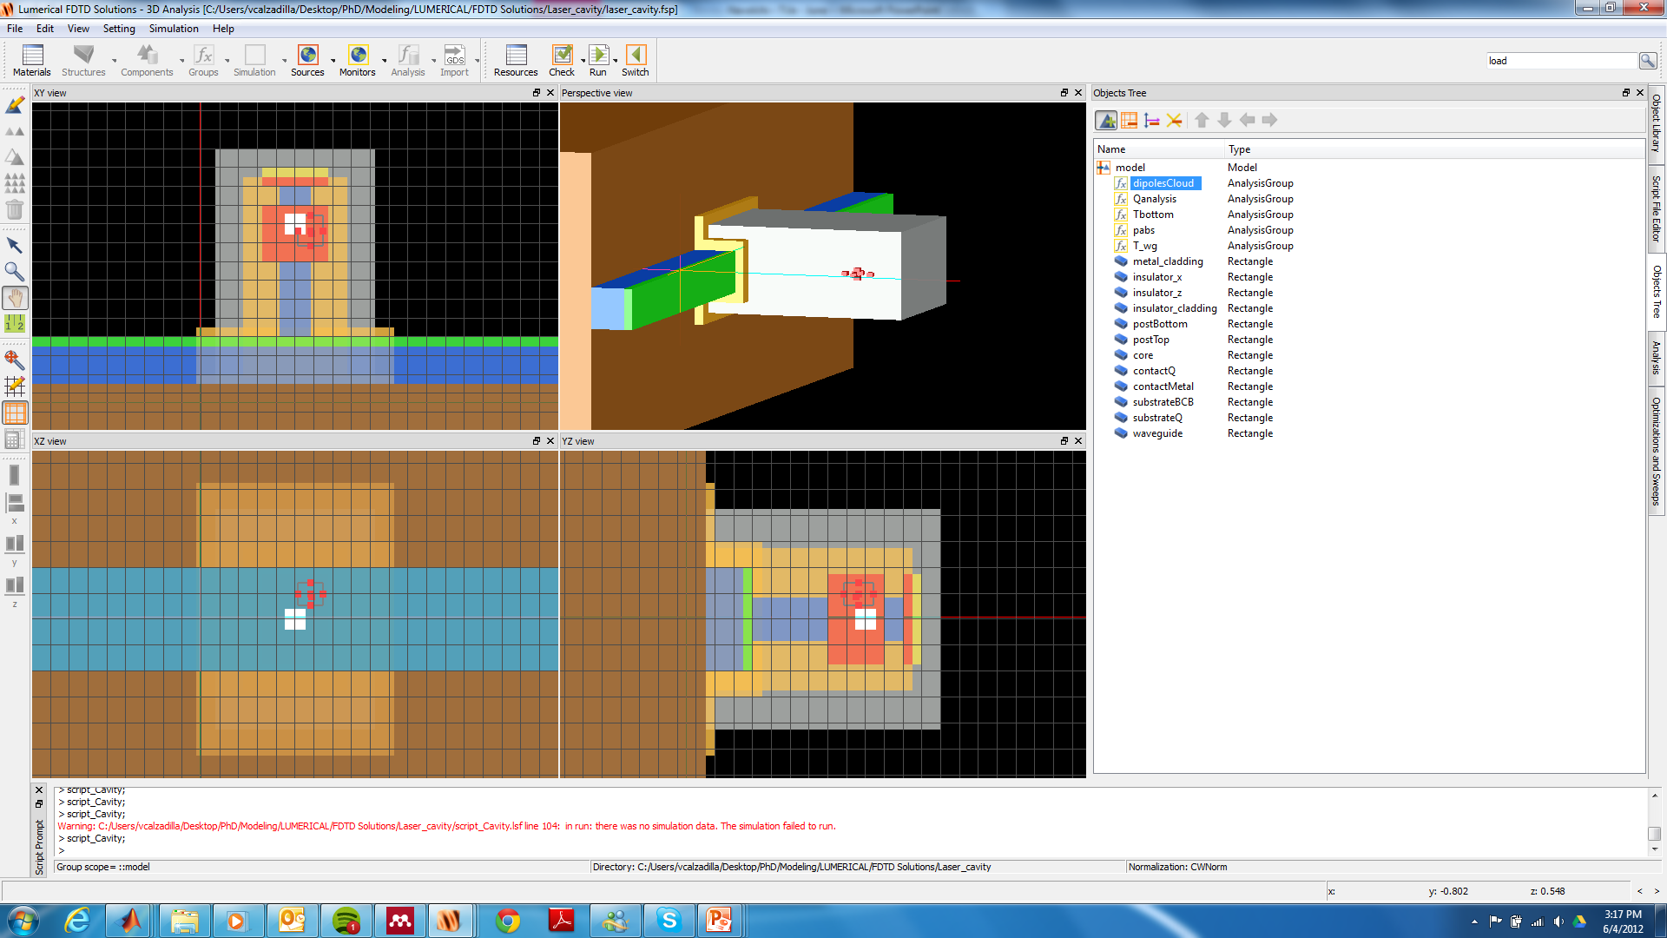

Metallo-dielectric nanolaser
Symmetric cavity:
Length and width are initially the same
Wide active core
Undercut
Thick insulation
layer

Slide 12
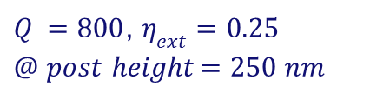


Q factor and external efficiency
$Q =800$, $η_{ext}=0.25$
$@$ 𝑝𝑜𝑠𝑡 ℎ𝑒𝑖𝑔ℎ𝑡$=250$𝑛𝑚
$Q = 1349$, $λ=1.45 μm$ $@ t_{d}=100 nm$
$$h$$
For a thin insulation → high absorption
For a thick insulation → high outcoupling loss
Q-factor decreases for a short post leading to an increase of external efficiency

Slide 13

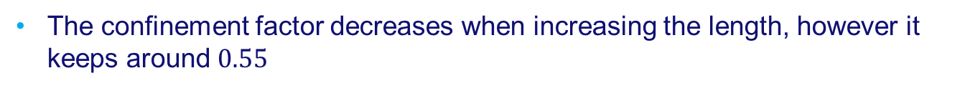
Efficiencies and threshold gain
Post height = 250 nm
Insulation thickness = 100 nm
Post height = 250 nm
Insulation thickness = 100 nm
$$l$$
The confinement factor decreases when increasing the length, however it keeps around $0.55$

Slide 14
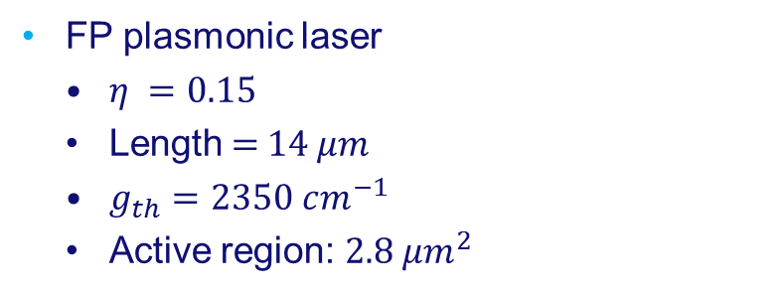
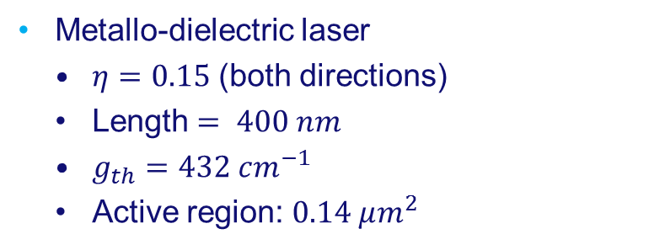
Comparison
FP plasmonic laser
  $η =0.15$
  Length = 14 𝜇𝑚
  $g_{th}=2350 cm^{−1}$
  Active region: $2.8{ μm}^{2}$
Metallo-dielectric laser
  $η=0.15$ (both directions)
  Length$= 400 nm$
  $g_{th}=432 cm^{−1}$
  Active region: $0.14 μm^{2}$
Metallo-dielectric laser has:
  ~ 5 times lower threshold gain
  ~ 20 times higher current density for the same pumping current.

Slide 15
Conclusions
Room temperature operation of a FP plasmonic laser longer than 50 𝜇𝑚 is possible only at high current densities and low efficiency.
High Q-factor Metallo-dielectric lasers supporting a dielectric mode offer much better performance.
We will fabricate a metallo-dielectric nanolaser on a III-V wafer bonded to silicon. For simplicity, we will firstly demonstrate a device operating with an InP output waveguide.

Slide 16
Questions ?

