Slide 1
Work Package 4 Presentation
Juan P. Martínez Pastor
University of Valencia (UVEG), Spain

Slide 2
Outline
WP3 Position in Project
Objectives
Tasks
Milestones and Deliverables
Status of Work
  Task 4.1. Design and modelling of Plasmonic Amplifier
  Task 4.3. Colloidal QDs for gain
  Task 4.4. QD-based Plasmonic Amplifier
  Task 4.5. QD-based Photodetectors
Summary and Outlook

Slide 3
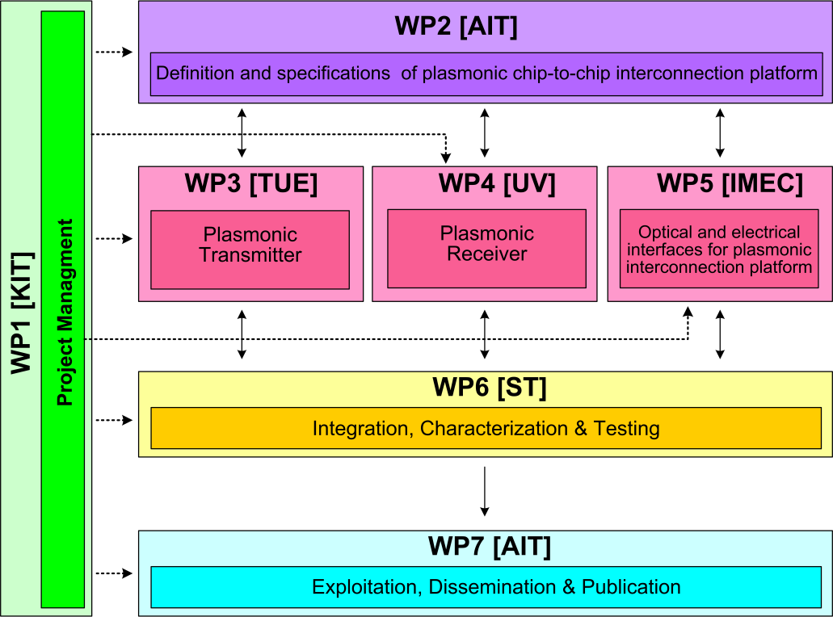




WP4 Position in Project
Contributors:

Slide 4
Tasks
 | Names of the Tasks | Time Period [months]
Task 4.1 | Design and modeling of plasmonic pre-amplifier | 1 – 18
Task 4.2 | Design and modeling of plasmonic photodetector | 1 – 24
Task 4.3 | Colloidal quantum dots with optimized gain and electrical injection scheme | 1 – 18
Task 4.4 | Fabrication and characterization of QD-based plasmonic amplifiers | 6 – 30
Task 4.5 | Fabrication of plamsonic polymer QD based photodetectors | 1 – 36

Slide 5
Objectives
Simulation studies to optimize
  Plasmonic amplifier
  Plasmon/Photon detector
Fabrication
  Optically pumped plasmonic amplifier
  Electrically driven plasmonic amplifier
  Plasmon/Photon detector
Performance targets
  Plasmonic amplifier: 10 dB on-chip gain (5 μm wide)
  Detector: Responsivity > 1 A/W (EQE ≈ 80 %)

Slide 6
Milestones
 | Names of the Milestones | Month | Partner
MS16 | Decision on optimized structures for plasmonic amplifiers | 12 | UVEG
MS17 | Synthesis of nanoparticles with gain at 1550nm | 12 | UGENT
MS18 | Demonstration of conductive QD layers with photoconductive properties | 15 | UVEG
MS19 | Demonstration of metal-(lithographic) polymer and QD metal-(lithographic) polymer nanocompo-sites | 15 | UVEG
MS20 | Demonstration and decision on photodetector operation: nano-gap (MIM) vs. Schottky / heterostructure | 18 | UVEG
MS21 | Electroluminescence from QD stack embedded within conductive oxides (>1µW) | 18 | IMCV
MS22 | Demonstration of plasmonic amplifiers with optical pumping exhibiting 10dB gain | 21 | IMCV
MS23 | Operation of QD based photodetector with responsivity > 0.1 A/W | 24 | UVEG
MS24 | Demonstration of SPP amplifiers with electrical injection exhibiting 10dB/cm gain | 30 | UVEG

Slide 7
Deliverables
 | Names of the Deliverables | Month | Partner
D4.1 | Designs of plasmonic amplifiers | 18 | UVEG
D4.2 | Report on optical properties of QDs layers and polymer nanocomposites | 18 | UVEG
D4.3 | Designs of plasmonic photodetectors | 24 | UVEG
D4.4 | Report on SPP amplifiers by using QDs | 30 | IMEC
D4.5 | Report on plasmonic photodetectors | 33 | UVEG

Slide 8
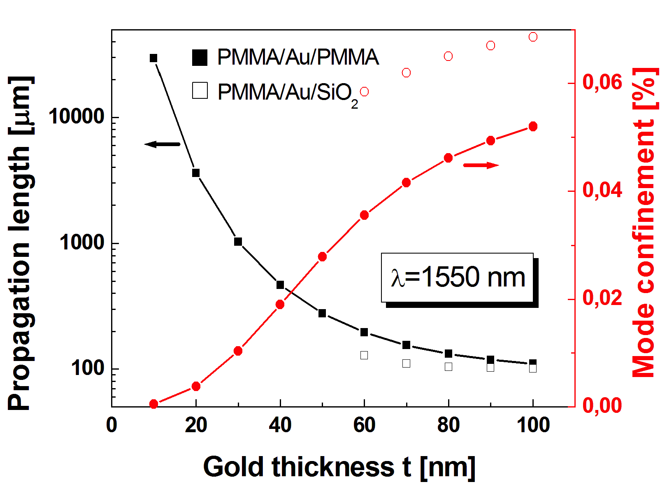
Task 4.1 Design&Modelling of P.A.
Symmetric vs Asymmetric structures
MS16
    t = 30 nm is a good compromise
    Symmetric design has SPP solution in the entire t-range

Slide 9
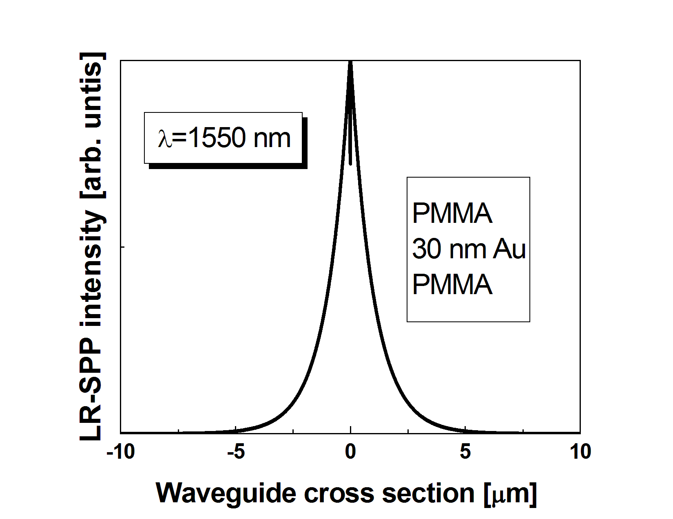
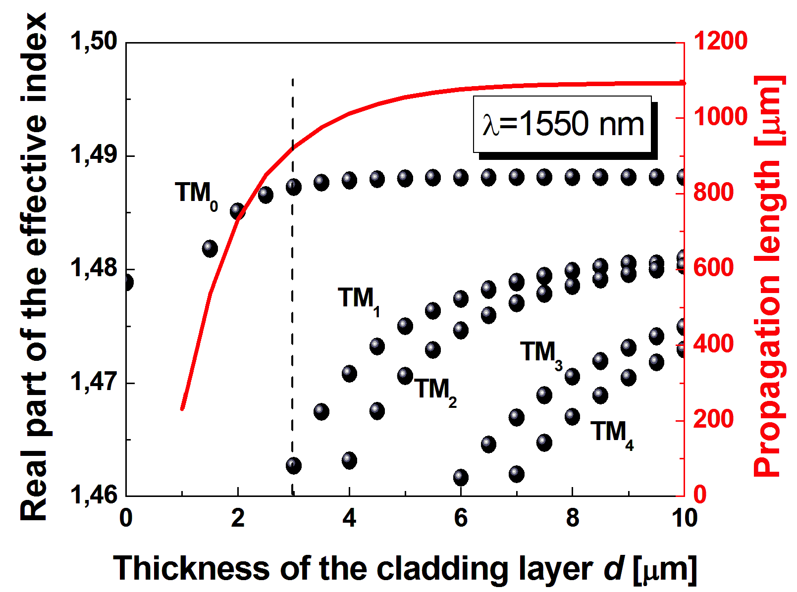
Task 4.1 Design&Modelling of P.A.
Long Range SPP
MS16
    d = d₁ = d₂ < 3 μm
    Propagation length decreases for d < 4 μm
    LR-SPP extends > 3 μm
    High order modes appear

Slide 10
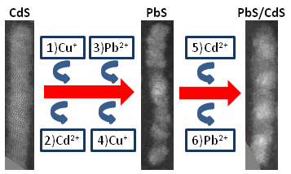
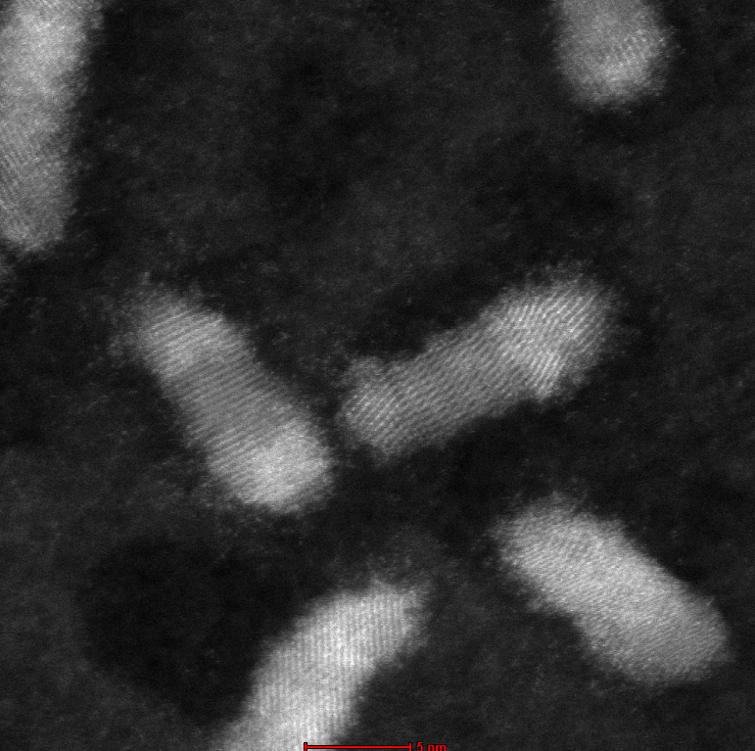
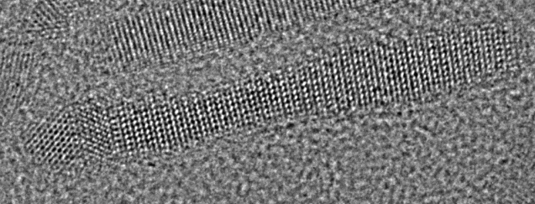
Task 4.3 Colloidal QDs with gain …
CATIONIC EXCHANGE PROCEDURE:
from CdS to PbS/CdS rods
PbSe/CdSe dots in Rod
PbSe
CdSe
PbS
CdS
PbS/CdS Partially Exchanged Rods
    Synthesis of heterostructured core-shell quantum nanorods:
    IR λ_{em} tunable
    High quantum yield > 60 %
MS17

Slide 11
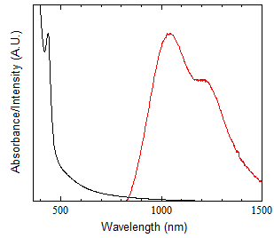
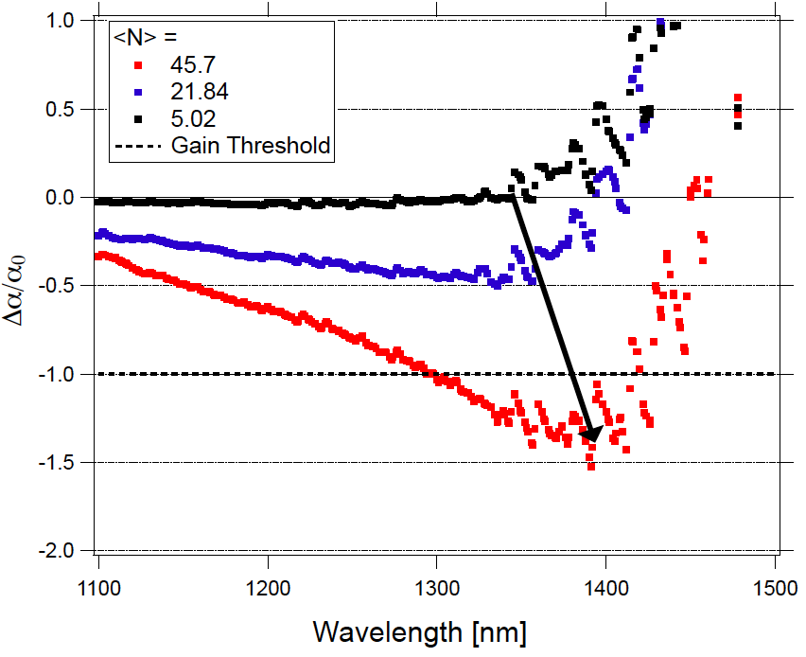
Task 4.3 Colloidal QDs with gain …
    Rod-shaped PbS do cross the transparency threshold under high occupation (45 excitons per rod)
MS17
Yolanda Justo, Bart Goris, John Sundar Kamal, Pieter Geiregat, Sara Bals, and Zeger Hens, "Multiple Dot-in-Rod PbS/CdS Heterostructures with High Photoluminescence Quantum Yield in the Near-Infrared", Journal of the American Chemical Society 2012, 134, 5484-5487.

Slide 12
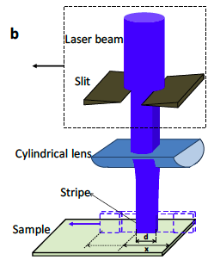
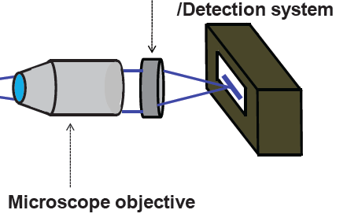
Task 4.3 Colloidal QDs with gain …
Gain measured on dielectric films doped with Q-nanorods
    Characterization of gain material in PMMA by Variable Stripe Length method
    Rate equation model for interpretation of guided PL: saturated gain + losses
I. Suárez, H. Gordillo, R. Abargues, S. Albert, and J. Martínez-Pastor, Photoluminiscence wave-guiding in CdSe and CdTe QDs-PMMA nanocomposite films, Nanotechnology 22, 435202 (2011).

Slide 13
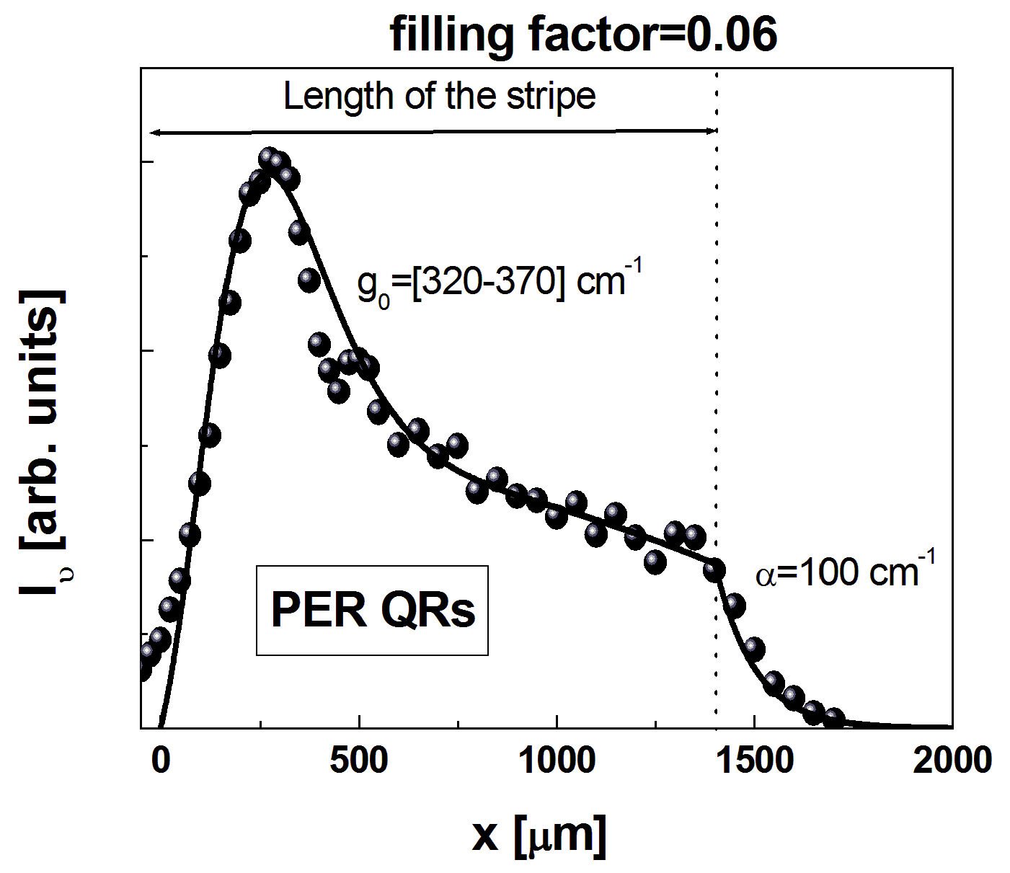
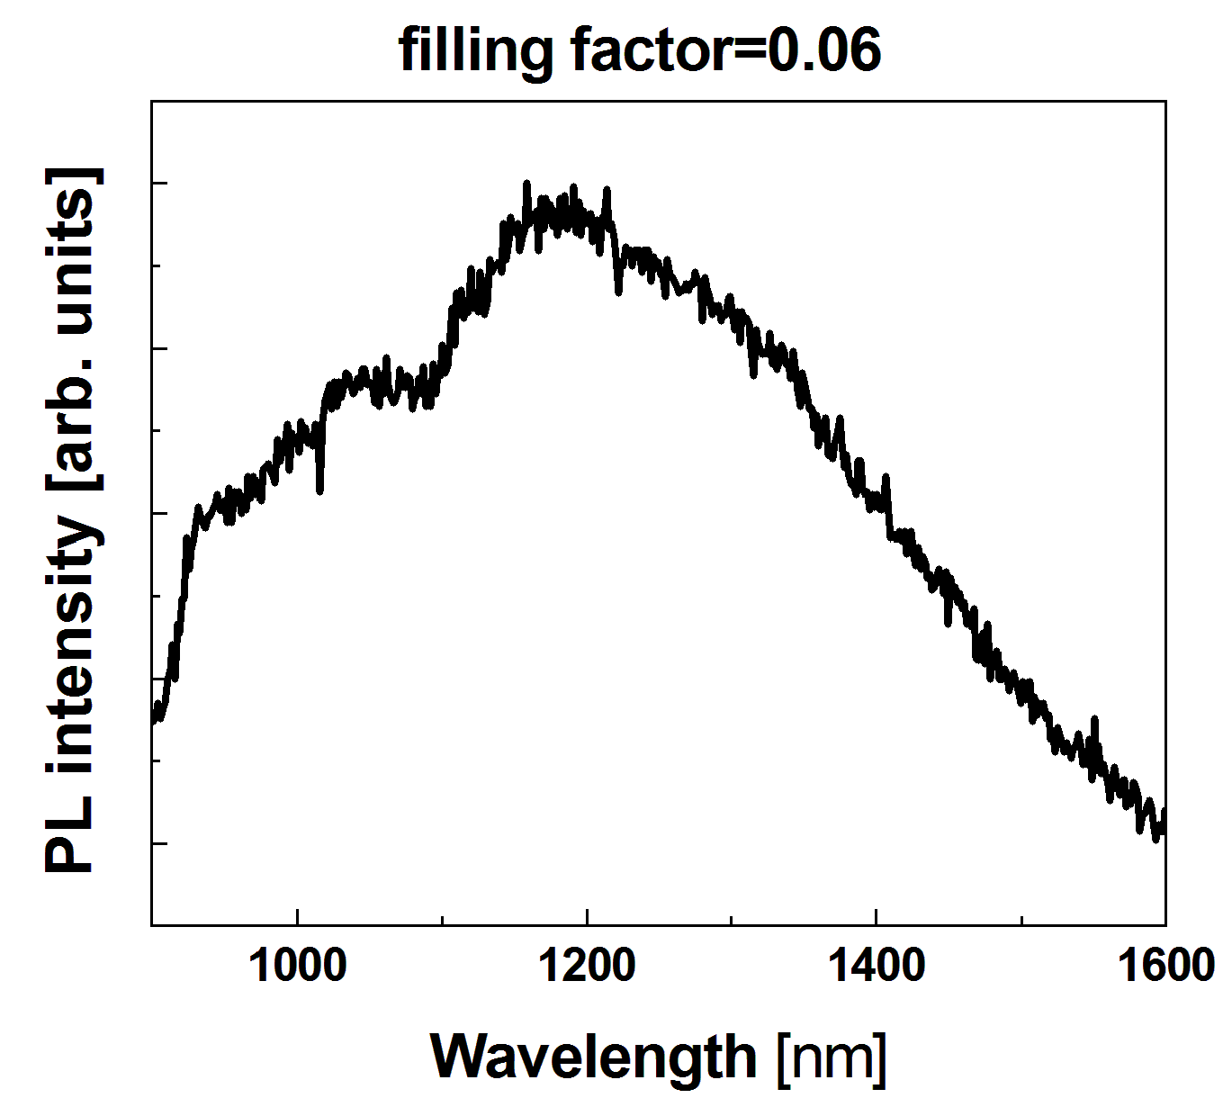
Task 4.3 Colloidal QDs with gain …
MS16
MS17
    Best Gain/losses ratio in PbS/CdS PER
    High gain in 300 μm of pumping stripe
    Gain saturation due to Auger mechanism

Slide 14
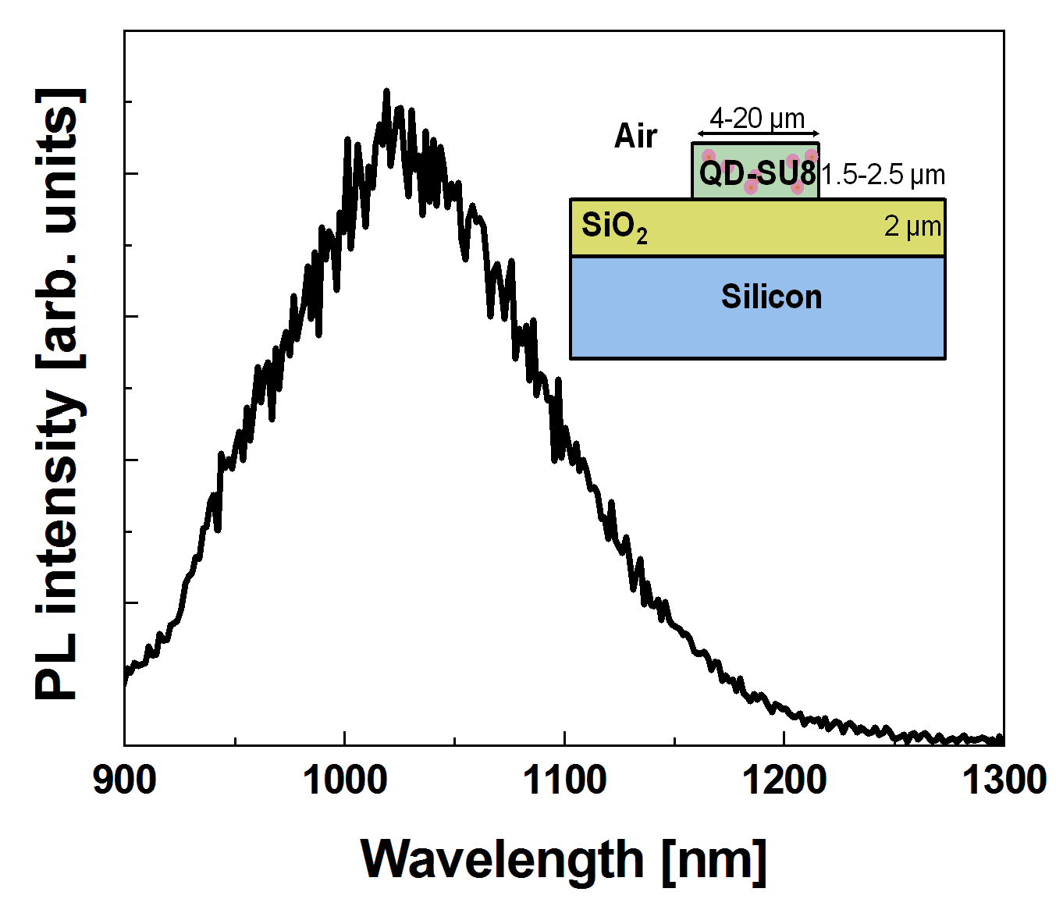
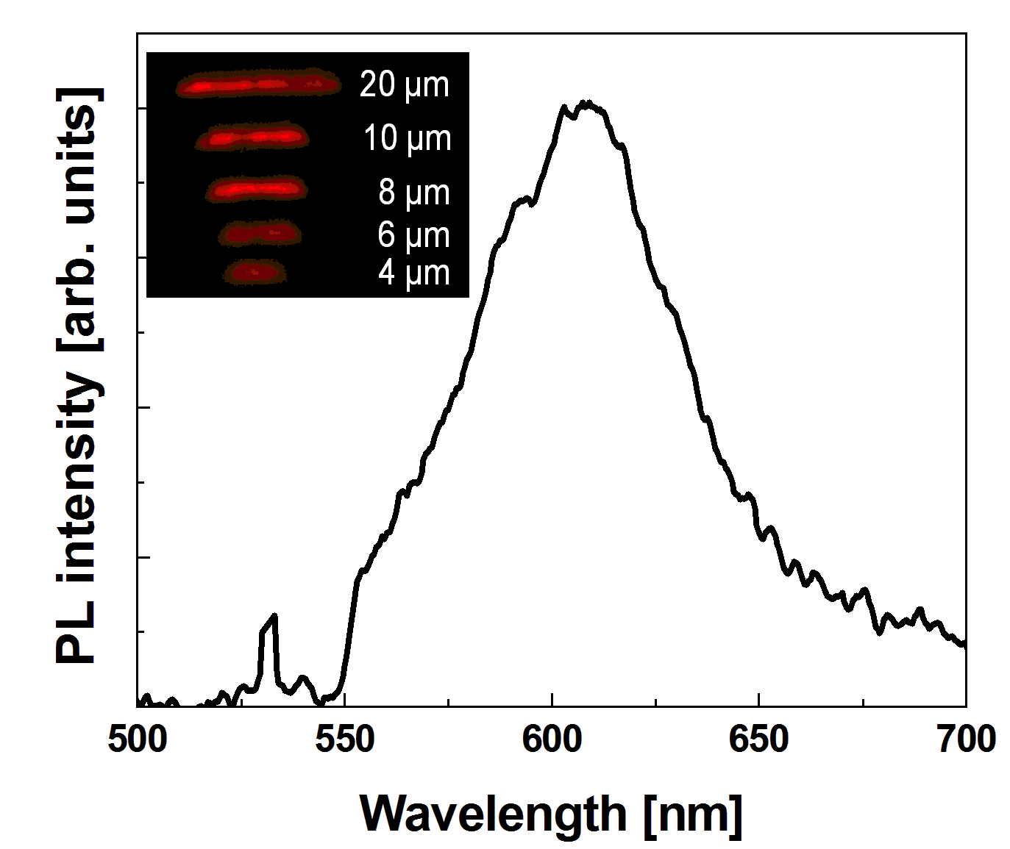
Task 4.3 Colloidal QDs with gain …
QDs in patternable polymers: SU-8
    QDs incorporated in SU-8 by ligand exchange
    Demonstrated the fabrication of 4-20 μm wide stripes.
    Different QDs (CdSe, PbS)
H. Gordillo, I. Suárez, R. Abargues, P. Rodríguez-Cantó, S. Albert and J.P. Martínez-Pastor, Polymer/QDs nanocomposites for wave-guiding applications, Journal of Nanomaterials, Vol. 2012, Article ID 960201 (doi:10.1155/2012/960201), 1-9 (2012).

Slide 15
Task 4.3 Colloidal QDs with gain …
QD layers for electrically driven PA
    AC electroluminescence concept
    Compatible with Si-technology
At beginning of Positive voltage pulse
At end of positive voltage pulse

Slide 16
Task 4.3 Colloidal QDs with gain …
QD layers for electrically driven PA
Normalized Intensity
Wavelength [nm]
    AC electroluminescence is identical to PL

Slide 17
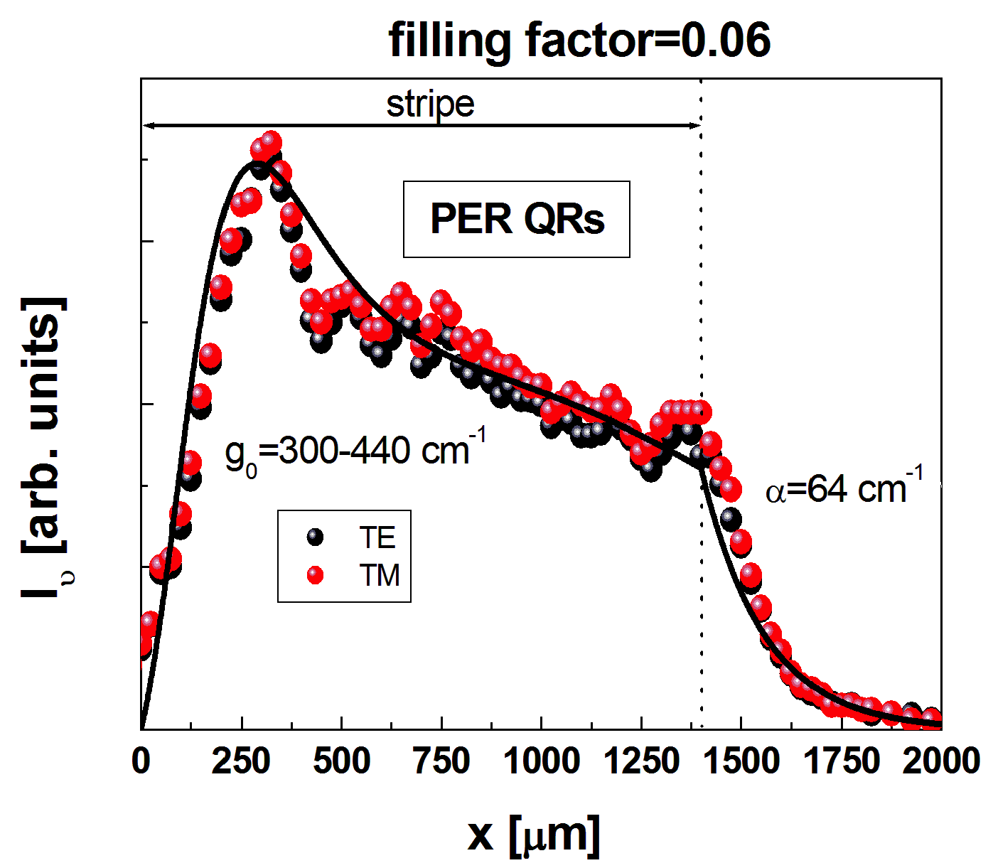
Task 4.4 Fabrication of QD-based PA
Optically pumped Plasmonic Amplifier
    TM, TE are plasmonic/photonic hybrid modes
    Gain and losses are similar to those measured in pure dielectric modes.
    Symmetric structure under preparation

Slide 18
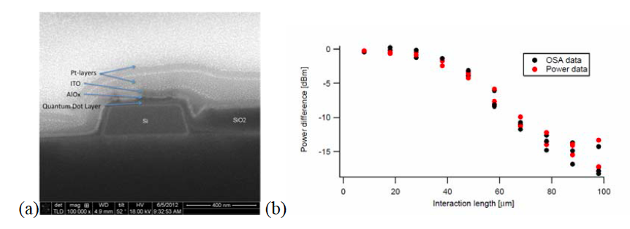
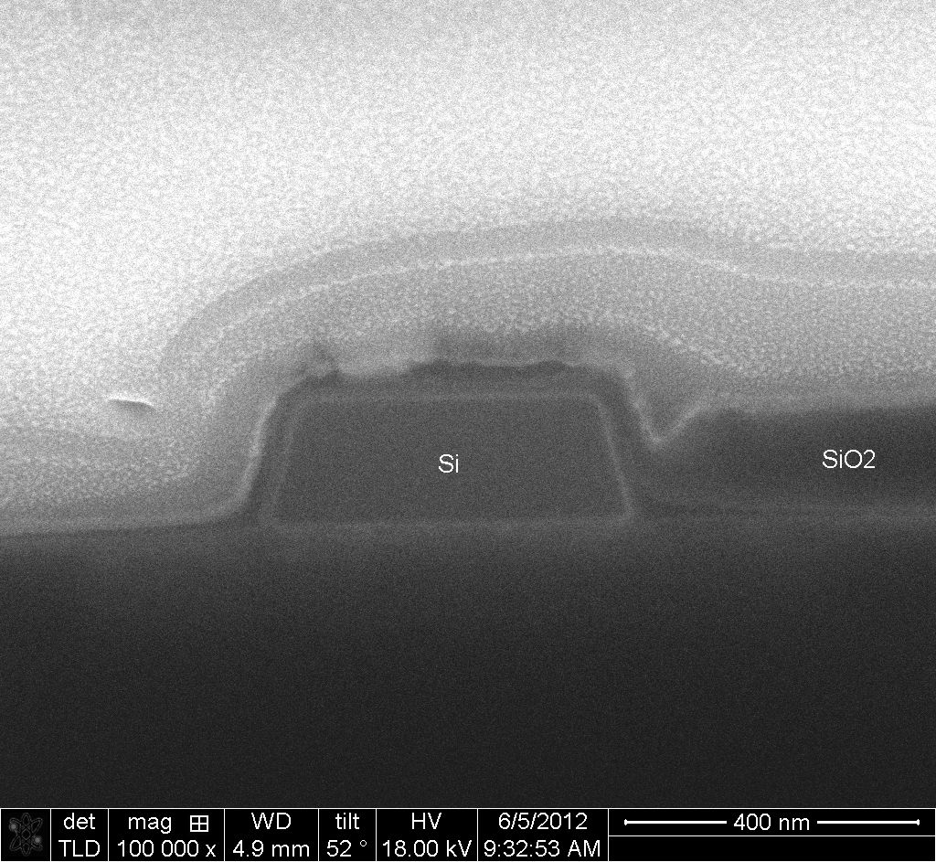
Task 4.4 Fabrication of QD-based PA
Electrically driven Plasmonic Amplifier
Power Difference [dBm]
Interaction Length [μm]
    QDS interact with the optical mode of the waveguide
    Losses increase after AlO_{x} and ITO

Slide 19
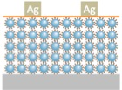
Task 4.5 Fabrication of Photodetector
Photodetection based on QD layers
10
MPA ligand
1
A
External Quantum Efficiency (%)
EDT ligand
0.1
    QD solids (layer-by-layer method) using different ligands (MPA and EDT).
    Better dark conducitivities and photocurrent with MPA due to shorter molecular distance between QDs (1.6 nm) and less surface defects.

Slide 20
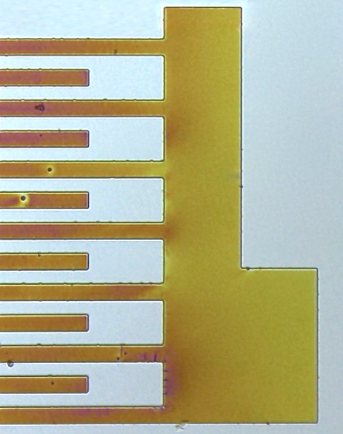
WP4 presentation
Photodetection based on conductive polymers
UV Light
Metal NP
Conducting
IPN Patterns
Photomask
Lithographic process
Photoresist
Resist + precursor
100 µm
Substrate
2. Post bake 120-140 ºC
R. Abargues, P.J. Rodríguez-Cantó, R. García-Calzada, and J. Martínez-Pastor, Patterning of Conducting Polymers using UV lithography: The in-situ polymerization approach, J. Phys. Chem C 116, 17547-17553 (2012).
200 µm
Conductivity (S/cm)
No laser | Laser at 533 nm
6,43518599 | 6,47054798
0,03181512 | 0,03241319
    Demonstrated conductive 3T with Cu(ClO₄)₂ inside Novolak.
    Demonstrated conductive 3T + Au nanoparticles in PMMA.

Slide 21
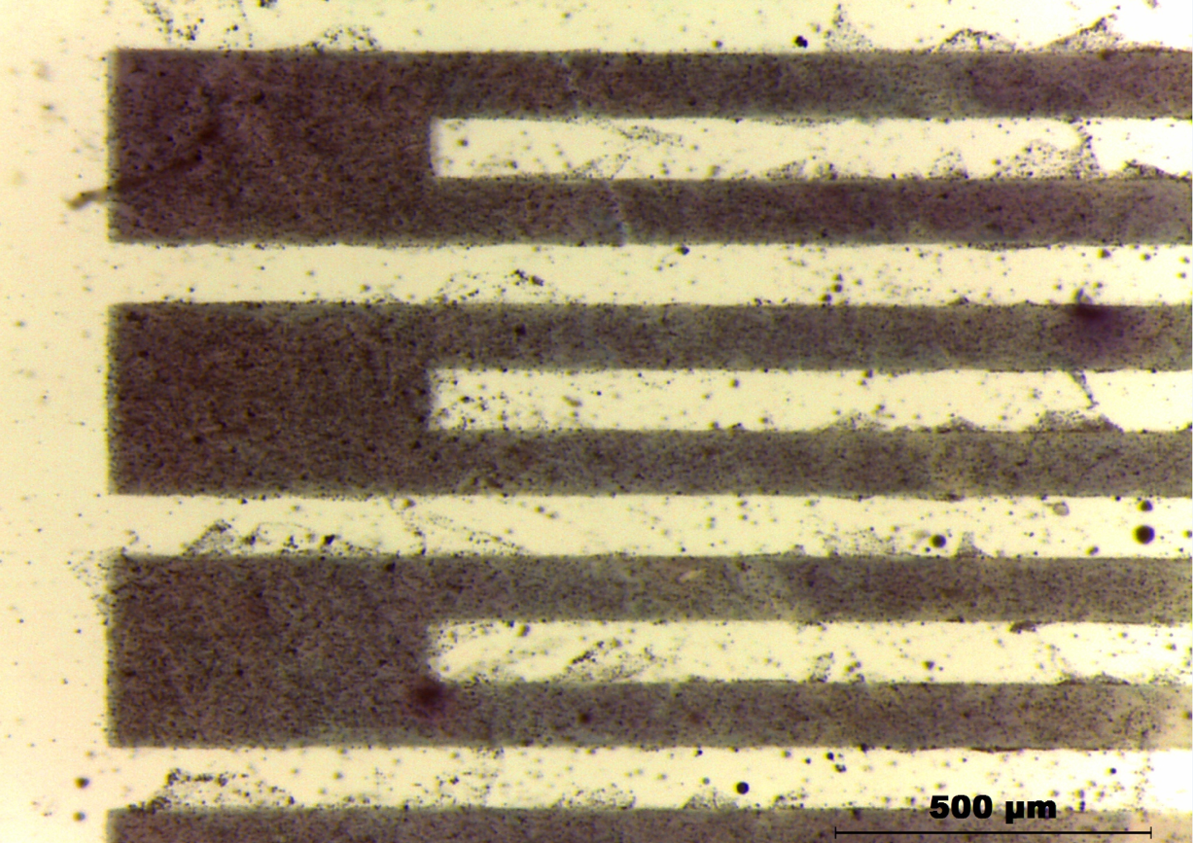
6. Summary and Outlook
WP4 presentation
Plasmonic Amplifier:
PbX/CdX hetero-nanostructures emitting at IR with high QY and exhibiting ASE
Design of optimized structures for SPP amplification using QD doped polymers
Selection of best materials doping polymers for gain (dielectric waveguides)
Results on symmetric and asymmetric plasmonic waveguide structures
Proof of concept of Si-based waveguides with QD gain and AC electroluminescence using QD layers
New method (patent pending) for developing nano/micro-patterns using a resist containing Ag-NPs
Photodetector:
Proof of concept of QD-solids (layer-by-layer method) as photoconductors
Conducting polymers interpenetrated in patternable polymers, including synthesis in-situ of metal NPs and hydrazine treatment to enhance photoconductivity
Materials: PbX/CdX hetero-nanostructures emitting at 1550 nm with high QY and optimized ASE.
Polymer-based PA: Corroborate experimentally conclusions on MS16 and begin with design and experiments on Au-2D waveguides (a new method has been developed to metalize nano/micro-patterns using a resist containing Ag-nanoparticles).
Hybrid-Si PA: DRIES/ZEGER ???

