Slide 1
Work Package 5 Presentation
Dries Van Thourhout
IMEC, Belgium

Slide 2
Outline
WP5 Position in Project
Objectives
Tasks
Milestones and Deliverables
Status of Work
Summary and Outlook

Slide 3
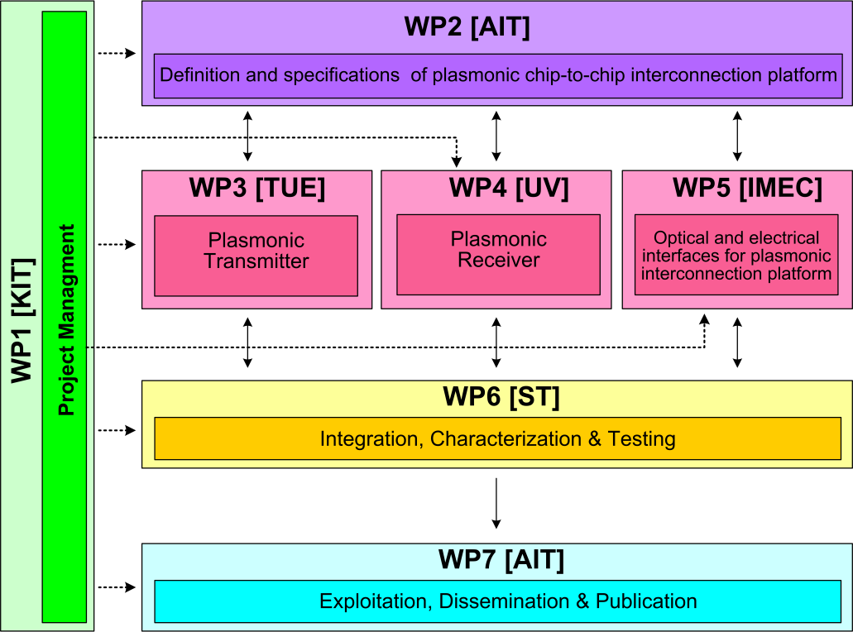



WP3 Position in Project
Contributors:

Slide 4
Objectives
Overall Objective :
Specific Objectives:
  Coupling light between silicon backbone and plasmonic devices
  Beam Shaping grating couplers to direct light between chips
  Compact filters for noise suppression
  Specify and implement Dual Die Communication Module (DDCM)
Design and implement optical and electrical interfaces for plasmonic interconnect

Slide 5
Tasks
 | Names of the Tasks | Time Period [months]
Task 5.1 | Modeling and fabrication of coupling Si waveguide to plasmonic waveguide | 1 – 15
Task 5.2 | Design and fabrication of Si beamshaper | 1 – 30
Task 5.3 | Design and fabrication of passive ultra-compact components as filters | 1 – 15
Task 5.4 | Signal generation module design | 4 – 12
Task 5.5 | Signal Generation Module implementation via FPGA | 13 – 24

Slide 6
Milestones
 | Names of the Milestones | Month | Partner
MS25 | Decision on optimized plasmonic waveguide couplers | 6 | KIT
MS26 | Fabrication of plasmonic waveguide couplers with less than 3 dB coupling loss | 12 | KIT
MS27 | Design of first generation beam shapers and compact optical filters | 12 | IMEC
MS28 | DDCM with electrical PHY design and verification | 12 | ST
MS29 | Data codecs for power consumption reduction | 15 | ST
MS30 | Decision on plasmonic waveguide couplers with less than 3 dB coupling loss | 15 | KIT
MS32 | Fabrication of compact optical filters and first generation beam shapers | 18 | IMEC
MS33 | Data codecs for error detection and correction | 18 | ST

Slide 7
Deliverables
 | Names of the Milestones | Month | Partner
D5.1 | DDCM specification document | 6 | ST
D5.2 | DDCM with electrical PHY design and verification data base | 12 | ST
D5.3 | Compact optical filters (2nm bandwidth, >30nm FSR) and first generation beam shapers | 21 | imec
D5.4 | Generic DDCM compatible with plasmonic-based PHY specification document | 24 | ST
D5.5 | Report on plasmonic waveguide couplers | 24 | imec
D5.6 | Generic DDCM compatible with plasmonic-based PHY design and verification data base | 30 | st
D5.7 | Second generation beam shapers (distance 1mm, with bandwidth > 10nm and efficiency > 3dB) | 33 | imec

Slide 8
Tasks
 | Names of the Tasks | Time Period [months]
Task 5.1 | Modeling and fabrication of coupling Si waveguide to plasmonic waveguide | 1 – 15
Task 5.2 | Design and fabrication of Si beamshaper | 1 – 30
Task 5.3 | Design and fabrication of passive ultra-compact components as filters | 1 – 15
Task 5.4 | Signal generation module design | 4 – 12
Task 5.5 | Signal Generation Module implementation via FPGA | 13 – 24

Slide 9
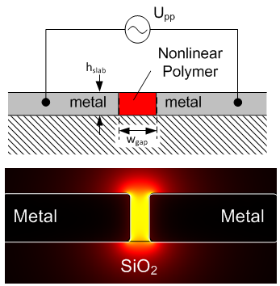
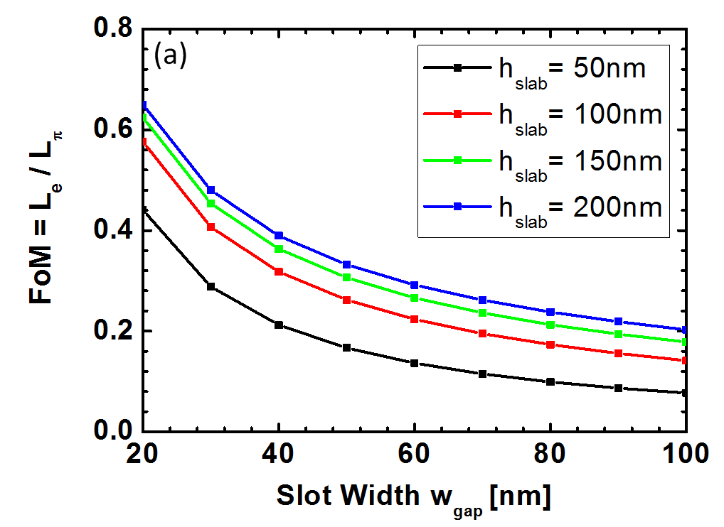
3D Design of the Phase Modulator
U_{pp}=4.5V

Slide 10
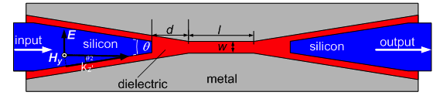
Task 5.1 - SPP Excitation in the Slot
θ

Slide 11
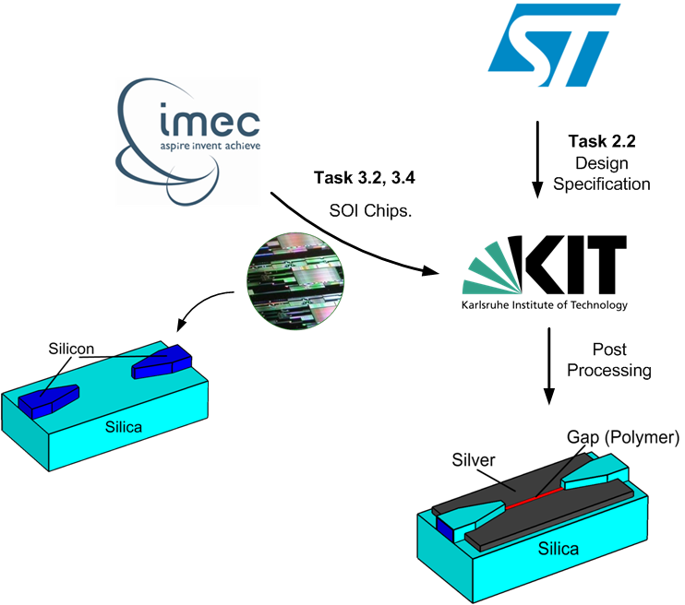
Task 5.1 - Fabrication by KIT & IMEC
Design

Slide 12
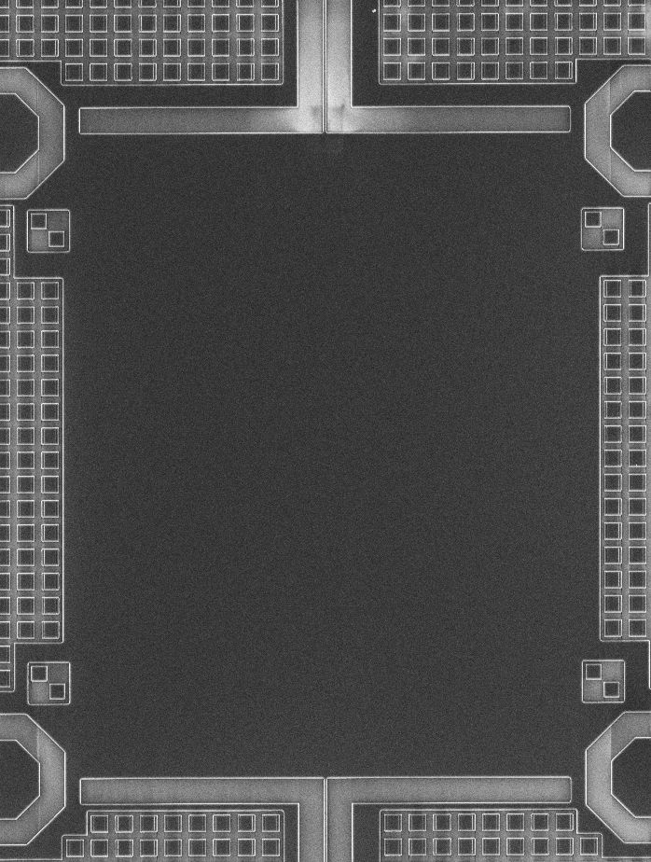
Task 5.1 - Fabrication by KIT & IMEC
Design Layout
SOI chip Fabricated by IMEC
Si slab
Si nanowire
10μm

Slide 13
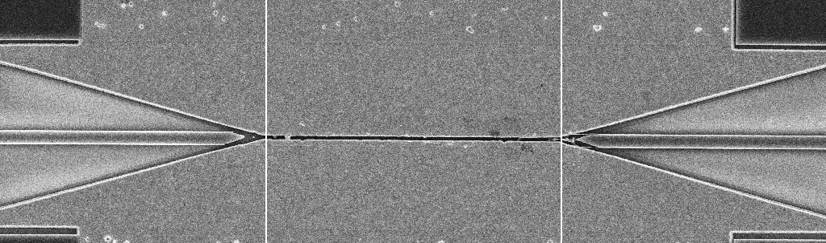
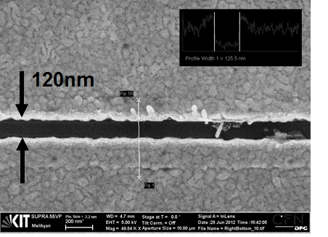
Task 5.1 - Fabrication by KIT & IMEC
SEM image of the device
Au
Si nanowire
Au

Slide 14
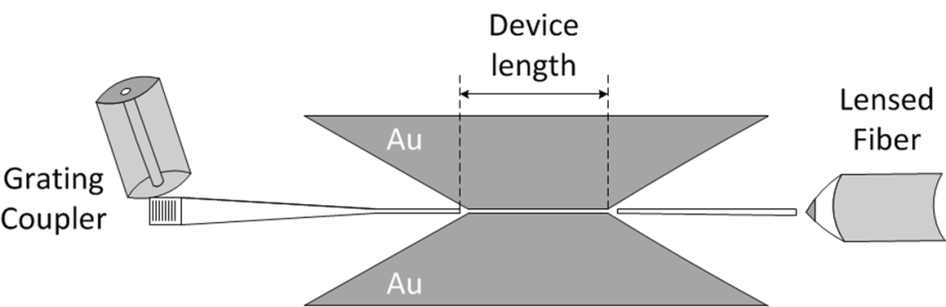
Task 5.1 - Optical Characterization
Light Coupling Configuration
Cut-back measurement
2dB coupling loss
per tapered coupler!

Slide 15
Tasks
 | Names of the Tasks | Time Period [months]
Task 5.1 | Modeling and fabrication of coupling Si waveguide to plasmonic waveguide | 1 – 15
Task 5.2 | Design and fabrication of Si beamshaper | 1 – 30
Task 5.3 | Design and fabrication of passive ultra-compact components as filters | 1 – 15
Task 5.4 | Signal generation module design | 4 – 12
Task 5.5 | Signal Generation Module implementation via FPGA | 13 – 24

Slide 16
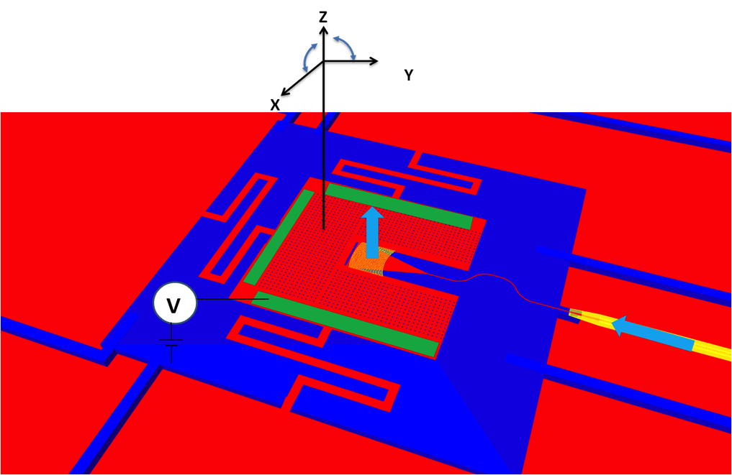
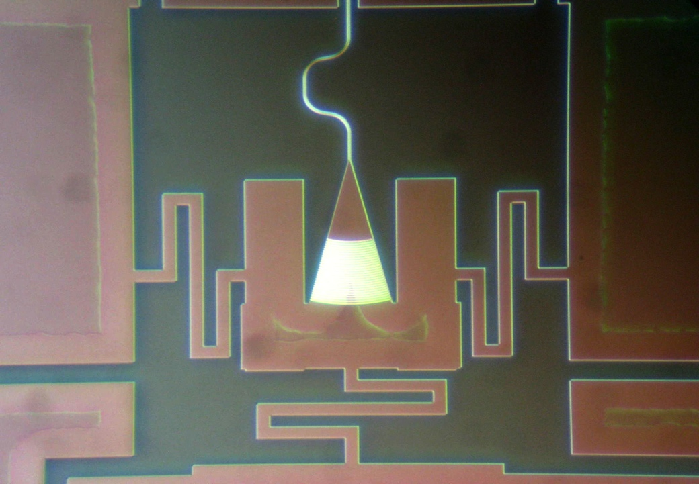
Task 5.2 – Optical Beam Steerers
Original objective: focusing grating, distance 100μm, 5dB loss (GEN1)
New objective: develop movable gratings
        1 μm movement in plane
        1 degree rotation

Slide 17
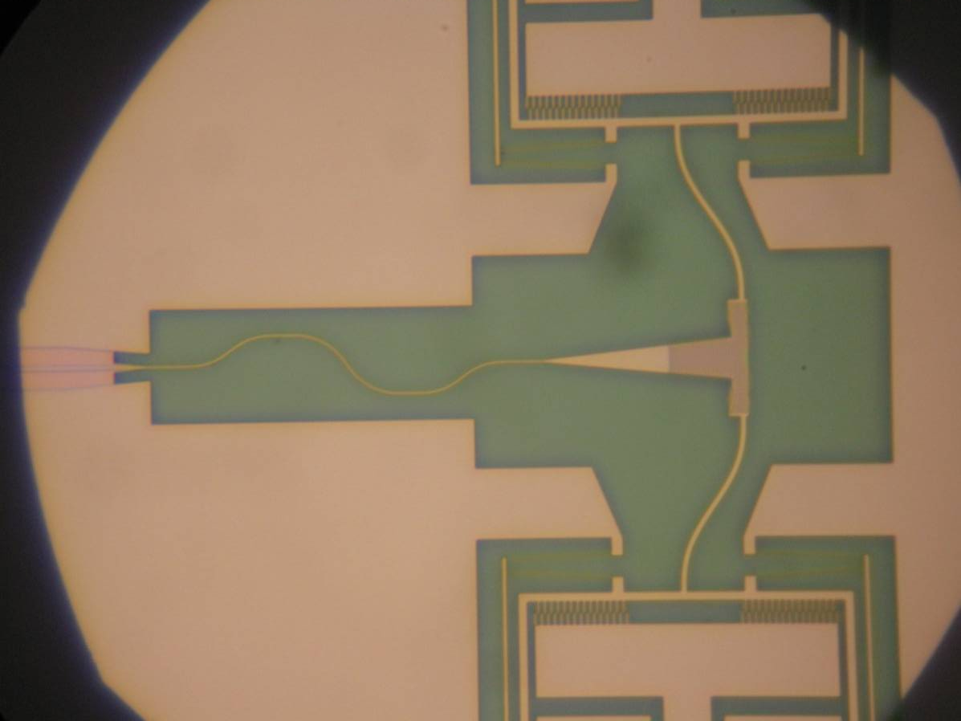
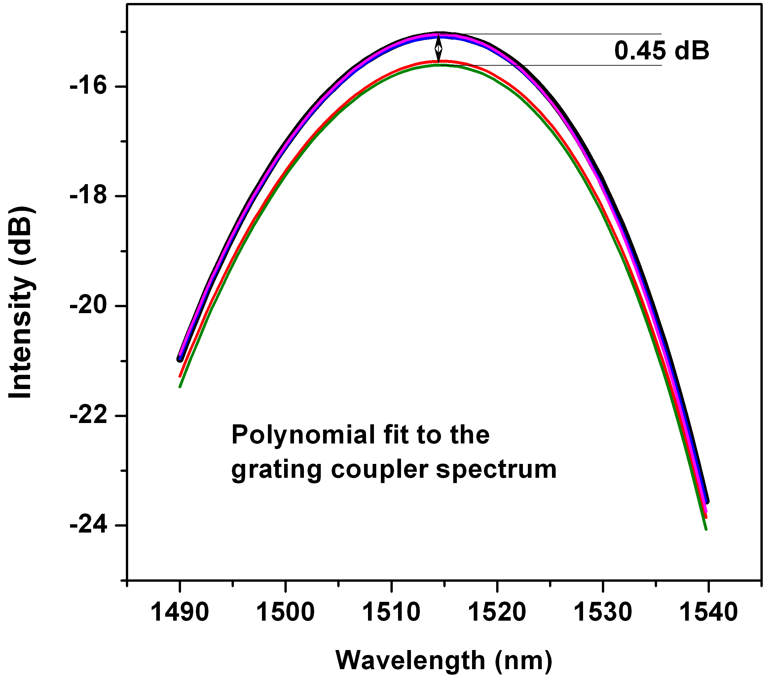
Task 5.2 – Optical Beam Steerers
Status:
  First generation designed
  Fabrication completed
  Characterisation on going: 1 μm lateral movement measured

Slide 18
Tasks
 | Names of the Tasks | Time Period [months]
Task 5.1 | Modeling and fabrication of coupling Si waveguide to plasmonic waveguide | 1 – 15
Task 5.2 | Design and fabrication of Si beamshaper | 1 – 30
Task 5.3 | Design and fabrication of passive ultra-compact components as filters | 1 – 15
Task 5.4 | Signal generation module design | 4 – 12
Task 5.5 | Signal Generation Module implementation via FPGA | 13 – 24

Slide 19
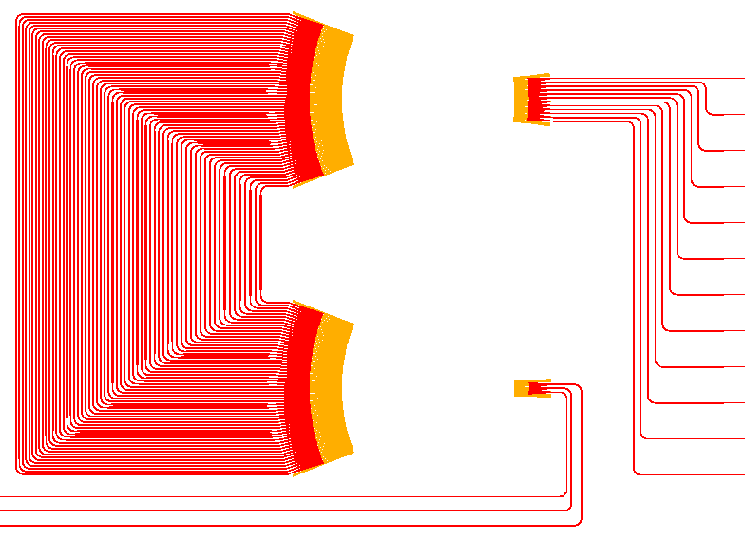
Task 5.3 – Optical filter
Goal: filter optical amplifier noise before detector
Objective: 3nm bandwidth, 10dB suppression, 30nm FSR
Activities:
Designed different types of filters (AWG, ring)
Fabricated + Characterised filters
AWG
Ring
100um

Slide 20
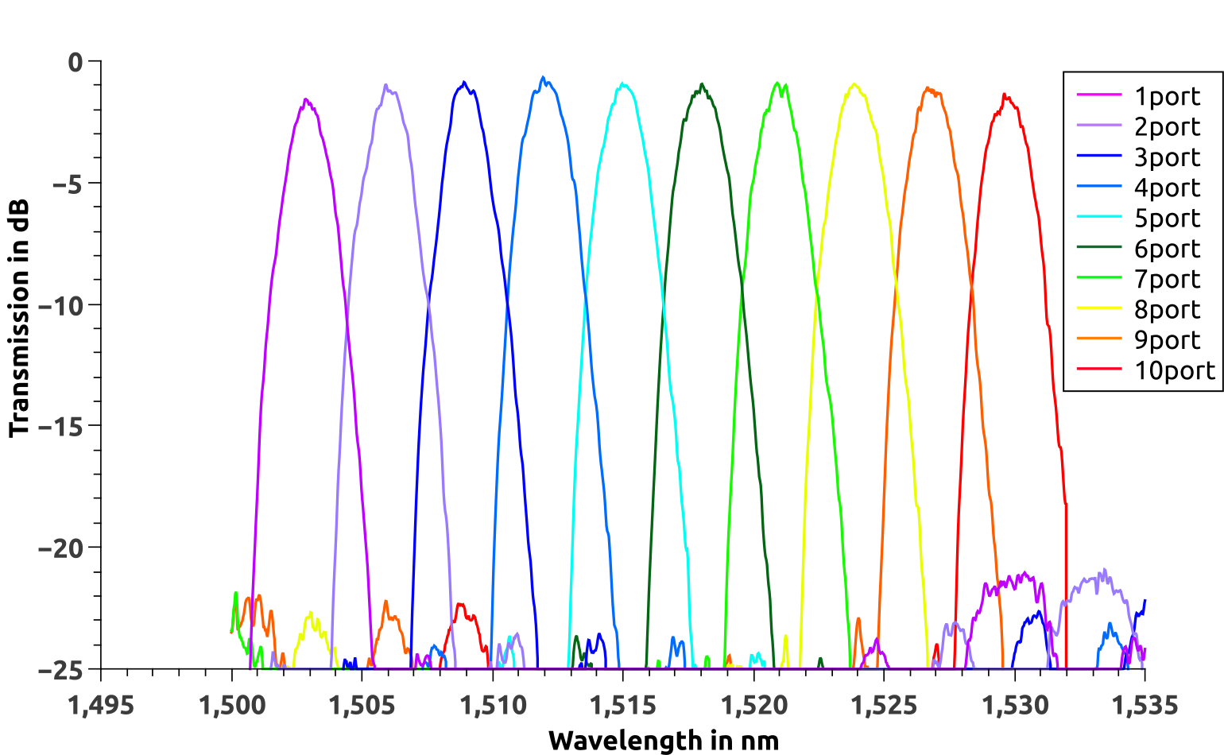
Task 5.3 – Optical Filter
Standard AWG
Device Details:
10x400 GHz AWG - size: 370x330 um² - design FSR = 42 nm
Measurement details:
Insertion Loss: -0.90dB Non Uniformity: 0.8 dB
Crosstalk: 22 dB 3dB Bandwidth: 1.75 nm

Slide 21
Task 5.3 – Optical Filter
Flat-top AWG
Device Details:
12x400 GHz AWG - size: 560x350 um² - design FSR = 38.2 nm
Measurement details:
Insertion Loss: 3.29dB Crosstalk: 17 dB 3dB Bandwidth: 3.30 nm

Slide 22
Task 5.3 – Optical Filter
Single ring
3dB Bandwidth = 0.34nm
Crosstalk <-20dB
Size: 25x25 um²
Double ring
3dB Bandwidth = 1.12nm
Crosstalk <-20dB
Size: 50x25 um²

Slide 23
Tasks
 | Names of the Tasks | Time Period [months]
Task 5.1 | Modeling and fabrication of coupling Si waveguide to plasmonic waveguide | 1 – 15
Task 5.2 | Design and fabrication of Si beamshaper | 1 – 30
Task 5.3 | Design and fabrication of passive ultra-compact components as filters | 1 – 15
Task 5.4 | Signal generation module design | 4 – 12
Task 5.5 | Signal Generation Module implementation via FPGA | 13 – 24

Slide 24
Task 5.4 – Main achievements
DDCM functional specification completed (D5.1)
DDCM design activity completed (MS28/D5.2)
  VHDL design completed
    All features in place (STNoC support, virtual wires, Qos, credit-based flow control, PHY adapter, electrical PHY)
  Verification environment in place for both VHDL and netlist
  Full regression in place and passing
DDCM design characterization completed
  Area: around 300 Kgates
  Speed: up to 450 MHz
  PHY Tx crossing latency: 3.5 cycles at 450MHz
  PHY Rx crossing latency: 0.5 cycles at 450MHz
  Total crossing latency: 4 cycles at 450MHz i.e. 8.88ns
A patent proposal about alternative optical link proposed by ST Support Technologies Group has been submitted and is currently under evaluation by ST patent committee

Slide 25
Task5.4 – DDCM Specification
The DDCM is composed of a transmitter (Tx) and a receiver (Rx).
The former is responsible for sending to the other die initiator requests, target responses, asynchronous events and credit information, the latter is responsible for collecting the same information from the other die.
The phisical channel is unidrectional, two channels ensure the simultaneous communication between the two dice.

Slide 26
Task5.4 – DDCM Specification
Both DDCM transmitter and receiver are composed of a controller, composed of storage FIFOs, QoS and flow control logic, serialization and frequency conversion modules, responsible for encapsulating the system information in a format suitable to be transmitted across the physical channel, and a PHY, responsible for the actual data transmission at physical level.

Slide 27
Task 5.4 - What’s next
Digital
Analog
Photonic
Traffic source
Security encoder
LP encoder
EDC encoder
Emitter/
modulator driver
Emitter/
modulator
Serializer
Physical channel (waveguide, fiber, free space)
Detector
TIA
Deserializer
EDC decoder
LP decoder
Security decoder
Traffic Destination
New modules to be developed include codecs for data encryption for security, codecs for reducing dynamic power consumption, and codecs for error detection and correction in case of noisy physical channel.

Slide 28
Summary
Progress fully according to plan
Optical interfaces designed, fabricated and tested
  Coupler dielectric <> plasmonic waveguide
  Optical filters
  Optical beam shapers
Electrical interfaces designed and implemented

Slide 29
Outlook
Task 5.1 – Couplers
  Further optimization of the process
  Next post-processing is being carried out by KIT
  New cut-back measurement
Task 5.2 – Beam shapers
  Incorporate foucssing grating on moving platform
Task 5.3 – Filters
  Completed (incorporate in final demonstrator)
Task 5.4 – DDCM specification
  Completed
Task 5.5 – DDCM implementation
  Signal Generation Module implementation via FPGA

