Slide 1
Work Package 6 Presentation
Alberto Scandurra
STMicroelectronics, Italy

Slide 2
Outline
WP6 Position in Project
Objectives
Tasks
Milestones and Deliverables
Status of Work
  Plasmonic/Metallic Laser
  Plasmonic Modulator
Summary and Outlook

Slide 3
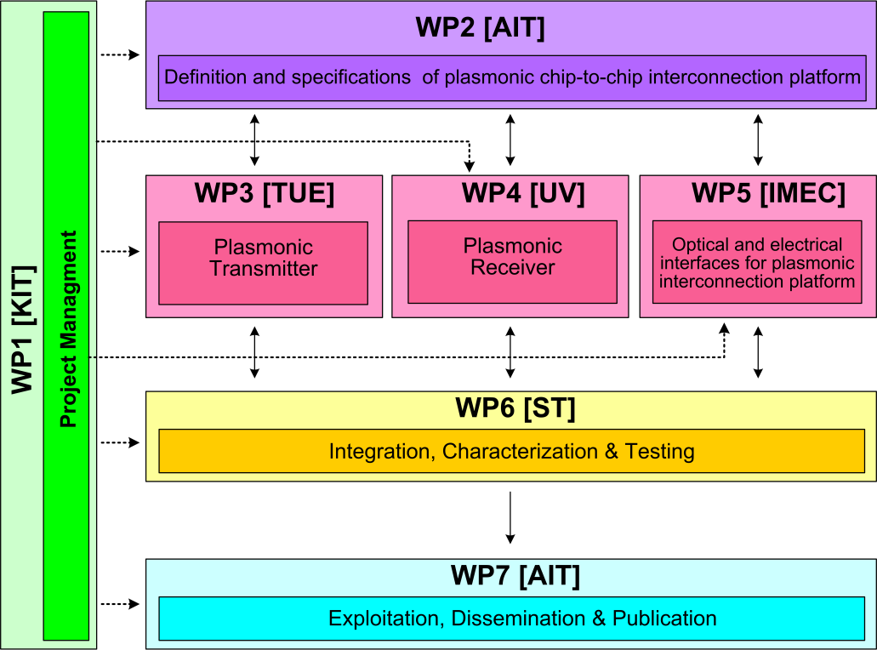






WP6 Position in Project
Contributors:

Slide 4
Objectives
Validation the research activities carried out in the other WPs by means of a demonstrator implementing a simple System-in-Package exploiting all the developed building-blocks (plasmonic devices and digital/analog modules)

Slide 5
Tasks
 | Names of the Tasks | Time Period [months]
T6.1 | Characterization of active and passive plasmonic devices | 7-33
T6.2 | Assembly and packaging of plasmonic devices into System in Package | 30-36
T6.3 | Plasmonic chip-to-chip interconnect prototype testing and evaluation | 32-36
T6.4 | System in Package integration and characterization | 22-36

Slide 6
Milestones
 | Names of the Milestones | Month | Partner
MS37 | Plasmonic active device characterization results | 12 | AIT
MS38 | Plasmonic passive components characteriaztion results with a 1dB coupling loss | 24 | AIT
MS39 | Concept for system integration developed | 27 | AIT
MS40 | Individual plasmonic devices characterization, testing and evaluation | 30 | AIT
MS41 | Chip to chip interconnect characterization | 33 | ST
MS42 | Plasmonic components integration to demonstrate chip-to-chip interconnect | 33 | KIT
MS43 | Plasmonic chip-to-chip interconnect prototype testing and evaluation | 36 | ST

Slide 7
Deliverables
 | Names of the Deliverables | Month | Partner
D6.1 | Report on characterization results of all plasmonic devices | 27 | AIT
D6.2 | Report on characterization results of all optical interface plasmonic passive components | 27 | AIT
D6.3 | Report on chip-to-chip interconnect characterization | 36 | ST
D6.4 | Report on plasmonic chip-to-chip interconnect prototype testing and evaluation | 36 | ST

Slide 8
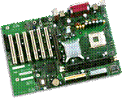
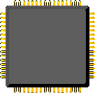


Status of Work: Demonstrator
Got FPGA equipment for demonstrator (ZeBu)
  Managing up to 32 Mgates at the speed of up to 30 MHz
  Currently installed in ST Grenoble by verification/validation group
  NAVOLCHI activity starting remotely in a few weeks
  FPGA equipment planned to be moved to ST Catania beginnning of next year
PC / Linux
PCIe
I/F
ZeBu
Cycle-Based
Reconfigurable
TestBench
(RTB)
Design-Under-Test
(DUT)
Live Real World
Testing
Verilog/VHDL
SystemVerilog
Hardware Transactors
Clock Trees
Logic
Resources
Target System
C/C++
Clock
Server
FPGA
Embedded Testbench
FPGA
SystemC
Memory
Resources
FPGA
Vectors
FPGA
Probes (Dyn./Flex/Stat.)
Memory
Server
Logic Tiles
Transaction-Based
Triggers
Memory
FPGA
Hard
Cores
C/C++
Memory
FPGA
Logic Analyzer
Memory
FPGA
SystemVerilog
TX
FPGA
RX
SVA’s
Memory
SystemC
DirectICE
Smart Z-ICE
Software
Debuggers

Slide 9
Summary and Outlook
  Summary
    No deliverables expected during first year (first deliverables expected month 27)
  Outlook
  Modeling and fabrication of coupling Si waveguide to plasmonic waveguide
  Design and fabrication of Si beam shaper
  Design and fabrication of passive ultra-compact components and filters
  Signal generation module design

