Slide 1
Work Package 3 Presentation
Victor Dolores-Calzadilla, Meint Smit
Eindhoven University of Technology (TU/e), The Netherlands

Slide 2
Outline
WP3 Position in Project
Objectives
Tasks
Milestones and Deliverables
Status of Work
  Plasmonic/Metallic Laser
  Plasmonic Modulator
Summary and Outlook

Slide 3
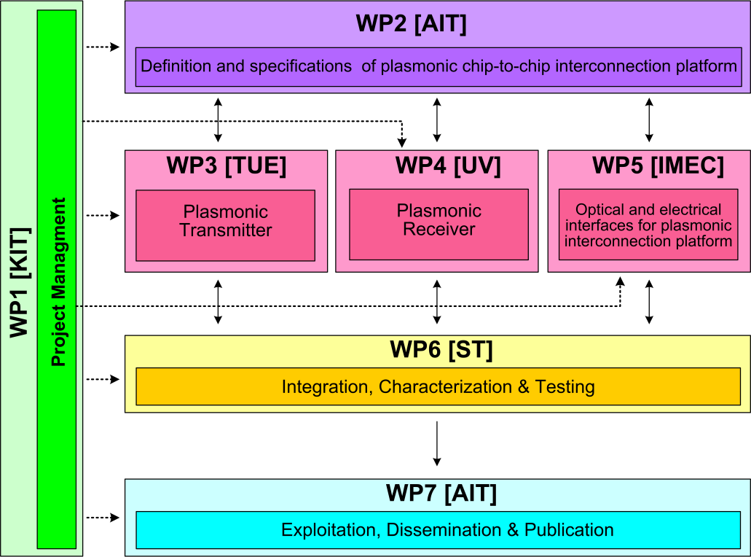



WP3 Position in Project
Contributors:

Slide 4
Objectives
Simulation studies to optimize
  Plasmonic/metallic nanolaser
  Plasmonic modulator
Fabrication
  Electrically pumped plasmonic/metallic nanolaser
  Electrically driven plasmonic modulator
Performance targets
  Laser: active region < 1 μm², output power > 100 μW
  Modulator: extinction ratio > 10 dB for length < 10 μm, and modulation speed > 40 Gbit/s

Slide 5
Tasks
 | Names of the Tasks | Time Period [months]
Task 3.1 | Modelling of device structure (plasmonic laser) and optimization of bonding technology | 1 – 6
Task 3.2 | Modelling of plasmonic modulator | 1 – 18
Task 3.3 | Fabrication of nano plasmonic laser | 7 – 30
Task 3.4 | Fabrication of Si-plasmonic modulators | 7 – 27

Slide 6
Milestones
 | Names of the Milestones | Month | Partner
MS8 | Decision on an optimized structure for metallic/plasmonic nanolaser and its coupling to a Si-waveguide | 6 | TU/e
MS9 | Decision on an optimized structure for plasmonic modulator | 6 | KIT
MS10 | Grown wafer structure for plasmonic lasers | 12 | TU/e
MS11 | Fabrication of plasmonic modulator on a SOI platform | 15 | KIT
MS12 | Decision on an optimized structure for plasmonic modulator with a maximum loss of 20dB | 18 | KIT
MS13 | Initial characterization of unbonded plasmonic lasers | 18 | TU/e
MS14 | Initial testing and characterization of plasmonic modulators | 21 | KIT
MS15 | Initial testing of bonded plasmonic lasers | 24 | TU/e

Slide 7
Deliverables
 | Names of the Deliverables | Month | Partner
D3.1 | Report on studies of optimized structure for metallic/plasmonic nanolaser and its coupling to Si-waveguide | 12 | TU/e
D3.2 | Report on modelling of the modulator structure | 12 | KIT
D3.3 | Fabrication of plasmonic laser device | D3.3 | TU/e
D3.4 | Report on fabrication of modulators | 24 | KIT

Slide 8
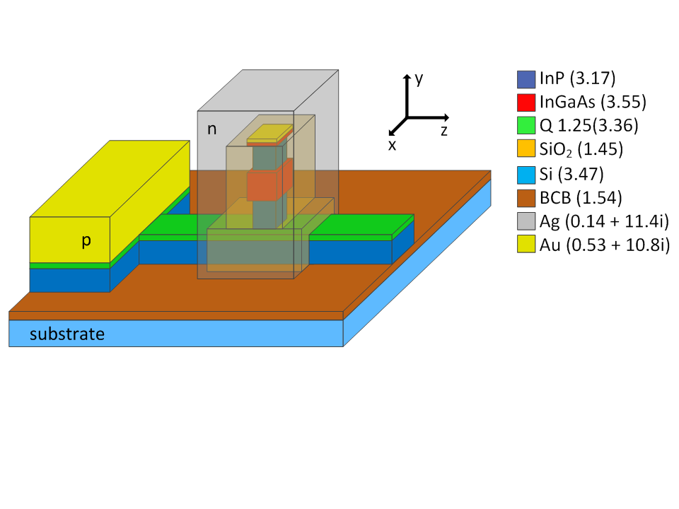
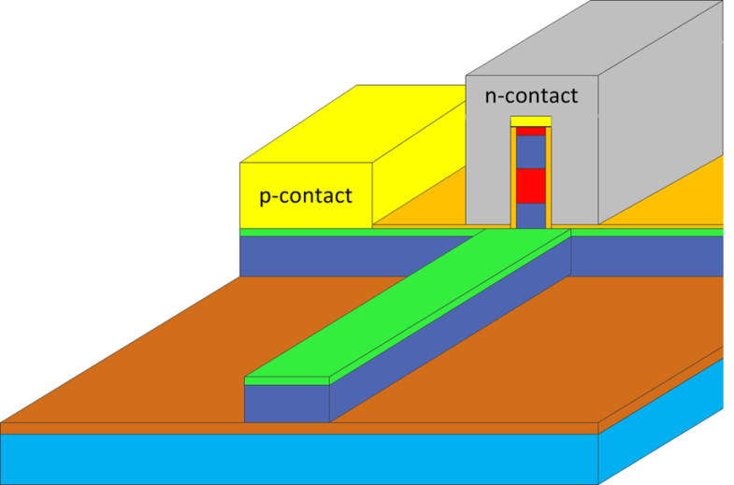
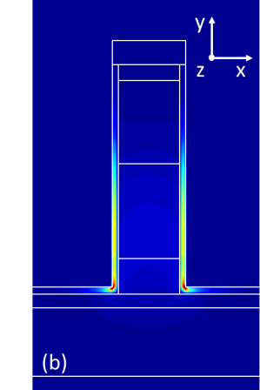
Task 3.1 Modelling of the Nanolaser
Fabry Perot Plasmonic Laser
Metallo-Dielectric Nanolaser
  Main issues:
    High propagation loss ( ~ 0.16 dB / μm)
    Poor confinement factor
|E|², TE mode
|E|², TE mode

Slide 9
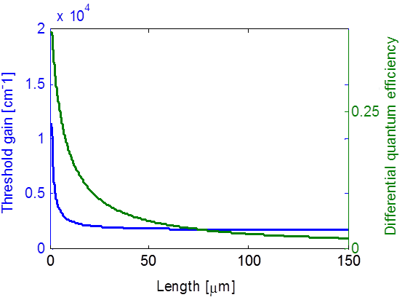
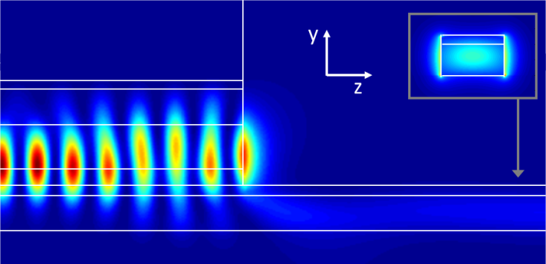
Task 3.1 Modelling of the Nanolaser
Fabry Perot Plasmonic Laser
|E|², longitudinal cross section showing the waveguide coupling
For room temperature operation g_{th} < 2500 cm⁻¹:
  Long devices ( > 50 μm )
  Low efficiency

Slide 10
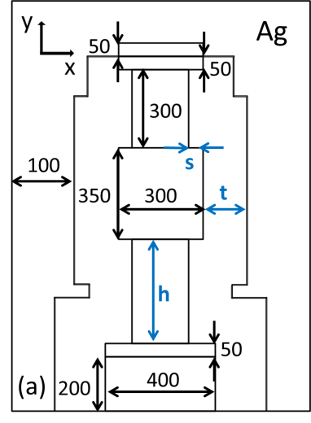
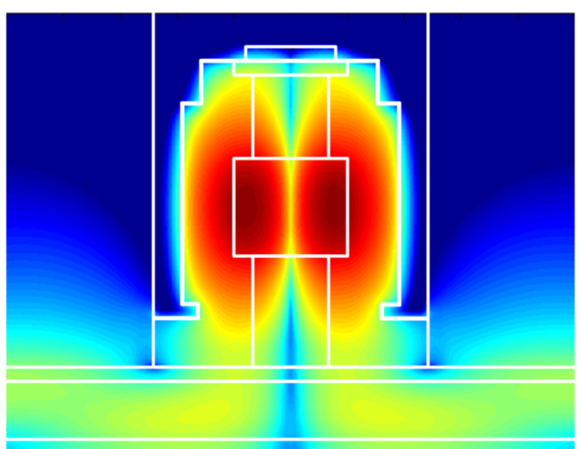
Status of Work: Nanolaser
Metallo-Dielectric Nanolaser
log(|E|²)
Optimization for high Q-factor and high coupling efficiency

Slide 11
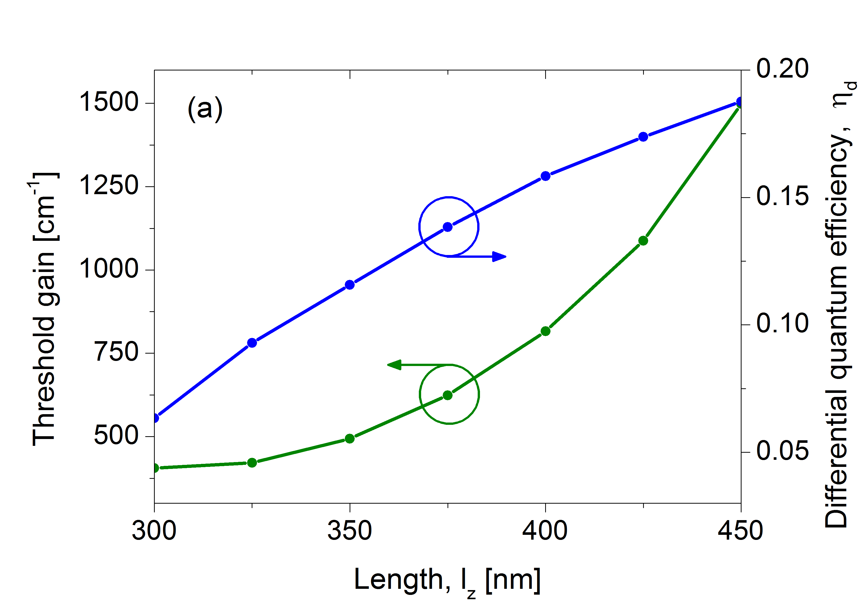
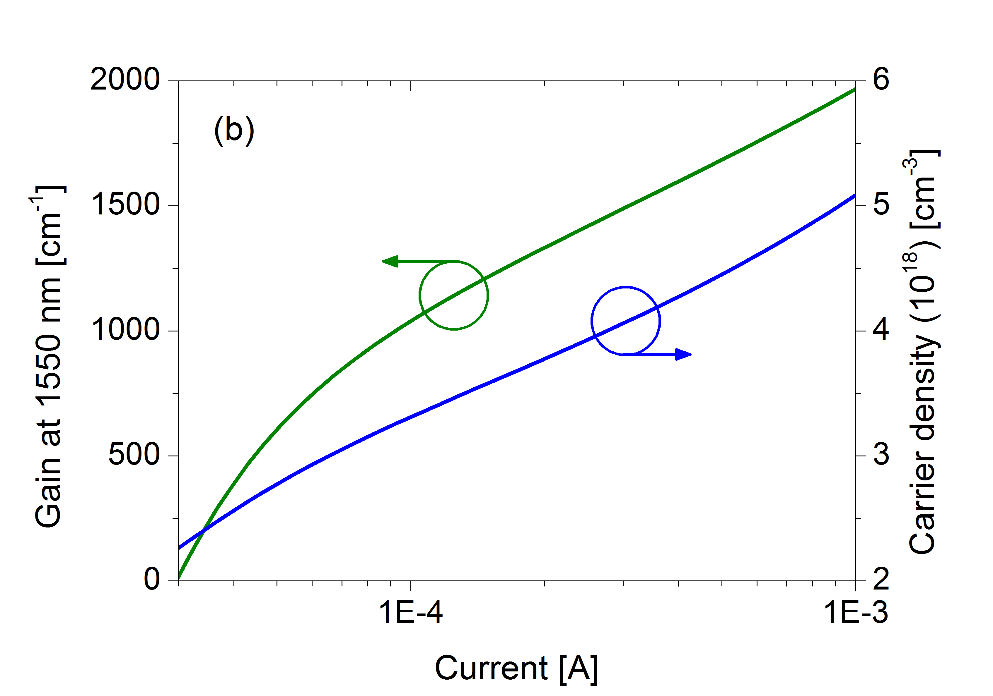
Task 3.1 Modelling of the Nanolaser
Calculated threshold gain and current
For length = 400 nm
Threshold current ~70 μA
Differential efficiency ~ 0.16
Expected power: 50 μW for 0.5 mA

Slide 12
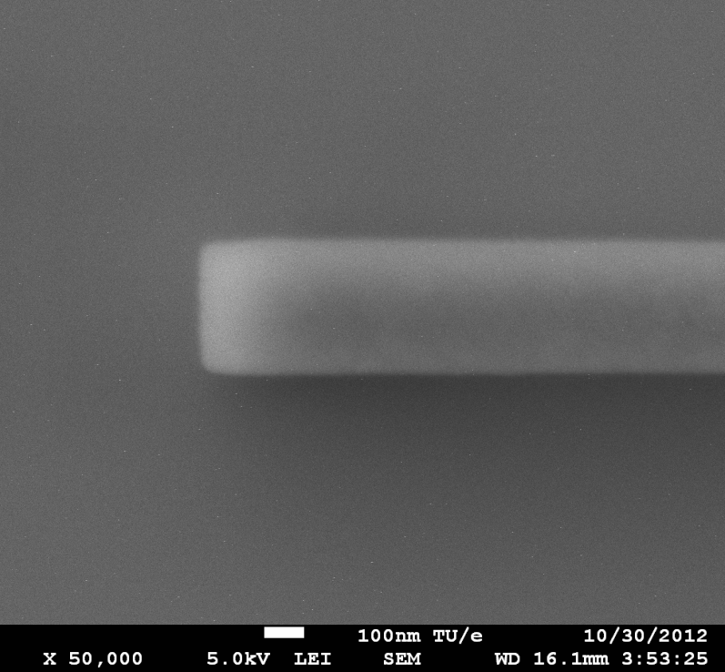
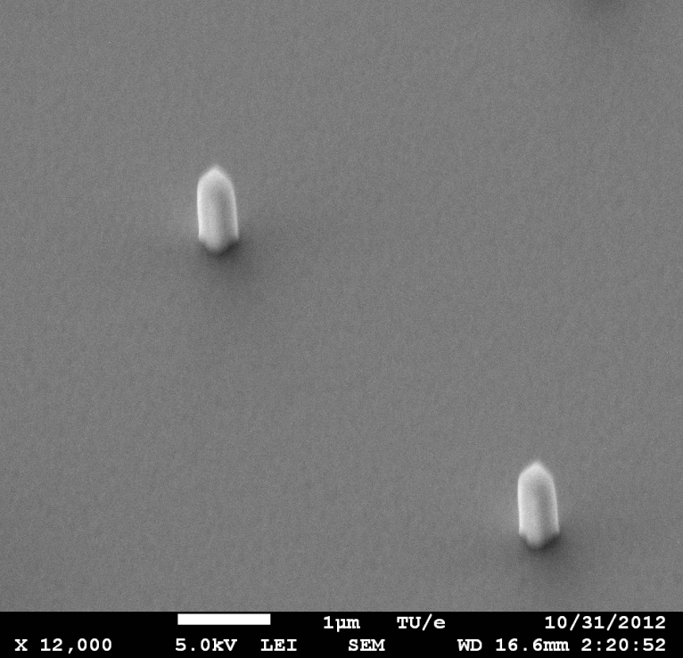
Task 3.3 Fabrication of the Nanolaser
Fabrication started
Waveguides (400 nm wide)
Pillars (300 nm x 300 nm)

Slide 13
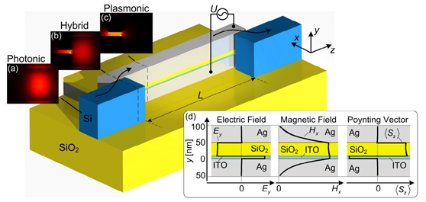
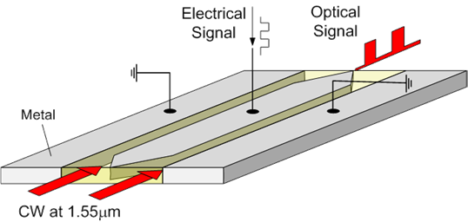
Plasmonic Modulator Approaches
SPP Absorption Modulator
SPP Phase Modulator

Slide 14
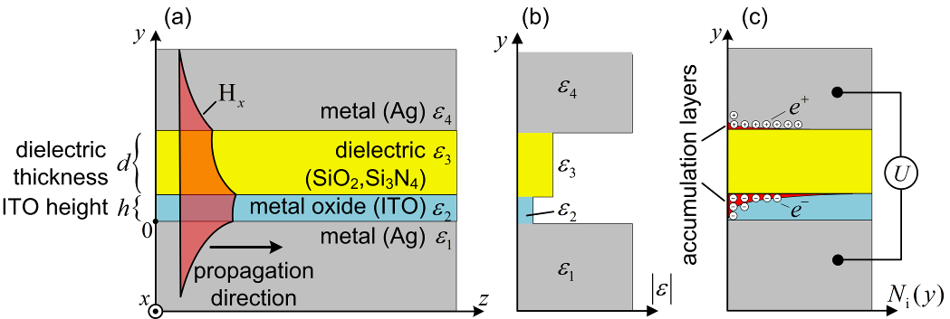
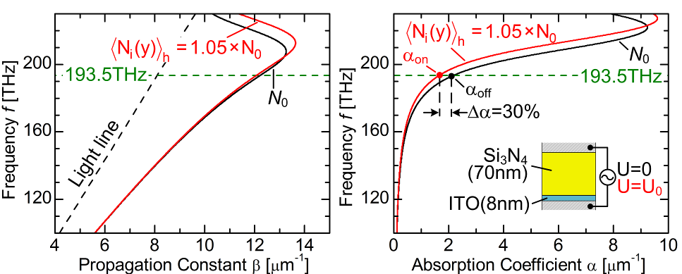
Task 3.2 Modelling of the Modulator
SPP Absorption Modulator
A Melikyan, N. Lindenmann, S. Walheim, P. M. Leufke, S. Ulrich, J. Ye, P. Vincze, H. Hahn, T. Schimmel, C. Koos, W. Freude, and J. Leuthold, “Surface plasmon polariton absorption modulator.,” Optics express, vol. 19, no. 9, pp. 8855–69, Apr. 2011.

Slide 15
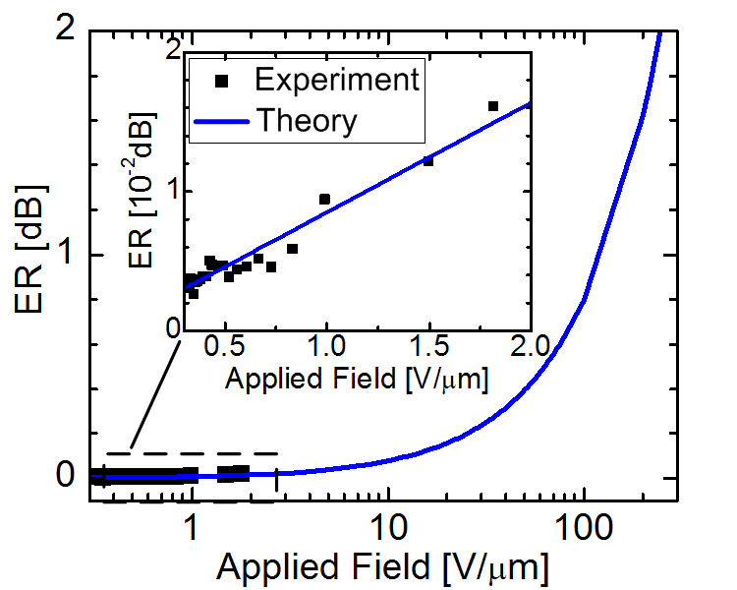
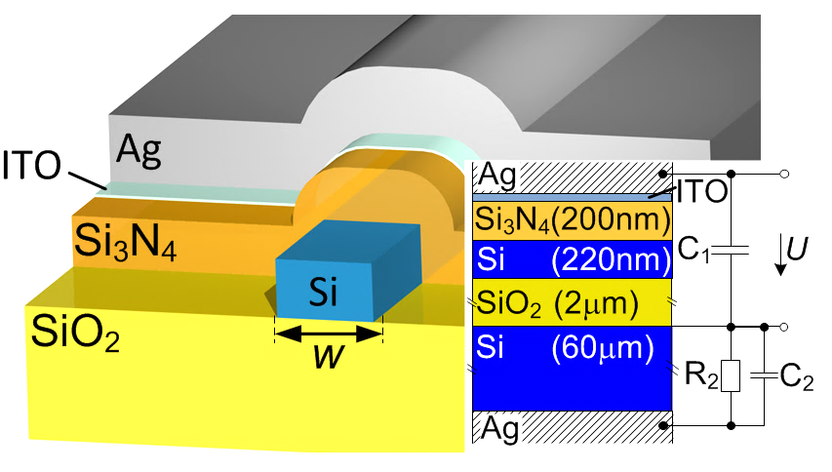
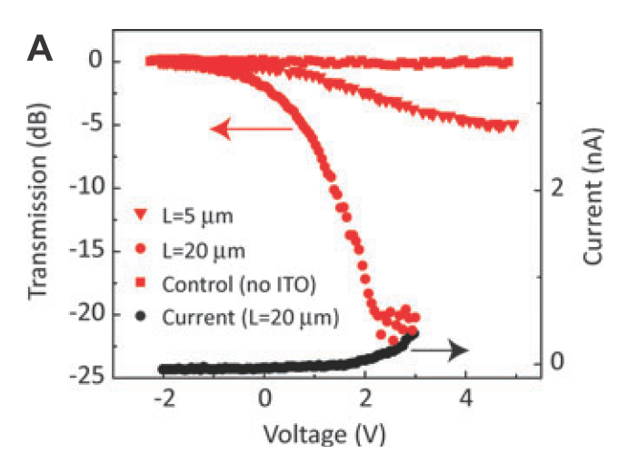
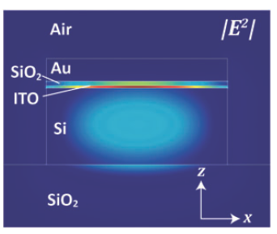
Task 3.2 Modelling of the Modulator
A. Melikyan, et al.: Opt. Express, vol. 19, 2011
5μm
20μm
V. J. Sorger, et al.: Nanophotonics, vol. 1, 17-22, 2012

Slide 16
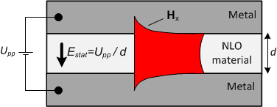
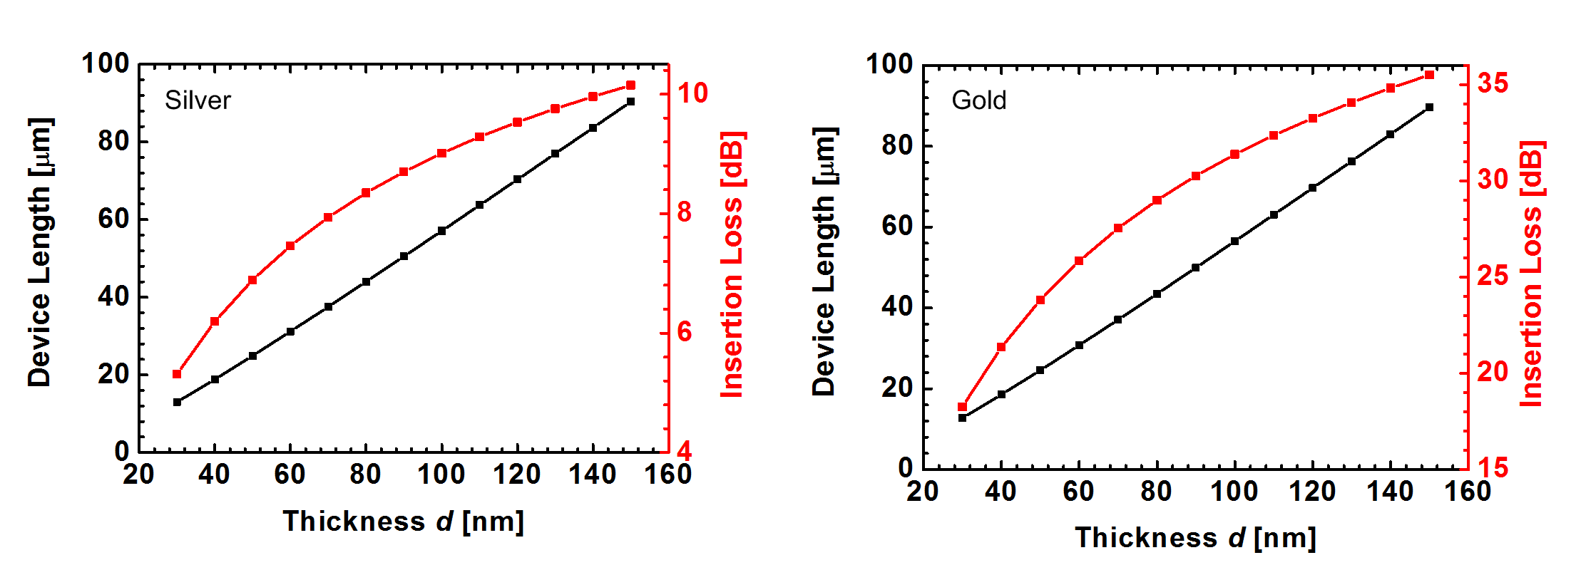
Task 3.2 Modelling of the Modulator
SPP Phase Modulator
Large figure of merit
Easy coupling structure
Easier fabrication
U_{pp}=4.5V
U_{pp}=4.5V

Slide 17
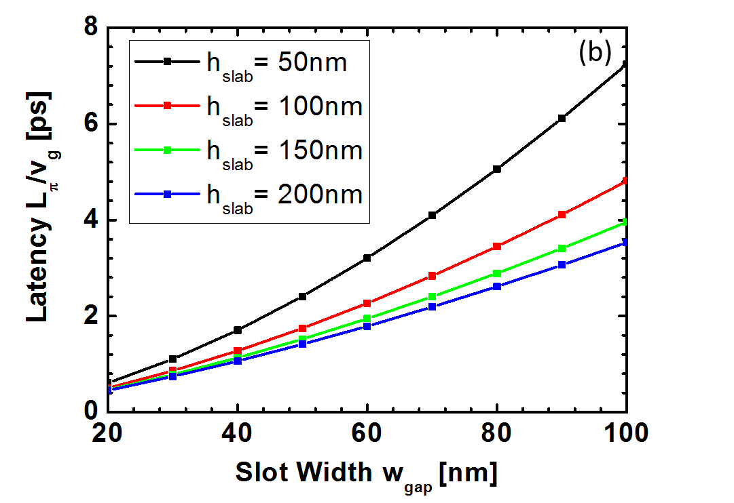
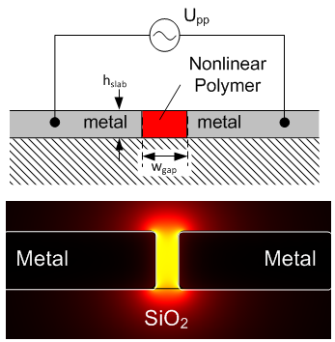
Task 3.2 Modelling of the Modulator
Latency and electrical properties
  Cutoff frequency of the low pass > 1THz

Slide 18
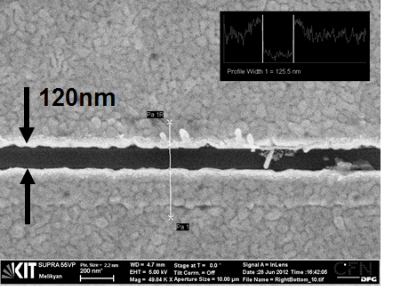
Task 3.4 Fabrication of the Modulator
SEM image of the device
Au
Si nanowire
Au
  Fabrication by KIT and IMEC

Slide 19
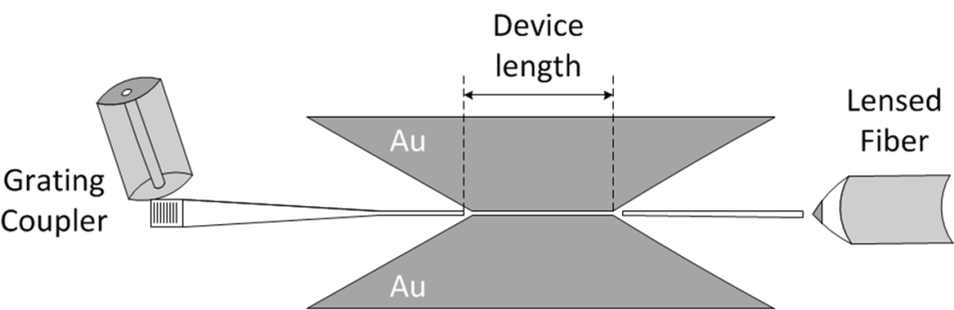
Task 3.4 Fabrication of the Modulator
Optical characterization
167nm

Slide 20
Summary and Outlook
  Summary
    Different designs of plasmonic/metallic lasers and plasmonic modulators were studied and optimized for operation near 1.55μm
    The fabrication of the metallo-dielectric nanolaser and the phase modulator has started
    Optical characterization of modulator structure without EO polymer was carried out
  Outlook
    Further study on longer ( < 10μm) lasers to get higher output power
    Continue fabrication activities (EO polymer coating for modulator, InP-Si wafer bonding for lasers, etc)
    Characterization of devices

