Slide 1
Work Package 4 Presentation
Juan P. Martínez Pastor
University of Valencia (UVEG), Spain

Slide 2
Outline
WP3 Position in Project
Objectives
Tasks
Milestones and Deliverables
Status of Work
  Task 4.1. Design and modelling of Plasmonic Amplifier
  Task 4.3. Colloidal QDs for gain
  Task 4.4. QD-based Plasmonic Amplifier
  Task 4.5. QD-based Photodetectors
Summary and Outlook

Slide 3
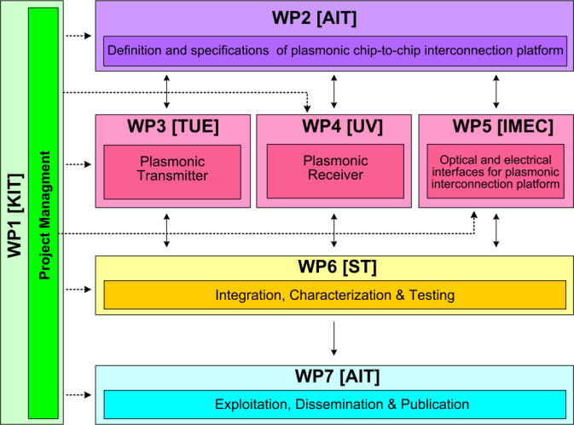




WP4 Position in Project
Contributors:

Slide 4
Tasks
 | Names of the Tasks | Time Period [months]
Task 4.1 | Design and modeling of plasmonic pre-amplifier | 1 – 18
Task 4.2 | Design and modeling of plasmonic photodetector | 1 – 24
Task 4.3 | Colloidal quantum dots with optimized gain and electrical injection scheme | 1 – 18
Task 4.4 | Fabrication and characterization of QD-based plasmonic amplifiers | 6 – 30
Task 4.5 | Fabrication of plasmonic polymer QD based photodetectors | 1 – 36

Slide 5
Objectives
Simulation studies to optimize
  Plasmonic amplifier
  Plasmon/Photon detector
Fabrication
  Optically pumped plasmonic amplifier
  Electrically driven plasmonic amplifier
  Plasmon/Photon detector
Performance targets
  Plasmonic amplifier: 10 dB on-chip gain (5 μm wide)
  Detector: Responsivity > 1 A/W (EQE ≈ 80 %)

Slide 6
Milestones
 | Names of the Milestones | Month | Partner
MS16 | Decision on optimized structures for plasmonic amplifiers | 12 | UVEG
MS17 | Synthesis of nanoparticles with gain at 1550nm | 12 | UGENT
MS18 | Demonstration of conductive QD layers with photoconductive properties | 15 | UVEG
MS19 | Demonstration of metal-(lithographic) polymer and QD metal-(lithographic) polymer nanocompo-sites | 15 | UVEG
MS20 | Demonstration and decision on photodetector operation: nano-gap (MIM) vs. Schottky / heterostructure | 18 | UVEG
MS21 | Electroluminescence from QD stack embedded within conductive oxides (>1µW) | 18 | IMCV
MS22 | Demonstration of plasmonic amplifiers with optical pumping exhibiting 10dB gain | 21 | IMCV
MS23 | Operation of QD based photodetector with responsivity > 0.1 A/W | 24 | UVEG
MS24 | Demonstration of SPP amplifiers with electrical injection exhibiting 10dB/cm gain | 30 | UVEG

Slide 7
Deliverables
 | Names of the Deliverables | Month | Partner
D4.1 | Designs of plasmonic amplifiers | 18 | UVEG
D4.2 | Report on optical properties of QDs layers and polymer nanocomposites | 18 | UVEG
D4.3 | Designs of plasmonic photodetectors | 24 | UVEG
D4.4 | Report on SPP amplifiers by using QDs | 30 | IMEC
D4.5 | Report on plasmonic photodetectors | 33 | UVEG

Slide 8
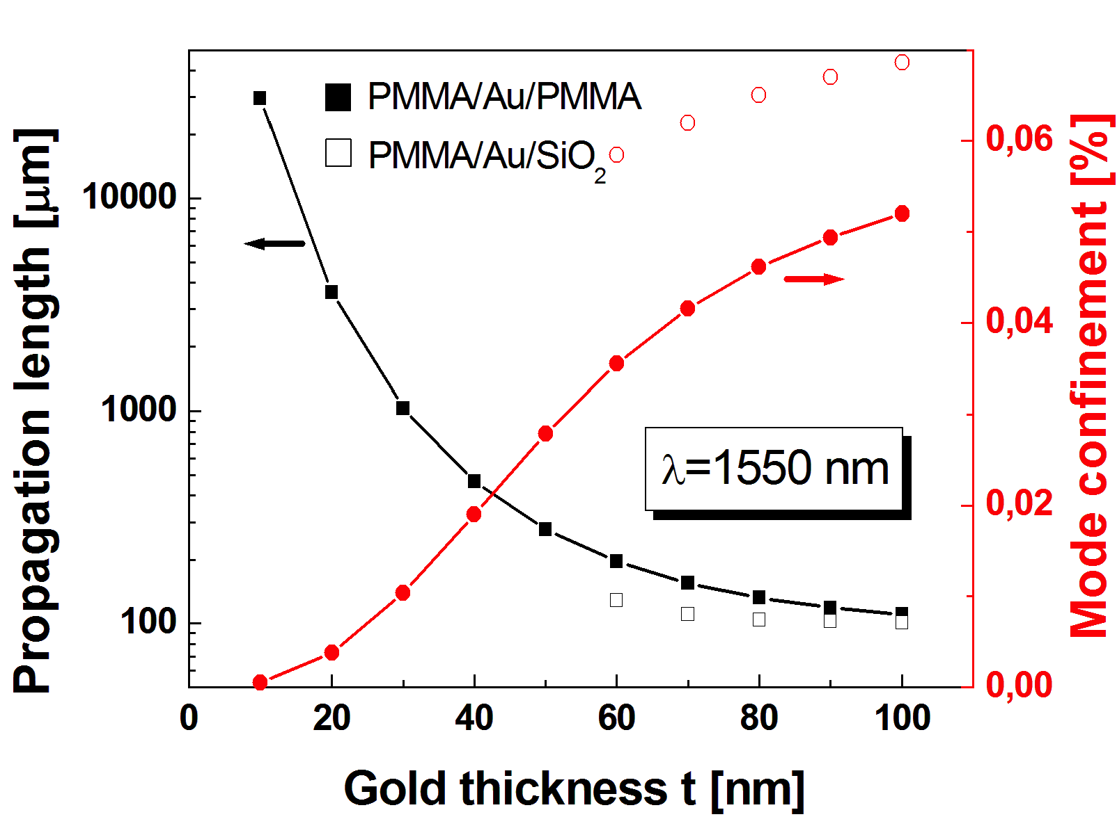
Task 4.1 Design&Modelling of P.A.
Optimizing design for LR-SPP propagation: Au thickness
NO GAIN
Asymmetric
Symmetric
    t = 30 nm is a good compromise
    Symmetric design has SPP solution in the entire t-range
Reported on MS16

Slide 9
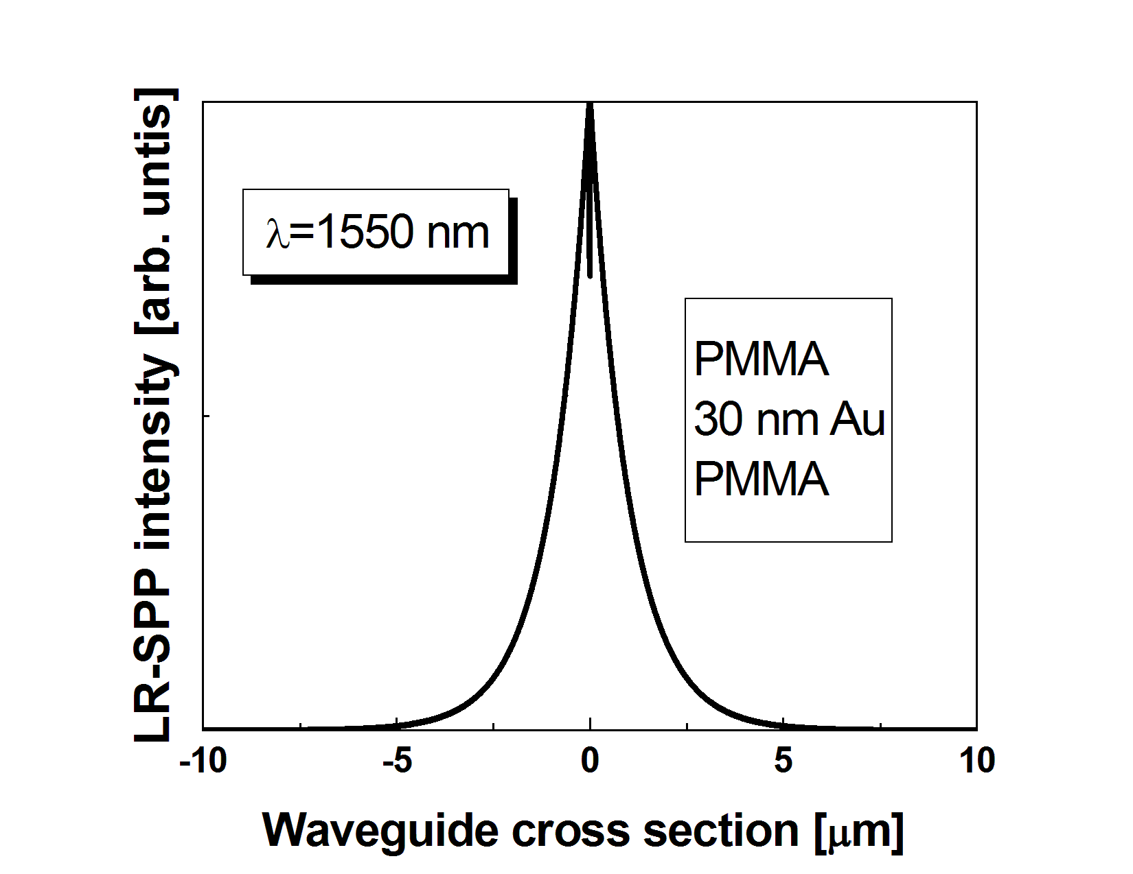
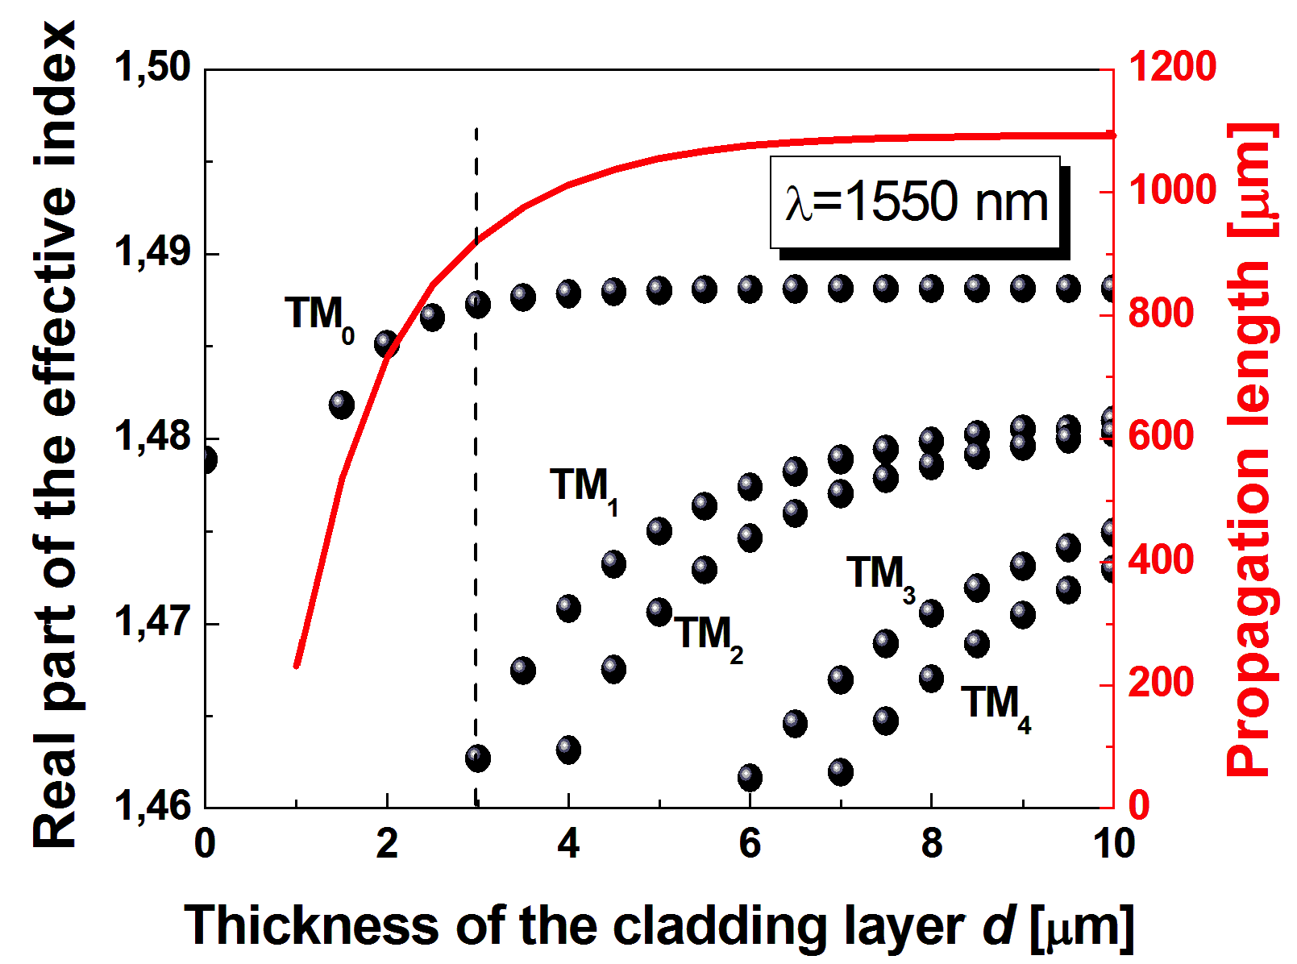
Task 4.1 Design&Modelling of P.A.
Optimizing design for LR-SPP propagation: cladding layers
    d = d₁ = d₂ < 3 μm
    Propagation length decreases for d < 4 μm
    LR-SPP extends > 3 μm
    High order modes appear
Reported on MS16

Slide 10
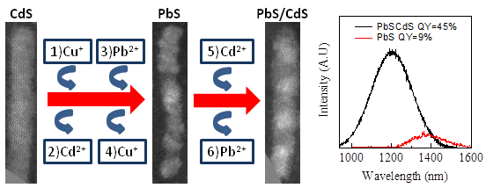
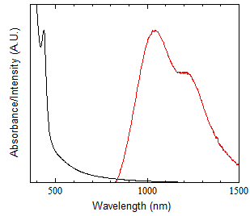
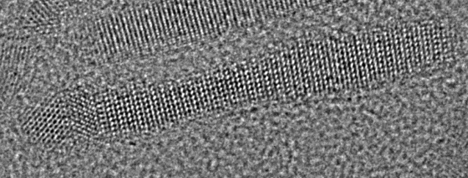
Task 4.3 Colloidal QDs with gain …
MOST PROMISING MATERIALS FOR GAIN: PbS/CdS (PBSe/CdSe) rods
Y. Justo, B. Goris, J. S. Kamal, P. Geiregat, S. Bals, and Z. Hens, JACS 2012, 134, 5484-5487.
PbS/CdS Partial Exchange Rod material
    PL
    ABSORPTION
PbS
CdS
PbS/CdS Partially Exchanged Rods
Reported on MS17
    Synthesis of heterostructured core-shell quantum nanorods:
    Tunable IR λ_{em}
    High quantum yield = 45- 55 %

Slide 11
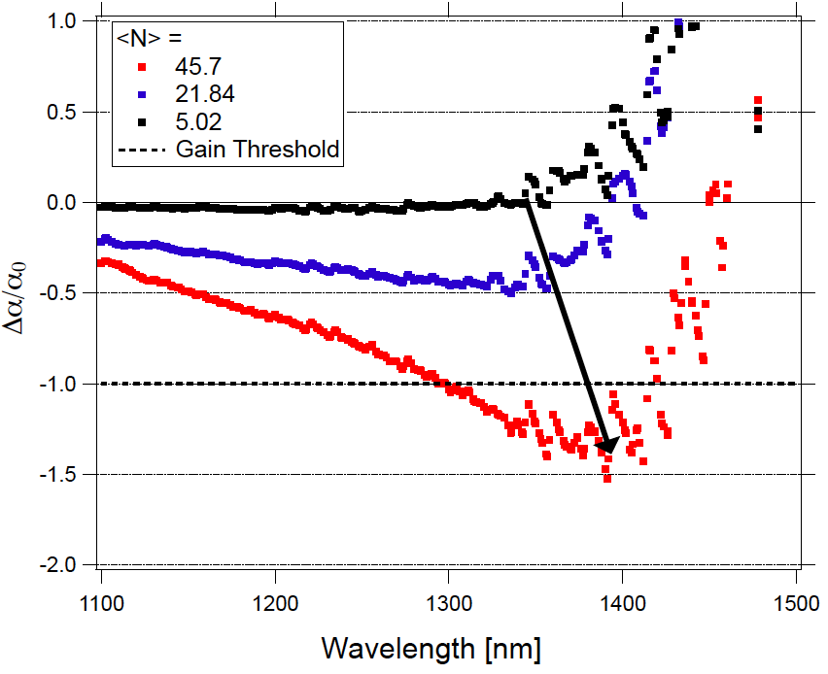
Task 4.3 Colloidal QDs with gain …
MOST PROMISING MATERIALS FOR GAIN: PbS/CdS (PBSe/CdSe) rods
Reported on MS17
    Rod-shaped PbS do cross the transparency threshold under high occupation (45 excitons per rod)

Slide 12
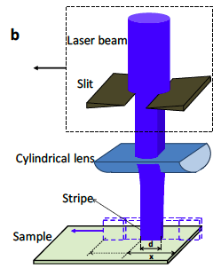
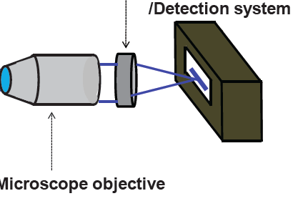
Task 4.3 Colloidal QDs with gain …
Gain measured on dielectric films doped with Q-nanorods
    Characterization of gain material in PMMA by Variable Stripe Length method
    Rate equation model for interpretation of guided PL: saturated gain + losses
Polarizer
Detection system
Mycroscope objective
I. Suárez, H. Gordillo, R. Abargues, S. Albert, and J. Martínez-Pastor, Photoluminiscence wave-guiding in CdSe and CdTe QDs-PMMA nanocomposite films, Nanotechnology 22, 435202 (2011).

Slide 13
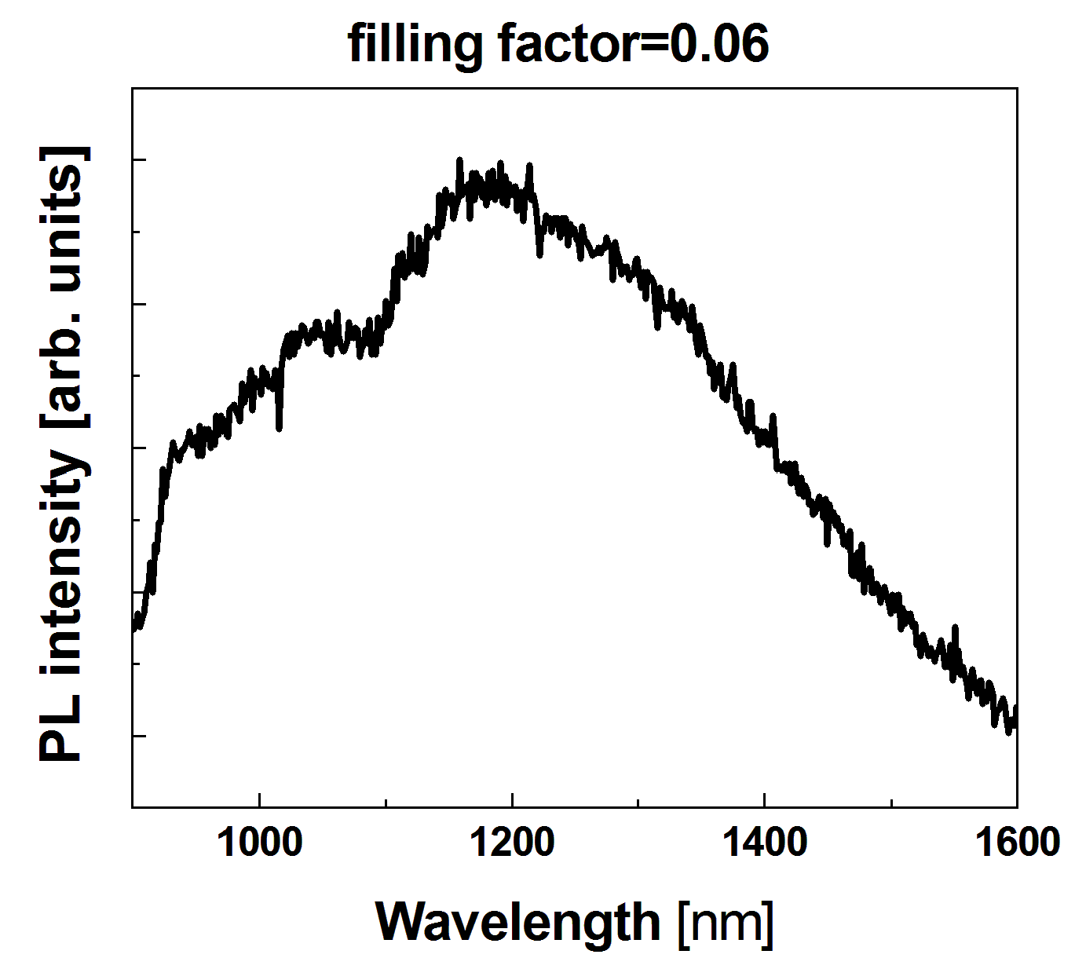
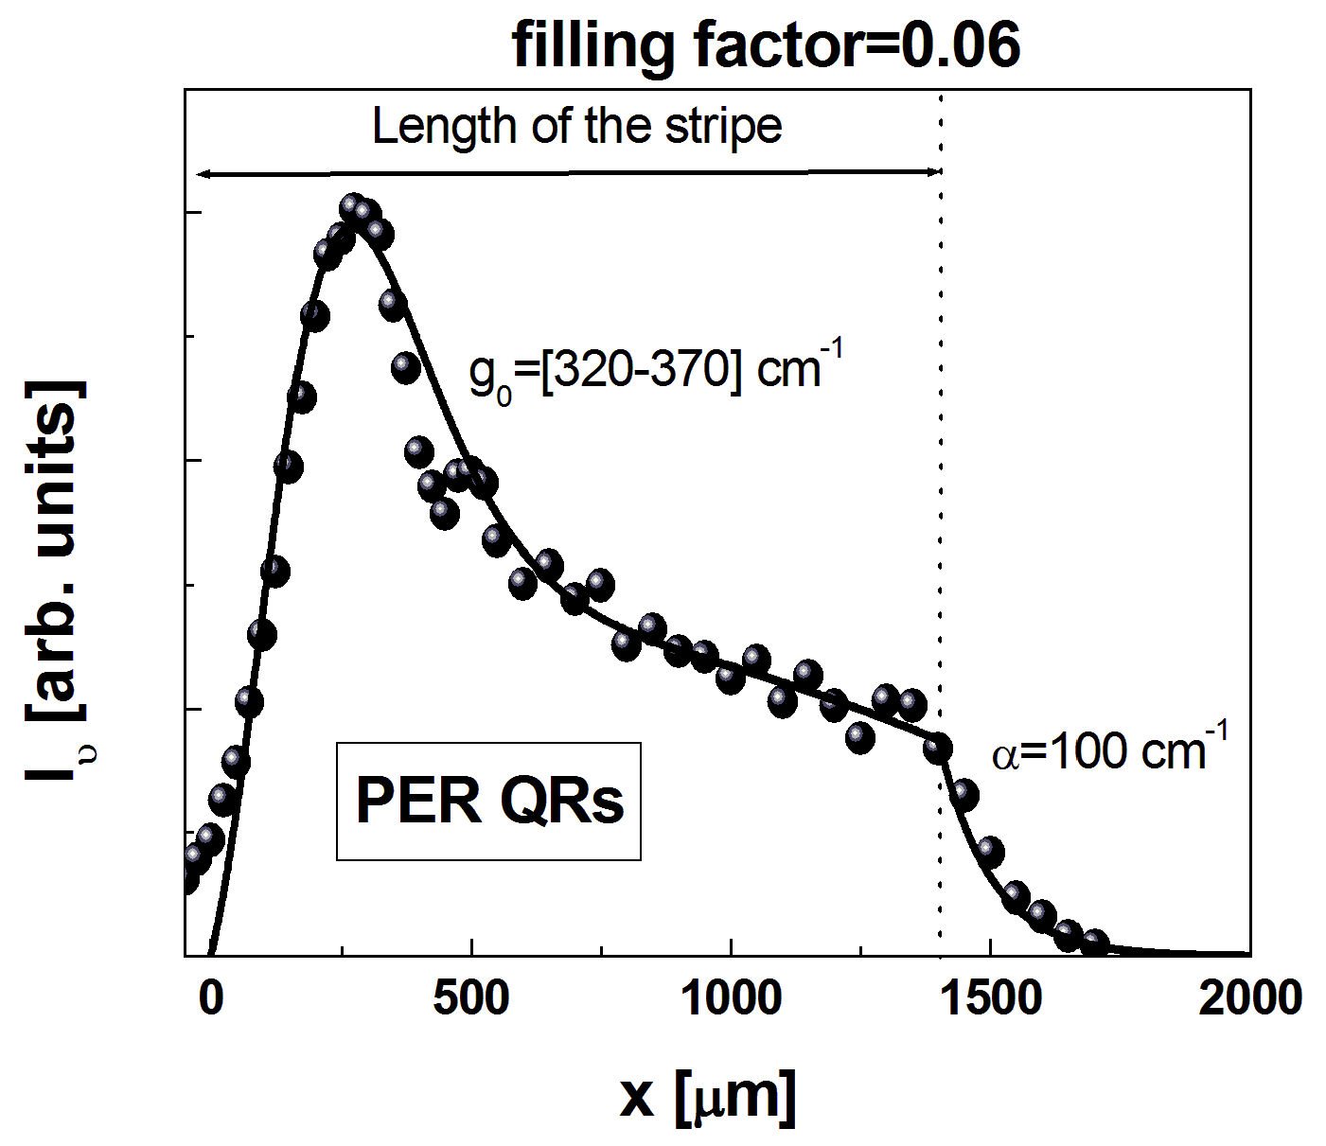
Task 4.3 Colloidal QDs with gain …
Gain measured on dielectric films doped with Q-nanorods
λ_{det}
λ_{det}
Reported on MS17
    Best Gain/losses ratio in PbS/CdS PER
    High gain in 300 μm of pumping stripe
    Gain saturation due to Auger mechanism

Slide 14
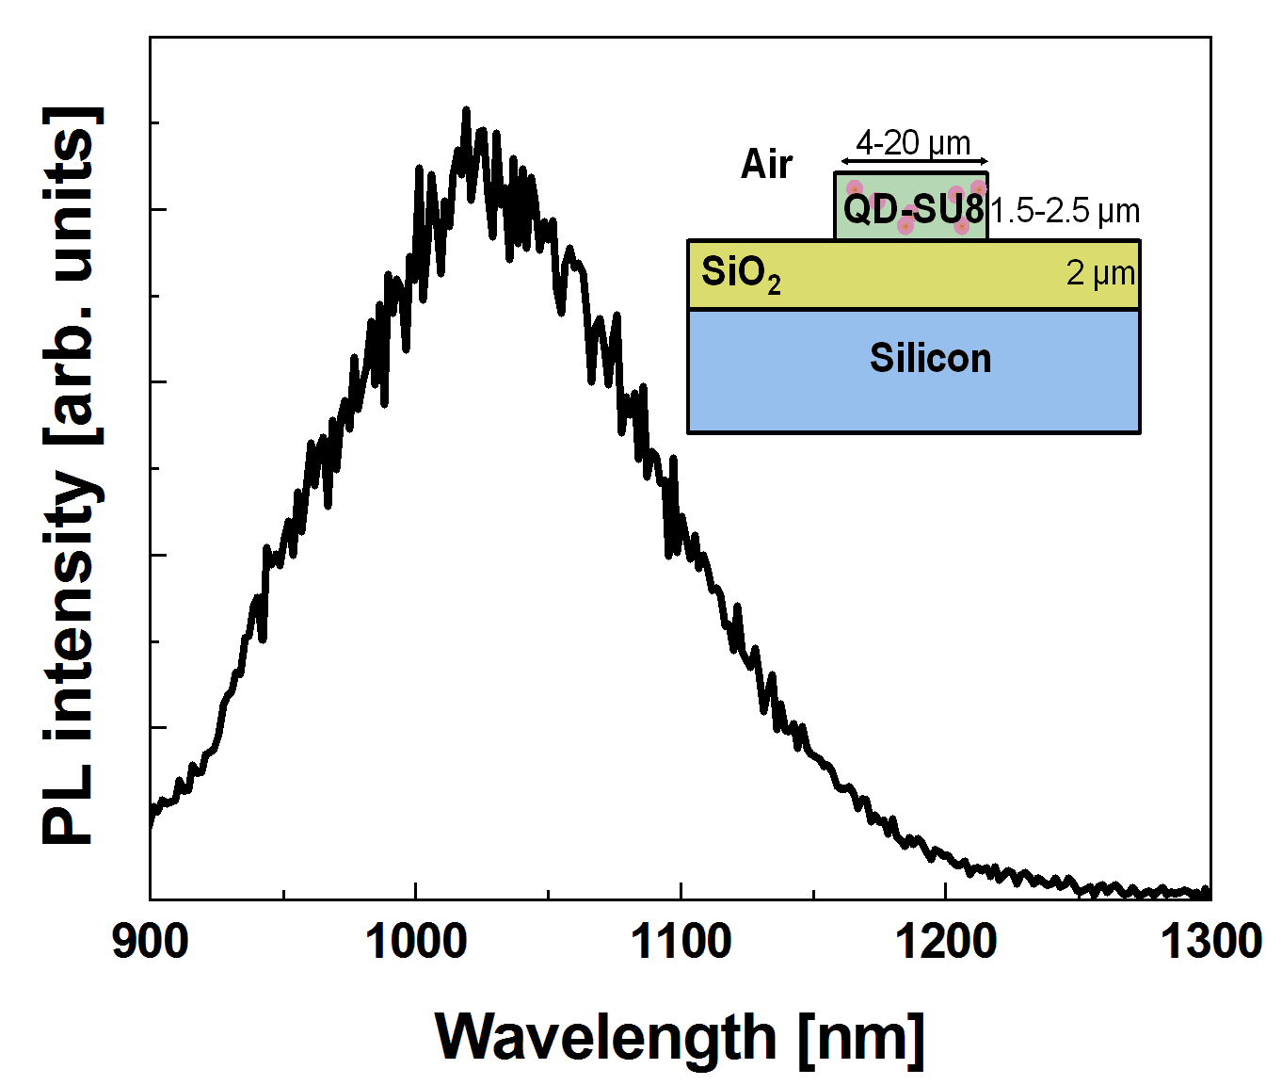
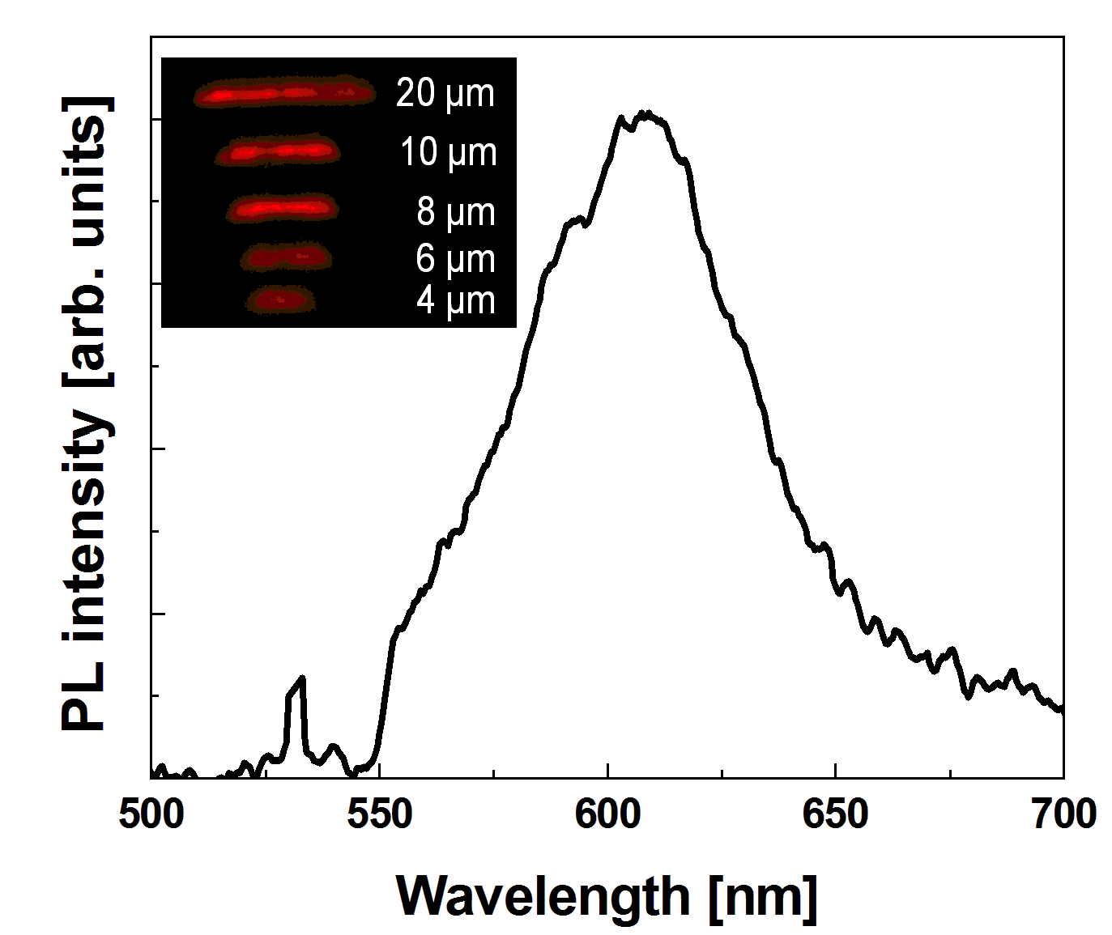
Task 4.3 Colloidal QDs with gain …
QDs in SU-8 for fabricating Plasmonic Amplifier
    QDs incorporated in SU-8 by ligand exchange
    Demonstrated the fabrication of 4-20 μm wide stripes.
    Different QDs (CdSe, PbS)
H. Gordillo, I. Suárez, R. Abargues, P. Rodríguez-Cantó, S. Albert and J.P. Martínez-Pastor, Polymer/QDs nanocomposites for wave-guiding applications, Journal of Nanomaterials, Vol. 2012, Article ID 960201 (doi:10.1155/2012/960201), 1-9 (2012).

Slide 15
Task 4.3 Colloidal QDs with gain …
QD layers for electrically driven PA
    AC electroluminescence concept
    Compatible with Si-technology
At beginning of Positive voltage pulse
At end of positive voltage pulse
V. Wood, M. J. Panzer, D. Bozyigit, Y. Shirasaki, I. Rousseau, S. Geyer,
M. G. Bawendi, and V. Bulovic, Electroluminescence from Nanoscale Materials via Field-Driven Ionization, Nano Lett. 2011, 11, 2927–2932

Slide 16
Task 4.3 Colloidal QDs with gain …
QD layers for electrically driven PA
Normalized Intensity
Wavelength [nm]
    AC electroluminescence is identical to PL
    Efficiencies are 0.14 lumen/watt

Slide 17
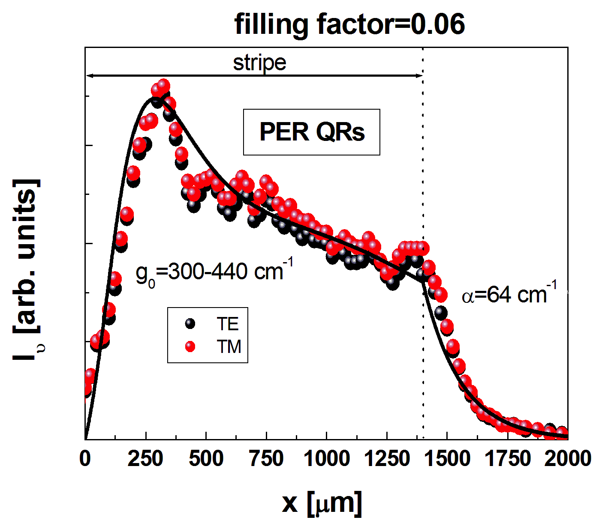
Task 4.4 Fabrication of QD-based PA
Fabrication of optically pumped Plasmonic Amplifier
    TM, TE are plasmonic/photonic hybrid modes
    Gain and losses are similar to those measured in pure dielectric modes
    Symmetric structure under preparation

Slide 18
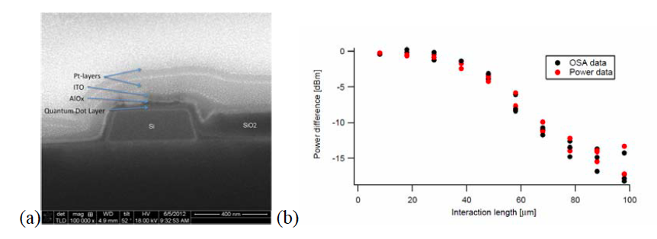
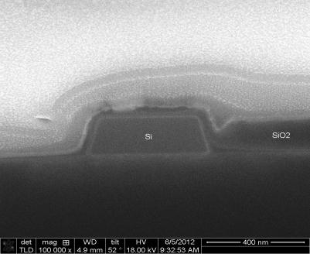
Task 4.4 Fabrication of QD-based PA
Fabrication of Electrically driven Plasmonic Amplifier
Power Difference [dBm]
Interaction Length [μm]
    QDS interact with the optical mode of the waveguide
    Losses increase after AlO_{x} and ITO

Slide 19
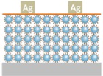
Task 4.5 Fabrication of Photodetector
Photodetection based on QD layers
MPA ligand
(3-mercaptopropionic acid)
10
A
d = 130 nm
1
External Quantum Efficiency (%)
EDT ligand
(1,2-ethanedithiol)
ITO
0.1
Responsivity
MPA: 0.006 – 0.018 A/W
EDT: 0.001 – 0.006 A/W
    QD solids (layer-by-layer method) using different ligands (MPA and EDT).
    Better dark conductivities and photocurrent with MPA due to shorter molecular distance between QDs (1.6 nm) and less surface defects.

Slide 20
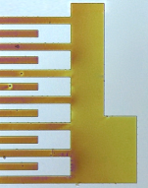
Task 4.5 Fabrication of Photodetector
Photodetection based on conductive polymers
UV Light
Metal NP
Conducting
IPN Patterns
Photomask
Lithographic process
100 µm
Photoresist
Resist + precursor
Substrate
2. Post bake 120-140 ºC
200 µm
R. Abargues, P.J. Rodríguez-Cantó, R. García-Calzada, and J. Martínez-Pastor, Patterning of Conducting Polymers using UV lithography: The in-situ polymerization approach, J. Phys. Chem C 116, 17547-17553 (2012).
    Demonstrated conductive 3T^{(*)} with Cu(ClO₄)₂ inside Novolak.
    Demonstrated conductive 3T^{(*)} with HAuCl₄ + formation of Au NPs in PMMA.
Conductivity: 10-30 S/cm
Responsivity at 533 nm: 0.006 A/W at 10 V
^{(*)}3T: Terthiophene

Slide 21
Summary and Outlook
Summary
Plasmonic Amplifier:
Design of optimized structures for plasmonic amplification
Hetero-nanostructures emitting at the infrared with high quantum yield have been synthesized:
- High gain in cladding layers for optical pumping concept
- AC Electrical driven concept
Fabrication of optical and electrical driven plasmonic amplifiers
Photodetector:
Photoconductors based on QD-layers
Photoconductors based on polymers interpenetrated in patternable polymers
Outlook
Materials: Optimize hetero-nanostructures emitting at 1550 nm
Polymer-based PA: Corroborate experimentally conclusions on MS16 (symmetric design) and begin with on Au-2D waveguides (+ design)
Hybrid-Si PA: Design, fabrication and characterization of electrically driven structures
Photodetectors: Design, fabrication and characterization of structures

