Slide 1




Unit of Materials and Optoelectronic Devices
University of Valencia
www.uv.es/umdo
I. Suárez, P.J. Rodríguez-Cantó and J.P. Martínez-Pastor
Isaac.suarez@uv.es
Current State of the work and preparation of Review Meeting
Karlsruhe April 26th 2013, Karslruhe

Slide 2
Outline
1-Current Status of the work
1.1-Plasmonic amplifiers by using polymers doped with QDs
1.2-Plasmonic photodetectors based with QDs and metal nanostructures
2- Collaboration with other partners
3- Next steps
4- Review meeting in Brussels
4.1-Tasks
4.2-Deliverables and Milestones
4.2-Review comments
4.3-Dissemination
2/21

Slide 3
Plasmonics amplifiers
Design of plasmonic amplifiers
Objective: QD-PMMA nanocomposites to provide gain in a SPP at λ=1.55 µm
Modelling with the Transfer Matrix Method to optimize geometrical parameters
Preliminary work at λ=0.6 µm and currently λ=1.55 µm
Three structures tested:
Asymmetric
Symmetric
Bilayer
3/21

Slide 4
Plasmonics amplifiers
Design of plasmonic amplifiers
Asymmetric structures
Good for λ=600 nm but can not support SPP at λ=1.55 µm
t=30 nm to optmize mode confinement (2 %) and propagation length (11 µm)
d<1 µm to avoid high order TM modes
g≈1500 cm⁻¹ to compensate losses at λ=600 nm
4/21

Slide 5
Plasmonics amplifiers
Design of plasmonic amplifiers
Symmetric structures
Not improvement at λ=600 nm and good at λ=1.55 µm
t=30 nm to optmize mode confinement (0.01%) and propagation length (1 mm)
d=2-3 µm to avoid high order TM modes
g≈12 cm⁻¹ to compensate losses at λ=1550 nm
5/21

Slide 6
Plasmonics amplifiers
Design of plasmonic amplifiers
Bilayer structures
PMMA
QD-PMMA
PMMA
SiO₂
Si
- Pump laser coupled to the cladding to increase its propagation length
- As long as the pump beam propagates QDs are excited and PL coupled to SPPs
- The evanescent SPP tail occurs at the cladding
d₁≈1.5 µm: SPP at 1/e ➔ d₁≈0.6 µm to minimize absorption
d₂≈2-3 µm d₃≈3 µm: optimum TE₀ propagation at 404 nm (pump)
λ=1.55 µm
6/21

Slide 7
Plasmonics amplifiers
Experimental work
Nanostructures
Nanoparticle | λ absorption (nm) | λ PL (nm)
CdSe QDs (UVEG) | 580 | 600
PbS QDs(UGent) | 1490 | 1500
PbS/CdS QRs(UGent) | 600 | 1300
PERQRs(UGent) | 450 | 1200
PbS/CdSe QRs(UGent) | 1200 | 1500
Large Stokes-Shift between absorption and emission is desirable to avoid reabsorption
7/21

Slide 8

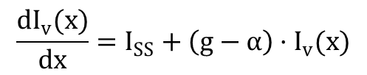
Plasmonics amplifiers
Experimental work
Symmetric and asymmetric structures
$$\frac{dI_{v}(x)}{dx}=I_{SS}+\left(g−α\right)·I_{v}(x)$$
$$g=g_{0}·e^{−d/L}$$
Gain and losses by using VSL method ➔new model with rate equations
- Samples with different ff in the PMMA ➔ g₀ increases, but also α: largee Stokes-Shift
Best results for PER QRs
No changes of the spectra as a function of the power
8/21

Slide 9
Plasmonics amplifiers
Experimental work
Bilayer structures
CdSe and PbS QDs in asymmetic waveguides as a probe of concept
d₃ (cladding) = 0 to 9 µm
d₁=0.25 µm (VIS) d₁=0.5 and 1 µm (IR)
Losses (VSL) decrease with thickness of the cladding: 80 to 40 cm⁻¹
Pump laser coupled to the structures
9/21

Slide 10
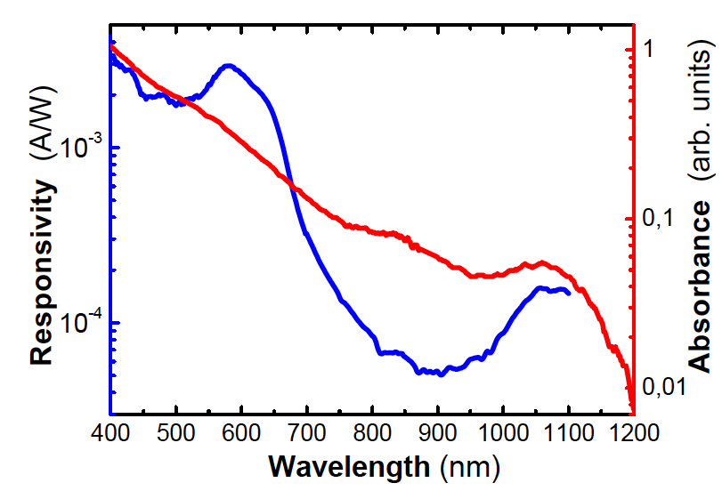
Plasmonic photodetectors
Photodetector with PbS QDs by LbL
New data by using PbS with more passivated surface
Resistivity of the layers: ρ ≈ 5-8.10⁴ Ω cm
Responsivities 0.5 A/W in the visible and 1 mA/W at 1000 nm (exciton ground state absorption)
Photoconductive gain 50 mA/W (1 V) at a single wavelength (600 nm)
TOP
S = 1 mm²
Absorption edge
Ag
I
QD-layer (300 nm)
PDOT
ITO
10/21

Slide 11
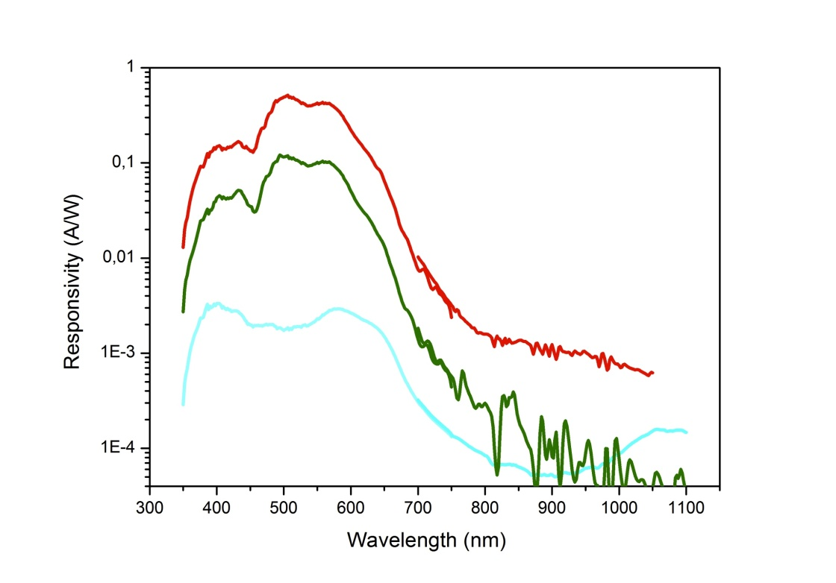
Plasmonic photodetectors
Photodetector with PbS QDs by LbL
New data by using PbS with more passivated surface
Resistivity of the layers: ρ ≈ 5-8.10⁴ Ω cm
Responsivities 0.5 A/W in the visible and 1 mA/W at 1000 nm (exciton ground state absorption)
Photoconductive gain 50 mA/W (1 V) at a single wavelength (600 nm)
TOP
S = 1 mm²
d>600 nm
d>300 nm
Ag
I
QD-layer (300 nm)
PDOT
ITO
11/21

Slide 12
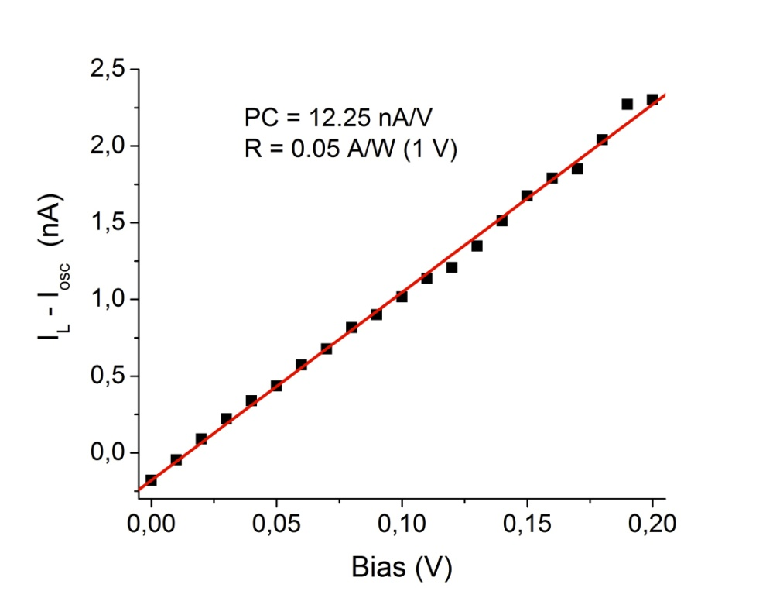
Plasmonic photodetectors
Photodetector with PbS QDs by LbL
New data by using PbS with more passivated surface
Resistivity of the layers: ρ ≈ 5-8.10⁴ Ω cm
Responsivities ≈ 0.5 A/W in the visible and 1 mA/W at 1000 nm (exciton ground state absorption)
Photoconductive gain ≈ 0.1 A/W (1 V) at single wavelength (600 nm)
TOP
45 μm
I
I
Ag
QD-layer (300 nm)
GLASS
12/21

Slide 13
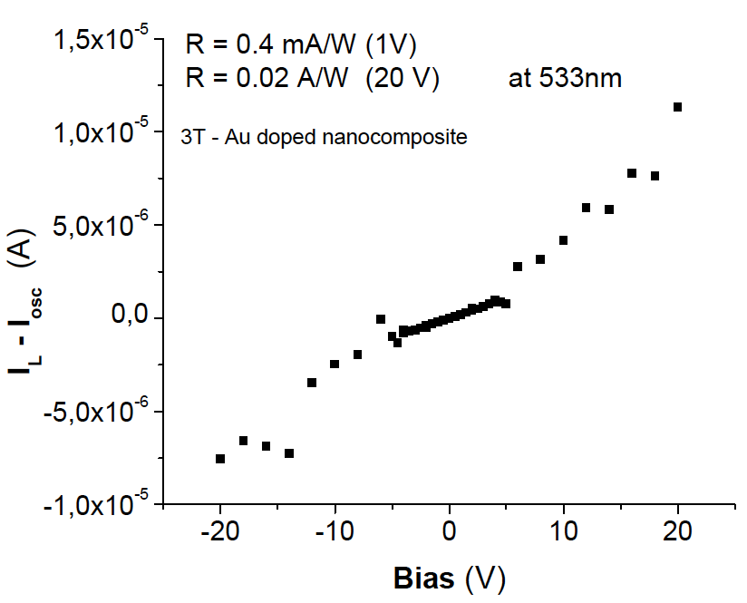
Plasmonic photodetectors
Conductive/PhC polymers (PMMA)
    Conductive 3T with HAuCl₄
    (doping+formation of Au NPs)
Metal NP
Conducting
IPN Patterns
Resistivity: 3T-Au layers ρ ≈ 10 Ω cm
Photoconductive gain: 3T gold layers 0.4 mA/W (@1 V) at 532 nm
                0.02 A/W(@20 V) at 532 nm
TOP
100 μm
I
I
Ag
QD-layer (300 nm)
GLASS
13/21

Slide 14
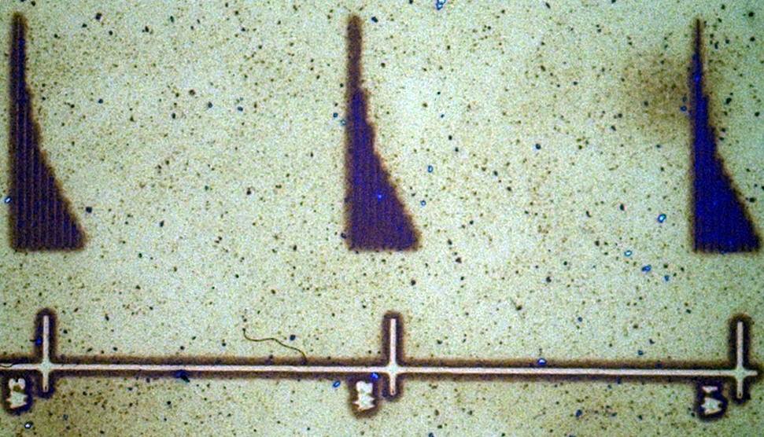
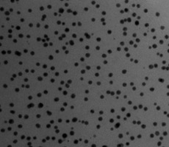
Plasmonic micro/nanostructures
From polymer nanocomposite to metal nanostructures
Growth of NPs
Pattern Metallization
Growing Solution
Growing Solution
Au(III) or Ag(I)
+ Reducing Agent
Syntering
Initial
D = 10 nm
100 μm length
width: 120 nm
width: 220 nm
50 nm
width: 320 nm
4 hours
D = 40 nm
10 μm length
50 nm
14/21

Slide 15
Collaboration with other partners
UGENT and IMEC
Sample exchange: PbS, PbS/CdS, PbS/CdSe, PER, PbS/CdS
New material to provide gain
Common deliverables
AIT
March: visit of E. Fitrakis to dicusse new designs
In contact for plasmonic design and deliverables
15/21

Slide 16
New steps
Plasmonic design
2 D mode solver for dielectric load and nanostripes
New samples & experiments
Bilayer symmetric structures in the IR (PbS QDs)
Samples with new QDs from UGENT
2 D samples
Crystal to double 800 nm Ti:Al₂O₃
CW 450 nm laser with 400 mW
Modelling
Rate equations to explain VSL method
16/21

Slide 17
Tasks
 | Names of the Tasks | Time Period [months]
Task 4.1 | Design and modeling of plasmonic pre-amplifier | 1 – 18
Task 4.2 | Design and modeling of plasmonic photodetector | 1 – 24
Task 4.3 | Colloidal quantum dots with optimized gain and electrical injection scheme | 1 – 18
Task 4.4 | Fabrication and characterization of QD-based plasmonic amplifiers | 6 – 30
Task 4.5 | Fabrication of plamsonic polymer QD based photodetectors | 1 – 36
17/21

Slide 18
Deliverables and Milestones
 | Names of the Milestones | Month | Partner
MS16 | Decision on optimized structures for plasmonic amplifiers | 12 | UVEG
MS17 | Synthesis of nanoparticles with gain at 1550nm | 12 | UGENT
MS18 | Demonstration of conductive QD layers with photoconductive properties | 15 | UVEG
MS19 | Demonstration of metal-(lithographic) polymer and QD metal-(lithographic) polymer nanocompo-sites | 15 | UVEG
MS20 | Demonstration and decision on photodetector operation: nano-gap (MIM) vs. Schottky / heterostructure | 18 | UVEG
MS22 | Demonstration of plasmonic amplifiers with optical pumping exhibiting 10dB gain | 21 | IMCV
MS23 | Operation of QD based photodetector with responsivity > 0.1 A/W | 24 | UVEG
MS24 | Demonstration of SPP amplifiers with electrical injection exhibiting 10dB/cm gain | 30 | UVEG
18/21

Slide 19
Deliverables and Milestones
 | Names of the Deliverables | Month | Partner
D4.1 | Designs of plasmonic amplifiers | 18 | UVEG
D4.2 | Report on optical properties of QDs layers and polymer nanocomposites | 18 | UVEG
D4.3 | Designs of plasmonic photodetectors | 24 | UVEG
D4.4 | Report on SPP amplifiers by using QDs | 30 | IMEC
D4.5 | Report on plasmonic photodetectors | 33 | UVEG
D.7.1 | First report on NAVOLCHI dissemination and promotion activities | 18 | AIT
D.7.2 | First report on NAVOLCHI exploitation activities | 18 | AIT
19/21

Slide 20
Review comments
Justify the choice of λ=600 nm to test the amplifier?
We were working 6 months before the beginning of the project (once known the eligibility) on our technology (QDs on polymers) with the most available quantum dots (CdSe), having higher quantum yield in comparison to PbS or PbSe (emitting in the infrared). This investigation was published in our paper in september 2011 (and uploaded to Navolchi). In the first year of the project, some more work was developed with CdSe in SU-8 and in preliminary amplification measurements (to optimize our experimental set-up and physical background). It is for this that we included comparison (in MS16) between 600 and 1550 nm, in modeling mainly, and also in order to publish some more interesting works in next future (on the basis of presentation in last ICTON2012). In parallel we did some work with our PbS in SU-8 and ONCE we received material from UGent we begun to work full time in the infrared with all available materials, as reflected in MS16 and MS17 (and next deliverables in April). At the end of 2012 we received an InGaAs infrared camera and now well prepared to continue 100% in the infrared.
We used CdSe to demonstrate some alternative concept, as a double layer wave-guides where QDs are incorporated in PMMA and SU-8 to waveguide emitted light (as a thin film or patterned 2D structures) that we sent recently to IEEE-JLT (in attachment). Tell me if interesting to acknowledge Navolchi in this paper. The idea can be used in the infrared, but still not the moment.
20/21

Slide 21
Dissemination
Conferences
4 posters.
4 talks.
1 talk at SPP, Canada 26-31th May, 2013
1 talk at ICTON, Cartagena,
1 poster at Optoel, Madrid, 23-27th June, 2013
Journal papers
5 papers accepted and 1 submitted.
1 paper under review (Journal of Lightwave Technology)
1 paper accepted to IEEE Photonics Journal
Some works in preparation
Patents
1 patent: regrowth of metal micro/nanopatterns
Students
PhD student (dielectric waveguides): Henry Gordillo (June 2013).
Master thesis of 2 students (conductive polymers and regrowth (2012).
21/21

