Slide 1
Karlsruhe, April 2013

Slide 2
Material characterisation
(in solution, transient absorption setup)

Slide 3
Sample
SF
Fiber
CCD detector
WL Probe
Pump
Fundamental
Delay Stage
WL crystal
Oscillator (YKGW) & Amplifier
1028 nm
Chopper
OPA + Doubler
700 nm
ND filters

Slide 4
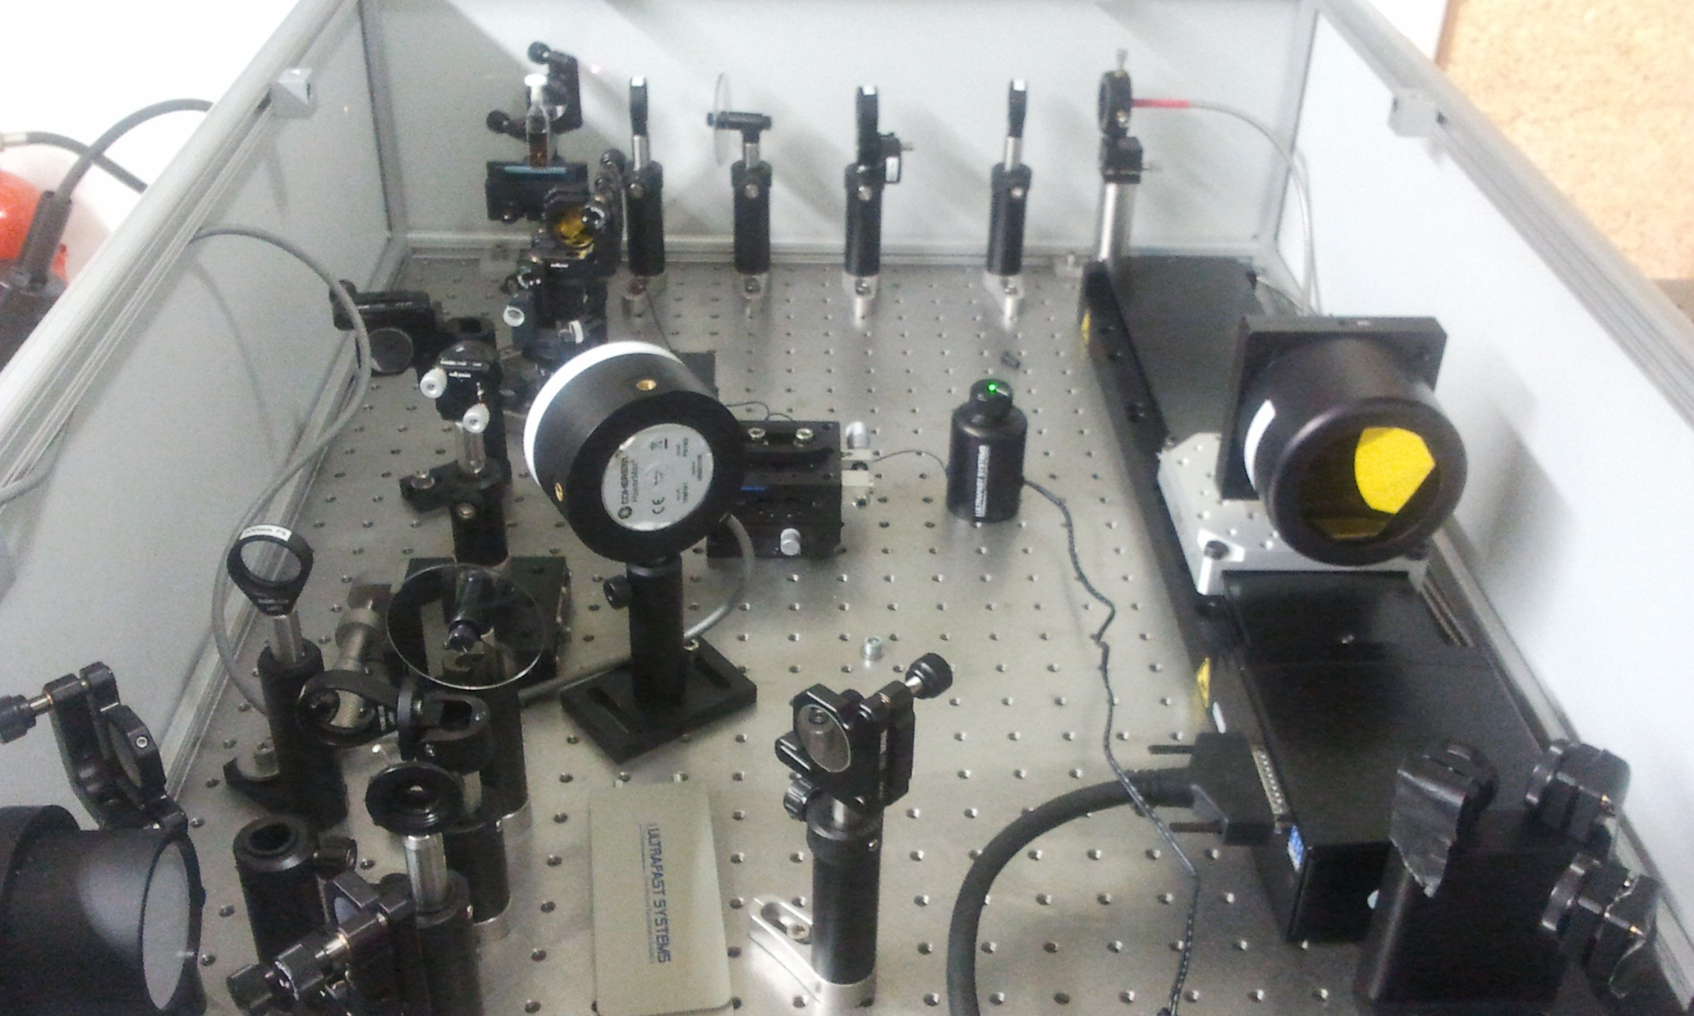
White light
680 nm
1028 nm
White light (up to 1600 nm) is created in sapphire crystal through 1028 nm pumping (fundamental of laser oscillator Nd:KGW).

Slide 5
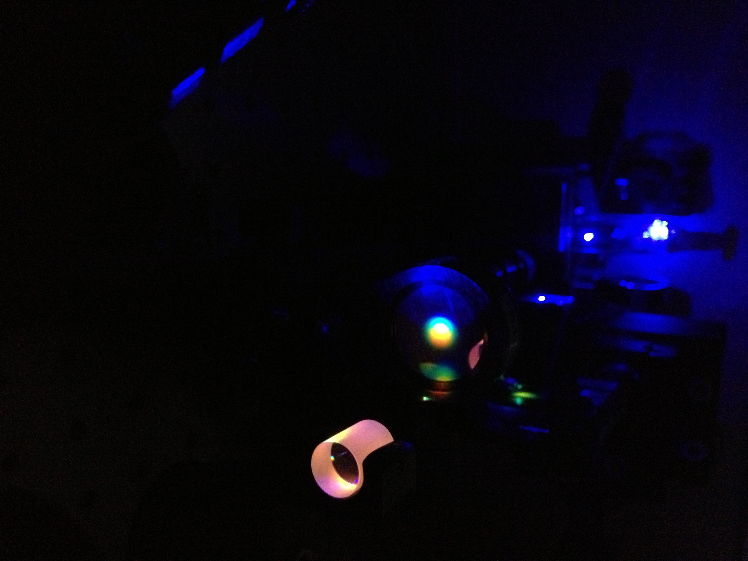
Sample pumped by 450 nm light
White light supercontinuum generated in sapphire crystal
Sapphire crystal

Slide 6
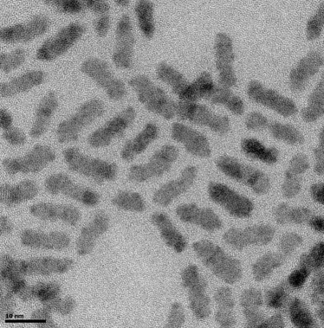
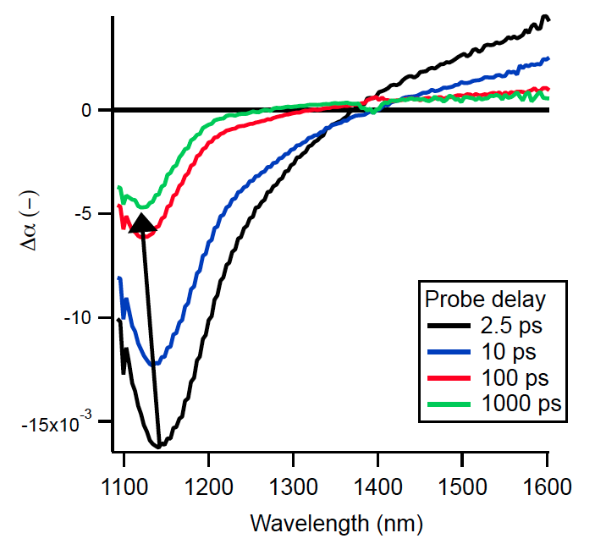
TA measurements
Measurements on NIR emitting PbS nanocrystals
Rods
Characterization of optical gain potential and new optical properties
Dots
Fundamental characterization, used as input for the gain measurements and more basic understanding of ultrafast carrier behavior in PbS
Future ?
New materials & continue fundamental study of PbS

Slide 7
Quantum Rods (PbX/CdX)
Quantum Rods ?
Optical gain performance is not better than PbS spherical nanocrystals !
New phenomenon: quantum confinement due to twin plane formation → publication under consideration
Future ?
Work on new materials (InP,HgTe) to achieve lower threshold transparency → Collaboration with TU Delft will continue

Slide 8
PbS dots
Can we understand the ultrafast carrier behavior in PbS ?
TA spectrum ?
- Bleach: due to carrier population of energy levels (Pauli Exclusion)
- Energy Shift: due to repulsive (attractive) coulomb interactions between excitons
- Photo-induced absorption: due to intraband absorption of carriers
Useful as input for future measurements, even on new materials (such as InP or HgTe, see Ugent contribution)

Slide 9
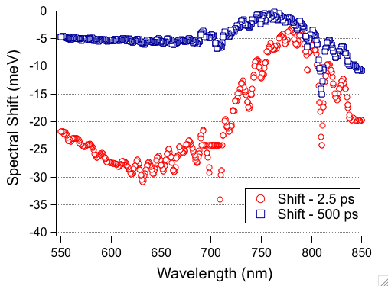
Energy shifts
Presence of exciton shifts energy levels (Stark shift) !
Direct influence on 1S-1S transition BUT not only in the NIR → also in the visible part of the spectrum !
Publication under construction
Extract energy shift from TA signals in the visible part of the spectrum and evaluate Stark shifts on ‘bulk’ states of nanocrystals.
Ultrafast Shifts → modulator ?

Slide 10
Fabrication electrically pumped qdot amplifier on silicon chips

Slide 11
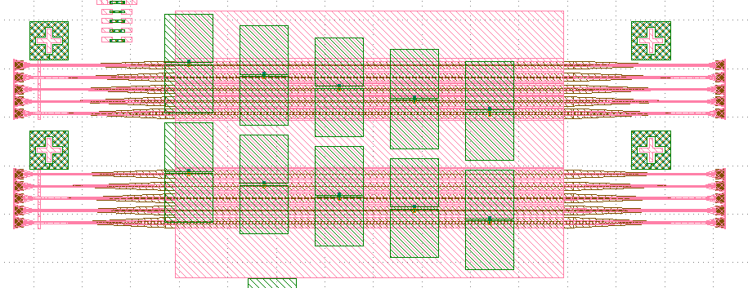
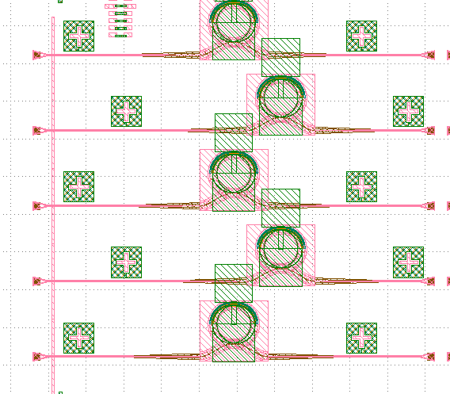
Integration of NC – LED on silicon
Straight wg (variation in width and length)
Wafers have arrived (24/04)
4 Processing Steps:
Anode definition (high T)
Oxide (ALD)/Nanocrystal/Oxide
Insulator (SiOx) deposition and opening
Cathode (Au)
Contact mask already available
Bulk device characterization in parallel
Rings (variation in width and radius)

Slide 12
Integration of NC – LED on silicon
Straight wg
Wafers have arrived (24/04)
4 Processing Steps:
Anode definition (high T)
Oxide (ALD)/Nanocrystal/Oxide
Insulator (SiOx) deposition and opening
Cathode (Au)
Contact mask already available
Bulk device characterization in parallel
To be checked
Rings
Critical

Slide 13
Device integration – Cross section
3
2
4
1
Access metallization (Top Contact)
Isolator
Ground contact
Rs
Rc
How will this structure behave under high voltage AC fields ?

Slide 14
Integration of NC on silicon
Pumping optically !
Study of coupling of NC-emission with optical modes in straight waveguides and ring resonators → premise for electrical pumping
Pumping electrically !
New AC source (Falco Systems) acquired: up to 100 kHz , 70Vpp → demonstrated on bulk devices, behaviour on microscale ?
Intrinsically pulsed signal, could be useful for modulator ?

Slide 15
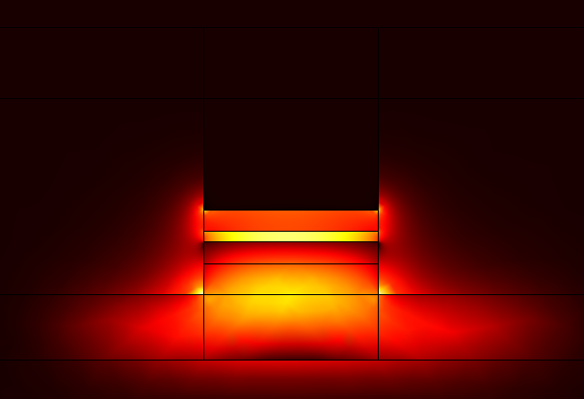
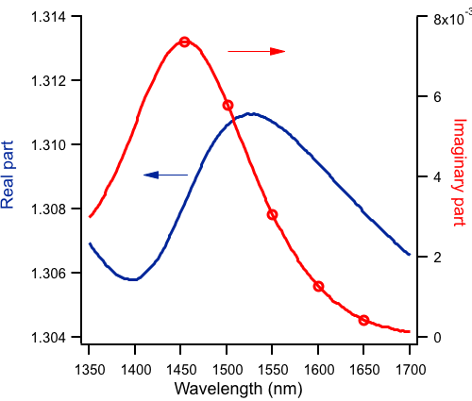
Simulations on integrated structure
COMSOL model with input from passive measurements !
Typical propagation lengths @ emission wavelength = 300 micron !

Slide 16
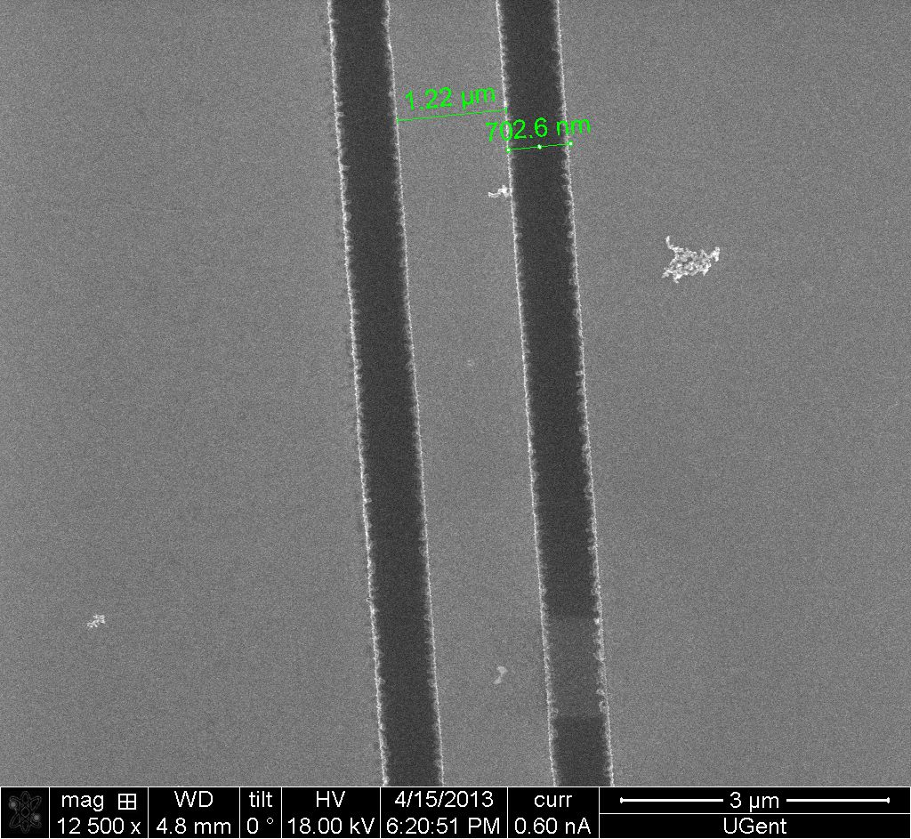
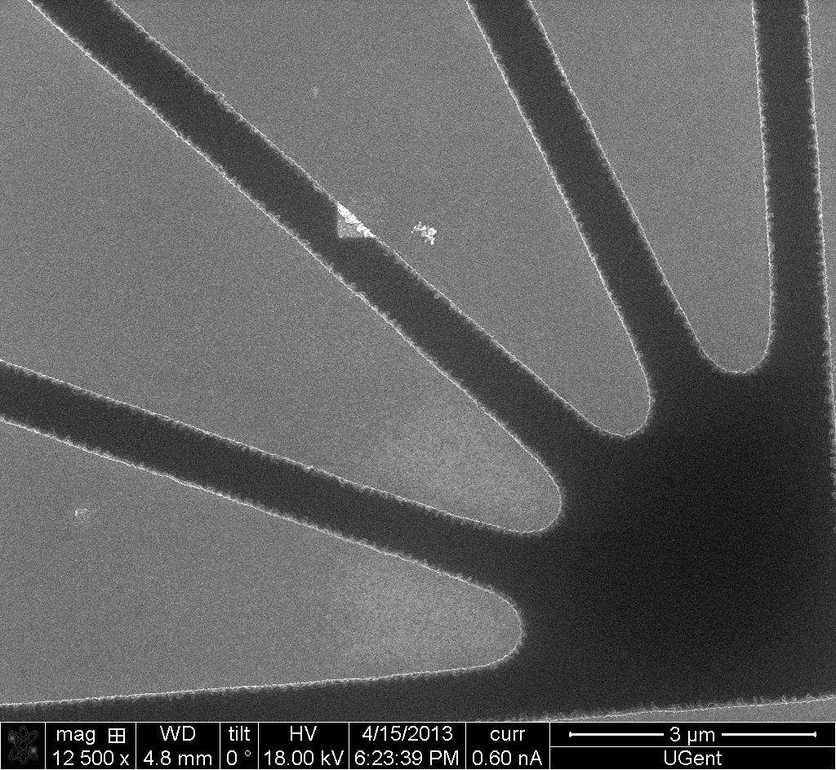
Colloidal quantum dots (CQDs) patterning
Since the position of QDs in the cavity is critically important for coupling between QDs and cavity optical mode, the local patterning of QDs is highly desired. We use lithography and Langmuir–Blodgett (LB) technique. The lithography is used to define the pattern, and LB for single CQDs film deposition. We have developed optical photoresist process which can define at least 0.8μm wide waveguide and 0.8μm wide trench. The lift-off process is also optimized to achieve a perfect pattern of QDs.
After LB deposition

Slide 17
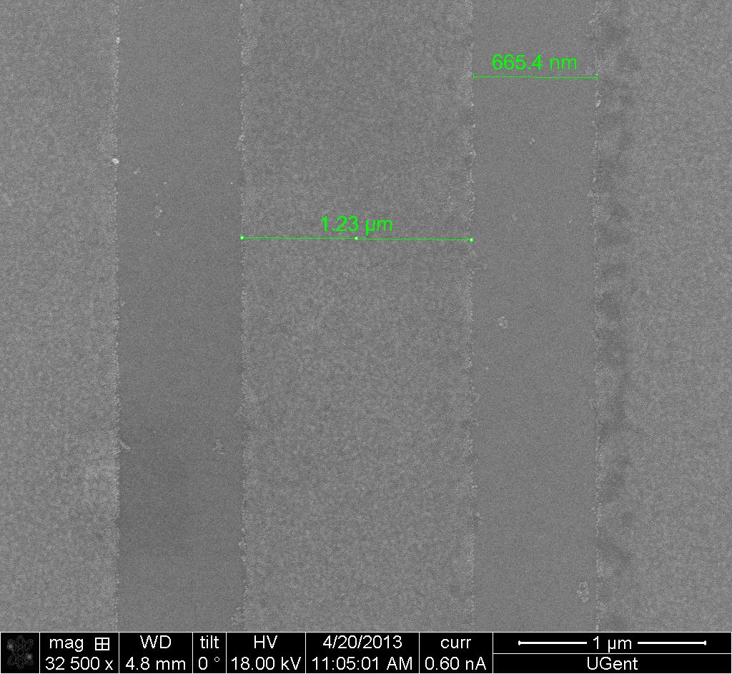
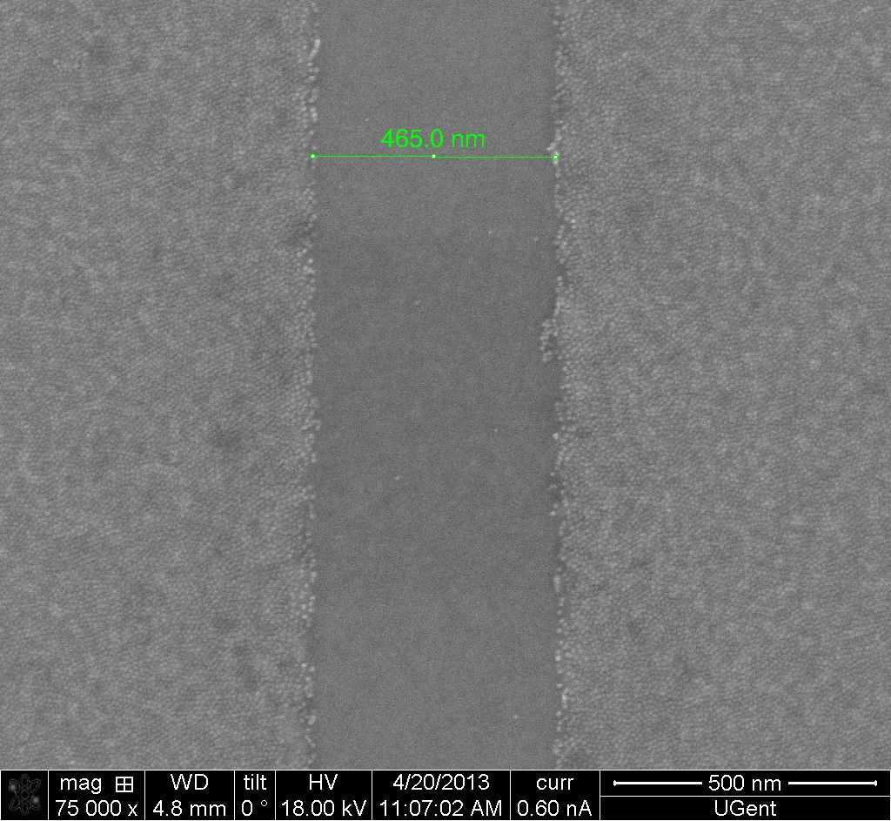
After lift-off of resist
This method is versatile for patterning CQDs. For even smaller pattern, the e-beam lithography can be used.

Slide 18
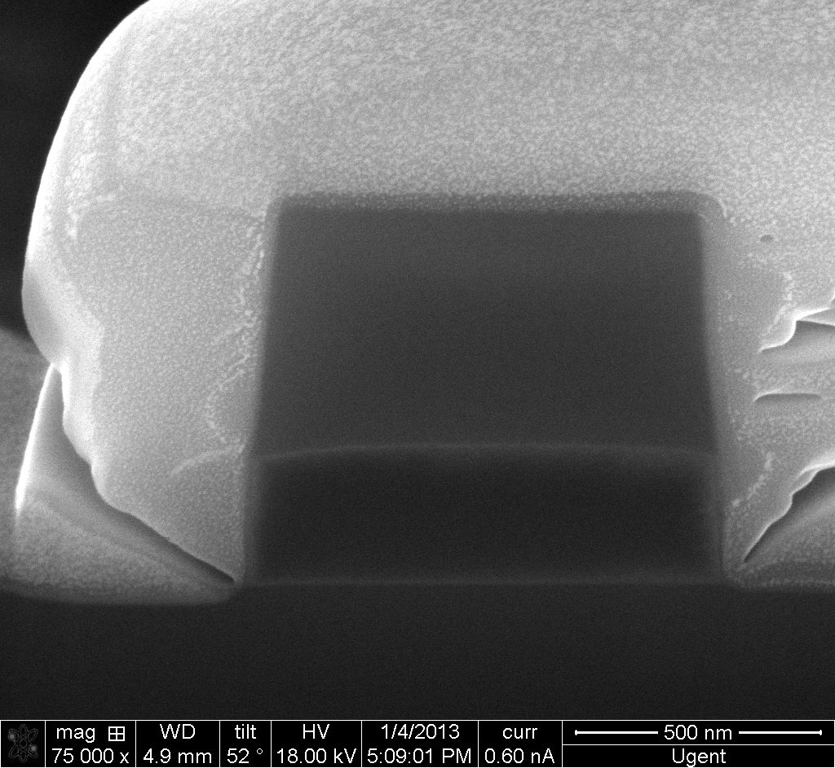
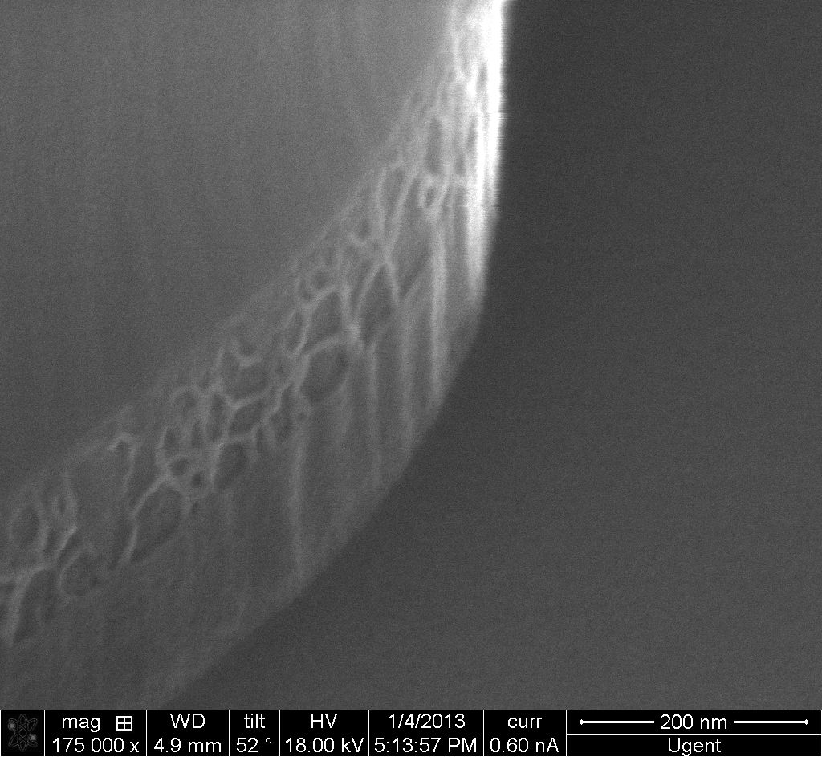
Etching of SiNx
An anisotropic dry etching for SiNx has been developed to etch PECVD SiNx with definite feature size and steep and smooth sidewalls. The SiNx can be deposited at high (270°) or low temperature(120°). This process works well for either single or two layers of SiNx deposited at different temperature.
FIB cross section of 1.0μm wide and 300nm thick SiNx waveguide with resist
Sidewall surface (two layers of SiNx)

Slide 19
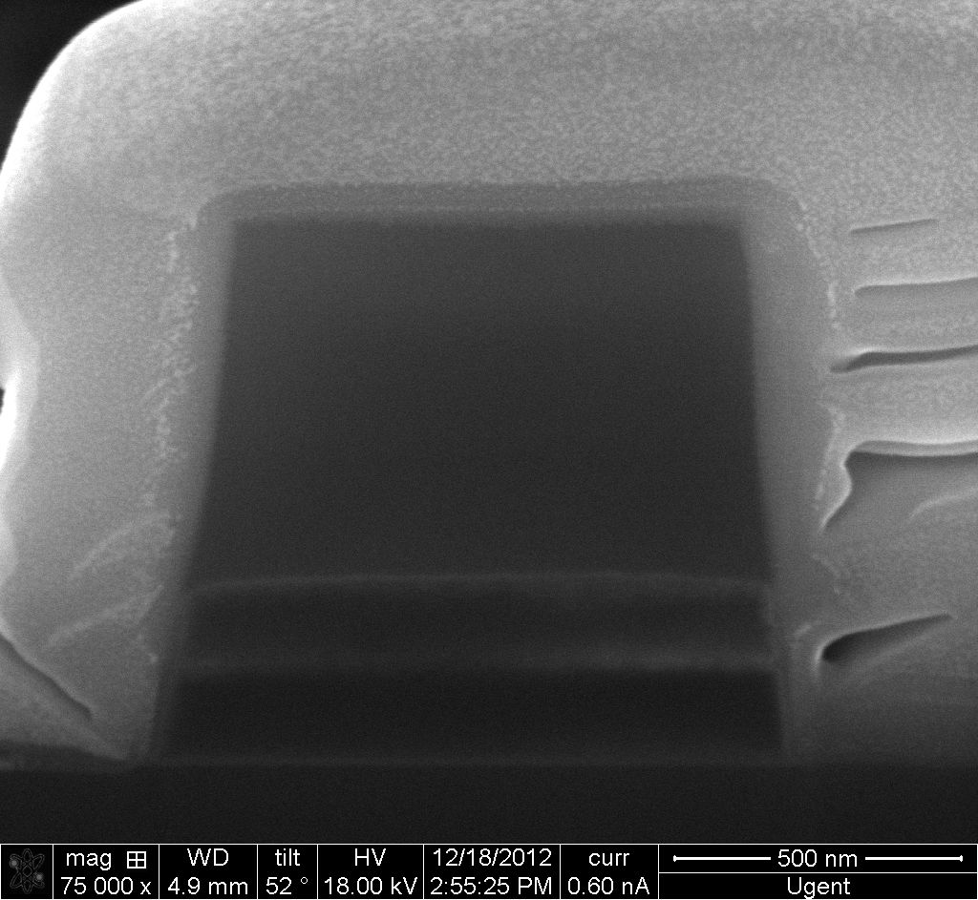
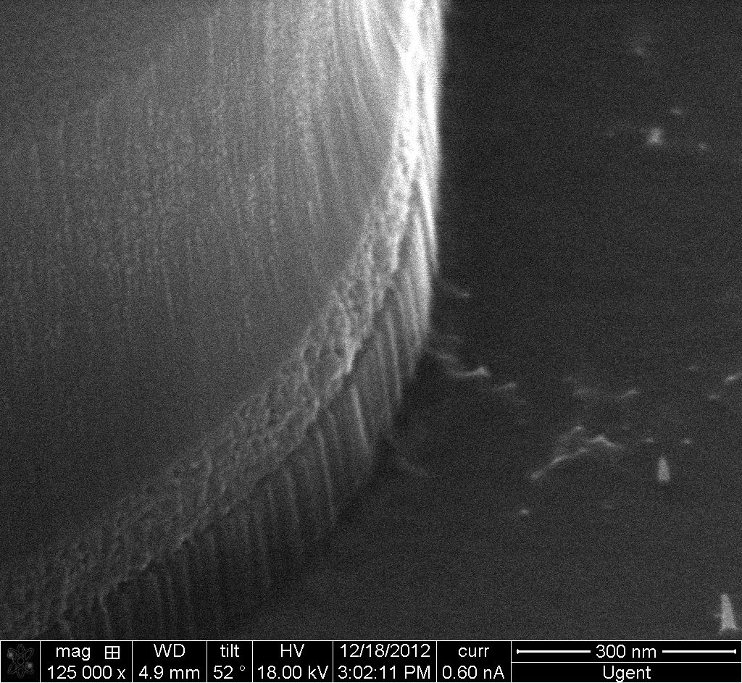
We also demonstrated that it’s possible to etch such structure like SiNx-QDs-SiNx sandwich structure.
FIB cross section of SiNx-QDs-SiNx layers
Sidewall surface (two types of SiNx)

Slide 20
2. Measurement of emission of QDs coupled to SOI cavity (still ongoing…)
Setup for measurement
Deposit core/shell QDs emitting around 1550nm on the top of cavity center
Optical pump QDs with visible laser out coupled by fiber
Collect PL emission from one side of on-chip grating
Pump with visible laser
PL collection by monochrometer or OSA

Slide 21
Optical coupling, chip to chip

Slide 22
State-of-the-art

Slide 23
Alignment tolerance

Slide 24
Option 1: no focusing optics
Receiving Beam Waist [um]
Distance between chips [um]
Coupling distance = gaussion beam waist
Mismatch loss = 20%

Slide 25
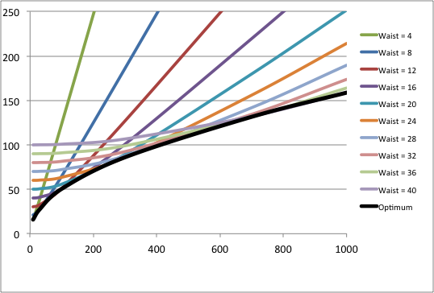
Option 1: no focusing optics
Take into account 2.5 x beam waist to avoid crosstalk
Minimum channel pitch
Distance between chips [um]

Slide 26
Option 2: focusing optics
Minimum channel pitch
Distance between chips [um]
Distance that can be reached is doubled (for given pitch)
Losses decrease (20% improvement)
Alignment tolerance decreases

Slide 27
Navolchi motivation
Considere optical interconnect on board

Slide 28
Power consumption
Electrical power consumption
Optical power consumption

Slide 29
NAVOLCHI vs. current silicon photonics
Escape bandwidth: no difference
Real estate: NAVOLCHI wins
Power consumption: ??? (NAVOLCHI loses ?)

Slide 30
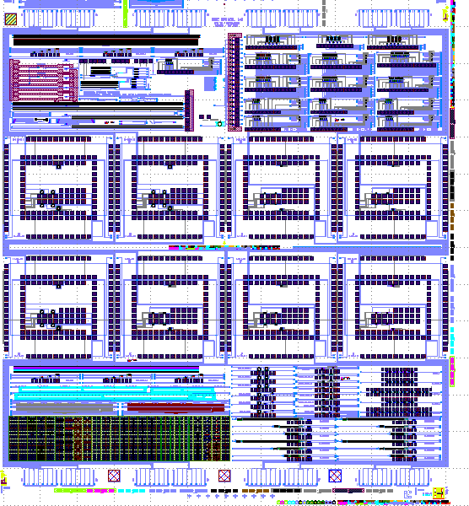
Back up detectors
Some samples delivered today, for initial tests

