Slide 1

NAVOLCHI - Nano Scale Disruptive Silicon-Plasmonic Platform for Chip-to-Chip Interconnection

Slide 2
AGENDA

Slide 3
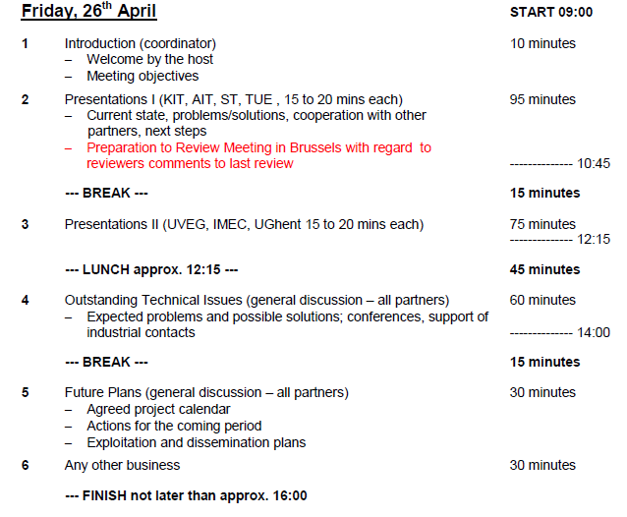
Agenda

Slide 4
Status of Work:
Partner Presentations
Notes:
Partner presentations (10min each)
Institute / company (short)
Contribution to the project, own work effort and timeline (focus)

Slide 5
Time Scale
No problems expected

Slide 6
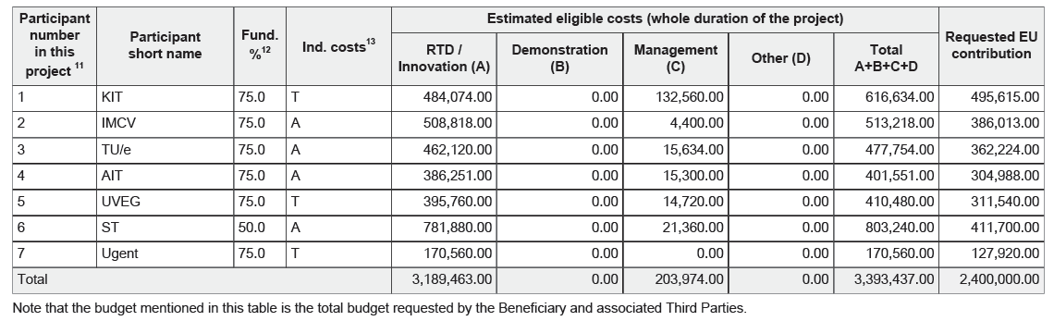
Resources: Budget and Pre-financing
A: Actual Costs; T: Transitional Flat Rate
1. Tranche: |  | 1 400 000 € | 58%
 | Total Sum | 58% | 1 Tranche
KIT | 495 615 € | 289 109 € | 290 000 €
IMCV | 386 013 € | 225 174 € | 225 000 €
TU/e | 362 224 € | 211 297 € | 210 000 €
AIT | 304 988 € | 177 910 € | 180 000 €
UVEG | 311 540 € | 181 732 € | 180 000 €
ST | 411 700 € | 240 158 € | 240 000 €
Ugent | 127 920 € | 74 620 € | 75 000 €
 | 2 400 000 € | 1 400 000 € | 1 400 000 €
First payment done
at project start
Next payment after
first report period (M18)

Slide 7
Preparation to Brussels
Important topics to prepare:
18 month periodic report
Brussels presentation
  Work progress
  Reaction on reviewers recommendations
Separate documents with reactions on reviewers comments

Slide 8
18 months periodic report
What Coordinator needs from you:
Work package summary
WP objectives
WP progress, status and future work
Finances table
Man power table
→ Within next 3 weeks!

Slide 9
18 months periodic report
Please refer to
Project reference manual on web site
Template for periodic report on web site
Last 9 month intermediate report on web site

Slide 10
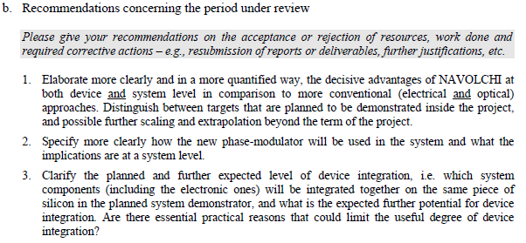
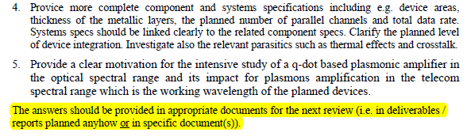
Reviewers Comments: Responsibilities
Recommendations concerning the period under review
AIT
AIT/KIT
AIT/ST
AIT
IMEC/UVEG

Slide 11
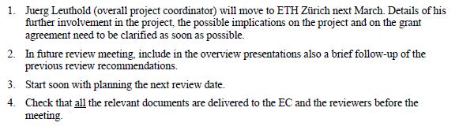

Reviewers Comments: Responsibilities
Recommendations concerning future work
J. L.
KIT
KIT

Slide 12
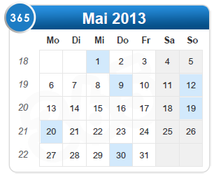
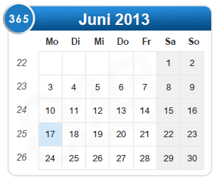
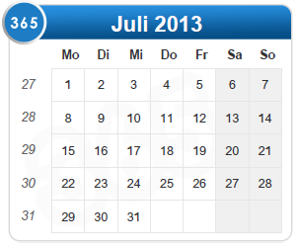
Brussels preparation
Next (additional) phone conferences:
May 13th
May 27th
June 10rd
July 1st
(& meeting?)

Slide 13
  If appropriate: Discussion
  Deliverables & Milestones

Slide 14
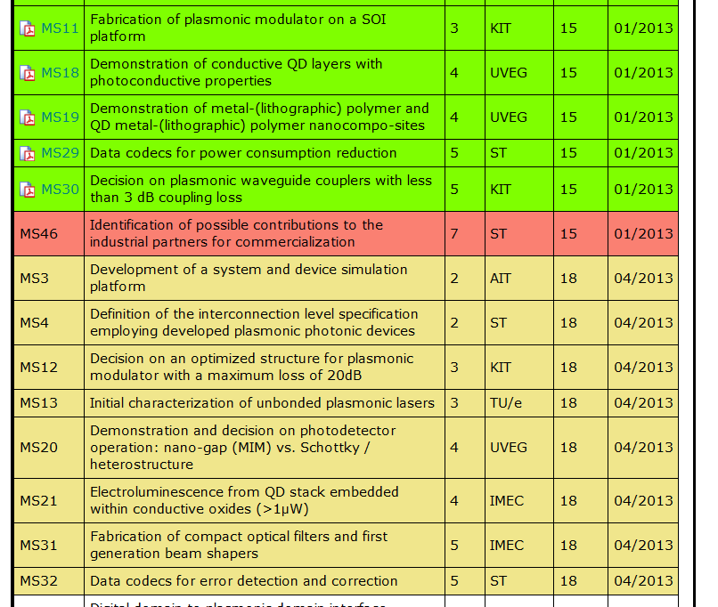
January and April Milestones

Slide 15
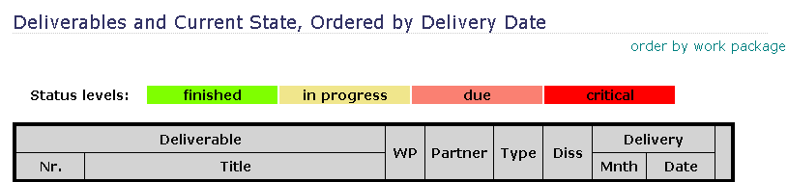
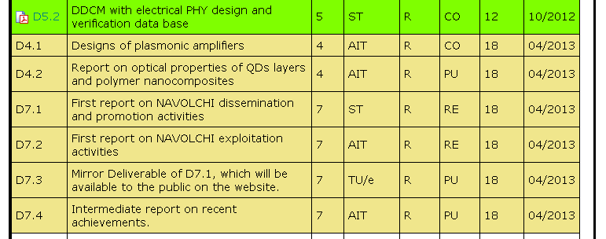
April Deliverables

Slide 16
  Open Issues
  Next Tel. Conf.

Slide 17
Open Issues
Any important things to discuss?

Slide 18
Next Phone Conference
First Monday of the next month,
4:00 pm (CET)
May 6th, 2013
Shifted to May 13th, 2013
due to previous meeting in Karlsruhe

Slide 19
  Bye!

