Slide 1

Progress meeting
Karlsruhe
Victor Calzadilla, Dominik Heiss
Andrea Fiore, Meint Smit
26-04-2012

Slide 2

Contents
Tasks
Milestones and deliverables
Current status
  Optical simulations
  Electrical simulations
  Thermal simulations
  Fabrication progress
Dissemination activities
Technical issues
1st review – Comments with respect to TU/e

Slide 3
Tasks
 | Names of the tasks | Time period [months]
Task 3.1 | Modelling of device structure (plasmonic laser) and optimization of bonding technology | 1 – 6
Task 3.3 | Fabrication of nano plasmonic laser | 7 – 30

Slide 4
Milestones and deliverables
 | Names of the milestones | Month
MS8 | Decision on an optimized structure for metallic/plasmonic nanolaser and its coupling to a Si-waveguide | 6
MS10 | Grown wafer structure for plasmonic lasers | 12
MS13 | Initial characterization of unbonded plasmonic lasers | 18
MS15 | Initial testing of bonded plasmonic lasers | 24
 | Names of the deliverables | Month
D3.1 | Report on studies of optimized structure for metallic/plasmonic nanolaser and its coupling to Si-waveguide | 12
D3.3 | Fabrication of plasmonic laser device | 24

Slide 5
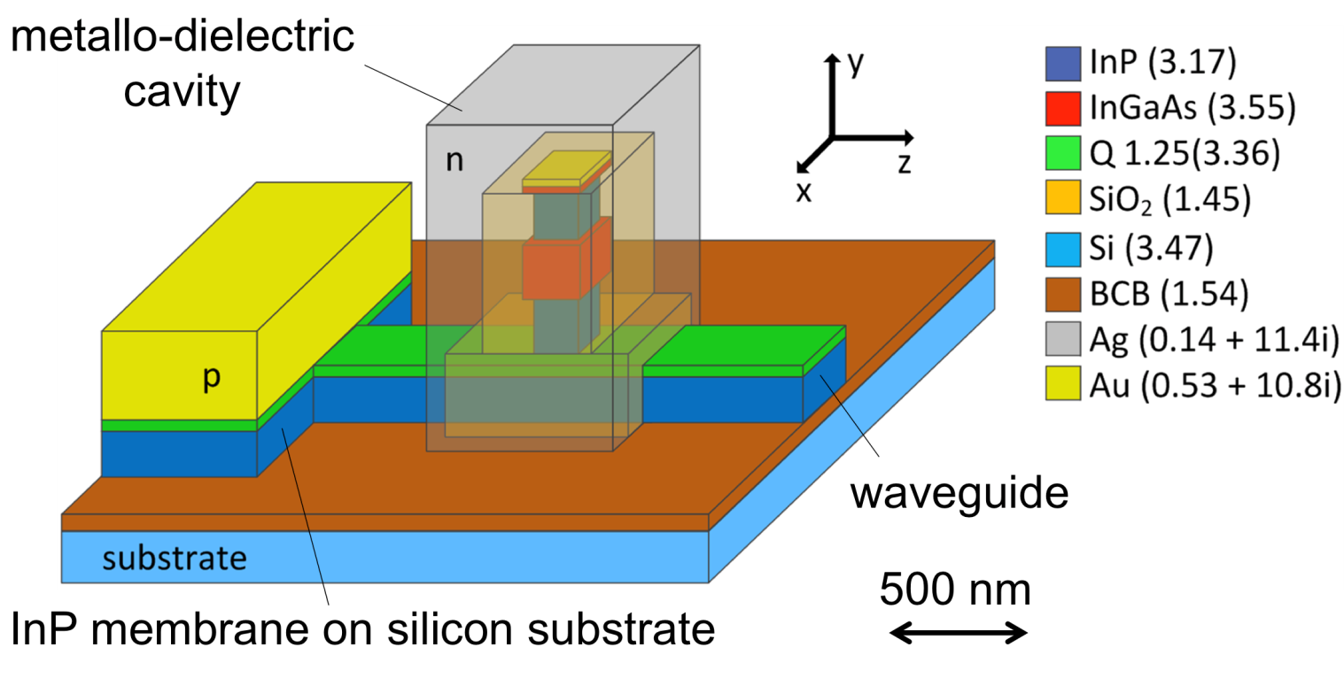
Laser structure
First III-V wafer sent to UGhent for bonding
Laser dimensions: 300nm x 400nm x 1µm

Slide 6
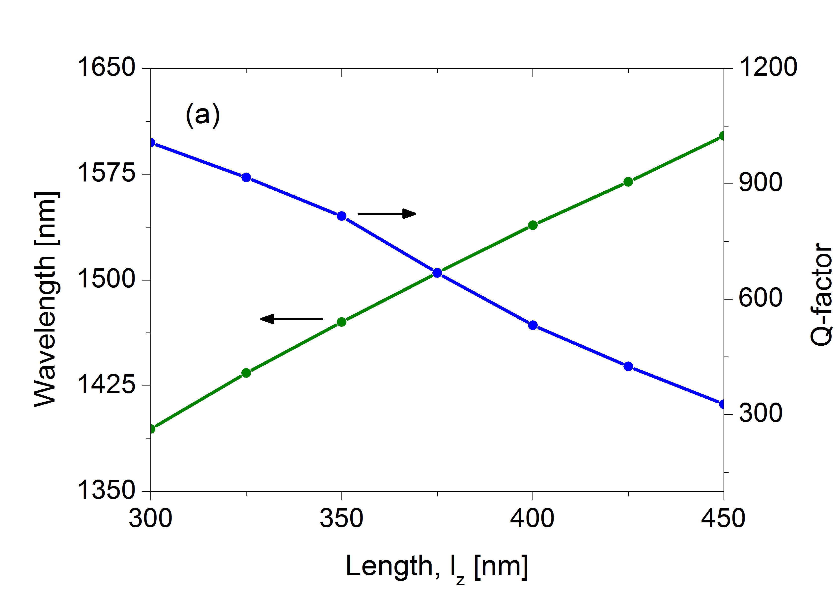
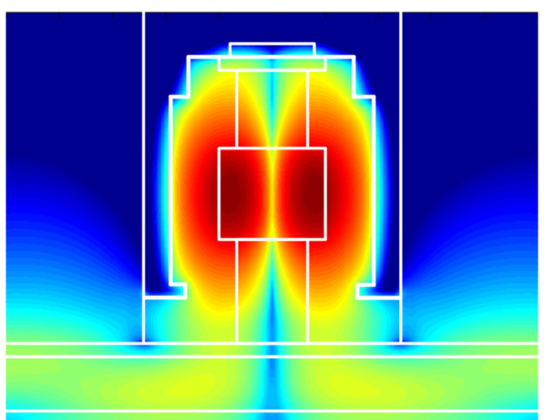
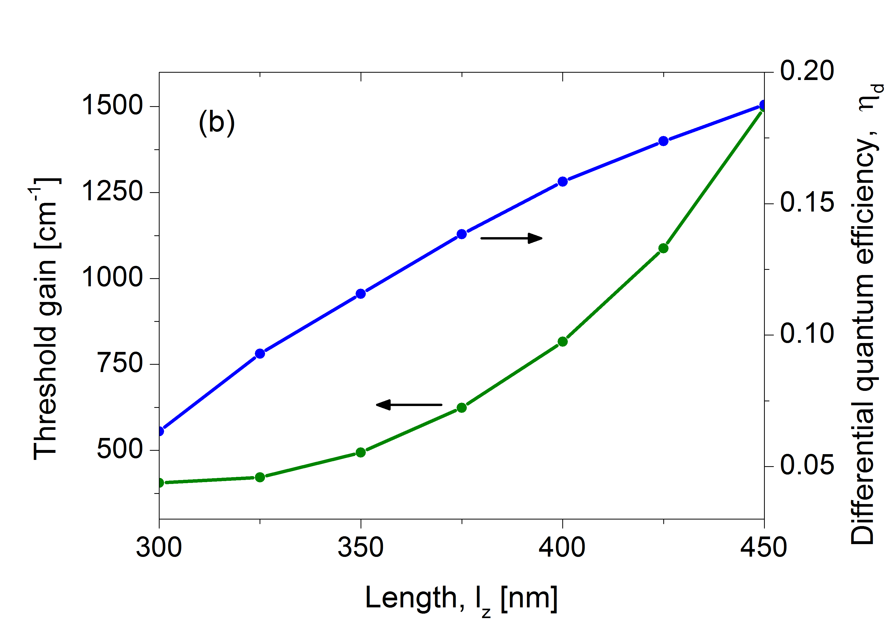
Optical simulations
xy
|E|², TE mode
log(|E|²)
Threshold gain ~ 800 cm⁻¹
Differential efficiency ~ 0.16

Slide 7
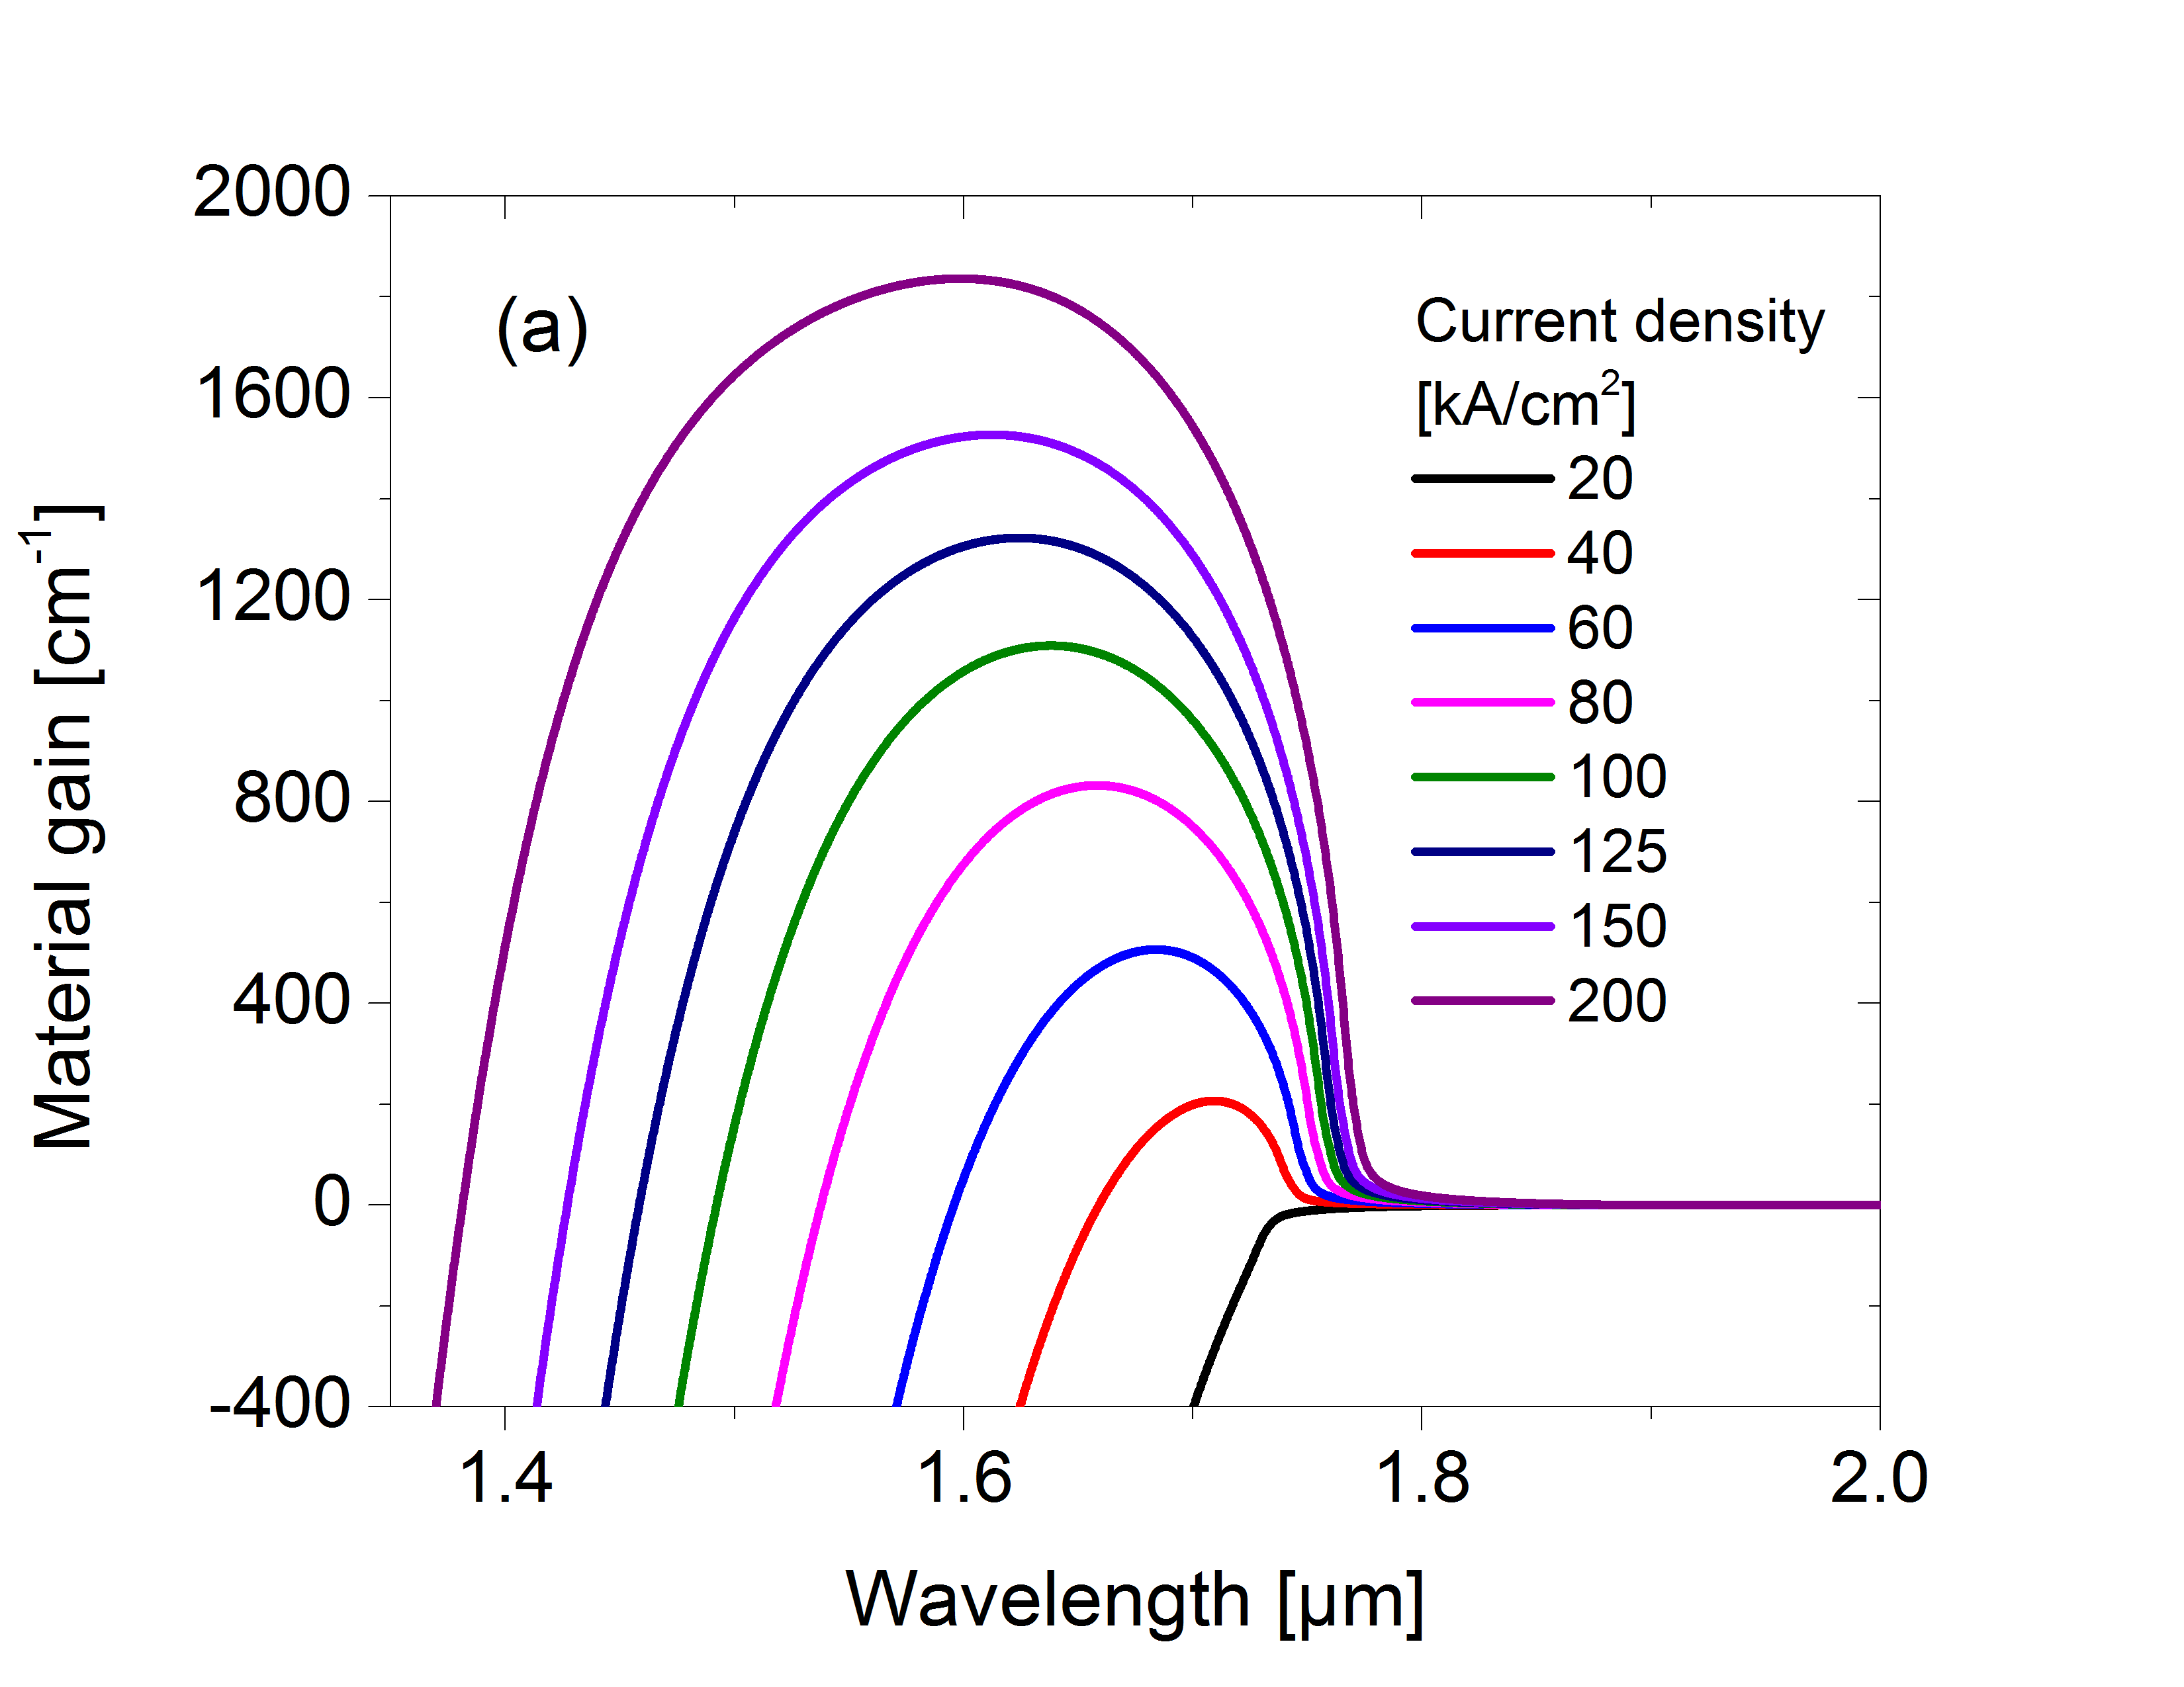
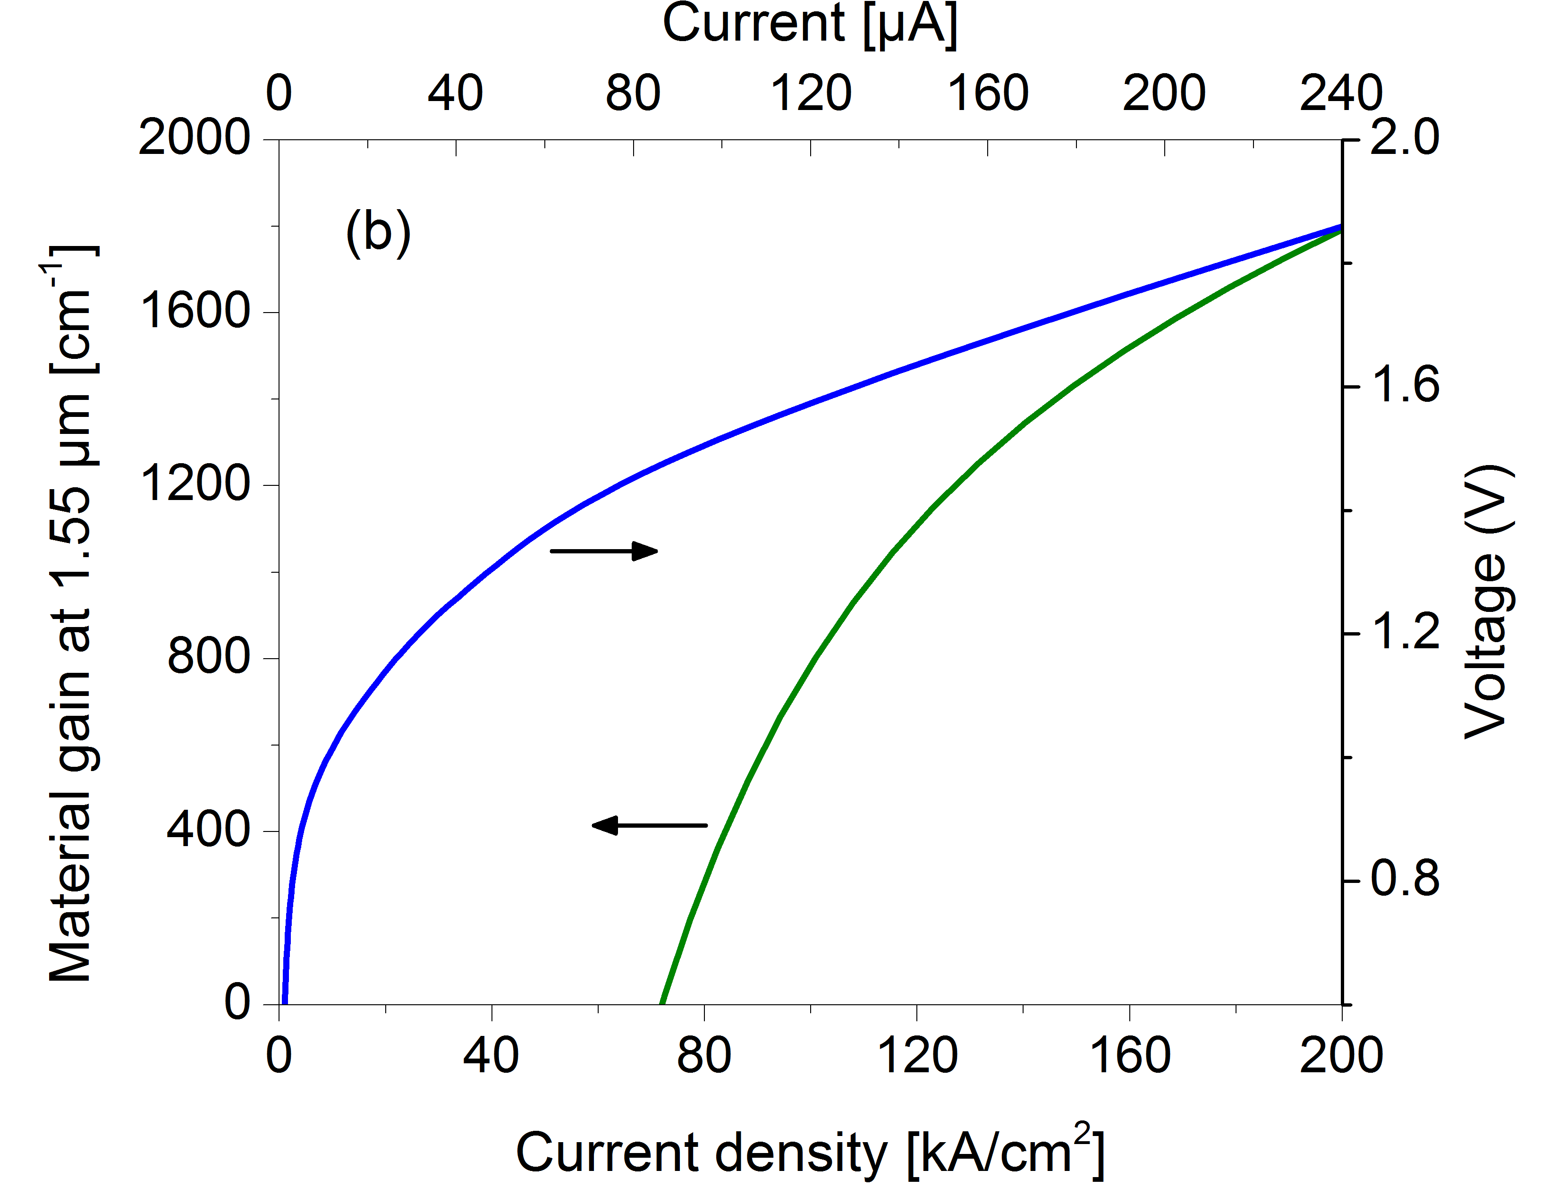
Electrical simulations
Current density ~ 100kA/cm²
Threshold current (cavity: 300x400 µm²) ~ 120 µA

Slide 8
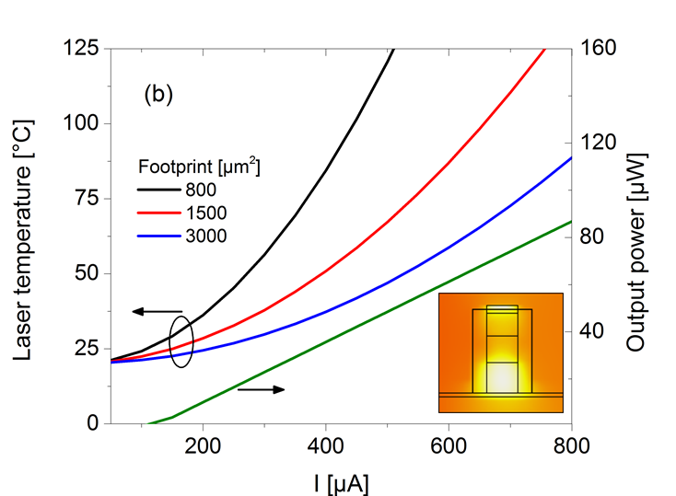
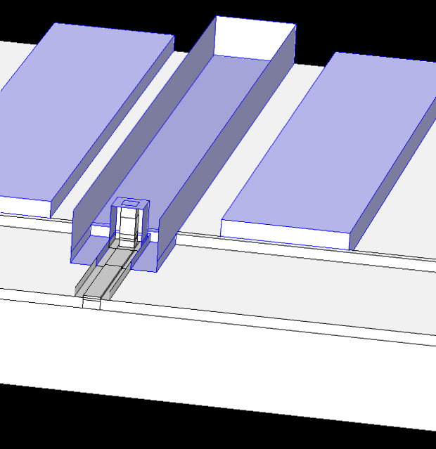
Thermal simulations
Device cooling from top
Output power: 50 µW @ 0.5 mA
If no self-heating!

Slide 9
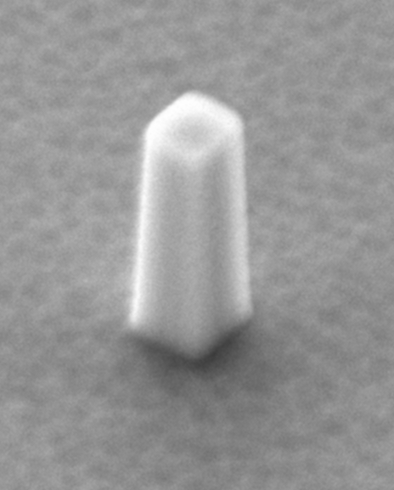
Fabrication
Nanopillars
HSQ
HPR photoresist
SiOx
InP-substrate
EBL + development
Polymer RIE
Nitride RIE
ICP-RIE
200 nm
No sidewall roughness
High verticality is possible

Slide 10
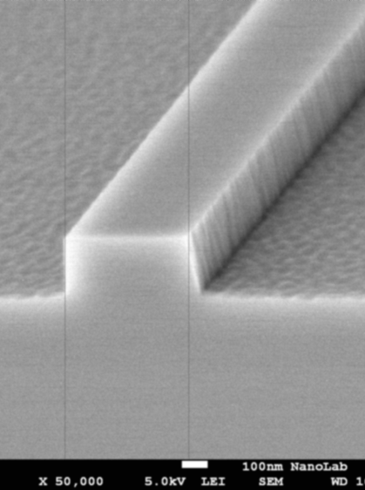
Fabrication
Waveguides
HSQ
InP-substrate
EBL + development
ICP-RIE
No planarization needed
No critical roughness

Slide 11
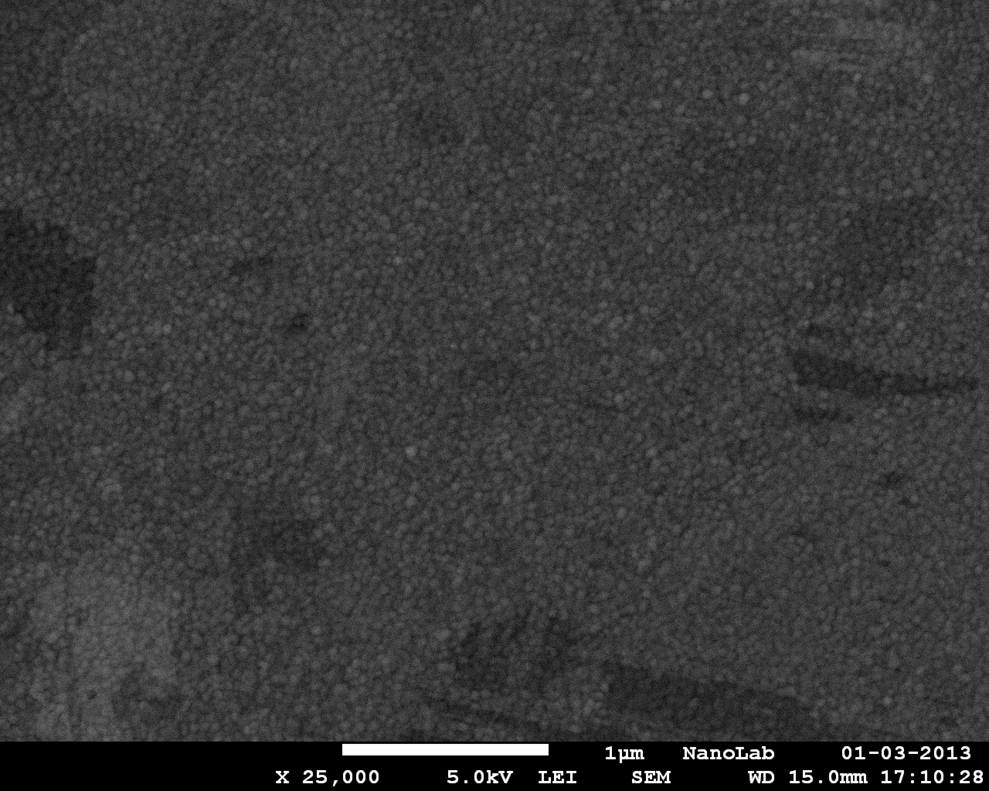
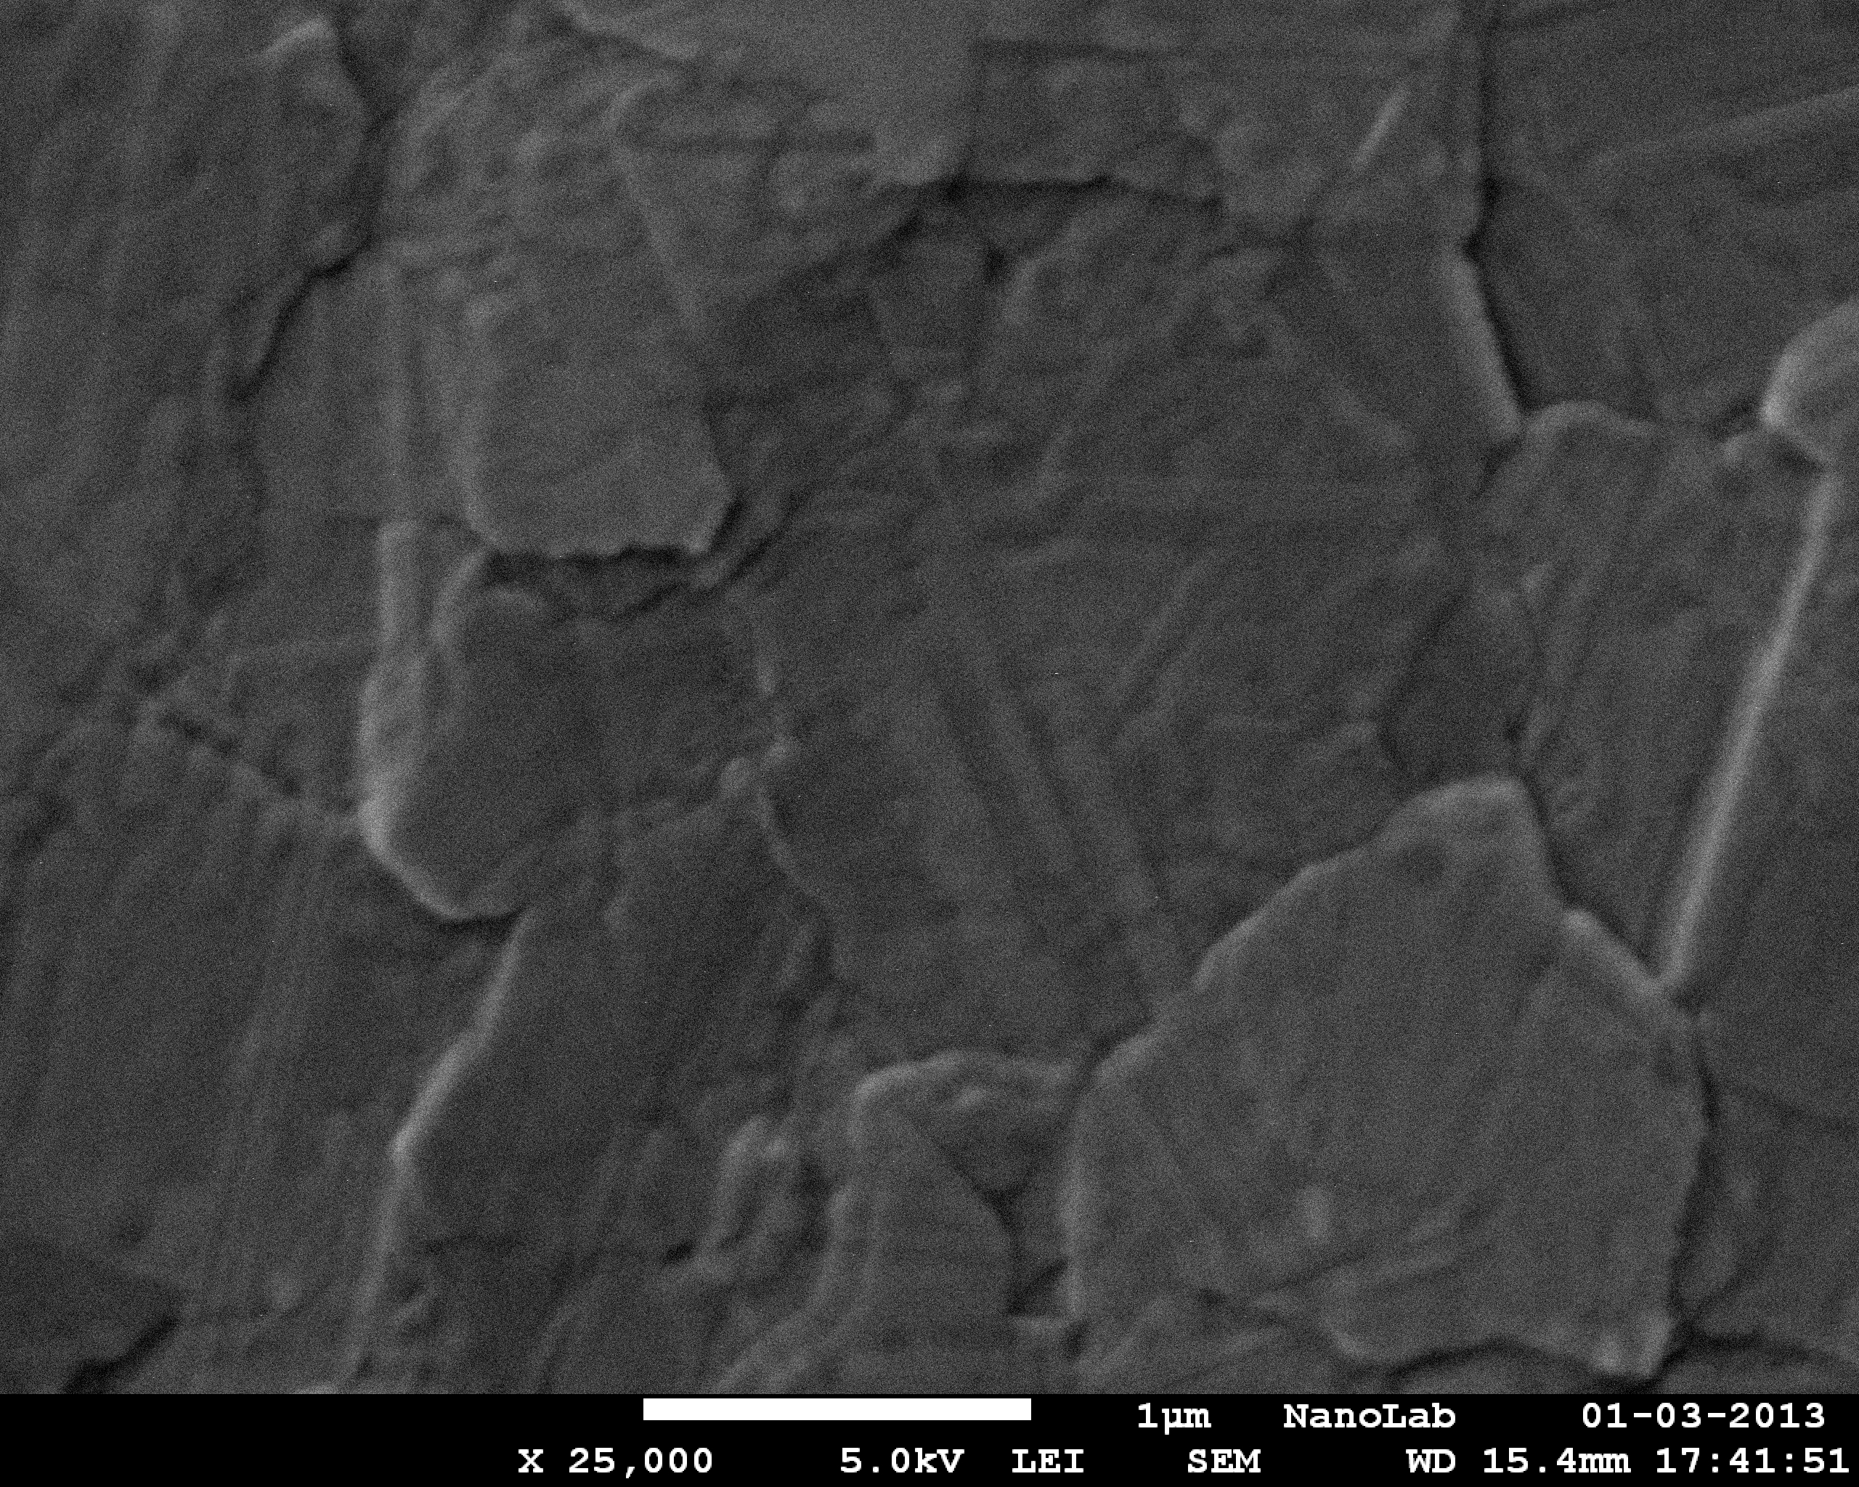
Silver annealing (RTA)
Just after deposition
Grains: ~30 nm
After 400 C, 1 min
Grains > 1µm
→ Reduced loss

Slide 12
Next fabrication activities
Immediate: Overlay EBL exposure (pillar on waveguide)
Others:
  Realization of undercuts
  Thin films deposition
  Deposition of ohmic contact layers
  Silver cladding deposition
  Optical lithography steps (adhesion pads, p-contact, device separation)

Slide 13
Dissemination activities
Conference talks at:
  ICTON 2013
  IPR 2013 (Integrated Photonics Research, Silicon and Nano-Photonics)
  OECC/PS 2013 (OptoElectronics and Communications Conference/Photonics in Switching)

Slide 14
Technical issues
Lasers will be processed after bonding
  MS13 (Month 18): Characterization of unbonded plasmonic lasers
  MS15 (Month 24): Testing of bonded plasmonic lasers
Output power levels
  NAVOLCHI: 100 µW
  Current design (ideally): 50 µW @ 0.5 mA
We will merge them: MS-Characterization and testing of first run of metal-cavity lasers (Date: February 2013?)
→ Practically: compromise between output power and footprint (lasers pitch)

Slide 15
1s review – Comments with respect TUe
Specify thickness of metal: < 1 µm
Device area: ~30x50 µm²
  Compromise with output power
Investigate relevant parasitics (thermal): done

