Slide 1
Coordinator Presentation
“Project NAVOLCHI”
Jürg Leuthold
Karlsruhe Institute of Technology (KIT), Germany

Slide 2
Attendees
ETH | Juerg Leuthold
KIT | Manfred Kohl
AIT | Emmanouil-Panagiotis Fitrakis
TU/e | Meint Smit & Victor Calzadilla
UVEG | Juan Martinez Pastor .
IMEC | Dries Van Thourhout
Ugent | Hens Zeger
ST | Alberto Scandurra
AIT | Emmanouil-Panagiotis Fitrakis

Slide 3
Review Meeting Agenda
9:15 Coordinators Talk
9:40 Review of Project Administration (WP1)
9:50 Presentations of Work Packages (WP2)
10:15 Break
10:30 Presentations of Work Packages (WP3-WP5)
12:00 Lunch
12:45 Presentations of Work Packages (WP6, WP7)
13:45 Break
14:00 General Discussion
14:30 Discussion between EC Officer and Reviewers
15:30 Feedback to Consortium
16:00 End of Meeting

Slide 4
Outline Coordinator Talk
Project Overview.
  Vision.
  Partners.
  Structure.
Reviewers Recommendations from Review 1.
Status of Work: The Project after 1½ Years, WP Summaries.
Outlook.

Slide 5
Project Overview
Vision:
Very high speed (~ Tbit/s) chip to chip interconnects with
- smallest footprint
- cross talk noise immunity
- low power consumption
for future generation high speed computing.
MHz → GHz → THz
NAVOLCHI approach:
Plasmonics
Plasmonics
Electronics Photonics Electronics

Slide 6
Project Overview
ICT-2011.3.5: Core and Disruptive Photonic Technologies
Focus:
Impact:
Improving Europe’s position in systems communication technologies, in particular SiP.
Environment: Decrease CO₂-emission while electronic data processing increases.
Employment: Strengthening of SMEs for international competition.
ICT-2011.3.1: Very advanced nanoelectronic
components: design, engineering, technology and manufacturability (!)

Slide 7



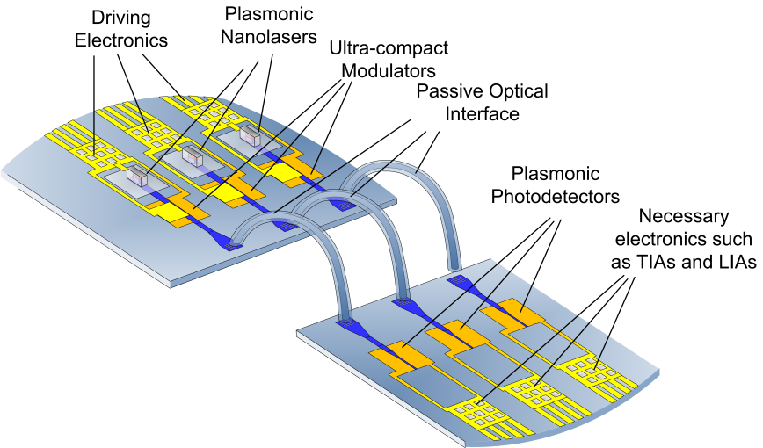





Partners Contributions
Specifications,
dissemination
Management
Optical amplifier

Slide 8
Project Overview
NAVOLCHI Technical Core (Challenges):
  Transmitter
  → Laser
  → Modulator
  Receiver
  → Plasmonic Amplifier
  → Photodetector
  Passive Components
  Integration

Slide 9
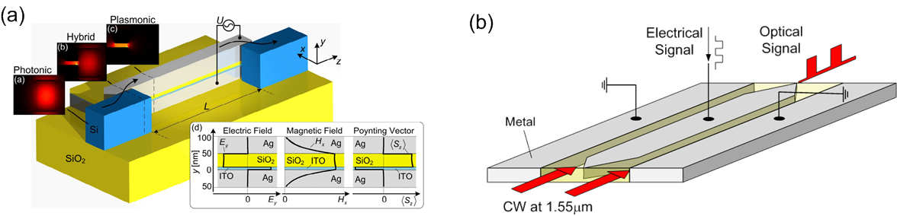
Project Overview: Objectives
Objective 1: Development of Transmitter.
a) Plasmonic Laser
- extinction ratio < 3 dB
- size < 10 µm
b) Plasmonic Modulator:
Absorption (a) / Phase (b)

Slide 10
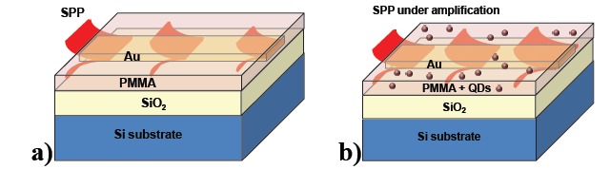
Project Overview: Objectives
Objective 2: Development of Receiver.
a) Plasmonic Amplifier
- colloidal QDs
- gain 10 dB
b) Fast Plasmonic Photodetector
- quantum efficiency > 80%
- responsitivities > 0.1 A/W
without amplif.
with amplif.

Slide 11
Project Overview: Objectives
Objective 3: Passive Components.
a) Waveguide Couplers
- size 50 – 100 nm
- efficiency >30%
b) Beam Shaping Couplers
- chip distance 1 mm
- bandwidth > 10 nm
- efficiency > 3 dB
c) Optical Filters
- bandwidth 3 nm
- suppression 10 dB
- spectral range 30 nm

Slide 12




Project Overview: Objectives
Objective 4: Benchmarking of plasmonic interconnect technology against other reference technologies.
Typical: 3-12 Gbit/s, 15pJ/Bit, 50 ns
(Formerly: ‚Light Peak‘ by Intel + Apple)
WP 6: +
(‚BLAZER‘ by Luxtera)

Slide 13









Partners
 | Karlsruhe Institute of Technology, Germany | KIT | Management, modulator, coupler
 | Interuniversity Microelectronics Centre VZW-IMEC, Belgium | IMEC | Interfaces
 | Eindhoven University of Technology, Netherlands | TU/e | Plasmonic nano laser
 | Research and education laboratory in information technologies, Greece | AIT | Specifications, integration, dissemination
 | University of Valencia, Institute of Materials Science, Spain | UVEG | Plasmonic amplifier, photo detector
 | ST-Microelectronics, Italy | ST | Electronics, integration, characterization
 | Ghent University, Belgium | Ugent | Optical amplifiers based on colloidal QDs

Slide 14
Structure: Interrelation of WPs

Slide 15
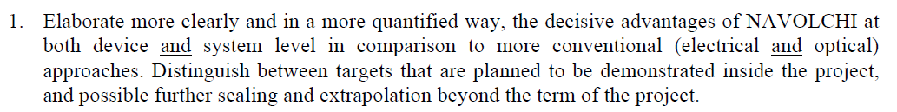
Review 1 Recommendations
Example: Plasmonic Modulator and Competing Technologies
Parameter | H. C. Nguyen et al., Opt. Express, 2013 | T. Baba, et al. Opt. Express 21, 2013 | Our modulator I - generation 200nm – slot (submitted) | Our modulator II - generation 140nm – slot (new result)
Principle | Photonic Crystal | Ring Resonator | Metallic slot | Metallic slot
Phase-Modulation | Possible | No | Yes | Yes
VpL [Vmm] | Not known | 280 Vmm | 3.1Vmm | 1.3Vmm
f3dB [GHz] | Not known but 40 Gbit/s shown | 40GHz | at least 45GHz | at least 65GHz
Pre-emphasis sig. | No | yes | no | no
Operation range Dl | 12nm | < 1nm | 80 nm | 120 nm
Size [ L x w ] | 90 x 6mm² | 15 x 6mm² | 34 x 1mm² | < 29 x 1mm²
V [Vpp] | 5.3Vpp | 2Vpp | 7.5Vpp | 4.75 Vpp
Insertion Loss [dB] | 6.2dB | 5.2dB modulation losses + device losses 7 to 20 dB! | 13dB | 14dB

Slide 16
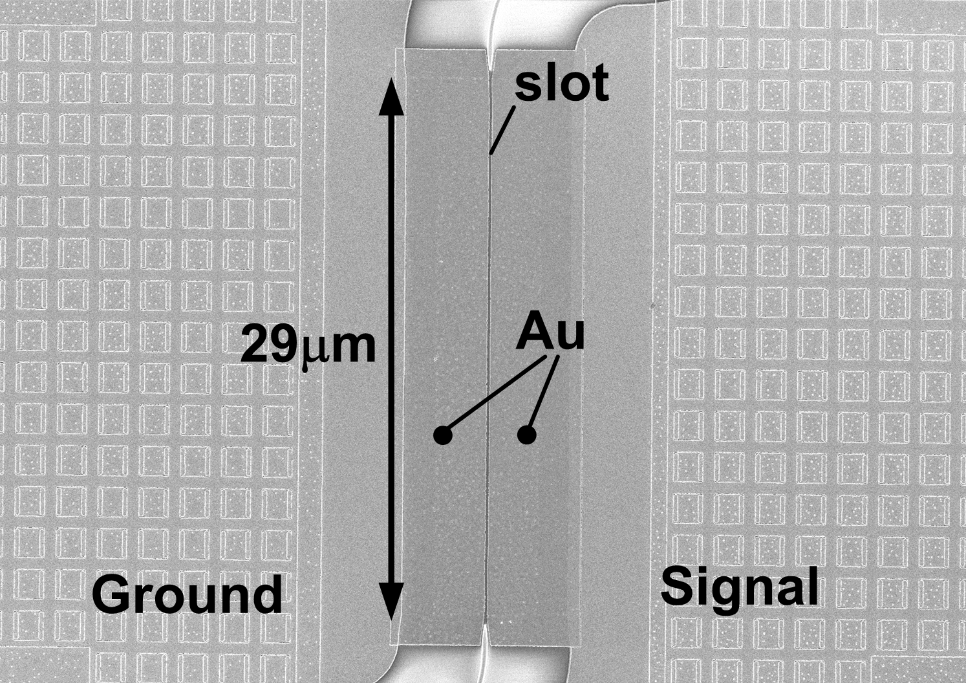
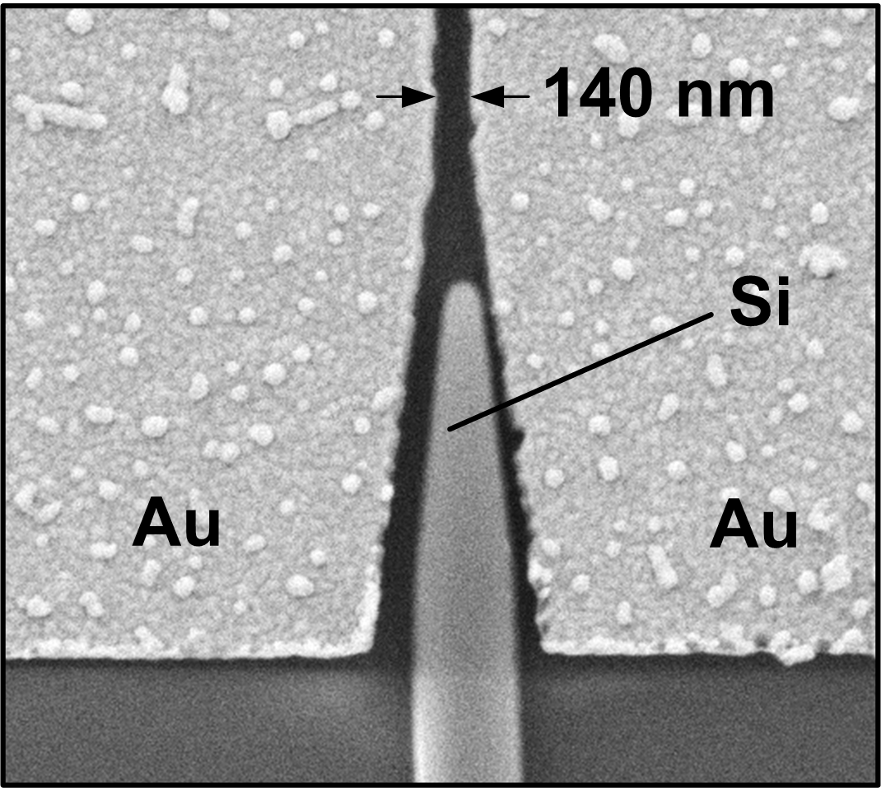
Review 1 Recommendations
Example: Plasmonic Modulator
[1] “GigOptix”, http://www.gigoptix.com/

Slide 17
Review 1 Recommendations
Example: Plasmonic Modulator and Frequency Response

Slide 18
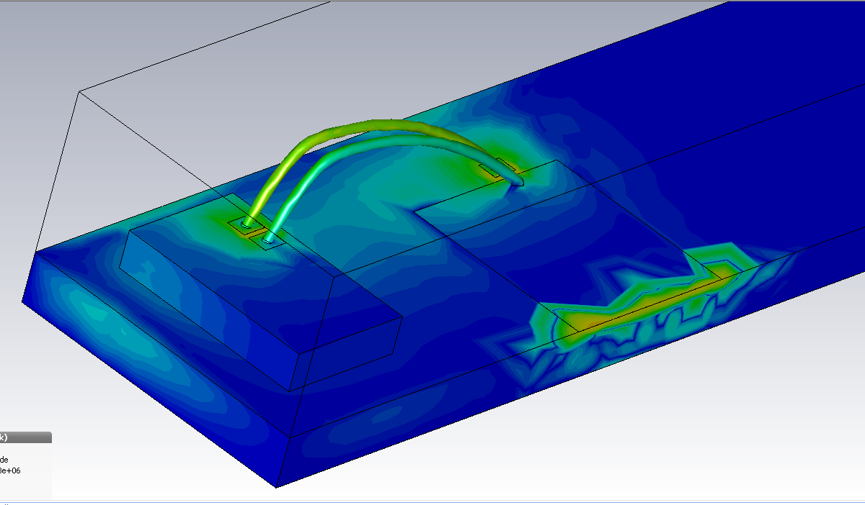
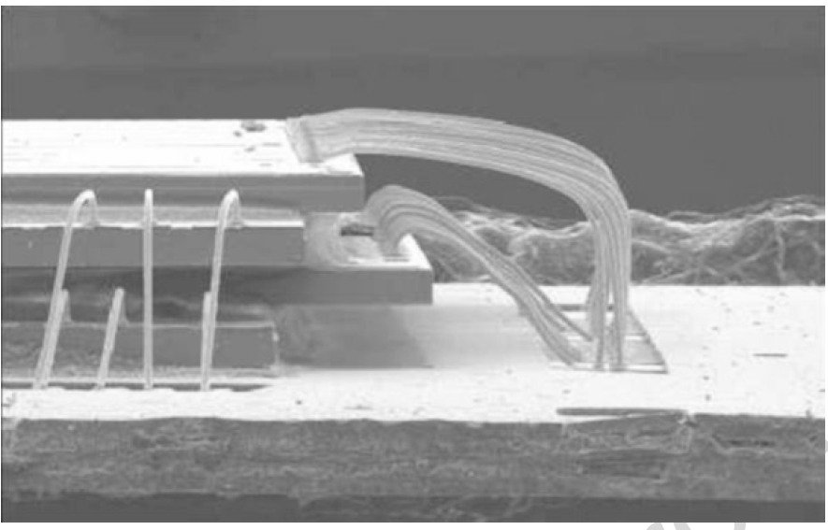
Review 1 Recommendations
Example: Electrical Cross-Talk – an Issue

Slide 19
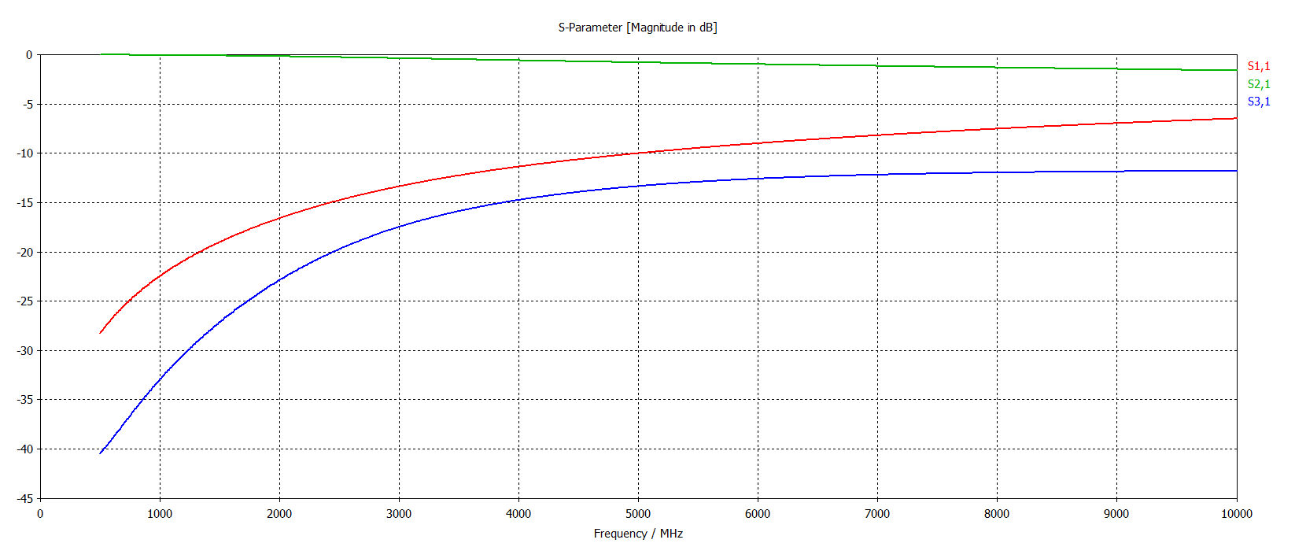
Review 1 Recommendations
Example: Electrical Cross-Talk – an Issue
Substrate: silicon
Wires and pads: PEC
Length: 1.3 mm
Radius: 12.5 µm
Separation: 150 µm
Frequency: sweep

Slide 20
Review 1 Recommendations
Integration of the plasmonic phase modulator (PPM) in a system.
Using either a Mach-Zehnder-Interferometer (a) or a ring resonator (b), the phase-keyed signal after the PPM is converted to an intensity modulated signal for direct detection with a photodetector.
Two applications envisioned.
Interconnect: fully integrated modulator & CMOS electronics on-chip.
→ size matters & bit-rates are low.
→ Power required in the receivers will be low➔ no amplifiers needed
b) Modulator in backbone transmitters.
→ ultimate goal is a miniaturization → small form factor size.
→ Amplifiers are in receiver anyhow.

Slide 21
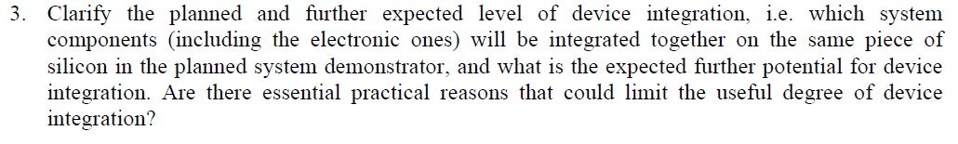
Review 1 Recommendations
Demonstrator: all digital parts on FPGA, analog parts and plasmonic devices on boards
Real systems: all components (digital and analog parts, plasmonic devices) integrated together in the same Silicon chip
FPGA
Electric
signals
Board
Plasmonic
signals
Board
Electric
signals
FPGA
Storage
Synchronization
QoS
Flow control
Ser/Des
Codecs
Drivers
Modulators
Amplifiers
Detectors
TIAs
Amplifiers
Drivers
Modulators
Amplifiers
Detectors
TIAs
Amplifiers
Storage
Synchronization
QoS
Flow control
Ser/Des
Codecs
Chip
Plasmonic
signals
Chip

Slide 22
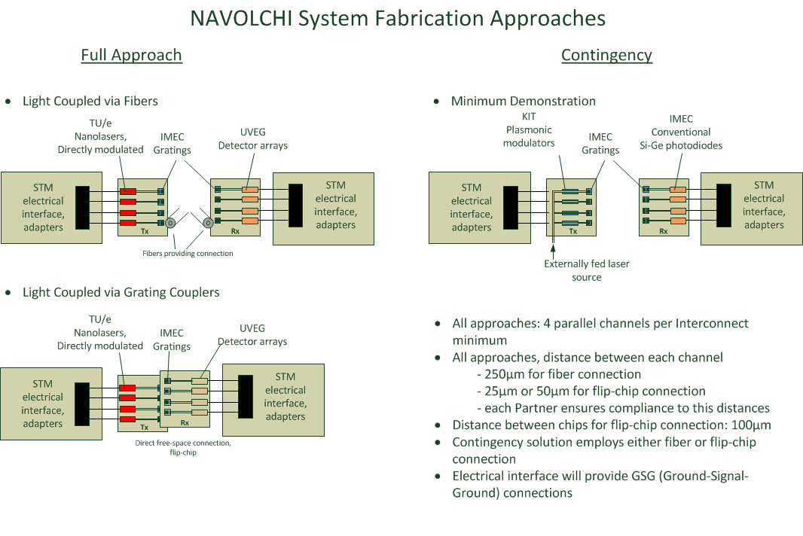
Review 1 Recommendations

Slide 23
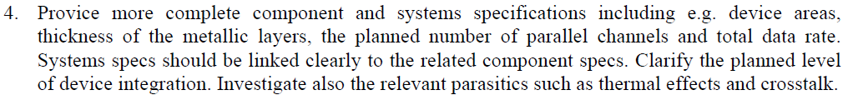
Review 1 Recommendations
Will be discussed in WP2 Talk

Slide 24
Review 1 Recommendations
From the point of view of Materials (D4.2):
Literature background on CdSe and CdTe QDs was more important than for QDs emitting at the infrared,
The quantum yield of core-QDs based on these materials was larger than in the case of available core-QDs emitting at the infrared (demonstrated chemically compatible and waveguiding in both cases before month 3),
Preliminary work developed before beginning of the project
By the same reasons these materials were used to carry out first tests on different amplifier concepts (D4.1).
Once efficient colloidal nanostructures emitting at the infrared were available at appropriate quantities (after Month 3-4), research was focused on these materials (the implementation of the different concepts and conclusions were practically similar).

Slide 25
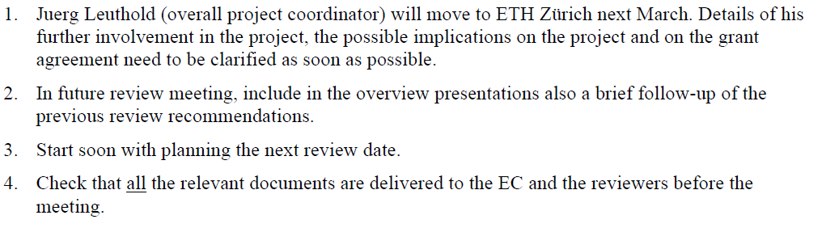
Review 1 Recommendations
Recommendations for future work:

Slide 26
WP 2 Summary
Objectives:
  Initial benchmarking.
  To define optical interconnection system environment and parameters within which the plasmonic devices have to function and that will be used for evaluating its performance with respect to chip to chip communication.
  To develop a cycle accurate VHDL model of serializer/deserializer.
  Device definitions.
  System modeling.
Achievements:
  Requirements & needs reviewed.
  Devices defined.
  Initial benchmarking carried out.
  System targets set.
  System design scenarios selected.

Slide 27
WP 3 Summary
Objectives
  Design and simulate a plasmonic/metallic nanolaser and a plasmonic modulator
  Fabricate the electrically driven plasmonic/metallic nanolaser and plasmonic modulator
Achievements
    Modeling of plasmonic modulators
    Fabrication of plasmonic phase modulator. Demonstration of at least 65 GHz RF bandwidth and 40 Gbit/s of data modulation
    Modeling of metal-cavity lasers
    Lithographic and etching processes to fabricate the laser were developed. Fabrication tests were done.

Slide 28
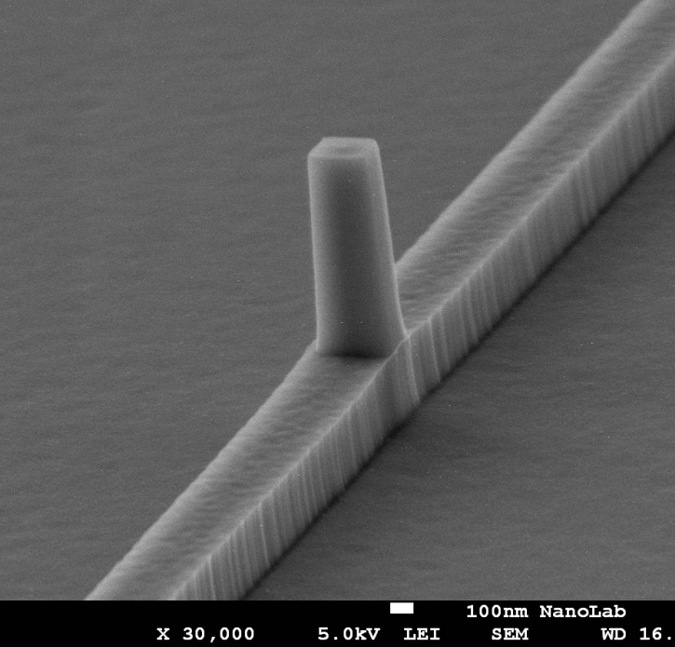
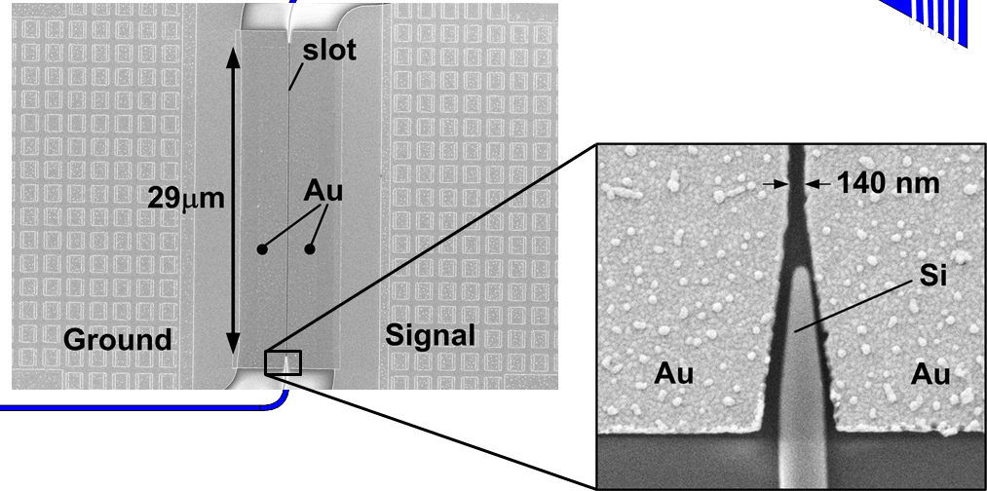
WP3 Highlights
Metallo-dielectric nanolaser fabrication (work in progress)
Phase Modulator fabrication (completed)
Nanopillar on waveguide
First structures fabricated
>> 65 GHz bandwidth demonstrated!
17 fJ/bit measured!

Slide 29
WP 4 Summary
Objectives:
  Simulation studies to optimize
    Plasmonic amplifier
    Plasmon/Photon detector (nanogap)
  Fabrication
    Optically pumped plasmonic amplifier
    Electrically driven plasmonic amplifier
    Plasmon/Photon detectors (Schottky, nano/micro-gap photoconductor)
  Performance targets
    Plasmonic amplifier: 10 dB on-chip gain (5 mm wide)
    Detector: Responsivity > 1 A/W (EQE ≈ 80 %)

Slide 30
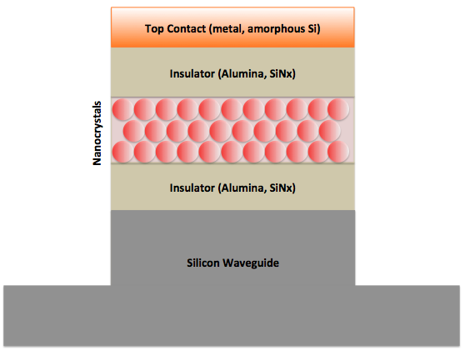
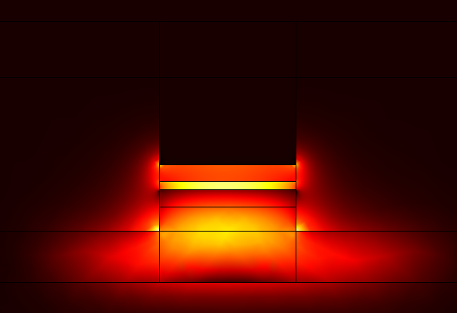
WP 4 Summary
Achievements:
Plasmonic Amplifier:
  PbX/CdX hetero-nanostructures emitting at IR with high QY and exhibiting ASE
  Design of optimized structures for SPP amplification using QD doped polymers
  Selection of best nanostructures for polymer based waveguides with (saturating) gain: new materials needed
  Different plasmonic IMI waveguide structures were tested
  Si-based waveguides with top QD-layer were tested: dipole-dipole absorption enhancement by QD self-assembling
  Demonstrated AC electroluminescence using QD layers
  Nano/micro-patterns directly developed using e-beam/UV-photolithography resists containing Ag-NPs
HgTe QDs
Hybrid silicon-plasmonic amplifier

Slide 31
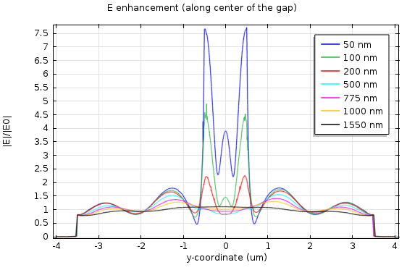
WP 4 Summary
Achievements:
Photodetector:
  PbS QD-solids were developed by using layer-by-layer method in air
  Schottky photodetectors: 0.7 A/W and EQE ≈ 100 % for λ < 600 nm (thicker layers needed at IR)
  Plasmonic nanogap structures modelled using Comsol
  Conducting polymers + metal NPs exhibit photoconductivity at their Localized Surface Plasmon Resonance
Y
X

Slide 32
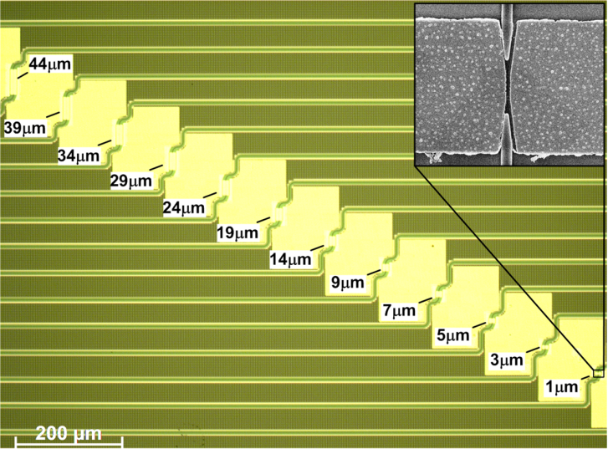
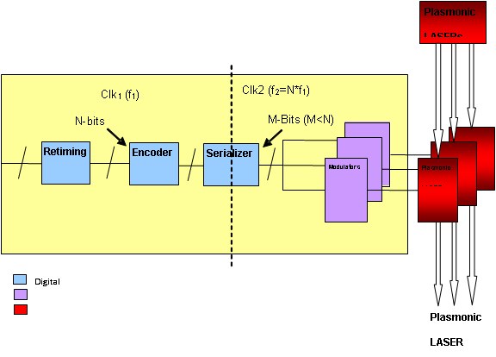
WP 5 Summary
Objectives:
  Demonstration of coupler silicon waveguide to plasmonic modulator
  Demonstration of adjustable grating couplers
  Design and implementation of DDCM
Achievements:
Couplers with <3dB loss
Adjustable gratings
Definition DDCM

Slide 33
WP 6 Summary
Objectives:
  Modeling and fabrication of coupling Si waveguide to plasmonic waveguide
  Design and fabrication of Si beam shaper
  Design and fabrication of passive ultra-compact components and filters
  Signal generation module design
Achievements:
  Started testing and characterization of all the passive and active plasmonic devices (AIT)
  Fabricated and characterized plasmonic phase modulator (KIT)
  Developed Transaction Level Model view of the demonstrator validation platform (ST)

Slide 34
WP 7 Summary
Objectives:
  Dissemination through paper submission to high quality scientific journals and conferences
  Organizing workshops & seminars on NAVOLCHI technology
  Dissemination through the website
  Issuing press releases and brochures
  Patents
  Theses at partners’ institutes
Achievements:
  Dissemination: 14 journals, 37 conferences, 1 scientific magazine, 1 white paper, website, press release, brochure
  Exploitation: 1 patent, 7 PhD and MSc theses
  Promotion: 2 workshops, 1 open seminar

