Slide 1
WP-1 Presentation
“NAVOLCHI Management”
Manfred Kohl
Karlsruhe Institute of Technology (KIT), Germany

Slide 2
Outline
Overview and Project Governance
Resources: Budget and Manpower
Communication: Meetings and Phone Conferences
Management Deliverables
Status of Work: The Project after 1½ Years
Summary

Slide 3

Overview of WPs

Slide 4
Management: Main Tasks
Strategic management at project level
Control of work package activities, including technical quality control
Organisation of project reporting and meetings
Control of deliverable preparation
Conflict management

Slide 5
Project Governance

Slide 6







General Assembly: Representatives
Coordinator (Chair): Juerg Leuthold
+
 | KIT | Manfred Kohl
 | IMEC | Dries Van Thourhout
 | TU/e | Meint Smit
 | AIT | Ioannis Tomkos
 | UVEG | Juan Martinez Pastor
 | ST | Alberto Scandurra
 | Ugent | Zeger Hens

Slide 7
Project Management Committee:
Technical Project Manager (Chair): Manfred Kohl
Jürg Leuthold
+
Coordinator: Juerg Leuthold
Manfred Kohl
+
WP 1 Leader | KIT | Manfred Kohl
WP 2 Leader | AIT | Emmanouil-Panagiotis Fitrakis
WP 3 Leader | TU/e | Meint Smit
WP 4 Leader | UVEG | Juan Martinez Pastor .
WP 5 Leader | IMEC | Dries Van Thourhout
WP 6 Leader | ST | Alberto Scandurra
WP 7 Leader | AIT | Dimitrios Klonidis
(+ Dr. Isaac Suárez)
(+ Experts)

Slide 8
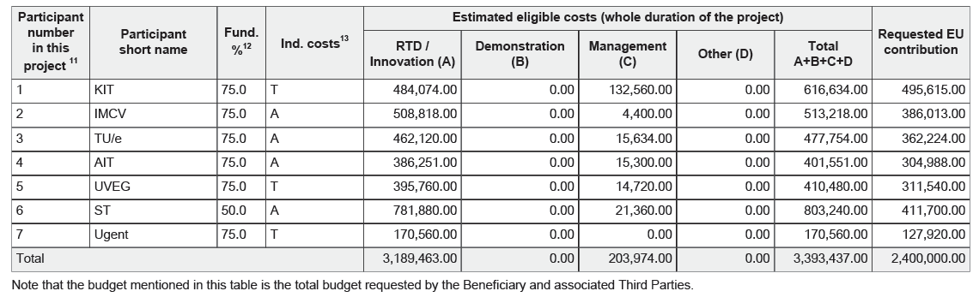
Resources: Budget and Pre-financing
A: Actual Costs; T: Transitional Flat Rate
1. Tranche: |  | 1 400 000 € | 58%
 | Total Sum | 58% | 1 Tranche
KIT | 495 615 € | 289 109 € | 290 000 €
IMEC | 386 013 € | 225 174 € | 225 000 €
TU/e | 362 224 € | 211 297 € | 210 000 €
AIT | 304 988 € | 177 910 € | 180 000 €
UVEG | 311 540 € | 181 732 € | 180 000 €
ST | 411 700 € | 240 158 € | 240 000 €
Ugent | 127 920 € | 74 620 € | 75 000 €
 | 2 400 000 € | 1 400 000 € | 1 400 000 €
First payment done
at project start:
Next payment after
first report period (M18)

Slide 9
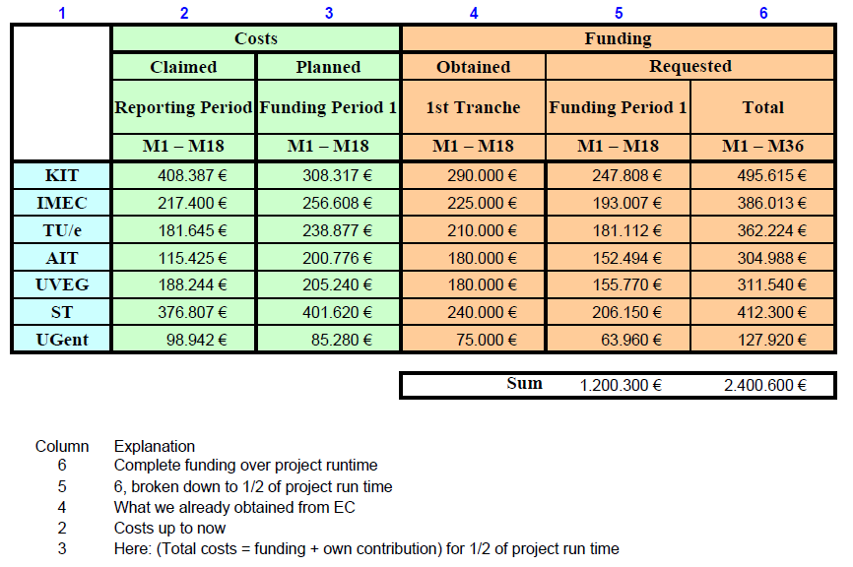
Resources: Budget after Month 18

Slide 10
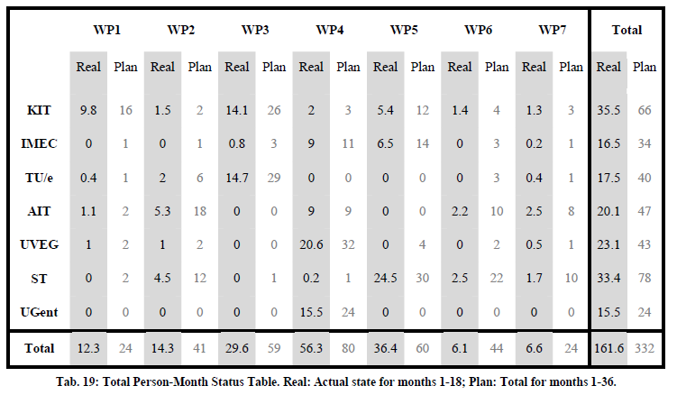
Resources: Manpower up to Month 18

Slide 11
Communication
Meetings:
  Kick-Off in Karlsruhe, Germany
  6-Month Meeting in Warwick, UK
  12-Month Meeting in Ghent, Belgium
  18-Month Meeting in Karlsruhe, Germany
Phone Conferences:
  18 up to now (July 2013), typically monthly
  Topics: Work progress, adjustments, ..
  Presentations documented at WEB-Site

Slide 12
Time Scale
No problems expected

Slide 13

Management Deliverables
Deliverables covered by work package 1 with delivery dates are:
 | Names of the Deliverables | Month | Partner
D1.1: | Project web site with .eu domain and continuous update | 1 | KIT
D1.2: | Project reference online manual | 3 | KIT
D1.3: | Project quality assurance manual | 6 | KIT
D1.4: | Intermediate progress report (1) containing work progress and management activities up to month 9 07/2012 | 9 | KIT
D1.5: | Intermediate Progress Report | 27 | KIT
All have been prepared in time

Slide 14
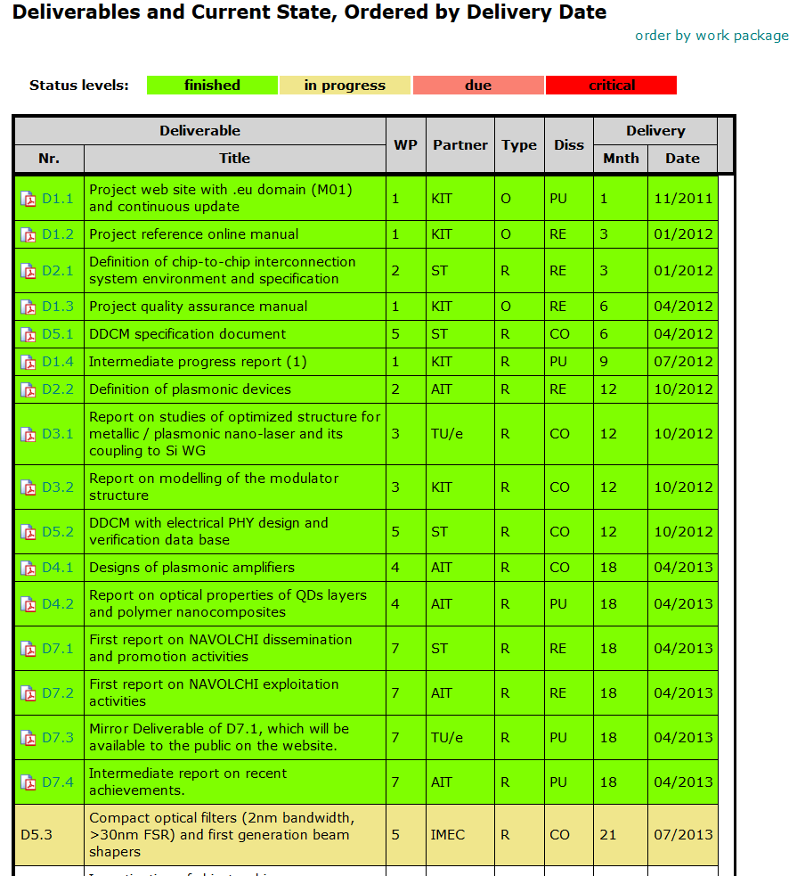
Status: Deliverables
All deliverables finished in time
Next deliverable in M21 (July 2013)
No critical status level expected

Slide 15
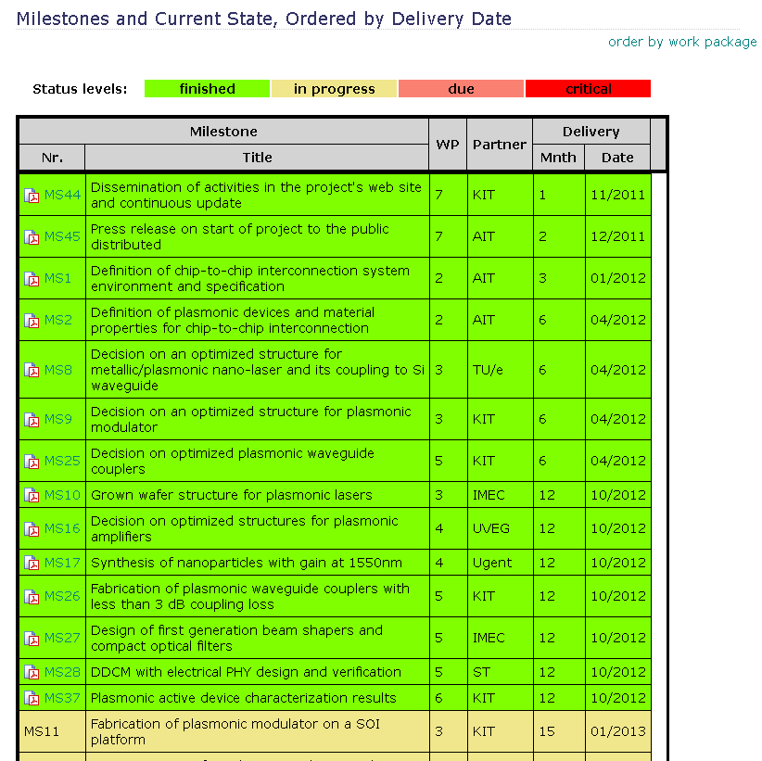
Status: Milestones (already reviewed)
Presented in review 1 (November 2012)
All milestones finished in time

Slide 16
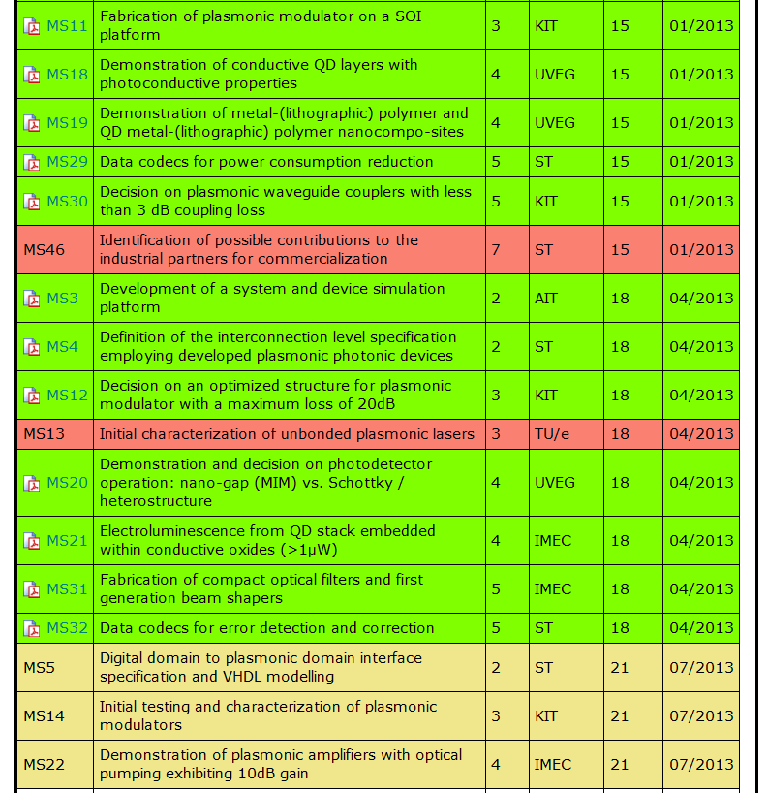
Status: Milestones
MS46:
Delayed due to management restructuration within ST
MS13:
Obsolete due to revised MS plan
Next milestones in M21 (July 2013)
No further critical status level expected

Slide 17
Summary
Project Structure
Partner Communication
Resources
Technical and Scientific Progress
Dissemination

Slide 18
Thank you!

Slide 19
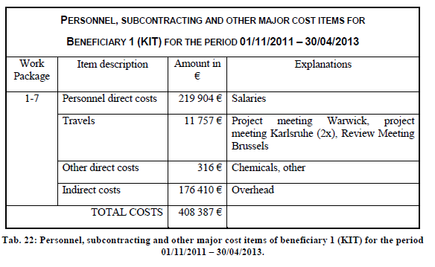
Budget KIT

Slide 20
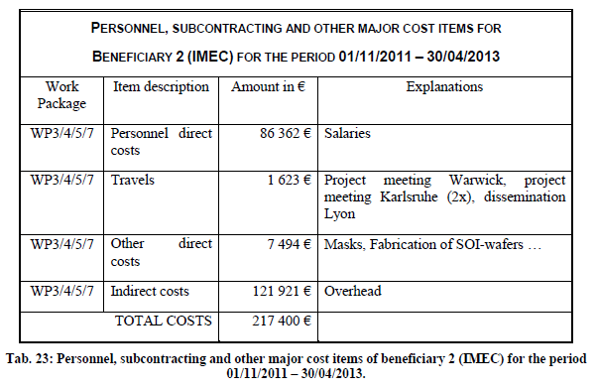
Budget IMEC

Slide 21
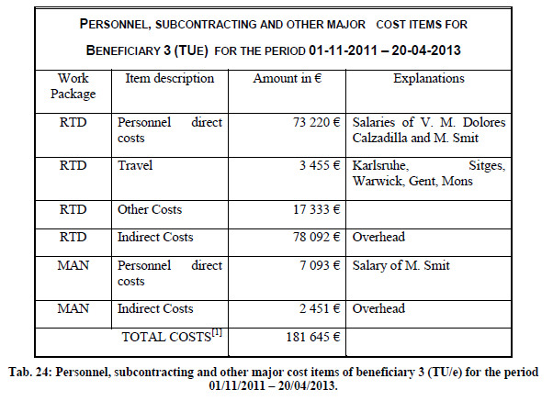
Budget TUe

Slide 22
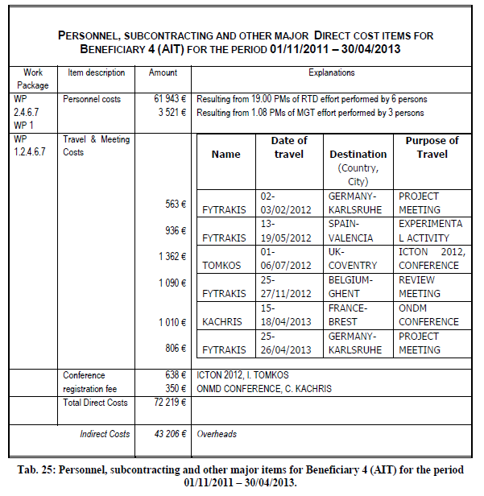
Budget AIT

Slide 23
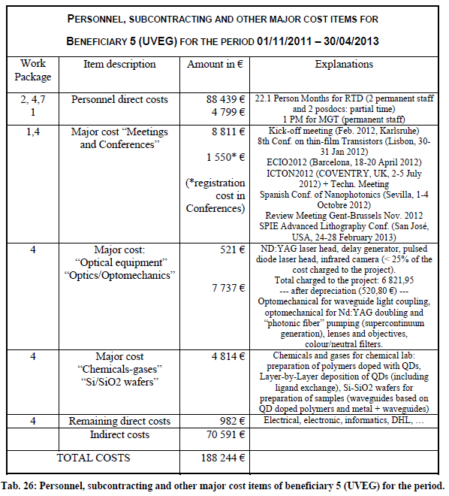
Budget UVEG

Slide 24
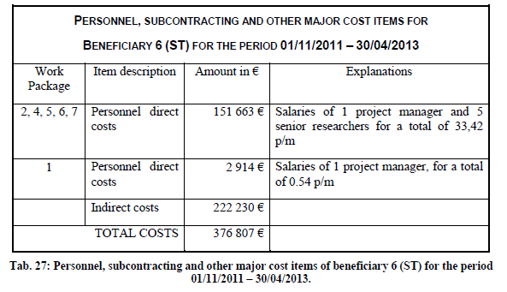
Budget ST

Slide 25
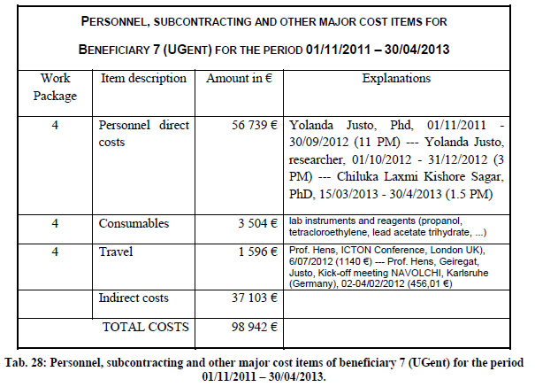
Budget UGent

