Slide 1
Work Package 2: Definition and Specifications of Plasmonic Chip-to-Chip Interconnection Platform
Emmanouil-P. Fitrakis, Ioannis Tomkos (AIT, Greece)

Slide 2
Outline
WP2 Position in Project
Objectives
Tasks
Milestones and Deliverables
Status of Work
Summary and Outlook

Slide 3
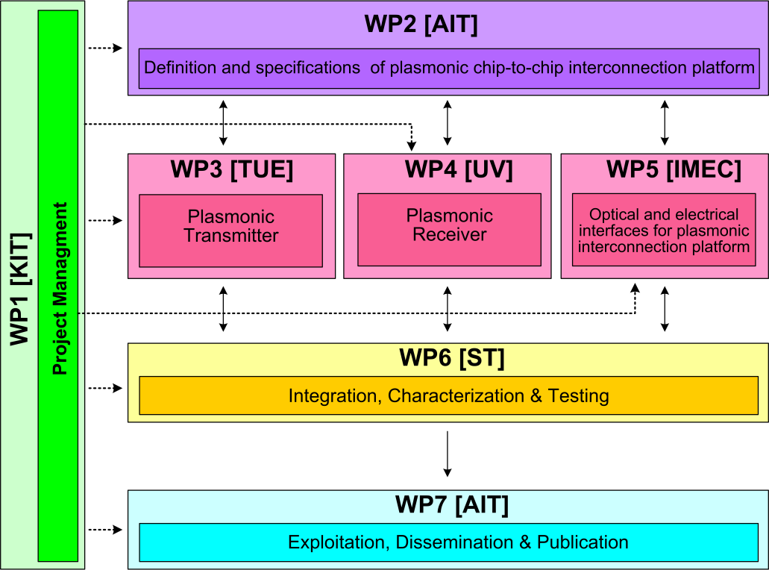






WP2 Position in Project
Contributors:

Slide 4
Objectives
Review requirements and needs for chip-to-chip interconnects
Initial benchmarking
Set target specifications for system
Define subsystem plasmonic devices
System modeling
Development of a cycle accurate VHDL model of a serializer/deserializer

Slide 5
Tasks
 | Names of the Tasks | Time Period [months]
Task 2.1 | Analysis of chip to chip interconnect requirements and needs | 1 – 6
Task 2.2 | Modeling of devices and system for communications applications | 13 – 36
Task 2.3 | Value analysis in terms of cost and green aspects | 25 – 30
Task 2.4 | Techno-economical evaluation and benchmarking | 24 – 36
Task 2.5 | VHDL modeling of plasmonic interconnect and CMOS interface circuits | 10 – 24

Slide 6
Milestones
 | Names of the Milestones | Month | Partner
MS1 | Definition of chip-to-chip interconnection system environment and specification | 3 | AIT
MS2 | Definition of plasmonic devices and material properties for chip-to-chip interconnection | 6 | AIT
MS3 | Development of a system and device simulation platform | 18 | AIT
MS4 | Definition of the interconnection level specification employing developed plasmonic devices | 18 | ST
MS5 | Digital domain to plasmonic domain interface specification and VHDL modelling | 21 | ST
MS6 | Plasmonic interconnect VHDL modelling | 24 | ST
MS7 | Investigation of the cost and power consumption efficiency of the developed plasmonic devices | 28 | AIT

Slide 7
Deliverables
 | Names of the Deliverables | Month | Partner
D2.1 | Definition of chip-to-chip interconnection system environment and specification | 3 | ST
D2.2 | Definition of plasmonic devices | 12 | AIT
D2.3 | Investigation of chip-to-chip interconnection-level specifications employing new plasmonic devices | 24 | AIT
D2.4 | Interface and plasmonic interconnect models and reports | 24 | ST
D2.5 | Techno-economical evaluation with respect to the cost efficiency and green aspects | 30 | AIT
D2.6 | Report on new applications and their opportunities | 36 | AIT

Slide 8
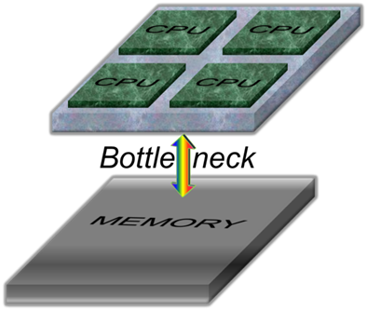
Task 2.1 Requirements and Needs
I. What we are interested in
  In the context of chip-to-chip interconnects, we are looking for:
  Large bandwidth to resolve the data rate bottleneck
  Small Size for increased integrability
  Low latency also for improved performance and scalability
  Low power consumption for energy and cost considerations
  In multicore systems, the chip-to-chip interconnect is the data rate bottleneck
(see D2.1)

Slide 9
Task 2.1 Requirements and Needs
I. What we are interested in
Chip-to-chip optical interconnection requires high speed transceivers that are monolithically integrated with electronic ICs, which can convert digital information from electrical domain to optical domain and vice versa.
  Such transceivers should be compact, offer large bandwidth, low latency and consume little power in order to be economically and technologically efficient.
The most promising technology for realization of such transceivers is the CMOS compatible silicon photonics platform whose low cost and large scale fabrication is ensured by well-developed advanced CMOS fabrication techniques.
Unfortunately, there is a size mismatch between silicon electronics and silicon photonics. Even state-of-the-art Si photonic transceivers are bulky comparing to electronic transistors. Therefore, the integrated silicon photonic transceivers would occupy large portion of the optoelectronic ICs making them not economically viable…

Slide 10
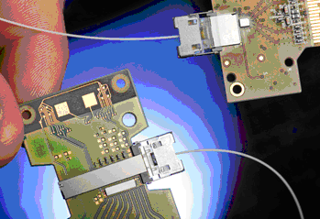
Task 2.1 Requirements and Needs
II. Market & Projects Review
In order to set the system targets, market products and research projects were reviewed.
See D2.2 and Intermediate Report
Link | Type | Throughput (total) | Latency | Pins/Channels | Power
Intel 50G Link | Opt. | 50 Gb/s |  | 4
UNIC | Opt. | 5 Gb/s* |  |  | 5 mW*
TI C2C | Electr. | 6.4 Gb/s | 50 ns | 16
MIPI LLI | Electr. | 5.8 Gb/s | 80 ns | 4 | 15 pJ/bit
MIPI UniPort | Electr. | 3.2 Gb/s | high | 4 | 15 pJ/bit
*first-year results of research project.
Intel 50G

Slide 11
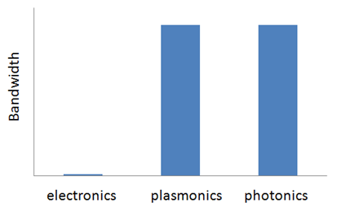
Task 2.1 Requirements and Needs
III. Bandwidth In-Principle Considerations
Photonics has superior data rate capability per channel to electronics, due to greater operating frequencies (x1000).
Surface plasmon-polaritons (electromagnetic waves coupled to metal surface charge oscillations) have optical bandwidths and retain the data rate capabilities of photonics.
Plasmonics have better crosstalk properties than electronics.

Slide 12
Task 2.1 Requirements and Needs
III. Bandwidth in NAVOLCHI
In NAVOLCHI, we are aiming at 7.2 Gbit/s per channel, fulfilling industrial partner’s current needs and being competitive with cutting-edge photonics systems.
Larger data rates will be demonstrated for individual devices.
In the final demonstrator, 4 devices will be in parallel,operated at the speed of FPGAs provided by ST.

Slide 13
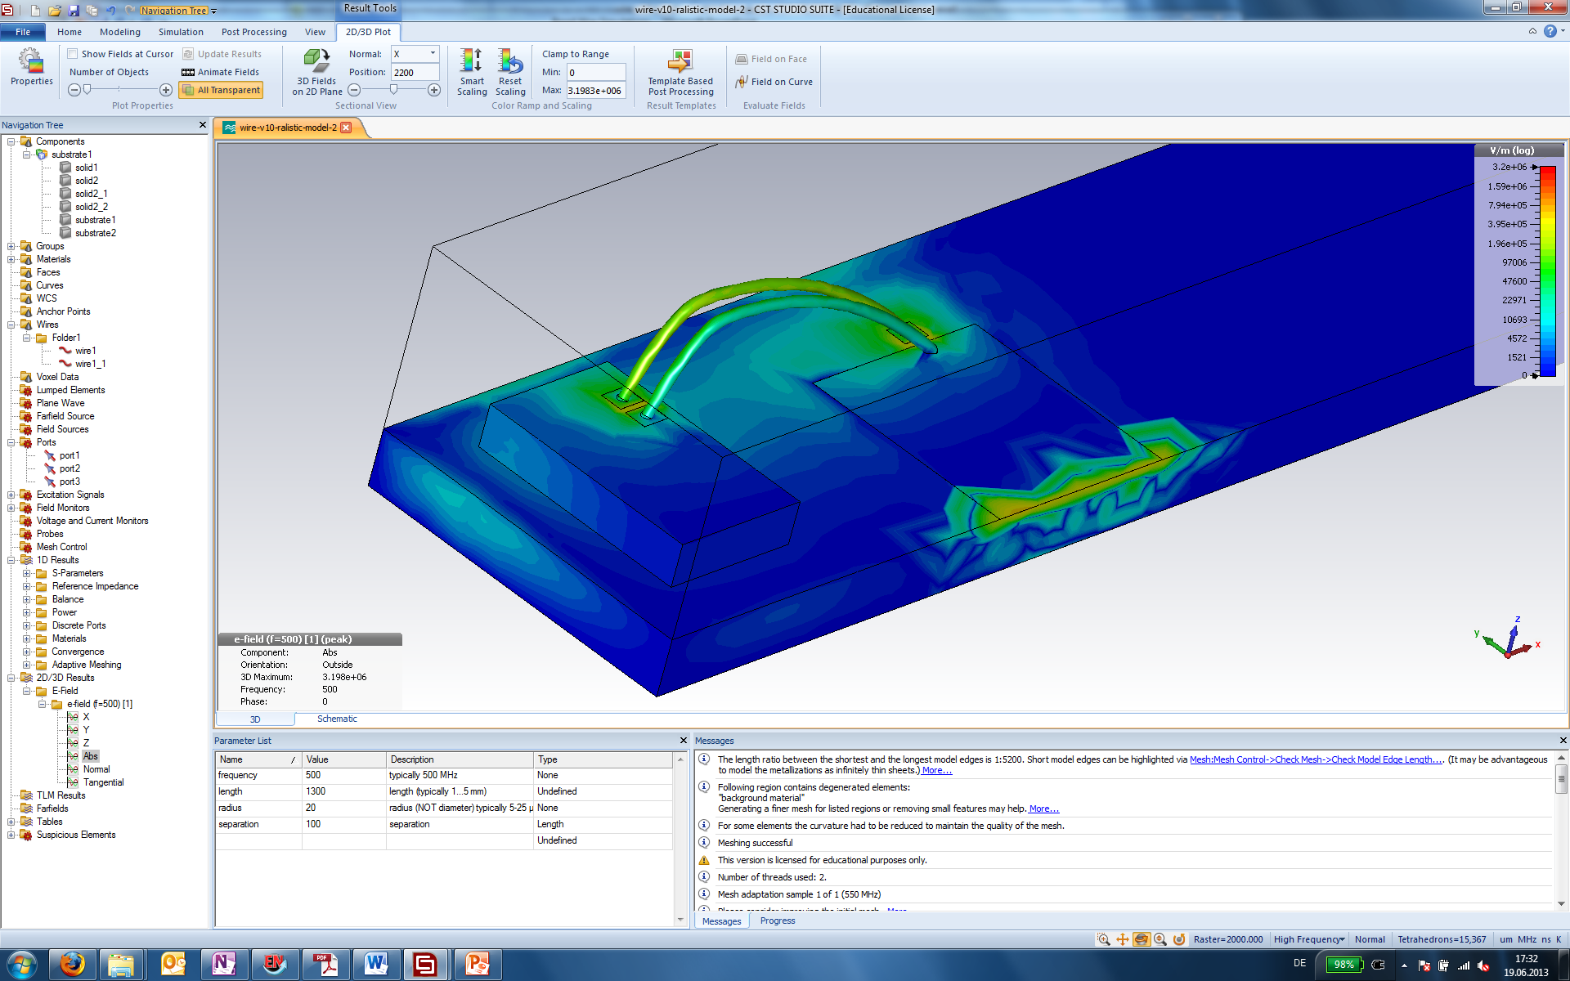
Task 2.1 Requirements and Needs
IV. Crosstalk. Comparison with Electronics.
Signal
Input port 1
Output port
ground
Quiet line
Output port 3
Substrate: silicon
Wires and pads: PEC
Length: 1.3 mm
Radius: 12.5 µm
Separation: 150 µm
Frequency: sweep

Slide 14
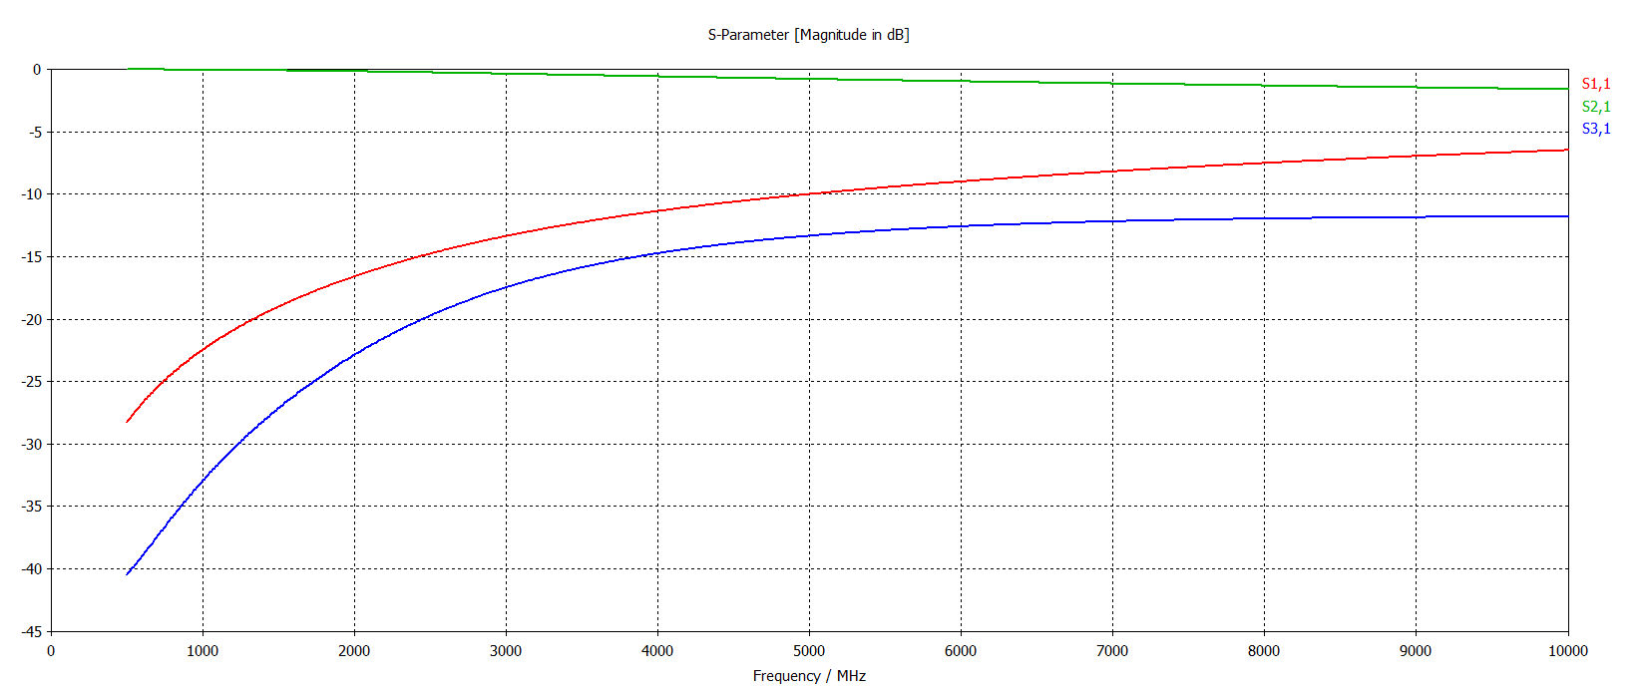
Task 2.1 Requirements and Needs
IV. Crosstalk. Electronics & Frequency.
transmission
reflection
crosstalk
Crosstalk becomes significant in the GHz range (e.g. -15 dB at 4 GHz)

Slide 15
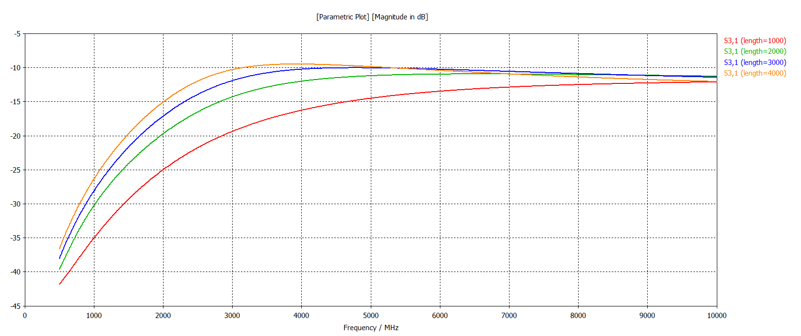
Task 2.1 Requirements and Needs
IV. Crosstalk. Electronics & Length.
Crosstalk increases with increasing wire length.
4 mm long bond wires, for example, show a crosstalk of -15 dB at 2 GHz.

Slide 16
Task 2.1 Requirements and Needs
IV. Crosstalk in Electronics. Comparison.
In electronics, there are crosstalk issues already at pitches ~ 150 μm at GHz frequencies between electrical wirebonds.
In photonics & plasmonics, there are no such issues even at smaller pitches, as light is mostly confined in waveguides and tails only extend to wavelength distances (microns).
  Plasmonics: ~1 micron
  Photonics: ~2 microns
In NAVOLCHI, we are planning for channel physical separations of 35 and 250 microns with no crosstalk.

Slide 17
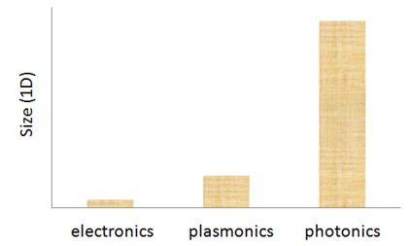
Task 2.1 Requirements and Needs
V. Size. Theory.
Electronics are approaching their size limit (several nanometers for device features). Quantum tunneling for < 15 nm. Silicon lattice constant ~ 0.5 nm.
Photonics is much bulkier than electronics. Minimum possible confinement of light in any dimension of conventional photonics is called the diffraction limit: λ/2 (~500 nm for telecom frequencies in glass). This limit comes up when one tries to solve Maxwell’s Equations for materials with positive permittivities (i.e. non-metals).
Confinement in plasmonics can beat the diffraction limit by about an order of magnitude in any dimension (λ/20). In laboratory practice, dimensions of < λ/2 (subwavelength) are typical. This makes plasmonic devices significantly more compact. There is a trade-off between confinement and loss.
In practice, photonic/plasmonic devices are longer than the limits, because many wavelengths are needed for meaningful light-matter interaction.

Slide 18
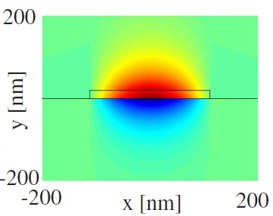
Task 2.1 Requirements and Needs
V. Size. NAVOLCHI
In NAVOLCHI, we are aiming at areas of tens of μm2 for the devices, beating state-of-the-art integrated photonic devices by 1-2 orders of magnitude.
Ultimate bottleneck is caused by heat dissipation and loss trade-off.
insulators
metal

Slide 19
Task 2.1 Requirements & Needs
VI. Latency. Theory & NAVOLCHI.
In plasmonics, the RC constant is very small leading to low latency.
Plasmonic devices can be shorter than conventional photonic devices, also translating to low latency.

Slide 20
Task 2.2 Modeling of Devices & System
I. Industry needs & NAVOLCHI targets
Parameter | For Now | Future
Data Rate | 7.2 Gbit/s[1,2] /channel | 230-780 Tbit/s (2022)[3,4]
Power Consum. | 1 pJ/bit[2,4] | 50-100 fJ/bit (2022)[3,4]
Latency | 8.8 ns @450 MHz[1] | ?
Footprint | 100 μm2 | < 5 μm2[5]
Input by ST.
See available products in D2.2.
ITRS 2009.
D. A. B. Miller, “Device requirements for optical interconnects to silicon chips”, Proc. of the IEEE 97, 1166-1185 (2009).
Input by partners.
Notes:
For Now: both industry needs and NAVOLCHI targets
Future: Industry needs

Slide 21
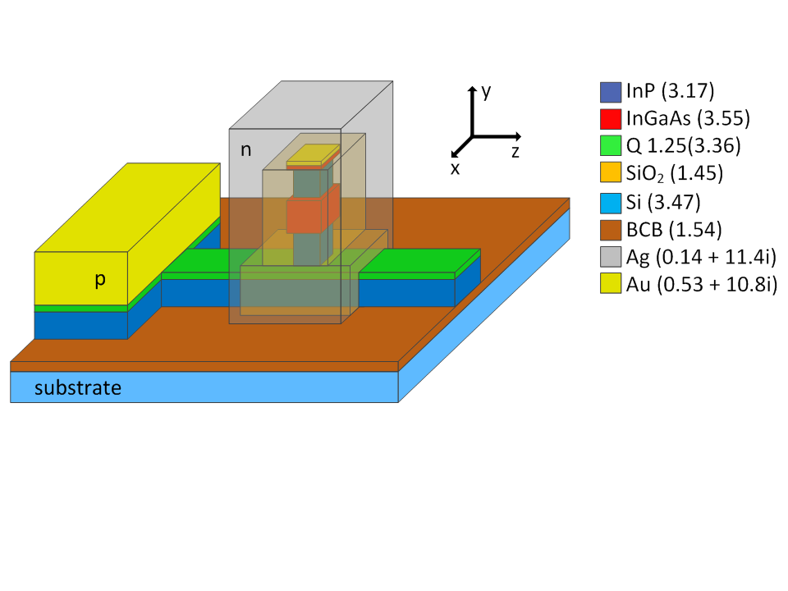
Task 2.2 Modeling of Devices & System
II. Device Specifications.
Device | Data Rate | Latency | Power Cons. | Length | Loss
Laser | DC (40 μW) | N/A | 110 fj/bit | 30 μm | eff 5%
Modulator | 40 Gb/s | 15 ps | < fJ/bit | < 50 μm | < 20 dB
Amplifier* | transp. | 1.5 ps | < 30 pJ/bit | 250 μm | N/A
Detector** | ? | slow | < 1 μW/V | 10 μm | resp 10-3 (10-100 nW)
Gratings | transp. | N/A | N/A | 10 μm | 1 dB
Filters | transp. | < 20 ps | < 0.2 pJ/bit | 330 μm | 1 dB
* optically pumped scenario
** nano-gap photoconductor scenario
TOP
1-15 μm
I
I
Ag
QD-layer (300 nm)
GLASS

Slide 22
Task 2.2 Modeling of Devices & System
III. Challenges Arisen
Challenges have arisen with some device specifications, as they do not cooperate with the system targets:
  Amplifier power consumption estimated at <30 pJ/bit (system goal: 1 pJ/bit)
    Possible solution: Avoid use of amplifier.
  Photodetector too slow for system goal (8.8 ns)
    Looking for faster solutions.
    Contingency plan on next slide.

Slide 23
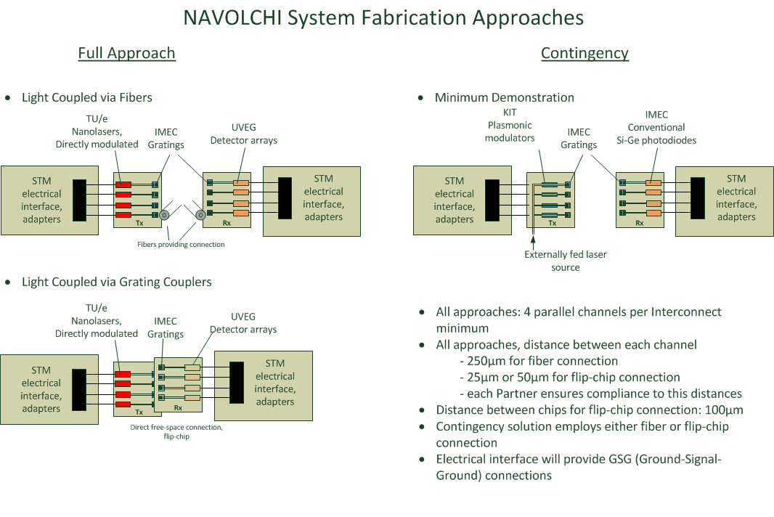
Task 2.2 Modeling of Devices & System
IV. NAVOLCHI System

Slide 24
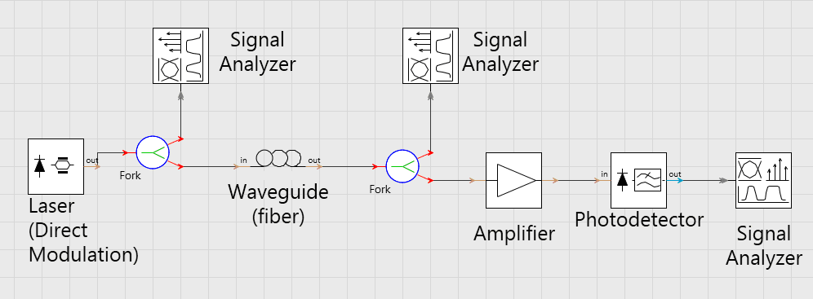
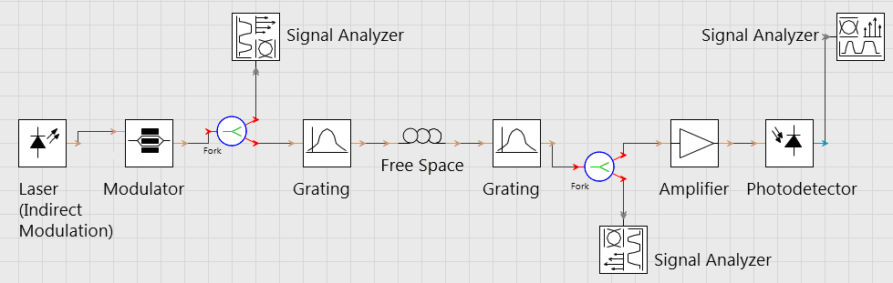
Task 2.2 Modeling of Devices & System
V. System Modeling
NAVOLCHI simulation platform scenario in VPI Photonics.
Generic modules already exist in VPI, but they are also Matlab-programmable for further control.
1st results to be presented in D2.3 (month 24)

Slide 25
Task 2.5 VHDL Modeling
Verilog-A training
2-days training at ST Agrate
Language for modeling analog electronic parts as well as mechanical, thermal and optical parts
Fully compatible with Verilog and VHDL languages

Slide 26
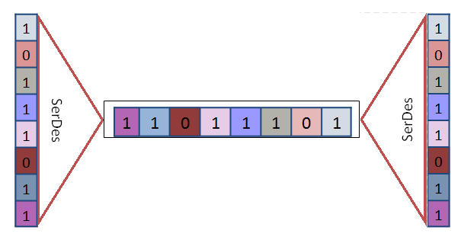
Task 2.5 VHDL Modeling
VHDL modeling of generic serializer/deserializer
Parametric building-blocks with configurable input and output size
Allowing to carry out architectural exploration simply changing the values of the parameters
Different configurations already verified and characterized in terms of area occupancy and operation frequency

Slide 27
Summary and Outlook
  Summary
    Requirements and needs reviewed
    System target specs set
    Devices defined
    Initial benchmarking
    System design drafts
  Outlook
    Simulations for system and subsystems specifications convergence
    Interaction with technical WPs to meet system targets
    VHDL modeling of CMOS electronics, physical layer, and their interfacing
    Technoeconomics, green aspects & roadmapping

