Slide 1
Work Package 3: Plasmonic Transmitter
Victor Dolores-Calzadilla, Meint Smit
Eindhoven University of Technology (TU/e), The Netherlands

Slide 2
Outline
WP3 Position in Project
Objectives
Tasks
Milestones and Deliverables
Status of Work
  Plasmonic/Metallic Laser
  Plasmonic Modulator
Summary and Outlook

Slide 3
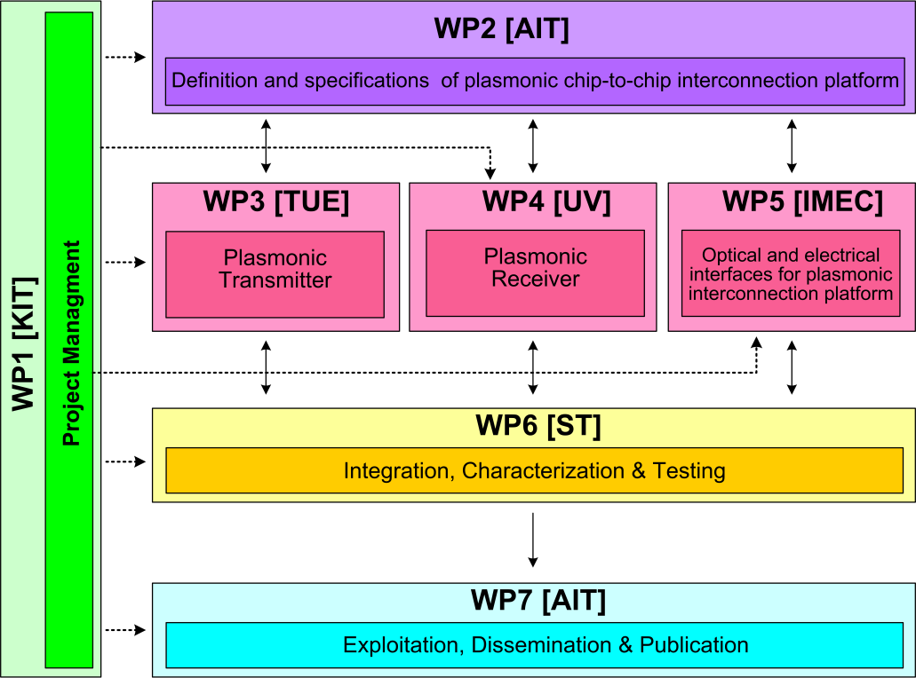



WP3 Position in Project
Contributors:

Slide 4
Objectives
Simulation studies
  Plasmonic/metallic nanolaser
  Plasmonic modulator
Fabrication
  Electrically pumped plasmonic/metallic nanolaser
  Electrically driven plasmonic modulator
Performance targets
  Laser: active region < 1 μm², output power > 100 μW
  Modulator: extinction ratio > 3dB for length < 10 μm, and a total modulation speed > 40 Gbit/s

Slide 5
Tasks
 | Names of the Tasks | Time Period [months]
Task 3.1 | Modelling of plasmonic laser and optimization of bonding technology | 1 – 6
Task 3.2 | Modelling of plasmonic modulator | 1 – 18
Task 3.3 | Fabrication of plasmonic/metallic nanolaser | 7 – 30
Task 3.4 | Fabrication of Si-plasmonic modulators | 7 – 27

Slide 6
Milestones
 | Names of the Milestones | Month | Partner
MS8 | Decision on an optimized structure for metallic/plasmonic nanolaser and its coupling to a Si-waveguide | 6 | TU/e
MS9 | Decision on an optimized structure for plasmonic modulator | 6 | KIT
MS10 | Grown wafer structure for plasmonic lasers | 12 | TU/e
MS11 | Fabrication of plasmonic modulator on a SOI platform | 15 | KIT
MS12 | Decision on an optimized structure for plasmonic modulator with a maximum loss of 20dB | 18 | KIT
MS13 | Characterization of initial fabrication results of plasmonic/metallic lasers | 18 | TU/e
MS14 | Initial testing and characterization of plasmonic modulators | 21 | KIT
MS15 | Initial testing of bonded plasmonic lasers | 24 | TU/e

Slide 7
Deliverables
 | Names of the Deliverables | Month | Partner
D3.1 | Report on studies of optimized structure for metallic/plasmonic nanolaser and its coupling to Si-waveguide | 12 | TU/e
D3.2 | Report on modelling of the modulator structure | 12 | KIT
D3.3 | Fabrication of plasmonic laser device | 24 | TU/e
D3.4 | Report on fabrication of modulators | 24 | KIT

Slide 8
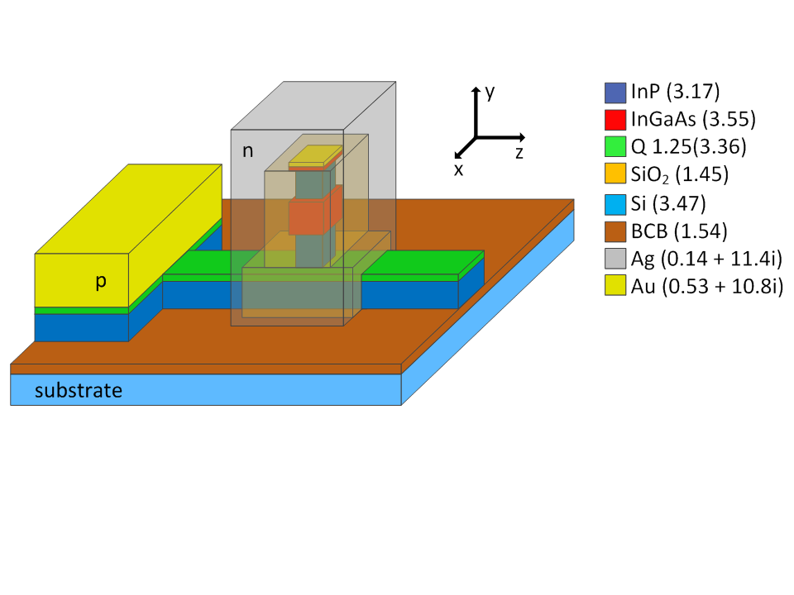
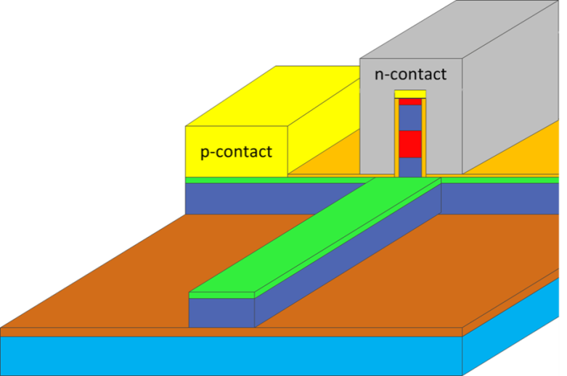


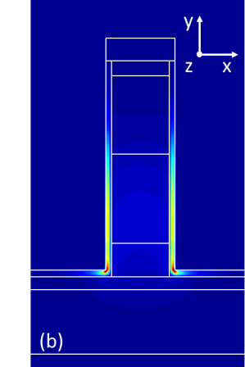
Metallic/Plasmonic Laser Approaches
Fabry-Perot plasmonic laser
Metallo-dielectric nanolaser
xy
  High propagation loss ( ~ 0.16 dB / µm)
  Poor confinement in active region
Reported in MS8 & D3.1
|E|²
|E|²
V. Calzadilla et al., Towards plasmonic lasers for optical interconnects, ICTON, 2012
V. Calzadilla et al., Waveguide-coupler nanolasers in III-V membranes on silicon , ICTON, 2013

Slide 9
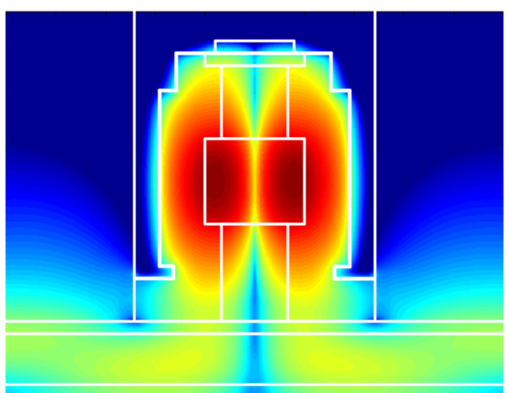
Task 3.1 Modelling of the Nanolaser
Optical and electrical optimization of metallo-dielectric nanolaser
Q ~ 530 @ 1.55 µm
Threshold gain ~ 800 cm⁻¹
Threshold current ~ 120 µA
Differential efficiency ~ 0.16
Output power ~ 40 µW @ 420 µA (2V)
Evanescent coupling, log(|E|²)
Dimensions:
  Pillar: 300nm x 400nm x 1µm (height)
  Waveguide: 400nm x 250 nm

Slide 10
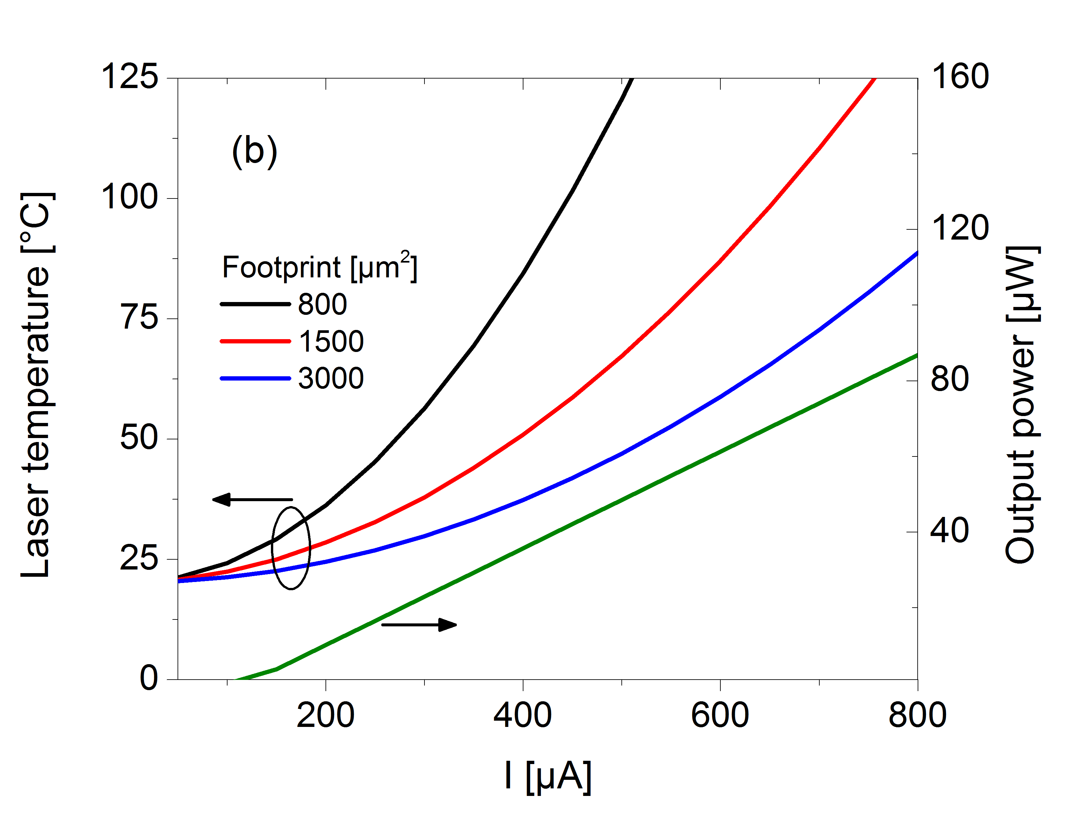
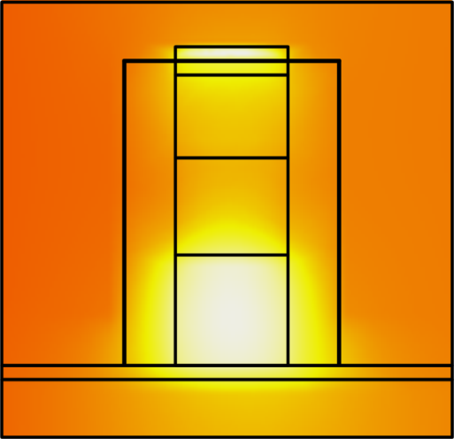

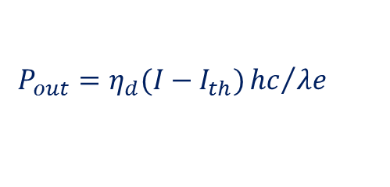
Task 3.1 Modelling of the Nanolaser
Thermal simulations
$$P_{out}=η_{d}(I−I_{th}){hc}/{λe}$$
Heat sink/spreading layer
7 mW/mm²K
Planarization layer
Ag
n
(no self-heating)
p
Self-heating → Footprint vs Output power

Slide 11
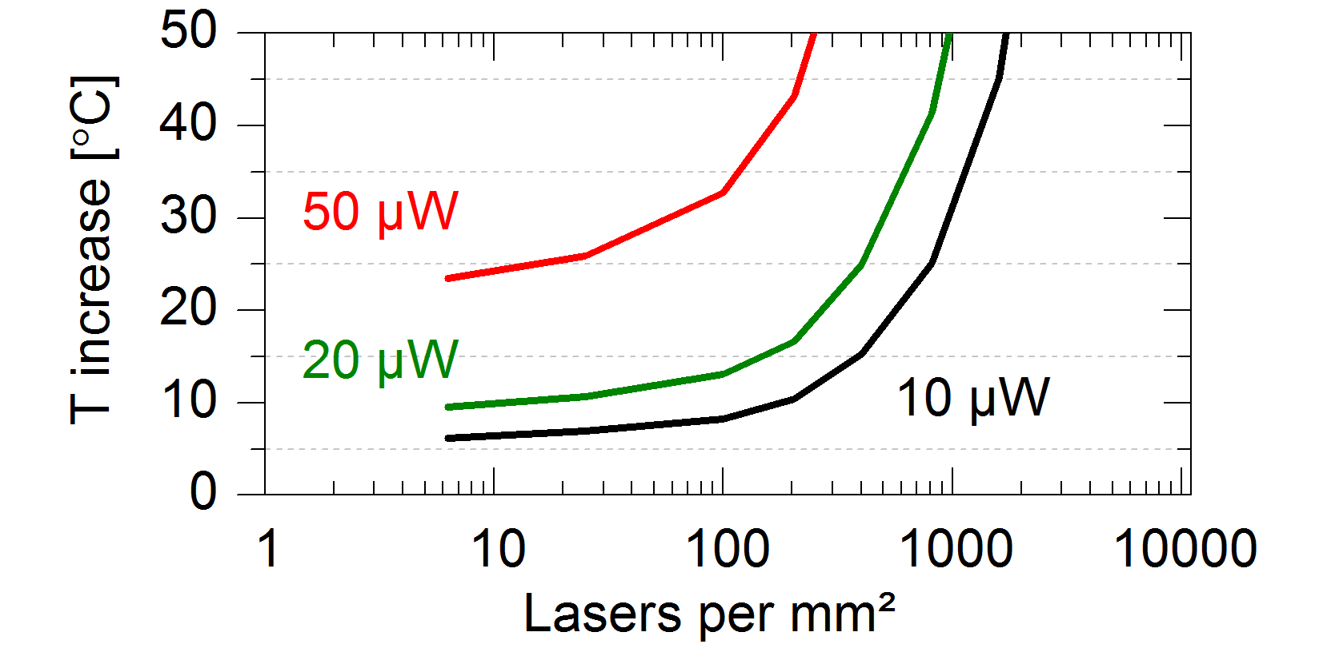
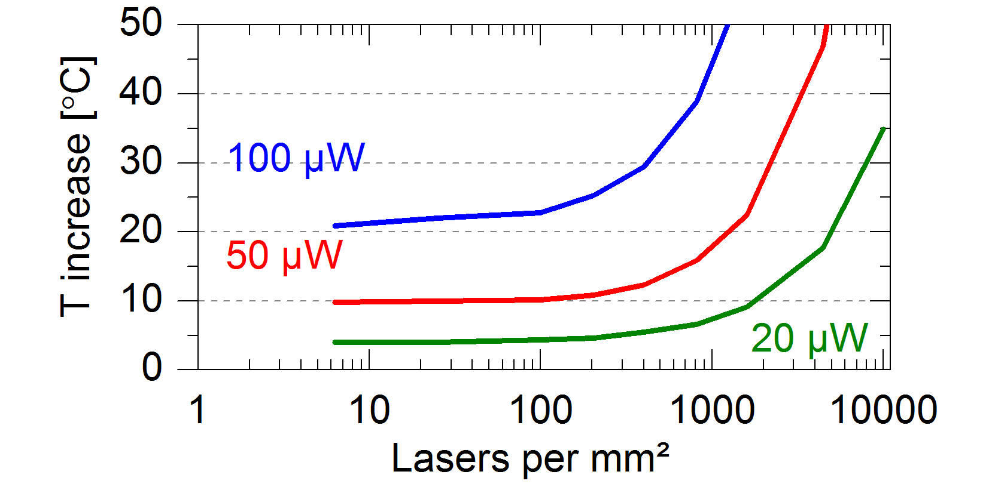
Task 3.1 Modelling of the Nanolaser
Output power and integration density
Fan cooled:
7 mW/mm²K ^{[1]}
Water cooled:
95 mW/mm²K ^{[2]}
Periodic report (M1-M18)
[1] Guenin B., Electronics Cooling, Vol. 16, No. 12, (2010)
[2] Colgan E.G. et al. , IEEE Transactions on components and packaging technologies, Vol. 30, No. 2, (2007)

Slide 12
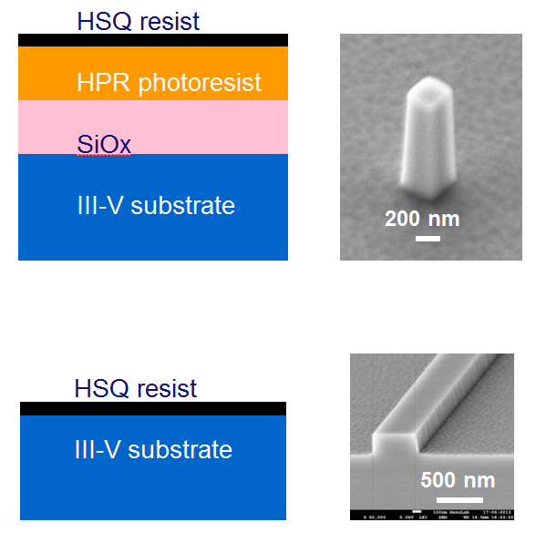
Task 3.3 Fabrication of the Nanolaser
Nanopillars
Waveguides
EBL + development
Polymer RIE
Nitride RIE
ICP-RIE
No sidewall roughness
High verticality is possible
EBL + development
ICP-RIE
Periodic report (M1-M18)

Slide 13
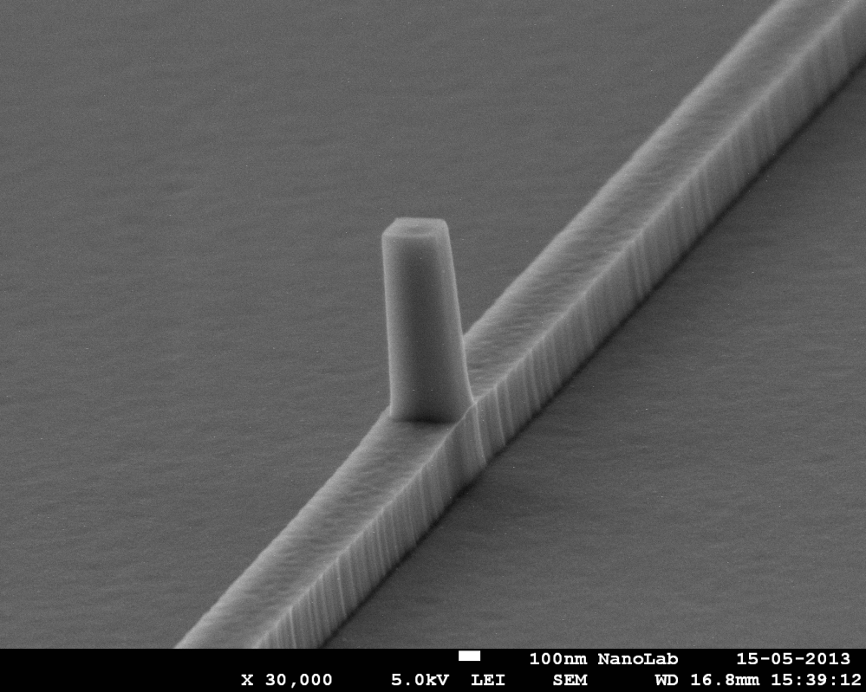
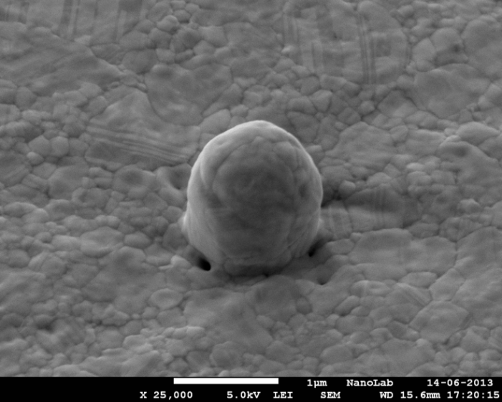
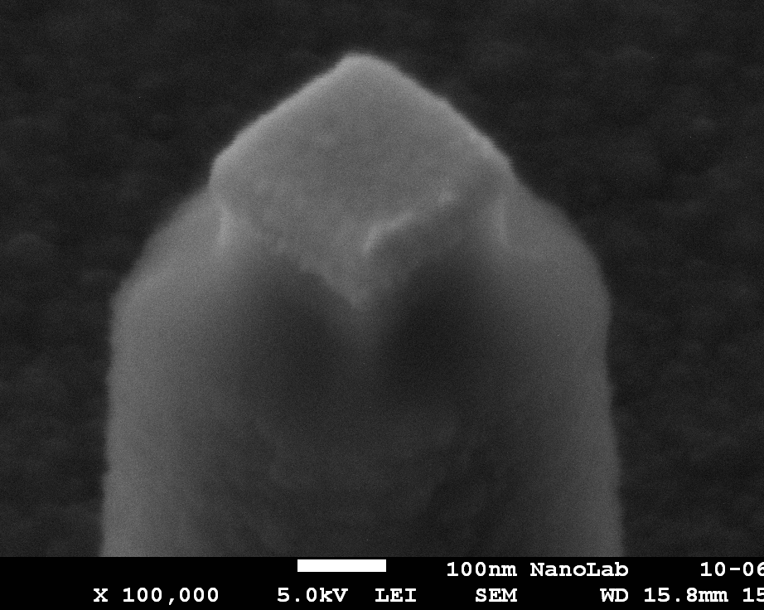
Task 3.3 Fabrication of the Nanolaser
Tests carried out in InP-wafers
A III-V wafer was grown and bonded to Si
Nanopillar on waveguide
Silver encapsulation
Ohmic contacts
SiOx
Periodic report (M1-M18)
Reported in MS10

Slide 14
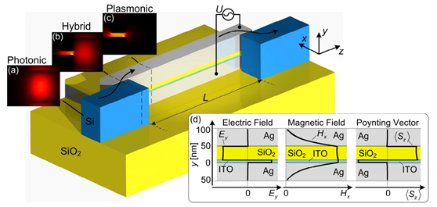
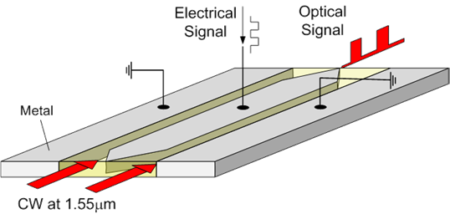
Plasmonic Modulator Approaches
SPP absorption modulator
SPP phase modulator
Reported in MS9 & D3.2

Slide 15
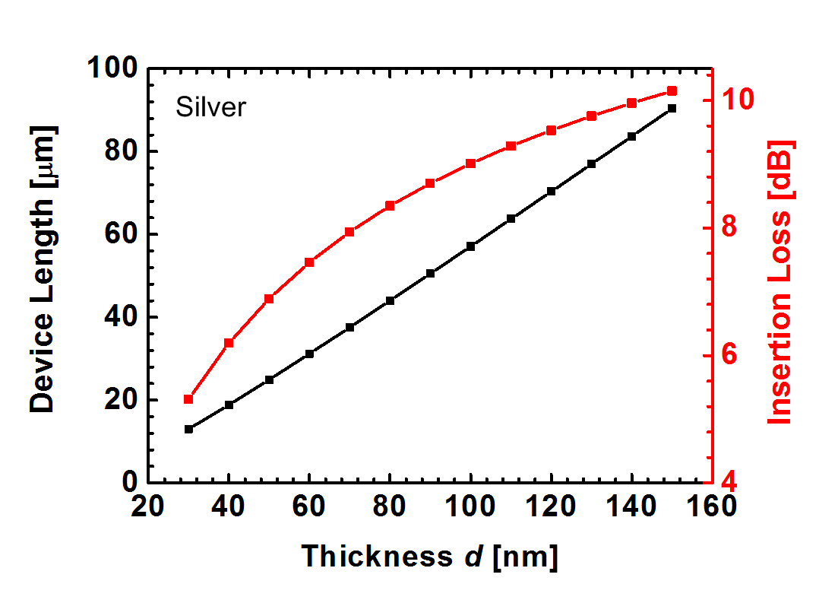
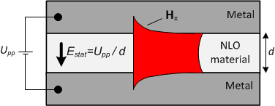
Task 3.2 Modelling of the Modulator
SPP phase modulator
U_{pp}=4.5V
Large figure of merit
Easy coupling structure
Easier fabrication

Slide 16
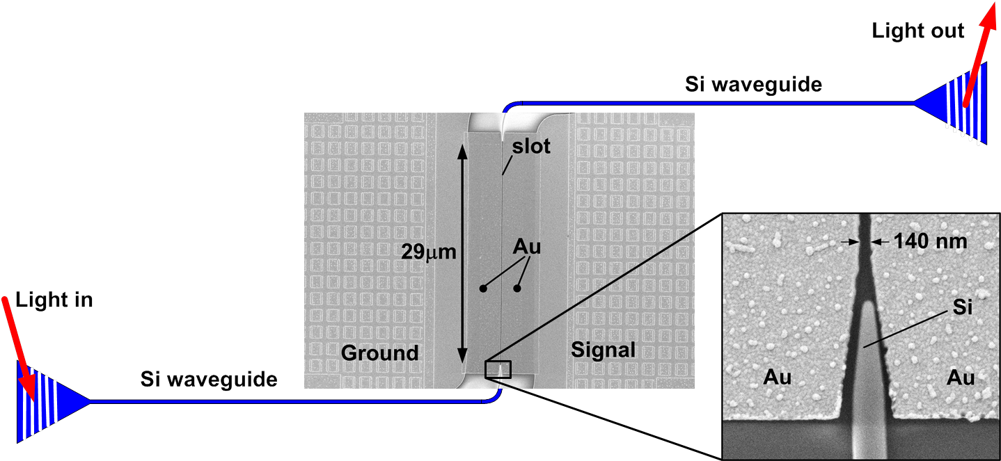
Task 3.4 Fabrication of the Modulator
Passive silicon-on-insulator (SOI) wafer processing
E-beam lithography for defining 140 nm wide slot in gold
Coating with an electro-optic polymer
Poling of electro-optic polymer with static electric field
Reported in MS11
A. Melikyan, et al. "Surface Plasmon Polariton High-Speed Modulator," in CLEO: 2013, PDP paper CTh5D.2

Slide 17
Task 3.4 Fabrication of the Modulator
Characterization results
r₃₃ ≈ 21 pm / V
V_{π}×L = 1.3 Vmm
V_{m} = 0.1 V
V_{m} = 0.8 V
65 GHz RF bandwidth (λ_{c} = 1.55μm)
Broadband optical operation (f_{m} = 45GHz)
A. Melikyan, et al. "Surface Plasmon Polariton High-Speed Modulator," in CLEO: 2013, PDP paper CTh5D.2

Slide 18
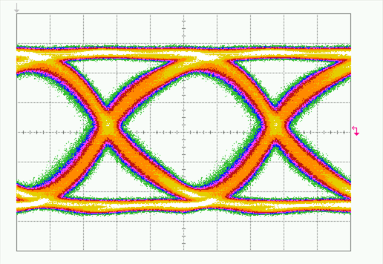
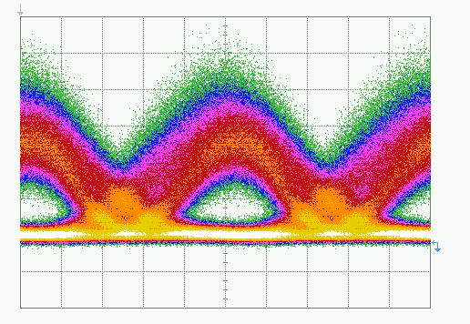
Task 3.4 Fabrication of the Modulator
Demonstration ‒ DPSK Data Modulation
Electrical signal (40Gbit/s)
Optical signal (40Gbit/s)
U_{pp} = 4.9V
BER = 6 × 10⁻⁵

Slide 19
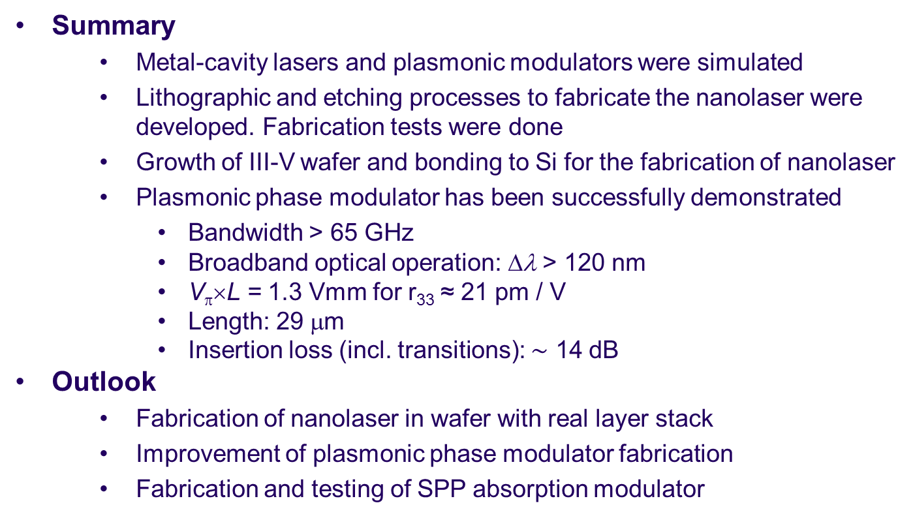
Summary and Outlook
  Summary
    Metal-cavity lasers and plasmonic modulators were simulated
    Lithographic and etching processes to fabricate the nanolaser were developed. Fabrication tests were done
    Growth of III-V wafer and bonding to Si for the fabrication of nanolaser
    Plasmonic phase modulator has been successfully demonstrated
Bandwidth > 65 GHz
Broadband optical operation: Δλ > 120 nm
V_{π}×L = 1.3 Vmm for r₃₃ ≈ 21 pm / V
Length: 29 μm
Insertion loss (incl. transitions): $\sim$ 14 dB
  Outlook
    Fabrication of nanolaser in wafer with real layer stack
    Improvement of plasmonic phase modulator fabrication
    Fabrication and testing of SPP absorption modulator

