Slide 1
Work Package 4 Presentation
Juan P. Martínez Pastor
University of Valencia (UVEG), Spain

Slide 2
Outline
WP4 Position in Project
Objectives
Tasks
Milestones and Deliverables
Status of Work
  Task 4.1. Design and modelling of Plasmonic Amplifier
  Task 4.3. Colloidal QDs for gain
  Task 4.4. QD-based Plasmonic Amplifier
  Task 4.5. QD-based Photodetectors
Summary and Outlook

Slide 3
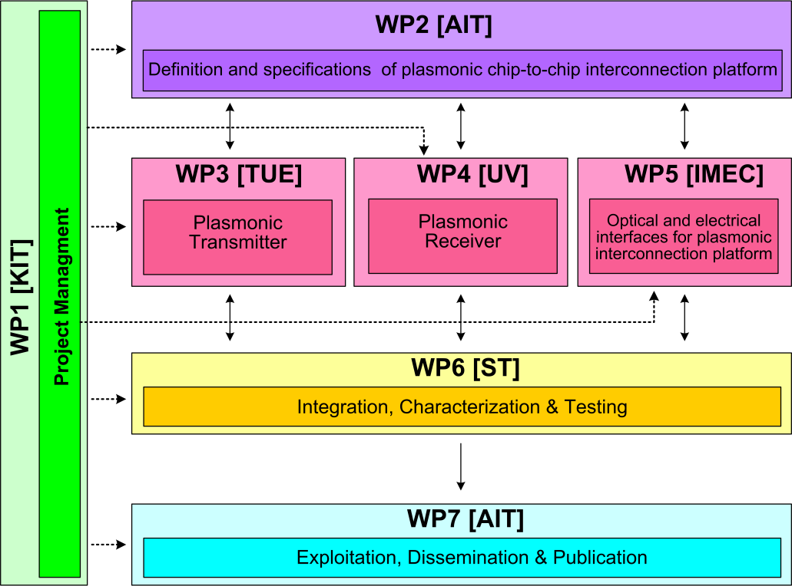




WP4 Position in Project
Contributors:

Slide 4
Tasks
 | Names of the Tasks | Time Period [months]
Task 4.1 | Design and modeling of plasmonic pre-amplifier | 1 – 18
Task 4.2 | Design and modeling of plasmonic photodetector | 1 – 24
Task 4.3 | Colloidal quantum dots with optimized gain and electrical injection scheme | 1 – 18
Task 4.4 | Fabrication and characterization of QD-based plasmonic amplifiers | 6 – 30
Task 4.5 | Fabrication of plasmonic QD based photodetectors | 1 – 36

Slide 5
Objectives
Simulation studies to optimize
  Plasmonic amplifier
  Plasmon/Photon detector
Fabrication
  Optically pumped plasmonic amplifier
  Electrically driven plasmonic amplifier
  Plasmon/Photon detector
Performance targets
  Plasmonic amplifier: 10 dB on-chip gain (5 μm wide)
  Detector: Responsivity > 1 A/W (EQE ≈ 80 %)

Slide 6
Milestones
 | Names of the Milestones | Month | Partner
MS16 | Decision on optimized structures for plasmonic amplifiers | 12 | UVEG
MS17 | Synthesis of nanoparticles with gain at 1550nm | 12 | UGENT
MS18 | Demonstration of conductive QD layers with photoconductive properties | 15 | UVEG
MS19 | Demonstration of metal-(lithographic) polymer and QD metal-(lithographic) polymer nanocompo-sites | 15 | UVEG
MS20 | Demonstration and decision on photodetector operation: nano-gap (MIM) vs. Schottky / heterostructure | 18 | UVEG
MS21 | Electroluminescence from QD stack embedded within conductive oxides (>1µW) | 18 | IMCV
MS22 | Demonstration of plasmonic amplifiers with optical pumping exhibiting 10dB gain | 21 | IMCV
MS23 | Operation of QD based photodetector with responsivity > 0.1 A/W | 24 | UVEG
MS24 | Demonstration of SPP amplifiers with electrical injection exhibiting 10dB/cm gain | 30 | UVEG

Slide 7
Deliverables
 | Names of the Deliverables | Month | Partner
D4.1 | Designs of plasmonic amplifiers | 18 | UVEG
D4.2 | Report on optical properties of QDs layers and polymer nanocomposites | 18 | UVEG
D4.3 | Designs of plasmonic photodetectors | 24 | UVEG
D4.4 | Report on SPP amplifiers by using QDs | 30 | IMEC
D4.5 | Report on plasmonic photodetectors | 33 | UVEG

Slide 8
Task 4.1 Design&Modelling of P.A.
Structure 1: Polymer-QD/Au amplifier (planar)
    Optimum structures for d₂ ≈ 2 μm (bottom cladding) and d₁+d₃ ≈ 5 μm (t = 30 nm): single mode operation and balance between mode confinement and propagation length.
    Results included in MS16 and D4.1.

Slide 9
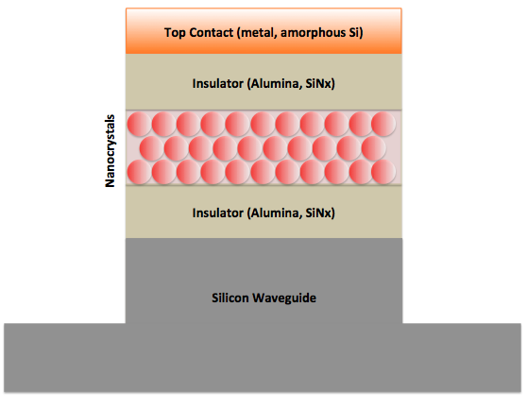
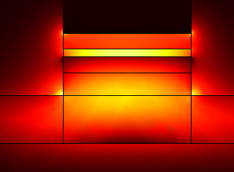
Task 4.1 Design & Modelling of P.A.
Structure 2: silicon-plasmonic amplifier
Au-contact
AlOx
QDOT-layer
AlOx
Si-waveguide
    Advantages:
      - Compatible with electrical injection
      - Light strongly concentrates in active layer due to plasmonic+slot effect
      - Easy coupling to silicon waveguides

Slide 10
Task 4.1 Design & Modelling of P.A.
Structure 2: silicon-plasmonic amplifier
Propagation Length (μm)
Confinement Factor
Transparancy Gain [1/μm]
Thickness QDOT layer [nm]
Thickness QDOT layer [nm]
Thinner QDOT-layer ➔ lower gain needed !

Slide 11
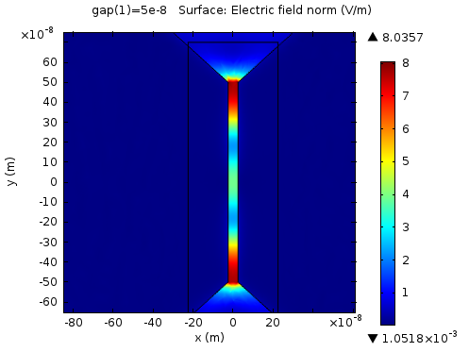
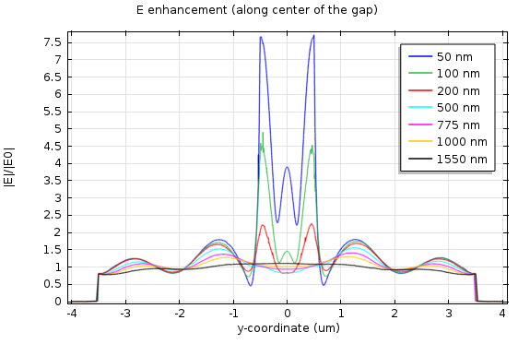
Task 4.2 Design & Modelling of P.D.
Focus on nanogap design for which electric field enhancement is possible by plasmonics associated to metal contacts:
COMSOL
1 μm
Y
    E-enhancement produced for sub-wavelength nanogap
    Fabrication under progress

Slide 12
Task 4.3 Colloidal QDs with gain …
QD materials (results included in MS17 and D4.2)
Issue – PbX chalcogenides show gain but limited to very high fluence and short gain lifetimes. Similar conclusion obtained in dielectric waveguides containing these materials.
Initial approach to solve this by heterostructure formation/engineering (PbX/CdX) not successful.
ALTERNATIVE: HgTe QDs
- Equivalent to successful CdX QDs
Synthesis accomplished
- IR region reached
    Amplified spontaneous emission currently studied on HgTe QDs

Slide 13
Task 4.3 Colloidal QDs with gain …
QD-layers:
absorption enhancement in quantum dot self-assembled monolayers
    Absorption enhancement E by dipole-dipole interaction due to self-assembling: dependence on ligand length and QD (PbS) diameter.

Slide 14
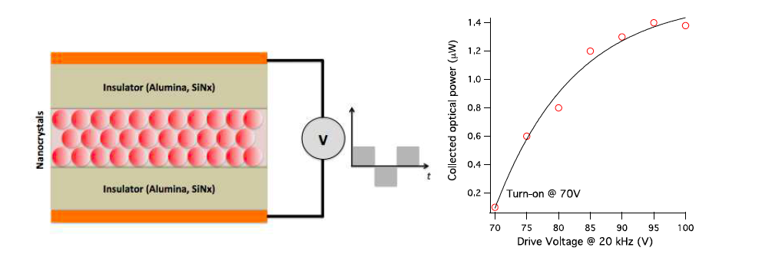
Task 4.3 Colloidal QDs with gain …
QD-layers: electrically driven Plasmonic Amplifier
    AC electroluminescence
    MS21

Slide 15
Task 4.4 Fabrication of QD-based PA
Structure 1: Polymer-QD/Au amplifier (planar)
d₃= 5 µm
d₁= 0.7 µm
T = 25 nm
d₂= 2 µm
    Pumping is not attenuated because travelling through PMMA.
    Emitted light couples to TM (LR-SPP) and TE modes, but are spatially separated.
    Use of HgTe QDs for gain.
    D4.2

Slide 16

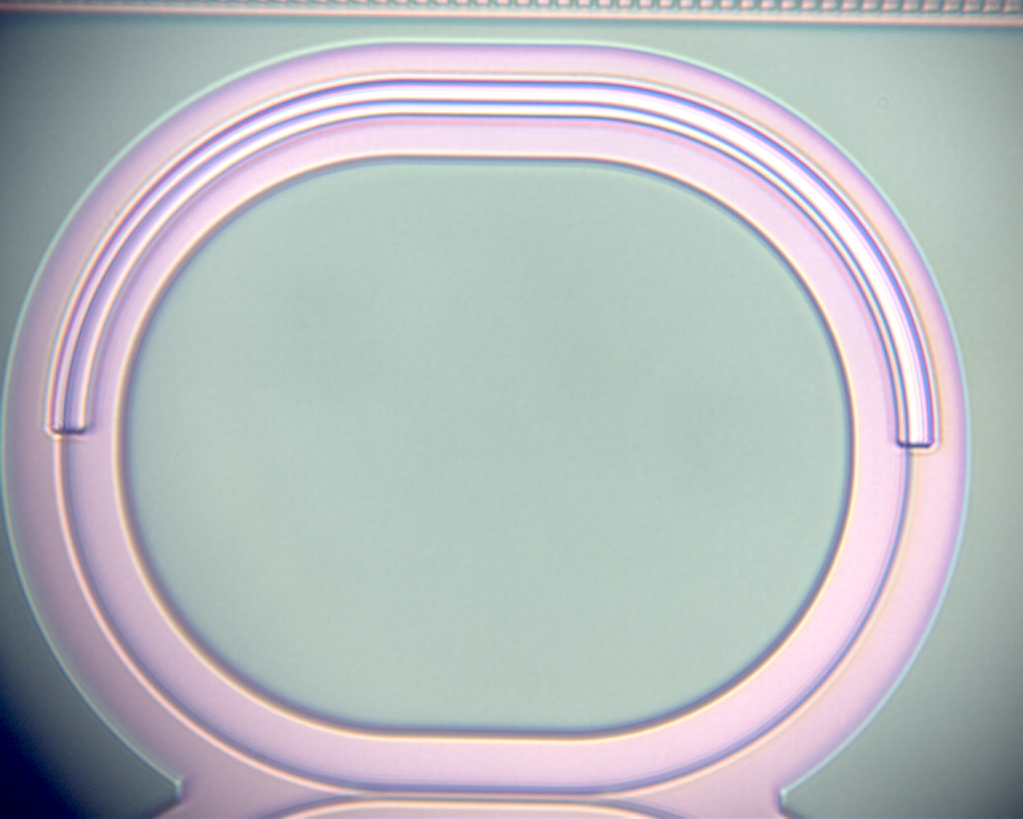

Task 4.4 Fabrication of QD-based PA
Hybrid silicon-plasmonic amplifier
Silicon waveguides + QDOT layer
On resonator structure
After Gold Deposition

Slide 17
Task 4.4 Fabrication of QD-based PA
Hybrid silicon-plasmonic amplifier
After Gold Deposition
Transmission measurement
Simulation: 0.8 dB/μm and measurement: 1.4 dB/μm
Reasonable agreement (roughness gold layer)
Next steps:
Measure Electroluminescence
Measure transmission under optical + electrical pumping

Slide 18
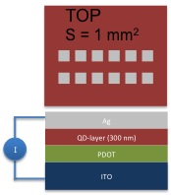
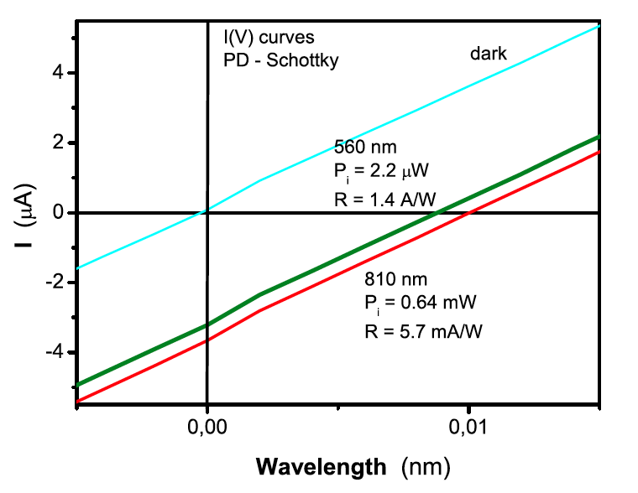
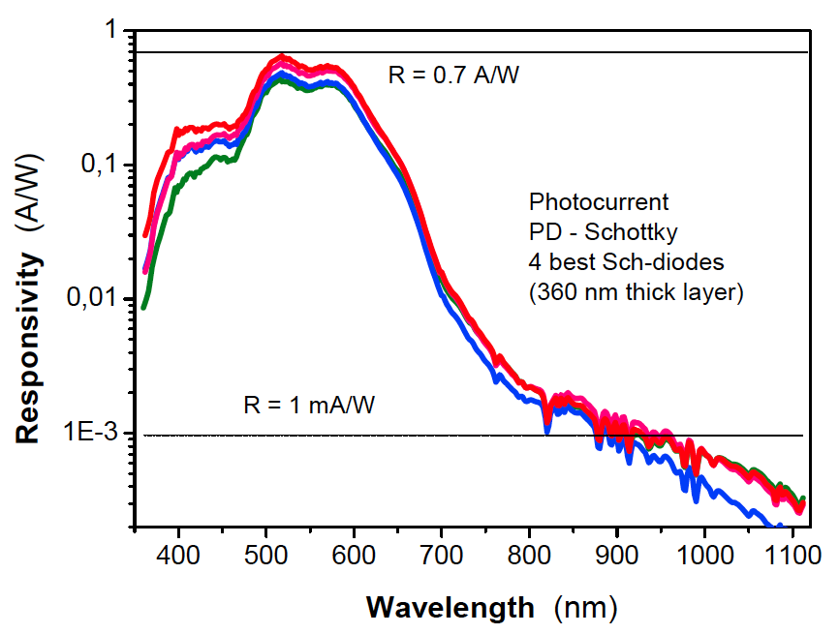
Task 4.5 Fabrication of Photodetector
QD-Schottky photodetectors
560 nm
P_{i}= 4.4 μW
R= 0.7 A/W
810 nm
P_{i}= 1.3 mW
R= 2.9 mA/W
Bias (V)
    QD solids (layer-by-layer method) using MPA ligands stable in air during months.
    Limitation by series resistance but photocurrent is not seriously affected
    Improvement of stoichiometry and purification leaded to better Responsivities
    Improvement are possible by increasing thickness, roughness reduction and electrode optimization.

Slide 19
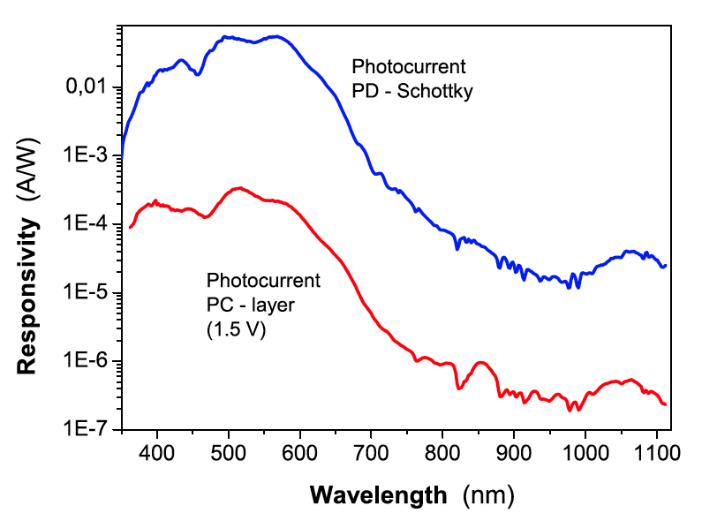
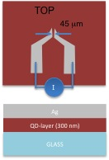
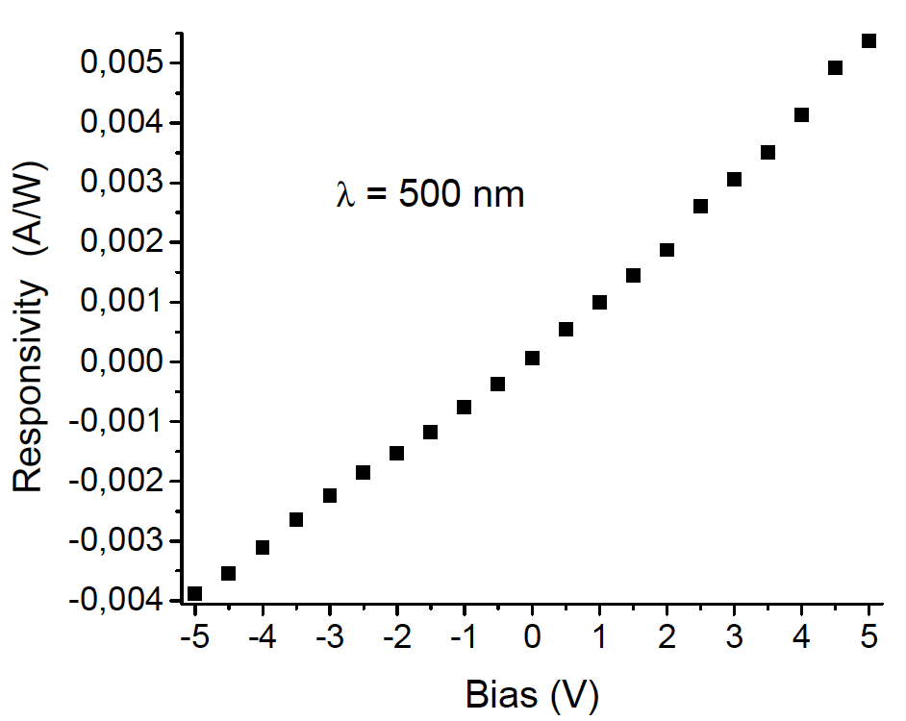
Task 4.5 Fabrication of Photodetector
QD-microgap photoconductors
    Responsivity in PC exhibit similar spectral dependence, but 2-3 orders of magnitude smaller than measured in Schottky photodiodes.
    Improvement is possible by increasing thickness, roughness reduction and electrode separation (< diffusion length).
    Nanogap design would lead to plasmonic enhancement of photodetection.

Slide 20
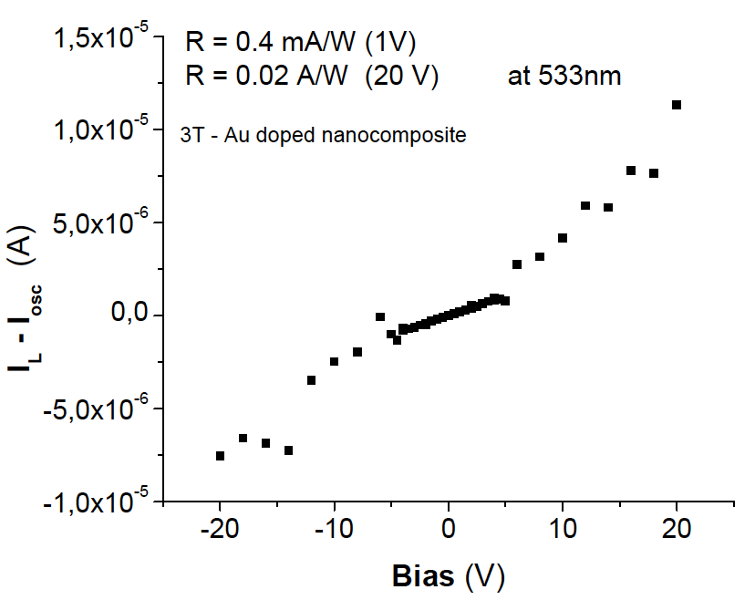
Task 4.5 Fabrication of Photodetector
Photodetection based on conductive polymers
    These polymers + Au NPs exhibit enhanced photoconductivity at the Localized Surface Plasmon Resonance, possibly by electron photoemission.

Slide 21
Summary and Outlook
Plasmonic Amplifier:
- PbX/CdX hetero-nanostructures emitting at IR with high QY and exhibiting ASE
- Design of optimized structures for SPP amplification using QD doped polymers
- Selection of best nanostructures for polymer based waveguides with (saturating) gain: new materials needed
- Different plasmonic IMI waveguide structures were tested
- Si-based waveguides with top QD-layer were tested: dipole-dipole absorption enhancement by QD self-assembling
- Demonstrated AC electroluminescence using QD layers
- Nano/micro-patterns directly developed using e-beam/UV-photolithography resists containing Ag-NPs
Photodetector:
PbS QD-solids were developed by using layer-by-layer method in air
Schottky photodetectors: 0.7 A/W and EQE ≈ 100 % for λ < 600 nm (thicker layers needed at IR)
Plasmonic nanogap structures modelled using Comsol
Conducting polymers + metal NPs exhibit photoconductivity at their Localized Surface Plasmon Resonance

