Slide 1
Work Package 5 Presentation
Dries Van Thourhout
IMEC, Belgium

Slide 2
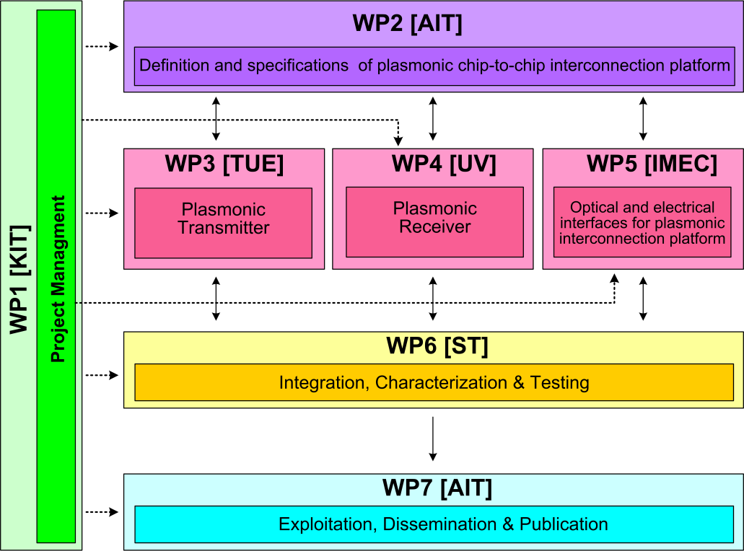



WP3 Position in Project
Contributors:

Slide 3
Objectives
Overall Objective :
Specific Objectives:
  Coupling light between silicon backbone and plasmonic devices
  Beam Shaping grating couplers to direct light between chips
  Compact filters for noise suppression
  Specify and implement Dual Die Communication Module (DDCM)
Design and implement optical and electrical interfaces for plasmonic interconnect

Slide 4
Tasks
 | Names of the Tasks | Time Period [months]
Task 5.1 | Modeling and fabrication of coupling Si waveguide to plasmonic waveguide | 1 – 15
Task 5.2 | Design and fabrication of Si beamshaper | 1 – 30
Task 5.3 | Design and fabrication of passive ultra-compact components as filters | 1 – 15
Task 5.4 | Signal generation module design | 4 – 12
Task 5.5 | Signal Generation Module implementation via FPGA | 13 – 24

Slide 5
Milestones
 | Names of the Milestones | Month | Partner
MS25 | Decision on optimized plasmonic waveguide couplers | 6 | KIT
MS26 | Fabrication of plasmonic waveguide couplers with less than 3 dB coupling loss | 12 | KIT
MS27 | Design of first generation beam shapers and compact optical filters | 12 | IMEC
MS28 | DDCM with electrical PHY design and verification | 12 | ST
MS29 | Data codecs for power consumption reduction | 15 | ST
MS30 | Decision on plasmonic waveguide couplers with less than 3 dB coupling loss | 15 | KIT
MS32 | Fabrication of compact optical filters and first generation beam shapers | 18 | IMEC
MS33 | Data codecs for error detection and correction | 18 | ST

Slide 6
Milestones
 | Names of the Milestones | Month | Partner
MS33 | Design of second generation beam shapers | 24 | imec
MS34 | Generic DDCM compatible with plasmonic-based PHY | 24 | ST
MS35 | Fabrication of second generation beam shapers | 30 | imec
MS36 | DDCM evolution for NiP solutions | 30 | ST

Slide 7
Deliverables
 | Names of the Milestones | Month | Partner
D5.1 | DDCM specification document | 6 | ST
D5.2 | DDCM with electrical PHY design and verification data base | 12 | ST
D5.3 | Compact optical filters (2nm bandwidth, >30nm FSR) and first generation beam shapers | 21 | imec
D5.4 | Generic DDCM compatible with plasmonic-based PHY specification document | 24 | ST
D5.5 | Report on plasmonic waveguide couplers | 24 | imec
D5.6 | Generic DDCM compatible with plasmonic-based PHY design and verification data base | 30 | st
D5.7 | Second generation beam shapers (distance 1mm, with bandwidth > 10nm and efficiency > 3dB) | 33 | imec

Slide 8
Tasks
 | Names of the Tasks | Time Period [months]
Task 5.1 | Modeling and fabrication of coupling Si waveguide to plasmonic waveguide | 1 – 15
Task 5.2 | Design and fabrication of Si beamshaper | 1 – 30
Task 5.3 | Design and fabrication of passive ultra-compact components as filters | 1 – 15
Task 5.4 | Signal generation module design | 4 – 12
Task 5.5 | Signal Generation Module implementation via FPGA | 13 – 24

Slide 9
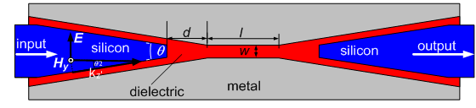
Task 5.1 Modeling and Fabrication of SPP Couplers
Finite Difference Time Domain (FDTD) method is used
Couplers are optimized for their highest transmission
θ
Reported in MS25 (month 6)

Slide 10
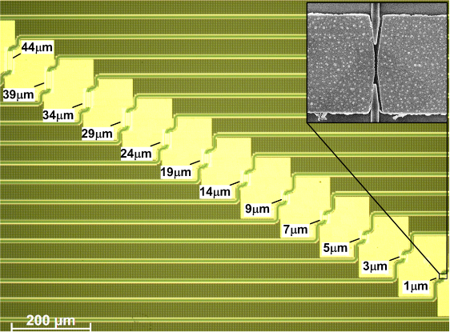
Task 5.1 Modeling and Fabrication of SPP Couplers
Silicon-on-insulator wafer processing at IMEC
Post processing at KIT for defining metallic slots
Coating with polymer cladding

Slide 11
Task 5.1 Modeling and Fabrication of SPP Couplers
Coupling loss is ~3dB per metal taper!
Reported in MS26 (month 12) + MS30 (month 15)

Slide 12
Tasks
 | Names of the Tasks | Time Period [months]
Task 5.1 | Modeling and fabrication of coupling Si waveguide to plasmonic waveguide | 1 – 15
Task 5.2 | Design and fabrication of Si beamshaper | 1 – 30
Task 5.3 | Design and fabrication of passive ultra-compact components as filters | 1 – 15
Task 5.4 | Signal generation module design | 4 – 12
Task 5.5 | Signal Generation Module implementation via FPGA | 13 – 24

Slide 13
Task 5.2 – Optical Beam Steerers
Global idea: Couple light between two chips by vertical grating couplers
Objective for first project half:
Develop movable gratings to facilitate easy alignment
Target: 1 μm movement in plane
Status:
  Several generations of devices designed
  Developed underetching process compatible with SOI-platform
  Characterised devices

Slide 14
Task 5.2 – Optical Beam Steerers
Movable grating coupler platform
Grating coupler
Comb Actuator

Slide 15
Task 5.2 – Optical Beam Steerers
Relatively large structures: need dedicated release process
Developed using Vapor HF (VHF) under etch: avoids stiction

Slide 16
Task 5.2 – Optical Beam Steerers
Status:
  Demonstrated ±1μm lateral movement
  Forward movement not yet successful
Next steps:
  Replace standard grating coupler by focusing grating coupler
  Single device ➔ collectively aligned array of grating couplers
  Move towards more compact actuators (e.g. V-beam)

Slide 17
Tasks
 | Names of the Tasks | Time Period [months]
Task 5.1 | Modeling and fabrication of coupling Si waveguide to plasmonic waveguide | 1 – 15
Task 5.2 | Design and fabrication of Si beamshaper | 1 – 30
Task 5.3 | Design and fabrication of passive ultra-compact components as filters | 1 – 15
Task 5.4 | Signal generation module design | 4 – 12
Task 5.5 | Signal Generation Module implementation via FPGA | 13 – 24

Slide 18
Task 5.3 – Optical Filter
Single ring
3dB Bandwidth = 0.34nm
Crosstalk <-20dB
Size: 25x25 um²
Evaluated different types of filters
Specifications of proposal fulfilled
Ready for integration in demonstrator
Double ring
3dB Bandwidth = 1.12nm
Crosstalk <-20dB
Size: 50x25 um²
Reported in MS27 (month 12) + MS32 (month 18)

Slide 19
Tasks
 | Names of the Tasks | Time Period [months]
Task 5.1 | Modeling and fabrication of coupling Si waveguide to plasmonic waveguide | 1 – 15
Task 5.2 | Design and fabrication of Si beamshaper | 1 – 30
Task 5.3 | Design and fabrication of passive ultra-compact components as filters | 1 – 15
Task 5.4 | Signal generation module design | 4 – 12
Task 5.5 | Signal Generation Module implementation via FPGA | 13 – 24

Slide 20
Task 5.4 Main achievements
MS29 (Data codecs for power consumption reduction) document completed, delivered and blocks implemented
MS32 (Data codecs for error detection and correction) document completed and delivered
Generic N to M serializer/deserializer implemented and functionally verified
  To be characterized in terms of area occupancy and speed
Generic bi-synchronous FIFO implemented, verified and characterized
  Area and timing are size-dependent, maximum speed is 800 MHz

Slide 21
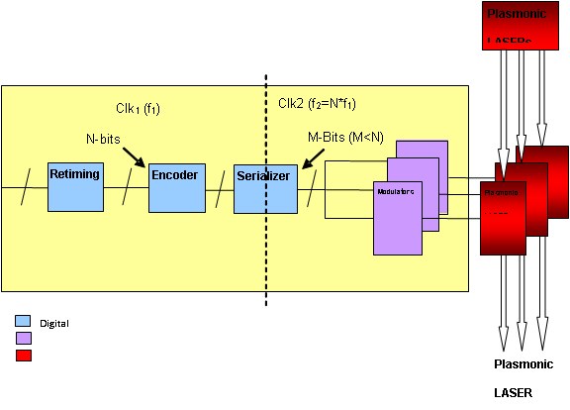
Task 5.4 Main achievements

Slide 22
Tasks
 | Names of the Tasks | Time Period [months]
Task 5.1 | Modeling and fabrication of coupling Si waveguide to plasmonic waveguide | 1 – 15
Task 5.2 | Design and fabrication of Si beamshaper | 1 – 30
Task 5.3 | Design and fabrication of passive ultra-compact components as filters | 1 – 15
Task 5.4 | Signal generation module design | 4 – 12
Task 5.5 | Signal Generation Module implementation via FPGA | 13 – 24

Slide 23
Task 5.5 Main achievements
FPGA mapping activity
  Completed TLM (Transaction Level Model) view of the whole platform
  First release done
  First platform characterization in progress

Slide 24
Summary
Progress fully according to plan
Optical interfaces designed, fabricated and tested
  Coupler dielectric <> plasmonic waveguide
  Optical filters
  Optical beam shapers
Electrical interfaces designed and implemented

Slide 25
Outlook
Task 5.1 – Couplers
  Completed
Task 5.2 – Beam shapers
  Design focussing gratings to implement on moving platform
Task 5.3 – Filters
  Completed
Task 5.4 – Signal generation module design
  Completed
Task 5.5 – DDCM FPGA implementation
  Ongoing, test equipment arrived in Catania

