Slide 1
Work Package 6: Integration, Characterization & Testing
Alberto Scandurra, (ST, Italy)

Slide 2
Outline
WP6 Position in Project
Objectives
Tasks
Milestones and Deliverables
Status of Work
Summary and Outlook

Slide 3
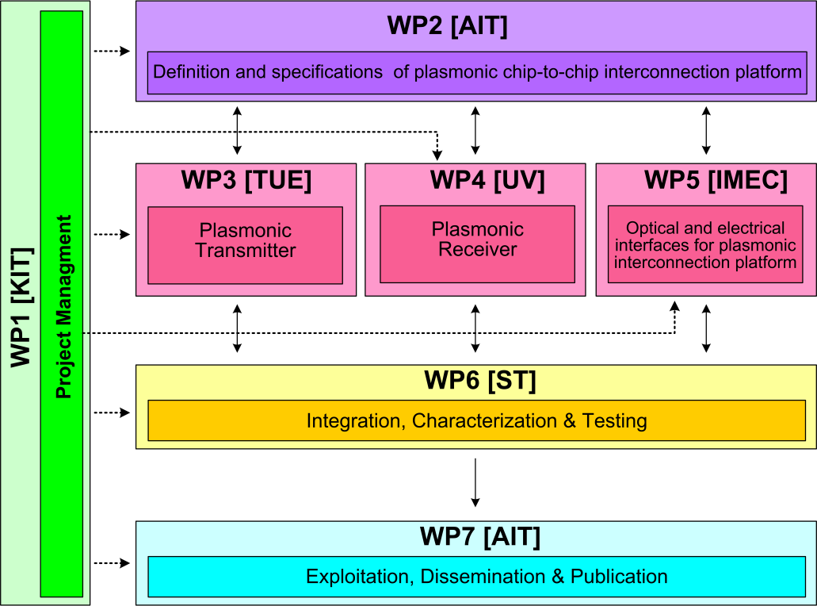






WP7 Position in Project
Contributors:

Slide 4
Objectives
Characterization and testing of active and passive plasmonic devices
Integration of plasmonic devices with the electrical parts the chip-to-chip communication structure is composed of
Characterization and testing of a complete System in Package

Slide 5
Tasks
 | Names of the Tasks | Time Period [months]
Task 6.1 | Characterization of active and passive plasmonic devices | 7 – 33
Task 6.2 | Assembly and packaging of plasmonic devices into System in Package | 30 – 36
Task 6.3 | Plasmonic chip to chip interconnect prototype testing and evaluation | 32 – 36
Task 6.4 | System-in-Package integration and characterization | 22 - 36

Slide 6
Milestones
 | Names of the Milestones | Month | Partner
MS37 | Plasmonic active device characterization results |  | KIT
MS38 | Plasmonic passive components characterization results with a 1dB coupling loss | 24 | KIT
MS39 | Concept for system integration developed | 27 | AIT
MS40 | Individual plasmonic devices characteriaztion, testing and evaluation | 30 | TU/e
MS41 | Chip to chip interconnect characterization | 33 | ST
MS42 | Plasmonic components integration to demonstrate chip-to-chip interconnect | 33 | AIT
MS43 | Plasmonic chip to chip interconnect prototype testing and evaluation | 36 | ST

Slide 7
Deliverables
 | Names of the Deliverables | Month | Partner
D6.1 | Report on characterization results of all plasmonic devices | 27 | TU/e
D6.2 | Report on characterization results of all optical interface plasmonic passive components | 27 | KIT
D6.3 | Report on chip to chip interconnect characterization | 36 | ST
D6.4 | Report on plasmonic chip-to-chip interconnect prototype testing and evaluation | 36 | AIT

Slide 8
Task 6.1 Characterization of active and passive plasmonic devices
Started testing and characterization of all passive and active plasmonic devices (AIT)
Fabricated various plasmonic phase modulators with various lengths in order to estimate the coupling losses of metal taper mode converters (KIT)
Electro optical characterization of a 34 μm long plasmonic phase modulator with 200 nm wide metallic slot
  Flat optical transmission with a 13 dB insertion loss
  Flat frequency response up to at least 45 GHz

Slide 9
Task 6.4 System-in-Package integration and characterization
Demonstrator
Transaction Level Model (TLM) view of the validation platform
  Stimuli generators models
  Traffic destinations models
  Chip to Chip communication module VHDL view integrated by means of a TLM wrapper
FPGA equipment identified (Zebu), acquired and started to be studied (ST)

Slide 10
Summary and Outlook
  Summary
    Started characterization and testing of all active and passive plasmonic devices
    Fabricated and characterized some plasmonic phase modulators
    Developed a Transaction Level Model (TLM) view of the validation platform
  Outlook
    Complete characterization and testing of all active and passive plasmonic devices
    Integration of plasmonic devices with the electrical parts the chip-to-chip interconnect
    Characterization and testing of a complete System in Package

