Slide 1
Work Package 7: Dissemination & Exploitation
Emmanouil-P. Fitrakis, Dimitrios Klonidis, Ioannis Tomkos (AIT, Greece)

Slide 2
Outline
WP7 Position in Project
Objectives
Tasks
Milestones and Deliverables
Status of Work
Summary and Outlook

Slide 3
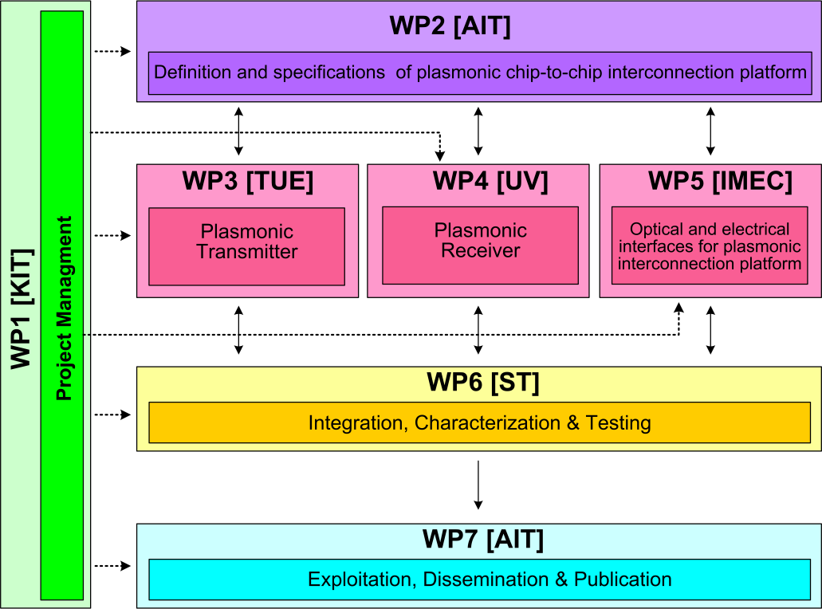






WP7 Position in Project
Contributors:

Slide 4
Objectives
Dissemination through paper submission to high quality scientific journals and conferences
Organizing workshops & seminars on NAVOLCHI technology
Dissemination through the website
Issuing press releases and brochures
Patents
Theses at partners’ institutes

Slide 5
Tasks
 | Names of the Tasks | Time Period [months]
Task 7.1 | Dissemination of results | 1 – 36
Task 7.2 | Exploitation of results | 12 – 36
Task 7.3 | Promotion of Results | 24 – 36

Slide 6
Milestones
 | Names of the Milestones | Month | Partner
MS44 | Dissemination of activities in the project’s web site and continuous update | 1 | KIT
MS45 | Press release on start of project distributed to the public | 2 | AIT
MS46 | Identification of possible contributions to the industrial partners for commercialization | 15 | ST
MS47 | Organization of workshop on silicon photonics interface for chip-to-chip communication | 34 | TU/e
MS48 | Public web site for NAVOLCHI prepared to stay open for at least another year | 36 | KIT
MS49 | Press release distributed comprising key results with a public target audience | 36 | AIT

Slide 7
Deliverables
 | Names of the Deliverables | Month | Partner
D7.1 | First report on NAVOLCHI dissemination and promotion activities | 18 | ST
D7.2 | First report on NAVOLCHI exploitation activities | 18 | AIT
D7.3 | Mirror Deliverable of D7.1, which will be available to the public on the website | 18 | TU/e
D7.4 | Intermediate report on recent achievements | 18 | AIT
D7.5 | Reports on the impact and outcome of the organized promotion events | 36 | AIT
D7.6 | Final report on NAVOLCHI dissemination and promotion activities | 36 | AIT
D7.7 | Dissemination kit | 36 | AIT

Slide 8
Task 7.1 Dissemination
I. Activities
Journal articles: 8 accepted + 5 under review
1 scientific magazine cover article (Optics & Photonics News, May 2013)
37 conference papers and talks (all)
1 white paper on innovation potential (AIT, all)
Project website (KIT):
Brochure with NAVOLCHI activities and goals (AIT, all)
Press release on start of project (AIT, all)
www.navolchi.eu

Slide 9
Task 7.1 Dissemination
II. Journal Publication Details Part 1/2
(UVEG) R. Abargues et al, "Patterning of conducting polymers using UV lithography: The in-situ polymerization approach", J. of Physical Chemistry C, 22866698, ACS Publications (2012).
(UVEG) H. Gordillo et al, "Polymer/QDs nanocomposites for wave-guiding applications”, J. of Nanomaterials, 960201 (2012).
(UVEG) A. Bueno et al, "Temperature sensor based on colloidal quantum dots - PMMA nanocomposite waveguides", IEEE Sensors Journal 12, 3069-3074 (2012).
(UVEG) I. Suarez et al, “Color tuning and white light by dispersing CdSe, CdTe and CdS in PMMA nanocomposite waveguides”, IEEE Photon. J. 5, 2201412 (2013).
(UVEG) H. Gordillo et al, “Color tuning and white light by dispersing CdSe, CdTe and CdS in PMMA nanocomposite waveguides”, submitted (under revision) to IEEE Photonics J.
(UVEG) P. J. Rodriguez-Canto et al, “UV-Patterning of In-Situ Synthesized Conducting Polymers for Polymeric Display Devices”, submitted to the Synthetic Metals J.

Slide 10
Task 7.1 Dissemination
II. Journal Publication Details Part 2/2
(UVEG) P. J. Rodriguez-Canto et al, “Novel patternable and conducting metal-polymer nanocomposite: a step toward advanced mutlifunctional materials”, submitted to the SPIE Journal.
(UVEG) R. Abarguez et al, “Metal-polymer nanocomposite resists: a step toward in situ nanopatterns metallization”, submitted to the SPIE Journal.
(UGENT+IMEC) B. De Geyter et al, “Broadband and picosecond intraband absorption in lead-based colloidal quantum dots” ACS Nano 6, 6067-6074 (2012).
(UGENT+IMEC) P. Geiregat et al, Giant and Broad-band absorption enhancement in colloidal quantum dot monolayers through dipolar coupling”, ACS Nano, 7(2),987-993.
(UGENT+IMEC) B. De Geyter et al, “From fabrication to mode mapping in silicon nitride microdisk with embedded colloidal quantum dots”, Applied Physics Letters, 101(16), p.161101-4 (2012).
(UGENT+IMEC) A. Omari et al, “Light Absorption in Hybrid Silicon-On-Insulator/Quantum Dot Waveguides” , submitted to Phys Rev.
(UGENT) Y. Justo et al, "Multiple dot-in-rod PbS/CdS heterostructures with high photoluminescence quantum yield in the near-infrared", J. of the American Chemical Society 134, 5484-5487 (2012).
for the full list of publications, see NAVOLCHI website (www.imt.kit.edu/projects/navolchi/publications/index-publications.html)

Slide 11
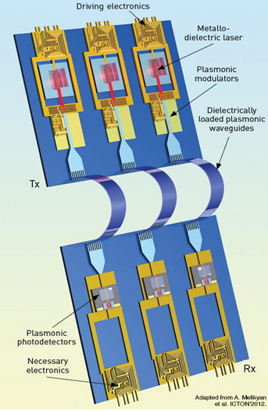
Task 7.1 Dissemination
III. Scientific Magazine Cover Article
Plasmonic Communications: Light on a Wire; May 2013 cover article for Optics & Photonics News
J. Leuthold et al (Prof. Leuthold invited, all)
Contents:
Plasmonic Waveguides
Plasmonic lasers & metal-cavity nanolasers
Plasmonic Modulators
Plasmonic Photodetectors & Amplifiers

Slide 12
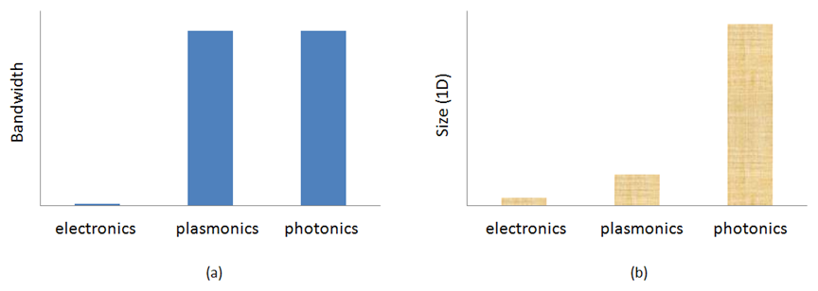
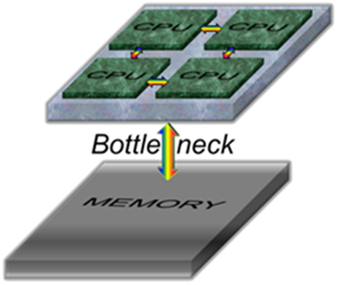
Task 7.1 Dissemination
IV. White Paper
Plasmonic technology innovation: The chip-to-chip interconnect;
E. P. Fitrakis et al (AIT, all)
Chip-to-chip optical interconnects: revenue not expected until 2018, due to technological and cost challenges.
But are already considered as an enabling technology, due to increasing board-level communication speeds.

Slide 13
Task 7.2 Exploitation
I. Intellectual Property
Patent:
Method to obtain metallic structures of nano- and micro-metric size from lithographic resists based on nanocomposites; (P201201282)
Rafael Abargues, Pedro Cantó Rodríguez, Mari Luz Martínez Marco, Juan Martínez Pastor, José Luis Valdés;
Owner: University Of Valencia and Intenanomat SL.

Slide 14
Task 7.2 Exploitation
II. Theses
(KIT, MSc) Calus Gaertner,“Plasmonic Modulators”.
(UVEG, PhD) Henry Gordillo Millán, on Fabrication and characterization of polymer doped with quantum dots for photonic applications.
(UVEG, PhD) Mari Luz Martínez Marco, on conducting polymers containing metal nanoparticles and metal nano- and micro-structures using polymer-based patterns.
(UVEG, MSc) Víctor Latorre Garrido, “Optical and electrical properties of PMMA-3T-Au”.
(UGent+IMEC, MSc) Floris Taillieu, “Broadband colloidal quantum dot LED for active plasmonics”.
(UGent+IMEC, MSc) Qi Lu, “Colloidal Nanocrystal Light Sources on Silicon”.
(UGent, PhD) Sukumar Rudra, “Diffractive Micro-Electromechanical Structures in Si and SiGe”.

Slide 15
Task 7.3 Promotion
Workshops & Seminars
NAVOLCHI workshops on:
Plasmonics-based components at ICTON 2012 (Warwick, UK), (AIT, KIT)
  Communication was established with plasmonics-related EU-funded project PLATON
CMOS-based plasmonics at ICTON 2013 (Cartagena, Spain) (AIT, KIT)
(www.ict-platon.eu)
NAVOLCHI open seminar on:
Plasmonic communications and innovation (Attiki, Greece), (AIT). Students and Professionals.

Slide 16
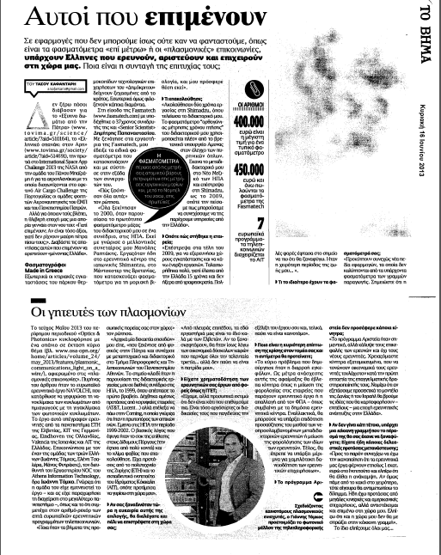
Task 7.3 Promotion
NAVOLCHI in the Greek News
Ioannis Tomkos (AIT) interview in one of the most popular newspapers in Greece (“Vima Kyriakis”, typically sells ~ 100’000 copies/issue) on 16/6/2013, with focus on NAVOLCHI.
(article title translates to “The plasmon charmers”)

Slide 17
Summary and Outlook
  Summary
    Dissemination: 14 (9+5 subm.) journals, 37 conferences, 1 scientif. magazine, 1 white paper, website, press release, brochure
    Exploitation: 1 patent, 7 PhD and MSc theses
    Promotion: 2 workshops, 1 seminar, newspaper article
  Outlook
    More journals/conferences
    Workshops/seminars
    Patents

