Slide 1
NAVOLCHI, Eindhoven Meeting
28 January 2014
Work Package 2: Definition and Specifications of Plasmonic Chip-to-Chip Interconnection Platform
Christoforos Kachris, Emmanouil-P. Fitrakis, Ioannis Tomkos
(AIT, Greece)

Slide 2
Outline
WP2 Position in Project
Objectives
Tasks
Milestones and Deliverables
Status of Work
Summary and Outlook

Slide 3
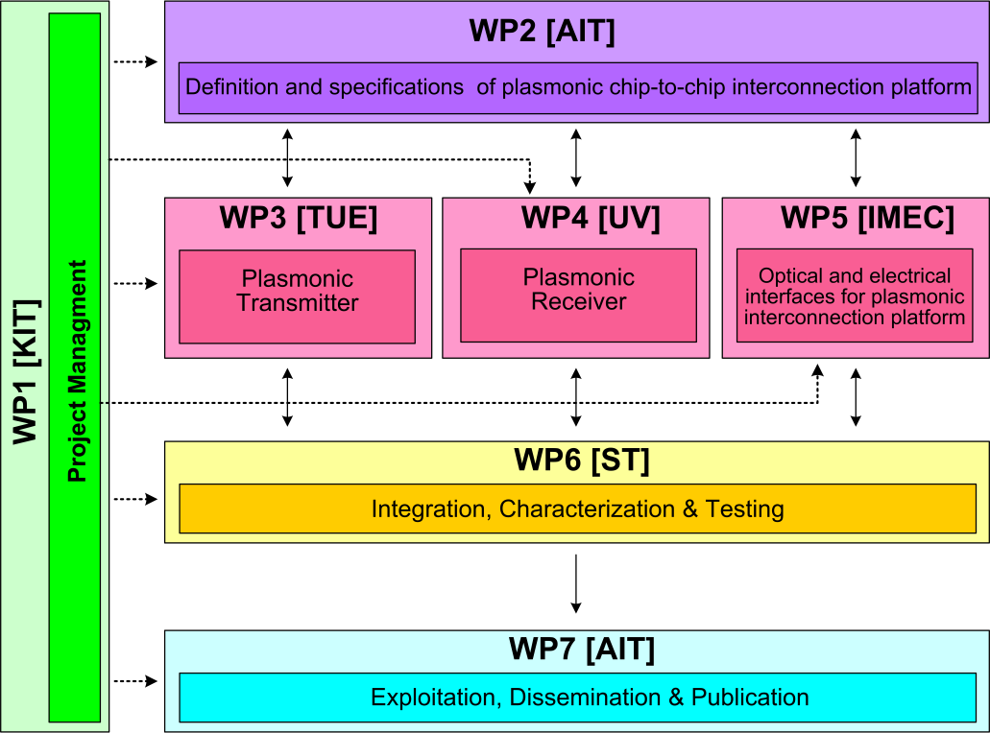






WP2 Position in Project
Contributors:

Slide 4
Objectives
Review requirements and needs for chip-to-chip interconnects
Initial benchmarking
Set target specifications for system
Define subsystem plasmonic devices
System modeling
Development of a cycle accurate VHDL model of a serializer/deserializer

Slide 5
Tasks
 | Names of the Tasks | Time Period [months]
Task 2.1 | Analysis of chip to chip interconnect requirements and needs | 1 – 6
Task 2.2 | Modeling of devices and system for communications applications | 13 – 36
Task 2.3 | Value analysis in terms of cost and green aspects | 25 – 30
Task 2.4 | Techno-economical evaluation and benchmarking | 24 – 36
Task 2.5 | VHDL modeling of plasmonic interconnect and CMOS interface circuits | 10 – 24

Slide 6
Milestones
 | Names of the Milestones | Month | Partner
MS1 | Definition of chip-to-chip interconnection system environment and specification | 3 | AIT
MS2 | Definition of plasmonic devices and material properties for chip-to-chip interconnection | 6 | AIT
MS3 | Development of a system and device simulation platform | 18 | AIT
MS4 | Definition of the interconnection level specification employing developed plasmonic devices | 18 | ST
MS5 | Digital domain to plasmonic domain interface specification and VHDL modelling | 21 | ST
MS6 | Plasmonic interconnect VHDL modelling | 24 | ST
MS7 | Investigation of the cost and power consumption efficiency of the developed plasmonic devices | 28 | AIT

Slide 7
Deliverables
 | Names of the Deliverables | Month | Partner
D2.1 | Definition of chip-to-chip interconnection system environment and specification | 3 | ST
D2.2 | Definition of plasmonic devices | 12 | AIT
D2.3 | Investigation of chip-to-chip interconnection-level specifications employing new plasmonic devices | 24 | AIT
D2.4 | Interface and plasmonic interconnect models and reports | 24 | ST
D2.5 | Techno-economical evaluation with respect to the cost efficiency and green aspects | 30 | AIT
D2.6 | Report on new applications and their opportunities | 36 | AIT

Slide 8
Task 2.2 Modeling of Devices & System
I. Industry needs & NAVOLCHI targets
Parameter | For Now | Future
Data Rate | 7.2 Gbit/s^{[1,2]} /channel | 230-780 Tbit/s (2022)^{[3,4]}
Power Consum. | 1 pJ/bit^{[2,4]} | 50-100 fJ/bit (2022)^{[3,4]}
Latency | 8.8 ns @450 MHz^{[1]} | ?
Footprint | 100 μm² | < 5 μm^{2[5]}
Input by ST.
See available products in D2.2.
ITRS 2009.
D. A. B. Miller, “Device requirements for optical interconnects to silicon chips”, Proc. of the IEEE 97, 1166-1185 (2009).
Input by partners.
Notes:
For Now: both industry needs and NAVOLCHI targets
Future: Industry needs

Slide 9
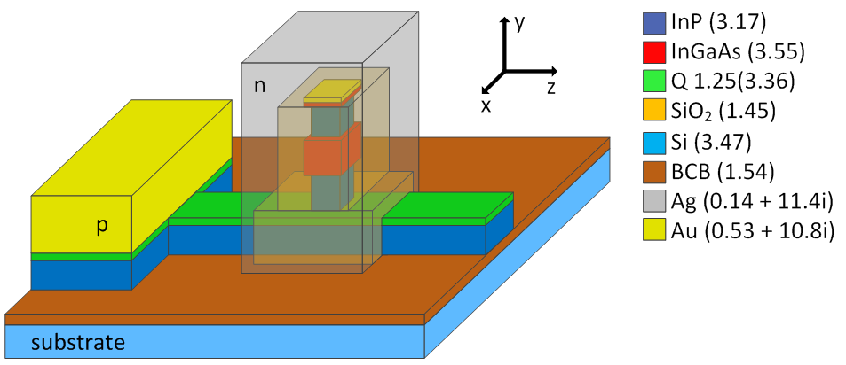
Task 2.2 Modeling of Devices & System
II. Device Specifications.
Device | Data Rate | Latency | Power Cons. | Length | Loss
Laser | DC (40 μW) | N/A | 110 fj/bit | 30 μm | eff 5%
Modulator | 40 Gb/s | 15 ps | < fJ/bit | < 50 μm | < 20 dB
Amplifier* | transp. | 1.5 ps | < 30 pJ/bit | 250 μm | N/A
Detector** | ? | slow | < 1 μW/V | 10 μm | resp 10⁻³ (10-100 nW)
Gratings | transp. | N/A | N/A | 10 μm | 1 dB
Filters | transp. | < 20 ps | < 0.2 pJ/bit | 330 μm | 1 dB
* optically pumped scenario
** nano-gap photoconductor scenario
TOP
1-15 μm
I
I
Ag
QD-layer (300 nm)
GLASS

Slide 10
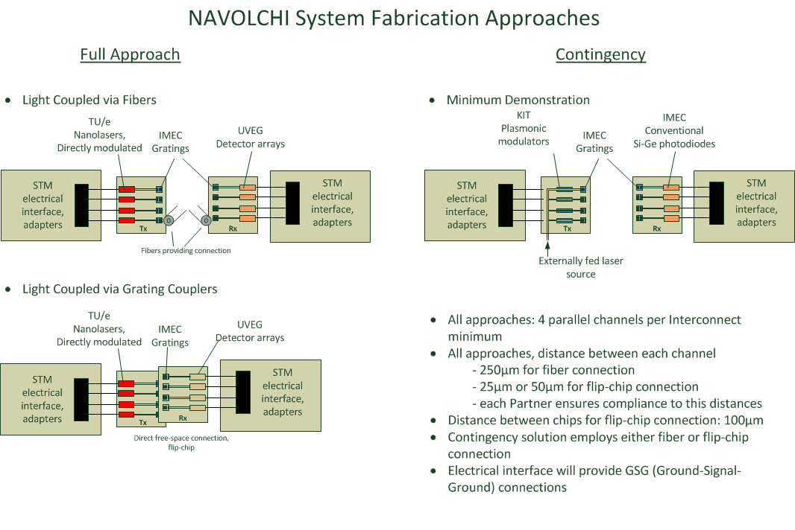
Task 2.2 Modeling of Devices & System
IV. NAVOLCHI System

Slide 11
Task 2.2 Modeling of Devices & System
D2.3 Investigation of chip-to-chip interconnection level specifications employing new plasmonic devices
The simulation platform has been realized with the commercial VPI Photonics software. Eight system configurations have been studied in total. The study is focused on the question of device characteristics, so that the system target specifications are achieved.
The simulation platform presented here is used for the evaluation of the device specs in relation to the system specs. The aim of this process is to provide feedback and guide the device leaders so that the system specs are ultimately achieved.
The plasmonic transmitter consists of a metallo-dielectric laser and a plasmonic modulator.
The plasmonic receiver consists of a plasmonic pre-amplifier and a plasmonic photodetector. Gratings are used to couple light out of and into the chips.

Slide 12
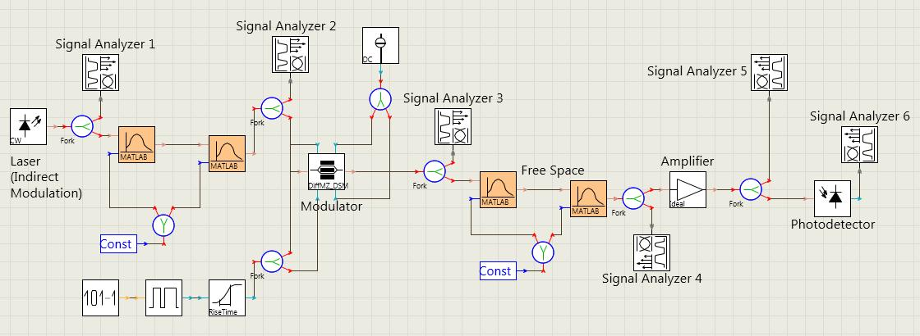
Indirect modulation scenario with plasmonic amplifier
The metallic nanolaser feeds the plasmonic modulator.
The modulator sends the modulated signal to the receiver chip, where it goes through the plasmonic amplifier before ending up in the photodetector.
The laser, the modulator and the receiver are on 3 different chips.
The communication between the chips is established by gratings to send and receive the signal.

Slide 13
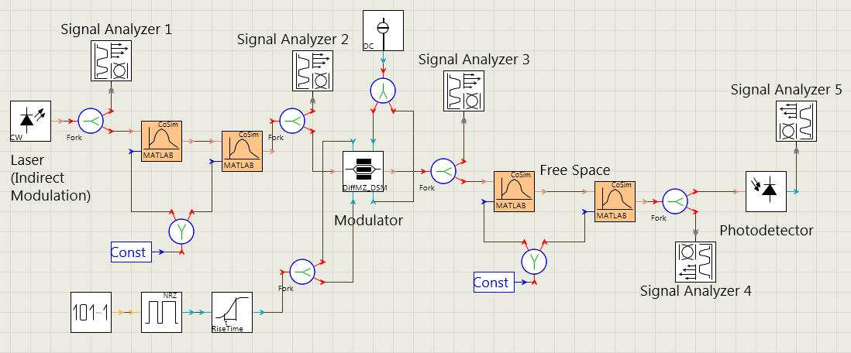
Indirect modulation scenario without a plasmonic amplifier at the receiver
The indirect modulation scenario is studied with two different photodetectors. A plasmonic one from UVEG and a standard PIN one from IMEC. In addition, each case is studied with and without the amplifier.

Slide 14
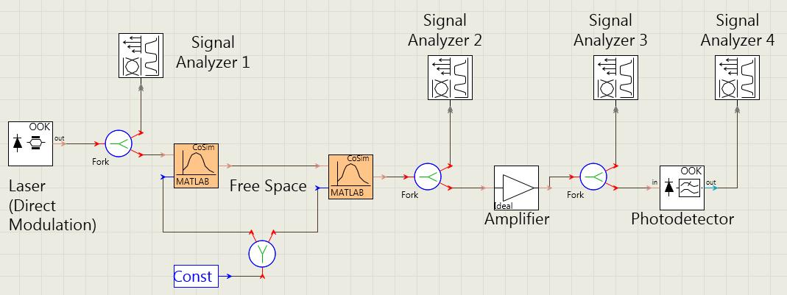
Direct modulation scenario with plasmonic amplifier
The idea here is that the power of the metallo-dielectric laser is low (~ 50 μW) and maybe that will not be enough to cooperate with the plasmonic modulator

Slide 15
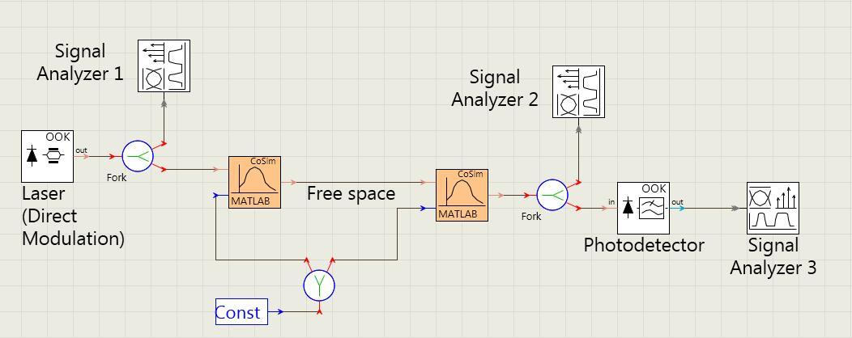
Direct modulation scenario without plasmonic amplifier
The idea here is that the power of the metallo-dielectric laser is low (~ 50 μW) and maybe that will not be enough to cooperate with the plasmonic modulator
All scenarios have been simulated with the receiver comprising (a) PIN detector from IMEC, or (b) plasmonic detector developed at UVEG.

Slide 16
Parameters
The main device parameters used for the indirect modulation simulations are the following:
Metallo-dielectric Laser: DC emission at 1550 nm, power at 50 μW (but other powers have been simulated too).
Plasmonic Modulator: phase modulator in mach-zehnder configuration, biased at optimal conditions, insertion loss at 10 dB. Extinction ratio simulated below. Bit rate 7.2 Gb/s.
Gratings: advanced gratings from IMEC with 2dB loss.
Plasmonic amplifier: Maximum output power at 0.2 W, Noise Figure 4 dB, Noise Bandwidth 25 THz. The gain goal within NAVOLCHI is 10 dB, but various gains have been simulated.
PIN Detector: Responsivity 0.5 A/W, dark current 100 nA, thermal noise 10 pA/Hz^(1/2).
Plasmonic Detector: Responsivity 0.1 A/W, dark current 1 μΑ, thermal noise 25 fA/Hz^(1/2).

Slide 17
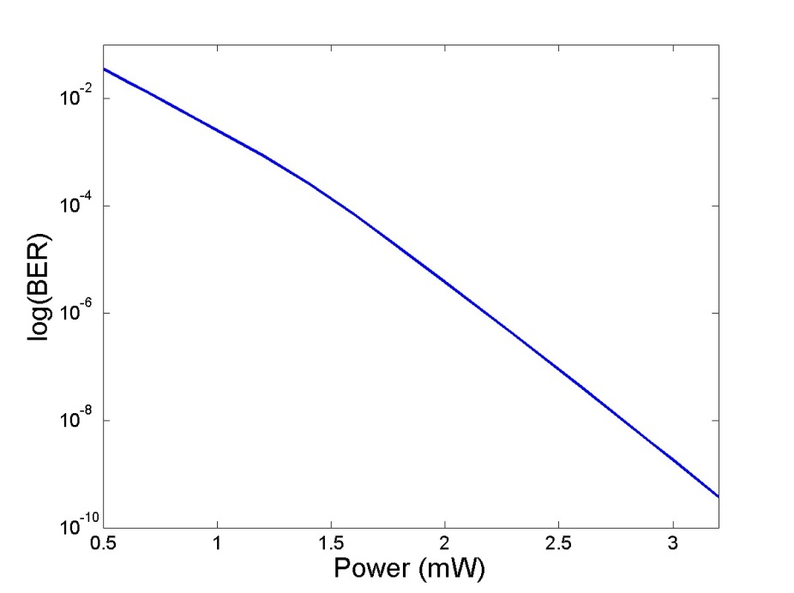
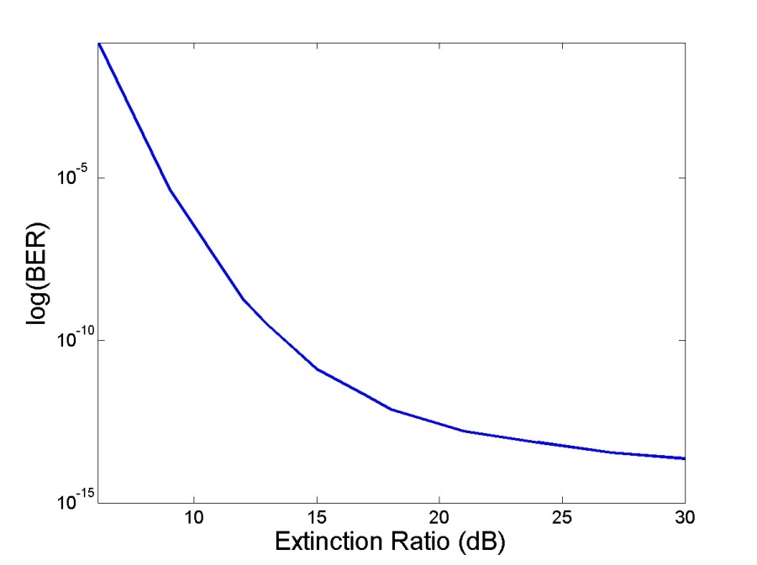
Results without plasmonic amplifier
Scenario with indirect modulation and plasmonic photodetector, without plasmonic amplifier. BER vs laser output power. Extinction ratio is set at 12 dB
Indirect modulation scenario with plasmonic detector, without plasmonic amplifier. BER vs Extinction Ratio of modulator. Laser power is set at 3 mW.
BER is 2.5e-3 dB at 1 mW, 3.8e-6 dB at 2 mW, and only falls < 1e-9 dB at powers greater than 3 mW.
The expected output power of the metallo-dielectric laser is 50 μW, and therefore too low for this system.
We note that BER is 4.5e-6 dB at an extinction ratio of 9 dB, 1.8 dB at an extinction ratio of 12 dB, and 1.3e-11 dB at an extinction ratio of 15 dB.

Slide 18
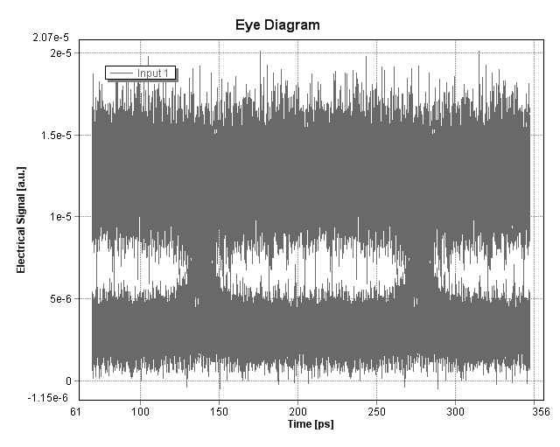
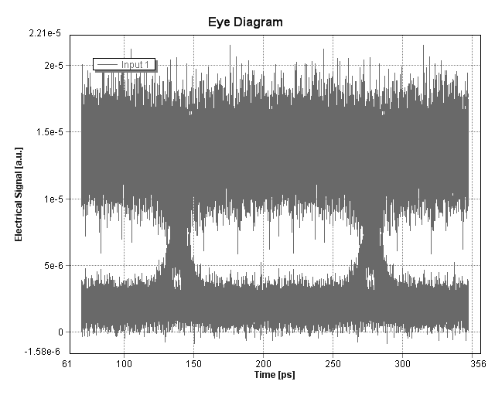
Indirect modulation scenario
Indirect modulation scenario, with plasmonic detector and without plasmonic amplifier for the same received power. Eye diagrams at a laser power of 3 mW, for an extinction ratio of 9 (left) and 12 (right) dB.

Slide 19
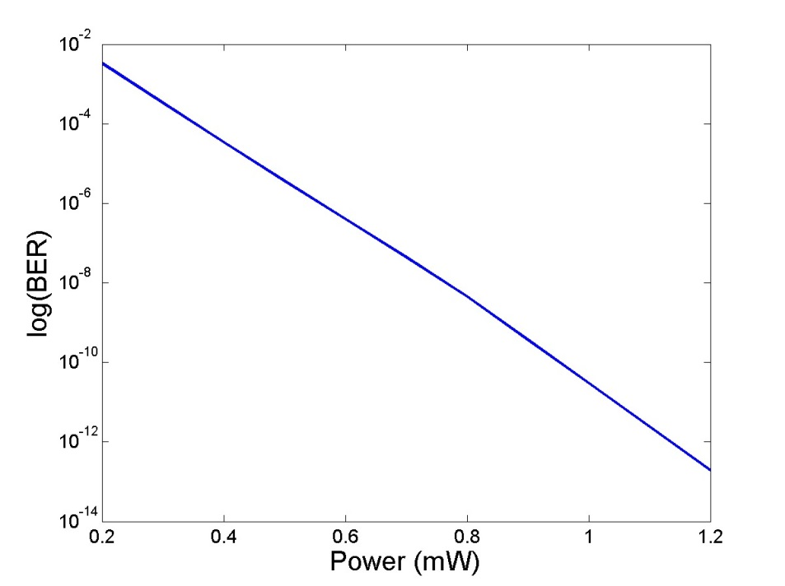
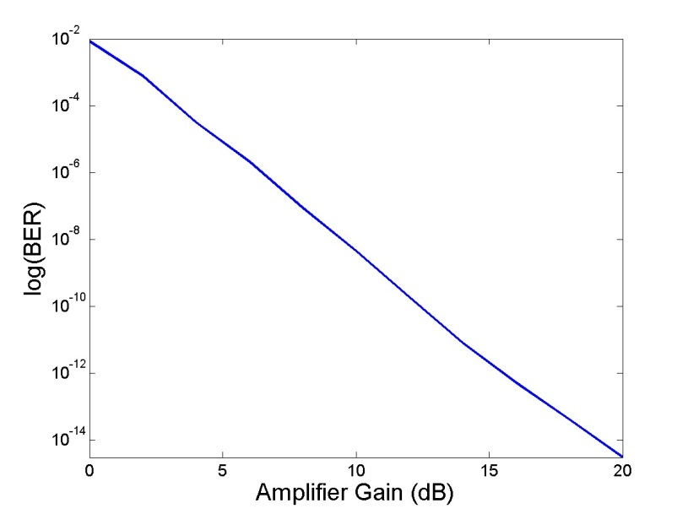
Addition of a plasmonic amplifier at the receiver
Indirect modulation with plasmonic detector and amplifier. BER vs Power. The modulator extinction ratio is 12 dB and the amplifier gain is 10 dB.
Indirect modulation with plasmonic detector and amplifier. BER vs Amplifier Gain. Laser power is 0.8 mW and modulator extinction ratio is 12 dB.
The amplifier increases the signal power, but also adds noise. At a laser power of 50 μW and an amplifier gain of 10 dB, the BER turns out to be an unacceptable 0.11 dB.
We see that BER < 1e-8 for amplifier gains greater than 9 dB (for ext. ratio 12 dB and laser output power of 0.8 mW).

Slide 20
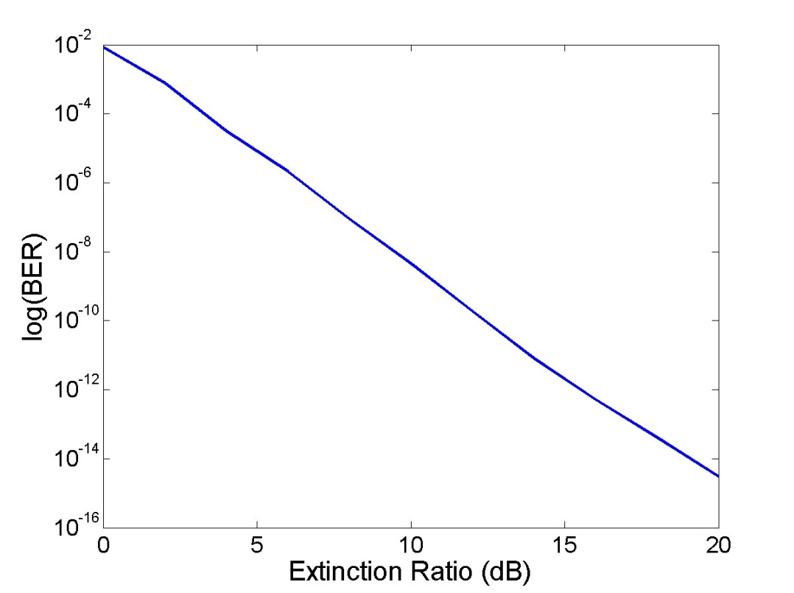
Influence of the modulator extinction ratio on BER
Indirect modulation with plasmonic detector and amplifier. BER vs Extinction Ratio of modulator. Laser power is 0.8 mW and amplifier gain is 10 dB.
We note that BER < 4.5e-9 dB for extinction ratios greater than 12 dB.

Slide 21
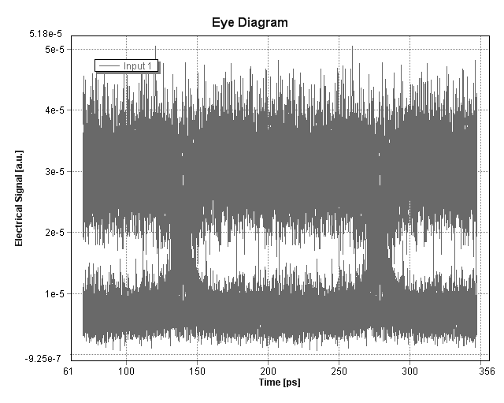
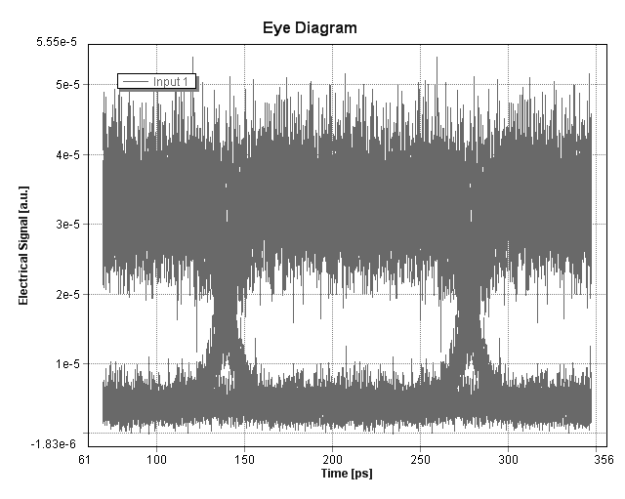
Indirect modulation scenario, with plasmonic detector and with plasmonic amplifier
Indirect modulation scenario, with plasmonic detector and with plasmonic amplifier for the same received power. Eye diagrams at a laser power of 0.8 mW, for an extinction ratio of 9 (left) and 12 (right) dB.

Slide 22
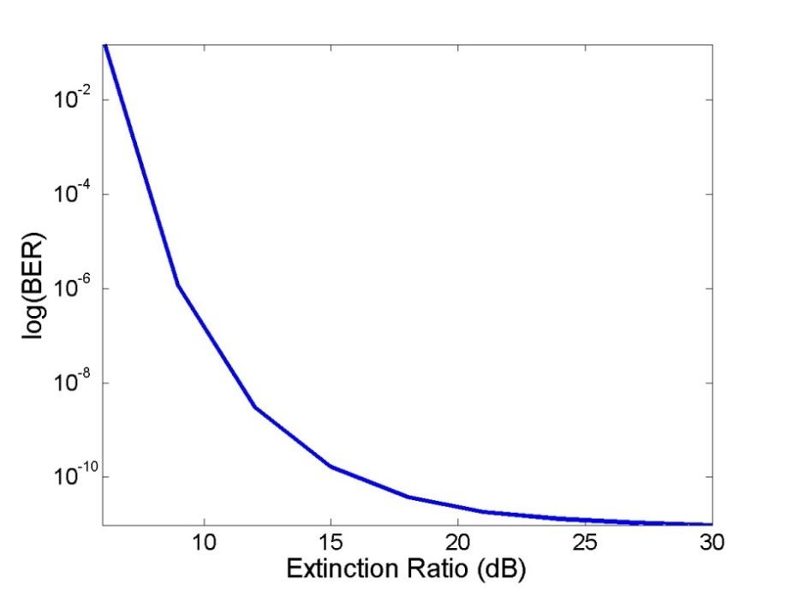
Influence of the modulator extinction ratio on BER
We did the same calculations for the case when the PIN detector is used instead of the plasmonic one. The PIN detector has greater responsivity (0.5 vs 0.1 A/W), smaller dark current (0.1 vs 1 μW), but worse thermal noise (10 vs 0.025 pA/Hz^(1/2)) than the plasmonic detector. However, please note that the plasmonic photodetector properties are merely estimated at this point.
At a laser output power of 50 μW and an extinction ratio of 12 dB, the BER is calculated to be an unacceptable 0.29 dB.
Laser power (mW) | BER (dB)
0.05 | 0.29
0.5 | 4x10⁻⁴
0.6 | 3.5x10⁻⁵
0.7 | 2.1x10⁻⁶
0.8 | 9.4x10⁻⁸
0.9 | 3x10⁻⁹
1 | 7.5x10⁻¹¹
Indirect modulation scenario with PIN detector, without plasmonic amplifier. BER vs Extinction Ratio of modulator. Laser power is set at 0.9 mW.

Slide 23
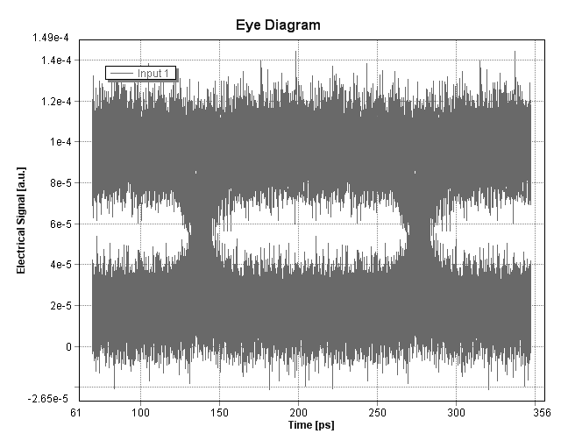
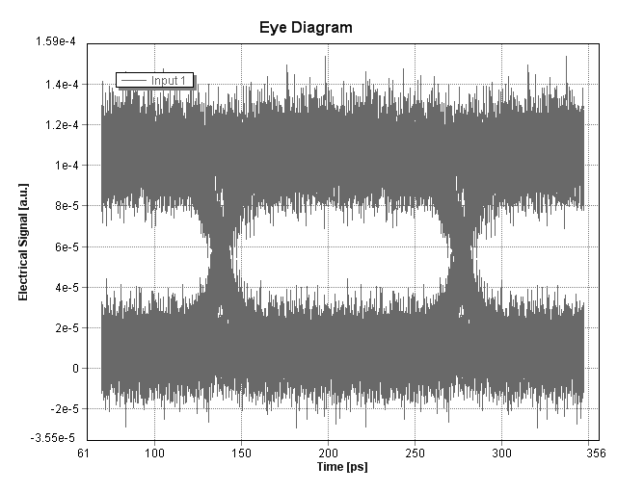
Eye Diagrams
Indirect modulation scenario, with PIN detector and without plasmonic amplifier. Eye diagrams at a laser power of 0.9 mW, for an extinction ratio of 9 (left) and 12 (right) dB.

Slide 24
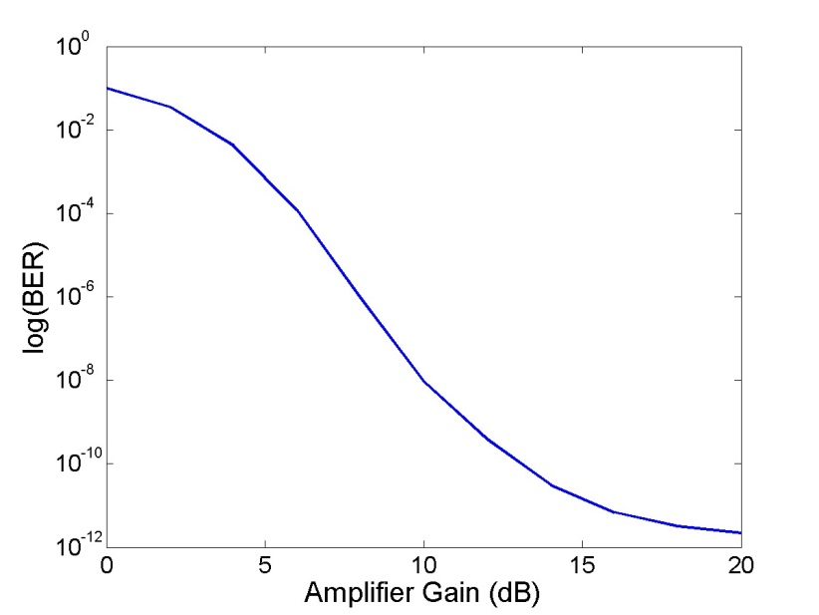
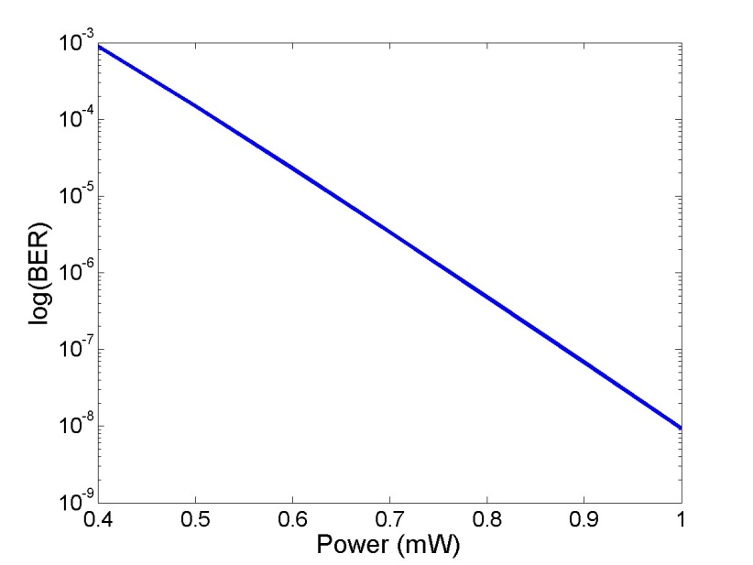
Addition of a plasmonic amplifier at the receiver chip.
Indirect modulation with PIN detector and amplifier. BER vs Power. The modulator extinction ratio is 12 dB and the amplifier gain is 10 dB.
At a laser power of 50 μW and an amplifier gain of 10 dB, the BER turns out to be an unacceptable 0.22 dB.
Indirect modulation with PIN detector and amplifier. BER vs Amplifier Gain. Laser power is 1 mW and modulator extinction ratio is 12 dB.
We see that BER < 1e-8 for amplifier gains greater than 10 dB (for ext. ratio 12 dB and laser output power of 1 mW). The curvature is due to the increased thermal noise of the PIN detector.
BER is 1.5e-4 dB at 0.5 mW, 4.8e-7 dB at 0.8 mW, and 9.3e-9 dB at 1 mW. Comparing to the scenario with the plasmonic amplifier, we see that the larger thermal noise of the PIN detector leads to worse BERs.

Slide 25

Influence of the modulator extinction ratio on BER
Indirect modulation with PIN detector and amplifier. BER vs Extinction Ratio of modulator. Laser power is 1 mW and amplifier gain is 10 dB.

Slide 26
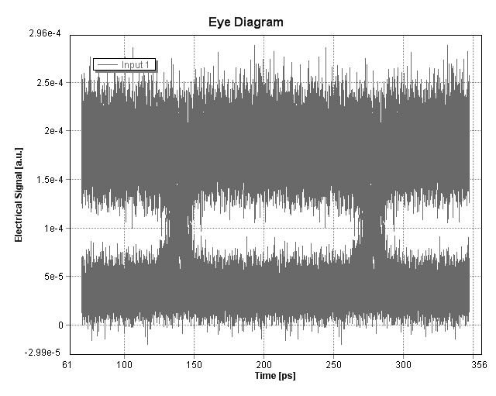
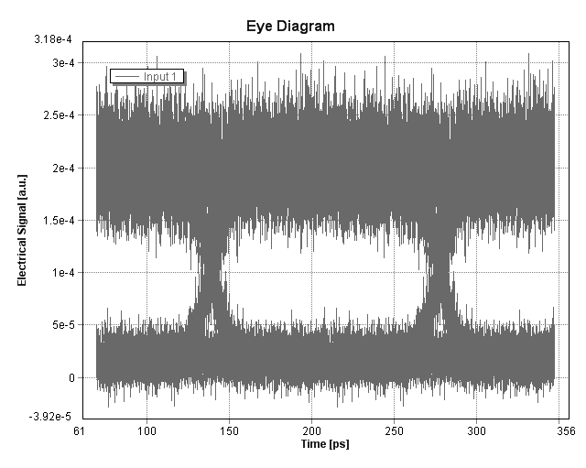
Indirect modulation scenario, with PIN detector and plasmonic amplifier
Indirect modulation scenario, with PIN detector and plasmonic amplifier for the same received power. Eye diagrams at a laser power of 1 mW, for an extinction ratio of 9 (left) and 12 (right) dB.

Slide 27
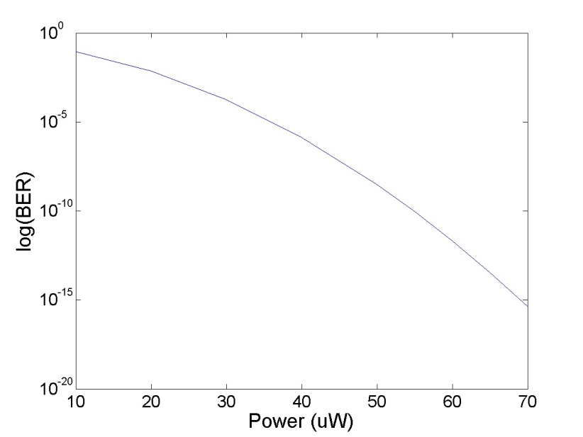
Direct modulation
We note that at the time of submission of this deliverable, there were no phase data (or estimations) available for the phase characteristics of the devices. We have therefore omitted such calculations. When such data is available, additional direct modulation simulations will be performed, should it be requested.
At a laser output power of 50 μW, the BER is calculated to be 3e-9 dB
Scenario with direct modulation and PIN photodetector, without plasmonic amplifier. BER vs laser output power.
We see that BER < 1e-9 dB for powers > 50 μW, and vanishes for powers greater than 70 μW.
The expected output power of the metallo-dielectric laser is 50 μW, and therefore appropriate for this system.

Slide 28
Direct modulation
If we now add the plasmonic amplifier to the system, BER vanishes already for a gain of 3 dB.
Amplifier Gain (dB) | BER (dB)
0 | 1.8e-6
1 | 2.8e-9
2 | 1.35e-13
>3 | 0
We next turn to the case with the plasmonic detector, without an amplifier.
The metallo-doelectric laser output power (50 μW) is therefore more than enough for an error-free system.
Laser Power (μW) | BER (dB)
10 | 5e-5
20 | 4.5e-13
>30 | 0

Slide 29
Conclusions
Eight different configurations have been studied in total:
with direct or indirect modulation,
with plasmonic or PIN detector,
with or without amplifier.
The Bit Error Rate has been calculated for each case, sweeping parameters such as the laser output power or the amplifier gain.
In the direct modulation case the signal phase distortions have not been taken into account due to lack of chirping information for the plasmonic devices. In addition, we noted that many of the device parameters used in the simulations are estimations at this point of development.

Slide 30
Conclusions
The results for the indirect modulation case show that the estimated metallo-dielectric laser (that is being developed within NAVOLCHI) output power is too low to receive an acceptable BER at the receiver end. Powers on the order of magnitude of mW are needed for error-free transmission this case, as opposed to the 50 μW that the NAVOLCHI laser delivers.
On the other hand, in the direct modulation scenario the 50 μW of laser output power seem to be enough for error-free transmission.
In view of these results, it appears appropriate that the laser (metallo-dielectric laser) and the modulator (plasmonic modulator) that are being developed within NAVOLCHI are demonstrated separately at the end of the project.
For example, separate plasmonic chip-to-chip systems can be demonstrated. In one case, the metallo-dielectric laser will be used with direct modulation at the transmitter. In a second system, the plasmonic modulator can be paired with a commercial laser at the transmitter.

Slide 31
Next steps
  Techno-economical evaluation with respect to the cost efficiency and green aspects.
  Feedback/estimates both for the current technology and on the plasmonic technology on:
    Throughput
    Latency
    Power/Energy consumption
    Footprint
    Cost
  Comparison against:
    Electrical interconnect
    Photonic interconnect

Slide 32
Required Input
  Techno-economical evaluation with respect to the cost efficiency and green aspects.
Module | Power | Throughput | Area | Cost
Laser
Modulator
Amplifier
Detector
Filters

