Slide 1


NAVOLCHI - Nano Scale Disruptive Silicon-Plasmonic Platform for Chip-to-Chip Interconnection

Slide 2
KIT: Coordinators presentation
Notes:
Partner presentations (10min each)
Institute / company (short)
Contribution to the project, own work effort and timeline (focus)

Slide 3
Outline:
Status
ST and AIT Personal Situation
Reaction on Reviewers Comments
Intermediate Progress Report

Slide 4
  Status

Slide 5
Time Scale
System Integration Phase!

Slide 6
Budget
NAVOLCHI Finances
Tranche 1: | 1.400.000 €
Tranche 2: | 596.326 €
Partner | Total Funding |  | Tranche 1 | Tranche 2 |  | Open
KIT | 495.615 € | 21% | 290.000 € | 123.145 € |  | 82.470 €
IMCV | 386.013 € | 16% | 225.000 € | 95.912 € |  | 65.101 €
TU/e | 362.224 € | 15% | 210.000 € | 90.001 € |  | 62.223 €
AIT | 304.988 € | 13% | 180.000 € | 75.780 € |  | 49.208 €
UEVG | 311.540 € | 13% | 180.000 € | 77.408 € |  | 54.132 €
ST | 411.700 € | 17% | 240.000 € | 102.295 € |  | 69.405 €
UGent | 127.920 € | 5% | 75.000 € | 31.784 € |  | 21.136 €
Sum | 2.400.000 € | 100% | 1.400.000 € | 596.326 € |  | 403.674 €

Slide 7
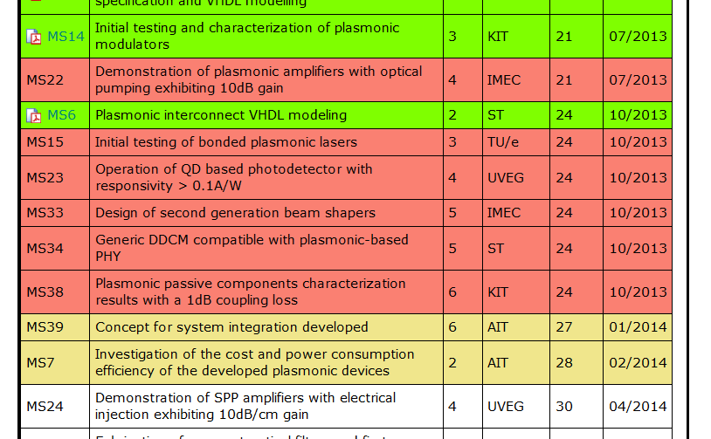
Missing and Upcoming Milestones

Slide 8
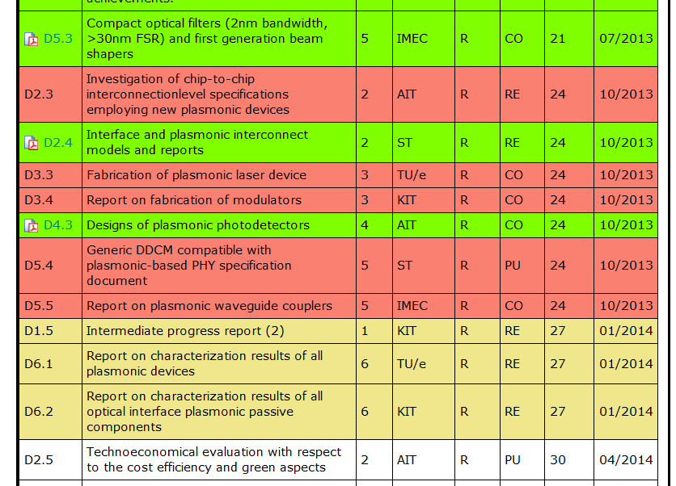
Missing and Upcoming Deliverables

Slide 9
  Second Intermediate Report

Slide 10
27 Months Intermediate Report D1.5
What Coordinator needs from you:
Work package summary
WP objectives
WP progress, status and future work with respect to tasks, deliverables and milestones
→ as soon as possible!

Slide 11
27 Months Intermediate Report
Please refer to
Project reference manual on web site
Last 9 month intermediate report on web site

Slide 12
  Reviewers Comments

Slide 13
Reviewers Comments from Rev. 2
Status of deliverables
All deliverables due for this review have been submitted in good quality.
Recommendations concerning the period under review (and past periods)
<n.a.>
Recommendations regarding future work
Before implementing the system level demonstrator(s), make an analysis of the expected interconnect parameters at system level (e.g. data rate, latency, power consumption, foot print) for different possible architectures of the system level demonstrator, based on known or expected component performances. Compare these system level values with data from other research groups and commercial data. Report these data in deliverable D1.5 or in milestone report M39, as appropriate. When this document is ready, send it also to the reviewers.
In deliverable D6.3, extend this comparison with the actually measured system level data.
Final comment
At present there seems to be no need for another intermediate review (i.e. in the middle of period 2). However, should significant unexpected problems or delays occur, inform the project officer in time for taking appropriate action (including possibly an intermediate review to be organised on short notice, and/or preparing an amendment of the grant agreement).
AIT
AIT/ST
!

Slide 14
  ST and AIT Personal situation
  Scenarios for system demonstrator

Slide 15
ST
“MCD can guarantee only the completion of the digital parts design
and the FPGA mapping, while board design and implementation for
demonstrator cannot be carried out”
“Activity and related budget has to be moved to another partner”
Topics affected by STs pull-out:
Tasks, deliverables and milestones
Manpower, finances
Who becomes WP-Leader 6?
Who prepares reports (intermediade, final)

Slide 16
ST, Activities
WP | WP-Leader | Task | Task-Leader | Contrib | Month
1 | KIT | 1.1 | KIT | All | 1-36
 |  | 1.2 | KIT | All | 1-36
2 | AIT | 2.1 | ST | AIT | 1-6
 |  | 2.2 | AIT | AIT, ST, KIT, TUE, IMEC, UVEG | 13-36
 |  | 2.3 | AIT | AIT, ST, KIT, TUE, IMEC, UVEG | 25-30
 |  | 2.4 | AIT | AIT, ST, KIT, TUE, IMEC, UVEG | 24-36
 |  | 2.5 | ST | ST | 10-24
3 | TUE | 3.1 | TUE | IMEC | 1-6
 |  | 3.2 | KIT | KIT, IMEC | 1-18
 |  | 3.3 | TUE | TUE, IMEC | 7-30
 |  | 3.4 | KIT | KIT, IMEC | 7-27
4 | UVEG | 4.1 | AIT | KIT, UVEG, IMEC, UGent | 1-18
 |  | 4.2 | UVEG | UVEG, KIT | 1-24
 |  | 4.3 | UVEG | UVEG, UGent | 1-18
 |  | 4.4 | IMEC | UVEG | 6-30
 |  | 4.5 | UVEG | IMEC, KIT | 1-36
5 | IMEC | 5.1 | KIT | IMEC, UVEG | 1-15
 |  | 5.2 | IMEC | ------- | 1-30
 |  | 5.3 | IMEC | KIT | 1-15
 |  | 5.4 | ST | IMEC, KIT | 4-12
 |  | 5.5 | ST | ST, IMEC, KIT | 13-24
6 | ST | 6.1 | AIT | TUE, IMEC, KIT, UVEG | 7-33
 |  | 6.2 | KIT | KIT, ST | 30-36
 |  | 6.3 | AIT | KIT, AIT, ST | 32-36
 |  | 6.4 | AIT | ST, AIT | 22-36
7 | AIT | 7.1 | AIT | All | 1-36
 |  | 7.2 | IMEC | KIT, IMEC, TUE, UVEG, ST | 12-36
 |  | 7.3 | AIT | KIT, AIT, ST | 24-36
T 5.5: Signal Generation Module implementation via FPGA
→ ST is strongly involved until end of project in WPs 1,2,(5),6,7

Slide 17
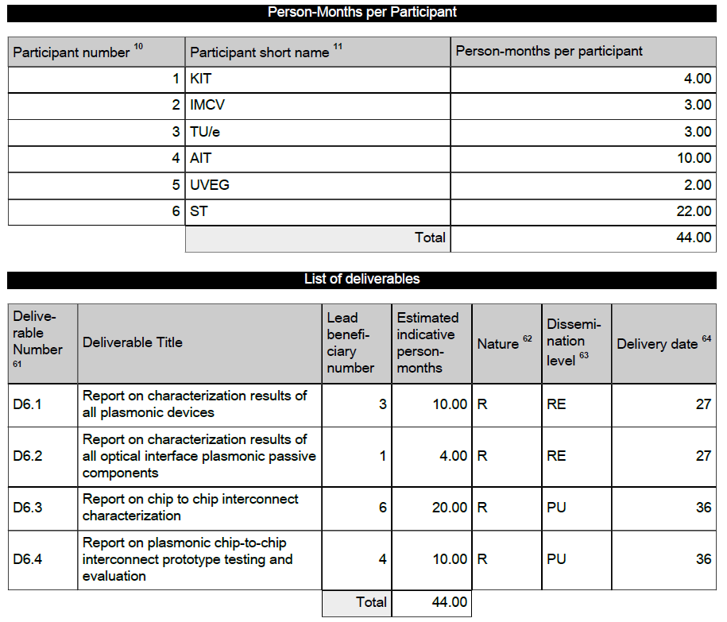
ST, WP 6 Activities
22 MM

Slide 18
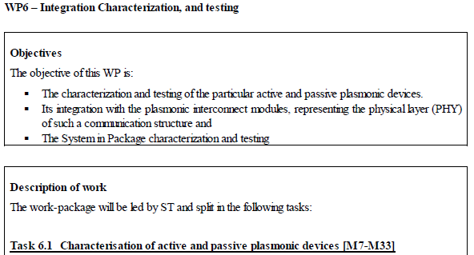
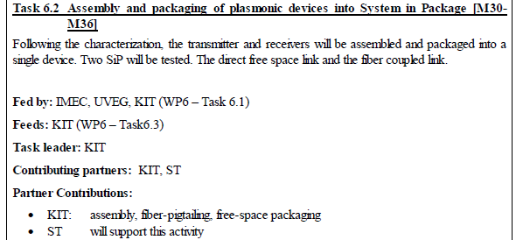
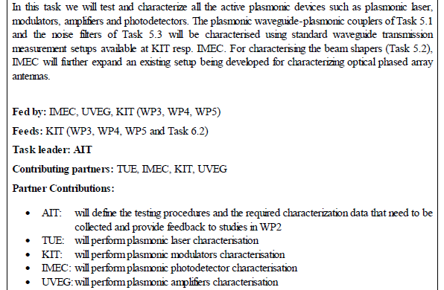
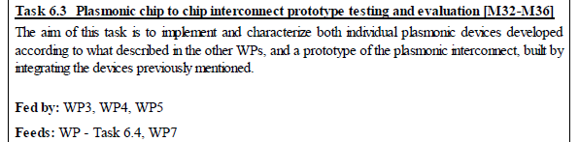
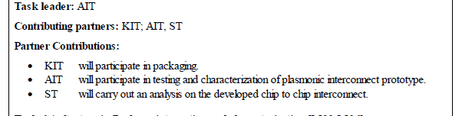
ST, WP 6 Activities

Slide 19
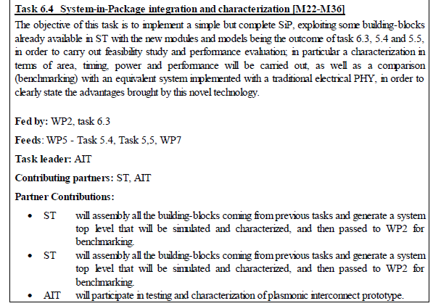
ST, WP 6 Activities

Slide 20
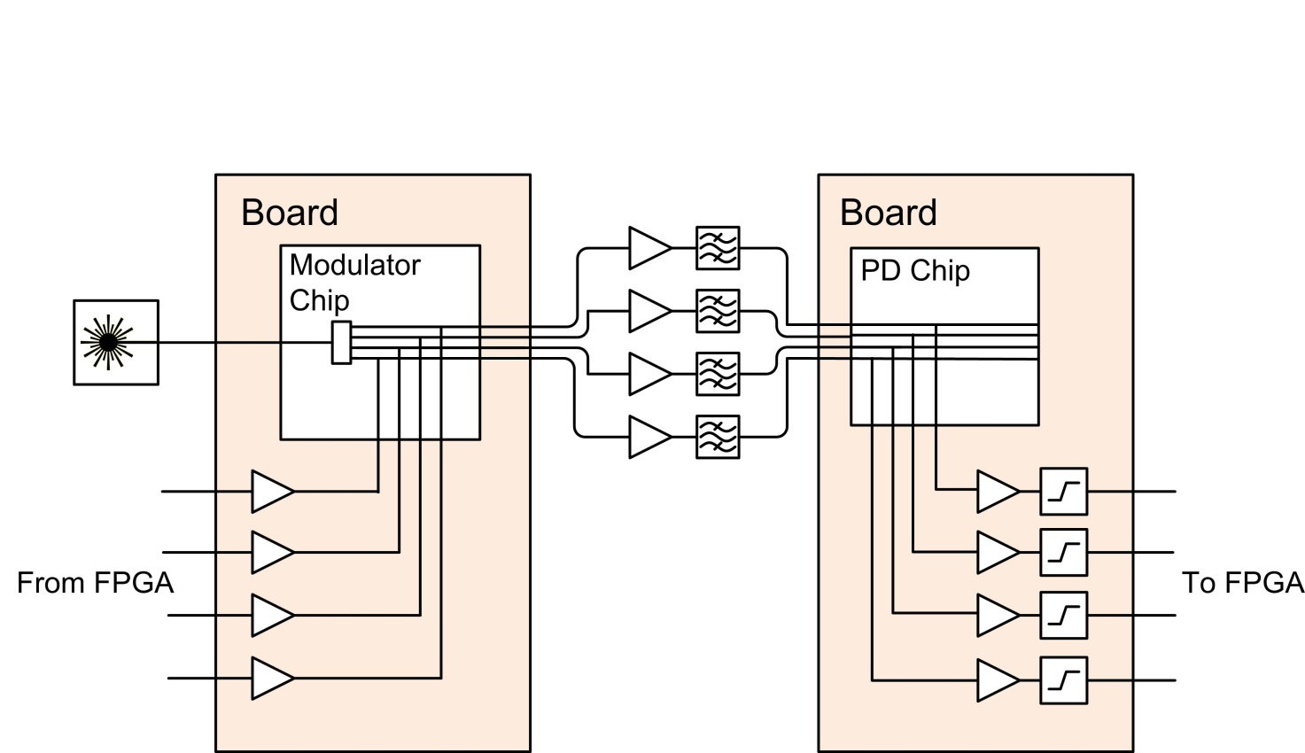
Scenarios for System Demonstrator
Phase Modulator
and
Mach-Zehnder
Nanogap or
Shottky
Photodetector
Options:
Light via fiber
Light via grating coupler
External laser source and IMEC Si-Ge photodetector

Slide 21
Scenarios for System Demonstrator
Action Items to be decided !
Design
Fabrication
Testing
Design
Fabrication
Testing

Slide 22
  Next Meeting
  Next Tel. Conf.

Slide 23
Next Meeting
Where?
Not in Karlsruhe, because final meeting
(autumn 2014) may be there
When?
Before summer 2014

Slide 24
Next Phone Conference
First Monday of the next month,
4:00 pm (CET)
May 3rd, 2014

Slide 25
  Bye!

