Slide 1
NAVOLCHI Project Meeting Eindhoven Surface Plasmon Polariton Absoprtion Modulator
Claudia Hoessbacher
Institute of Electromagnetic Fields (IFH)

Slide 2
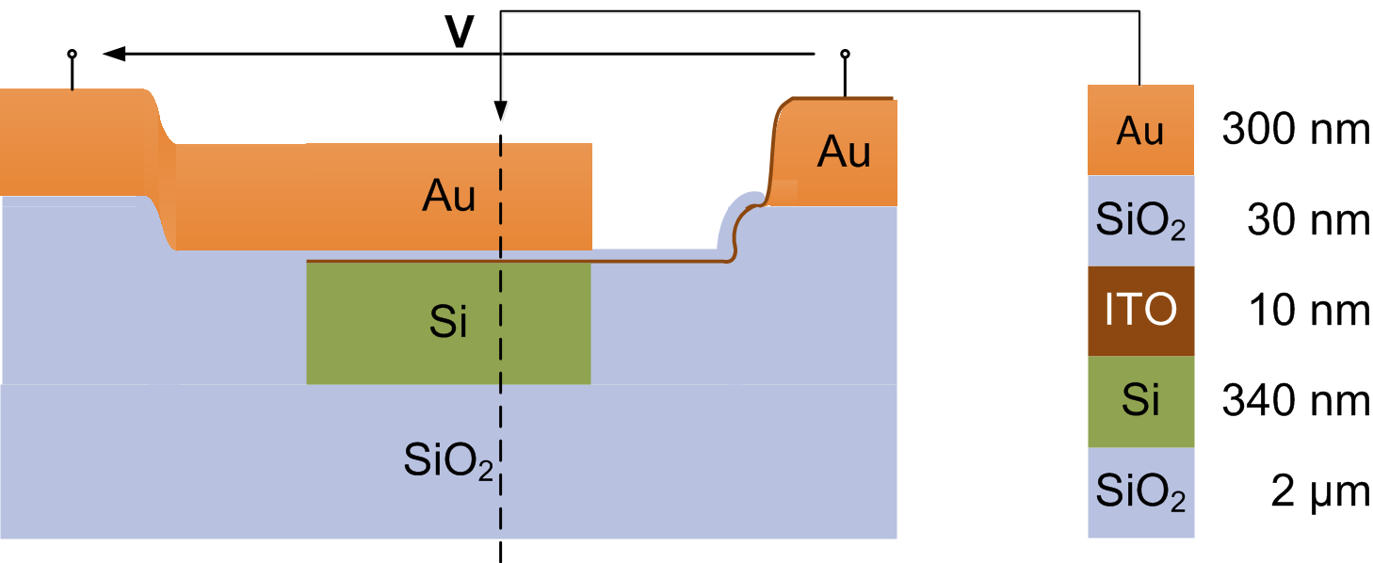
Design
Working principle: carrier density of ITO may be changed by applying a voltage → absorption of ITO modulated
Notes:
Modulator: metal-oxide-ITO layer stack guiding the surface plasmon polariton; here Au, SiO2, ITO
Light is coupled to the plasmonic WG via a photonic silicon strip waveguide placed below
Working Principle: core: ITO layer; carrier density may be switched by means of an electric field → absorption modulated
The top electrode is provided by the top metal of the plasmonic waveguide. The bottom electrode is the ITO layer, contacted from the side

Slide 3
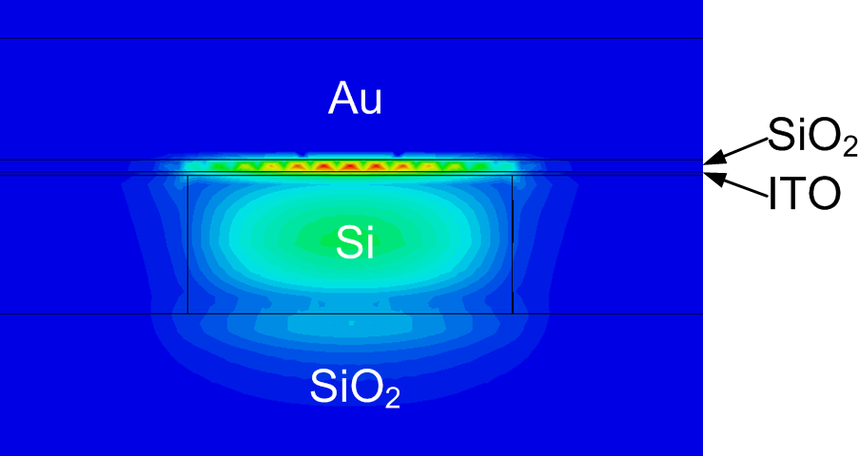
Mode
SiO₂
ITO
Without voltage
Notes:
Field confined in SiO2 layer

Slide 4
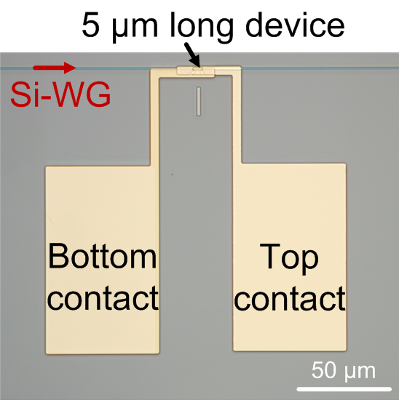
Optical Microscope Image Single Device

Slide 5
Optical Microscope Image Four Channel Array (50 µm ptich)
GC
MMIs
SPPAM
GC
Contact Pads
Arrays of 2 and 4 channels with pitches of 35 µm, 50 µm, 250 µm

Slide 6
SEM Image Cross Section
Si WG
Notes:
The rectangle in the middle is the silicon waveguide with the thin—and therefore barely visible—ITO and SiO₂ layers on top. The bottom electrode is shifted with respect to the top electrode. The trenches are caused by the fact that the cladding deposition on top of the silicon waveguide leads to a bump in the oxide layer. This bump is transferred when opening the oxide in the following step.

Slide 7
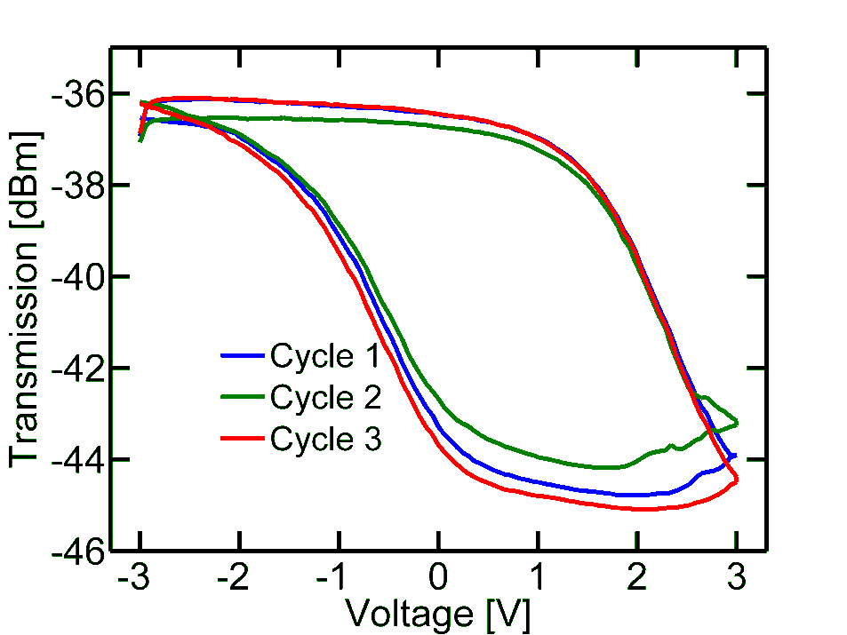
Characterization (in progress)

Slide 8
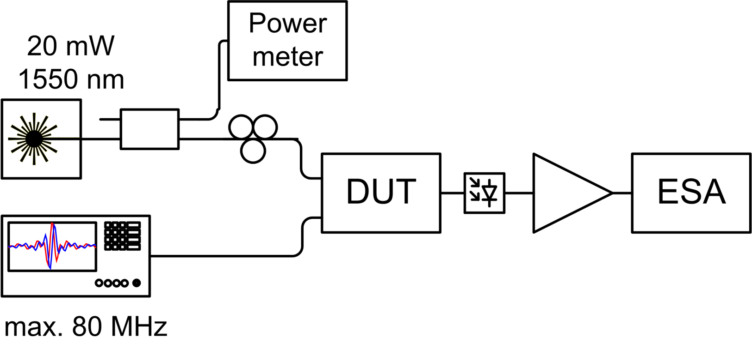
Characterization (in progress)

Slide 9
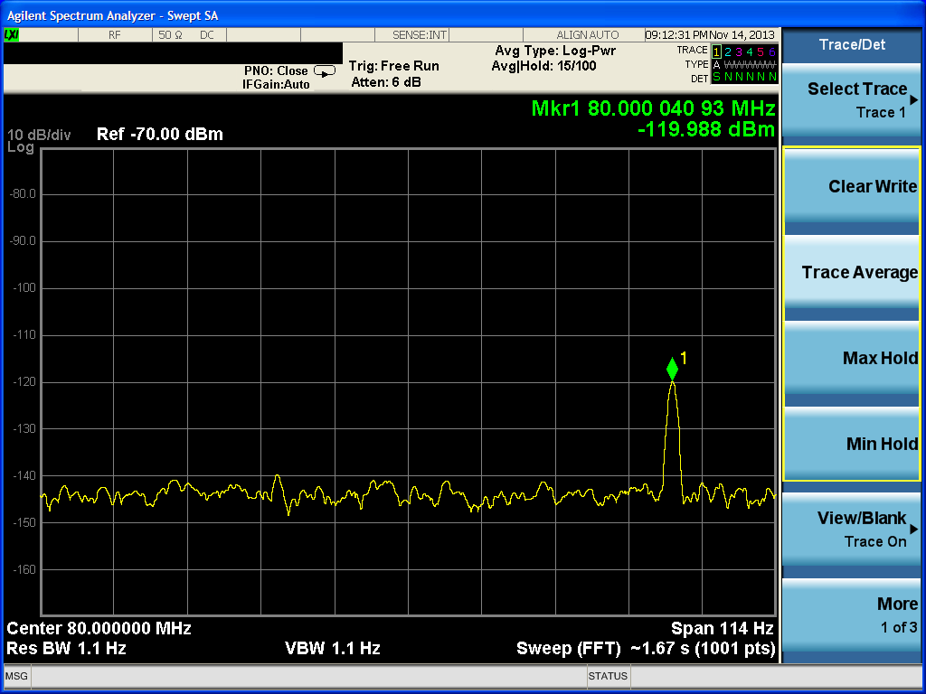
Characterization (in progress)
10 µm long device, sin ±1 V, 80 MHz
Notes:
Estimated ER=0.05 dB

