Slide 1
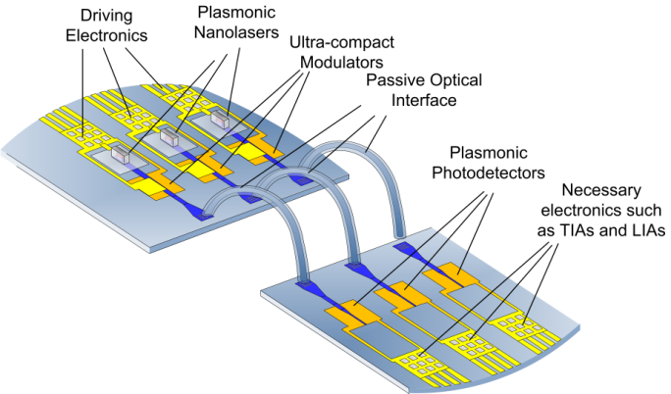
STMicroelectronics Progress Report

Slide 2
Recent progress
Completed digital building-blocks design and verification
Completed plasmonic interconnect models and verification
In order to simplify and speed up FPGA mapping, instead of the whole system (two DDCM modules) only PHY Adapter will be mapped and driven from external sources

Slide 3
Issues
ISG (Interconnect Systems Group) has been closed and all its resources have been moved to MCD (Micro Controller Division)
MCD has no interest in NAVOLCHI project, nevertheless ST doesn’t want to leave the project at this stage
MCD can guarantee only the completion of the digital parts design and the FPGA mapping, while board design and implementation for demonstrator cannot be carried out
Activity and related budget has to be moved to another partner
Not possible to attend the meeting in Eindhoven for heavy cost reduction
Deliverable D5.4 and milestone M34 forecasted for end of October suffered of some delay

Slide 4
NAVOLCHI demonstrator implementation
FPGA
Die #1
INI #1_1
INI #1_2
STAC 1
TNI #1_1
TNI #1_2
Board
Die #2
INI #2_1
INI #2_2
STAC 2
TNI #2_1
TNI #2_2

Slide 5
NAVOLCHI demonstrator implementation
Board
FPGA
Plasmonic LASERs
Bi-synchronous FIFO
OBI Enc
Ser
BI
Enc
Plasmonic modulators
Driver
89
89
90
3
4
4
4
TX
Light beams
Digital
Analog
Plasmonic

Slide 6
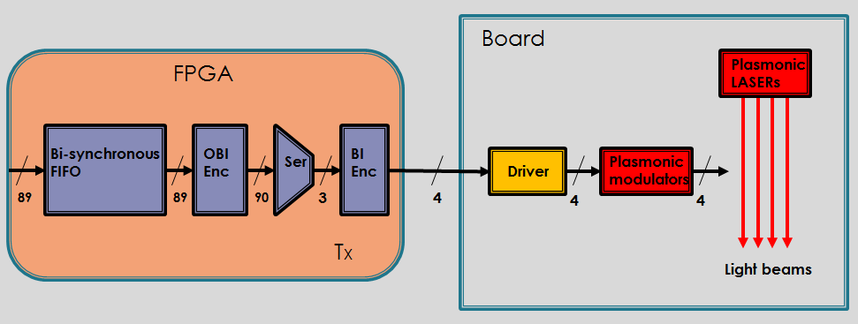
Codecs analysis and characterization
Optical Bus Inverter (OBI) Encoder minimizes the number of ones in 89 bits data word in order to reduce the number of LASERs turned on.
Bus Inverter (BI) Encoder minimizes the Hamming distance between back to back 4 bits data words in order to minimize the switching activity of each LASER
We carried out several tests placing the C language model of the blocks OBI_Enc, SER and BI_Enc alternately in a different sequence; in each one we used the same input vectors and verified that the best arrangement is OBI_Enc-SER-BI_Enc in terms of minimization of the number of ‘1’ and transactions between two back-to-back data words.
The analysis results and the characterization of the different arrangements in terms of area occupation, latency and power consumption are shown in the following slide.

Slide 7
Analysis Result
Arrangement | Average Gain % |  | Latency
OBI_Enc – SER – BI_Enc | 60 | 4320,39 | 4 | 2,183
SER – OBI_Enc | 41 | 4244,01 | 2 | 2,137
SER – BI_Enc | 38 | 1350,97 | 2 | 0,406
OBI_Enc – SER | 23 | 4244,01 | 3 | 2,137
BI_Enc – SER – OBI_Enc | 20 | 4320,39 | 4 | 2,183
BI_Enc – SER | 9 | 1350,97 | 3 | 0,406
SER | 0 | 1274,59 | 1 | 0,360
The Average Gain %, shown in the above table, is the arithmetic mean of the percentage gains obtained for each bit vector taken as input sample.
This gain was calculated as the ratio between the percentage of '0 'obtained in output compared to that present at the input.
Input vectors consisting of all ‘1’ or all ‘0’ have been excluded from the tests, because they represent two limiting cases of zero and infinite gain, regardless of the arrangement of the blocks.

Slide 8
NAVOLCHI demonstrator implementation
Board
Light beams
FPGA
Bi-synchronous FIFO
OBI Dec
BI Dec
CRC
Plasmonic detectors
Des
Comparators
TIAs
89
89
90
3
4
4
4
4
RX
Digital
Analog
Plasmonic

Slide 9
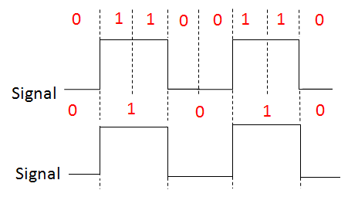
Digital Clock Recovery
Serial data stream could
have multiple interpretations
in the Receiver as shown in the next figure
TIAs
4
4
There is need to recover the clock from the data stream and to use it to sample the data
to extract the individual data bits. This task is carried out by a Clock Recovery Circuit.

Slide 10
Digital Clock Recovery
Decision Making Circuit
Data
TIAs
4
4
Clock Recovery Circuit
Incoming data
Recovered
Clock
Clock
Clock Recovery Circuit allows the Receiver to regenerate serial data with the fewest bit errors
and to obtain a correct interpretation of itself.

Slide 11
Digital Clock Recovery
Edge Detection
Sampling Circuit
D
Q
D-Flip Flop
Serial data
Digital Clock Recovery Circuit
The implemented Digital Clock Recovery Circuit consists of two main blocks:
an Edge Detection Circuit
a Sampling Circuit
The first generates a pulse when ‘0’ to ‘1’ or ‘1’ to ‘0’ transition of the incoming data occurs;
the second contains a 3 bit counter whose clock signal is approximately 8 times
the data rate and the MBS of its output is used as the Sampling Point of data.
This is approximately in the centre of the data bit. Moreover, an input transition
gets reset the counter; then the output of Sampling Circuit is the
clock signal for a D-flip flop to regenerate the real content of the data.

Slide 12
Edge Detection Circuit
The circuit which implements this function is shown in the following figure.
Vcc
Vcc
PRN
D
Q
CLRN
Vcc
Vcc
EDGES
D
PRN
Q
CLRN
The upper flip-flop generates a pulse from a negative transition of the incoming data, while
the lower generates a pulse from a positive transition. Pulse width depends on flip-flop and
inverter delay.

Slide 13
Sampling Circuit
Counter
1
0
0
CLK*8
SAMPLE
Data
$$\left[2…0\right]$$
Edges
EDGES
Sample
Counter
0 1 2 3 4 5 6
0 1 2 3 4 5 6 7
0 1 2 3 4
If a edge signal occurs, the counter is reset early.
If there are successive bits of the same states, the counter free-runs and continues to sample
the data correctly.
1
0
0
Data
Recovered
Clock

Slide 14
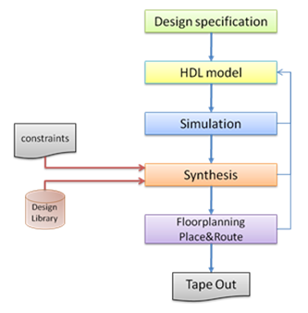
Digital Design Flow
RTL Design
Functional Verification
Synthesis
Formal Verification

Slide 15
VHDL models of Analog Interface and Plasmonic Interconnect
Modulator driver
Laser
Plasmonic waveguide
Plasmonic photodetector
TIA
CRC
Modulator driver
Laser
Plasmonic waveguide
Plasmonic photodetector
TIA
CRC
Modulator driver
Laser
Plasmonic waveguide
Plasmonic photodetector
TIA
CRC
Modulator driver
Nanolaser
Plasmonic waveguide
Plasmonic
amplifier
Plasmonic photodetector
TIA
CRC
Plasmonic
amplifier
Plasmonic
amplifier
Plasmonic
amplifier
4
4
Digital
Analog
Plasmonic
NAVOLCHI reports:
Interface and plasmonic interconnect models and reports (D2.4)
Plasmonic Interconnect VHDL modeling (MS6)

Slide 16
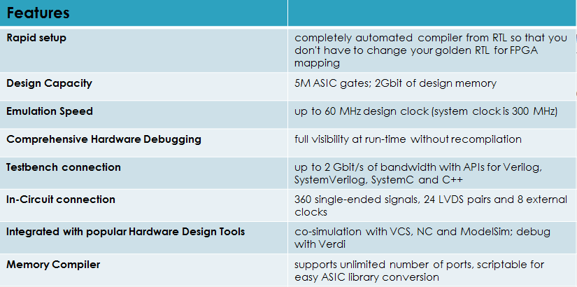
ZeBu-Personal
ZeBu-Personal is a personal emulator that combines the best aspects of traditional
emulation and rapid prototyping into a single, unified environment for both
ASIC/SoC debugging and embedded software validation.
ZeBu-Personal is built as an extended PCI Express motherboard that fits a daughter-
card mounted with three Xilinx Virtex-5 LX330 FPGAs. It plugs directly into a
desktop PC.

Slide 17
Short term plan
Synthesis for FPGA of all VHDL building-blocks (delayed for some HW failures and licence issues)
Deliverable D5.4 and milestone M34 related documents will be delivered as soon as possible

Slide 18
ST activities summary (1/6)
WP1 (Project management)
Effort (man-months) : 2
Tasks:
Meetings (DONE)
Periodic reports (DONE)
Milestones: N/A
Deliverables: N/A

Slide 19
ST activities summary (2/6)
WP2 (Definition and specifications)
Effort (man-months) : 12
Tasks:
T2.1 (analysis, DONE)
T2.2 (scenarios, DONE)
T2.3 (applications, DONE)
T2.4 (trends, DONE)
T2.5 (modeling, DONE)
Milestones:
MS5 (DONE)
MS6 (DONE)
Deliverables: N/A

Slide 20
ST activities summary (3/6)
WP3 (Objective: Plasmonic transmitter)
Effort (man-months) : 1
Tasks: Inputs according to chip-to-chip link needs (DONE)
Milestones: N/A
Deliverables: N/A
WP4 (Objective: Plasmonic receiver)
Effort (man-months) : 1
Tasks: Inputs according to chip-to-chip link needs (DONE)
Milestones: N/A
Deliverables: N/A

Slide 21
ST activities summary (4/6)
WP5 (Objective: Optical and electrical interfaces)
Effort (man-months) : 30
Tasks:
T5.4 (DDCM, DONE)
T5.5 (FPGA, in progress due M30)
Milestones:
MS28, MS29, MS32, MS34 (DONE)
MS36 (DDCM evolution for NiP solutions, due M30)
Deliverables:
D5.1, D5.2, D5.4 (DONE)
D5.6 (Generic DDCM compatible with…)

Slide 22
ST activities summary (5/6)
WP6 (Integration, characterization and testing)
Effort (man-months) : 22
Tasks:
T6.2 (Integration)
T6.3 (Measurements)
T6.4 (Assembly and characterization)
Milestones:
MS41 (Chip to chip interconnect characterization)
MS43 (Plasmonic chip to chip interconnect…)
Deliverables
D6.3 (Report on chip to chip interconnect characterization)
D6.4 (Report on plasmonic chip to chip interconnect…)

Slide 23
ST activities summary (6/6)
WP7 (Objective: Exploitation and dissemination)
Effort (man-months) : 10
Tasks:
T7.2 (Patents, to be done)
T7.3 (Promotion, to be done)
Milestones:
MS46 (DONE)
Deliverables:
D7.1 (DONE)

