Slide 1
Coordinator Presentation
“Project NAVOLCHI”
Manfred Kohl
Karlsruhe Institute of Technology (KIT), Germany

Slide 2
Attendees
KIT | Manfred Kohl, Argishty Melikyan
TU/e | Meint Smit, Victor Calzadilla
UVEG | Juan Martinez Pastor
IMEC (UGent) | Dries Van Thourhout
ETH (ST) | Juerg Leuthold, Claudia Hößbacher
AIT | Christoforos Kachris

Slide 3
Review Meeting Agenda
9:15 Coordinators Talk
9:40 Review of Project Administration (WP1)
9:50 Presentations of Work Packages (WP2)
10:15 Break
10:30 Presentations of Work Packages (WP3-WP5)
12:00 Lunch
12:45 Presentations of Work Packages (WP6, WP7)
13:45 Break
14:00 General Discussion
14:30 Discussion of expected innovations
15:00 Discussion between EC Officer and Reviewers
16:00 Feedback to Consortium
16:30 End of Meeting

Slide 4
Outline Coordinator Talk
Project Overview.
  Vision
  Partners
  Structure
Reviewers Recommendations from Review 2
Status of Work: - The Project after 3 Years
- WP Summaries
4. Review Objectives

Slide 5
Project Overview
Vision:
Very high speed (~ Tbit/s) chip to chip interconnects with
- smallest footprint
- cross talk noise immunity
- low power consumption
for future generation high speed computing
MHz → GHz → THz
NAVOLCHI approach:
Plasmonics
Plasmonics
Electronics Photonics Electronics

Slide 6
Project Overview
ICT-2011.3.5: Core and Disruptive Photonic Technologies
Focus:
Impact:
Improving Europe’s position in systems communication technologies, in particular SiP.
Environment: Decrease CO₂-emission while electronic data processing increases.
Employment: Strengthening of SMEs for international competition.
ICT-2011.3.1: Very advanced nanoelectronic
components: design, engineering, technology and manufacturability (!)

Slide 7



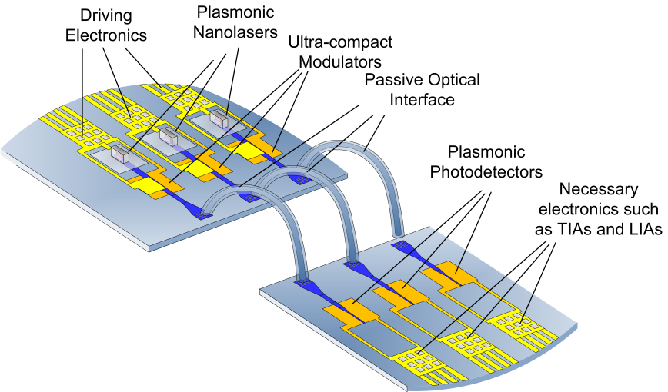





Partners Contributions
Specifications,
dissemination
Management
Optical amplifier

Slide 8
Project Ammendment
Specifications,
dissemination
Management
Optical amplifier

Slide 9
Structure: Interrelation of WPs
[ETH]

Slide 10
Project Overview
NAVOLCHI Technical Core (Challenges):
  Transmitter
  → Laser
  → Modulator
  Receiver
  → Plasmonic Amplifier
  → Photodetector
  Passive Components
  Integration

Slide 11
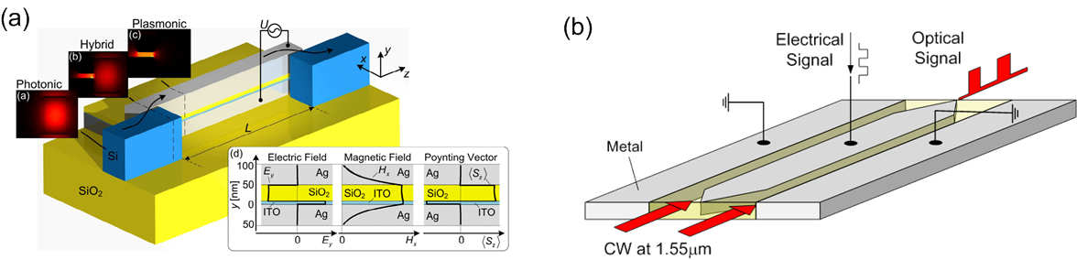
Project Overview: Objectives
Objective 1: Development of Transmitter.
a) Metallo-dielectric Nanolaser
- output power > 40 µW
- device length < 1 µm
b) Plasmonic Modulator:
Absorption (a) Phase (b)

Slide 12
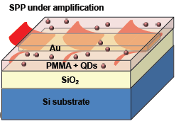
Project Overview: Objectives
Objective 2: Development of Receiver.
a) Plasmonic Amplifier
- colloidal QDs
- gain 10 dB
b) Fast Plasmonic Photodetector
- quantum efficiency > 80%
- responsitivities > 0.1 A/W

Slide 13
Project Overview: Objectives
Objective 3: Passive Components.
a) Waveguide Couplers
- size 50 – 100 nm
- efficiency >30%
b) Beam Shaping Couplers
- chip distance 1 mm
- bandwidth > 10 nm
- efficiency > 3 dB
c) Optical Filters
- bandwidth 3 nm
- suppression 10 dB
- spectral range 30 nm

Slide 14
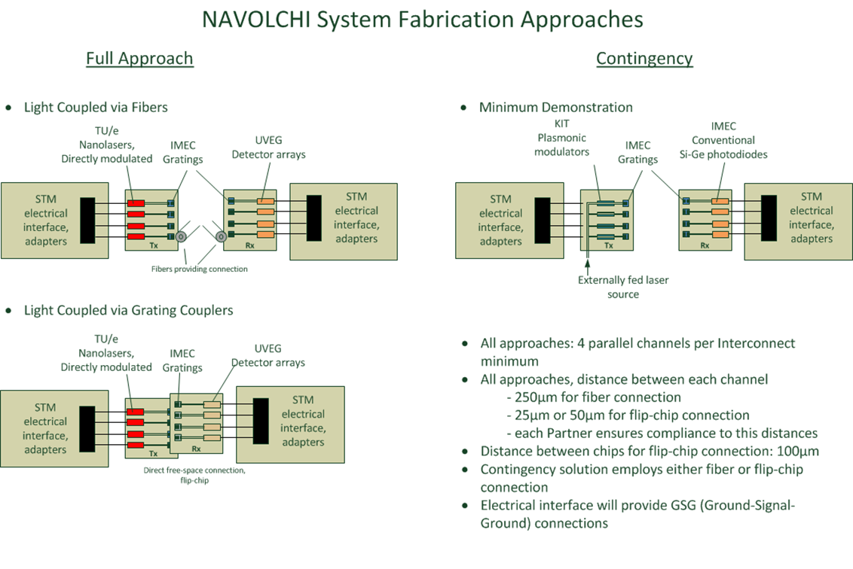
Project Overview: Objectives
Objective 4:

Slide 15
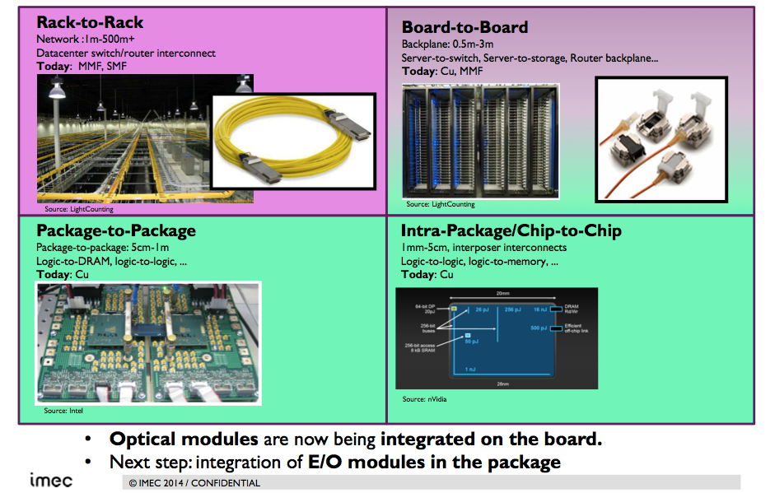
Project Overview: Objectives
Objective 4: Applications (Interconnect Challenge) / Benchmarking

Slide 16
Review 2 Results
Allow the project to continue without modifications

Slide 17
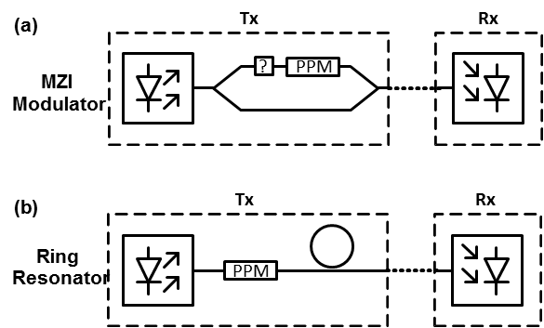
Review 2 Recommendations
1. Before implementing the system level demonstrator(s), make an analysis of the expected interconnect parameters at system level (e.g. data rate, latency, power consumption, foot print) for different possible architectures of the system level demonstrator, based on known or expected component performances. Compare these system level values with data from other research groups and commercial data. Report these data in deliverable D1.5 or in milestone report M39, as appropriate. When this document is ready, send it also to the reviewers.
Ongoing evaluation of the following interconnection systems (VPI Photonics software):
a) Directly modulated laser (DML) - based system
b) Phase modulation scheme:
plasmonic MZM + (metallo-dielectric) laser source,
(binary phase shift keying (BPSK) transmission,
differential phase shift keying (DPSK) detection)
c) Intensity modulation scheme:
plasmonic MZM driven + (metallo-dielectric) laser
(direct detection at the receiver)
(b)
(c)
→ D1.5

Slide 18
Review 2 Recommendations
1. Before implementing the system level demonstrator(s), make an analysis of the expected interconnect parameters at system level (e.g. data rate, latency, power consumption, foot print) for different possible architectures of the system level demonstrator, based on known or expected component performances. Compare these system level values with data from other research groups and commercial data. Report these data in deliverable D1.5 or in milestone report M39, as appropriate. When this document is ready, send it also to the reviewers.
M39: Concept for system integration is under continuous update
Delayed
2. In deliverable D6.3, extend this comparison with the actually measured system level data.
D6.3 - Report on chip to chip interconnect characterization
Rescheduled for month 45

Slide 19
WP 2 Summary
Objectives:
Initial benchmarking
Definition and specification of optical interconnection system environment and parameters (to be used for performance evaluation)
To develop a cycle accurate VHDL model of serializer/deserializer
System modeling
Achievements:
Modeling of the three architectures with latest characteristics of the system components:
A directly modulated laser (DML) - based system
A binary phase shift keying (BPSK) transmitter utilizing the MZM and external CW laser
An intensity modulation transmitter (MZM and external CW laser)
-> Evaluation of the end-to-end loss in the system (ongoing)
-> Analysis of the overall loss as function of system parameters
(bit-rate, targeted BER level)

Slide 20
WP 3 Summary
Objectives
  Design and simulate a plasmonic/metallic nanolaser and a plasmonic modulator
  Fabricate/characterize the electrically driven plasmonic/metallic nanolaser and plasmonic modulator

Slide 21
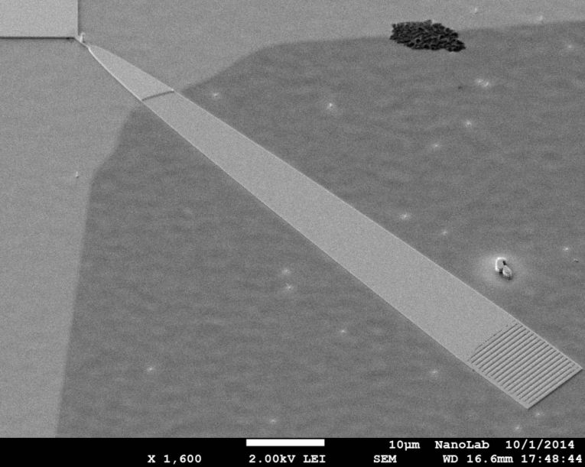
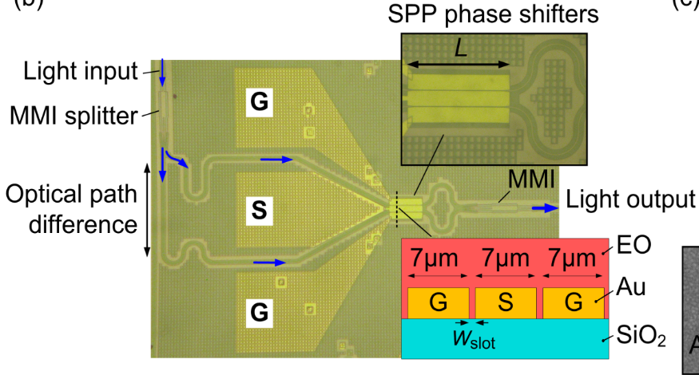
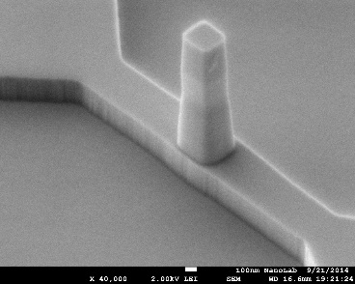
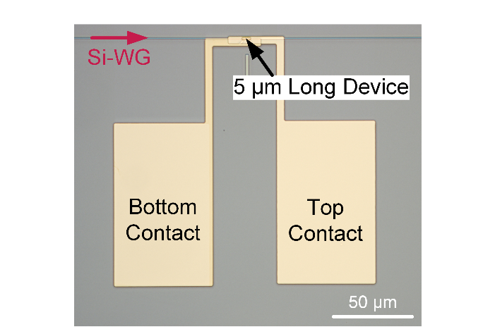
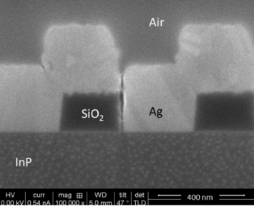
WP 3 Highlights
Nanolaser fabrication (2nd run in process)
Low-loss low-resistance ohmic contacts (Ge/Ag)
Metal grating coupler
Mach-Zehnder Modulator fabrication (completed)
Processing in III-V layer stack
on silicon substrate
Absorption Modulator fabrication (2nd run in process)

Slide 22
WP 3 Summary
Objectives
  Design and simulate a plasmonic/metallic nanolaser and a plasmonic modulator
  Fabricate/characterize the electrically driven plasmonic/metallic nanolaser and plasmonic modulator
Achievements
    Modeling of metal-cavity lasers and plasmonic modulators
    Technology development: silver-based ohmic contacts as well as lithographic and etching processes to fabricate the laser. Currently second run under fabrication.
    Plasmonic phase modulator with V_{π} L = 0.5 Vmm
      BPSK signaling at 40 Gbit/s (BER < 10⁻¹⁰)
    First plasmonic Mach-Zehnder modulators
      OOK signaling at 40 Gbit/s (BER < 6 ×10⁻⁴)
    First plasmonic absorption modulators
      ER 6 dB, 5 µm long, ±2 V, <200 nW, MHz modulation

Slide 23
WP 4 Summary
Objectives (plasmonic amplifier):
- IR Quantum Dots (HgTe) showing gain
- Plasmonic Amplifier based on polymers + HgTe QDs (optical injection)
- Si based Plasmonic Amplifier platform + HgTe QDs (optical / el. injection)
Achievements:
HgTe QDs (closed-packed film) show gain (pulsed excitation)
Metal waveguides (planar and ridges) have been fabricated and measured.
-> Increase of the SPP propagation length by optical pumping of QDs:
15 % / >100 % (HgTe / CdSe QDs)
Silicon Nitride + QDs waveguide platform
-> compatible with AC electrical injection
-> low losses (2.7 dB/cm @ 900nm)

Slide 24
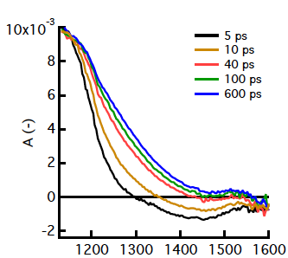
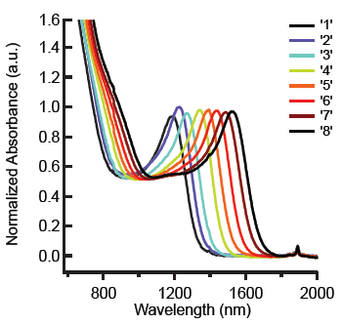
WP 4 Highlights
+ Colloidal QDs exhibit gain
at practical pumping powers
(modal gain: ~ 100 cm⁻¹)
- Lifetime: ~ 100 ps
+ Improved synthesis
+ Control of QD size
-> emission wavelength
-> narrow absorption bands

Slide 25
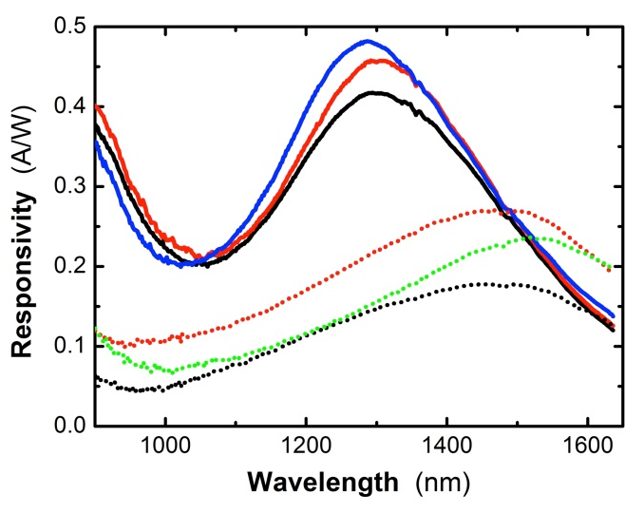
WP 4 Summary
Objectives (Photodetectors using QDs and metal nanostructures):
- PbS QD - films for absorption at 1550 nm.
- Photodetectors based on these films with R > 0.1 A/W.
- Fabrication of nano-gap waveguide photoconductors.
Achievements:
Schottky photodetectors:
+ high responsivities
e.g. 0.4 A/W @t 1500-1600 nm
+ low power
- time response: 100 µs
QD layer thickness:
d=500 nm
d=250 nm
Plasmonic nanogap structures were fabricated on glass/ITO substrates

Slide 26
WP 5 Summary
Objectives:
  Completion first generation beam shapers and filters. Initiation design second generation beam shapers
  Selection optimal design couplers waveguide-plasmonic devices
  Specification and functional verification DDCM for plasmonic PHY
Achievements:
  D5.3: Compact optical filters and first generation beam shapers completed
  D5.4: Specification document describing generic DDCM compatible with plasmonic-based PHY completed
  D5.5: Plasmonic waveguide couplers: completion design study and selection optical design

Slide 27
WP 5 Summary
DDCM module specified and verified
Second generation coupler designed and under fabrication
STNoC/STBus/AXI initiator
STNoC/STBus/AXI target
Virtual wires
Trade-off distance/pitch
DDCM Tx
DDCM Rx
Die #1
Die #2
Unidirectional physical links
DDCM Rx
DDCM Tx
STNoC/STBus/AXI target
STNoC/STBus/AXI initiator
Virtual wires
Request traffic flow
Response traffic flow
Virtual wires

Slide 28
WP 6 Summary
Objectives
  Characterization and testing of active and passive plasmonic devices
  Integration of plasmonic devices with the electrical parts the chip-to-chip communication structure is composed of
  Characterization and testing of a complete System in Package
Achievements
    Characterzation of plasmonic devices almost completed
    2D in-plane packaging started
    Integration with electronics started

Slide 29
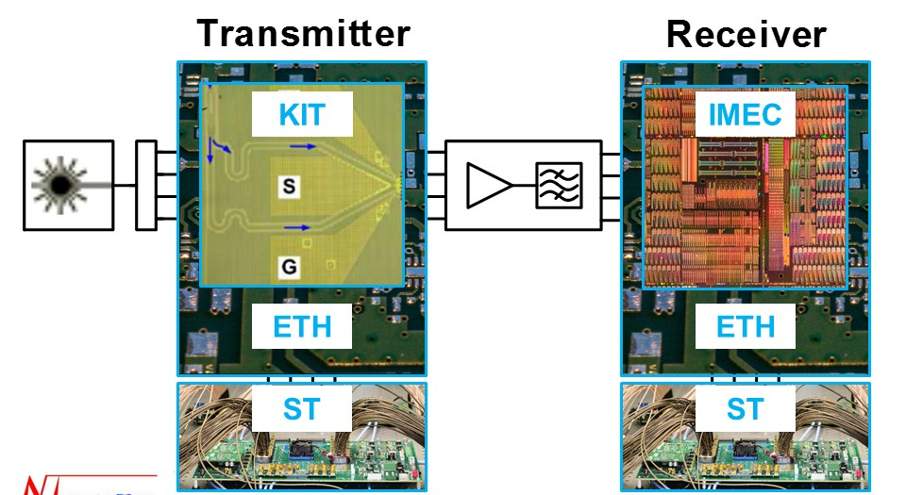
WP 6 Highlights
Interconnect system – contingency plan
2D in plane packaging

Slide 30
WP 7 Summary
Objectives:
  Dissemination through paper submission to high quality scientific journals and conferences
  Organizing workshops & seminars on NAVOLCHI technology
  Dissemination through the website
  Issuing press releases and brochures
  Patents
  Theses at partners’ institutes
Achievements within reporting period:
  11 journal paper
  14 conference papers
  8 talks/posters
  1 patent
  8 finished thesis

Slide 31
Review Objectives
The continued relevance of the objectives and breakthrough potential with respect to the scientific and industrial state-of-the-art
The breakthrough potential of the plasmonic components (nanolaser, phase modulator, photodetector) remains valid. Their integratation in a photonic circuit has not yet been demonstrated.
The degree of fulfilment of the project work plan and of the related deliverables
-> WP presentations
The resources planned and utilised in relation to the achieved progress
-> Table of person-months at WP level
The expected potential impact in economic, competition and social terms, and the beneficiaries' plan for the use and dissemination of foreground.
Photonic interconnect technology is crucial for increasing the capacity of data centers. The plasmonic components developed in NAVOLCHI are key components in such interconnects. Other long-terms prospects are foreseen.

Slide 32
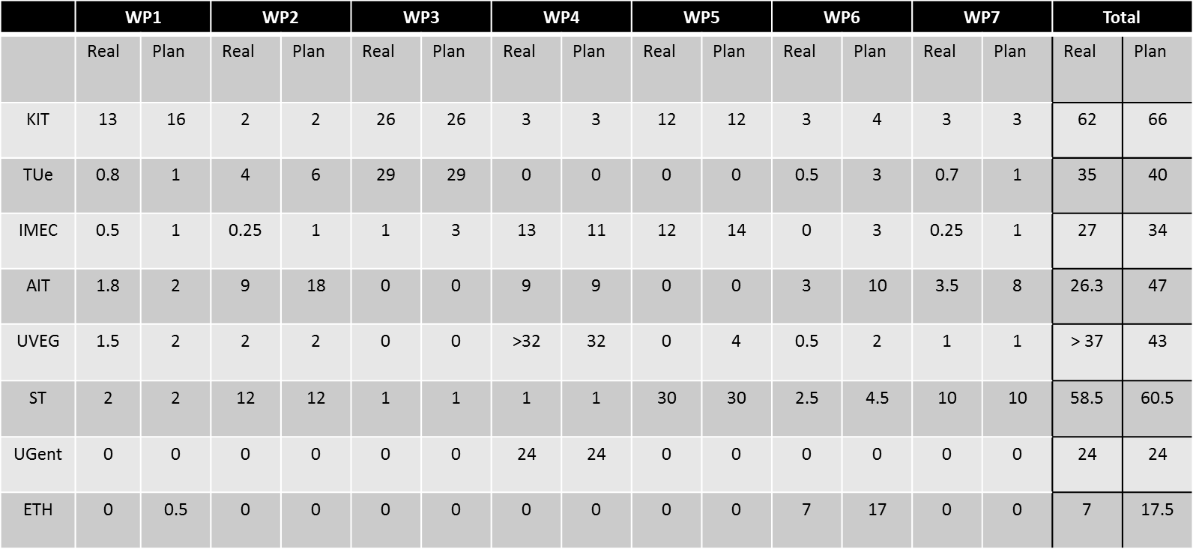
Review Objectives
The resources planned and utilised in relation to the achieved progress

