Slide 1
WP-1 Presentation
“NAVOLCHI Management”
Manfred Kohl
Karlsruhe Institute of Technology (KIT), Germany

Slide 2
Outline
Overview and Project Governance
Management Deliverables
Communication: Meetings and Phone Conferences
GA-Amendment
Current Status: Deliverables and Milestones
Innovation
Summary

Slide 3

Overview of WPs

Slide 4
Management: Main Tasks
Strategic management at project level
Control of work package activities, including technical quality control
Organisation of project reporting and meetings
Control of deliverable preparation
Conflict management

Slide 5
Project Governance

Slide 6







General Assembly: Representatives
Coordinator (Chair): Juerg Leuthold
Manfred Kohl
+
 | KIT | Manfred Kohl
 | IMCV | Dries Van Thourhout
 | TU/e | Meint Smit
 | AIT | Ioannis Tomkos
 | UVEG | Juan Martinez Pastor
 | ST | Alberto Scandurra
 | Ugent | Zeger Hens
IMEC
ETH
Jürg Leuthold

Slide 7
Project Management Committee:
Technical Project Manager (Chair): Manfred Kohl
Jürg Leuthold
+
Coordinator: Juerg Leuthold
Manfred Kohl
+
WP 1 Leader | KIT | Manfred Kohl
WP 2 Leader | AIT | Emmanouil-Panagiotis Fitrakis
WP 3 Leader | TU/e | Meint Smit
WP 4 Leader | UVEG | Juan Martinez Pastor .
WP 5 Leader | IMEC | Dries Van Thourhout
WP 6 Leader | ST | Alberto Scandurra
WP 7 Leader | AIT | Dimitrios Klonidis
Christoforos Kachris
ETH
Jürg Leuthold
Christoforos Kachris

Slide 8
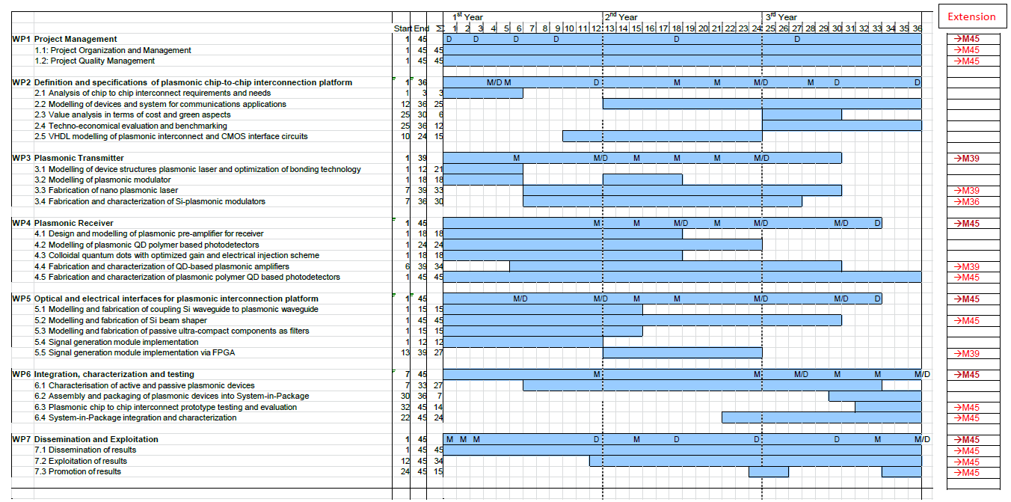
Time Scale (including extension)
Originally planned end attained
Some tasks are extended by nine months

Slide 9

Management Deliverables
Deliverables covered by work package 1 with delivery dates are:
  D1.1: Project web site with .eu domain (M01) and continuous update 11/2011
  D1.2: Project reference online manual 01/2012
  D1.3: Project quality assurance manual 04/2012
  D1.4: Intermediate progress report (1) containing work progress and management activities up to month 9 (07/2012)
  D1.5: Intermediate progress report (2) containing work progress and management activities up to month 27 (01/2014)
All have been prepared in time.

Slide 10
Communication
Meetings:
  Kick-Off in Karlsruhe, Germany
  6-Month Meeting in Warwick, UK
  12-Month Meeting in Ghent, Belgium
  18-Month Meeting in Karlsruhe, Germany
  27-Month Meeting in Eindhoven, Belgium
  36-Month Meeting in Brussels, Belgium
Phone Conferences:
  30 up to now (November 2014), typically monthly
  Topics: Work progress, adjustments, ..
  Presentations documented at WEB-Site

Slide 11
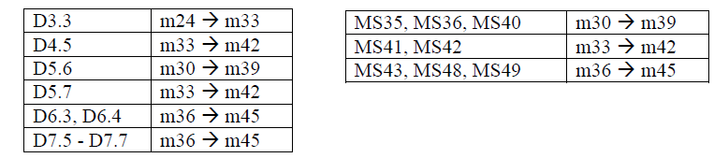
GA-Amendment
Main topics
Project extension by 9 months
ETH as new partner to overtake tasks from ST
Modification of DoW, mainly WP6 (task6.3 and task 6.4), which will be finished by ETH
Accepted by EC: 16 Sept. 2014
Consequence: Shift of deliverables and milestones:

Slide 12
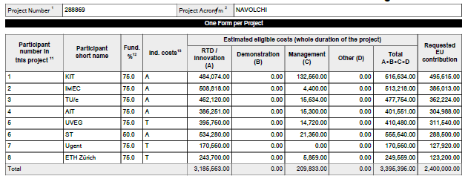
GA-Amendment
New budget breakdown
ST is instructed to pay 123,2 t€ to Coordinator, who remits it to ETH

Slide 13
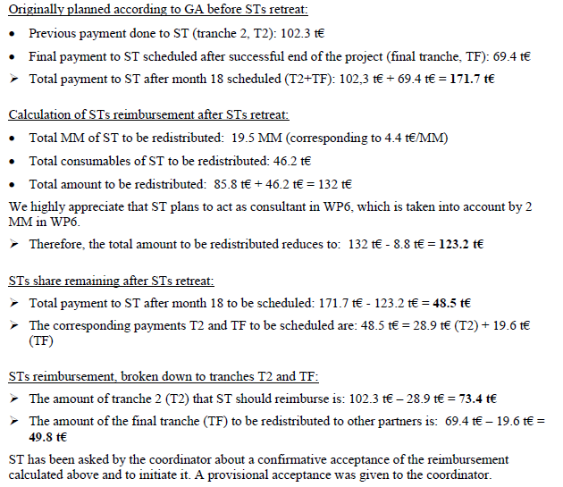
GA-Amendment
Detailed calculation
of STs liabilities

Slide 14
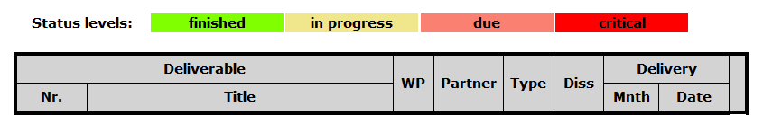
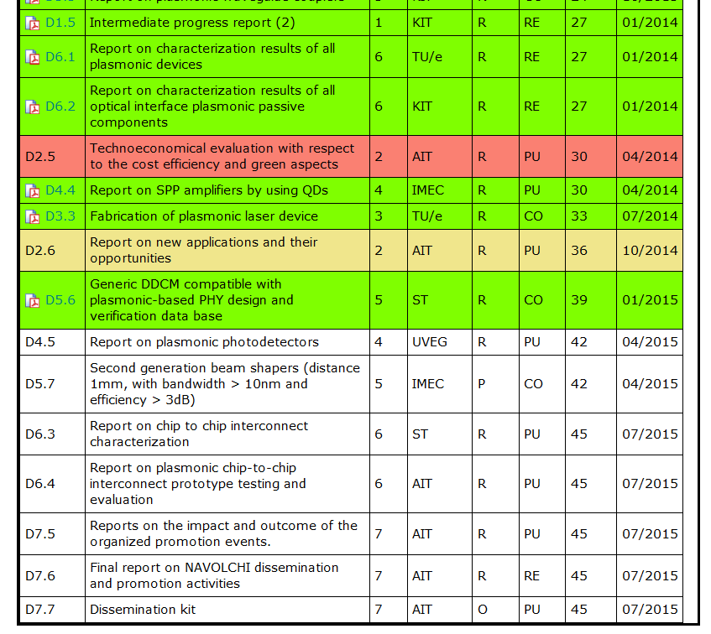
Status: Deliverables
Most deliverables finished in time, except D2.5 and D2.6
Next deliverable in M42 (April 2015)
With project extension by 9 month, no critical status level expected

Slide 15
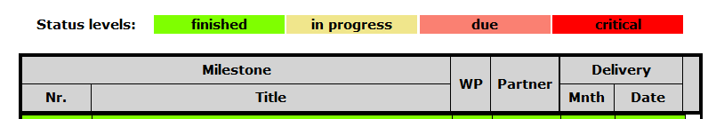
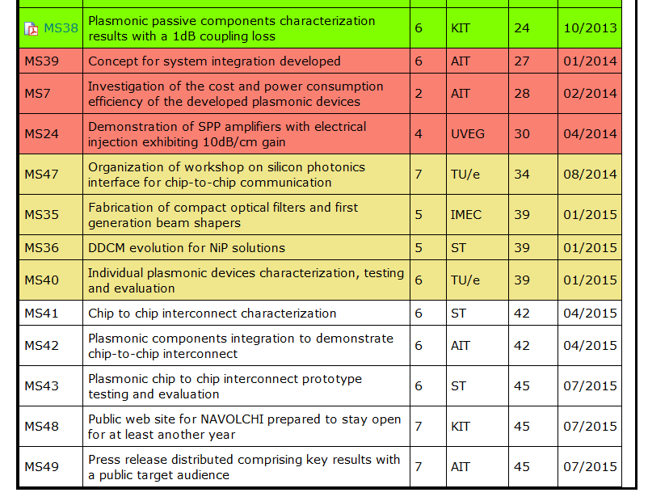
Status: Milestones
MS39: Continuously updated; final decisions expected at preparatory meeting; will be fixed immediately after review meeting
MS7, MS24: Late !
MS47: in submission
Next milestones in M39 (January 2015)
With project extension by 9 month, no critical status level expected
Fabrication of second generation of beam shapers

Slide 16
Innovation
Innovation questionnaire (October, 23th 2014)
Summary:
Extra topic in this meeting: Topic 6, 30 minutes
Further information in WP7 presentation
The main innovations of the NAVOLCHI project are a plasmonic transmitter and a novel nano-scale plasmonic chip-to-chip and system-in-package interconnection platform to overcome the bandwidth, foot-print and power consumption limitations of todays electrical and optical interconnect solutions. The proposed plasmonic scheme combines efficiently the advantages of photonics devices (high bandwidth, low latency) with the advantages of the electronic systems (small footprint, low-cost and energy-efficient).

Slide 17


Summary
Project Structure
Partner Communication
Technical and Scientific Progress
Solutions of Problems during extension
Plan for Further Progress

Slide 18
Thank you!

