Slide 1
Work Package 2: Definition and Specifications of Plasmonic Chip-to-Chip Interconnection Platform
Christoforos Kachris, Thymios Lallas, Dimitris Klonidis, Ioannis Tomkos
Athens Information Technology, Greece

Slide 2
Outline
WP2 Position in Project
Objectives
Tasks
Milestones and Deliverables
Status of Work
Summary and Outlook

Slide 3
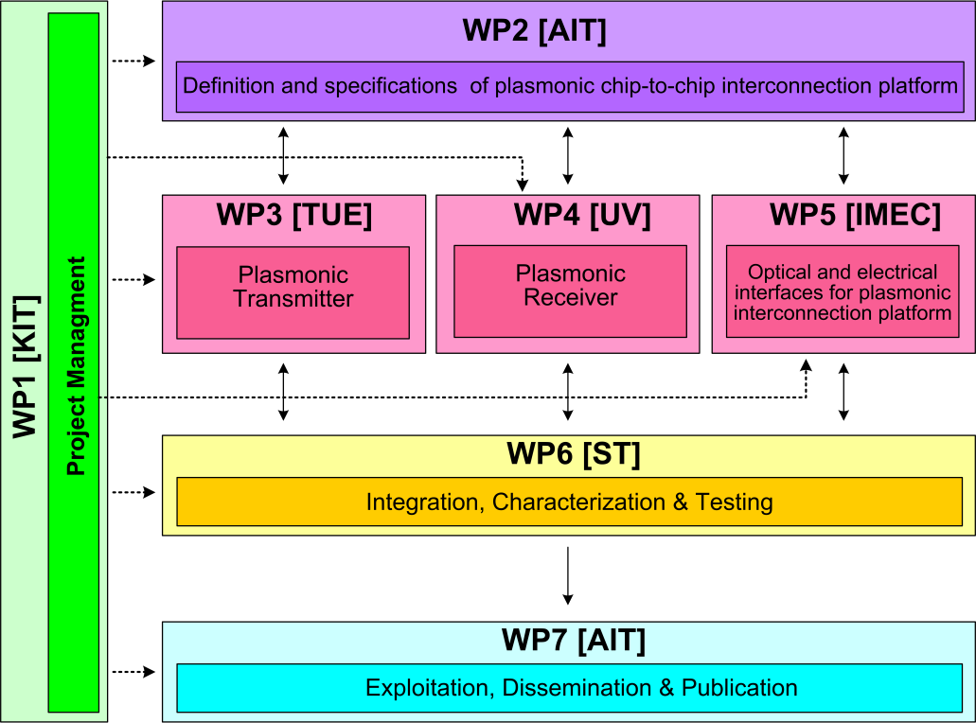






WP2 Position in Project
Contributors:

Slide 4
Objectives
Review requirements and needs for chip-to-chip interconnects
Initial benchmarking
Set target specifications for system
Define subsystem plasmonic devices
System modeling
Development of a cycle accurate VHDL model of a serializer/deserializer

Slide 5
Tasks
 | Names of the Tasks | Time Period [months]
Task 2.1 | Analysis of chip to chip interconnect requirements and needs | 1 – 6
Task 2.2 | Modeling of devices and system for communications applications | 13 – 36
Task 2.3 | Value analysis in terms of cost and green aspects | 25 – 30
Task 2.4 | Techno-economical evaluation and benchmarking | 24 – 45
Task 2.5 | VHDL modeling of plasmonic interconnect and CMOS interface circuits | 10 – 24

Slide 6
Milestones
 | Names of the Milestones | Month | Partner
MS1 | Definition of chip-to-chip interconnection system environment and specification | 3 | AIT
MS2 | Definition of plasmonic devices and material properties for chip-to-chip interconnection | 6 | AIT
MS3 | Development of a system and device simulation platform | 18 | AIT
MS4 | Definition of the interconnection level specification employing developed plasmonic devices | 18 | ST
MS5 | Digital domain to plasmonic domain interface specification and VHDL modelling | 21 | ST
MS6 | Plasmonic interconnect VHDL modelling | 24 | ST
MS7 | Investigation of the cost and power consumption efficiency of the developed plasmonic devices | 28 | AIT

Slide 7
Deliverables
 | Names of the Deliverables | Month | Partner
D2.1 | Definition of chip-to-chip interconnection system environment and specification | 3 | ST
D2.2 | Definition of plasmonic devices | 12 | AIT
D2.3 | Investigation of chip-to-chip interconnection-level specifications employing new plasmonic devices | 24 | AIT
D2.4 | Interface and plasmonic interconnect models and reports | 24 | ST
D2.5 | Techno-economical evaluation with respect to the cost efficiency and green aspects | 30 | AIT
D2.6 | Report on new applications and their opportunities | 36 | AIT

Slide 8
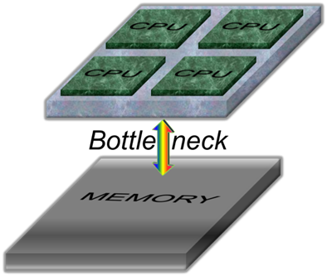
Task 2.1 Requirements and Needs
I. What we are interested in
  In the context of chip-to-chip interconnects, we are looking for:
  Large bandwidth to resolve the data rate bottleneck
  Small Size for increased integrability
  Low latency also for improved performance and scalability
  Low power consumption for energy and cost considerations
  In multicore systems, the chip-to-chip interconnect is the data rate bottleneck

Slide 9
Task 2.1 Requirements and Needs
I. What we are interested in
Chip-to-chip optical interconnection requires high speed transceivers that are monolithically integrated with electronic ICs, which can convert digital information from electrical domain to optical domain and vice versa.
  Such transceivers should be compact, offer large bandwidth, low latency and consume little power in order to be economically and technologically efficient.
The most promising technology for realization of such transceivers is the CMOS compatible silicon photonics platform whose low cost and large scale fabrication is ensured by well-developed advanced CMOS fabrication techniques.
Unfortunately, there is a size mismatch between silicon electronics and silicon photonics. Even state-of-the-art Si photonic transceivers are bulky comparing to electronic transistors. Therefore, the integrated silicon photonic transceivers would occupy large portion of the optoelectronic ICs making them not economically viable…

Slide 10
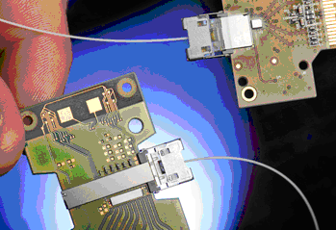
Task 2.1 Requirements and Needs
II. Market & Projects Review
In order to set the system targets, market products and research projects were reviewed.
See D2.2 and Intermediate Report
Link | Type | Throughput (total) | Latency | Pins/Channels | Power
Intel 50G Link | Opt. | 50 Gb/s |  | 4
UNIC | Opt. | 5 Gb/s* |  |  | 5 mW*
TI C2C | Electr. | 6.4 Gb/s | 50 ns | 16
MIPI LLI | Electr. | 5.8 Gb/s | 80 ns | 4 | 15 pJ/bit
MIPI UniPort | Electr. | 3.2 Gb/s | high | 4 | 15 pJ/bit
*first-year results of research project.
Intel 50G

Slide 11
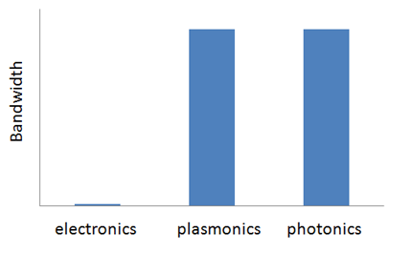
Task 2.1 Requirements and Needs
III. Bandwidth In-Principle Considerations
Photonics has superior data rate capability per channel to electronics, due to greater operating frequencies (x1000).
Surface plasmon-polaritons (electromagnetic waves coupled to metal surface charge oscillations) have optical bandwidths and retain the data rate capabilities of photonics.
Plasmonics have better crosstalk properties than electronics.

Slide 12
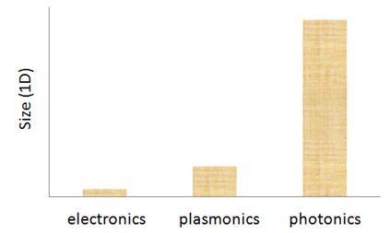
Task 2.1 Requirements and Needs
V. Size. Theory.
Electronics are approaching their size limit (several nanometers for device features). Quantum tunneling for < 15 nm. Silicon lattice constant ~ 0.5 nm.
Photonics is much bulkier than electronics. Minimum possible confinement of light in any dimension of conventional photonics is called the diffraction limit: λ/2 (~500 nm for telecom frequencies in glass). This limit comes up when one tries to solve Maxwell’s Equations for materials with positive permittivities (i.e. non-metals).
Confinement in plasmonics can beat the diffraction limit by about an order of magnitude in any dimension (λ/20). In laboratory practice, dimensions of < λ/2 (subwavelength) are typical. This makes plasmonic devices significantly more compact. There is a trade-off between confinement and loss.
In practice, photonic/plasmonic devices are longer than the limits, because many wavelengths are needed for meaningful light-matter interaction.

Slide 13
T2.2 Modeling of Devices & System
Three system architecture have been emulated
A directly modulated laser (DML) - based system in which the data are applied directly on the driving current of the metallo-dielectric laser source
A differential phase shift keying (DPSK) transmitter, utilizing the plasmonic MZM driven by the metallo dielectric laser source in continuous wave (CW) mode and with differential phase shift keying (DPSK) detection based on a passive delay line interferometer (DLI) at the receiver
An intensity modulation transmitter(OOK) utilizing the MZM and the laser source in CW mode, with direct detection at the receiver

Slide 14
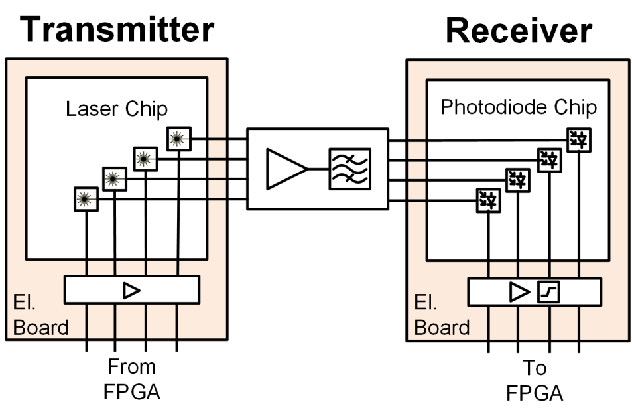
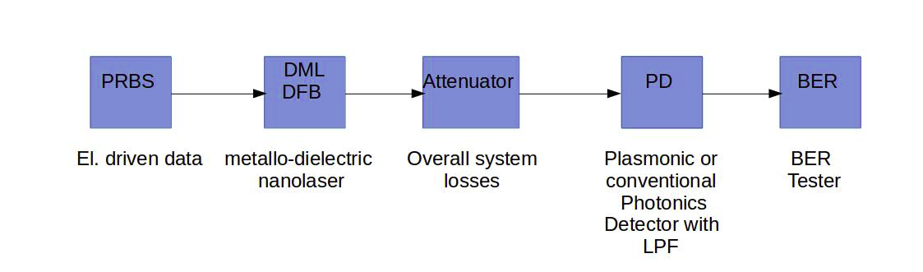
Scenario-1: Directly modulated laser
A directly modulated laser (DML) - based system in which the data are applied directly on the driving current of the metallo-dielectric laser source

Slide 15
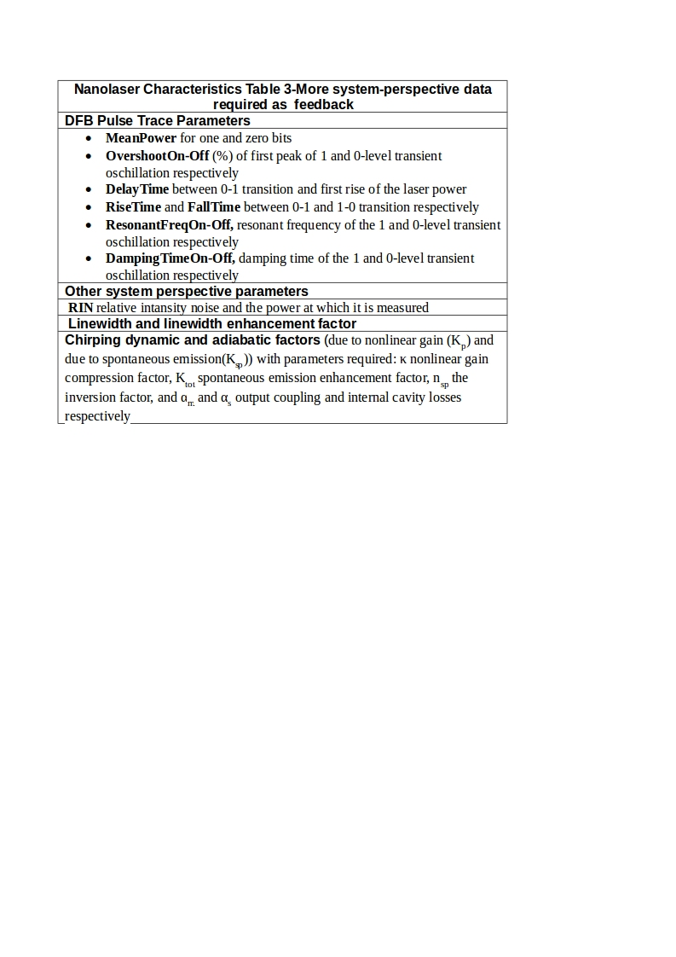
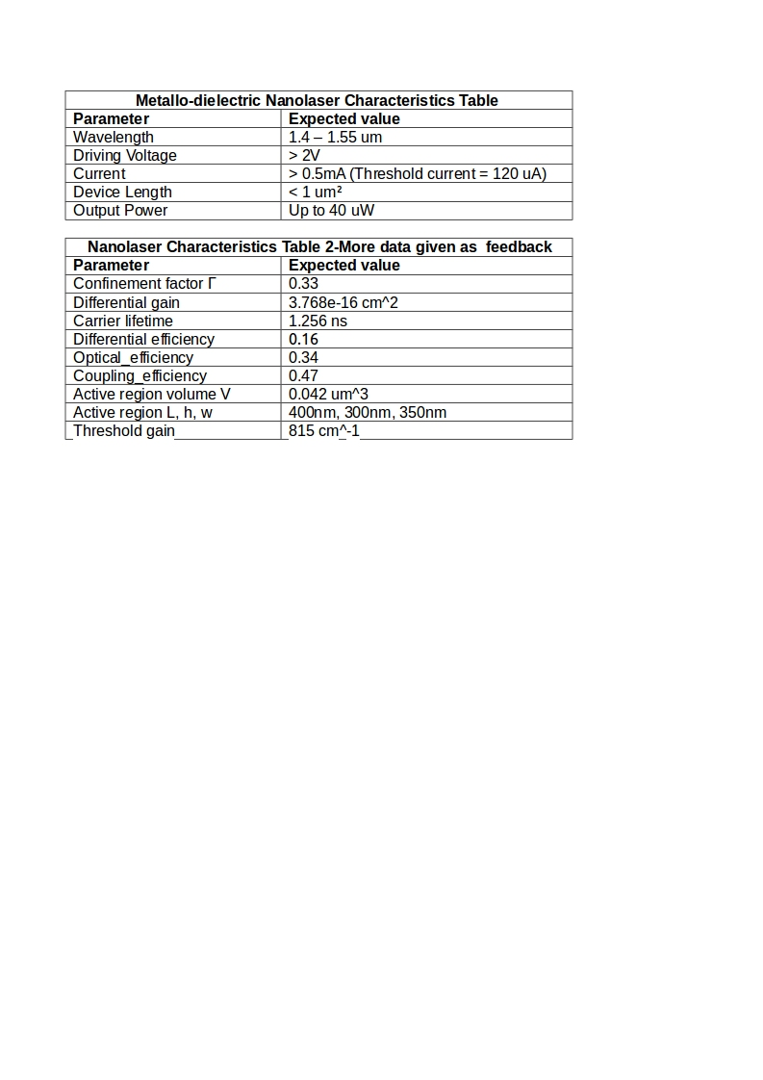
Scenario-1 remarks
A significant number of parameters concerning primarily the laser structure were not possible to be estimated as long as the specific device is under development. This creates a large number of uncertainties for the accurate evaluation of the DML-based system, since the resulted signal shape from this type of transmitter depends strongly on these parameters and affects the final performance evaluation results.

Slide 16
Scenario-1 remarks
An attenuator is placed between transmitter and receiver in order to simulate overall end to end system losses, and mainly those come from conventional fiber interconnection.
The photodetector could be either a conventional Si/Ge Photonics detector (IMEC feedback data) or a Plasmonics detector (UVEG feedback data).
DML nanolaser operates at low powers (appr. 40uW).

Slide 17
Scenario-1 results
BER performance is estimated for losses come from conventional fiber interconnection at proposed bitrate (7.2Gbps) for:
  a range of typical nanolaser output powers
  for a range of receiver responsivities covering both cases,
    a conventional photoreceiver and
    a plasmonic one.

Slide 18
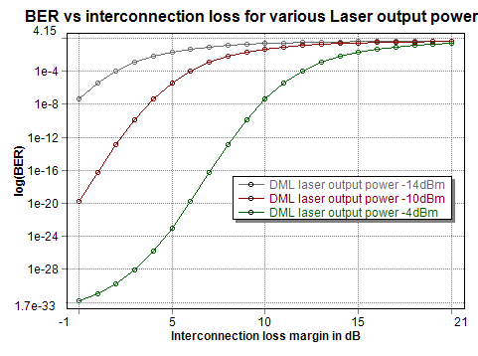
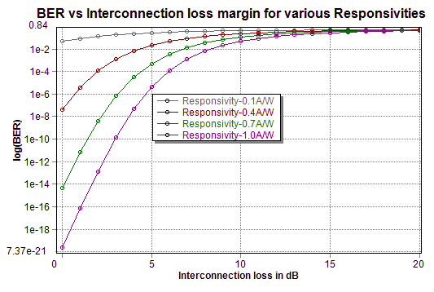
At const system bitrate:7.2Gbps and 0.4A/W Rx responsivity
A DML laser with output power over -10dBm is required
At const laser output power:-14dBm
At const system bitrate:7.2Gbps
Conventional detector’s responsivity (and even higher than 0.4A/W) is required for acceptable BER at lower than 10dB overall system loss
plasmonic
conventional
Notes:
Why the BER is high even for 0 losses?
Key point for each figure (which BER can be tolerated?)
What is the best-case and worst-case scenarios for losses?

Slide 19
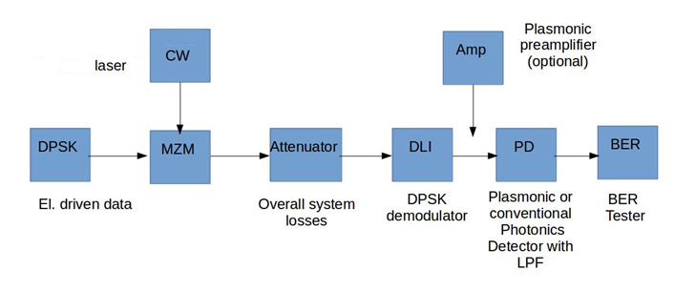
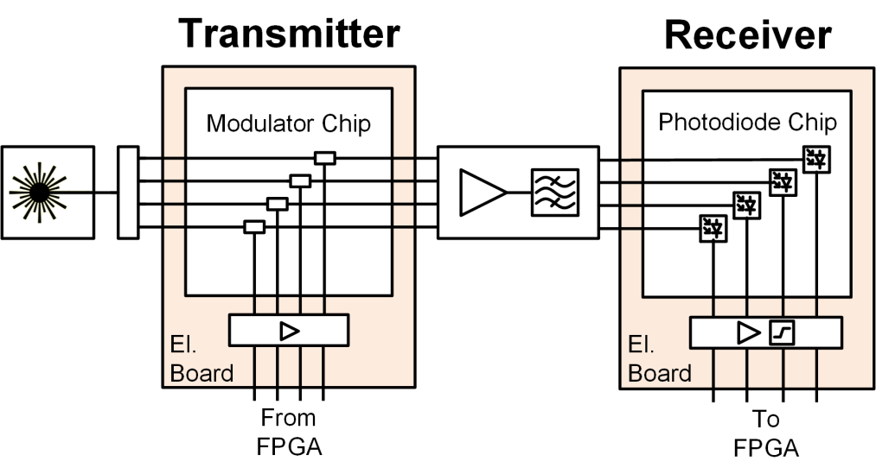
Scenario-2
External laser with phase modulated MZM (DPSK)
2 cases examined: with or without plasmonic preamplifier prior to detector
Notes:
Remove eml and metallo dielectric

Slide 20
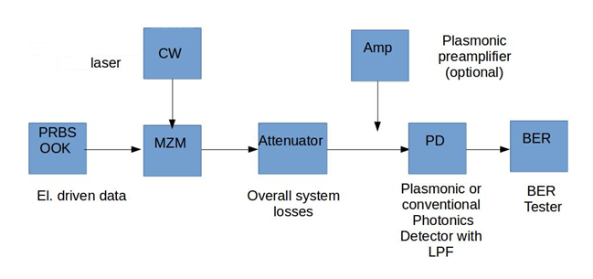
Scenario-3 external laser with amplitude modulated MZM (OOK)
2 cases examined: with or without plasmonic preamplifier prior to detector

Slide 21
EML scenarios common remarks
An attenuator is placed between transmitter and receiver in order to simulate overall end to end system losses, which include:
  Mainly losses come from chip to chip conventional fiber interconnection.
  Fiber losses between CW external laser and MZM chip
  Coupling losses between plasmonic amplifier and detector(in cases a preamplifier is used)
MZM overall losses include:
  Propagation loss across the Plasmonic Phase Shifter length
  Coupling losses due to photonic Multi Mode Interference coupler and due to photonic to plasmonic taper coupler

Slide 22
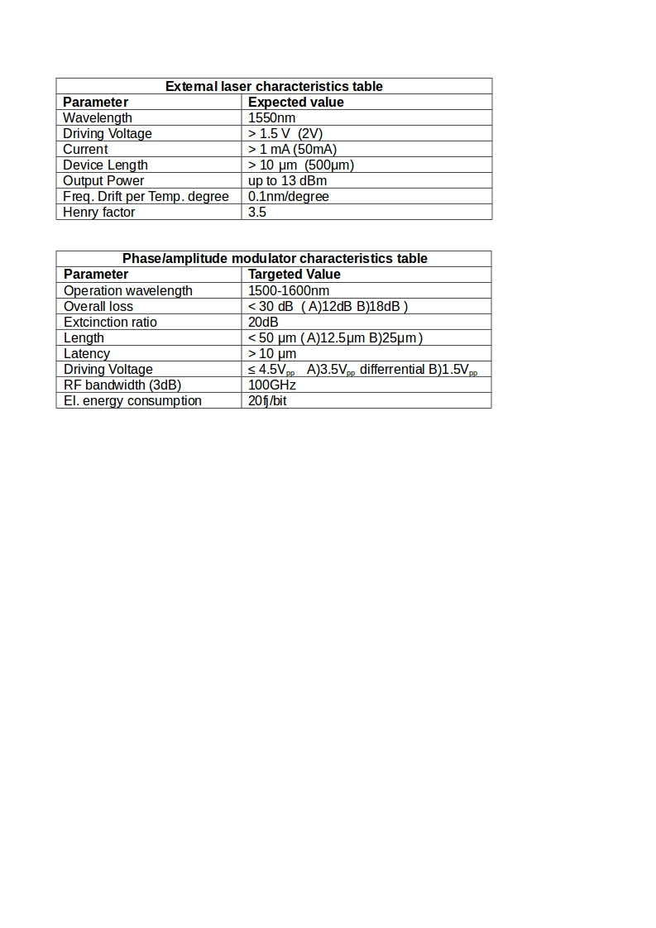
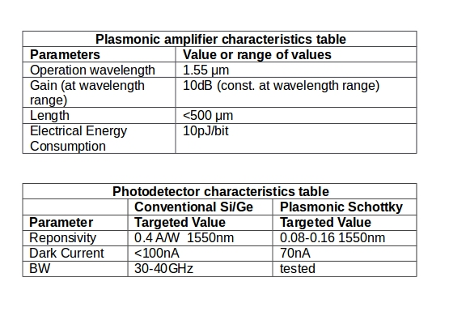
EML scenarios device characteristic tables

Slide 23
EML scenarios results: without amplifier
BER performance at specified bitrate (7.2Gbps) is estimated for maximum overall losses that the system can handle, for range of values of various critical parameters:
    CW laser output powers(no booster amplifier between CW and MZM)
    Amplified input powers to MZM (booster amplifier is placed between CW and MZM )
    MZM overall losses
    Detector responsivities(range covers both conventional Si/Ge and plasmonic detectors)
    Other system bitrates
For measuring BER performance versus chip to chip interconnection distance at specified bitrate and other bitrates, data values of interconnection loss in dB/mm and typical ranges of chip to chip distances are required.

Slide 24
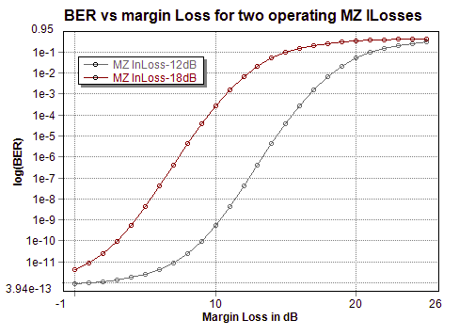
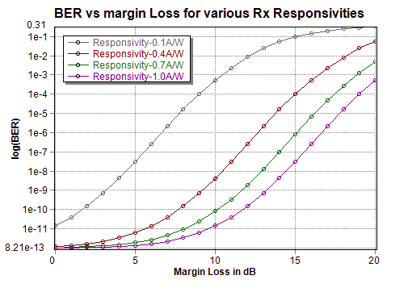
At const system bitrate:7.2Gbps
CW laser power 10dBm and 0.4A/W Rx responsivity.
BER performances can be significantly improved by reducing MZM total losses, especially when system is to be operated at higher than default bit rate (7.2Gbps).
At const system bitrate:7.2Gbps
CW laser power 10dBm, MZ loss 12dB.
External laser scenario shows good BER performances even for the lowest responsivity for system losses up to 10dB
Scenario 2: EML DPSK results

Slide 25
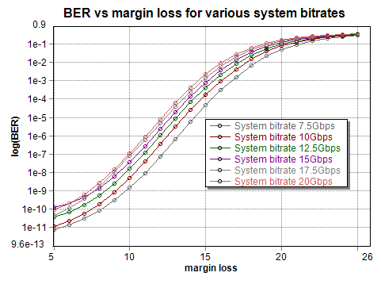
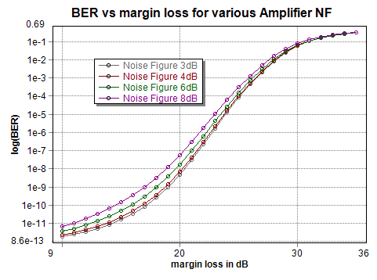
CW laser power 10dBm and 0.4A/W Rx responsivity.
System shows quite good BER performance for bit rates up to 20Gbps and overall losses up to 15dB
CW laser power 10dBm and 0.4A/W Rx responsivity at default bitrate(7.2Gbps) for various Noise Figures (NF) when an amplifier is used prior to detector(10dB target Gain).
System shows good BER performance for quite all NF range for total system loss around 20dB

Slide 26
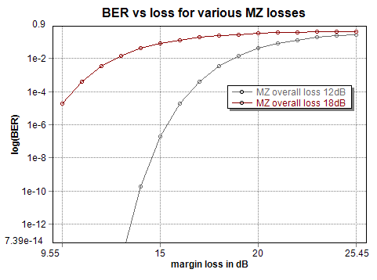
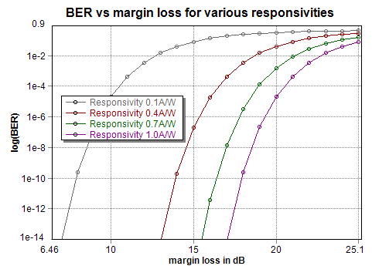
At const system bitrate:7.2Gbps
CW laser power 10dBm and 0.4A/W Rx responsivity.
BER performances can be significantly improved by reducing MZM total losses, and the improvements will be greater than DPSK scenario.
At const system bitrate:7.2Gbps
CW laser power 10dBm, MZ loss 12dB.
Again, OOK scenario shows adequate BER performance even for the lowest responsivity for system losses up to 10dB
Scenario 3: EML OOK results

Slide 27
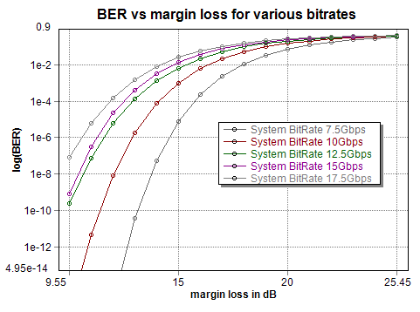
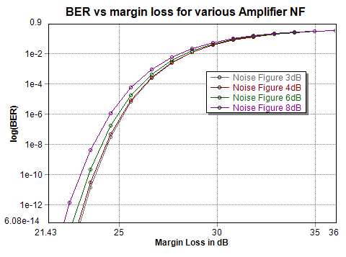
CW laser power 10dBm and 0.4A/W Rx responsivity.
System shows quite good BER performance for all range of bit rates and for overall losses up to 15dB
CW laser power 10dBm and 0.4A/W Rx responsivity at default bitrate(7.2Gbps) for various Noise Figures (NF) when an amplifier is used prior to detector(10dB target Gain).
System shows good BER performance for quite all NF range for total system loss up to 25dB

Slide 28
Conclusions
Direclty modulated (DML) scenario shows poor BER performance for such low operating laser powers(40uW).
Moreover a significant number of parameters concerning primarily the laser structure were not possible to be estimated as long as the specific device is under development. This creates a large number of uncertainties for the accurate evaluation of the DML-based system

Slide 29
Conclusions
External laser scenario with MZM shows better BER performances than DML but they can be significantly improved by reducing MZM total losses, especially when system is to be operated at higher than default bit rate (7.2Gbps).
External laser scenario performance can be greatly enhanced by placing a optical amplifier prior to detector, extending system total loss margins.

Slide 30

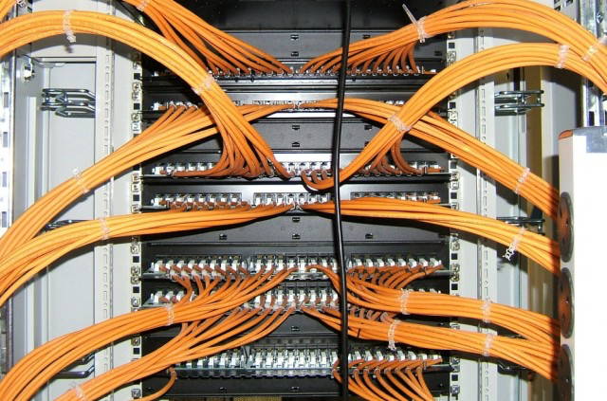
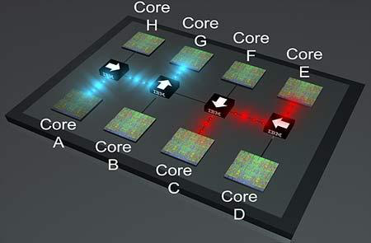
Optical Interconnect Application Domains
Network Interconnects in Datacenters
  Rack-to-rack
  5m-500m+
  Today: MMF→SMF transition, 100G links
Backplane
  Board-to-board
  0.5m-5m
  Today: Cu, MMF
Board
  Package-to-package
  5cm-1m
  Today: Cu
Intra-chip, Interposer
  1mm-5cm
  Today: Cu
PhotonIC
Intel/corning
IBM

Slide 31
Optical Interconnect Roadmap: Requirements
CMOS node | 28nm | 20nm | 14nm | 10nm | 7nm | 5nm
Max I/O BW | 1.6Tb/s | 3.2 Tb/s | 6.4Tb/s | 12.8 TB/s | 25.6 Tb/s | 51.2 Tb/s
Max Data Rate | 25 Gb/s | 35 Gb/s | 50 Gb/s | 70 Gb/s | 100 Gb/s | 140 Gb/s
Network 5-500m+ (SMF) | SiPh 20pJ/Bit | SiPh 10pJ/Bit | SiPh 5pJ/Bit | SiPh 2pJ/Bit | SiPh 1pJ/Bit | SiPh 0.5pJ/Bit
Backplane 0.5-5m (SMF or custom fiber) | Cu/VCSEL 10pJ/bit | Cu/VCSEL 5pJ/bit | Cu/VCSEL/SiPh 2pJ/bit | Cu/VCSEL/SiPh 1pJ/bit | SiPh 0.5pJ/bit | SiPh 0.2pJ/bit
Board 5cm-50cm (custom fiber or waveguide) | Cu 10pJ/bit | Cu 5pJ/bit | Cu/VCSEL/SiPh 2pJ/bit | Cu/VCSEL/SiPh 1pJ/bit | SiPh 0.5pJ/bit | SiPh 0.2pJ/bit
Interposer/chip 1mm-5cm (Si waveguide) | Cu | Cu | Cu | Cu | Cu/SiP 0.1pJ/bit | SiPh 0.05pJ/bit
SiPh : “silicon photonics”, refers to guided wave solutions, may include NAVOLCHI devices
Source: imec optical interconnect program - confidential

Slide 32
Optical Interconnect Roadmap – Devices ?
CMOS node | 20nm | 14nm | 10nm | 7nm | 5nm
Max Channel Rate | 35 GB/s | 50 GB/s | 70 GB/s | 100 GB/s | 140 GB/s
E/O power target | 10 pJ/bit | 5 pJ/bit | 1-2 pJ/bit | 0.1 – 1 pJ/bit | 50-500fJ/bit
Modulators | Si MZ | Si MZ, Ge EAM | Si ring Ge EAM | Broad band, high speed, low loss modulator – no current solution
Detectors | Ge pin | Ge pin | Ge pin or APD | Broad band, high speed, high responsivity detector – no current solution
Fiber | SMF array | SMF array | SMF array or MCF | MCF, on board waveguide links …
Lasers | DFB-array | DFB-array | DFB-array or comb | Low power, high efficiency lasers, integrated with silicon waveguides
Main target for NAVOLCHI
Need fundamentally new devices
Navolchi
- Wins on: broad band, high speed
- Still work needed: insertion loss, efficiency
Source: imec optical interconnect program - confidential

Slide 33
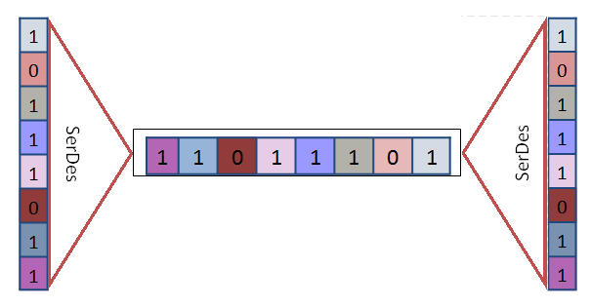
Task 2.5 VHDL Modeling
VHDL modeling of generic serializer/deserializer
Parametric building-blocks with configurable input and output size
Allowing to carry out architectural exploration simply changing the values of the parameters
Different configurations already verified and characterized in terms of area occupancy and operation frequency

Slide 34
Summary and Outlook
  Summary
    Modeling of 3 architectures with the latest characteristics of the system components
    Extraction of the system characteristics and specifications
    Preliminary results, (will be fine-tuned using the final characteristics of the components)
  Outlook
    Modeling of devices and system for communications applications with the final specification of the components
    Value analysis in terms of cost and green aspects
    Techno-economical evaluation and benchmarking

