Slide 1
Work Package 3: Plasmonic Transmitter
Victor Dolores-Calzadilla, Meint Smit
Eindhoven University of Technology (TU/e), The Netherlands

Slide 2
Outline
WP3 Position in Project
Objectives
Tasks
Milestones and Deliverables
Status of Work
  Plasmonic/Metallic Laser
  Plasmonic Modulator
Summary and Outlook

Slide 3
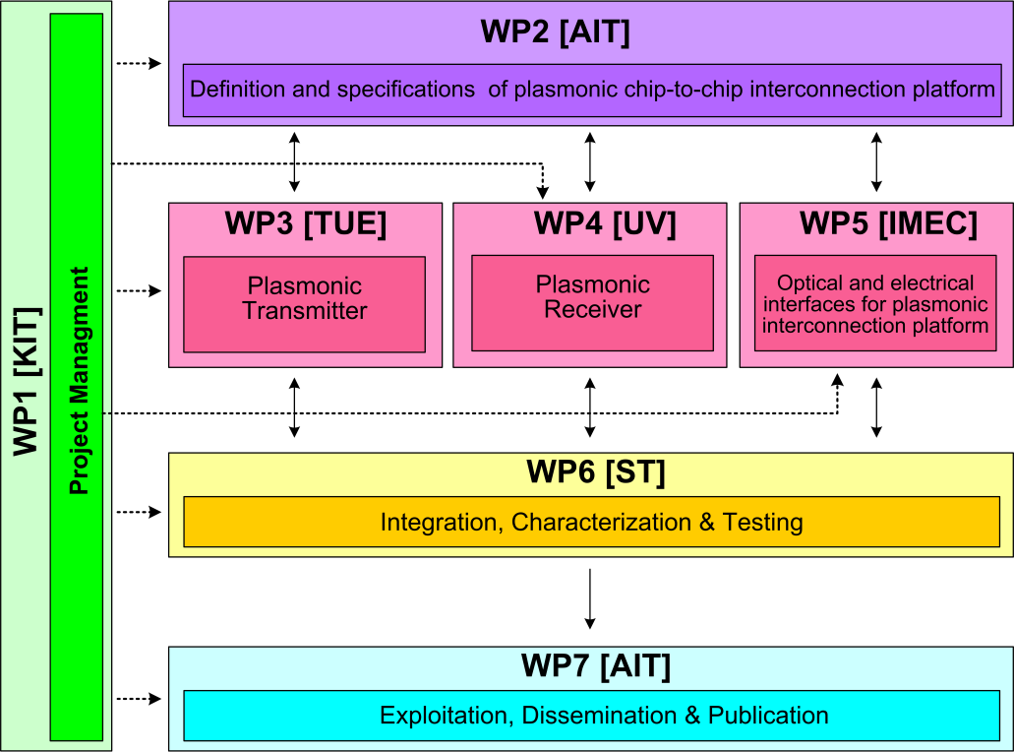



WP3 Position in Project
Contributors:

Slide 4
Objectives
Simulation studies
  Plasmonic/metallic nanolaser
  Plasmonic modulator
Fabrication
  Electrically pumped plasmonic/metallic nanolaser
  Electrically driven plasmonic modulator
Performance targets
  Laser: active region < 1 μm², output power > 100 μW
  Modulator: extinction ratio > 3dB for length < 10 μm, and a total modulation speed > 40 Gbit/s

Slide 5
Tasks
 | Names of the Tasks | Time Period [months]
Task 3.1 | Modelling of plasmonic laser and optimization of bonding technology | 1 – 6
Task 3.2 | Modelling of plasmonic modulator | 1 – 18
Task 3.3 | Fabrication of plasmonic/metallic nanolaser | 7 – 30
Task 3.4 | Fabrication of Si-plasmonic modulators | 7 – 27

Slide 6
Milestones
 | Names of the Milestones | Month | Partner
MS8 | Decision on an optimized structure for metallic/plasmonic nanolaser and its coupling to a Si-waveguide | 6 | TU/e
MS9 | Decision on an optimized structure for plasmonic modulator | 6 | KIT
MS10 | Grown wafer structure for plasmonic lasers | 12 | TU/e
MS11 | Fabrication of plasmonic modulator on a SOI platform | 15 | KIT
MS12 | Decision on an optimized structure for plasmonic modulator with a maximum loss of 20dB | 18 | KIT
MS13 | Initial characterization of unbonded plasmonic lasers | 18 | TU/e
MS14 | Initial testing and characterization of plasmonic modulators | 21 | KIT
*MS15 | Initial testing of bonded plasmonic lasers | 24 | TU/e
*MS15 to be updated after demonstration of nanolaser

Slide 7
Deliverables
 | Names of the Deliverables | Month | Partner
D3.1 | Report on studies of optimized structure for metallic/plasmonic nanolaser and its coupling to Si-waveguide | 12 | TU/e
D3.2 | Report on modelling of the modulator structure | 12 | KIT
*D3.3 | Fabrication of plasmonic laser device | 24 | TU/e
D3.4 | Report on fabrication of modulators | 24 | KIT
*D3.3 to be updated after demonstration of nanolaser

Slide 8
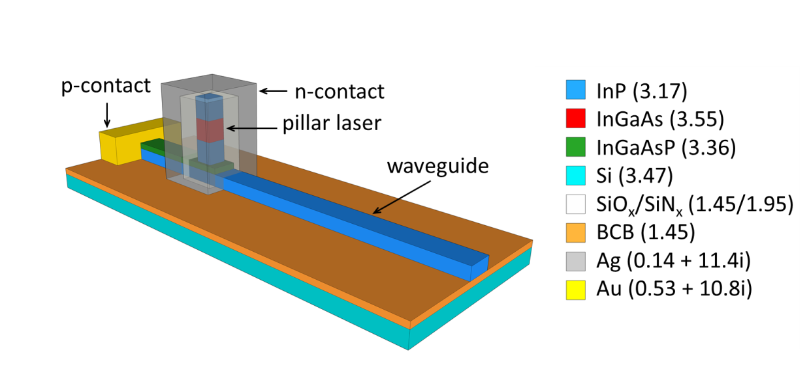
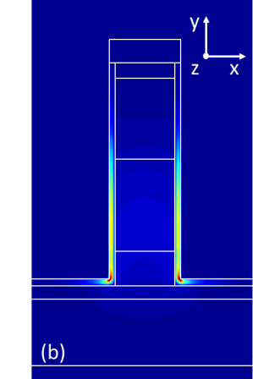

Metallic/Plasmonic Laser Approaches
Fabry-Perot plasmonic laser ^{[1]}
Metallo-dielectric nanolaser ^{[2]}
|E|²
xy
  High propagation loss and poor active confinement
Reported in MS8 & D3.1
|E|²
[1] V. Dolores-Calzadilla, et al., Towards plasmonic lasers for optical interconnects, ICTON 2012.
[2] V. Dolores-Calzadilla, et al., Waveguide-coupler nanolasers in III-V membranes on silicon , ICTON 2013.

Slide 9
Task 3.1 Modelling of the Nanolaser
Optical and electrical optimization
Direct modulation (small signal response)
Q ~ 530 @ 1.55 µm
Threshold gain ~ 800 cm⁻¹
Threshold current ~ 120 µA
Differential efficiency ~ 0.16
Output power ~ 40 µW @ 420 µA (2V)
Periodic report (M1-M18)
  f_{c} > 60 GHz
  for P_{out} = 50 µW

Slide 10
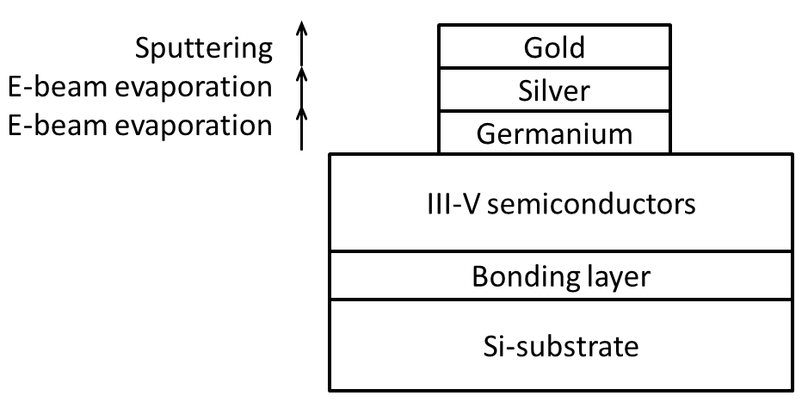
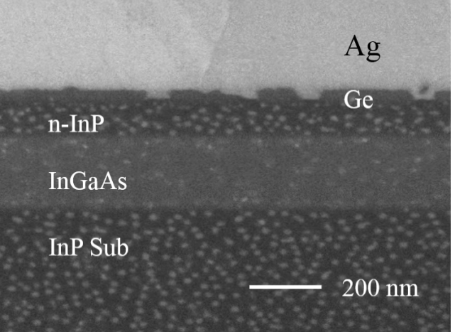
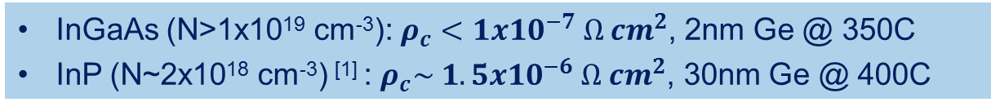
Task 3.3 Fabrication of the Nanolaser
Low-loss low-resistance Ge/Ag ohmic contacts ^{[1]}
InGaAs (N>1x10¹⁹ cm⁻³): $ρ_{c}<1x10^{−7} Ω cm^{2}$, 2nm Ge @ 350C
InP (N~2x10¹⁸ cm⁻³) ^{[1]} : $ρ_{c}\sim 1.5x10^{−6} Ω cm^{2}$, 30nm Ge @ 400C
Reported in D6.1
[1] L. Shen, V. Dolores-Calzadilla, et. al., Journal paper to be submitted

Slide 11
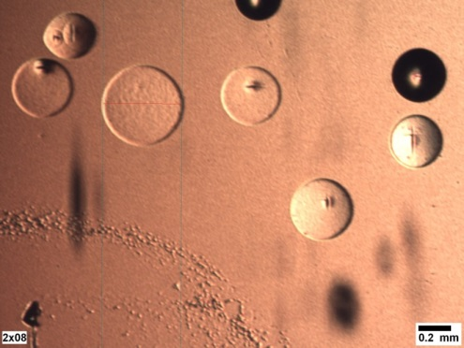
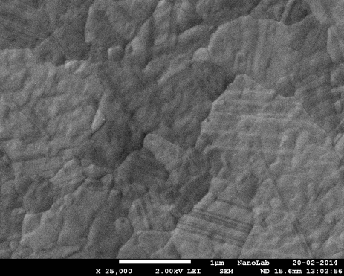
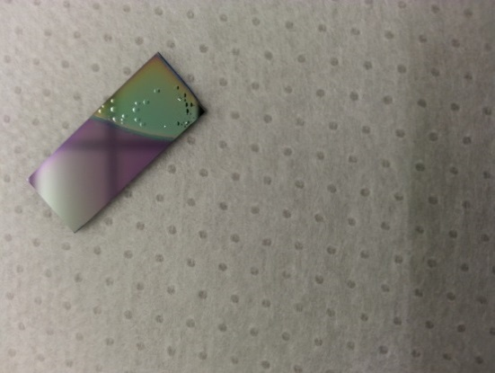
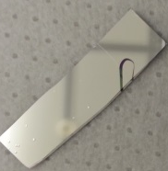
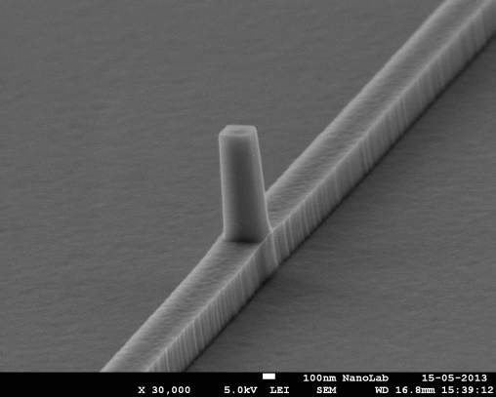
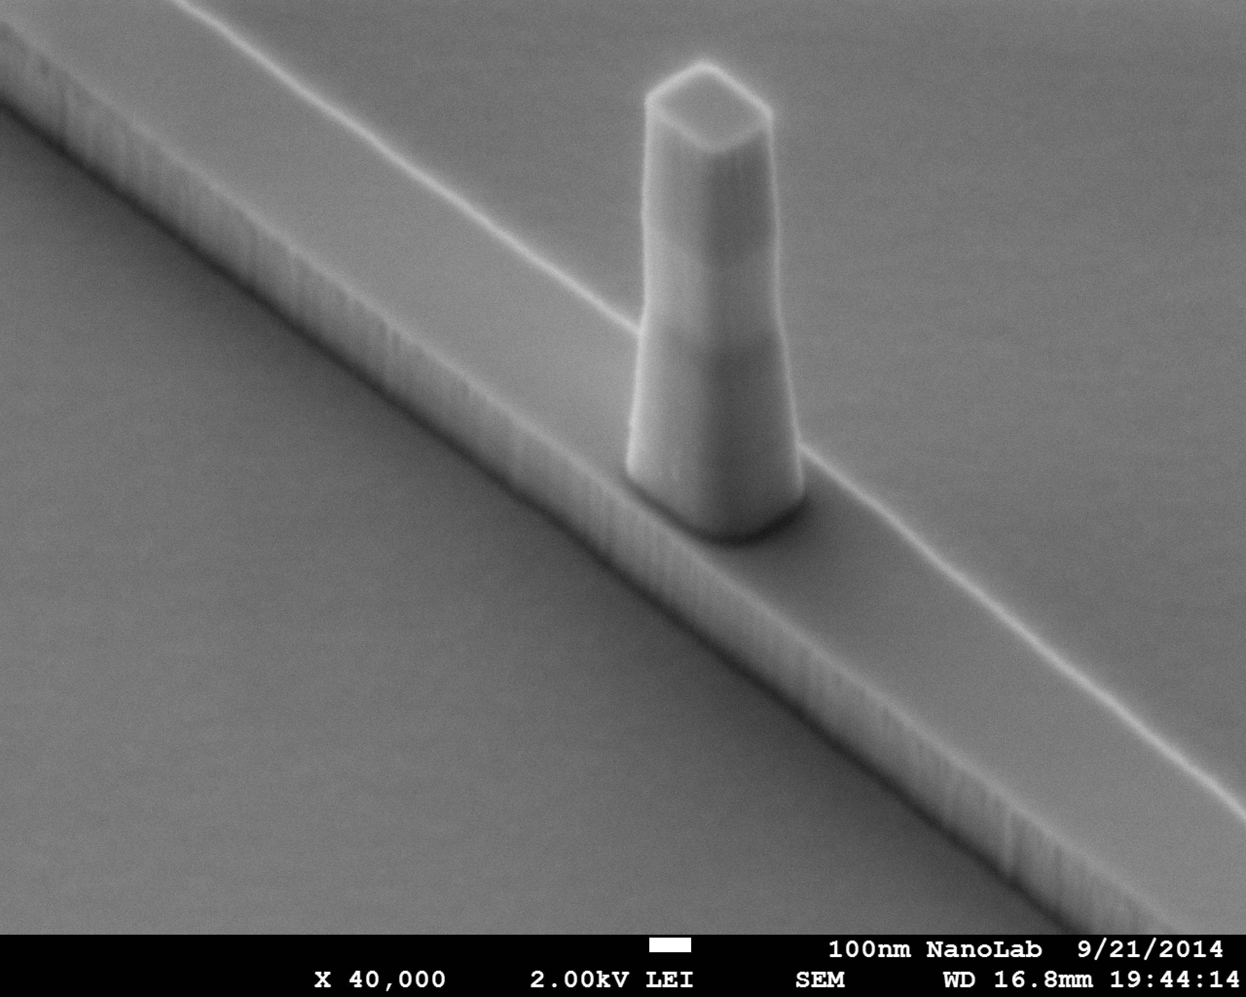
Task 3.3 Fabrication of the Nanolaser
Main fabrication issues
  Outgassing during annealing
  From dummy to real fabrication
Ag
  Typical defects at T>300C
  Outgassing minimized by using thick bonding layer
  III-V layer stack bonded to silicon
  Pure InP wafer

Slide 12
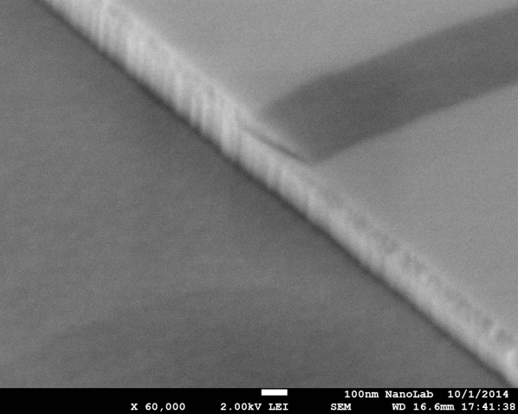
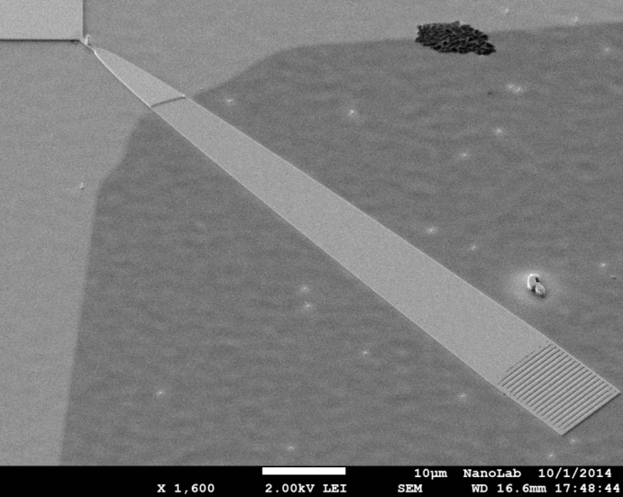
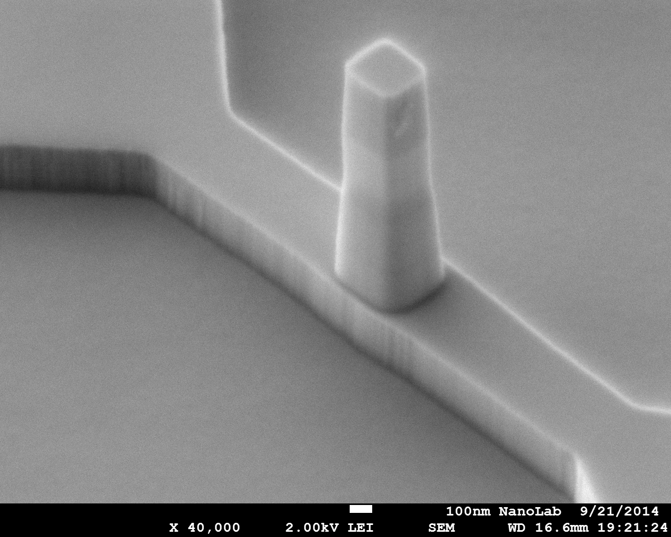
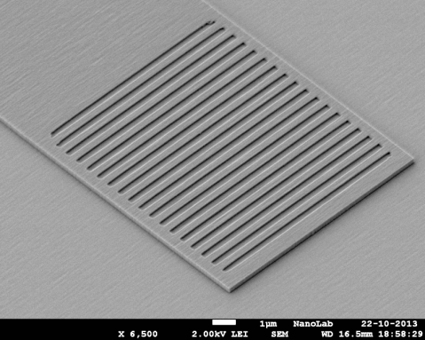
Task 3.3 Fabrication of the Nanolaser
Current fabrication of 2nd run (75% progress)
Pillar cavity
Q
InP
Interface from Q/InP to InP waveguide
Reported in D6.1
  Critical step: outgassing during silver annealing
Grating coupler

Slide 13
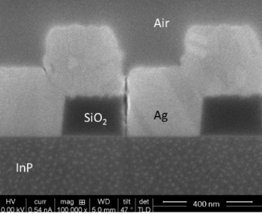
Another Relevant Device
Metal grating coupler ^{[1,2]}
First run:
6 dB loss @ 1550nm
Performance independent from buffer thickness
Enables high yield (thick) polymer bonding
Reduce optical parasitics into buffer/substrate
[1] V. Dolores-Calzadilla, D. Heiss, M. Smit, Optics Letters 39, 9 (2014).
[2] V. Dolores-Calzadilla, A. Higuera Rodriguez, D. Heiss, USA Provisional patent application filed (2014).

Slide 14
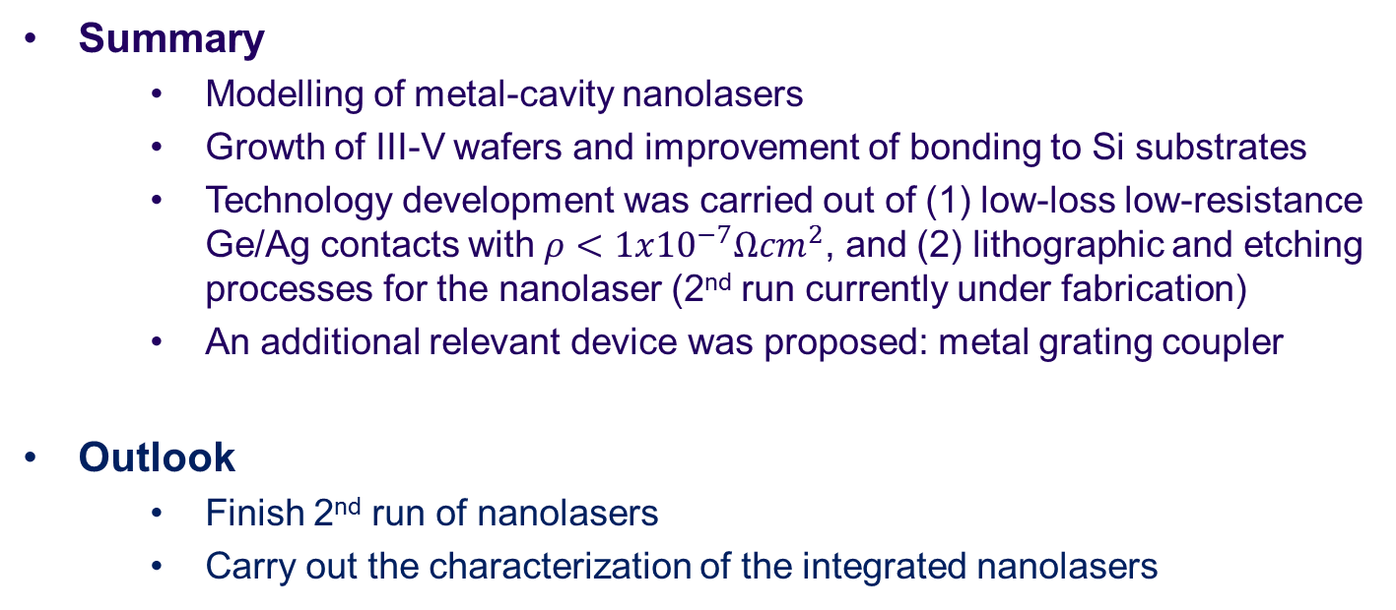
Summary and Outlook (Laser)
  Summary
    Modelling of metal-cavity nanolasers
    Growth of III-V wafers and improvement of bonding to Si substrates
    Technology development was carried out of (1) low-loss low-resistance Ge/Ag contacts with $ρ<1x{10}^{−7}Ωcm^{2}$, and (2) lithographic and etching processes for the nanolaser (2nd run currently under fabrication)
    An additional relevant device was proposed: metal grating coupler
  Outlook
    Finish 2nd run of nanolasers
    Carry out the characterization of the integrated nanolasers

Slide 15
Long-term Outlook (Laser)
  Classical lasers are not suitable for low power operation
    Relatively high threshold currents
    Low wall plug efficiency at low power levels
    Limited direct modulation speed
  Nanolasers
    Combine low threshold currents with high direct modulation speed
    Wall plug efficiency still requires improvement
    Particularly promising in combination with receiverless transmission (small capacity detectors)

Slide 16
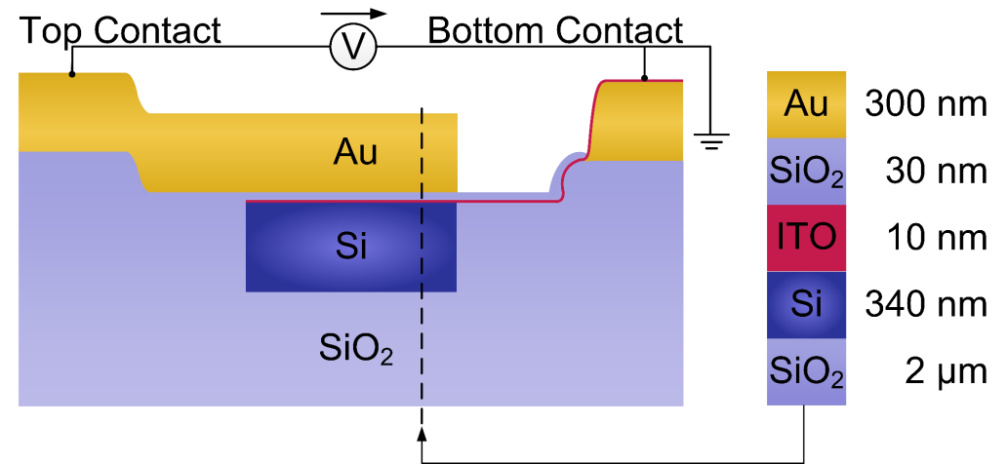
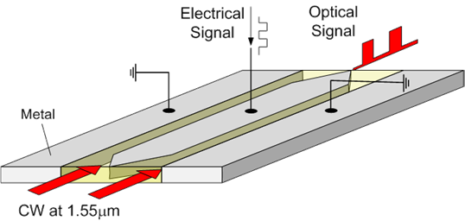
Plasmonic Modulator Approaches
SPP absorption modulator
SPP phase modulator
Reported in MS9 & D3.2

Slide 17
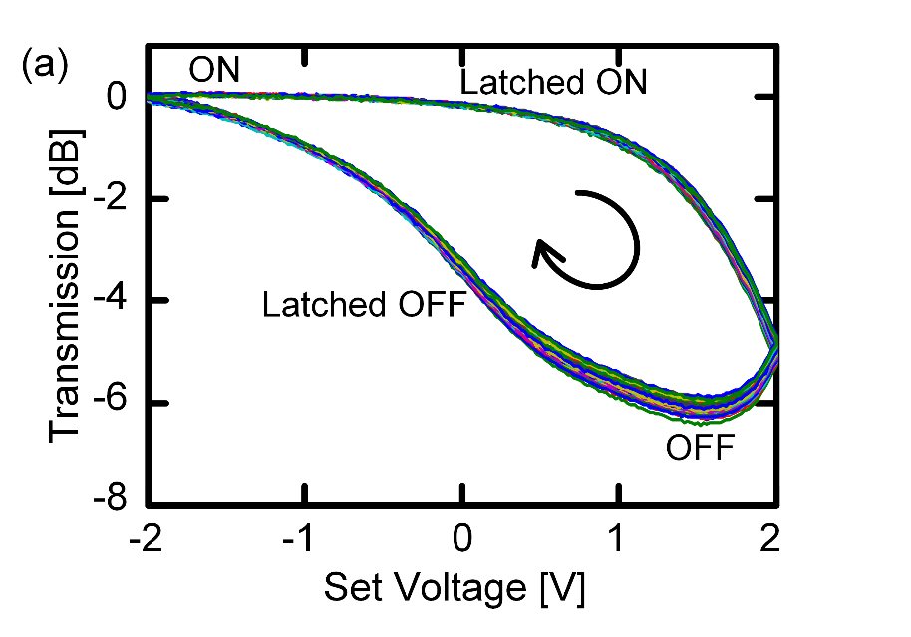
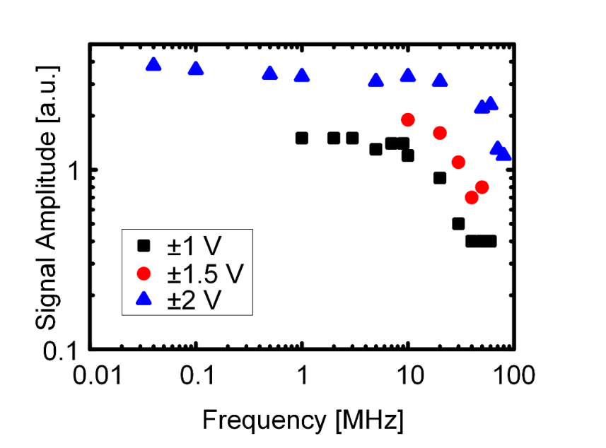
Task 3.4 Fabrication of the Modulator
5 µm long plasmonic switch
Performance
      Extinction ratio: 6 dB
      Length: 5 µm
      Operating voltage: 4 V
      Energy consumption: 76 fJ / bit
      Speed: MHz
Bottom
contact
Top
contact
Reported in D6.1
C. Hoessbacher, Y. Fedoryshyn, A. Emboras, A. Melikyan, M. Kohl, D. Hillerkuss, et al., "The plasmonic memristor: a latching optical switch," Optica, vol. 1, pp. 198-202, 2014/10/20 2014.

Slide 18
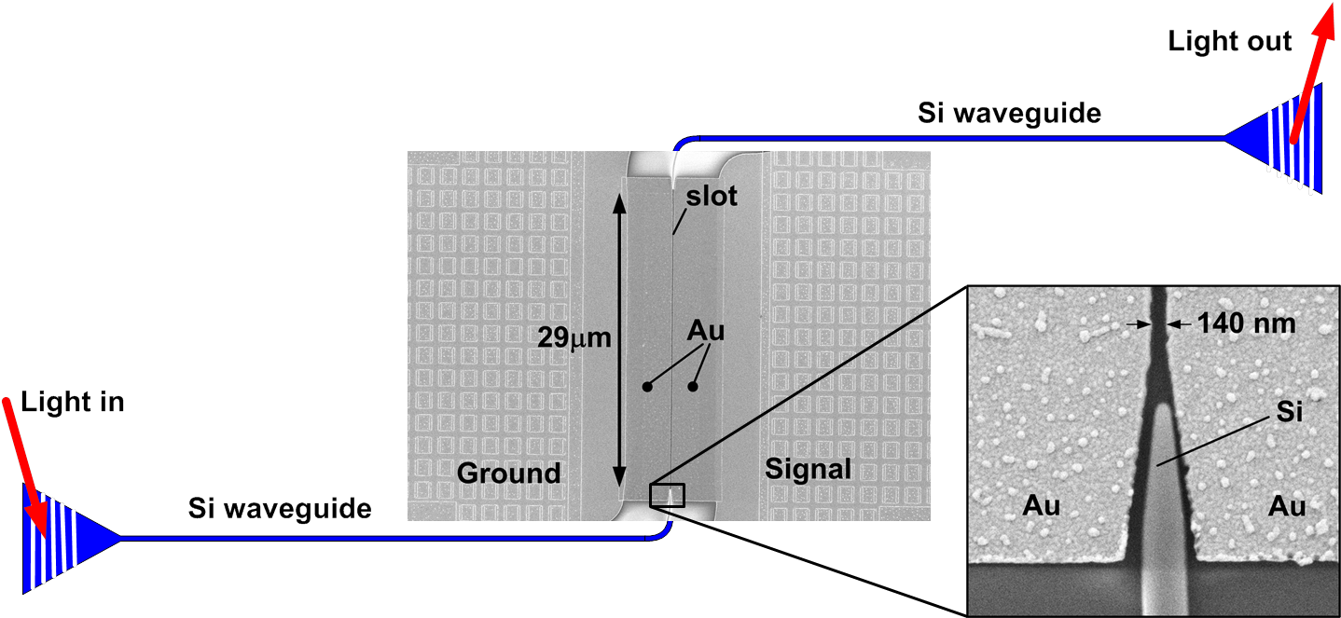
Task 3.4 Fabrication of the Modulator
Passive silicon-on-insulator (SOI) wafer processing
E-beam lithography for defining 140 nm wide slot in gold
Coating with an electro-optic polymer
  M3 (r₃₃ = 70 pm/V) [GigOptix]
  SEO100 (r₃₃ = 110 pm/V) [Soluxra]
  YLD/PSLD (r₃₃ = 230 pm/V) [Larry Dalton, UW]
Poling of electro-optic polymer with static electric field
Reported in MS11
A. Melikyan et al., "High-speed plasmonic phase modulators," Nature Photon. 8(2), 229–233 (2014).

Slide 19
Task 3.4 Fabrication of the Modulator
Characterization results
r₃₃ ≈ 21 pm / V
V_{π}×L = 1.3 Vmm
V_{m} = 0.1 V
V_{m} = 0.8 V
65 GHz RF bandwidth (λ_{c} = 1.55μm)
Broadband optical operation across 120nm (f_{m} = 45GHz)
A. Melikyan et al., "High-speed plasmonic phase modulators," Nature Photon. 8(2), 229–233 (2014).

Slide 20
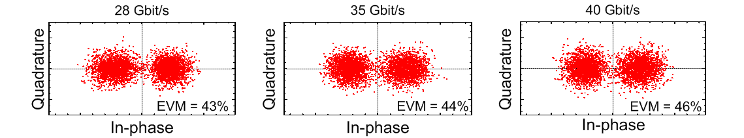
Task 3.4 Fabrication of the Modulator
Experimental setup for 200 nm slot modulator with M3-Gig (1stG)
V_{m} = 7.5 V_{pp}
Δϕ = 0.23rad
20dBm
Constellation diagrams (BER ≈ 10⁻³)

Slide 21
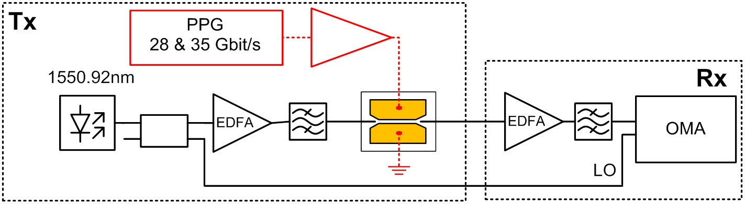
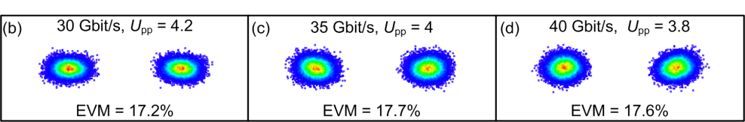
Task 3.4 Fabrication of the Modulator
Experimental setup for 140 nm slot modulator with YLD / PSLD (3rdG)
V_{m} ~ 4 V_{pp}
Δϕ ~ 1.46rad
10dBm
Constellation diagrams (BER < 10⁻¹⁰)

Slide 22
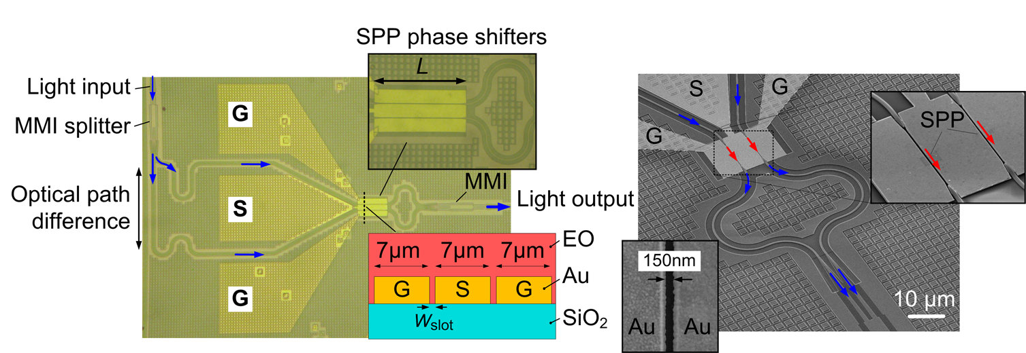
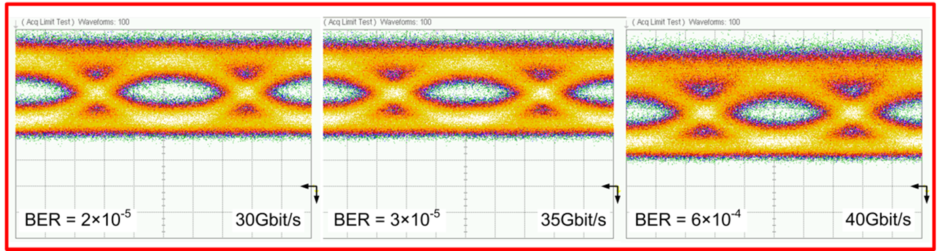
Task 3.4 Fabrication of the MZM
OOK signaling up to 40Gbit/s

Slide 23
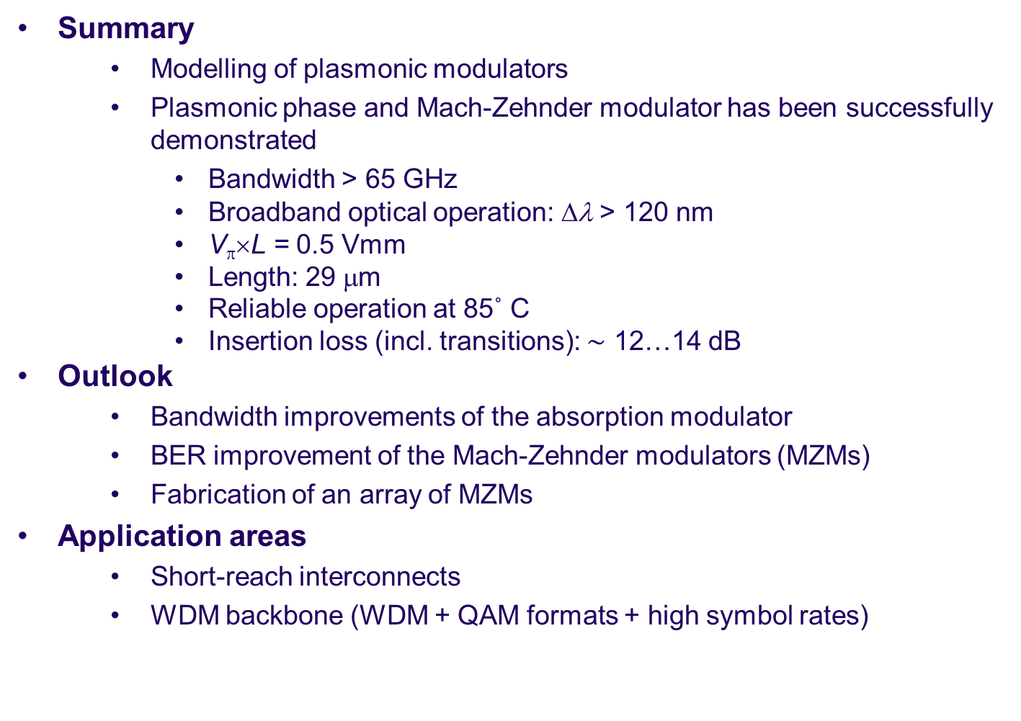
Summary and Outlook (Modulator)
  Summary
    Modelling of plasmonic modulators
    Plasmonic phase and Mach-Zehnder modulator has been successfully demonstrated
Bandwidth > 65 GHz
Broadband optical operation: Δλ > 120 nm
V_{π}×L = 0.5 Vmm
Length: 29 μm
    Reliable operation at 85˚ C
Insertion loss (incl. transitions): $\sim$ 12…14 dB
  Outlook
    Bandwidth improvements of the absorption modulator
    BER improvement of the Mach-Zehnder modulators (MZMs)
    Fabrication of an array of MZMs
  Application areas
    Short-reach interconnects
    WDM backbone (WDM + QAM formats + high symbol rates)

