Slide 1
Work Package 4 Presentation
“Project NAVOLCHI”
Juan P. Martínez Pastor
University of Valencia, Spain

Slide 2
Outline
WP4 Position in Project
Objectives
Tasks
Milestones and Deliverables
Status of Work
  Task 4.1. Design and modelling of P. A. (in 4.4)
  Task 4.2. Design and modelling of P. D. (in 4.5)
  Task 4.3. Colloidal QDs for gain
  Task 4.4. QD-based Plasmonic Amplifier
  Task 4.5. QD-based Photodetectors
Summary and Outlook

Slide 3
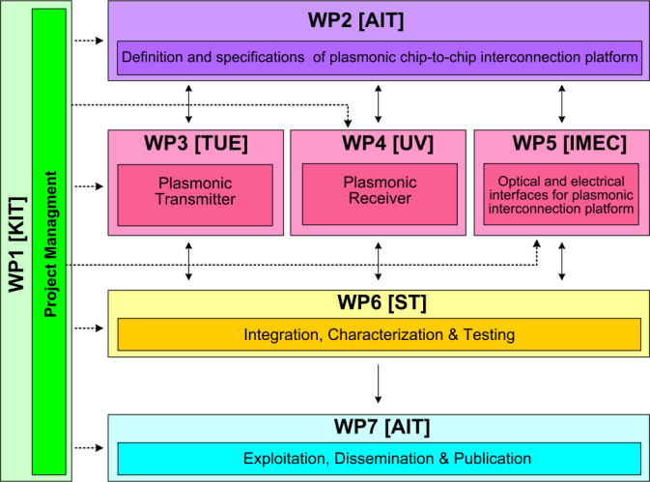




WPX Position in Project
Contributors:

Slide 4
Tasks
 | Names of the Tasks | Time Period [months]
Task 4.1 | Design and modeling of plasmonic pre-amplifier | 1 – 18
Task 4.2 | Design and modeling of plasmonic photodetector | 1 – 24
Task 4.3 | Colloidal quantum dots with optimized gain and electrical injection scheme | 1 – 18
Task 4.4 | Fabrication and characterization of QD-based plasmonic amplifiers | 6 – 30
Task 4.5 | Fabrication of plasmonic QD based photodetectors | 1 – 36

Slide 5
Objectives
Simulation studies to optimize
  Plasmonic amplifier
  Plasmon/Photon detector
Fabrication
  Optically pumped plasmonic amplifier
  Electrically driven plasmonic amplifier
  Plasmon/Photon detector
Performance targets
  Plasmonic amplifier: 10 dB on-chip gain (5 μm wide)
  Detector: Responsivity ≈ 1 A/W (EQE ≈ 80 %)

Slide 6
Milestones
 | Names of the Milestones | Month | Partner
MS16 | Decision on optimized structures for plasmonic amplifiers | 12 | UVEG
MS17 | Synthesis of nanoparticles with gain at 1550nm | 12 | UGENT
MS18 | Demonstration of conductive QD layers with photoconductive properties | 15 | UVEG
MS19 | Demonstration of metal-(lithographic) polymer and QD metal-(lithographic) polymer nanocompo-sites | 15 | UVEG
MS20 | Demonstration and decision on photodetector operation: nano-gap (MIM) vs. Schottky / heterostructure | 18 | UVEG
MS21 | Electroluminescence from QD stack embedded within conductive oxides (>1µW) | 18 | IMEC
MS22 | Demonstration of plasmonic amplifiers with optical pumping exhibiting 10dB gain | 21 | IMEC
MS23 | Operation of QD based photodetector with responsivity > 0.1 A/W | 24 | UVEG
MS24 | Demonstration of SPP amplifiers with electrical injection exhibiting 10dB/cm gain | 39 | UVEG IMEC

Slide 7
Deliverables
 | Names of the Deliverables | Month | Partner
D4.1 | Designs of plasmonic amplifiers | 18 | UVEG
D4.2 | Report on optical properties of QDs layers and polymer nanocomposites | 18 | UVEG
D4.3 | Designs of plasmonic photodetectors | 24 | UVEG
D4.4 | Report on SPP amplifiers by using QDs | 30 | IMEC
D4.5 | Report on plasmonic photodetectors | 42 | UVEG

Slide 8
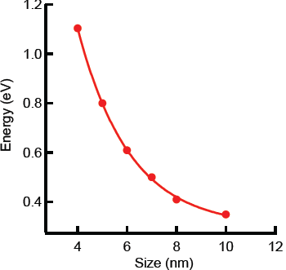
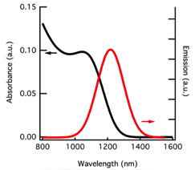
Task 4.3 Colloidal QDs with gain …
2014
2013
size
control
    HgTe QDs:
    Improved synthesis (from 2013 to now): exciton absorption clearly observed.
    IR region reached
    D4.4

Slide 9
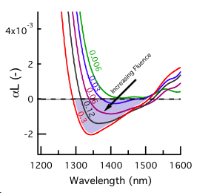
Task 4.3 Colloidal QDs with gain …
Diff. Absorption spectra
2.5 ns after pulse
Diff. Absorption spectra
as a function of delay
αL (-)
Wavelength (nm)
    HgTe QDs:
    Very high gain in colloidal state.
    There is still gain present in close-packed layers, but its lifetime is reduced to ~ 100 ps
    D4.4

Slide 10
Task 4.3 Colloidal QDs with gain …
waveguided PL (polymer-QD)
Diff. Absorption spectra
as a function of delay
αL (-)
Wavelength (nm)
    HgTe QDs:
    Very high gain in colloidal state.
    There is still gain present in close-packed layers, but its lifetime is reduced to ~ 100 ps. May be for this reason no amplification is found in dielectric waveguides.
    D4.4 – MS22

Slide 11
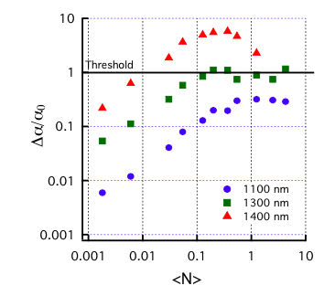
Task 4.3 Colloidal QDs with gain …
QD emitting around 1250 nm
    HgTe QDs (conclusion):
    Very low gain threshold (< 0.01 excitons/dot).
    Gain higher than 400 cm⁻¹ at 1550 nm in solution and expected in layers … provided synthesis improvement and preparation of layers under vacuum conditions.
    D4.4

Slide 12
Task 4.4 Fabrication of QD-based PA
Structure 1: Polymer-QD/Au amplifier
    Developed a method for a direct measure of the SPP propagation length in a plasmonic waveguide cladded with a QD-polymer layer: a probe fiber tip locally excites the QD emission partially coupled to SPP mode. We measure the PL intensity leaving the waveguide edge.
    D4.4

Slide 13
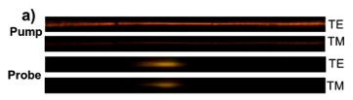
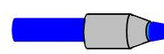
Task 4.4 Fabrication of QD-based PA
Structure 1: Polymer-QD/Au amplifier (planar)
CdSe QDs emitting around 600 nm
    Probe light couples to TM (LR-SPP) and TE modes, and they are spatially separated.
    When a pump beam is edge-coupled an increase of the propagation length by more than a factor 2 is measured.
    D4.4

Slide 14
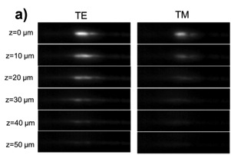
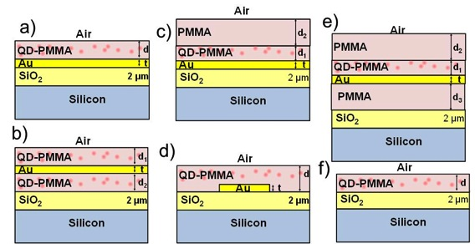
Task 4.4 Fabrication of QD-based PA
Structure 1: Polymer-QD/Au amplifier (planar)
HgTe QDs (PL band 1200-1600 nm)
    Probe light couples to TM (LR-SPP) and TE modes, and they are spatially separated.
    When a pump beam is edge-coupled an increase of the propagation length by more than a factor 2 is measured.
    At 1550 nm the propagation length of the SRPP only increases by 15 % (HgTe QDs).
    Needed material with gain
    D4.4

Slide 15
Task 4.4 Fabrication of QD-based PA
Structure 1: Polymer-QD/Au amplifier (ridge waveguides)
CdSe QDs emitting around 600 nm
In ridge waveguides the SPP mode is clearly observed under TM polarization.
Edge-pumping again increases the propagation length (by 60 %).
D4.4

Slide 16
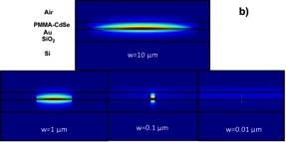
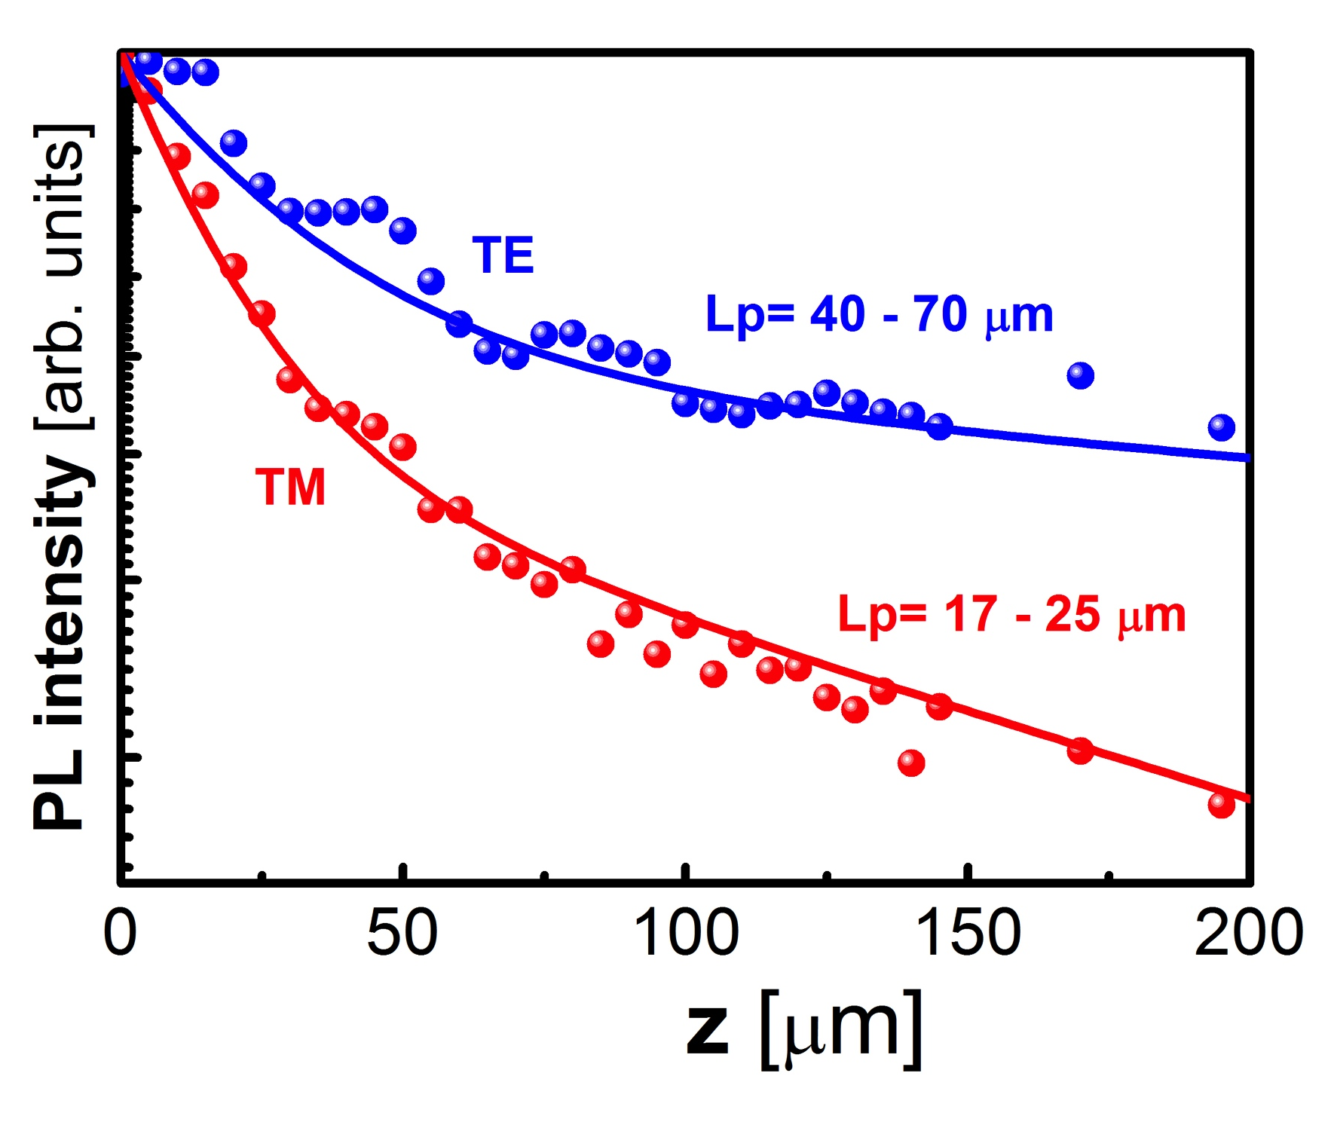
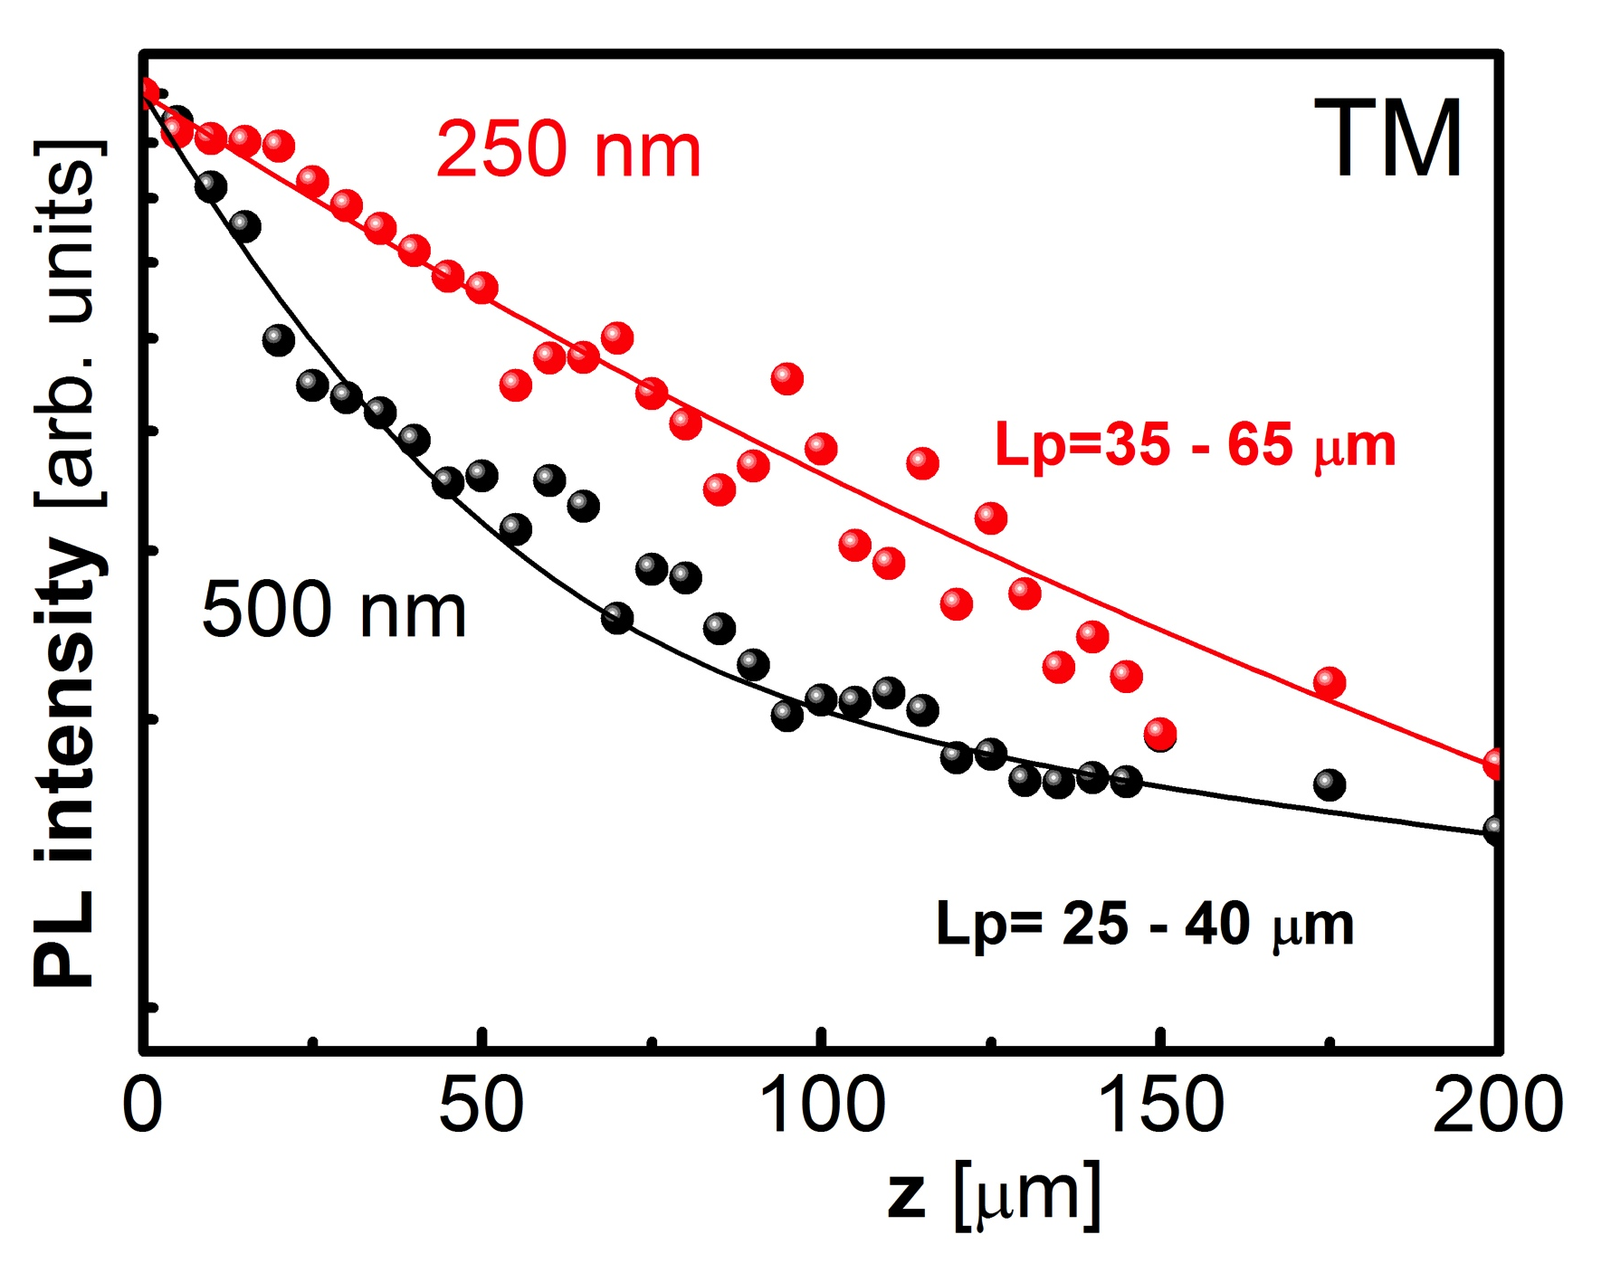
Task 4.4 Fabrication of QD-based PA
Structure 1: Polymer-QD/Au amplifier (ridge waveguides)
CdSe QDs emitting around 600 nm
In narrow metal waveguides the propagation length increases by reducing its width, in agreement with calculations.

Slide 17

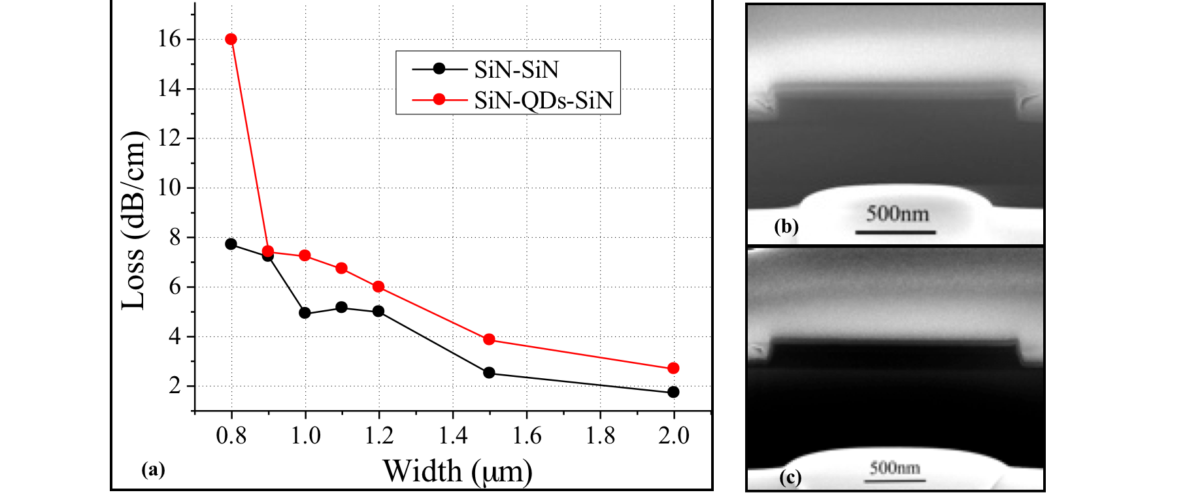
Task 4.4 Fabrication of QD-based PA
Structure 2: silicon-plasmonic amplifier
CdSe QDs emitting around 600 nm
    Silicon Nitride waveguide platform: demonstrated the QD patterning and loss as low as 2.7 dB/cm at 900 nm.

Slide 18
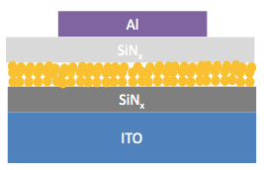
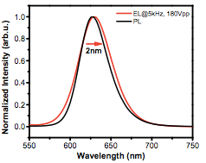
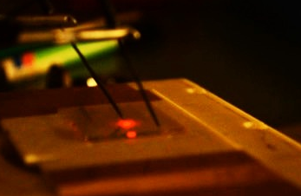
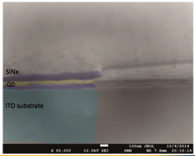
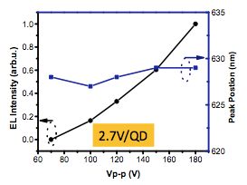
Task 4.4 Fabrication of QD-based PA
Structure 2: silicon-plasmonic amplifier
CdSe QDs emitting around 600 nm
    Silicon Nitride waveguide platform: compatible with electrical AC-injection.

Slide 19
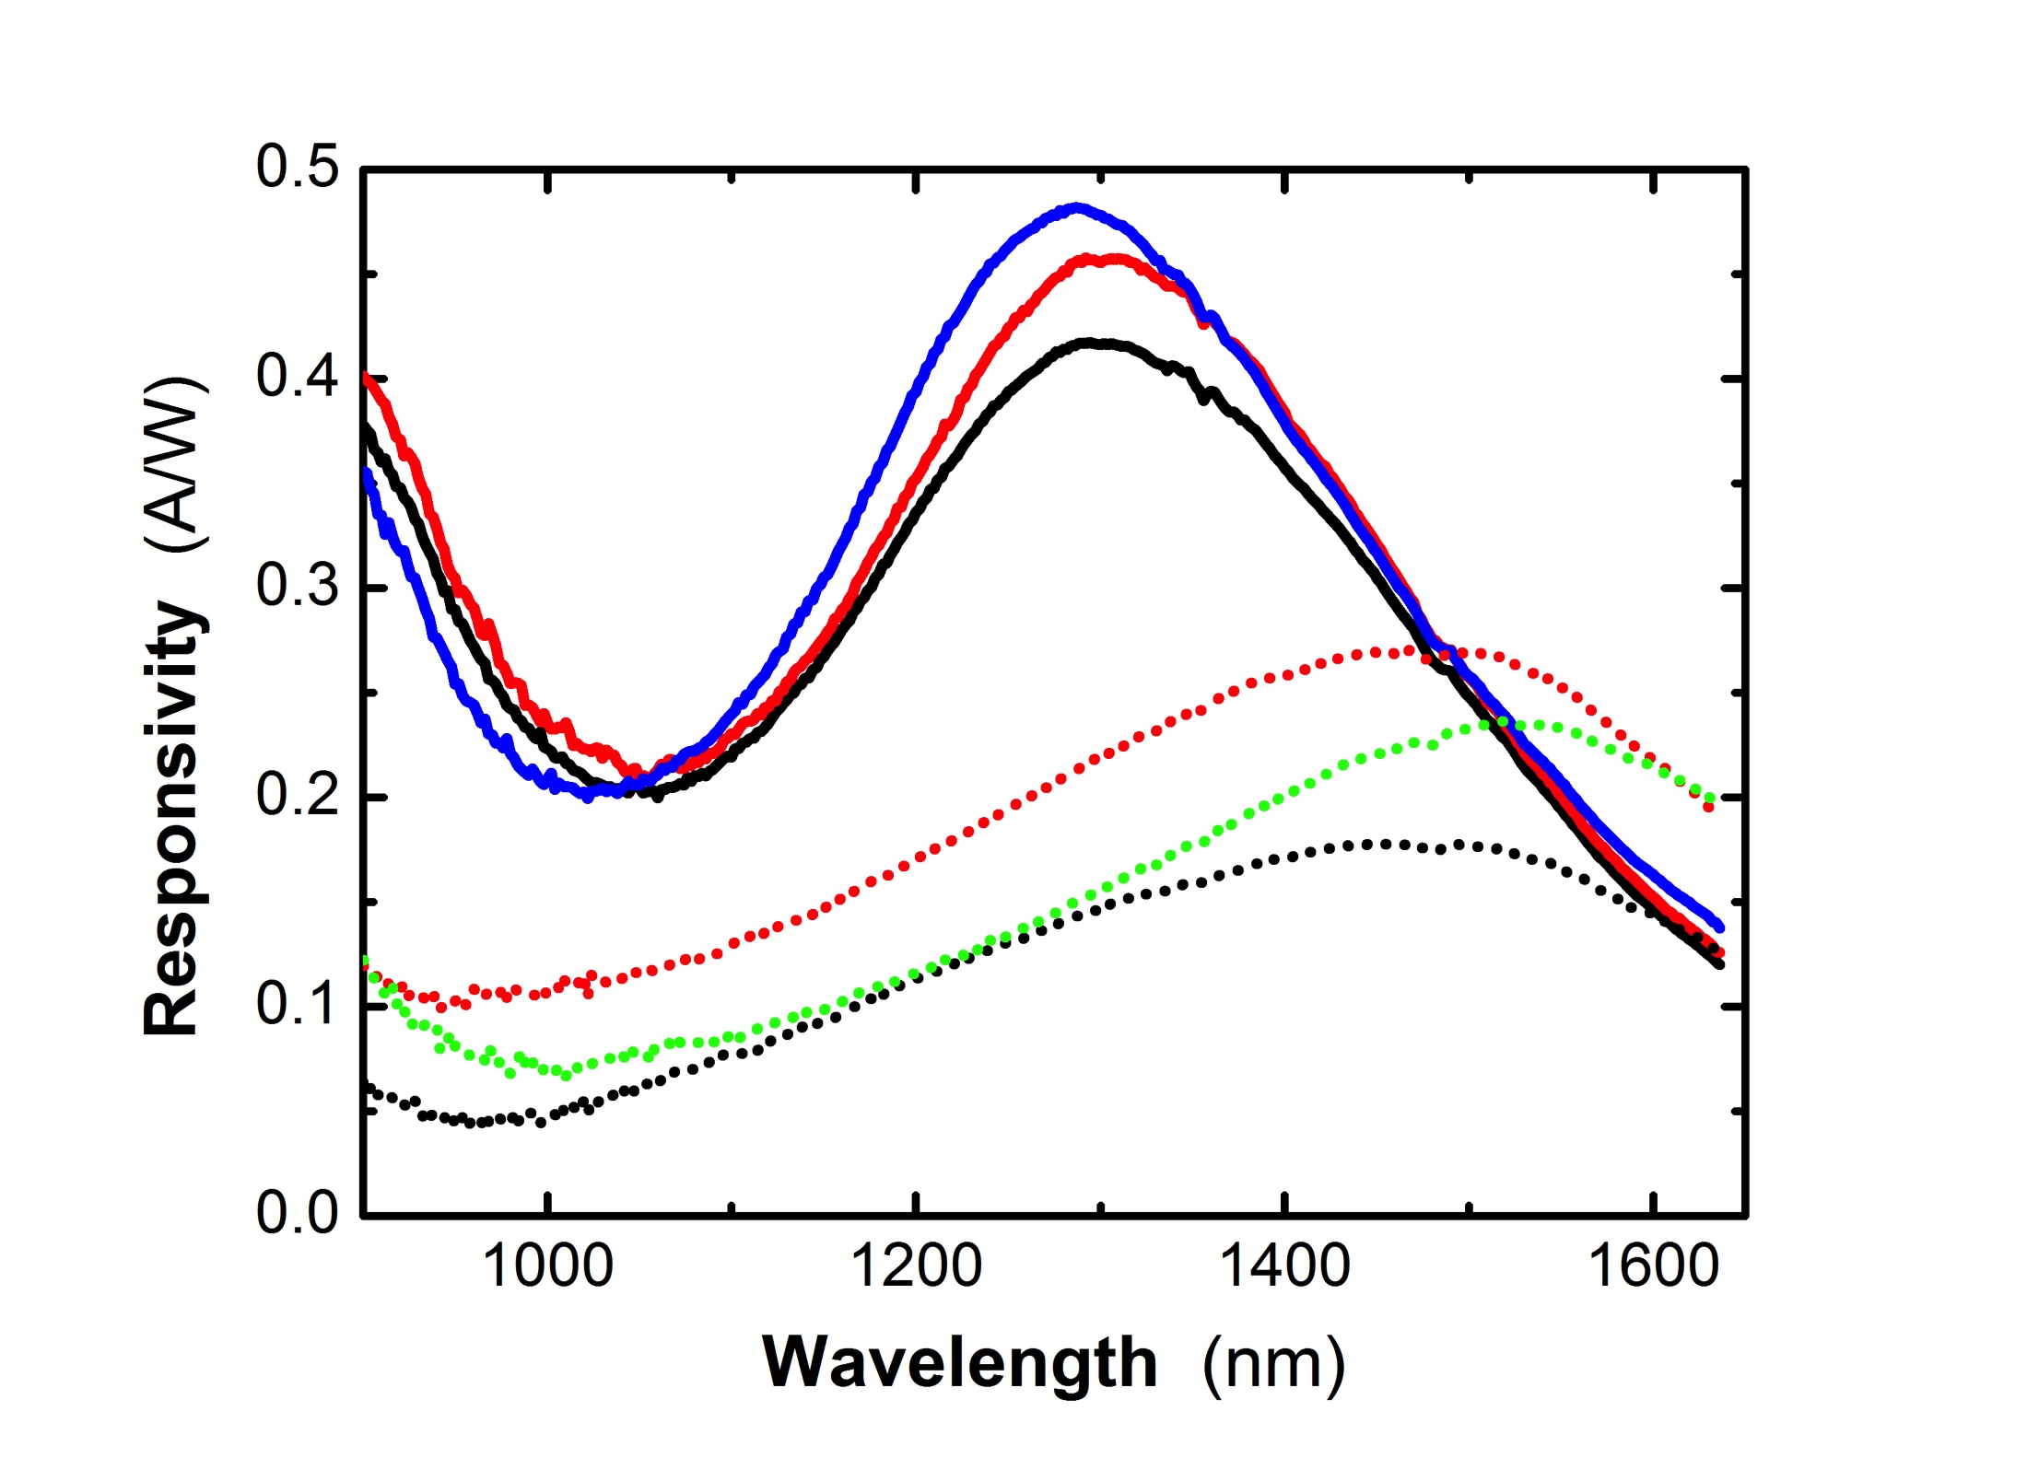
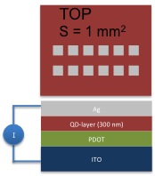
Task 4.5 Fabrication of Photodetector
QD-Schottky photodetectors (PbS QDs)
Different diodes
500 nm
300 nm
250 nm
    Reproducible devices with highest responsivities between of 0.1 to 0.3 A/W at 1550 nm.
    Time response ≈ 100 μs. Noise on the order of 85 nV/Hz^{1/2} at 1 kHz where intensity as low a 0.3 nW was measured with SNR > 10. The Detectivity is estimated to be very close to 10¹³ Jones.
    Introduce metal NPs to increase light trapping and change architecture to reduce reverse current.

Slide 20
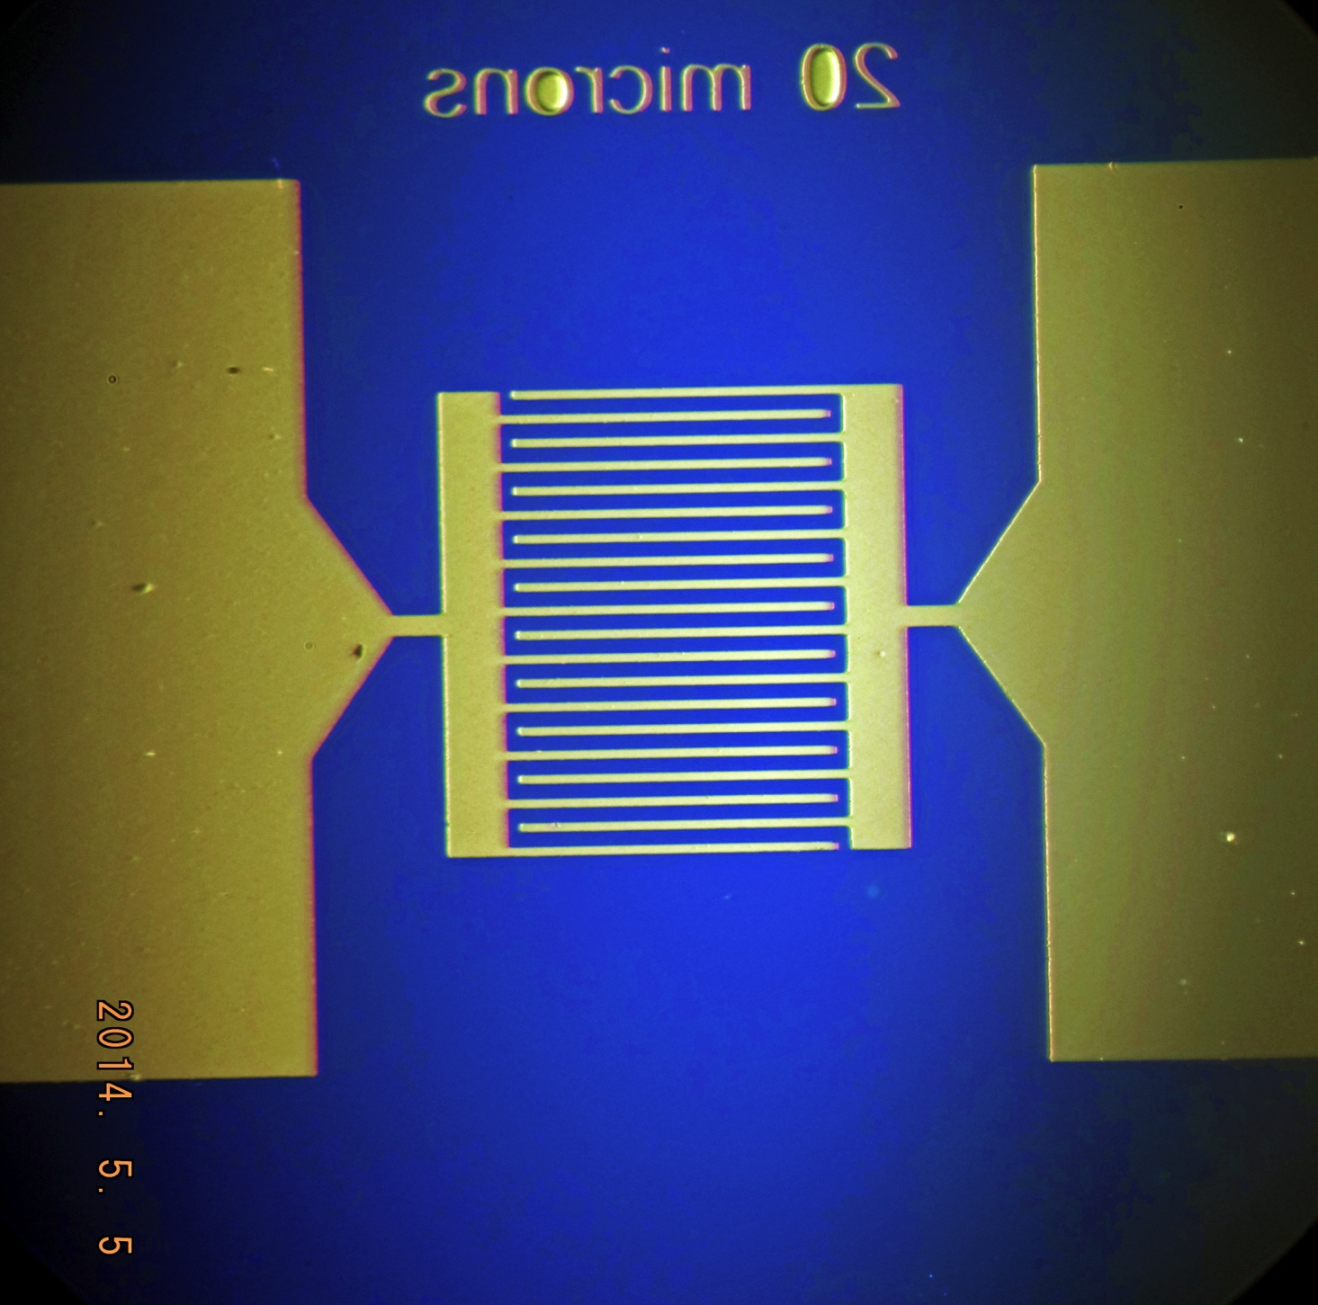
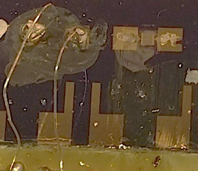
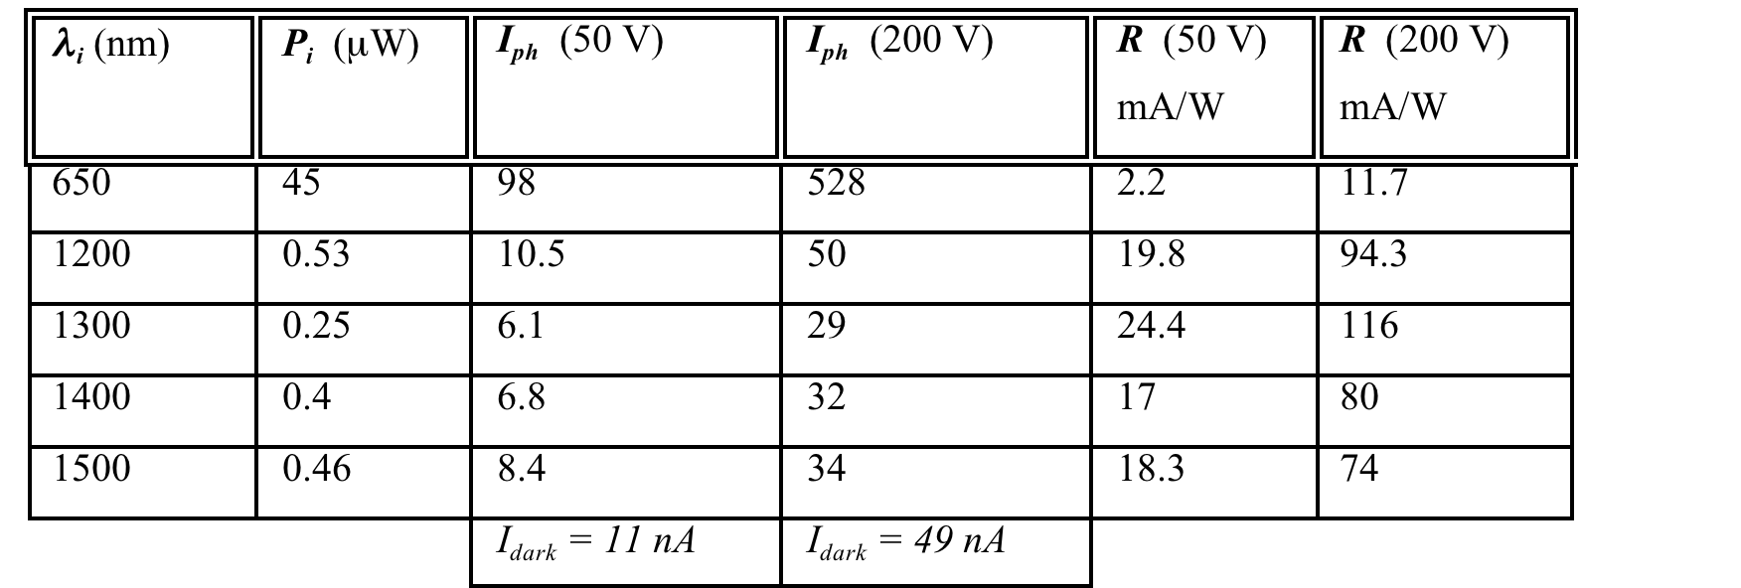
Task 4.5 Fabrication of Photodetector
QD-microgap photoconductors
    Photoconductor (200 μm distance) made on the same QD-layers as Schottky diodes gives good responsivity values.
    Interdigitated microgap: applied voltages up to 100 V: photocurrent of 43 nA for μW illumination at 1550 nm.
    Necessary to optimize ligand exchange on small areas by using microdispensing technique.

Slide 21
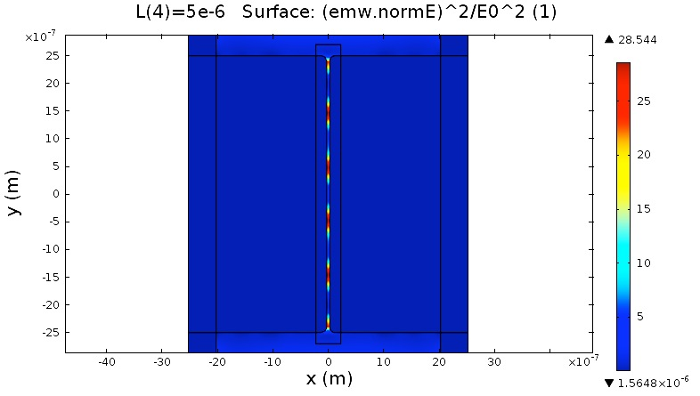
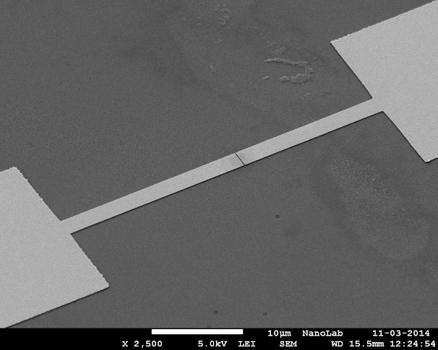
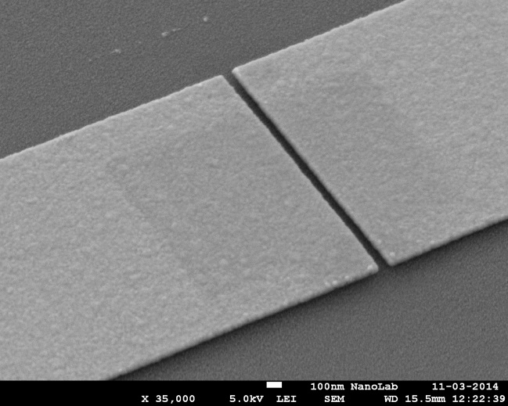
Task 4.5 Fabrication of Photodetector
Nano- gap plasmon waveguide photoconductor
5 μm
60 nm
    Nanogap structures successfully fabricated (TUE) on ITO(thin)/glass substrates.
    ITO etching and fabrication of new samples on strictly insulating SiO₂/Si substrate.

Slide 22
Summary
Plasmonic Amplifier:
Peak gain of HgTe QDs would of the order of 400 dB/cm for a closed-packed film of this material, but not the case experimentally. Optimized material under development.
QD-SiN based waveguides are compatible for electrical injection and hence the basis for optical amplifiers.
A pump-and-probe method have been developed for determining the plasmon propagation length In metal waveguides cladded by QD-polymer layers; the method can be said as validated by the measurements on metal ridge waveguides of different widths.
The presence of QD layers on metal waveguides, even without net gain properties, promotes an increase of the SPP propagation length: 15 and more than 100 % by using HgTe and CdSe QDs, respectively.
Photodetector:
Optimized solution processing technology for PbS-QD chottky photodetectors: responsivities as high as 0.3 A/W at 1500-1600 nm for QD layers 250 – 500 nm thick.
Microgap and plasmonic nanogap structures were fabricated on Si/SiO₂ and glass/ITO substrates, respectively.

Slide 23
Outlook
Plasmonic Amplifier:
HgTe QDs: further improvement of synthesis and preparation of layers under vacuum.
Demonstration of amplification in optically pumped QD-SiN based waveguides based on HgTe QDs.
Demonstration of electrically driven QD-SiN based waveguides using HgTe QDs.
Demonstration of propagation length and amplification in QD-polymer/Au waveguides by using HgTe QDs under pulsed optical pumping.
Photodetector:
Improve Schottky photodetector for reducing time response under reverse bias (introducing ZnO electrode).
Optimize ligand exchange in PbS-QD layers on small areas.
Further generations of microgap and nanogap photoconductors based on PbS-QDs.

