Slide 1
Work Package 5 Presentation
Dries Van Thourhout
IMEC, Belgium

Slide 2
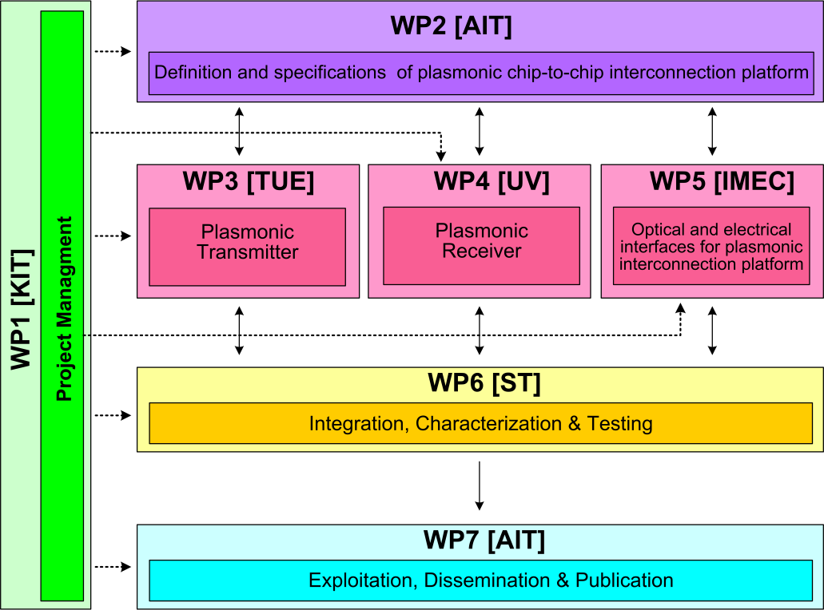



WP5 Position in Project
Contributors:

Slide 3
Objectives
Overall Objective :
Specific Objectives:
  Coupling light between silicon backbone and plasmonic devices
  Beam Shaping grating couplers to direct light between chips
  Compact filters for noise suppression
  Specify and implement Dual Die Communication Module (DDCM)
Design and implement optical and electrical interfaces for plasmonic interconnect

Slide 4
Tasks
 | Names of the Tasks | Time Period [months]
Task 5.1 | Modeling and fabrication of coupling Si waveguide to plasmonic waveguide | 1 – 15
Task 5.2 | Design and fabrication of Si beamshaper | 1 – 30
Task 5.3 | Design and fabrication of passive ultra-compact components as filters | 1 – 15
Task 5.4 | Signal generation module design | 4 – 12
Task 5.5 | Signal Generation Module implementation via FPGA | 13 – 24

Slide 5
Milestones
 | Names of the Milestones | Month | Partner
MS25 | Decision on optimized plasmonic waveguide couplers | 6 | KIT
MS26 | Fabrication of plasmonic waveguide couplers with less than 3 dB coupling loss | 12 | KIT
MS27 | Design of first generation beam shapers and compact optical filters | 12 | IMEC
MS28 | DDCM with electrical PHY design and verification | 12 | ST
MS29 | Data codecs for power consumption reduction | 15 | ST
MS30 | Decision on plasmonic waveguide couplers with less than 3 dB coupling loss | 15 | KIT
MS32 | Fabrication of compact optical filters and first generation beam shapers | 18 | IMEC
MS33 | Data codecs for error detection and correction | 18 | ST

Slide 6
Milestones
 | Names of the Milestones | Month | Partner
MS33 | Design of second generation beam shapers | 24 | imec
MS34 | Generic DDCM compatible with plasmonic-based PHY | 24 | ST
MS35 | Fabrication of second generation beam shapers | 39 | imec
MS36 | DDCM evolution for NiP solutions | 39 | ST

Slide 7
Deliverables
 | Names of the Milestones | Month | Partner
D5.1 | DDCM specification document | 6 | ST
D5.2 | DDCM with electrical PHY design and verification data base | 12 | ST
D5.3 | Compact optical filters (2nm bandwidth, >30nm FSR) and first generation beam shapers | 21 | imec
D5.4 | Generic DDCM compatible with plasmonic-based PHY specification document | 24 | ST
D5.5 | Report on plasmonic waveguide couplers | 24 | imec
D5.6 | Generic DDCM compatible with plasmonic-based PHY design and verification data base | 39 | st
D5.7 | Second generation beam shapers (distance 1mm, with bandwidth > 10nm and efficiency > 3dB) | 39 | imec

Slide 8
Tasks
 | Names of the Tasks | Time Period [months]
Task 5.1 | Modeling and fabrication of coupling Si waveguide to plasmonic waveguide | 1 – 15
Task 5.2 | Design and fabrication of Si beamshaper | 1 – 30
Task 5.3 | Design and fabrication of passive ultra-compact components as filters | 1 – 15
Task 5.4 | Signal generation module design | 4 – 12
Task 5.5 | Signal Generation Module implementation via FPGA | 13 – 24

Slide 9
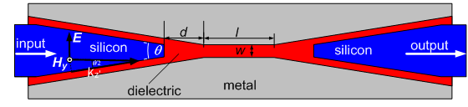
Task 5.1 Modeling and Fabrication of SPP Couplers
Finite Difference Time Domain (FDTD) method is used
Couplers are optimized for their highest transmission
θ
Reported in MS25 (month 6)

Slide 10
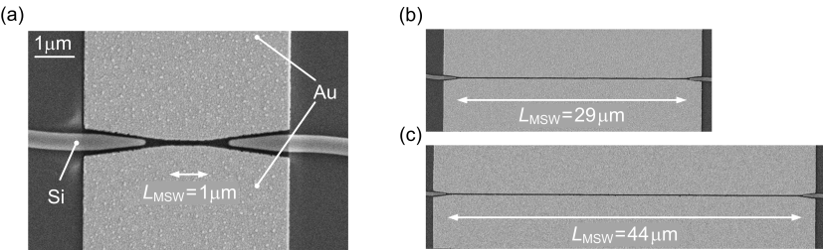
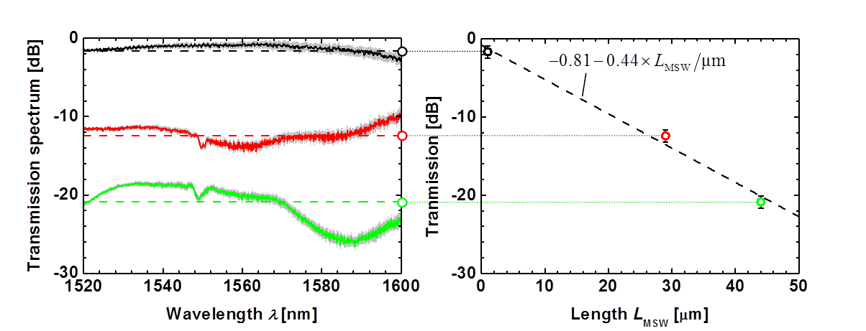
Task 5.1 Modeling and Fabrication of SPP Couplers
Deviced fabricated for loss estimation
Broadband taper coupling

Slide 11
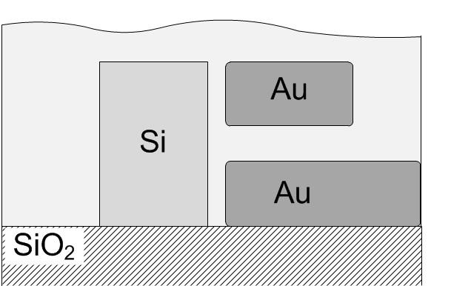
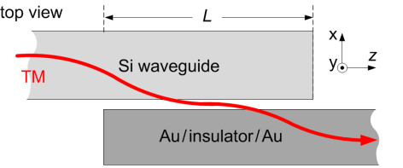
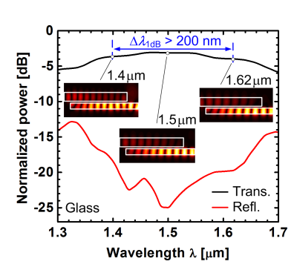

Task 5.1 Modeling and Fabrication of SPP Couplers
Photonic-to-plasmonic mode converter
A. Melikyan et al., Opt. Lett. 39, (2014)
Glass cladding
Electro-optic material cladding
g=30nm
g=60nm

Slide 12
Tasks
 | Names of the Tasks | Time Period [months]
Task 5.1 | Modeling and fabrication of coupling Si waveguide to plasmonic waveguide | 1 – 15
Task 5.2 | Design and fabrication of Si beamshaper | 1 – 30
Task 5.3 | Design and fabrication of passive ultra-compact components as filters | 1 – 15
Task 5.4 | Signal generation module design | 4 – 12
Task 5.5 | Signal Generation Module implementation via FPGA | 13 – 24

Slide 13
Task 5.2 – Optical Beam Steerers
Global idea: Couple light between two chips by vertical grating couplers
First generation (completed month 18):
Demonstrated electrostatically movable gratings to facilitate alignment
Second generation: Develop focusing grating coupler
  Need larger grating → lower index contrast
  Hence: combine standard ePIXfab platform with eBEAM for grating
  Status:
  Efficiency trade-offs evaluated
  ePIXfab design submitted and in fabrication
  Target for finalization: month 39

Slide 14
Task 5.2 – Optical Beam Steerers
a) Standard grating
optimum
b) Focussing grating
optimum

Slide 15
Task 5.2 – Optical Beam Steerers
Status
  Mask completed, designs under fabrication
Applications ?
  Free space chip-chip coupling no longer considered in project
  Also no longer considered in industry as a whole
  Still useful in some dedicated applications
    Coupling to VCSEL above grating coupler
    Transmission between levels in 3D-integrated chip modules
Design under fabrication

Slide 16
Tasks
 | Names of the Tasks | Time Period [months]
Task 5.1 | Modeling and fabrication of coupling Si waveguide to plasmonic waveguide | 1 – 15
Task 5.2 | Design and fabrication of Si beamshaper | 1 – 30
Task 5.3 | Design and fabrication of passive ultra-compact components as filters | 1 – 15
Task 5.4 | Signal generation module design | 4 – 12
Task 5.5 | Signal Generation Module implementation via FPGA | 13 – 24
Completed according to spec month 18

Slide 17
Tasks
 | Names of the Tasks | Time Period [months]
Task 5.1 | Modeling and fabrication of coupling Si waveguide to plasmonic waveguide | 1 – 15
Task 5.2 | Design and fabrication of Si beamshaper | 1 – 30
Task 5.3 | Design and fabrication of passive ultra-compact components as filters | 1 – 15
Task 5.4 | Signal generation module design | 4 – 12
Task 5.5 | Signal Generation Module implementation via FPGA | 13 – 24
Completed according to spec month 18

Slide 18
Task 5.4 – Signal Generation Module Design
A DDCM consists of a transmitter (DDCM Tx) and a receiver (DDCM Rx)
The DDCM is a parametric design that can be configured properly in order to meet specific system requirements and needs in terms of interfaces, FIFOs sizes, clock domains synchronization and functionality
A VHDL model of the plasmonics-based PHY has been developed in order to be co-simulated with the digital parts
STNoC/STBus/AXI initiator
STNoC/STBus/AXI target
Virtual wires
DDCM Tx
DDCM Rx
Die #1
Die #2
Unidirectional physical links
DDCM Rx
DDCM Tx
STNoC/STBus/AXI target
STNoC/STBus/AXI initiator
Virtual wires
Request traffic flow
Response traffic flow
Virtual wires

Slide 19
Tasks
 | Names of the Tasks | Time Period [months]
Task 5.1 | Modeling and fabrication of coupling Si waveguide to plasmonic waveguide | 1 – 15
Task 5.2 | Design and fabrication of Si beamshaper | 1 – 30
Task 5.3 | Design and fabrication of passive ultra-compact components as filters | 1 – 15
Task 5.4 | Signal generation module design | 4 – 12
Task 5.5 | Signal Generation Module implementation via FPGA | 13 – 24

Slide 20
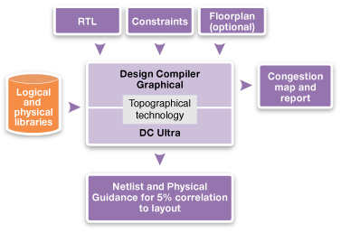
Task 5.4 – Signal Generation Module Implementation via FPGA
After digital design and functional verification phases, the developed VHDL code has been synthesized in order to get a gate level netlist of the DDCM
The synthesis environment is fully based on Synopsys tools
The technologies used for synthesis were CMOS 65nm and 40nm from ST
A flow for the characterization of the digital parts of the DDCM in terms of power consumption has been developed as well
The synthesis flow for FPGA has been carried out with the ZeBu equipment in ST
The synthesis engine in this case translates the VHDL design into a set of logic structures that can be mapped into the hardware basic logic structures available in the ZeBu FPGA chip.
The FPGA chip has been verified with the same environment used for VHDL

Slide 21
Summary
WP5 largely completed
Optical interfaces designed, fabricated and tested
  Coupler dielectric <> plasmonic waveguide
  Optical filters
  Optical beam shapers
Electrical interfaces designed and implemented

Slide 22
Outlook
Task 5.1 – Couplers
  Completed (month 24)
Task 5.2 – Beam shapers
  Finalizing second generation fabrication
Task 5.3 – Filters
  Completed (month 18)
Task 5.4 – Signal generation module design
  Completed (month 18)
Task 5.5 – DDCM FPGA implementation
  Completed (month 36)

