Slide 1
Work Package 7 Presentation
“Project NAVOLCHI”
Christoforos Kachris, Thymios Lallas, Dimitris Klonidis, Ioannis Tomkos
Athens Information Technology, Greece

Slide 2
Outline
WP7 Position in Project
Objectives
Tasks
Milestones and Deliverables
Status of Work
Summary and Outlook

Slide 3
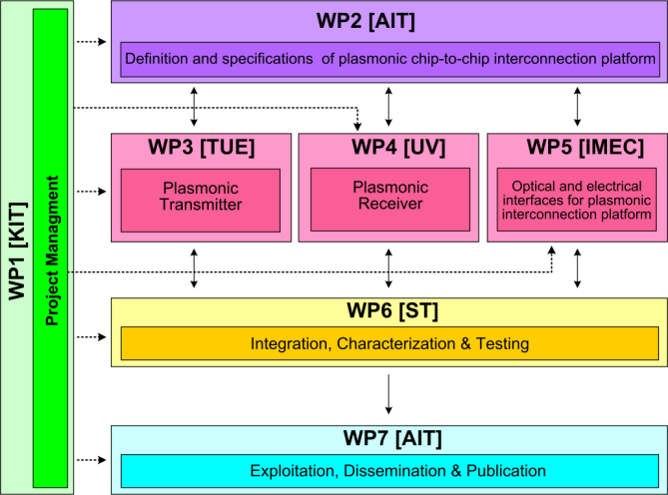






WP7 Position in Project
Contributors:

Slide 4
Objectives
Dissemination through paper submission to high quality scientific journals and conferences
Organizing workshops & seminars on NAVOLCHI technology
Dissemination through the website
Issuing press releases and brochures
Patents
Theses at partners’ institutes

Slide 5
Tasks
 | Names of the Tasks | Time Period [months]
Task 7.1 | Dissemination of results | 1 – 36
Task 7.2 | Exploitation of results | 12 – 45
Task 7.3 | Promotion of Results | 24 – 45

Slide 6
Milestones
 | Names of the Milestones | Month | Partner
MS44 | Dissemination of activities in the project’s web site and continuous update | 1 | KIT
MS45 | Press release on start of project distributed to the public | 2 | AIT
MS46 | Identification of possible contributions to the industrial partners for commercialization | 15 | ST
MS47 | Organization of workshop on silicon photonics interface for chip-to-chip communication* | 34 | TU/e
MS48 | Public web site for NAVOLCHI prepared to stay open for at least another year | 45 | KIT
MS49 | Press release distributed comprising key results with a public target audience | 45 | AIT
*In submission

Slide 7
Deliverables
 | Names of the Deliverables | Month | Partner
D7.1 | First report on NAVOLCHI dissemination and promotion activities | 18 | ST
D7.2 | First report on NAVOLCHI exploitation activities | 18 | AIT
D7.3 | Mirror Deliverable of D7.1, which will be available to the public on the website | 18 | TU/e
D7.4 | Intermediate report on recent achievements | 18 | AIT
D7.5 | Reports on the impact and outcome of the organized promotion events | 45 | AIT
D7.6 | Final report on NAVOLCHI dissemination and promotion activities | 45 | AIT
D7.7 | Dissemination kit | 45 | AIT

Slide 8
Task 7.1 Dissemination
I. Activities (for this period)
11 Journal articles
22 conference papers and talks (all)
Project website (KIT) : updated
www.navolchi.eu

Slide 9
Task 7.2 Exploitation
I. Intellectual Property
Patent:
(UVEG) Patent: “Method to obtain metallic structures of nano- and micro-metric size from lithographic resists based on nanocomposites„ (P201201282).
V. M. Dolores-Calzadilla, A. Higuera Rodriguez, D. Heiss, (2014). “Metal grating coupler for membrane-based integrated photonics”, USA Provisional Patent Application filed, application number: 61/979, 2014.

Slide 10
Task 7.2 Exploitation
II. Theses
(KIT) Claus Gaertner,“Plasmonic Modulators” (master thesis)
(UGent) Sukumar Rudra, “Diffractive Micro-Electromechanical Structures in Si and SiGe” (PhD Thesis).
(IMEC/UGent) Floris Taillieu, “Broadband colloidal quantum dot LED for active plasmonics” (master thesis).
(IMEC/UGent) Qi Lu, “Colloidal Nanocrystal Light Sources on Silicon”, (master thesis).
(UVEG) Henry Gordillo Millán, PhD thesis entitled “Guías ópticas activas de polímero con puntos cuánticos coloidales” (“Active optical waveguides based on polymers containing colloidal quantum dots”)
(UVEG) Mari Luz Martínez Marco, PhD thesis on conducting polymers containing metal nanoparticles and metal nano- and micro-structures using polymer-based patterns
(UVEG) Víctor Latorre Garrido, “Propiedades Eléctricas y Ópticas del PMMA 3TAu” (“Optical and electrical properties of PMMA-3T-Au”) (master thesis)
(UVEG) Alberto Maulu, PhD thesis on PbS quantum dot layers for developing photodetectors at telecom wavelengths

