Slide 1
Coordinator Presentation
“Project NAVOLCHI”
Manfred Kohl
Karlsruhe Institute of Technology (KIT), Germany

Slide 2
Attendees
KIT | Manfred Kohl
TU/e | Victor Calzadilla
UVEG | Juan Martinez Pastor
IMEC (UGent) | Dries Van Thourhout
ETH | Claudia Hößbacher, Jürg Leuthold
AIT | Ionnis Tomkos

Slide 3
Review Meeting Agenda
9:15 Coordinators Talk
9:45 Review of Project Administration (WP1)
10:00 Presentations of Work Packages (WP2)
10:20 - Break -
10:35 Presentations of Work Packages (WP3-WP5)
12:00 - Lunch -
12:45 Presentations of Work Packages (WP6, WP7)
13:30 - Break -
13:45 General Discussion
14:30 Discussion of Dissemination and Expected Innovations
15:00 Discussion between EC Officer and Reviewers
16:00 Feedback to Consortium
16:30 End of Meeting

Slide 4
Outline Coordinator Talk
Project Overview
  Vision
  Partners
  Structure
Reviewers Recommendations from Review 3
Status of Work: - The project after 45 months
- WP Summaries
4. Outlook

Slide 5
Project Overview
Vision:
Very high speed (~ Tbit/s) chip to chip interconnects with
- smallest footprint
- cross talk noise immunity
- low power consumption
for future generation high speed computing
MHz → GHz → THz
NAVOLCHI approach:
Plasmonics
Plasmonics
Electronics Photonics Electronics

Slide 6
Project Overview
ICT-2011.3.5: Core and Disruptive Photonic Technologies
Focus:
Impact:
Improving Europe’s position in systems communication technologies, in particular SiP
Environment: Decrease CO₂-emission while electronic data processing increases
Employment: Strengthening of SMEs for international competition
ICT-2011.3.1: Very advanced nanoelectronic
components: design, engineering, technology and manufacturability

Slide 7



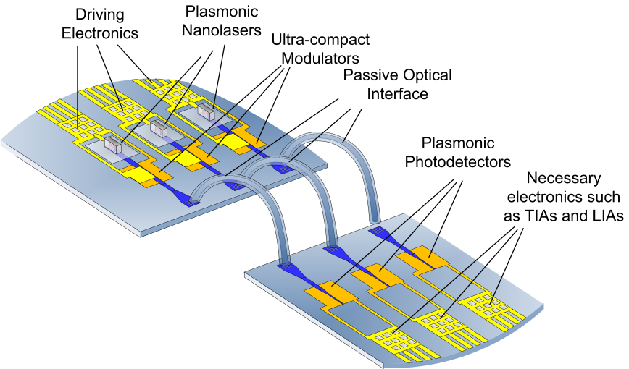






Partners Contributions
Specifications,
dissemination
Management
Optical amplifier

Slide 8
Structure: Interrelation of WPs
[ETH]

Slide 9
Project Overview
NAVOLCHI Technical Core (Challenges):
  Transmitter
  → Laser
  → Modulator
  Receiver
  → Plasmonic Amplifier
  → Photodetector
  Passive Coupling Components
  Integration

Slide 10
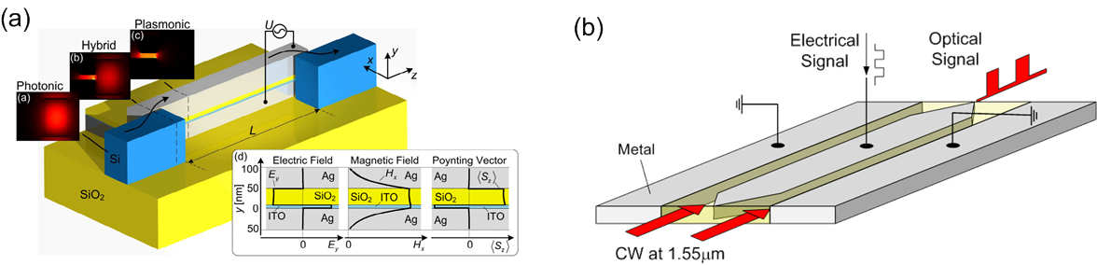
Project Overview: Objectives
Objective 1: Development of Transmitter.
a) Metallo-dielectric Nanolaser
- device length < 1 µm
b) Plasmonic Modulator:
Absorption (a) Phase (b)

Slide 11
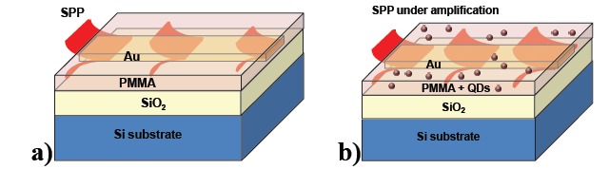
Project Overview: Objectives
Objective 2: Development of Receiver.
a) Plasmonic Amplifier
- colloidal QDs
- gain 10 dB
b) Fast Plasmonic Photodetector
- quantum efficiency > 80%
- responsitivities > 0.1 A/W
without amplif.
with amplif.

Slide 12
Project Overview: Objectives
Objective 3: Passive Components.
a) Waveguide Couplers
- size 50 – 100 nm
- efficiency >30%
b) Beam Shaping Couplers
- chip distance 1 mm
- bandwidth > 10 nm
- efficiency > 3 dB
c) Optical Filters
- bandwidth 3 nm
- suppression 10 dB
- spectral range 30 nm

Slide 13
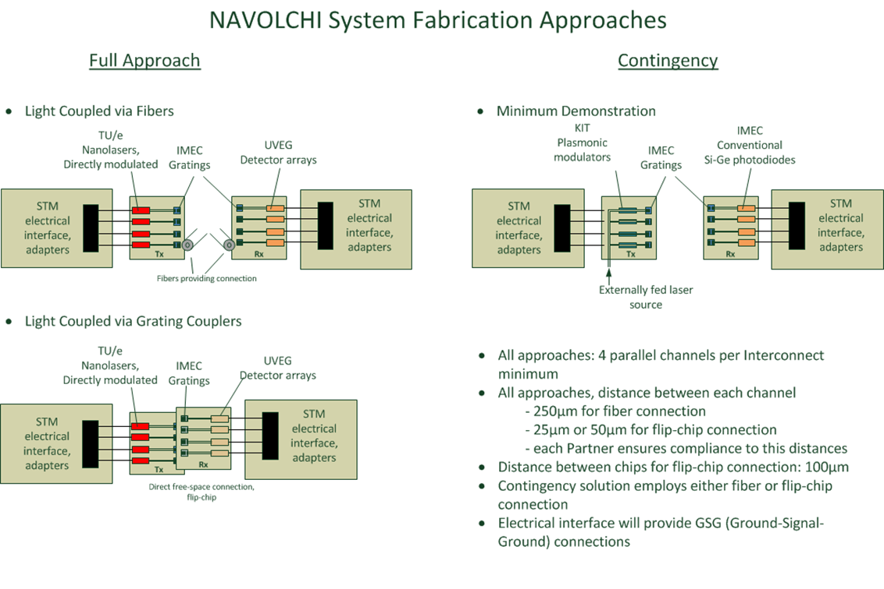
Project Overview: Objectives
Objective 4:

Slide 14
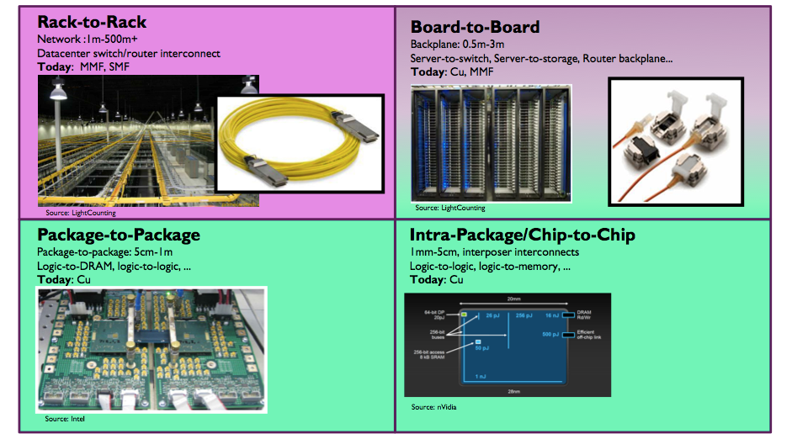
Project Overview: Objectives
Objective 4: Applications (Interconnect Challenge) / Benchmarking

Slide 15
Review 3 Results
There are no recommendations concerning the
period under review (05/2013 – 11/2014)

Slide 16
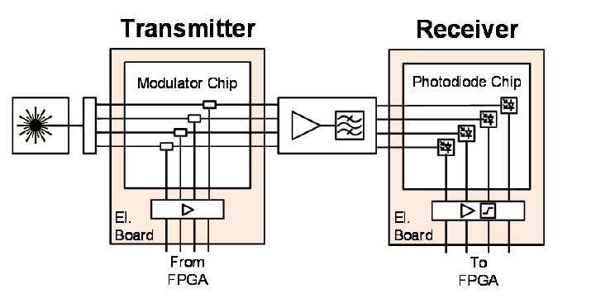
Review 3 Recommendations
1. Submit at month 40/41 an additional milestone report (MS50) on the final planning of system demonstrators based on progress in devices
Scenario: External laser + phase modulator + Si/Ge photodetector

Slide 17
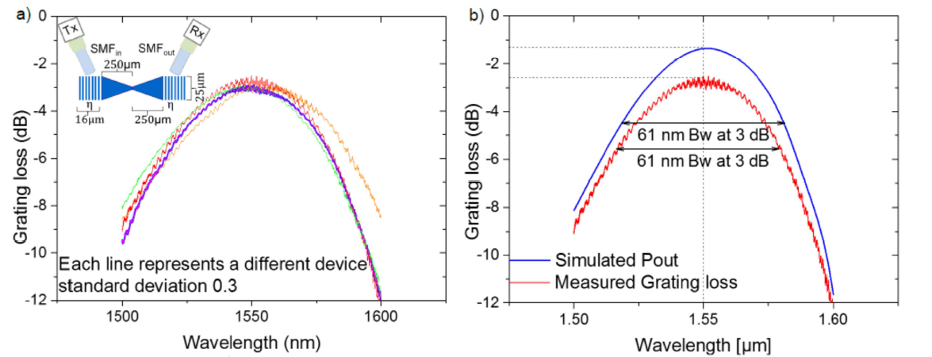
Review 3 Recommendations
2. Report also on the new enhanced metal grating couplers, for which no deliverable has been planned. This could be included in the new milestone MS51.

Slide 18

WP 2 Summary
Objectives:
Set target specifications for system
Define subsystem plasmonic devices
System modeling
Techno-economic study
Energy consumption study
Achievements:
  3 different architectures have been studied
    Scenario-1:direct modulation of metallo-dielectric nanolaser(DML)
    Scenarios 2 and 3: external laser with a phase/amplitude modulator(EML)
  Techno-economic evaluation of the plasmonic interconnects
  Energy consumption comparison with competitive technologies (electronics, photonics)

Slide 19
WP 2 Highlights
Plasmonic based chip interconnect technology:
may not be appropriate for intermediate and global interconnects due to its high waveguide losses
is considered as an optimal energy efficient solution implementing individual critical chip modules, such as modulators, laser sources and photodetectors

Slide 20
WP 3 Summary
Objectives: Transmitter Design, Fabrication, Characterization
  Design and simulation of plasmonic/metallic nanolaser and plasmonic modulator
  Fabrication/characterization of electrically driven plasmonic/metallic nanolaser and plasmonic modulator
Achievements:
    Modeling of metal-cavity lasers and plasmonic modulators
    First III-V waveguide-coupled nanopillar LED device with metal-cavity
    Several plasmonic modulation concepts:
      Absorption modulator: ER 6dB, MHz bandwidth
      Phase modulator: BPSK signaling at 40 Gbit/s (BER < 10⁻¹⁰)
      First plasmonic Mach-Zehnder modulators (MZM):
      OOK signaling at 40 Gbit/s (BER < 4×10⁻⁴)
      Advanced all-plasmonic MZM: Total length < 10 µm,
      up to 72 Gbit/s OOK

Slide 21
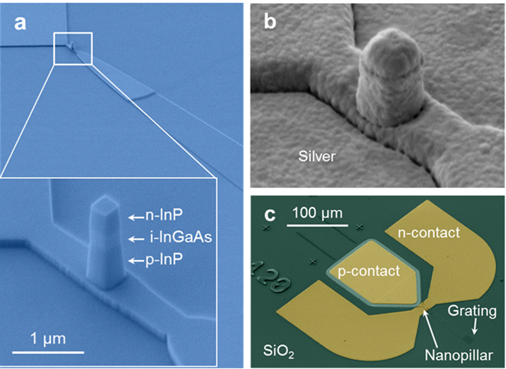
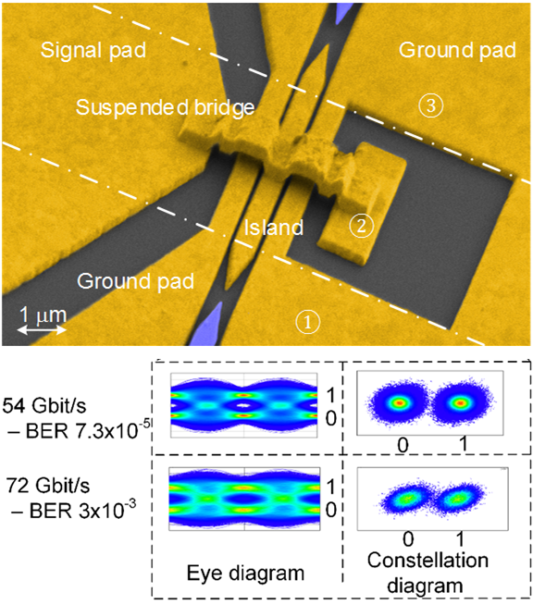
WP 3 Highlights
Nanopillar LED:
All-Plasmonic Mach-Zehnder Modulator:
Max output power: 60 nW
External on-chip quantum efficiency 10⁻²
Direct modulation up to 5 GHz
Nature Photonics 9 (2015) 525–528

Slide 22

WP 4 Summary
Objectives:
Quantum Dot Based Plasmonic Amplifiers:
Photodetectors:
Electrical injection
10dB on-chip gain
Quantum efficiencies QE > 80 %
Responsivities R > 0.1 A/W
Achievements:
Material with gain at 1.55 μm: HgTe QDs
Thin film phase: reduced performance due to clustering of QDs.
CdSe/CdS (thick shell): QDs lasing and amplification was demonstrated when embedded in SiN microdisk resonators and waveguides, respectively.
Propagation length of short-range SPP increases notably by the decreasing the width of the metal waveguide in agreement with calculations, both at visible (CdSe QDs) and infrared (HgTe QDs) wavelengths
Schottky photodiodes reach responsivities above 0.4/0.2 AW⁻¹ at 1.3/1.55 μm
Microgap photoconductors reach close to 1 A/W at very low incident powers
Fabrication of nano-gap waveguide photoconductors

Slide 23
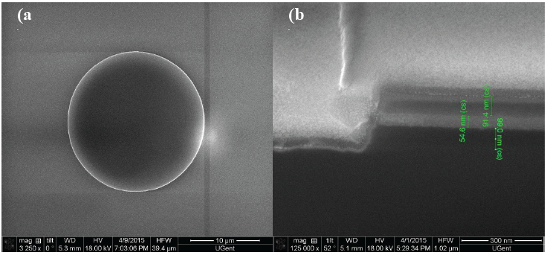
WP 4 Highlights
Microdisks of SiNx embedding QDs
The layer of QDs is sandwiched between two SiNx layers grown by PECVD.
Lasing in QD-SiN microdisks
Wavelength (nm)

Slide 24
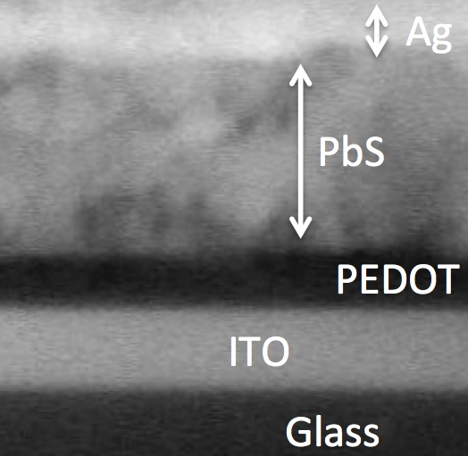
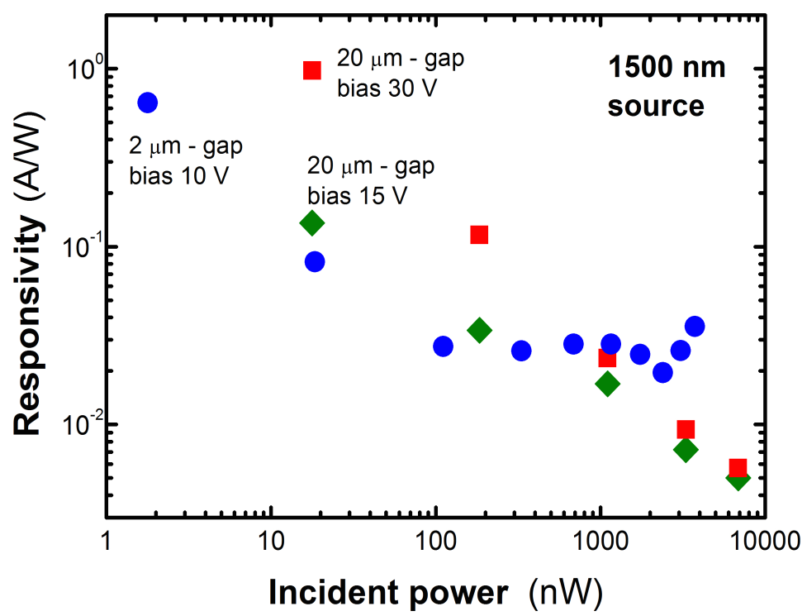
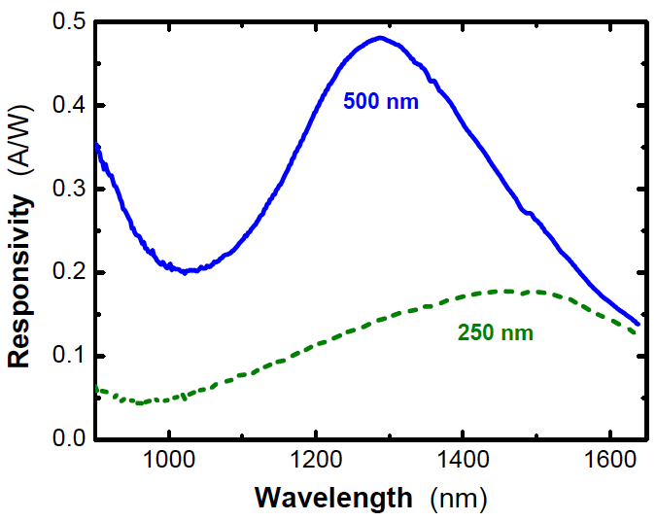


WP 4 Highlights
Schottky Photodiodes
R > 0.2 A/W at 1.55 μm
Micro-Gap Photoconductors
QD solid
R > 0.1 A/W
Nano-gap
fabricated

Slide 25
WP 5 Summary
Objectives:
  Develop interfaces for photonic and electronic components
Achievements:
  Developed highly efficient coupler Silicon Waveguide to Plasmonic modulator
  Demonstrated different kinds of optical filters
  Demonstrated electrostatically tunable grating couplers and novel grating coupler for SiN-QD platform
  Developed electronic interfaces to drive plasmonic devices

Slide 26
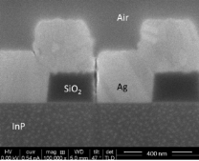
WP 5 Highlights
Metal grating coupler
Broadband and low loss coupler
(<1dB couple loss, 0.52dB/um prop)
Design & Fabrication novel grating couplers for SiN-QD platform

Slide 27
WP6 Summary
Objectives
  Characterization and testing of active and passive plasmonic devices
  Integration of plasmonic devices including electrical parts for chip-to-chip communication
  Characterization and testing of a complete System in Package
Achievements
Verification of the performance of plasmonic MZM array operating at 4 × 36 Gbit/s by data modulation experiments
Characterization of the receiver (Si-Ge photodiode array, PCB) at data rates of 3 x 28 Gbit/s
Successful operation of chip-to-chip interconnect at
3 x 10 Gbit/s, (1 x 20 Gbit/s with a BER of 7.9×10⁻⁵)

Slide 28
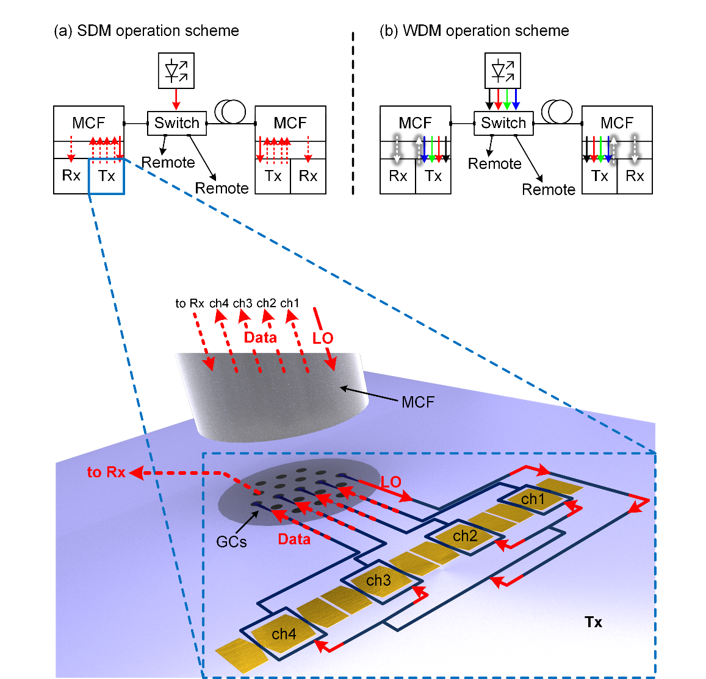
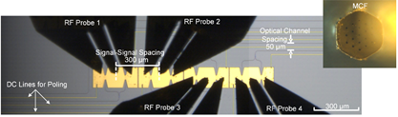
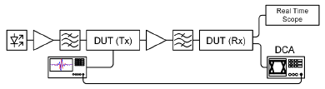
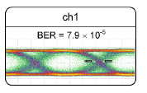
WP6 Highlights
Interconnect System Demonstrator
Four-Channel MZM Array
3 x 10 Gbit/s
Data Modulation Experiment
20 Gbit/s

Slide 29
WP 7 Summary
Objectives:
Dissemination through paper submission to high quality scientific journals and conferences
Organizing workshops & seminars on NAVOLCHI technology
Dissemination through the website
Achievements:
39 journals (among others 2 Nature Photonics and 1 cover story at Optics and Photonics News)
77 conference publications disseminating the project have been published by NAVOLCHI partners,
2 provisional patents
2 workshops

Slide 30
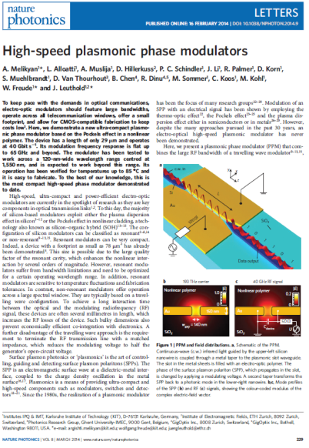
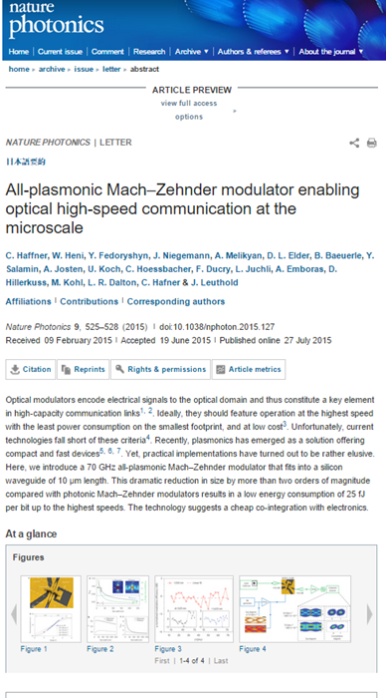
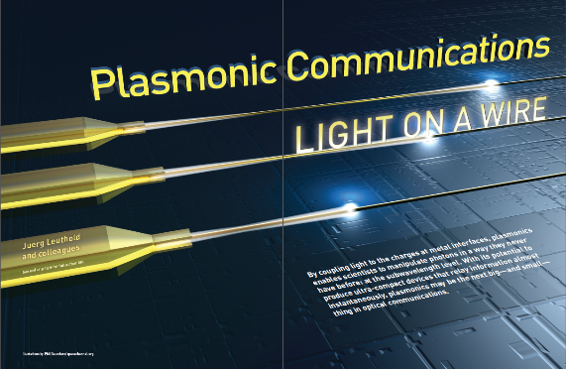
WP 7 Highlights
2 Nature Photonics and 1 cover story at Optics and Photonics News)

Slide 31
Review Objectives
The continued relevance of the objectives and breakthrough potential with respect to the scientific and industrial state-of-the-art
The breakthrough potential of the plasmonic components (nanolaser, phase modulator, photodetector) remains valid. Their integration in a photonic circuit has been demonstrated on the lab scale.
The degree of fulfilment of the project work plan and of the related deliverables
-> WP presentations
The resources planned and utilised in relation to the achieved progress
-> Table of person-months at WP level
The expected potential impact in economic, competition and social terms, and the beneficiaries' plan for the use and dissemination of foreground.
Photonic interconnect technology is crucial for increasing the capacity of data centers. The plasmonic components developed in NAVOLCHI are key components in such interconnects. Other long-terms prospects are foreseen.

