Slide 1
WP-1 Presentation
“NAVOLCHI Management”
Manfred Kohl
Karlsruhe Institute of Technology (KIT), Germany

Slide 2
Outline
Overview and Project Governance
Management Deliverables
Communication: Meetings and Phone Conferences
Current Status: Deliverables and Milestones
GA-Amendment, Use of the Resources and Financial Statements
Innovation
Summary

Slide 3

Overview of WPs

Slide 4
Management: Main Tasks
Strategic management at project level
Control of work package activities, including technical quality control
Organisation of project reporting and meetings
Control of deliverable preparation
Conflict management

Slide 5
Project Governance

Slide 6







General Assembly: Representatives
Coordinator (Chair): Juerg Leuthold
Manfred Kohl
+
 | KIT | Manfred Kohl
 | IMCV | Dries Van Thourhout
 | TU/e | Meint Smit
 | AIT | Ioannis Tomkos
 | UVEG | Juan Martinez Pastor
 | ST | Alberto Scandurra
 | Ugent | Zeger Hens
IMEC
ETH
Jürg Leuthold

Slide 7
Project Management Committee:
Technical Project Manager (Chair): Manfred Kohl
Jürg Leuthold
+
Coordinator: Juerg Leuthold
Manfred Kohl
+
WP 1 Leader | KIT | Manfred Kohl
WP 2 Leader | AIT | Emmanouil-Panagiotis Fitrakis
WP 3 Leader | TU/e | Meint Smit
WP 4 Leader | UVEG | Juan Martinez Pastor .
WP 5 Leader | IMEC | Dries Van Thourhout
WP 6 Leader | ST | Alberto Scandurra
WP 7 Leader | AIT | Dimitrios Klonidis
Christoforos Kachris
ETH
Jürg Leuthold
Christoforos Kachris

Slide 8
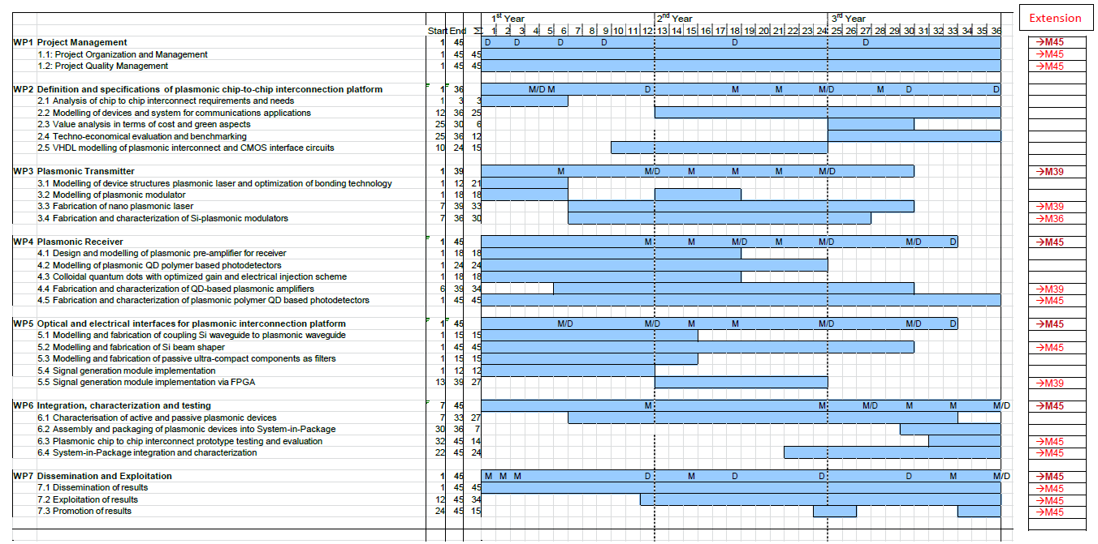
Time Scale (including extension)
Some tasks have been extended by nine months
All tasks finished after extension with month 45

Slide 9

Management Deliverables
Deliverables covered by work package 1 with delivery dates are:
  D1.1: Project web site with .eu domain (M01) and continuous update 11/2011
  D1.2: Project reference online manual 01/2012
  D1.3: Project quality assurance manual 04/2012
  D1.4: Intermediate progress report (1) containing work progress and management activities up to month 9 (07/2012)
  D1.5: Intermediate progress report (2) containing work progress and management activities up to month 27 (01/2014)
All have been prepared in time.

Slide 10
Communication
Meetings:
  Kick-Off in Karlsruhe, Germany
  6-Month Meeting in Warwick, UK
  12-Month Meeting in Ghent, Belgium
  18-Month Meeting in Karlsruhe, Germany
  27-Month Meeting in Eindhoven, Belgium
  36-Month Meeting in Brussels, Belgium
  Final Meeting in Brussels, Belgium
Phone Conferences:
  34 (up to June 2015), typically monthly
  Topics: Work progress, adjustments, ..
  Presentations documented at WEB-Site

Slide 11
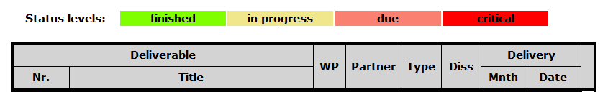
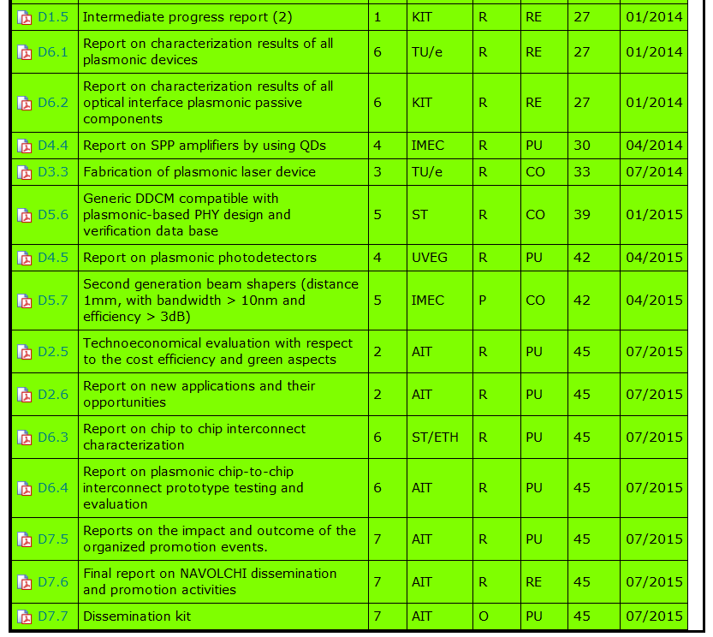
Status: Deliverables
All deliverables finished, most of them in time

Slide 12
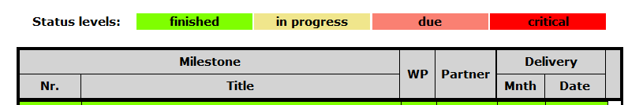
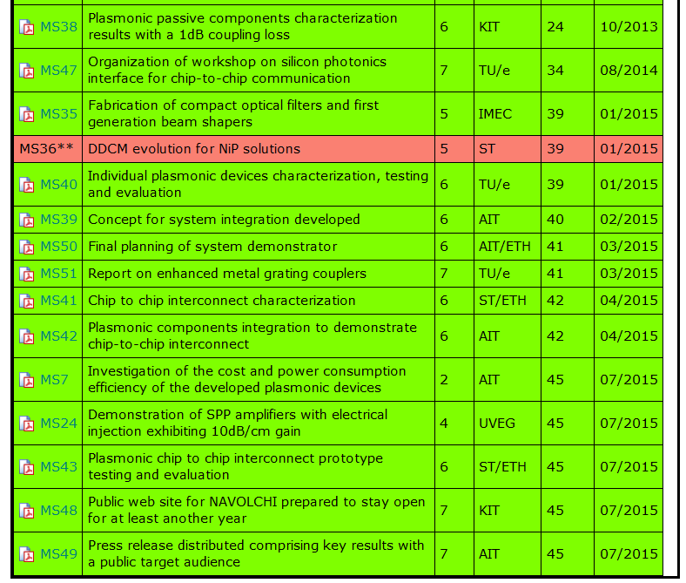
Status: Milestones
MS36: Skipped due to STs retreat
Fabrication of second generation of beam shapers

Slide 13
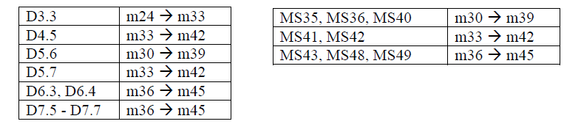
GA-Amendment
Main topics
Project extension by 9 months
ETH as new partner to overtake tasks from ST
Modification of DoW, mainly WP6 (task6.3 and task 6.4), which will be finished by ETH
Accepted by EC: 16 Sept. 2014
Consequence: Shift of deliverables and milestones:

Slide 14
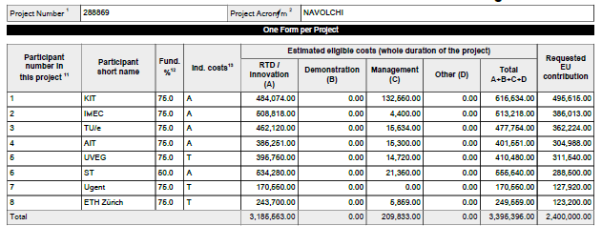
GA-Amendment
New budget breakdown
ST is instructed to pay 123,2 t€ to Coordinator, who remits it to ETH

Slide 15
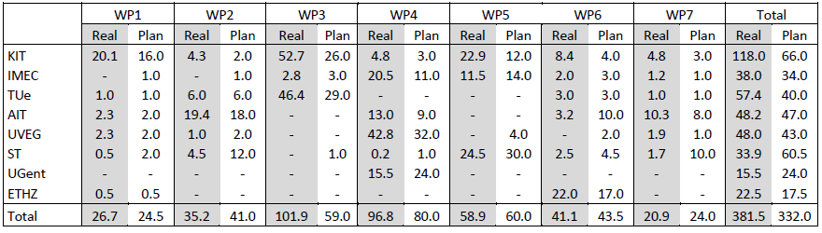
Person-Months at WP Level
Use of Resources
Final costs are not yet available
as Form‘s C were not yet complete by October 2nd

Slide 16
Innovation
Innovation questionnaire (September, 30th 2015)
Summary:
Alternative method for the fabrication of metal micro/nanostructures from metal-polymer nanocomposite resists and their subsequent electroless metallization. The process consists of three simple steps: 1. Fabrication of micro or nanopatterns by lithography or any other direct printing technologies, 2. In-situ synthesis of metal nanoparticle during a post-bake step and 3. Non-electrochemical metallization of nanocomposite patterns. The key point of this procedure is the use of a weak reducing agent so that the metal reduction selectively takes place on the surface of the metal nanoparticle acting as seeds, but not in the bulk of the growing solution. This fabrication method may be very useful for the fabrication of devices profiting of plasmonics (sensing, photovoltaics, optoelectronics…).

Slide 17

Summary
Project structure
Partner communication
Technical and scientific progress
Solutions of meantime problems during extension
Further dissemination
To be finalized:
Financial Statements

Slide 18
Thank you!

Slide 19
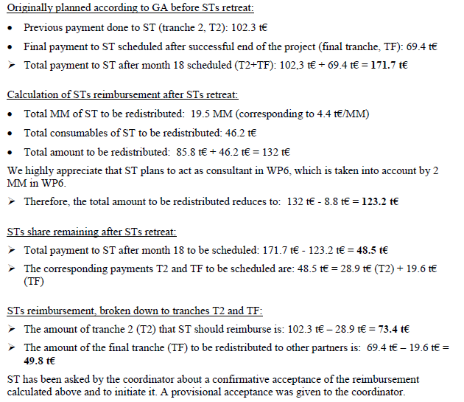
GA-Amendment
Detailed calculation
of STs liabilities

