Slide 1
Work Package 2 Presentation
“Project NAVOLCHI”
Ioannis Tomkos
Athens Information Technology, GR

Slide 2
Outline
WP2 Position in Project
Scope/Objectives
Tasks
Milestones and Deliverables
Summary

Slide 3
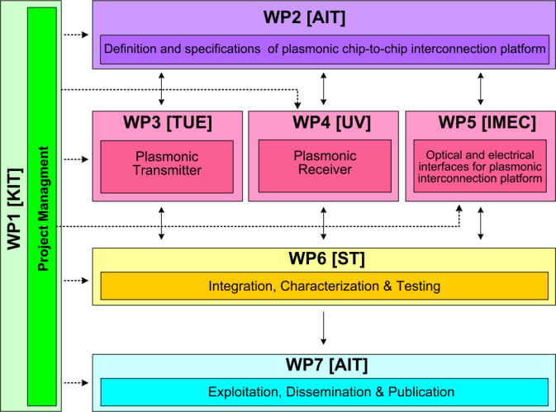




WP2 Position in Project
Contributors:

Slide 4
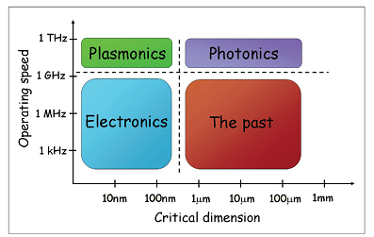
Plasmonics vs. Photonics vs. Electronics
Plasmonics can be as fast as photonics and as cost and effective as electronics!
For an interconnect technology, the first most critical parameter is the energy efficiency (measured in pJ/bit or mWatt/Gbps) and the second the cost per bit ($/Gbit). A third metric, less important but still significant for the system design, is the bandwidth density (Gbps/inch or Gbps/mm2).
For chip-scale interconnects, plasmonics offer the highest performance when considering all these parameters

Slide 5
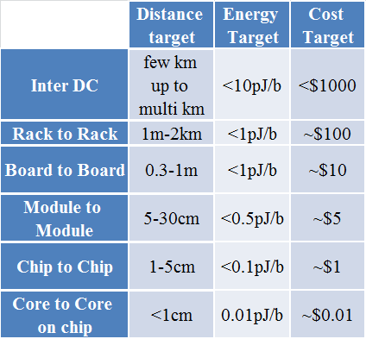
Target energy and cost of interconnects
Due to the high loss of plasmonics, they are only suitable for chip scale interconnects

Slide 6
Scope/Objectives of WP2
To demonstrate the feasibility of chip-scale plasmonic interconnects
To derive the specs for the components of the plasmonic interconnect
To estimate the energy efficiency of interconnects
To compare plasmonic interconnects with photonic and electronic ones
To present a roadmap for the evolution of interconnect technology

Slide 7
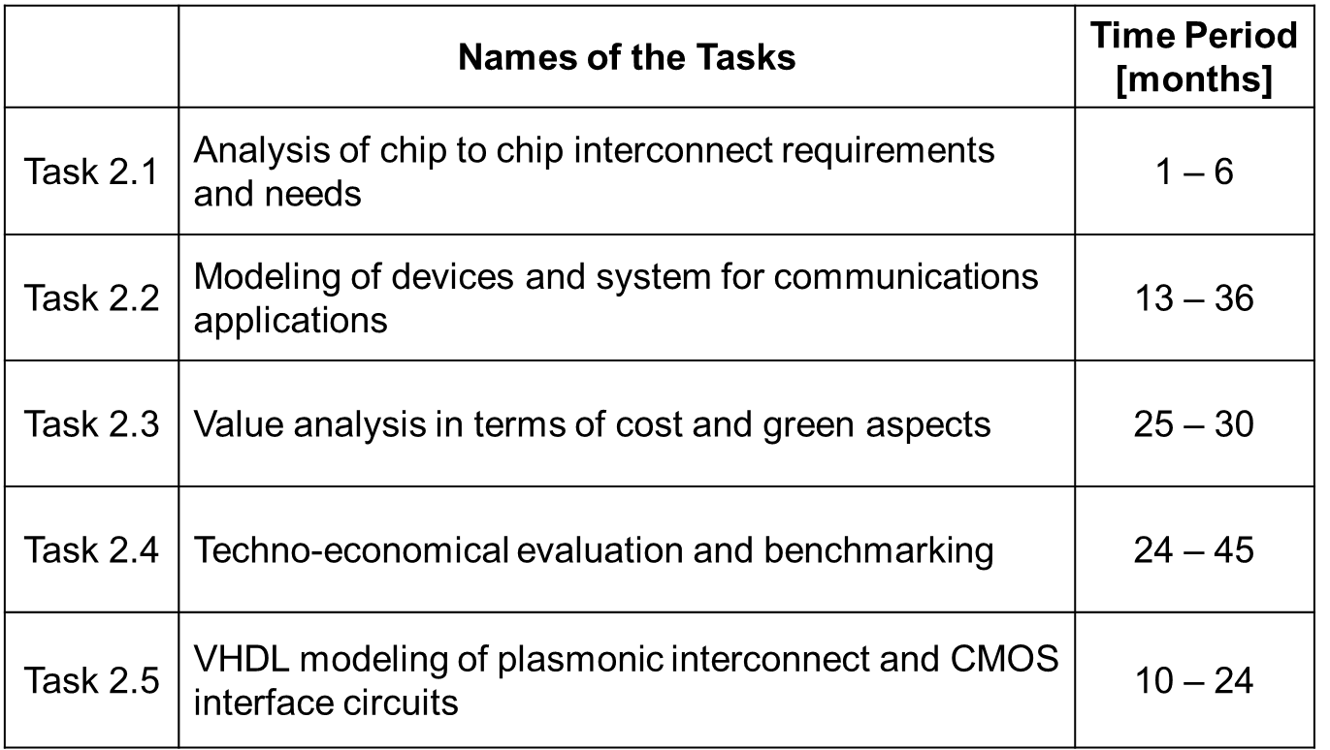
Tasks

Slide 8
Milestones
 | Names of the Milestones | Month | Partner
MS1 | Definition of chip-to-chip interconnection system environment and specification | 3 | AIT
MS2 | Definition of plasmonic devices and material properties for chip-to-chip interconnection | 6 | AIT
MS3 | Development of a system and device simulation platform | 18 | AIT
MS4 | Definition of the interconnection level specification employing developed plasmonic devices | 18 | ST
MS5 | Digital domain to plasmonic domain interface specification and VHDL modelling | 21 | ST
MS6 | Plasmonic interconnect VHDL modelling | 24 | ST
MS7 | Investigation of the cost and power consumption efficiency of the developed plasmonic devices | 37 | AIT

Slide 9
Deliverables
 | Names of the Deliverables | Month | Partner
D2.1 | Definition of chip-to-chip interconnection system environment and specification | 3 | ST
D2.2 | Definition of plasmonic devices | 12 | AIT
D2.3 | Investigation of chip-to-chip interconnection-level specifications employing new plasmonic devices | 24 | AIT
D2.4 | Interface and plasmonic interconnect models and reports | 24 | ST
D2.5 | Techno-economical evaluation with respect to the cost efficiency and green aspects | 45 | AIT
D2.6 | Report on new applications and their opportunities | 45 | AIT

Slide 10
Task 2.2 Modeling of the integrated system
3 simulation models have been developed and the corresponding systems have been evaluated:
Scenario 1: A directly modulated laser (DML) - based system in which the data are applied directly on the driving current of the metallo-dielectric laser source to produce NRZ OOK signals
Scenario 2: A differential phase shift keying (DPSK) transmitter, utilizing the plasmonic MZM driven by the metallo dielectric laser source in continuous wave (CW) mode and with differential phase shift keying (DPSK) detection based on a passive delay line interferometer (DLI) at the receiver
Scenario 3: An intensity modulation transmitter (NRZ OOK) utilizing the MZM and the laser source in CW mode, with direct detection at the receiver

Slide 11
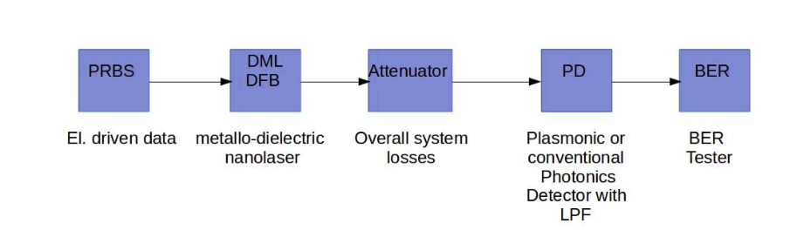
Scenario 1: Directly modulated laser
A directly modulated metallo-dielectric laser (DML) - based system

Slide 12
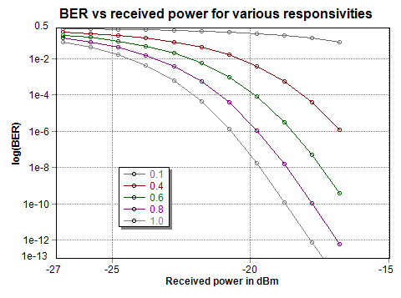
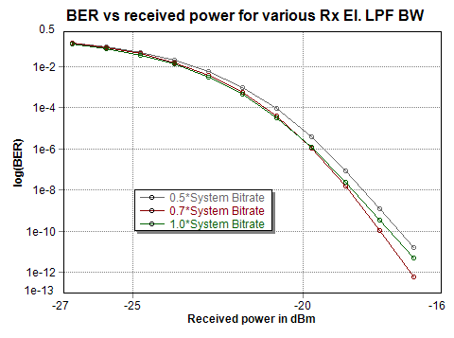
Scenario-1 results
BER vs rec. power at various Rx LPF BWs
BER vs rec. power at various responsivities

Slide 13
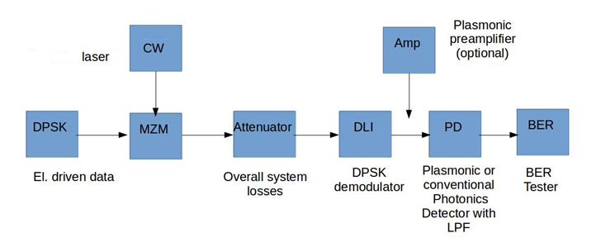
Scenario-2
Externally, phase modulated MZM (DPSK) via metallo-dielectric laser in CW (EML) - based system
2 cases examined: with or without plasmonic preamplifier prior to detector
This scenario assumes a PIN detector and has a DI in front of it for decoding (having 6dB loss)

Slide 14
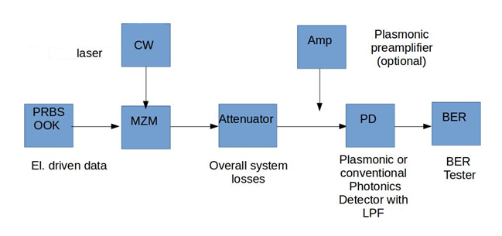
Scenario-3
Externally, amplitude modulated MZM (OOK) via metallo-dielectric laser in CW (EML) - based system
2 cases examined: with or without plasmonic preamplifier prior to detector

Slide 15
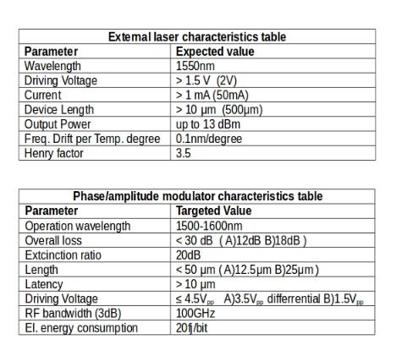
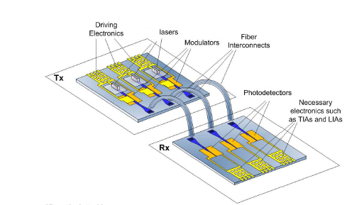
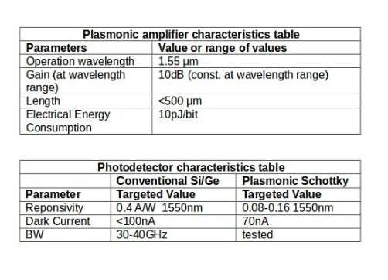
EML scenarios device characteristic tables

Slide 16
EML scenarios results: without amplifier
BER performance at specified bitrate (7.2Gbps) is estimated for maximum overall losses that the system can handle, for range of values of various critical parameters:
    CW laser output powers (no booster amplifier between CW and MZM)
    MZM overall losses
    Detector responsivities (range covers both conventional Si/Ge and plasmonic detectors)
    Amplified input powers to MZM (booster amplifier is placed between CW and MZM )
    Other system bitrates
For measuring BER performance versus interconnection distance at specified bitrate and other bitrates, data values of interconnection loss in dB/mm and typical ranges of chip to chip distances were assumed.

Slide 17
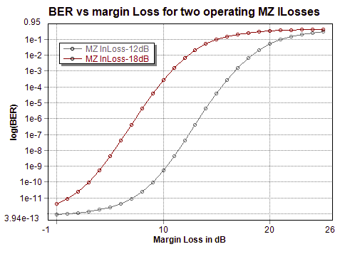
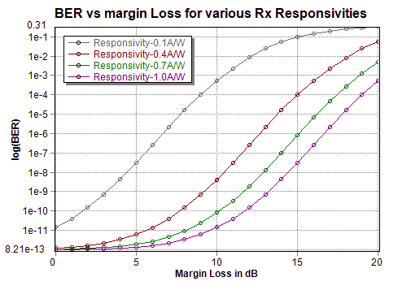
At const system bitrate:7.2Gbps
CW laser power 10dBm and 0.4A/W Rx responsivity
At const system bitrate:7.2Gbps
CW laser power 10dBm
Scenario 2: EML DPSK without amplifier

Slide 18
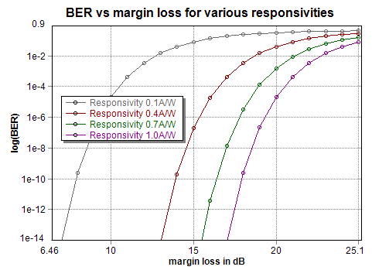
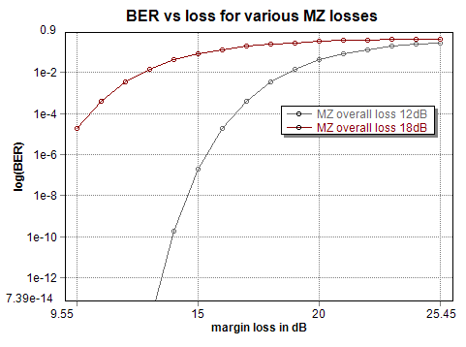
At constant system bitrate:7.2Gbps for various responsivity
At const system bitrate:7.2Gbps
CW laser power 10dBm and 0.4A/W Rx responsivity
Scenario 3: EML OOK without amplifier

Slide 19
Conclusions from the T2.2 studies
Directly modulated (DML) scenario shows poor BER performance for such low operating laser powers (40uW)
Externally modulated (EML) scenario shows better BER performances than DML (at an extra cost…)
  Performance can be further improved by reducing MZM total losses, especially when system is to be operated at higher than default bit rate (7.2Gbps)
In either case the performance can be greatly enhanced by placing a plasmonic amplifier prior to detector. However the technology to realize plasmonic amplifiers is still immature.

Slide 20
Task 2.4 Techno-economical study
A techno-economical evaluation of chip interconnects with respect to their cost and power consumption has been performed
A comparison among conventional electronic CMOS, photonic and the NAVOLCHI project interconnect approach was attempted, on the basis of energy efficiency and implementation issues
The comparison was performed for each of the components comprising the interconnect system
  Both active (transmitters, receivers) and passive modules (waveguides, couplers) were evaluated in terms of their energy efficiency

Slide 21
Energy efficiency of photonic and electronic interconnects
Source:
ASCAC Subcommittee for the Top Ten Exascale Research Challenges, US Dept Of Energy report, Feb 2014

Slide 22
Roadmap & energy efficiency comparison of different chip interconnect technologies
Year | Node techn. (nm) | Energy efficiency in pJ/bit |  |  |  | Optical technology roadmap
 |  | Navolchi (hybrid) | IBM optical | STmicro optical | CMOS convent. (ITRS projected) | Navolchi (hybrid) | Optical
2013 | 28 | 10-20 | ‹25 | 15 | 30-40 | Cu/VCSEL for Backplane | AOC and VCSEL Backplane
2015 | 24
 |  |  |  |  |  |  | Si Ph for Backplane
2016/2017 | 22/20 | ~5 | 5 | 4.4 | 11-8 |  | Si Ph for interposer and Board
2018 | 18 |  |  |  |  | Cu/VCSEL and Si Ph. for Backplane
2019/2020 | 17/15 | ~1-2 | ~1 | ‹1.7 | 4.5-3 |  | Si Ph on chip
2021-2024 | 14-11 |  |  |  |  | Cu/VCSEL and Si Ph. for Board
2025 | 10 | ~0.5 |  |  | 1.3 | Si Ph. Onto chip
beyond | 9-5 | ~0.05 |  |  | 0.8

Slide 23

Photonic and Plasmonic DM Sources
PHOTONIC SOURCES
Energy consumption fJ/bit | description | Bit rate | reference
VCSEL
77 | VCSEL | 25Gbps | [14]
140 | VSCEL | 34Gbps | [18]
158 | VCSEL | 40Gbps | [19]
203 | VCSEL | 38Gbps | [20]
SILICON NANOPHOTONIC SOURCES
13fJ/bit | Photonic crystal nanocavity laser w/wo QD gain region | NA | [21]
8.76fJ/bit | InGaAsP/InP buried heterostructure photonic crystal (PhC) laser | 20Gbps | [22]
4.4fJ/bit | PhC laser LEAP (Lambda-Scale Embedded Active Region Photonic-Crystal) | 10Gbps | [23]
8.76fJ/bit | Photonic Crystal Nanocavity | 20Gbps | [24]
1fJ/bit | Photonic Crystal Nanocavity with QD | 10Ghz | [25]
0.25fJ/bit | Crystal nanocavity LED | 10Ghz | [26]
PLASMONIC SOURCES
Energy consumption fJ/bit | description | Bit rate | reference
- | a tungsten photonics cavity sandwiched between layers of selenium(gain medium) | NA | [27]
5fJ/bit | Semiconductor nanolasers with metallo-dielectric cavities | <10Gbps | [28]

Slide 24
Photonic and Plasmonic Modulators
PHOTONIC MODULATORS
Energy consumption fJ/bit | description | Bit rate | reference
0.75fJ/bit | Ge quantum well waveguide-integrated modulator On silicon No resonator | 7Gbps | [30]
10 fJ/bit | asymmetric F-P EAM quantum-confined Stark (QCSE AFPM) effect in Ge/GeSi quantum wells | NA | [31]
3fJ/bit | silicon microdisk | 12.5Gbps | [32]
6fJ/bit | Ge QCSE | NA | [33]
25fJ/bit | Ge Si EAM FKE | >100 GHz | [34]
100fJ/bit | Ge EAM FKE | 30GHz | [35]
82 fJ/bit | ring resonator modulator | 32Gbps | [36]
50fJ/bit | microring based resonator EOM | 10Gbps | [37]
5pJ/bit | nano-photonic MZ | 10Gbps | [38]
7.9fJ/bit | silicon microring modulator | 1Gbps | [39]
PLASMONIC MODULATORS
Energy consumption fJ/bit | description | Bit rate | reference
18fJ/bit | EO phase modulator Pockels in nonlinear polymer | 40Gbps | [40]
20fJ/bit | Plasmonic MZ | 72Gbps | [41]
1fJ/bit | MDM compact plasmonic modulator based on resonance in a nano slit-groove | 40Gbps | [42]
2-4.3fJ/bit | ITO-EOM in a plasmonic silicon-on-insulator (SOI) hybrid design | >50Gbps | [43]
0.003fJ/bit | Layered metal/chalcogenide waveguide PM | >50Gbps | [44]
0.01fJ/bit | Array of Ag nanoparticles in EOP matrix PM | >50Gbps | [45]
16fJ/bit | Slotline Si/EOP/Si PM | >50Gbps | [46]
0.16fJ/bit | Hybrid Plasmonic with SOI Graphene-Based Electro-Optic Modulators | >50Gbps | [47]

Slide 25
Photonic and Plasmonic detectors
PHOTONIC DETECTORS
Energy consumption fJ/bit | description | Bit rate | reference
33fJ/bit | Micrometer scale Ge PD | 3Gbps | [48]
2.4fJ | Ge photodetectors on silicon | 40Gbps | [49]
5.6fJ/bit | Ge PD | 25Gbps | [50]
0.18fJ/bit | Ge/Si APD | 10Gbps | [51]
PLASMONIC DETECTORS
Energy consumption fJ/bit | description | Bit rate | reference
5aJ | Nanometallic Dipole Antenna Enhanced Photodetector | NA | [52]
70aJ/bit | integrated plasmonic Ge photodetector | 50GHz | [53]

Slide 26
Photonic and plasmonic waveguides and couplers
Si PHOTONIC WAVEGUIDES
material | attenuation | reference
silicon core on insulator (SOI) | 0.5dB/cm | [51]
silicon core on insulator (SOI) | 1.4-4.5dB/cm | [38]
PLASMONIC WAVEGUIDES
material | attenuation | reference
plasmonic(M-I-si.I-M) | 0.28-0.3dB/μm | [55]
Slot-line | 3.0733 dB/μm | [56]
Hybrid plasmonic | 0.01-0.22dB/μm | [56]
COUPLERS
Description | Coupling loss | reference
Fiber to Si waveguide | < 1dB | [57]
photonic to plasmonic mode conversion | 1.1dB | [58]
coupling losses per Si-to-DLSPP interface | 2.5 dB | [59]

Slide 27
Chip interconnect energy consumption at device level
Laser
Average energy efficiency, for each interconnect device module separately (laser sources, modulators and detectors) is presented

Slide 28
D2.6 Report on new applications and their opportunities
• The NAVOLCHI laser can be used also in other applications
  Sensors: It has been demonstrated that nanoscale cavity sources show high performance in certain sensing applications due to the large surface-to-volume ratio, which make them highly sensitive to the environment. By monitoring the emission intensity, a nanolight source can be used to sense the enviromental conditions. For example, recently an optically pumped plasmon nanocavity laser source achieved a sub-part-per-billion explosive molecule detection.
  • Biomedical: it has been suggested that nano- and micro-scale lasers based on fluorescent labelled DNA as gain medium may find applications in optical DNA sequencing.

Slide 29
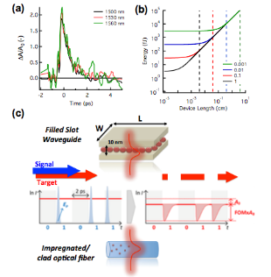
NAVOLCHI plasmonic amplifier: Wavelength conversion
Use of PbS based devices for wavelength conversion
We showed that the interplay between intraband and bandgap absorption in colloidal quantum dots (QDs) leads to a very strong and ultrafast modulation of the light absorption after photoexcitation in which slow components linked to exciton recombination are eliminated
  This approach enables all-optical wavelength conversion at rates matching state-of-the-art convertors in speed, yet with significantly cheaper materials

Slide 30
Summary
The feasibility of chip-scale plasmonic interconnects was demonstrated.
Plasmonic interconnects were compared with photonic and electronic ones
The energy efficiency of chip-scale interconnect technologies was estimated and a relevant roadmap was presented

Slide 31
Summary
The comparison showed that, among conventional electronic, photonic and plasmonic technologies, the plasmonic interconnects show the highest bandwidth density and the highest energy efficiency and are perfectly suitable for chip-scale interconnects
It is worth pointing out that the plasmonic modulators can reach energies down at sub-fj levels, while plasmonic detectors can reach energies down to attojoule levels.
Individual critical components, such as the modulators, laser sources and photodetectors, can be also used in other applications beyond chip-scale interconnects

