Slide 1
Work Package 3 Presentation
“Project NAVOLCHI”
Victor Dolores-Calzadilla, Meint Smit
Eindhoven University of Technology (TU/e), The Netherlands

Slide 2
Outline
WP3 Position in Project
Objectives
Tasks
Milestones and Deliverables
Status of Work
  Task 3.1. Modeling of plasmonic laser
  Task 3.2. Modeling of plasmonic modulator
  Task 3.3. Fabrication of plasmonic/metallic laser
  Task 3.4. Fabrication of Si-plasmonic modulators
Summary and Outlook

Slide 3
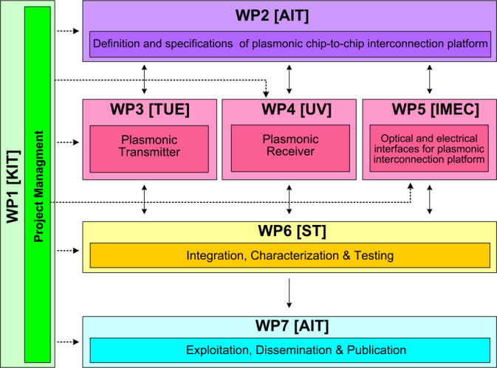




WP3 Position in Project
Contributors:

Slide 4
Objectives
Simulation studies
  Plasmonic/metallic nanolaser
  Plasmonic modulator
Fabrication
  Electrically pumped plasmonic/metallic nanolaser
  Electrically driven plasmonic modulator
Performance targets
  Laser: active region < 1 μm², output power > 100 μW
  Modulator: extinction ratio > 3dB for length < 10 μm, and a total modulation speed > 40 Gbit/s

Slide 5
Tasks
 | Names of the Tasks | Time Period [months]
Task 3.1 | Modelling of plasmonic laser and optimization of bonding technology | 1 – 6
Task 3.2 | Modelling of plasmonic modulator | 1 – 18
Task 3.3 | Fabrication of plasmonic/metallic nanolaser | 7 – 30
Task 3.4 | Fabrication of Si-plasmonic modulators | 7 – 27

Slide 6
Milestones
 | Names of the Milestones | Month | Partner
MS8 | Decision on an optimized structure for metallic/plasmonic nanolaser and its coupling to a Si-waveguide | 6 | TU/e
MS9 | Decision on an optimized structure for plasmonic modulator | 6 | KIT
MS10 | Grown wafer structure for plasmonic lasers | 12 | TU/e
MS11 | Fabrication of plasmonic modulator on a SOI platform | 15 | KIT
MS12 | Decision on an optimized structure for plasmonic modulator with a maximum loss of 20dB | 18 | KIT
*MS13 | Initial characterization of unbonded plasmonic lasers | 18 | TU/e
MS14 | Initial testing and characterization of plasmonic modulators | 21 | KIT
MS15 | Initial testing of bonded plasmonic lasers | 24 | TU/e
*MS13 has been identified as inappropriate to the course of the project and was skipped in agreement with EC

Slide 7
Deliverables
 | Names of the Deliverables | Month | Partner
D3.1 | Report on studies of optimized structure for metallic/plasmonic nanolaser and its coupling to Si-waveguide | 12 | TU/e
D3.2 | Report on modelling of the modulator structure | 12 | KIT
D3.3 | Fabrication of plasmonic laser device | 24 | TU/e
D3.4 | Report on fabrication of modulators | 24 | KIT

Slide 8
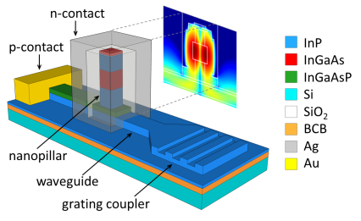
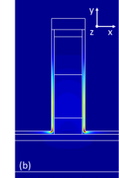

Task 3.1 Modelling of the Nanolaser
Fabry-Perot plasmonic laser ^{[1]}
Metallo-dielectric nanolaser ^{[2]}
|E|²
xy
  High propagation loss and poor active confinement
Reported in D3.1
|E|²
[1] V. Dolores-Calzadilla, et al., ICTON 2012.
[2] V. Dolores-Calzadilla, et al., ICTON 2013.

Slide 9
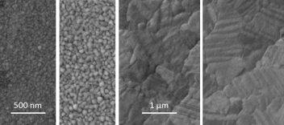
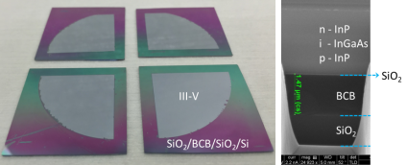
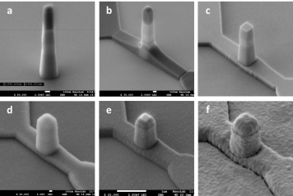
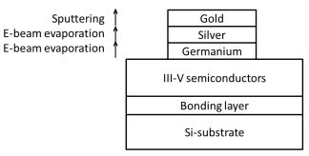
Task 3.3 Fabrication of the Nanolaser
Reported in D3.3 & FR
Technology development
Silver-deposition and treatment
III-V wafer bonding to Si-substrate
Low-loss Au/Ag/Ge contacts^{[1][2]}
Nanopillar on waveguides
[1] L. Shen, et. al., Optical Materials Express 5(2), 2015.
[2] L. Shen, et. al., Optical Materials Express (submitted), 2015.

Slide 10
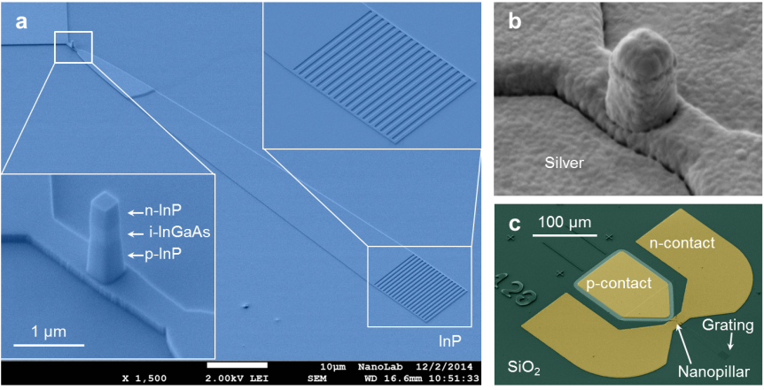
Task 3.3 Fabrication of the Nanolaser
Complete fabrication on III-V/Si ^{[1]}
[1] V. Dolores-Calzadilla, et. al., Nature Communications (to be submitted)

Slide 11
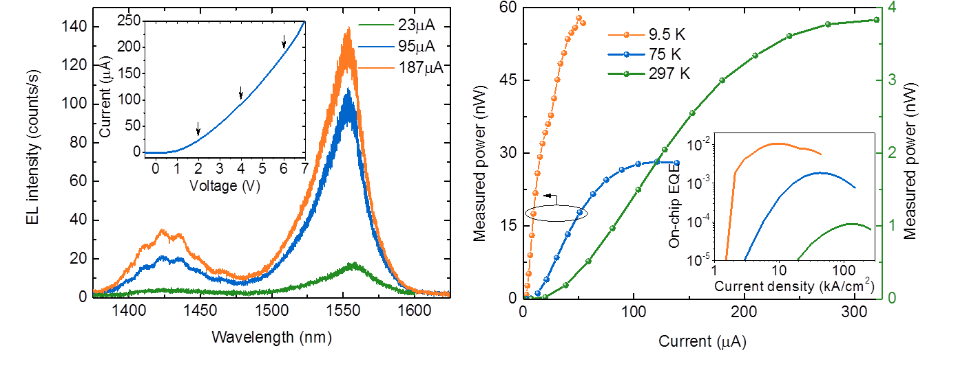
Task 3.3 Fabrication of the Nanolaser
Reported in FR
Static characteristics: LED operation
Reverse bias current: 0.5 µA
Minimum FWHM: 25 nm (Q~62)
Max. power: 60 nW
Max. on-chip Ext. Quantum Eff.: 10⁻²
State-of-the-Art: pW, 10⁻⁷ – 10^{-5 [1,2]}
Record value
[1] Shambat, et. al., Nature Communications 2, 2011.
[2] Huang, et. al., Nature Photonics 8, 2014.

Slide 12
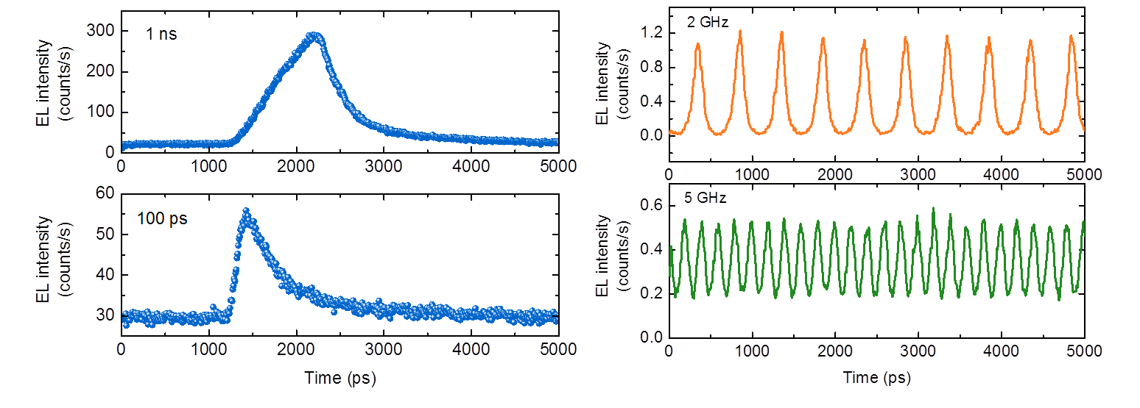
Task 3.3 Fabrication of the Nanolaser
Dynamic characteristics: LED operation
Electrical pulses: 1 ns to 100ps →sub-ns response
Due to strong non-radiative recombination
  Modulation depth:
  96% at 2 GHz
  42% at 5 GHz

Slide 13
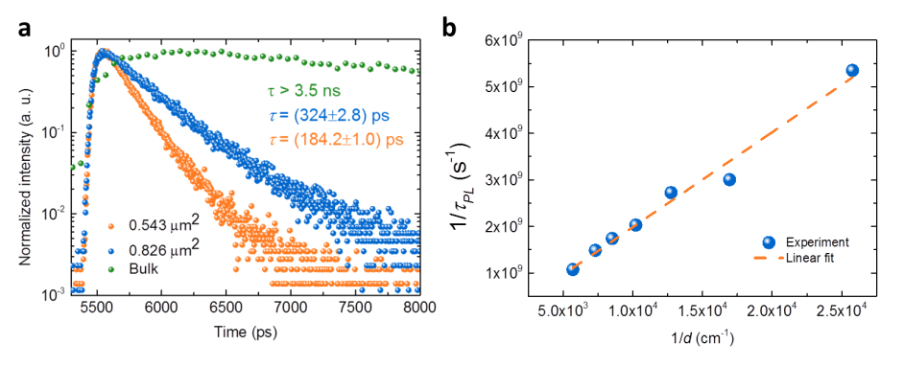
Task 3.3 Fabrication of the Nanolaser
Time-resolved photoluminescence of nanopillars
  Strong surface recombination!
  Surface recombination velocity S ~ 1x10⁵ cm/s

Slide 14
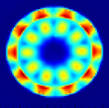
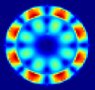
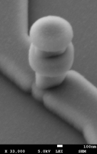
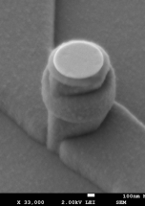
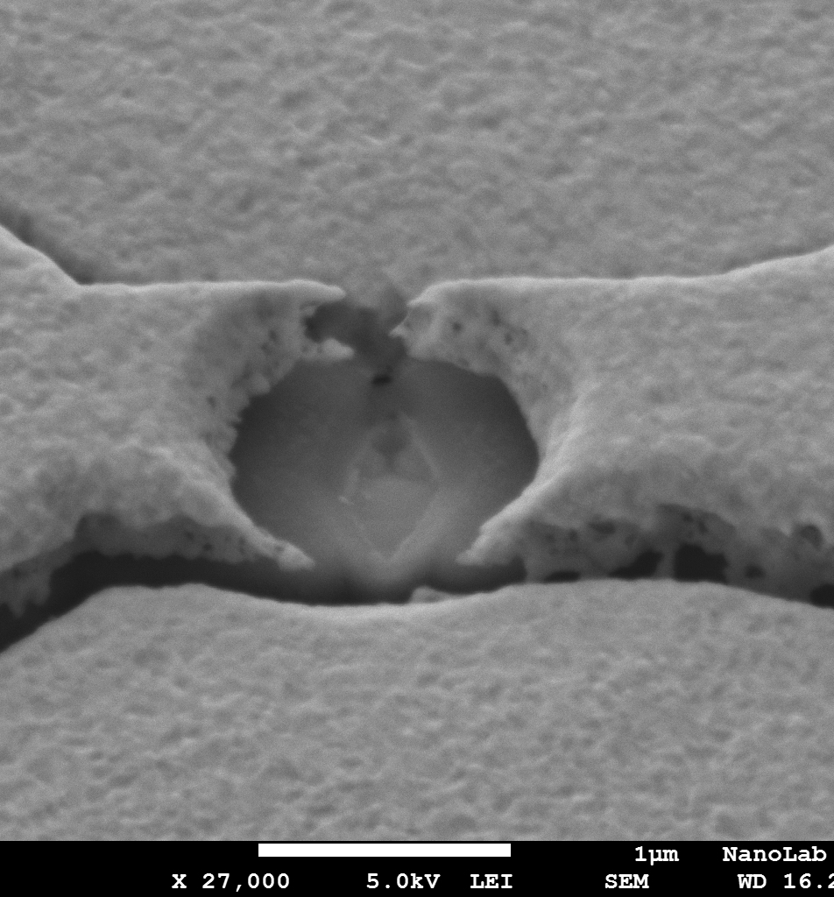
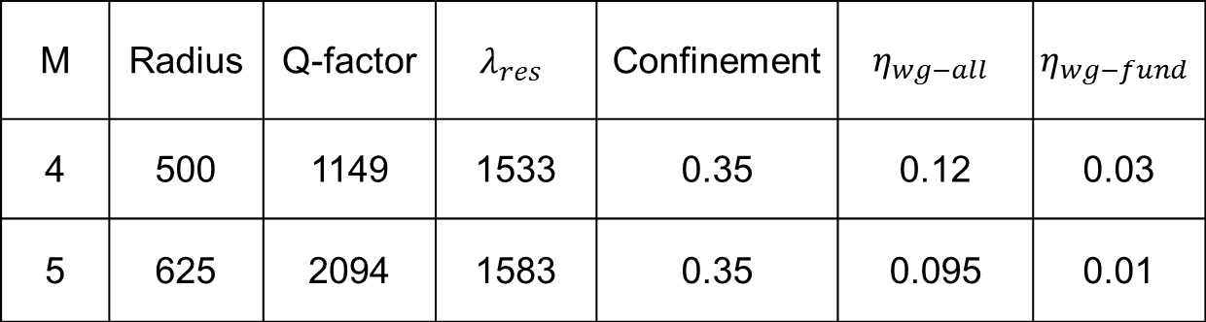
Task 3.3 Fabrication of the Nanolaser
Redesign: micro-cavity, undercut, whispering gallery mode
M | Radius | Q-factor | $$λ_{res}$$ | Confinement | $$η_{wg−all}$$ | $$η_{wg−fund}$$
4 | 500 | 1149 | 1533 | 0.35 | 0.12 | 0.03
5 | 625 | 2094 | 1583 | 0.35 | 0.095 | 0.01
Different stress
More fragile

Slide 15
Summary and Outlook (Light Source)
  Summary
    Modelling of waveguide-coupled metal-cavity nanolasers
    Technology development of metal-based devices in III-V/Si
    Fabrication completed and LED operation observed:
      Max. output power: 60 nW
      Max. on-chip EQE: 1%
      Switching speed up to 5 GHz
  Outlook
    Publish main results in journal paper
    Realize passivation studies for future nanoscale sources
    Use silver-based ohmic contacts in TUe’s membrane technology

Slide 16
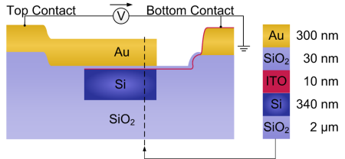
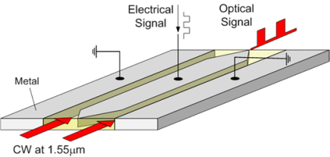
Task 3.2 Modelling of the Modulator
SPP absorption modulator
SPP phase modulator
Reported in MS9 & D3.2

Slide 17
Task 3.4 Fabrication of the Modulator
Phase Modulator
Concept
Ultra-fast
Instantaneous Pockels effect:
Small RC-time constant
Ultra-compact
Enhanced nonlinearity
Perfect overlap
Energy-efficient
Small V_{π} & small capacitance
Disadvantage: High losses
A. Melikyan et al., "High-speed plasmonic phase modulators," Nature Photon. 8(2), 229–233 (2014).

Slide 18
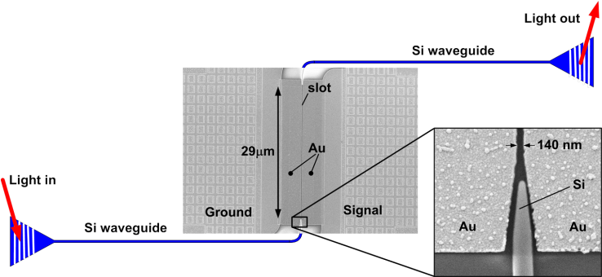
Task 3.4 Fabrication of the Modulator
Phase Modulator
Passive silicon-on-insulator (SOI) wafer processing
E-beam lithography for defining 140 nm wide slot in gold
Coating with an electro-optic polymer
Poling of electro-optic polymer with static electric field
Reported in MS11
A. Melikyan et al., "High-speed plasmonic phase modulators," Nature Photon. 8(2), 229–233 (2014).

Slide 19
Task 3.4 Fabrication of the Modulator
Phase Modulator
r₃₃ ≈ 21 pm / V
V_{π}×L = 1.3 Vmm
V_{m} = 0.1 V
V_{m} = 0.8 V
65 GHz RF bandwidth (λ_{c} = 1.55μm)
Broadband optical operation across 120nm (f_{m} = 45GHz)
A. Melikyan et al., "High-speed plasmonic phase modulators," Nature Photon. 8(2), 229–233 (2014).

Slide 20
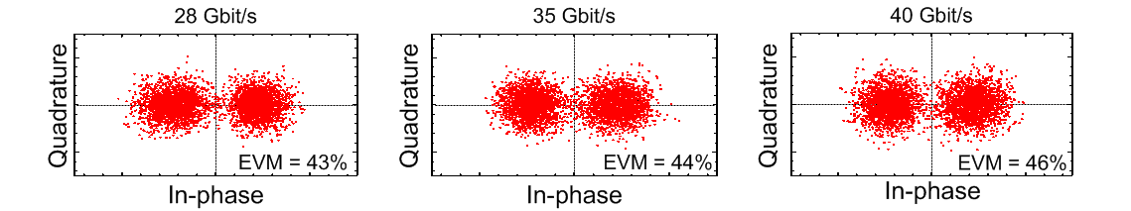
Task 3.4 Fabrication of the Modulator
Phase Modulator
A. Melikyan et al., "High-speed plasmonic phase modulators," Nature Photon. 8(2), 229–233 (2014).

Slide 21
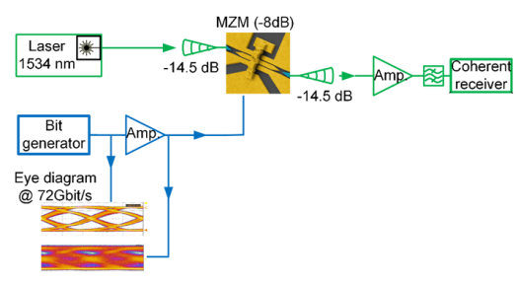
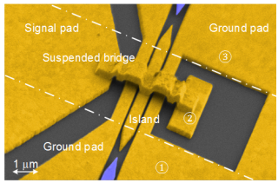
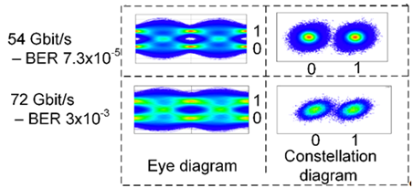
Task 3.4 Fabrication of the Modulator
All-Plasmonic MZM Modulator
Length 10 µm
Voltage-length poduct 60 Vµm
Energy consumption 25 fJ/bit
Insertion loss 8 ±1 dB
C. Haffner et al., “All-plasmonic Mach-Zehnder modulator enabling optical high-speed communication at the microscale”, Nature Photonics 9, 525 – 528 (2015)

Slide 22
Task 3.4 Fabrication of the Modulator
All-Plasmonic IQ Modulator
Unique footprint of an IQ Modulator: 750μm²
Haffner, et al., in Optical Communication (ECOC), 2015 European Conference on(2015).

Slide 23
Task 3.4 Fabrication of the Modulator
All-Plasmonic IQ Modulator
1st Gen. – QPSK – 120 Gbit/s – 143 fJ/Bit
– 16QAM – 60 Gbit/s – 27 fJ/Bit
2nd Gen. – QPSK – 72 Gbit/s – 78 fJ/Bit
IL 21.5 dB
IL 13.5dB
Haffner, et al., in Optical Communication (ECOC), 2015 European Conference on(2015).
Notes:
Bias applied
QPSK – 72 GBd – BER 7.5x10⁻³ 15um/40nm
16QAM -18 GBd –BER 1.3x10^{-2 15um/85nm}
BER 1.3x10^{-5 11um/85nm}

Slide 24
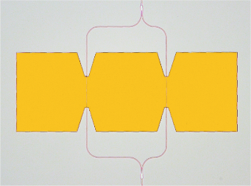
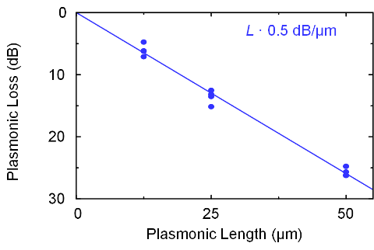
Task 3.4 Fabrication of the Modulator
MZM Modulator
Modulated out
Si
Au
ϑ
-ϑ
G
S
G
100 µm
CW in
W. Heni, et al., J. Lightwave Technol., in press (2015).
Melikyan et al., ,Optics Express, Vol. 23, Issue 8, pp. 9938-9946 (2015)).
Notes:
Ground-signal-ground configuration. Phase shift ϑ in two arms in opposite direction → push-pull
V_piL (Wolfgang): 90Vµm, Vpi=3.4 V, r33=160 pm/V

Slide 25
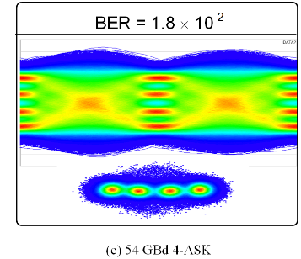
Task 3.4 Fabrication of the Modulator
MZM Modulator
Modulated out
108 Gbit/s 4-PAM
Si
Au
ϑ
-ϑ
G
S
G
100 µm
CW in
W. Heni, et al., J. Lightwave Technol., in press (2015).
Melikyan et al., ,Optics Express, Vol. 23, Issue 8, pp. 9938-9946 (2015)).
Notes:
Ground-signal-ground configuration. Phase shift ϑ in two arms in opposite direction → push-pull
V_piL (Wolfgang): 90Vµm, Vpi=3.4 V, r33=160 pm/V

Slide 26
Summary and Outlook (Modulator)
  Summary
    Different plasmonic phase and Mach-Zehnder modulators have been successfully demonstrated
Bandwidth > 65 GHz
Broadband optical operation: Δλ > 120 nm
Data transmission up to 72 Gbit/s
  Application areas
    Short-reach interconnects
    WDM backbone (WDM + QAM formats + high symbol rates)

