Slide 1
Work Package 4 Presentation
“Project NAVOLCHI”
JUAN P. MARTÍNEZ PASTOR
Institute of Materials Science, University of Valencia, Spain

Slide 2
Outline
WP4 Position in Project
Objectives
Tasks
Milestones and Deliverables
Status of Work
  Task 4.3. Colloidal QDs for gain
  Task 4.4. QD-based Plasmonic Amplifier
  Task 4.5. QD-based Photodetectors
Summary and Outlook

Slide 3
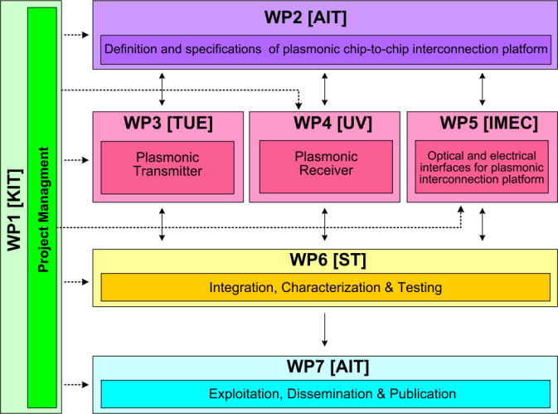




WP4 Position in Project
Contributors:

Slide 4
Tasks
 | Names of the Tasks | Time Period [months]
Task 4.1 | Design and modeling of plasmonic pre-amplifier | 1 – 18
Task 4.2 | Design and modeling of plasmonic photodetector | 1 – 24
Task 4.3 | Colloidal quantum dots with optimized gain and electrical injection scheme | 1 – 18
Task 4.4 | Fabrication and characterization of QD-based plasmonic amplifiers | 6 – 39
Task 4.5 | Fabrication of plasmonic QD based photodetectors | 1 – 45

Slide 5
Objectives
Simulation studies to define/optimize
  Plasmonic amplifier
  Plasmon/Photon detector
Fabrication
  Optical/Electrical pumped plasmonic amplifier
  Electrically driven plasmonic amplifier
  Plasmon/Photon detector
Performance targets
  Plasmonic amplifier: 10 dB on-chip gain
  Detector: Responsivity > 0.1 A/W

Slide 6
Milestones
 | Names of the Milestones | Month | Partner
MS16 | Decision on optimized structures for plasmonic amplifiers | 12 | UVEG
MS17 | Synthesis of nanoparticles with gain at 1550nm | 12 | UGENT
MS18 | Demonstration of conductive QD layers with photoconductive properties | 15 | UVEG
MS19 | Demonstration of metal-(lithographic) polymer and QD metal-(lithographic) polymer nanocompo-sites | 15 | UVEG
MS20 | Demonstration and decision on photodetector operation: nano-gap (MIM) vs. Schottky / heterostructure | 18 | UVEG
MS21 | Electroluminescence from QD stack embedded within conductive oxides (>1µW) | 18 | IMEC
MS22 | Demonstration of plasmonic amplifiers with optical pumping exhibiting 10dB gain | 21 | IMEC
MS23 | Operation of QD based photodetector with responsivity > 0.1 A/W | 24 | UVEG
MS24 | Demonstration of SPP amplifiers with electrical injection exhibiting 10dB/cm gain | 39 | UVEG IMEC

Slide 7
Deliverables
 | Names of the Deliverables | Month | Partner
D4.1 | Designs of plasmonic amplifiers | 18 | UVEG
D4.2 | Report on optical properties of QDs layers and polymer nanocomposites | 18 | UVEG
D4.3 | Designs of plasmonic photodetectors | 24 | UVEG
D4.4 | Report on SPP amplifiers by using QDs | 30 | IMEC
D4.5 | Report on plasmonic photodetectors | 42 | UVEG

Slide 8
Task 4.3 Colloidal QDs with gain …
HgTe colloidal QDs exhibited gain at telecom wavelengths !!
    Gain is still present in thin films of HgTe QDs under relatively low pump fluences, but lifetime decreses to 8/100 ps (biexponential decay), as deduced from bleaching kinetic curves.
    Decreased performance of HgTe QDs in thin film phase is attributed to charge accumulation due to surface traps and clustering of the QDs. MS24

Slide 9
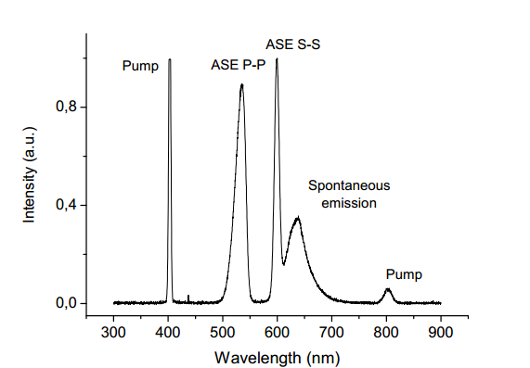
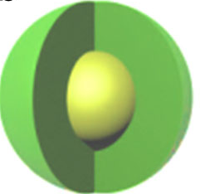
Task 4.3 Colloidal QDs with gain …
Optimum material to be replicated for infrared wavelengths
CdSe/CdS
core-(thick shell)
    Layers based on “Flash” CdSe/CdS core-(thick shell) colloidal QDs exhibits amplified spontaneous emission (ASE), due to improved surface passivation and reduced Auger recombination. MS24

Slide 10
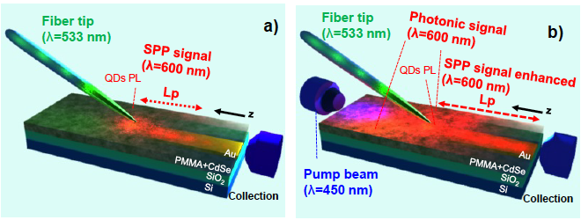
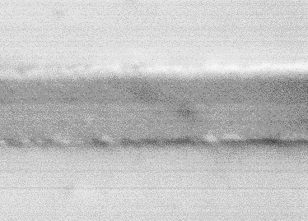
Task 4.4 Fabrication of QD-based PA
Polymer-based concept (optical pumping)
HgTe QDs: 1550 nm
L_{P}
measurement
Fabricated
Metal waveguides
500 nm
We developed a novel method to determine the propagation length (L_{P}) of SPP in fabricated waveguides by using the local excitation of PL from QDs dispersed in the cladding polymer waveguide.
TM modes in linear waveguides + QD(HgTe)/polymer exhibit short-range character with L_{P} increasing by a factor 2 by decreasing the width of the metal waveguide from 1000 to 250 nm.

Slide 11
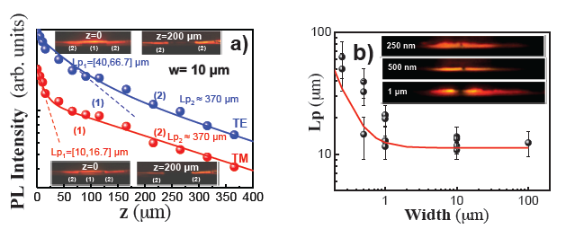
Task 4.4 Fabrication of QD-based PA
Polymer-based concept (optical pumping)
L_{P}
measurement
CdSe QDs: 600 nm
Fabricated
Metal waveguides
500 nm
The outstanding increase of L_{P} by decreasing the width of the metal waveguide is in agreement with calculations (this was demonstrated in more waveguides using CdSe QDs at 600 nm).

Slide 12
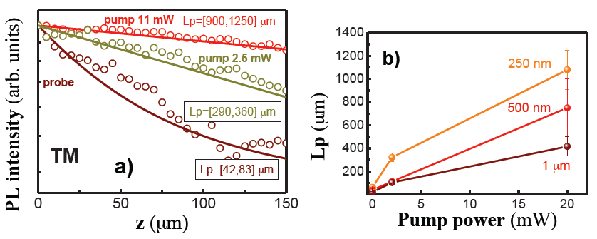
Task 4.4 Fabrication of QD-based PA
Polymer-based concept (optical pumping)
CdSe QDs
CdSe QDs
In optical pumping (end-fire coupling) experiments on polymer-(CdSe QDs) we find that measured L_{P} increases with power (photogenerated carriers) even if ASE was not observed in core-CdSe QDs used here. The enhancement is similar (25-35 times) for the different plasmonic waveguides, equivalent to an amplification of around 30 dB.
Unfortunately, any enhancement was observed after optical pumping of core HgTe QDs.

Slide 13
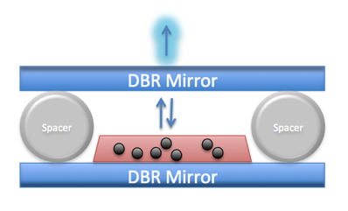
Task 4.4 Fabrication of QD-based PA
Lasing cavity containing HgTe-QD layer
HgTe QDs
Schematic of fabricated DBR (alternating low index silicon nitride (n = 2.1) and high index amorphous silicon (n = 3.3)) feedback on two mirrors to create an optically pumped ‘laser’ by using HgTe QDs.
Coupling of the QD spontaneous emission to one of the cavity modes is observed (cavity spacer of 5 μm).
    MS24

Slide 14
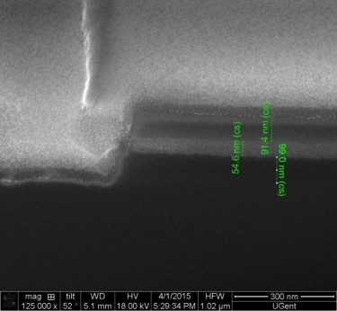
Task 4.4 Fabrication of QD-based PA
SiN-based concept (optical pumping)
Microdisk with bus waveguide were designed and fabricated by using SiN with a-Si pillar. The CdSe/CdS QDs were sandwiched between SiN layers.
Reasonably high Q values are obtained in all microdisks.
    MS24

Slide 15
Task 4.4 Fabrication of QD-based PA
SiN-based concept (optical pumping)
lasing
SE
ASE
Wavelength (nm)
Thick layers (45-55 nm) of CdSe/CdS QDs can be sandwiched between SiN layers.
    Lasing effect is observed in microdisks !! MS24

Slide 16
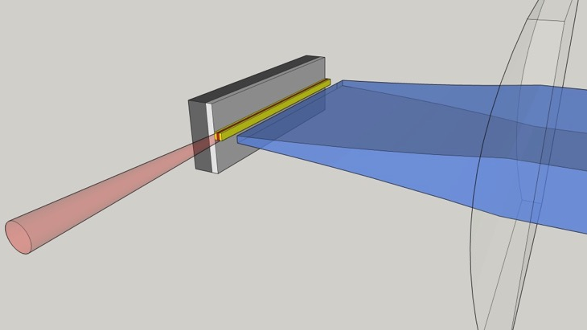
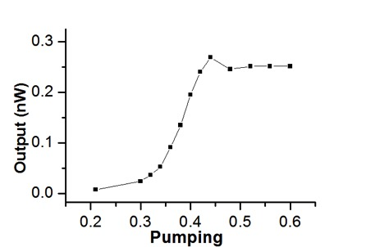
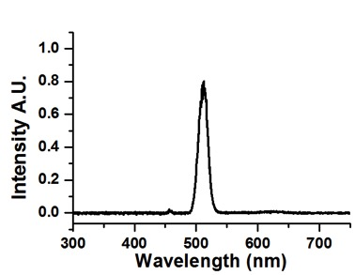
Task 4.4 Fabrication of QD-based PA
SiN-based concept (optical pumping)
(mW)
In SiN linear waveguides with sandwiched QD-layer the excitation power dependence shows a clear non-linear power dependence of the ASE!! MS24

Slide 17
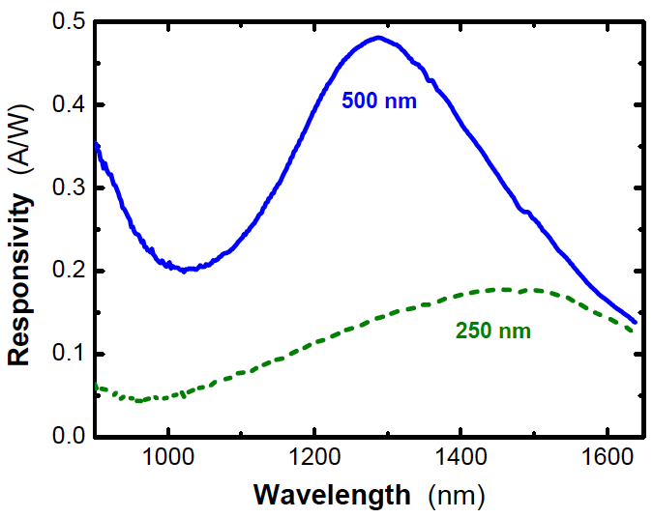
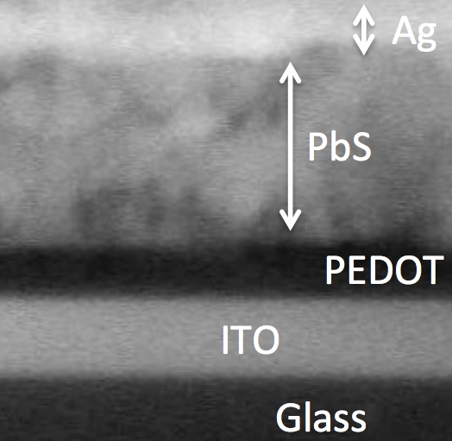
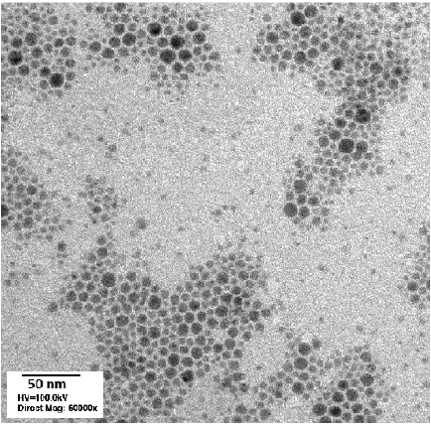
Task 4.5 Fabrication of Photodetector
Schottky Photodiodes R > 0.2 A/W at 1.55 μm R > 0.4 A/W at 1.31 μm
Ag₂Se
QD solid
    Reproducible devices with high responsivity, but slow time response.
    Curing and aging studied by XPS to correlate with electro-optical results.
    Synthesis and films of n and p doped ZnO nanoparticles were produced for solution processing electrodes.
    Synthesis of lead-free Ag₂Se QDs and fabrication of photoconductor detectors: bettter results than in literature. D4.5

Slide 18
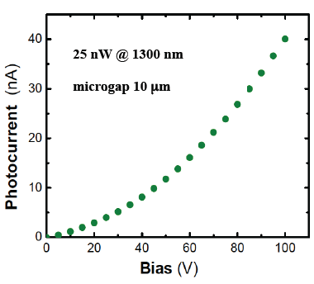
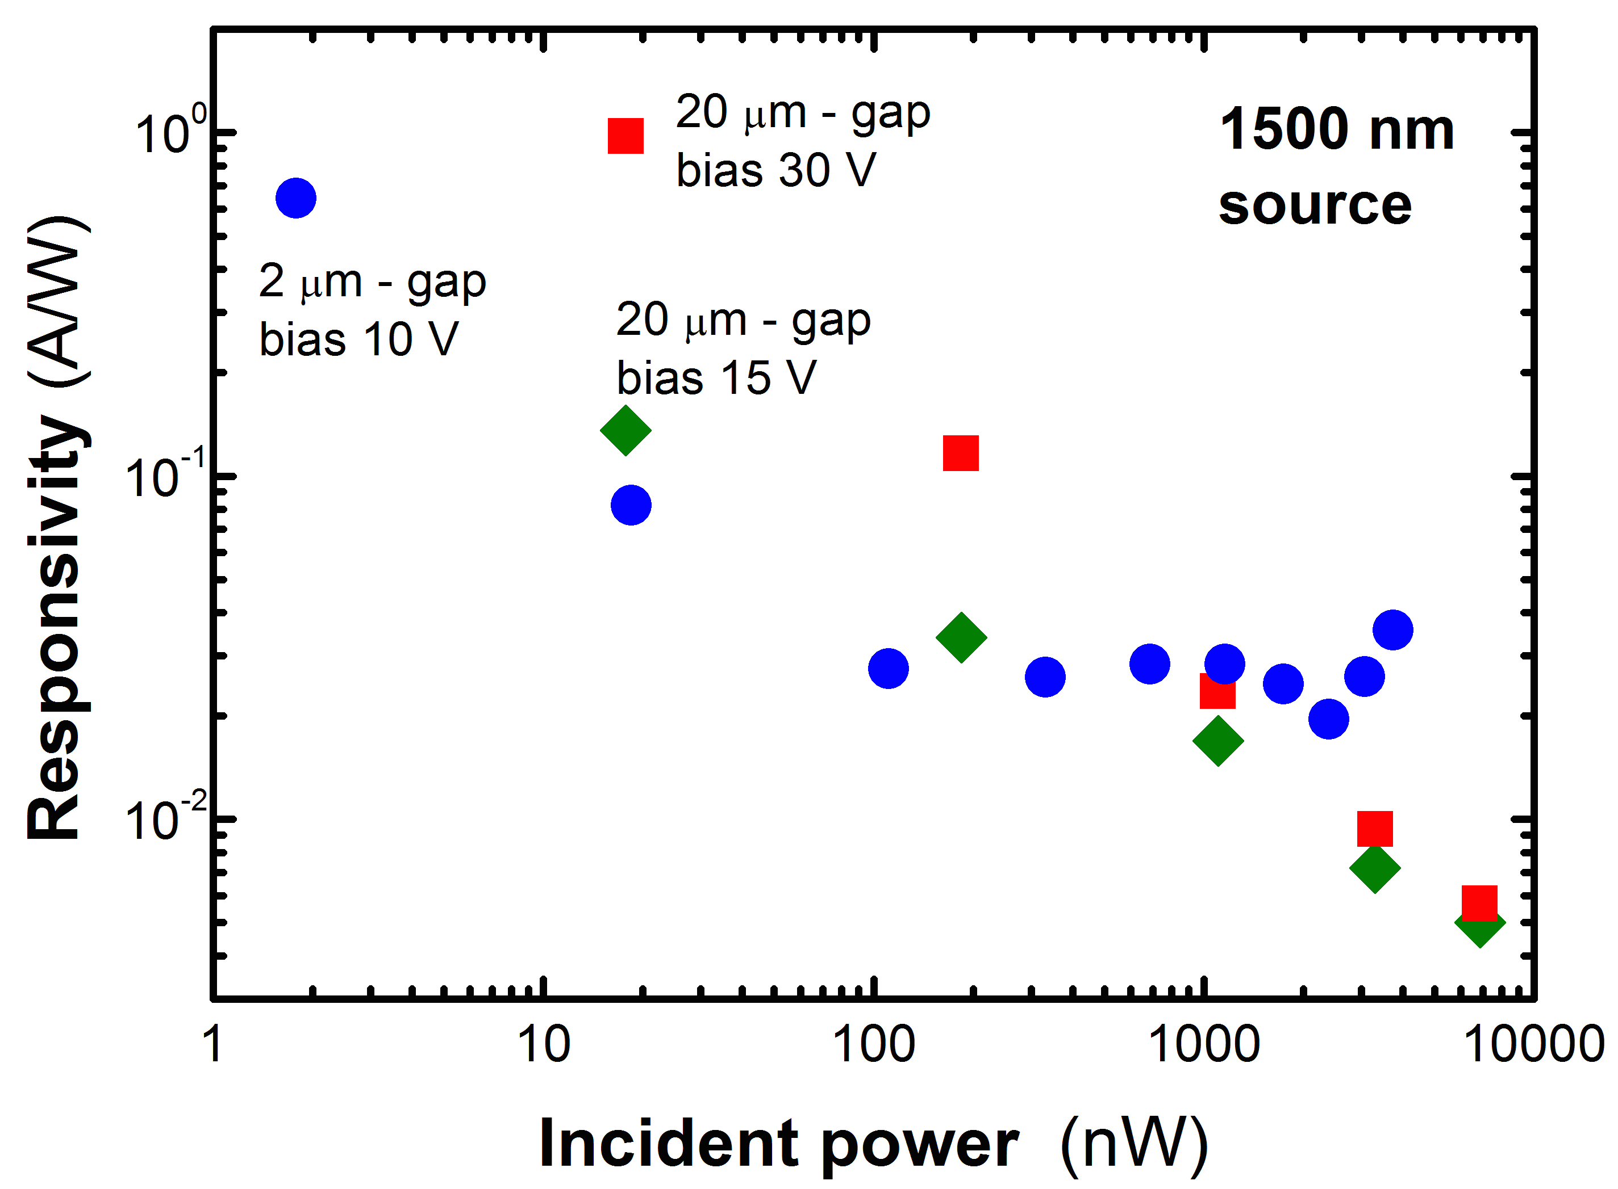
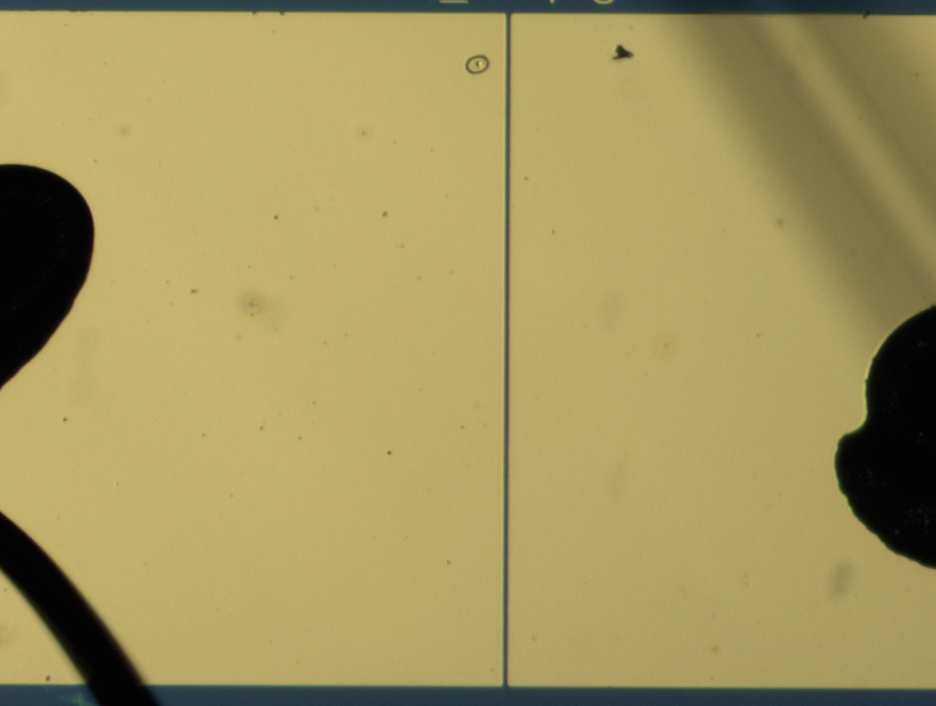
Task 4.5 Fabrication of Photodetector
Micro-gap photoconductor R ≈ 1 A/W @ 1.55 μm
R > 0.1 A/W
R > 1 A/W
R > 0.1 A/W
Microgap photoconductors were fabricated with reproducible electro-optical data after encapsulation: responsivities higher than 0.1 A/W at 1.3/1.5 μm under reasonably low bias voltage (depending on gap distance), but R decreases with incident power, contrary to the case of photodiodes.
D4.5

Slide 19
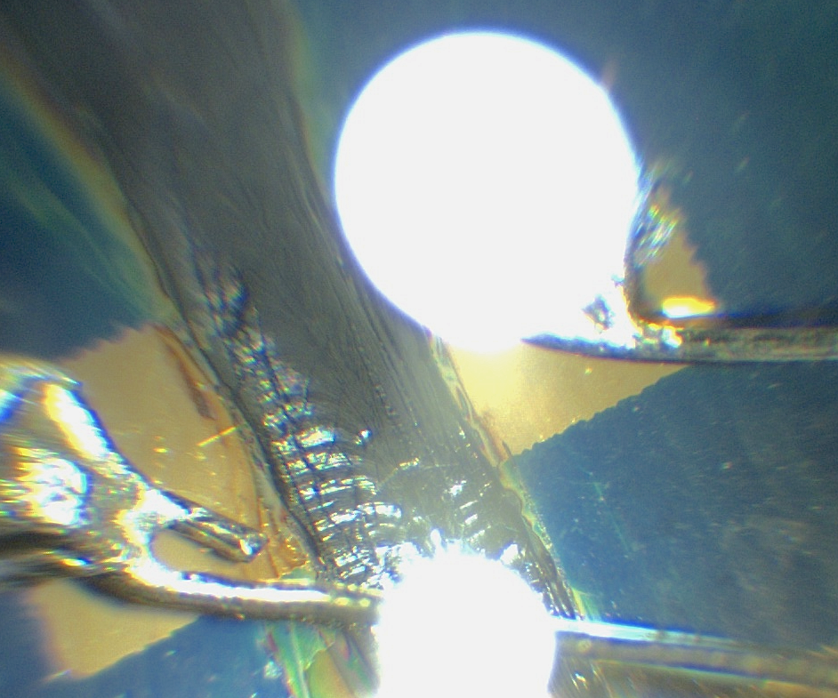

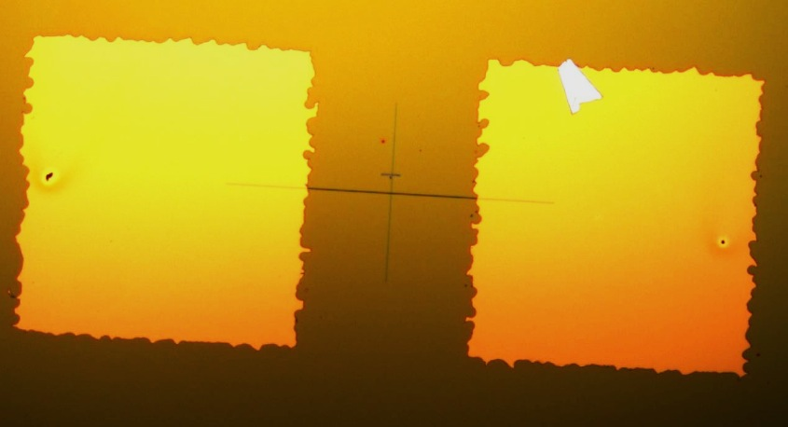
Task 4.5 Fabrication of Photodetector
Nano-gap fabricated on Si/SiO₂
Nanogap devices were fabricated on Si/SiO₂, but Al 2 μm-wide electrodes exhibited cracks in more than 80 % of devices. Previous functionalization of the surface was made to assure QD stacking in the nanogap.
D4.5

Slide 20
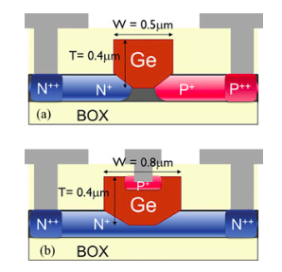
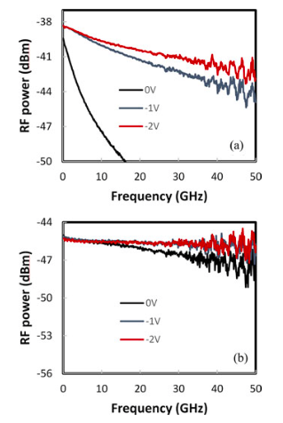
Task 4.5 Fabrication of Photodetector
Ge-detector arrays as contingency plan for demonstrator
Two designs evaluated – Grating coupler pitch matched to demonstrator
Lateral PIN
(medium BW, R=0.9A/W)
Vertical PIN
(high BW, R=0.5A/W)
Selected for demonstrator

Slide 21
Summary
Amplification/lasing devices based on QDs:
Identified material with gain at 1.55 μm: HgTe QDs. In thin film phase still showed gain but with reduced performance that was attributed to clustering of QDs.
CdSe/CdS (thick shell) QDs is a new engineered base material for gain even in solid state. With these QDs lasing and amplification was demonstrated when embedded in SiN microdisk resonators and waveguides, respectively.
The propagation length of short-range SPP increases notably by the decreasing the width of the metal waveguide in agreement with calculations, both at visible (CdSe QDs) and infrared (HgTe QDs) wavelengths. Only CdSe demonstrated an increase of L_{P} under pumping.
Photodetector:
Optimized solution processing technology for the reproducible fabrication of PbS-QD Schottky photodetectors with responsivities > 0.2 A/W @ 1.55 μm.
Reproducible fabrication of μgap (2-20 μm) photoconductors after encapsulation with R ≈ 1 A/W at 1.5 μm (at the lowest measured incident powers).
Nanogap structures were fabricated on a Si/SiO₂ substrate (under investigation).
See WP7 for papers, conferences, PhD-Master thesis related to this workpackage.

Slide 22
Outlook
Amplification/lasing devices based on QDs:
HgTe QDs could be functionalized to disperse in other polymers. To form solid thin films core-(thick shell) or similar engineered QD structures could be developed in next future.
We have demonstrated that MA-PbX₃ lead halide perovskites (HPVK) exhibit ASE using HPVK-PMMA waveguides. In planar plasmonic structures we continue to observe ASE. HPVK-QD hybrid materials can be another possibility for gain materials (QDs for wavelength conversion) and emitting devices at infrared wavelengths.
Photodetector:
Al-processing improvement and deposition control of PbS QDs on nanogap devices.
Monodisperse synthesis of Ag₂Se QDs for lead-free infrared photodetectors.

Slide 23
Outlook: HPVK-QDs
Polymer-based concept (optical pumping) incorporating HPVK gain material
λ_{ASE} ≈ 780 nm
MA-PbX₃ lead halide perovskites (HPVK) exhibit ASE using HPVK-PMMA waveguides. In planar plasmonic structures we continue to observe ASE even if losses are still high for having net gain along 1 mm long waveguides.

Slide 24
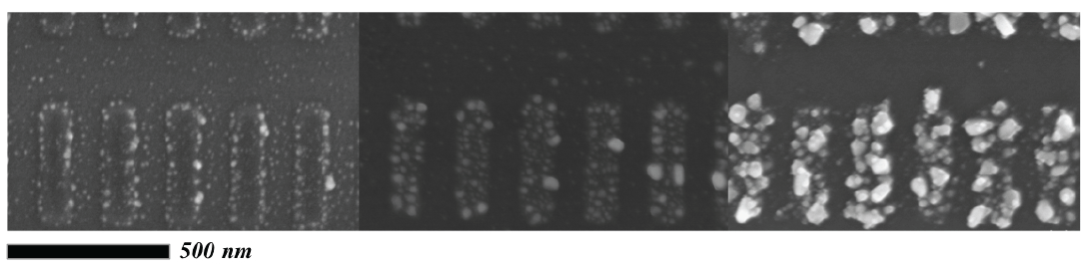
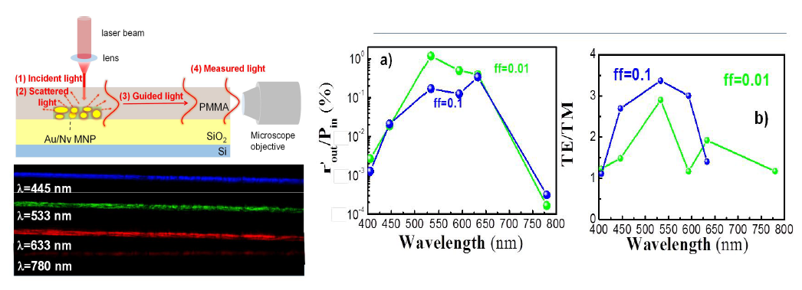
OTHER APPLICATIONS
Ag Nanorods for sensing
Au-nanoparticles for Optical coupling into waveguides
    We explored several applications with our patternable metal-polymer nanocomposite (patented):
    Metal nanorods for SERS-sensing.
    Optical coupling of normal incident light into polymer waveguides. D4.5

