Slide 1
Work Package 5 Presentation
“Project NAVOLCHI”
Dries Van Thourhout
imec, Belgium

Slide 2
Outline
WP5 Position in Project
Objectives
Tasks
Milestones and Deliverables
Status of Work
Task 5.2: Beamshapers
Summary and Outlook

Slide 3
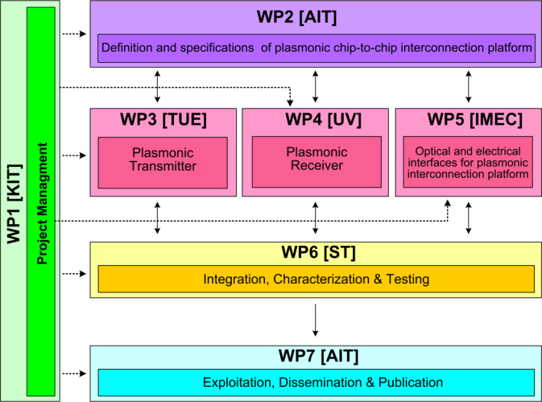
WPX Position in Project
Contributors:

Slide 4
Objectives
Overall Objective :
Specific Objectives:
Coupling light between silicon backbone and plasmonic devices
Beam Shaping grating couplers to direct light between chips
Compact filters for noise suppression
Specify and implement Dual Die Communication Module (DDCM)
Design and implement optical and electrical interfaces for plasmonic interconnect

Slide 5
Tasks
 | Names of the Tasks | Time Period [months]
Task 5.1 | Modeling and fabrication of coupling Si waveguide to plasmonic waveguide | 1 – 15
Task 5.2 | Design and fabrication of Si beamshaper | 1 – 30
Task 5.3 | Design and fabrication of passive ultra-compact components as filters | 1 – 15
Task 5.4 | Signal generation module design | 4 – 12
Task 5.5 | Signal Generation Module implementation via FPGA | 13 – 24
Completed & Reported month 36
Completed & Reported month 36
Completed & Reported month 36
Completed & Reported month 36

Slide 6
Milestones
 | Names of the Milestones | Month | Partner
MS25 | Decision on optimized plasmonic waveguide couplers | 6 | KIT
MS26 | Fabrication of plasmonic waveguide couplers with less than 3 dB coupling loss | 12 | KIT
MS27 | Design of first generation beam shapers and compact optical filters | 12 | IMEC
MS28 | DDCM with electrical PHY design and verification | 12 | ST
MS29 | Data codecs for power consumption reduction | 15 | ST
MS30 | Decision on plasmonic waveguide couplers with less than 3 dB coupling loss | 15 | KIT
MS32 | Fabrication of compact optical filters and first generation beam shapers | 18 | IMEC
MS33 | Data codecs for error detection and correction | 18 | ST

Slide 7
Milestones
 | Names of the Milestones | Month | Partner
MS33 | Design of second generation beam shapers | 24 | imec
MS34 | Generic DDCM compatible with plasmonic-based PHY | 24 | ST
MS35 | Fabrication of second generation beam shapers | 39 | imec
MS36 | DDCM evolution for NiP solutions | 39 | ST

Slide 8
Deliverables
 | Names of the Milestones | Month | Partner
D5.1 | DDCM specification document | 6 | ST
D5.2 | DDCM with electrical PHY design and verification data base | 12 | ST
D5.3 | Compact optical filters (2nm bandwidth, >30nm FSR) and first generation beam shapers | 21 | imec
D5.4 | Generic DDCM compatible with plasmonic-based PHY specification document | 24 | ST
D5.5 | Report on plasmonic waveguide couplers | 24 | imec
D5.6 | Generic DDCM compatible with plasmonic-based PHY design and verification data base | 39 | st
D5.7 | Second generation beam shapers (distance 1mm, with bandwidth > 10nm and efficiency > 3dB) | 39 | imec

Slide 9
Task 5.2 – Optical Beam Steerers
Original idea for demonstrator:
Vertical coupling between chips
Need for free space beam couplers
Design reveals this approach is limited in density
Updated demonstrator:
Coupling with high-density multi-core fiber (MFC)
Remaining person power devoted to innovative grating couplers
Metal grating coupler for InP-membrane platform
Coupler for SiN-QD platform

Slide 10
Task 5.2: Coupling through MCF
Evaluation coupling & XT performance
Chiral Photonics (PROFA)
4 out of 19 channels with 50 µm pitch
Crosstalk measured to be below -31 dB
Allows for optical amplifier between transmitter and receiver
Scalable to very high bandwidth density

Slide 11
Task 5.2 – Optical Beam Steerers
a) Standard grating
optimum
b) Focussing grating
optimum

Slide 12
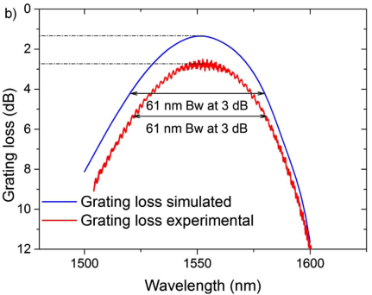
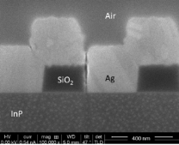
Metal grating coupler
Metal grating coupler ^{[1,2]}
Efficiency: 54%
Performance independent from buffer thickness
Enables high yield (thick) bonding
Reduce optical parasitics into buffer/substrate
Reported in MS51
[1] V. Dolores-Calzadilla, et. al., Optics Letters 39(9), 2014.
[2] A. Higuera-Rodriguez, et. al., Optics Letters 40(12), 2015.

Slide 13
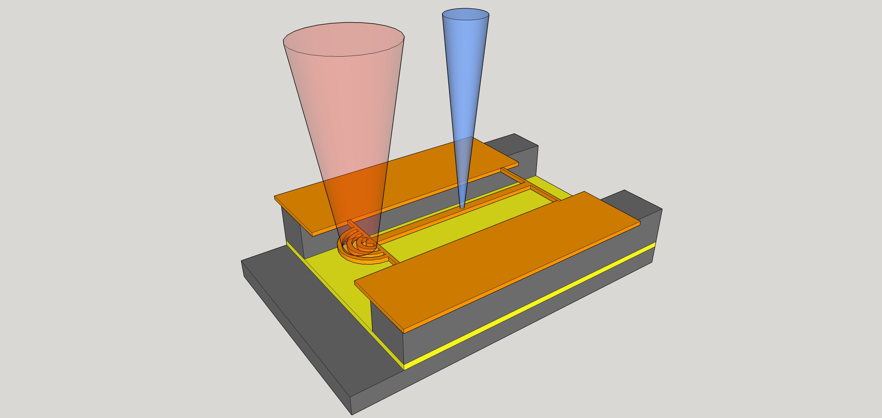
SiN-QD Grating Couplers: Concept
Aim: develop grating coupler to couple light from SiN-QD platform
From micro-sources and/or single photon emitters
Pump beam
QD-emission
SiN with QD-embedded

Slide 14
Parameters involved in simulation
Structure definition and parameters:
Grating periodicity (period length and number)
Cladding layer thickness
Grating etching depth; Filling factor;
Reflection layer(gold mirror or distributed bragg reflector(DBR))
Grating period
air
Mode source
Etching depth
SiN_{x}
etched
air
Cladding layer thickness
Gold mirror
Filling factor=1-etched/period
Si substrate
Notes:
To evaluate the performance of grating coupling, we measure the coupling into the fiber, divided by the overall upgoing power.
The period at 0.405μm will achieve high coupling efficiency. the bandwidth is about 25nm.
The step of silica cladding is 0.05μm, the upgoing power will achieve a maximum every 0.2μm.
The coupling efficiency can be achieved 37.3%. The bandwidth is also expand to 40nm

Slide 15
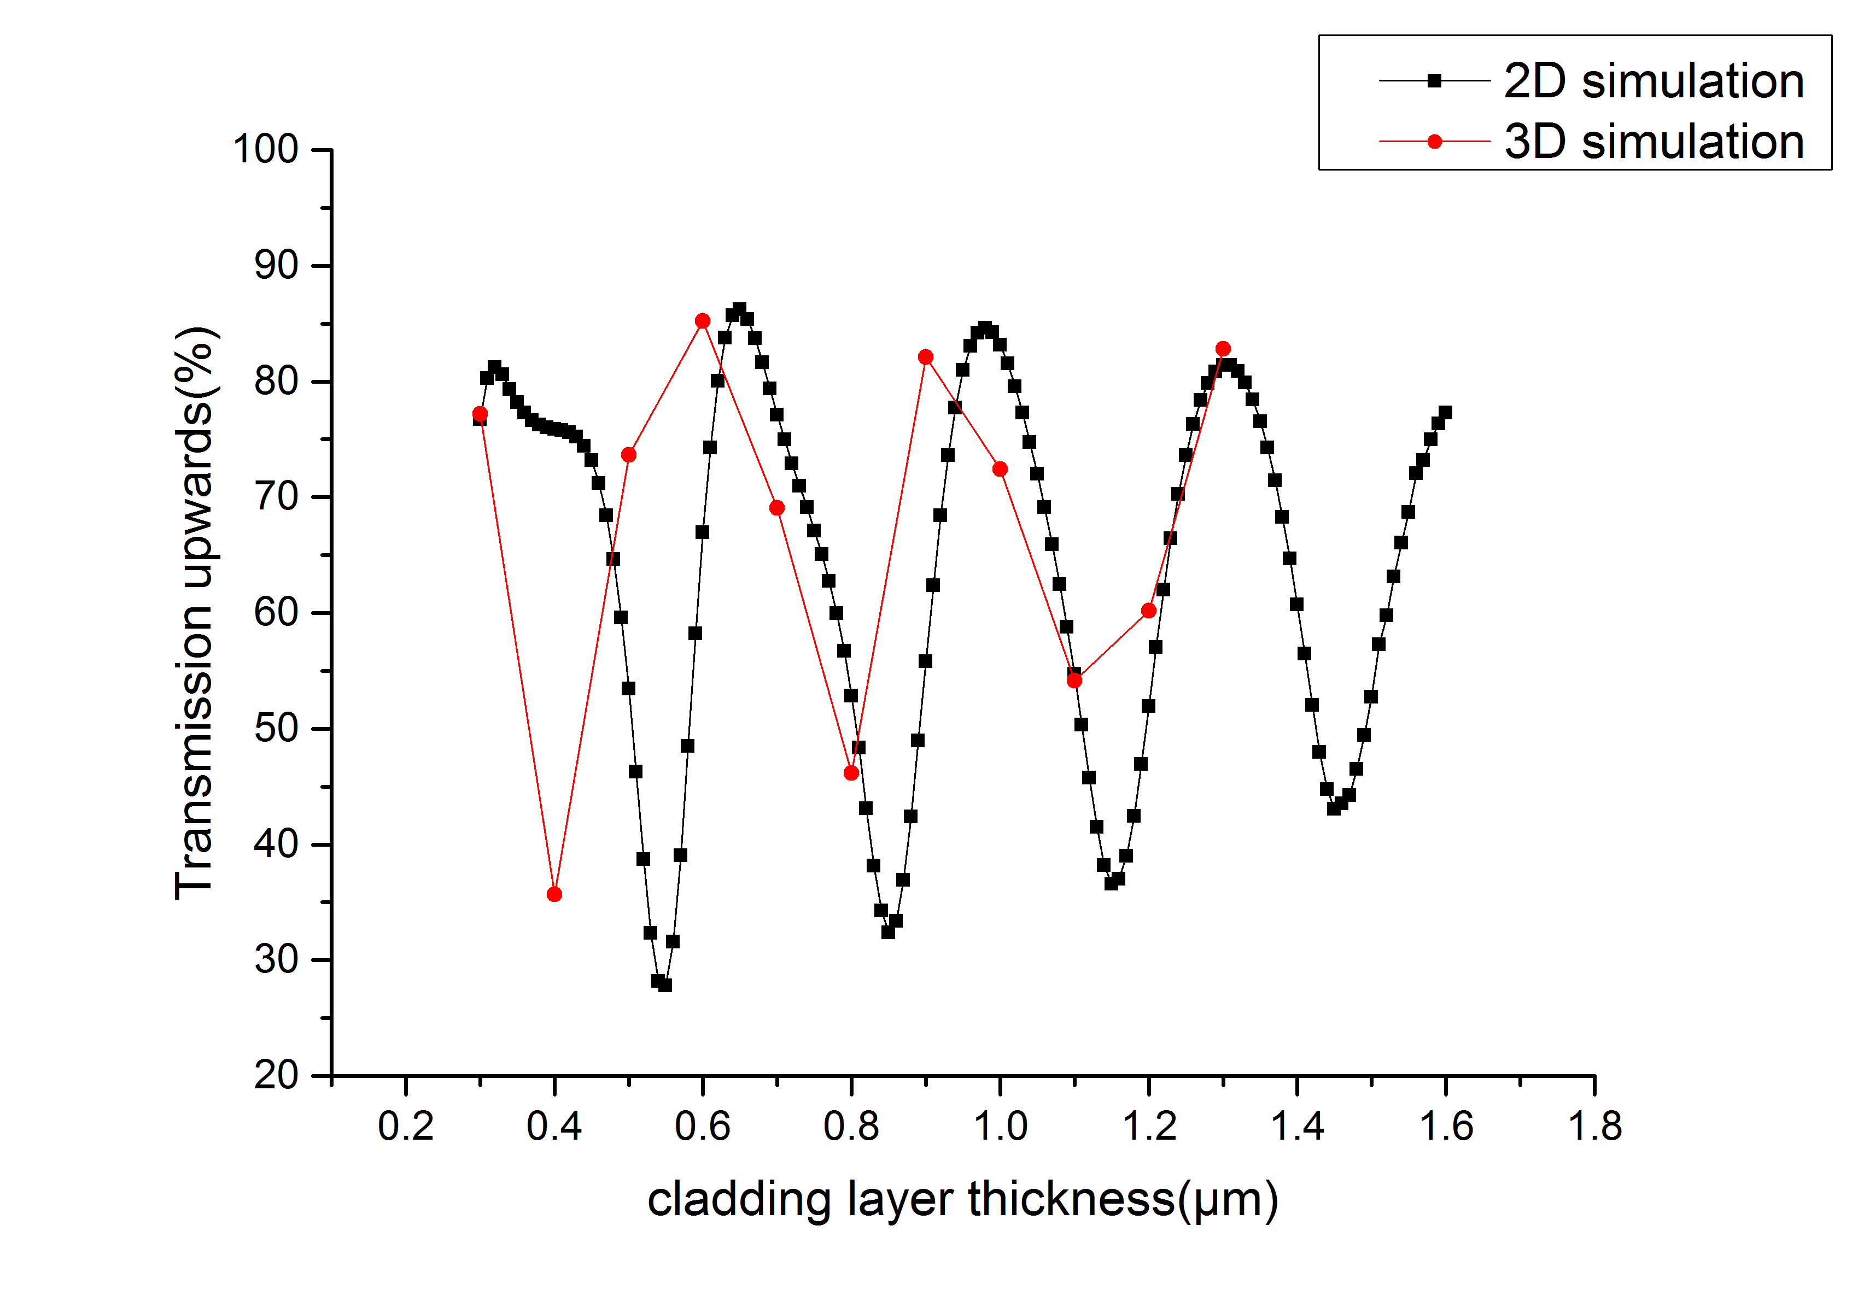
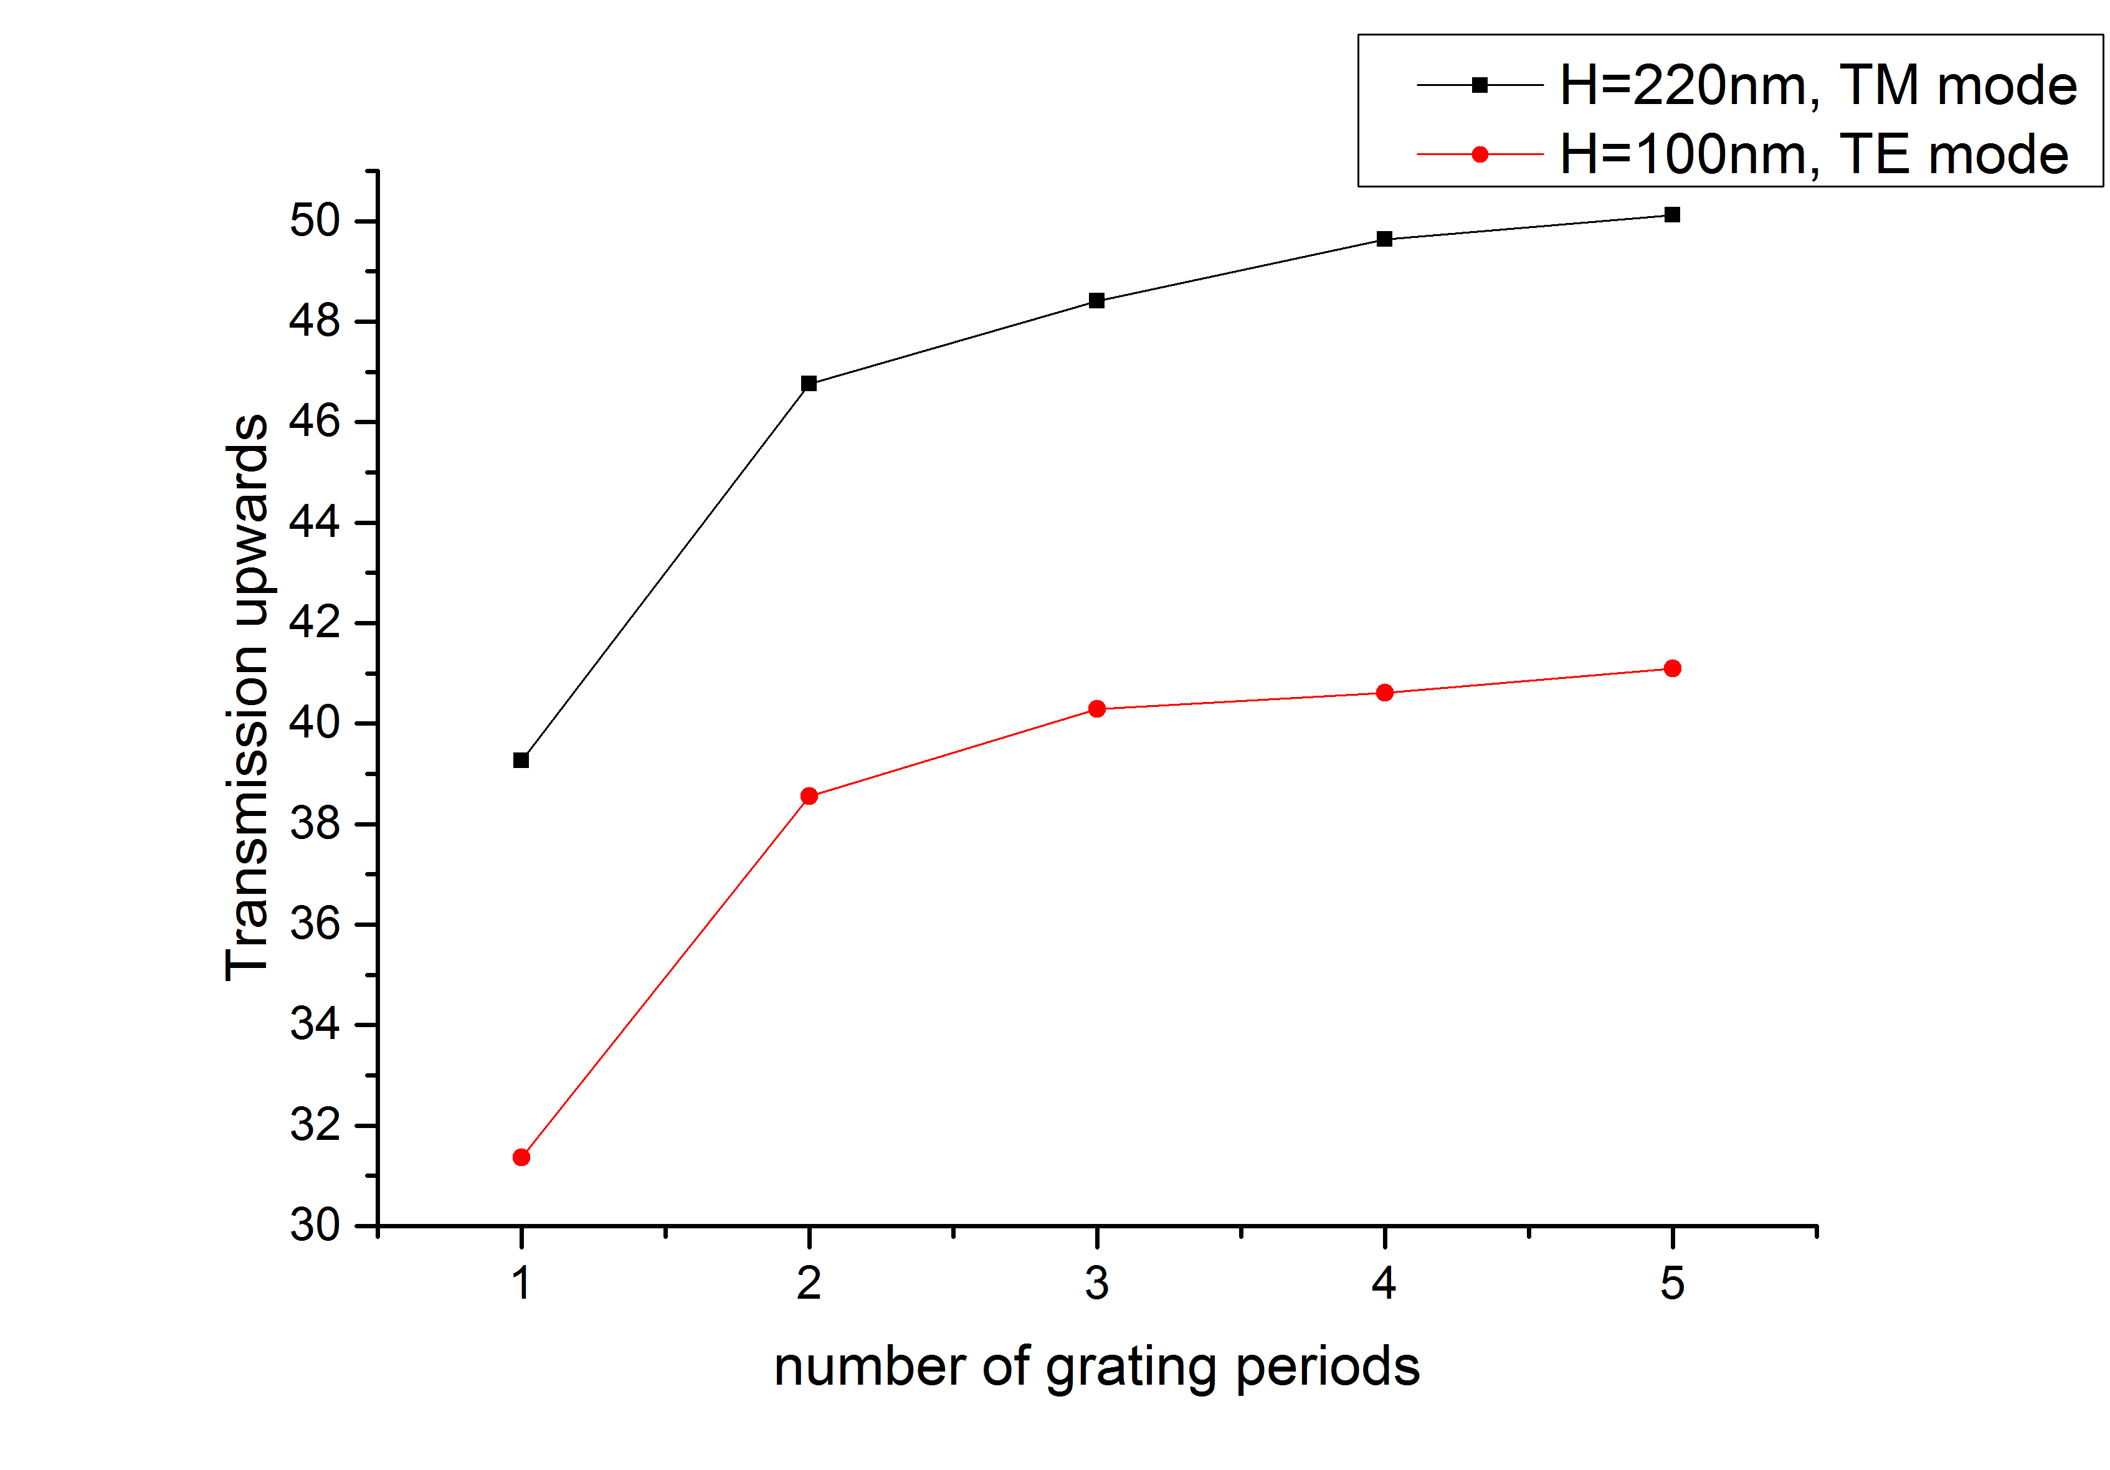
2D&3D Simulation SiN-QD Grating Coupler
Influence of Grating Height
Number of Periods
Up to 90% efficiency realistic (with bottom mirror)

Slide 16
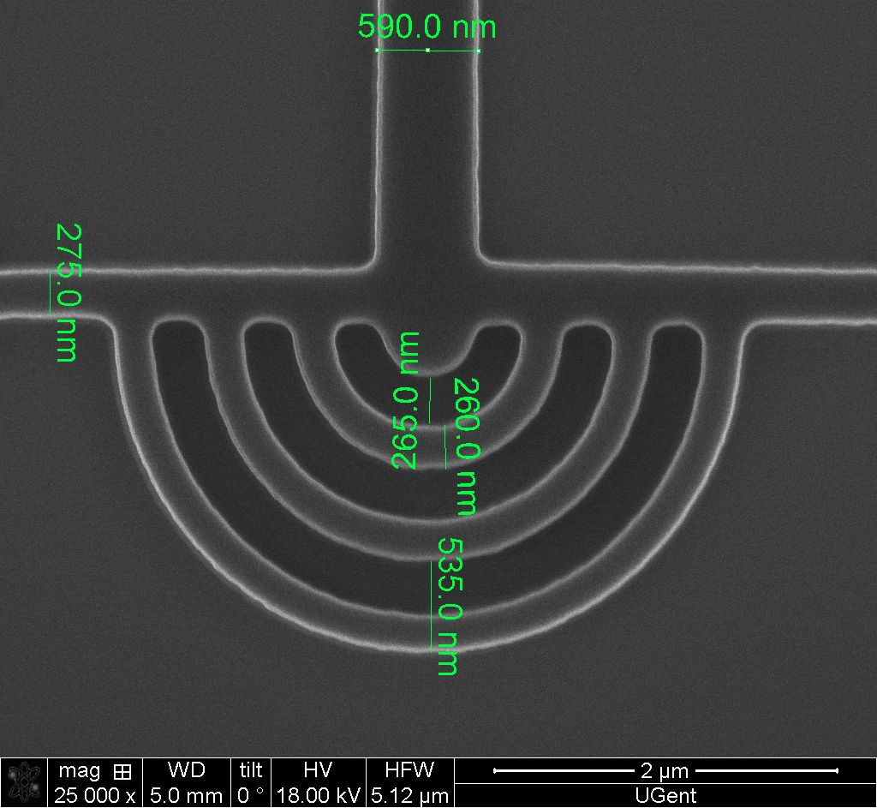
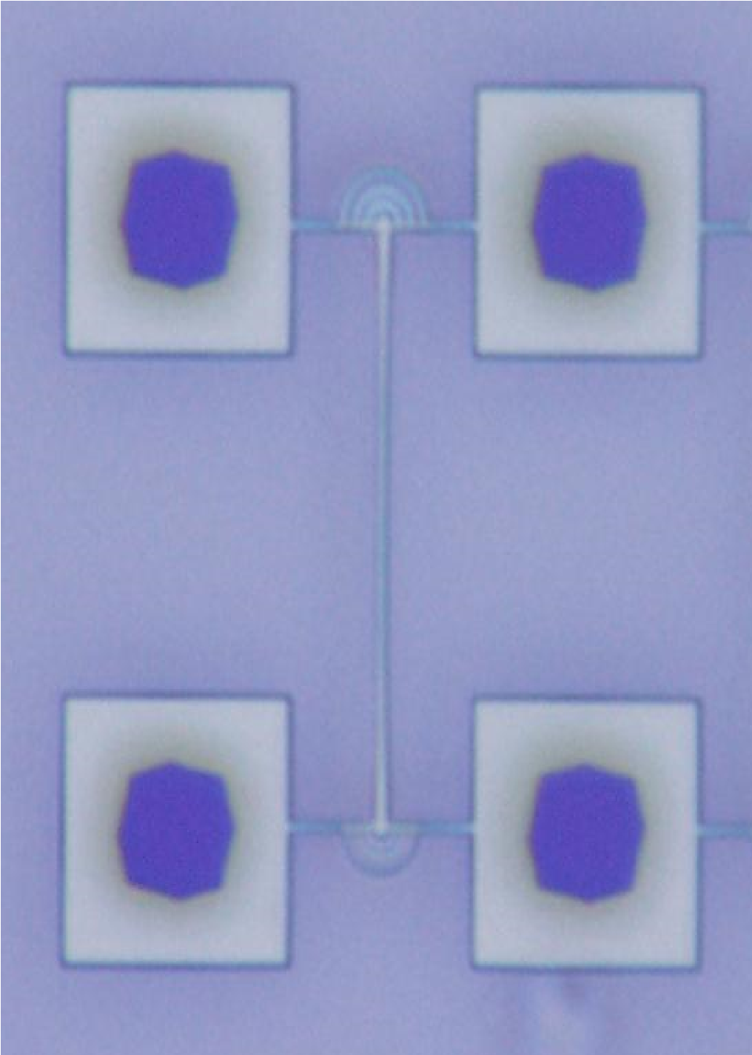
Fabrication
Initial process:
Stiction to surface
After etching
30μm
Optimised process:
No stiction
(tensile strained SiN, CPD)

Slide 17
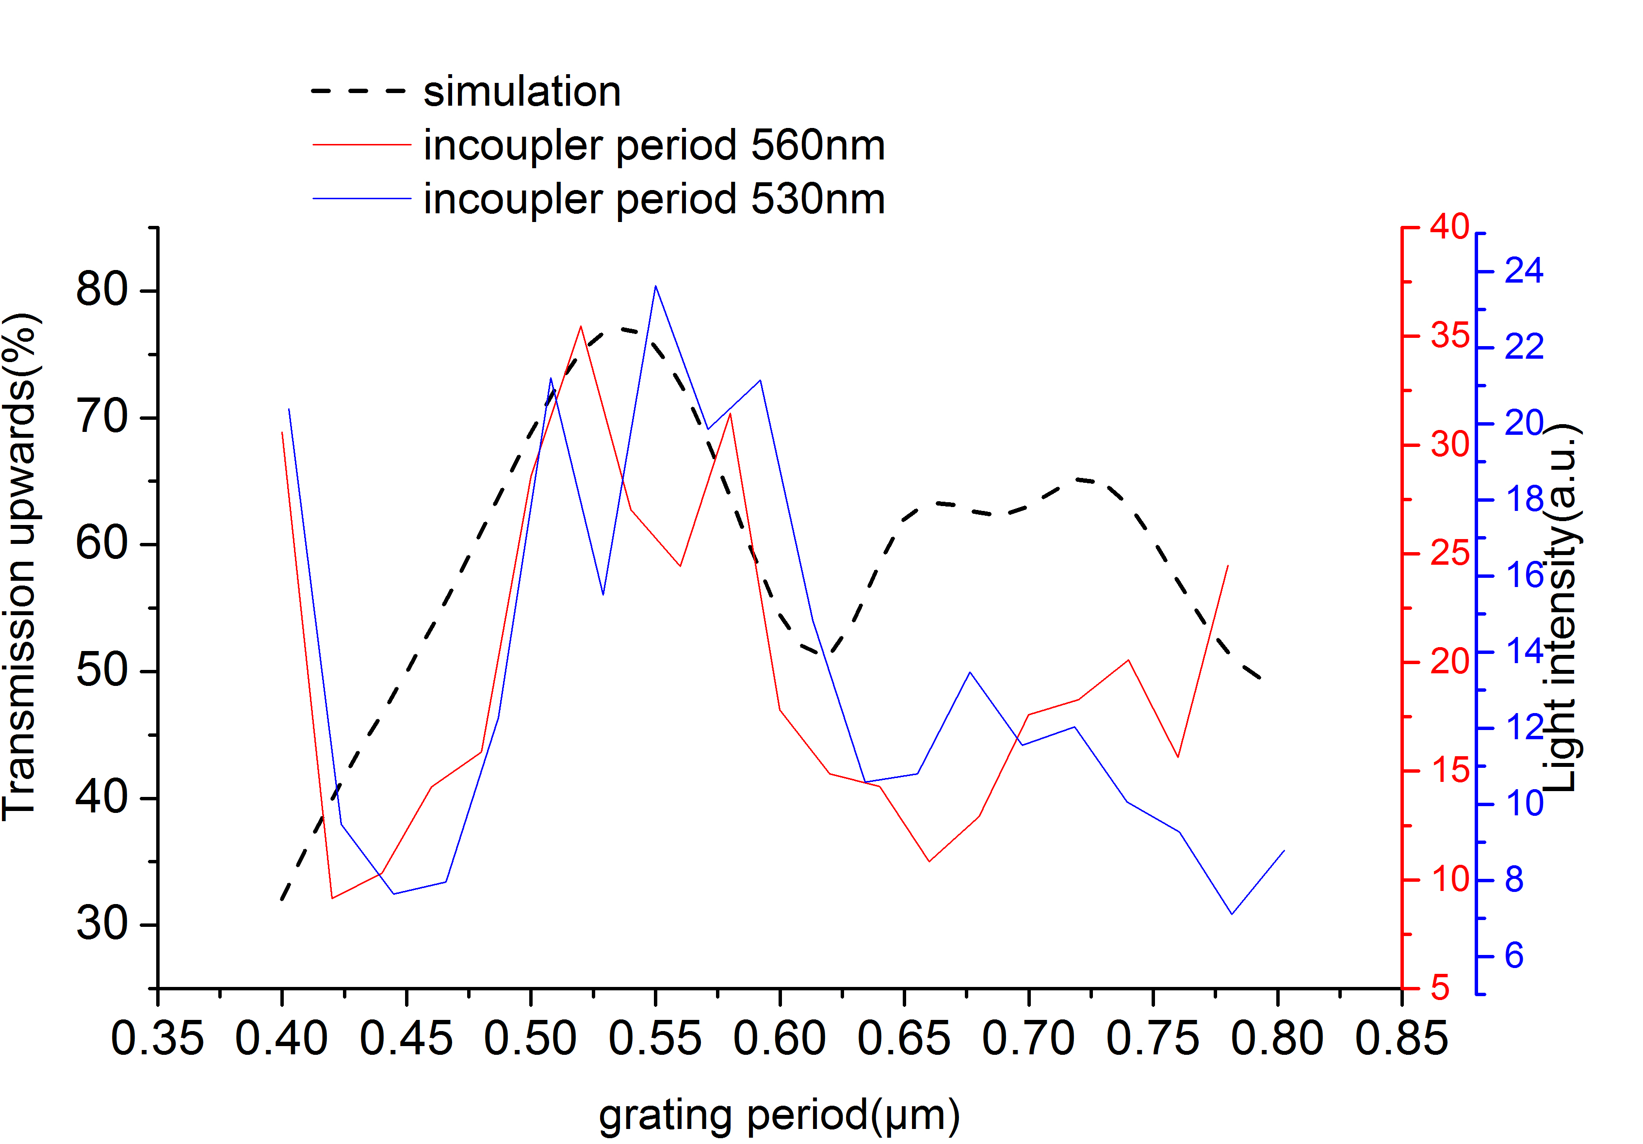
Comparison with simulation
Measurement, compared with optimized simulation
ff=0.5 for simulation,
ff=0.6 for fab.
Notes:
Measurement 5: couple in period 560nm; filling factor(0.6)
Measurement 1: couple in period 530nm; filling factor(0.6)

Slide 18
Summary
All WP5 tasks completed successfully
Efficient couplers silicon waveguide – plasmonic modulators demonstrated (<1dB loss)
Compact filters with controllable properties demonstrated
Electrostatically actuated grating couplers demonstrated
Grating coupler for SiN-QD and InP-membrane platforms demonstrated
Electrical interfaces designed and implemented in STNoC

Slide 19
Outlook & Exploitation
Efficient couplers silicon waveguide to plasmonic modulators demonstrated:
See WP3
Compact filters with controllable properties:
Design know-how transferred to Luceda (IMEC spin off in photonic CAD software)
Electrostatically actuated grating couplers:
Discussion with company on implementing Silicon Photonics MEMS in large-scale switch (on-going)
Grating coupler for SiN-QD platform:
New work towards single photon sources
Metal Grating coupler for InP-membrane platform:
Grating coupler implemented in IMOS-platform

