Slide 1
Work Package 6: Integration, Characterization & Testing
“Project NAVOLCHI”
Claudia Hoessbacher, Juerg Leuthold
ETH Zurich, Switzerland

Slide 2
Outline
WP6 Position in Project
Objectives
Tasks
Milestones and Deliverables
Status of Work
  Task 6.3 Plasmonic chip to chip interconnect prototype testing and evaluation
  Task 6.4 System-in-Package integration and characterization
Summary and Outlook

Slide 3
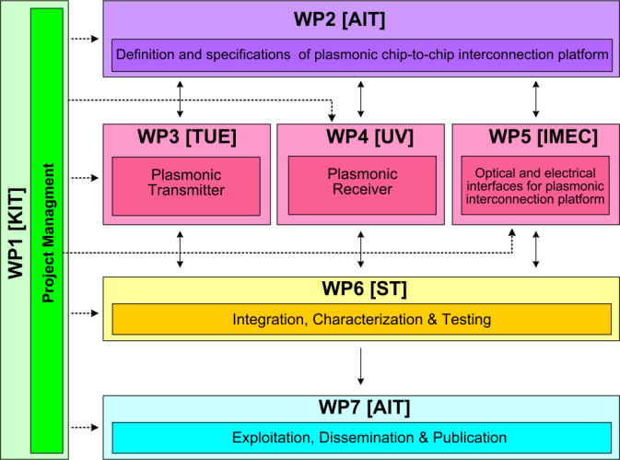







WP6 Position in Project
Contributors:
Notes:
All partners contributed, task 6.1

Slide 4
Objectives
Characterization and testing of active and passive plasmonic devices
Integration of plasmonic devices with the electrical parts the chip-to-chip communication structure is composed of
Characterization and testing of a complete System in Package

Slide 5
Tasks
 | Names of the Tasks | Time Period [months]
Task 6.1 | Characterization of active and passive plasmonic devices | 7 – 33
Task 6.2 | Assembly and packaging of plasmonic devices into System in Package | 30 – 36
Task 6.3 | Plasmonic chip to chip interconnect prototype testing and evaluation | 32 – 45
Task 6.4 | System-in-Package integration and characterization | 22 – 45

Slide 6
Milestones
 | Names of the Milestones | Month | Partner
MS37 | Plasmonic active device characterization results | 12 | KIT
MS38 | Plasmonic passive components characterization results with a 1dB coupling loss | 24 | KIT
MS39 | Concept for system integration developed | 40 | AIT
MS40 | Individual plasmonic devices characteriaztion, testing and evaluation | 39 | TU/e
MS41 | Chip to chip interconnect characterization | 42 | ST → ETH
MS42 | Plasmonic components integration to demonstrate chip-to-chip interconnect | 42 | AIT / ETH
MS43 | Plasmonic chip to chip interconnect prototype testing and evaluation | 45 | ST → ETH
Notes:
All milestones submitted
Note that three MS were shifted to ETH

Slide 7
Deliverables
 | Names of the Deliverables | Month | Partner
D6.1 | Report on characterization results of all plasmonic devices | 27 36 | TU/e
D6.2 | Report on characterization results of all optical interface plasmonic passive components | 27 | KIT
D6.3 | Report on chip to chip interconnect characterization | 45 | ST → ETH
D6.4 | Report on plasmonic chip-to-chip interconnect prototype testing and evaluation | 45 | AIT / ETH
Notes:
shift

Slide 8
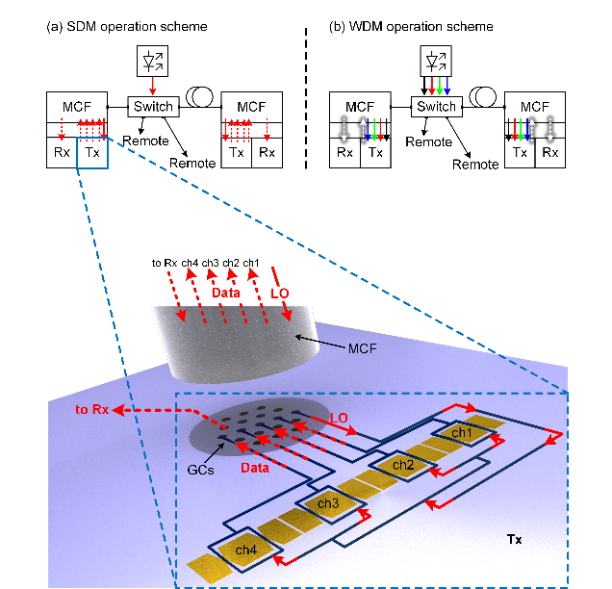
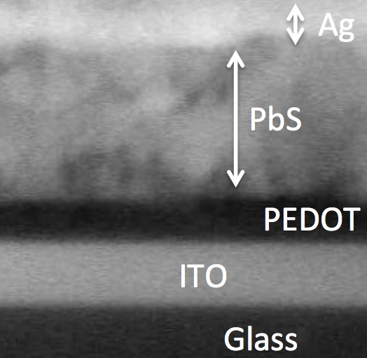
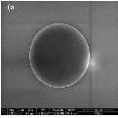
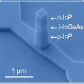
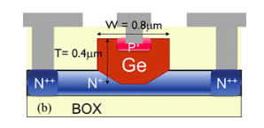

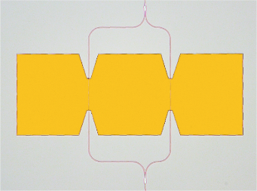
WP6 Vision of Plasmonic Interconnect
WP 4 PD
WP 4 Amplifier
WP 3 LED
WP 4 PD
WP 5 MCF
WP 4 MZM

Slide 9
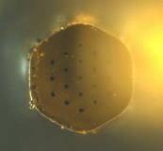
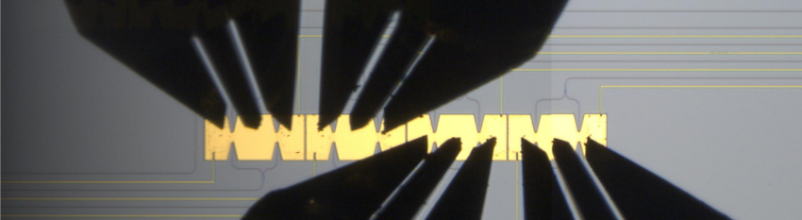
Task 6.3 Chip to chip interconnect prototype testing
Optical channnel spacing
RF probes
MCF
G
S
G
G
S
G
50 µm
Signal-signal spacing
300 µm
300 µm
G
S
G
G
S
G
RF probes
Limited by RF probes → few µm possible when co-integrated with electronics
Notes:
Array of 4 plasmonic MZMs, 12.5 µm long, si mmi, 100nm slot width
300 µm signal-signal spacing (defined by RF probes)
50 µm optical channel spacing → no RF probes → squeeze modulators inbetween those cores
V_piL (Wolfgang): 90Vµm, Vpi=3.4 V, r33=160 pm/V

Slide 10
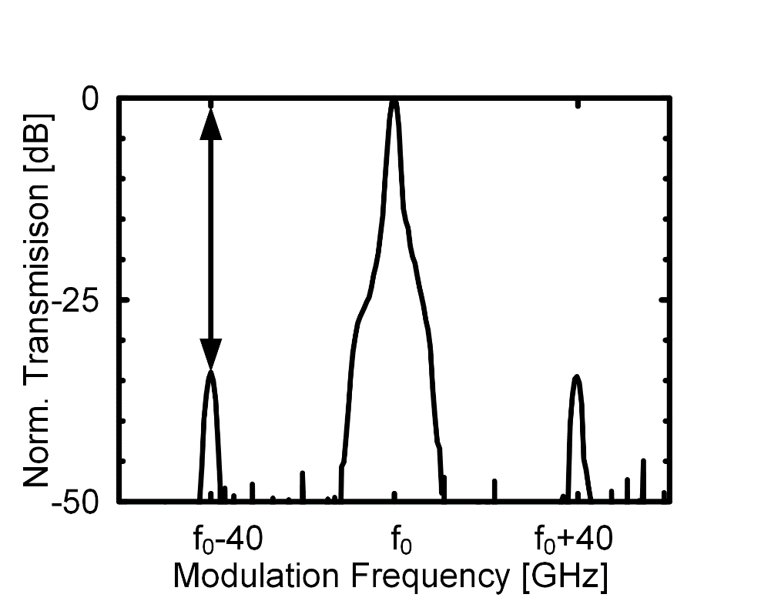
Task 6.3 Chip to chip interconnect prototype testing
Modulation Bandwidth
No bandwidth limitation up to 70 GHz
Notes:
modulation bandwidth: sin RF signal of -3 dBm. ratio between optical carrier and modulation sidebands with an OSA, normalized to 15 GHz. The resolution was limited to 15 GHz by the OSA. no bandwidth limitation up to 70 GHz (limit of measurement setup), 4 channels
Losses: 1 dB/µm, 16 dB IL, GC 13 dB, IL total ~ 40 dB
ER: optical 7…15 dB

Slide 11
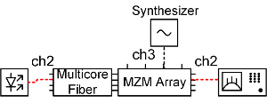


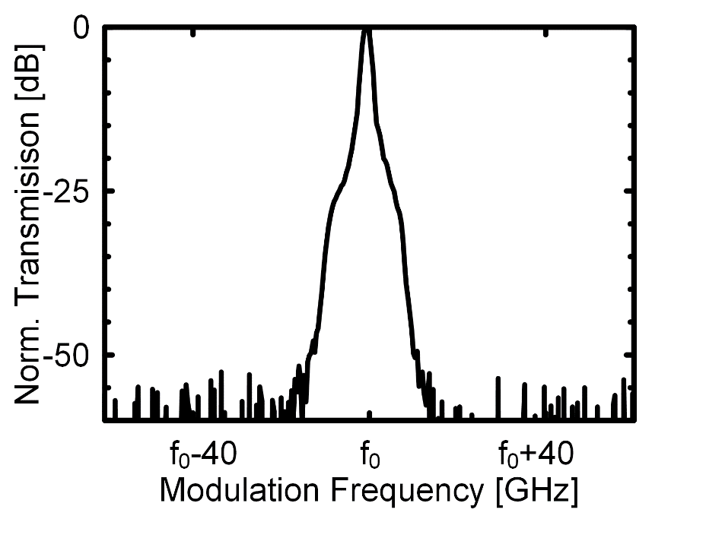
Task 6.3 Chip to chip interconnect prototype testing
Electrical Crosstalk
Optical Crosstalk
<-30 dB
<-31 dB
No sidebands
Notes:
electrical crosstalk: sinusoidal RF signal to channel 3, checking modulation signs in the optical signal of the unmodulated channel 2. <-30 dB. limited by the dynamic range of our experimental setup.
optical crosstalk, 4 different wavelengths through ch1…ch4 of the MCF, coupling to SiWGs without MZMs. spectrum with OSA. better than -31 dB

Slide 12
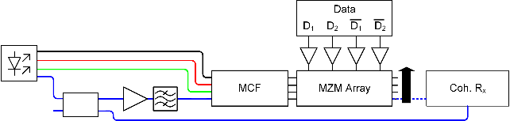
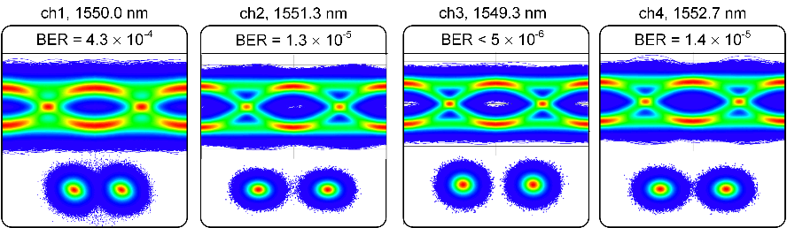
Task 6.3 Chip to chip interconnect prototype testing
Data Modulation Experiments
4 x 36 Gbit/s (BPSK)
Notes:
Experimental setup, Four electrical data streams were fed to the modulators by two independent DACs (72 GSa/s, 6 bit). The channel under test was fed back to a coherent receiver. The laser source of the channel under test was fed back to a coherent receiver.
measured optical eye diagrams and constellation diagrams for all four channels at 36 Gbit/s. All channels have bit error ratios (BERs) below the FEC limit
recoding length 500 µs
De Bruijn bit sequences (DBBS 2^15), dc-balanced PRBS
Input power up to 20 dBm
4 Vpp
Ch3: 20 million bits

Slide 13
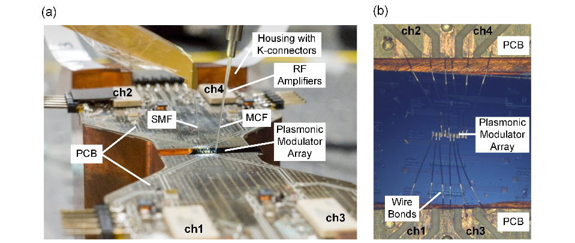
Task 6.4 System-in-Package integration and characterization
Transmitter – Customized Package

Slide 14
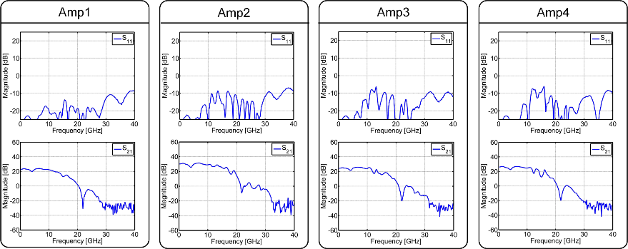
Task 6.4 System-in-Package integration and characterization
Transmitter – RF Amplifiers – S-Paramters

Slide 15
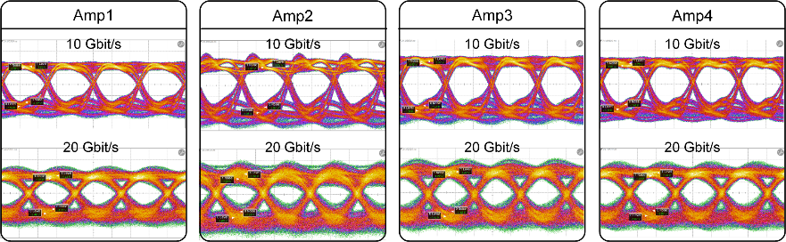
Task 6.4 System-in-Package integration and characterization
Transmitter – RF Amplifiers – Eye Diagrams
Notes:
No modulator yet, measure at output of RF amplifiers with Pico Probe

Slide 16
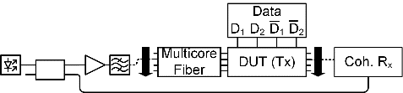
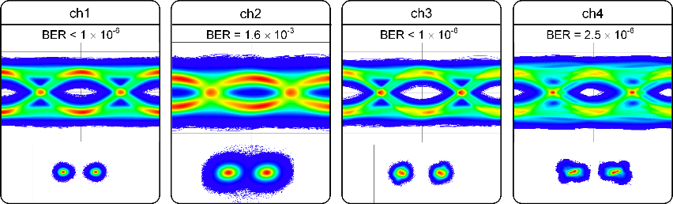
Task 6.4 System-in-Package integration and characterization
Transmitter Characterization – 4 x 10 Gbit/s

Slide 17
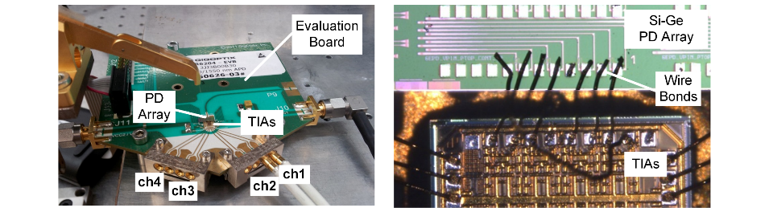
Task 6.4 System-in-Package integration and characterization
Receiver – Evaluation Board

Slide 18
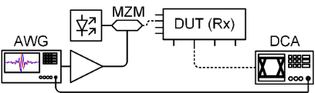
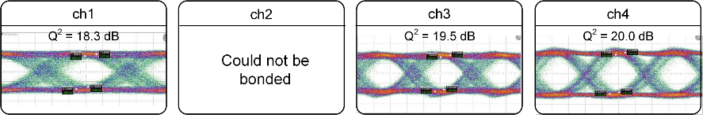
Task 6.4 System-in-Package integration and characterization
Receiver Characterization – 3 x 28 Gbit/s

Slide 19
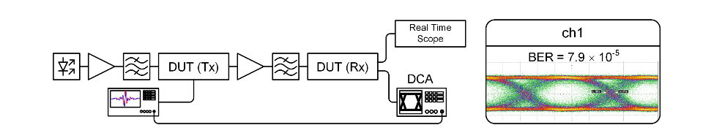
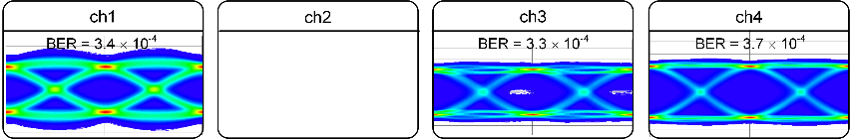
Task 6.4 System-in-Package integration and characterization
20 Gbit/s
3 x 10 Gbit/s
Notes:
3 x 10 Gbit/s with ~ VER ~3e-4

Slide 20
Summary and Outlook
  Summary
    Task6.4: Plasmonic chip to chip interconnect prototype
      50 µm spaced optical I/O
      12.5 µm long phase shifters
      No bandwidth limitation up to 70 GHz
      <-31 dB (<-30 dB) optical (electrical) crosstalk
      4 x 36 Gbit/s experimentally demonstrated
    Task6.4: Simple, but complete SiP for a chip-to-chip interconnect:
      Tx: Plasmonic modulator array packaged with RF amplifiers – 4 x 10 Gbit/s
      Rx: Si-Ge PDs packaged with TIAs – 3 x 28 Gbit/s
      First results for full link – 3 x 10 Gbit/s
  Outlook
    Further characterization of full link

