Slide 1
Work Package 7 Presentation
“Project NAVOLCHI”
Ioannis Tomkos
Athens Information Technology, GR

Slide 2
Outline
WP7 Position in Project
Objectives
Tasks
Milestones and Deliverables
Summary

Slide 3
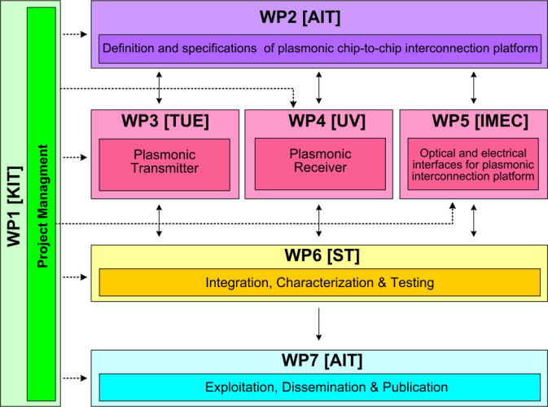




WP7 Position in Project
Contributors:

Slide 4
Objectives
Dissemination through paper submission to high quality scientific journals and conferences
Organizing workshops & seminars on NAVOLCHI technology
Dissemination through the website
Issuing press releases and brochures
Patents
Theses at partners’ institutes

Slide 5
Tasks
 | Names of the Tasks | Time Period [months]
Task 7.1 | Dissemination of results | 1 – 45
Task 7.2 | Exploitation of results | 12 – 45
Task 7.3 | Promotion of Results | 24 – 45

Slide 6
Milestones
 | Names of the Milestones | Month | Partner
MS44 | Dissemination of activities in the project’s web site and continuous update | 1 | KIT
MS45 | Press release on start of project distributed to the public | 2 | AIT
MS46 | Identification of possible contributions to the industrial partners for commercialization | 15 | ST
MS47 | Organization of workshop on silicon photonics interface for chip-to-chip communication* | 34 | TU/e
MS48 | Public web site for NAVOLCHI prepared to stay open for at least another year | 45 | KIT
MS49 | Press release distributed comprising key results with a public target audience | 45 | AIT
*In progress

Slide 7
Deliverables
 | Names of the Deliverables | Month | Partner
D7.1 | First report on NAVOLCHI dissemination and promotion activities | 18 | ST
D7.2 | First report on NAVOLCHI exploitation activities | 18 | AIT
D7.3 | Mirror Deliverable of D7.1, which will be available to the public on the website | 18 | TU/e
D7.4 | Intermediate report on recent achievements | 18 | AIT
D7.5 | Reports on the impact and outcome of the organized promotion events | 45 | AIT
D7.6 | Final report on NAVOLCHI dissemination and promotion activities | 45 | AIT
D7.7 | Dissemination kit | 45 | AIT

Slide 8
Task 7.1 Dissemination
I. Activities
39 journals (among others 2 Nature Photonics and 1 cover story at Optics and Photonics News)
77 conference publications disseminating the project have been published by NAVOLCHI partners (including 2 post-deadline papers),
Two NAVOLCHI workshops on plasmonics-based components has been organized at the ICTON 2012 conference at Warwick and at ICTON 2013 in Cartagena (attracting in each more than 50 attendees)
A white paper was issued
A brochure on NAVOLCHI activities and goals has been issued
www.navolchi.eu

Slide 9
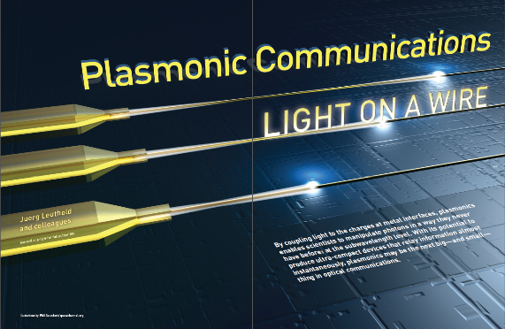
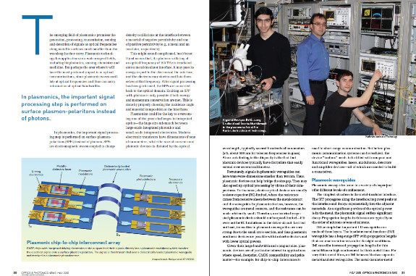
Cover article at
OSA Optics and Photonics News

Slide 10
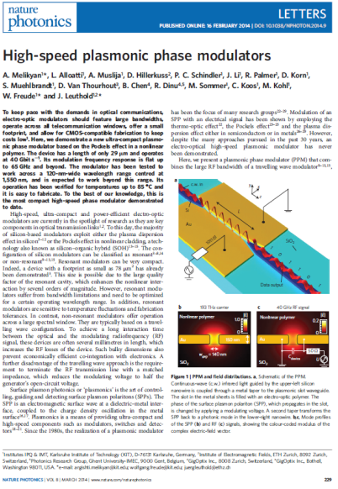
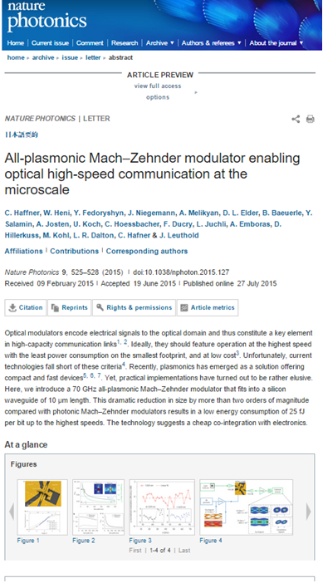
2 Nature photonics articles

Slide 11
Post deadline paper at ECOC 2015

Slide 12
Impact to Scientific Community - Citations
Paper | Number of citation (Google Scholar)
High-speed plasmonic phase modulators, Nature Photonics, 2014 | 76
Plasmonic communications: light on a wire, Optics and Photonics News, 2013 | 14
Electrically Controlled Plasmonic Switches and Modulators, IEEE STQE, 2015 | 2
The plasmonic memristor: a latching optical switch, Optica 2014 | 4
Photonic-to-plasmonic mode converter, Optics Letter, 2014 | 4
High-speed plasmonic Mach-Zehnder modulator in a waveguide, ECOC 2014 | 11
Surface plasmon polariton high-speed modulator, CLEO: Science and Innovations | 3
Highly efficient metal grating coupler for membrane-based integrated photonics, Optics Letters, 2014. | 4
Low-optical-loss, low-resistance Ag/Ge based ohmic contacts to n-type InP for membrane based waveguide devices, Optical Materials Express, 2015 | 2
Polymer/QDs nanocomposites for waveguiding applications Journal of Nanomaterials, 2012 | 6
Patterning of Conducting Polymers Using UV Lithography: The in-Situ Polymerization Approach The Journal of Physical Chemistry C 116, 17547-17553, 2012. | 3

Slide 13
Task 7.2 Exploitation
Intellectual Property
Patent:
(UVEG) Patent: “Method to obtain metallic structures of nano- and micro-metric size from lithographic resists based on nanocomposites„ (P201201282).
V. M. Dolores-Calzadilla, A. Higuera Rodriguez, D. Heiss, (2014). “Metal grating coupler for membrane-based integrated photonics”, USA Provisional Patent Application filed, application number: 61/979, 2014.

Slide 14
Task 7.3: Promotion events - Workshops
Two dedicated workshops have been organized for the promotion of the NAVOLHCI project.
The first activity was the “NAVOLCHI Special Section on Plasmonics Based Components” on ICTON 2012, in Coventry, England. The event attracted more than 50 attendees from both the industry and the academia.
The second workshop was organized in ICTON 2013. The session was entitled "CMOS Fabrication-Based Photonic Technologies for Communications" and was co-organized by the NAVOLCHI and the SOFI (on hybrid silicon-organics technology) projects.

Slide 15
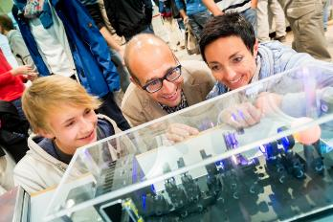
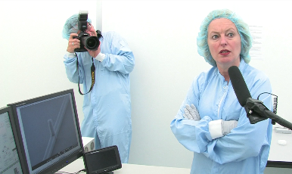
Task 7.3: Promotion events - Other
ETHZ also participated in the “Scienficia” event (http://www.scientifica.ch/scientifica-2015) in which they had a booth at this outreach event in Zurich and had the chance to present their activities in NAVOLCHI to over 25 000 visitors (general public).
Finally, TUe also presented our research on nanolasers funded by NAVOLCHI to Dr. Jet Bussemaker, Minister of Education, Culture and Science of The Netherlands, during her visit to the Technical University of Eindhoven.

Slide 16
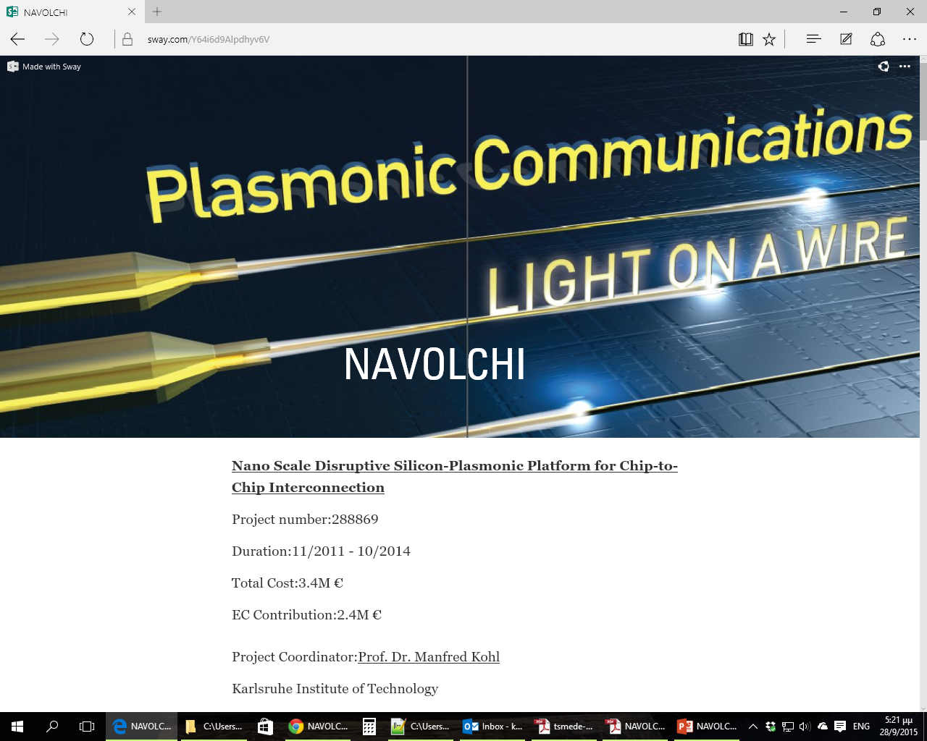
Dissemination kit
The dissemination kit contains suitable material with the most important achievements and results of the NAVOLCHI project. It includes high resolution pictures and images for the dissemination of the project.
The dissemination kit is available at: https://sway.com/Y64i6d9Alpdhyv6V

