Slide 1
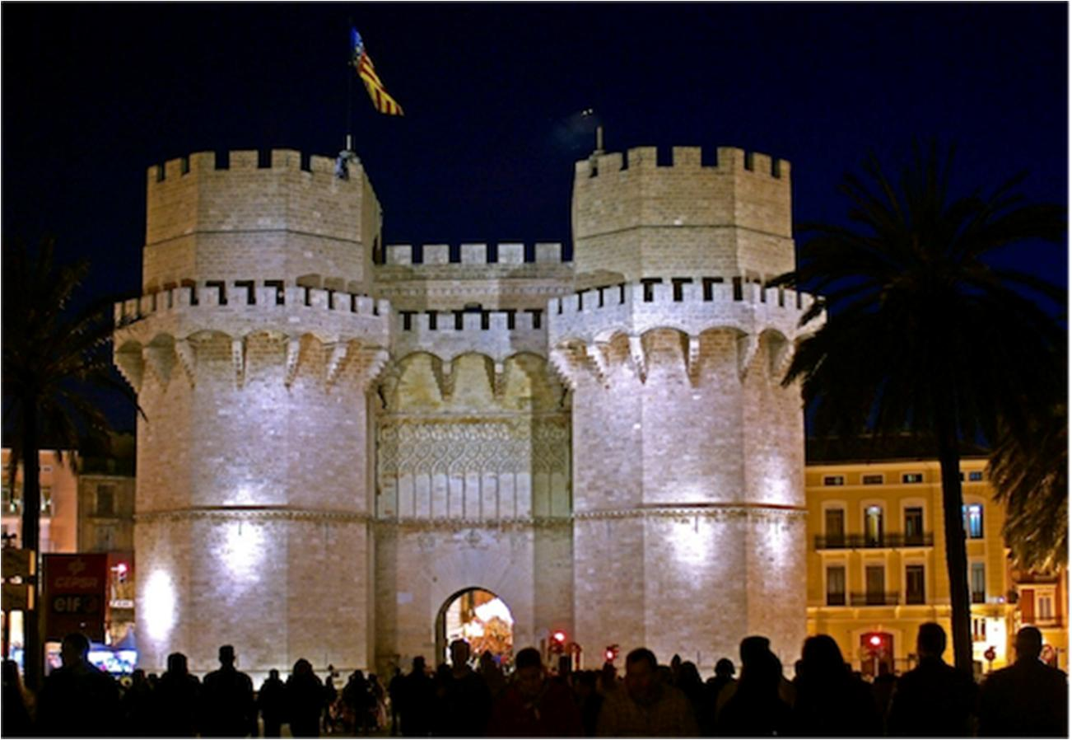

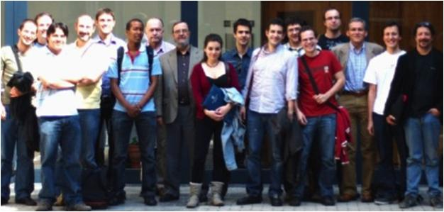
NAVOLCHI
Unit of Materials and Optoelectronic Devices
University of Valencia
www.uv.es/umdo
Prof. Dr. Juan P. Martínez Pastor
Dr. Pedro Rodríguez Cantó (QD and Polymer layers, metal nanostructures)
Dr. Isaac Suárez Álvarez (Plasmonics + Optical)
Henry Gordillo (PhD student: Plasmonics + Optical)
Mari Luz Martínez (PhD student: Polymer layers, metal nanostructures)
Dr. Rafael Abargues (Chemistry, Intenanomat/Spin-Off)
Dr. Guillermo Muñoz Matutano (Optical)
(Dr.) Josep Canet Ferrer (Optical)
David Rivas Góngora (Optical)
Torres de Serranos (1398)
Valencia, Spain

Slide 2

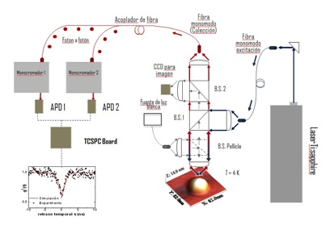
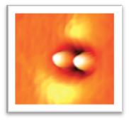
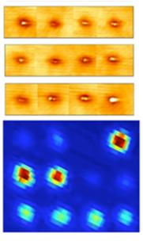
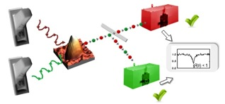
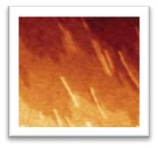
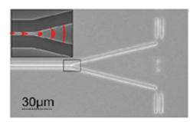
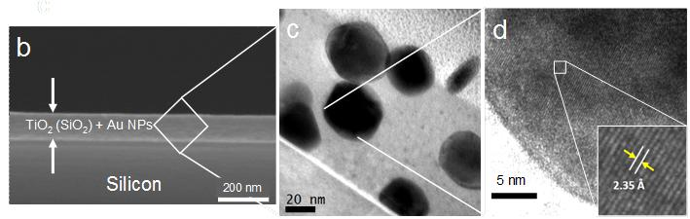
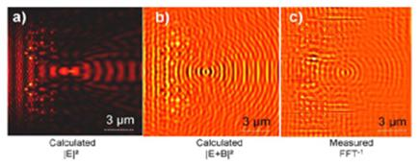
EXPERTISE
Quantum Nanostructures for Quantum Information Technologies:
optical properties at single level
Quantum Optics
Single-photon Logic gates
Plasmonic nanocomposites:
nanoparticles on oxides and polymers (resists)
SOI technology: photonic lens

Slide 3
Role in the project / Main Tasks
Plasmonic amplifiers by using polymers doped with QDs (embedding metal waveguides) (Task 4.3, 4.4., 5.1.)
Fabrication of metal nanostructures based on patternable metal-polymer nanocomposites
Demonstration of amplification in polymer thin films / stripes
Light coupling to metal waveguides and plasmon propagation / amplification
Plasmon/Photon-Plasmon Photodetectors based on QDs and metal nanostructures (Task 4.2., 4.3., 4.5.)
Stacks of QDs (layer-by-layer method) for photoconductors/photodetectors
Patternable conductive polymers with added plasmonic capabilities

Slide 4
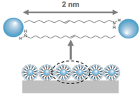
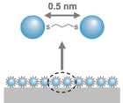


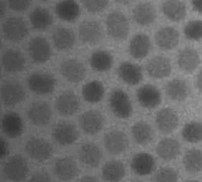
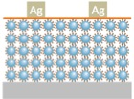
Workplan
Spincoating
Ligand Exchange
LbL
OA-capped PbS QDs
OA= Oleic Amine
QD monolayer
Ethanedithiol
HS-CH₂-CH₂-SH
QD monolayer
QD multilayer
Device Fabrication
8 nm
LiF
Development of layer stacks containing IV-VI QDs
ITO
OA-capped PbS QDs from solution
Thiol-capped PbS QDs in film
Absorption
λ _{MAX}= 975 nm
Absorption
λ _{MAX}= 960 nm
Emision
λ _{MAX}= 1126 nm
Emision
λ _{MAX}= 980 nm

Slide 5
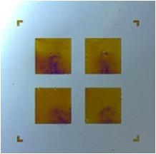
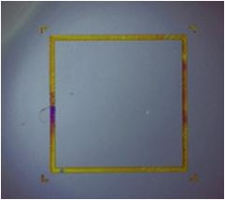
Workplan
UV Light
Conducting
IPN Patterns
Photomask
Lithographic process
Photoresist
Resist + precursor
Substrate
2. Post bake 120-140 ºC
In-situ synthesis of conducting polymer into the patternable host matrix
Possibility of in-situ synthesis of Au NPs into the PCP
Possibility of easy incorporation of QDs into or on top of the PCP

Slide 6
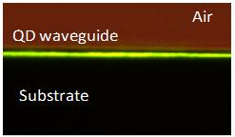
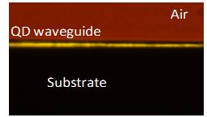
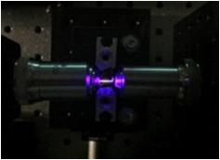
Workplan
Quantum Dots in polymers (for optical gain): planar waveguides
Dispersion of CdSe and CdTe in a PMMA film
Optimal conditions for waveguiding depends on NQD concentration.
NQD’s PL can be coupled to the waveguide modes.
It is possible to obtain multi-colour emission.
I. Suárez et al., “Photoluminiscence wave-guiding in CdSe and CdTe nanocomposite films”, Nanotechnology, 22, 435202 (2011)

Slide 7
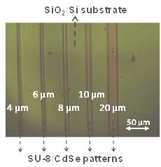
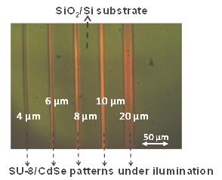
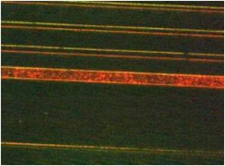
Workplan
Quantum Dots in polymers (for optical gain): stripe waveguides
Ligand change of CdSe to disperse QDs in SU-8 resist.
Stripe patterns of 4,6, 8, 10 and 20 µm
20 µm
QD wave-guiding PL
10 µm
Simulations BPM and effective idex method
8 µm
6 µm
4 µm
PL wave-guiding in the IR (PbS, PbSe)
* Core-shell PbS/PbSe from U. Ghent
* Sample with 1D-metal waveuides (IMEC) or silver nanowires
Improvement with core-shell QDs (possible amplification)
Experimental setup for light coupling into 1D-metal waveguides

