Slide 1
IMEC in Navolchi
Kick-off meeting, Nov. 2011

Slide 2
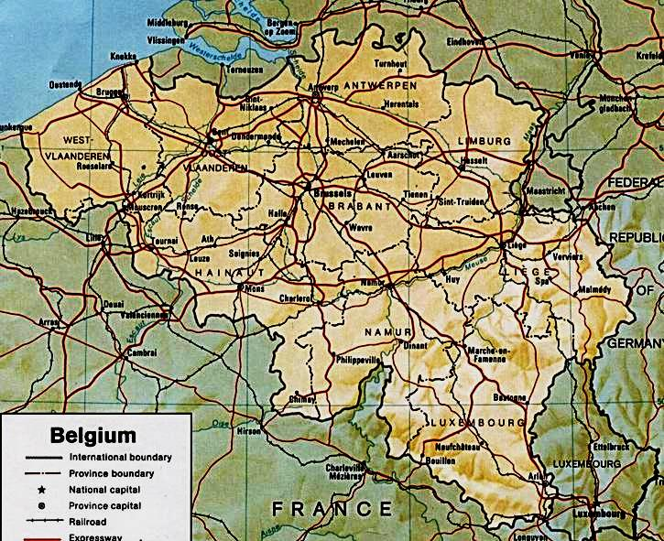
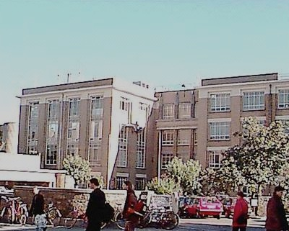


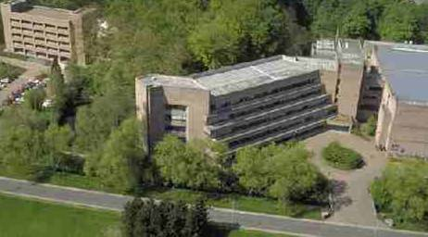
Photonics Group – Ghent University - IMEC
Ghent
Leuven
Brussels
Photonics Research Group
Headed by Roel Baets, 70 people
Exploratory research
Telecom, Datacom
Bio and physical sensing, beam steering …
“post-processing”
imec silicon photonics group
Coordinated by Philippe Absil
Industry oriented research
Optical Interconnect Program
“silicon processing”

Slide 3
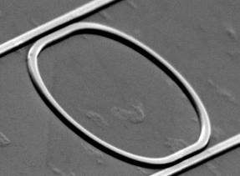
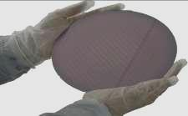
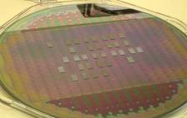
Research Vision and Focus: Technology
photonic integration
  Build photonic systems on a chip
silicon photonics
  Use the power of silicon CMOS-technology
  for integrated photonics
heterogeneous integration
  Avoid the weaknesses of silicon through
  combination with other materials and nanomaterials
Notes:
3

Slide 4
imec in NAVOLCHI
WP3 – transmitter
  Provide bonding to TU/e
  Provide passive silicon circuits through http://epixfab.eu/ platform
WP4 – amplifier for receiver
  Design and fabricate amplifier on silicon platform using UGent QDOTS
  Investigate possibilities for electrical injection
WP5 – interfaces
  WP-leader
  Design and fabricate passive filter for amplifier noise suppression
  Design and fabricate optical beam-steerer

Slide 5
WP4 - work
Objective: design and fabrication of QDOT amplifier
  Integrated with silicon waveguides
  Electrical injection
Timeline:
  Month 12 (M4.1) : decision on design
  Month 15 (M4.3) : conductive QD layers
  Month 18 (M4.6) : electroluminescence from QD-stack
  Month 21 (M4.8) : optically pumped amplifier (10dB gain)
  Month 30 (M4.9): electrical pumped amplifier 10dB/cm gain
Main input required: UGent QDOTS

Slide 6
WP4 - work
General approach (cross-section):
Stack of semiconducting oxide with QDot
Top-electrode
(forming plasmon waveguide)
Bottom Electrode
p-Si
H
Current flow

Slide 7


WP4 - Work
Initial focus of work:
  Overall design (Weiqiang Xie)
  Electrical injection: investigation of suitable layers (Pieter Geiregat)
  Improvement of related processes (QDOT embedding, local deposition, ebeam process …)(Katarzyna Komorowska)
Weiqiang

Slide 8
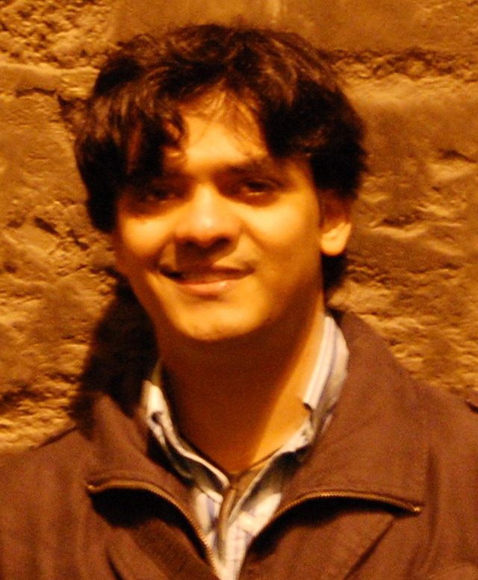
WP5 - work
Passive filter:
  1st gen: 3nm bandwidth, 10dB suppression, 30nm FSR
  options: ring resonator, AWG, PCG …
Beam steerer:
  1st gen: 5dB loss, 100um distance
  2nd gen: 3dB loss, 1mm distance, 10nm bandwidth
  “Challenging”
Time line:
  1st gen: Design (month 12, M5.3)→ Fabrication (month 18, M5.7) → characterisation (month 21, D5.3)
  2nd gen: Design (month 24, M5.9) → Fabrication (month 30, M5.11) → Characterisation (month 33, D5.7)
Sukumar Rudra

Slide 9
Providing silicon base circuits
Technology available:
  “Standard passives” : 220nm silicon, two etch depths (70nm, 220nm)
  “Advanced passives” : 220nm silicon + 380nm silicon, multiple etch depths
See: www.epixfab for details and schedule
2012 schedule on line Dec. 1
Need to discuss #runs + size with project partners

