Slide 1
NAVOLCHI
Role TU/e
Victor Calzadilla
(will start Jan 2012)
Meint Smit

Slide 2
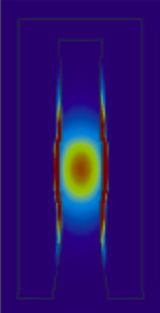
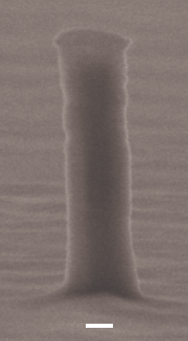
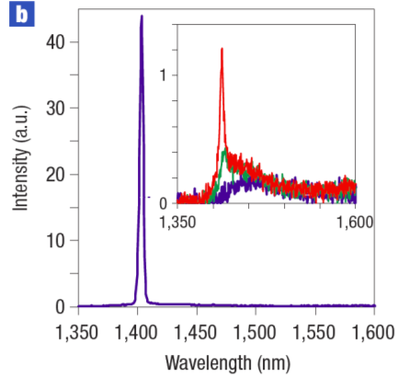
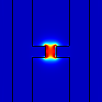
Metallic and Plasmonic lasers
A BREAKTHROUGH
The world’s smallest electrically injected laser (diameter 250 nm)
Martin Hill et al., Nature Photonics, October 2007
I_{th} = 6 μA @ 77K
Gold
InP

Slide 4
Plasmonic DFB lasers
Nature Photonics, October 2011, Research Highlight (editorial):
Most nanolasers demonstrated so far have exploited optical pumping at cryogenic temperatures, owing to problems with increased heating when using electrical pumping. Milan Marell and colleagues from Technische Universiteit Eindhoven in the Netherlands have now demonstrated electrically pumped room-temperature lasing at telecommunications wavelengths from gap–plasmon structures in semiconductor samples.

Slide 5
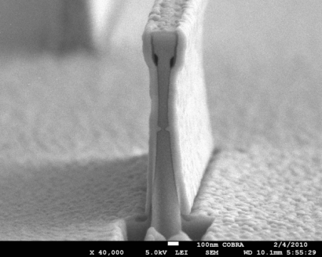
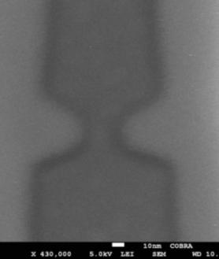
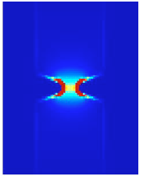

Potential
100 nm
silver
InP
20x20 nm
active region
Integration of more than 100,000 lasers on a chip
Operating at speeds beyond 1 THz ?
Superior to high-speed transistors
for ultrafast signal processing

Slide 6
A plasmonic laser on silicon

Slide 7
Task 3.1
Modelling of device structures plasmonic laser and optimization of bonding technology [M1-M6]
The aim of this task is to look at the choice of laser design and how to couple the laser output to the Si waveguide.
Task leader: TUE
Contributing Partners: TUE, IMEC
TUE will explore new plasmonic laser design possibilities and configurations for hybrid integra-tion with SOI waveguide. Some input from system specification will be used

Slide 8
Task 3.3
Fabrication of nano plasmonic laser [M7-M30]
In this task the actual nano laser will be fabricated. This process will consist of obtaining the epitaxial grown InP/InGaAs wafer, bonding it to the SOI waveguide structure, and then performing lithography, etch and material deposition steps to form the laser.
Task leader: TUE
Contributing Partners: TUE, IMEC,
TUE will fabricate the metallic nano-laser structures using their cleanroom facilities
IMEC will fabricate and supply the Si waveguide and SOI wafer and perform the required bond-ing of the InP wafer to the SOI wafer

Slide 9
Deliverables and milestones
Milestones:
M3.1 M06 Decision on an optimized structure for metallic/plasmonic nano- laser and its coupling to Si waveguides
M3.5 M18 Initial characterization of unbonded plasmonic lasers
M3.7 M24 Initial testing of bonded plasmonic lasers
Deliverables
D3.1 M12 Report on the studies of optimized structure for metallic/plasmonic nano-laser and its coupling to Si waveguides
D3.3 M24 Fabrication of plasmonic laser device(TUE)
D6.1 M28 Report on characterization results of all plasmonic de-vices
D7.3 M12 Mirror Deliverable of D7.1, which will be available to the public on the website. This report will be a filtered version of D7.1 and might be extended in order to explain the activities to a broader audience (AIT).Plasmonic components integration to demonstrate chip-to-chip interconnect (TUE)

