Slide 1
Experimental set-up for mesuring light coupling to plasmonic nanostructures
Coupling light in the gold nanowire with an optical fiber
Pumping QDs by end-fire coupling or from the surface
CCD camera monitors nanowire
Possibility to measure the spectra at the edge of the waveguide or on the surface
Experiment 1: samples based on 2D gold films (+ QD doped polymers)

Slide 2
Nanocomposite dielectric waveguides
PbS homogeneusly dispersed in a PMMA film
Low NQD concentration (ff~ 10⁻⁴ -10⁻³ ) to allow good wave-guiding.
NQD’s PL coupled to the waveguide modes
PMMA (SU-8)/(PbS or PbSe) nanocomposite waveguides:
emission in the 1550 nm region

Slide 3
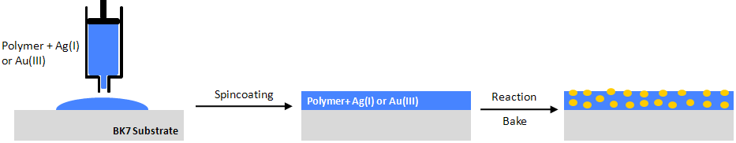
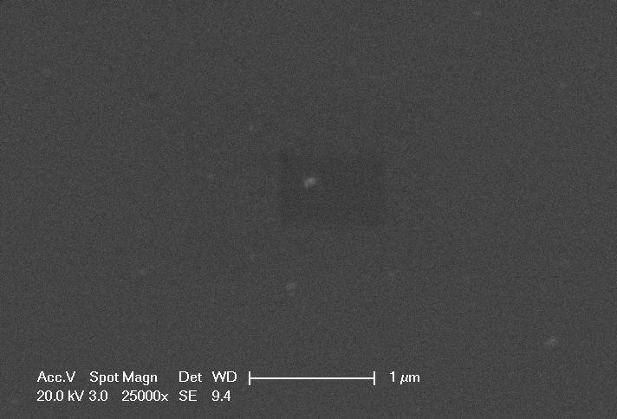
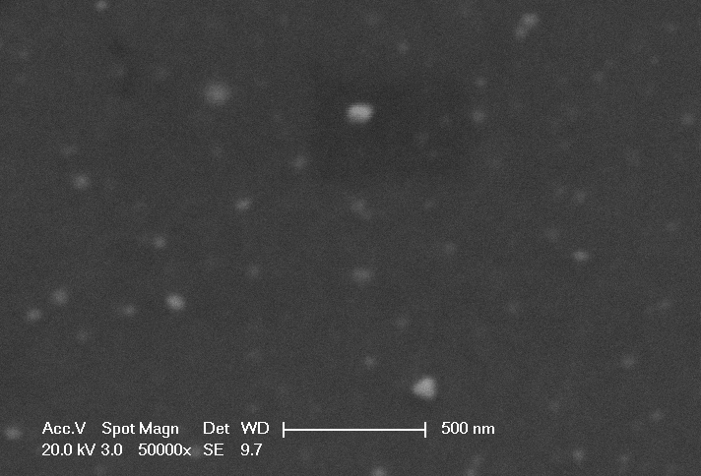
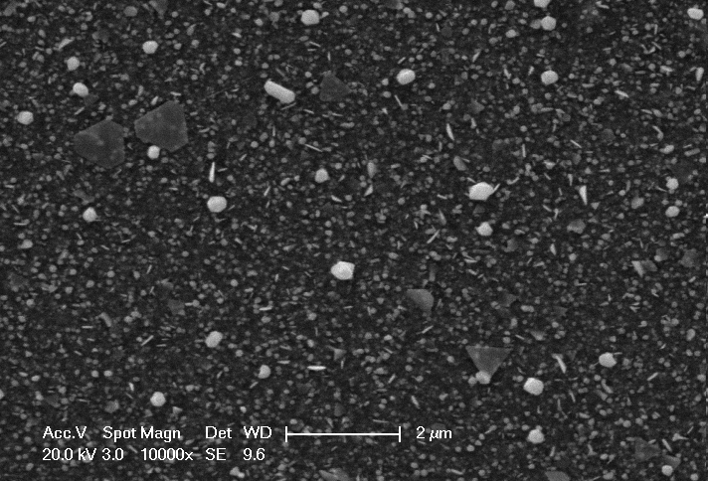
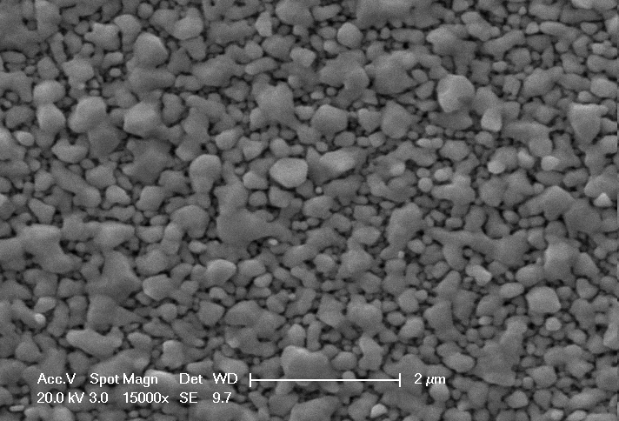
Development of plasmonic metal layers by chemical growing of metal NPs:
Towards prepatterned plasmonic nanostructures
Patented method
Patent pending
Nanocomposite Film
In-Situ synthesis of the Au/Novolac nanocomposite
t = 0
t = 3 days. Not cond.
Increase of LSPR with growth time:
Increase of size + density of Nanoparticles
t = 8 days. Not conductive
t = 21 days. Conductive

